Slide 1
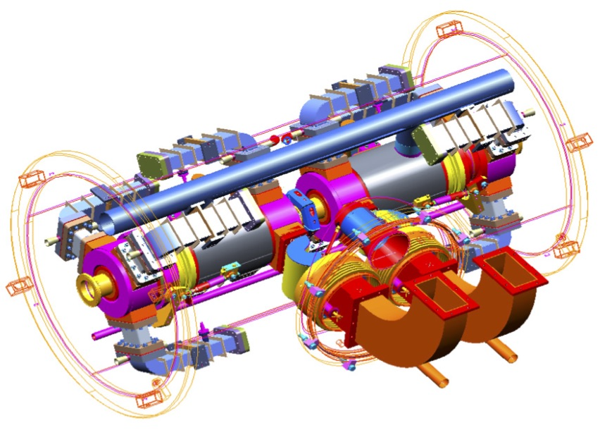
SRF Developments for ERLs
Bob Rimmer
Jlab high current cryomodule, SRF2009 MOOBAU02

Slide 2
Overview
Sorry this is not a comprehensive review !
Why does SRF for ERL’s need to be different?
What are the technical challenges?
What still needs to be done?
Where do we go from here?

Slide 3
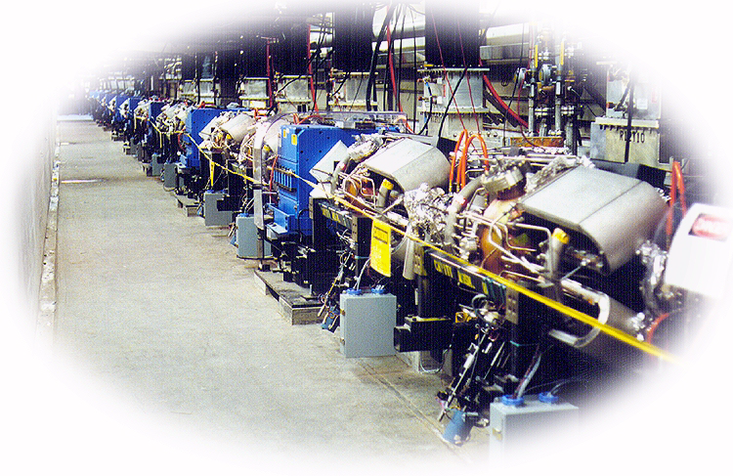
My first ERL: SELENE (but not SRF)
IR FEL for power beaming to satellites c.1998
A. Zholents, R. Rimmer, O. Walter, W. Wan, M. Zolotorev, "FEL Design for Power Beaming", Free- Electron Laser Challenges II, Proceedings of SPIE, Vol. 3614, p.72, (1999).

Slide 4
Why does SRF for ERL’s need to be different?
An ERL is not a LINAC or a ring, it’s something in between
Re-circulating LINAC and ERL’s pass the beam through the same cavities a finite number of times
  Lower capital cost, higher efficiency
  Ideal for CW or high rep-rate applications
  Can excite Higher-Order Modes (HOMs) in cavities
Beam power can be recovered on decelerating phase (ERL)
Circulating beam power can (should) exceed installed RF power
Injector is not energy recovered (but it could be)
Beam dump energy and power are reduced but not zero
Non-equilibrium beam distributions
May power an FEL, Compton source or internal target etc.

Slide 5
What are the technical challenges?
Can have regenerative Beam Break Up (BBU)
  Worse than a LINAC but better than a ring
  HOMs need to be damped
  HOM power needs to be safely dissipated (~kW’s)
Suggests cavity optimized for this application
  Cell shape for high current
  Frequency optimized for application
  HOM dampers for high power
Suggests cryomodule optimized for this application
Need a high current electron source and injector
Need to control beam losses
Any radiated or dissipated power comes from the RF
Transient beam loading on start up or due to changes in beam loading (e.g. FEL on-off)
Need a moderate power Beam dump (possible to reduce)

Slide 6
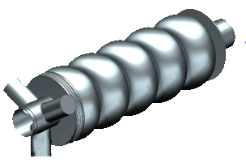
What has been done?
Cavities designed specifically for ERLs, ERL injectors ✔
Demo of energy recovery with gain (beam power > RF power) ✔
Demo of LLRF running with high Qext ✔
Demo of high energy (~1 GeV) ✔
Demo of multi-pass ✔
Demo of FEL beam quality ✔

Slide 7
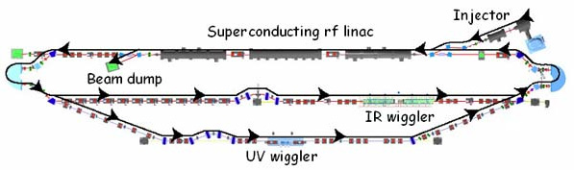
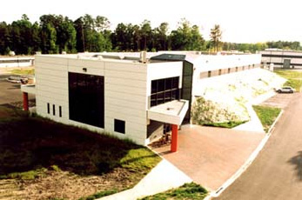
JLab 10 kW FEL
Fourth-generation light source with energy recovery
IR branch 14 kW world record
UV branch > 1 kW.
 | IR Branch | UV Branch
Wavelength range (microns) | 1.5 – 14 | 0.25 - 1
Bunch Length (FWHM psec ) | 0.2 - 2 | 0.2 - 2
Laser power (kW) | > 10 | > 1
Repetition Rate ( cw operation, MHz) | 4.7 – 75 | 4.7 - 75

Slide 8
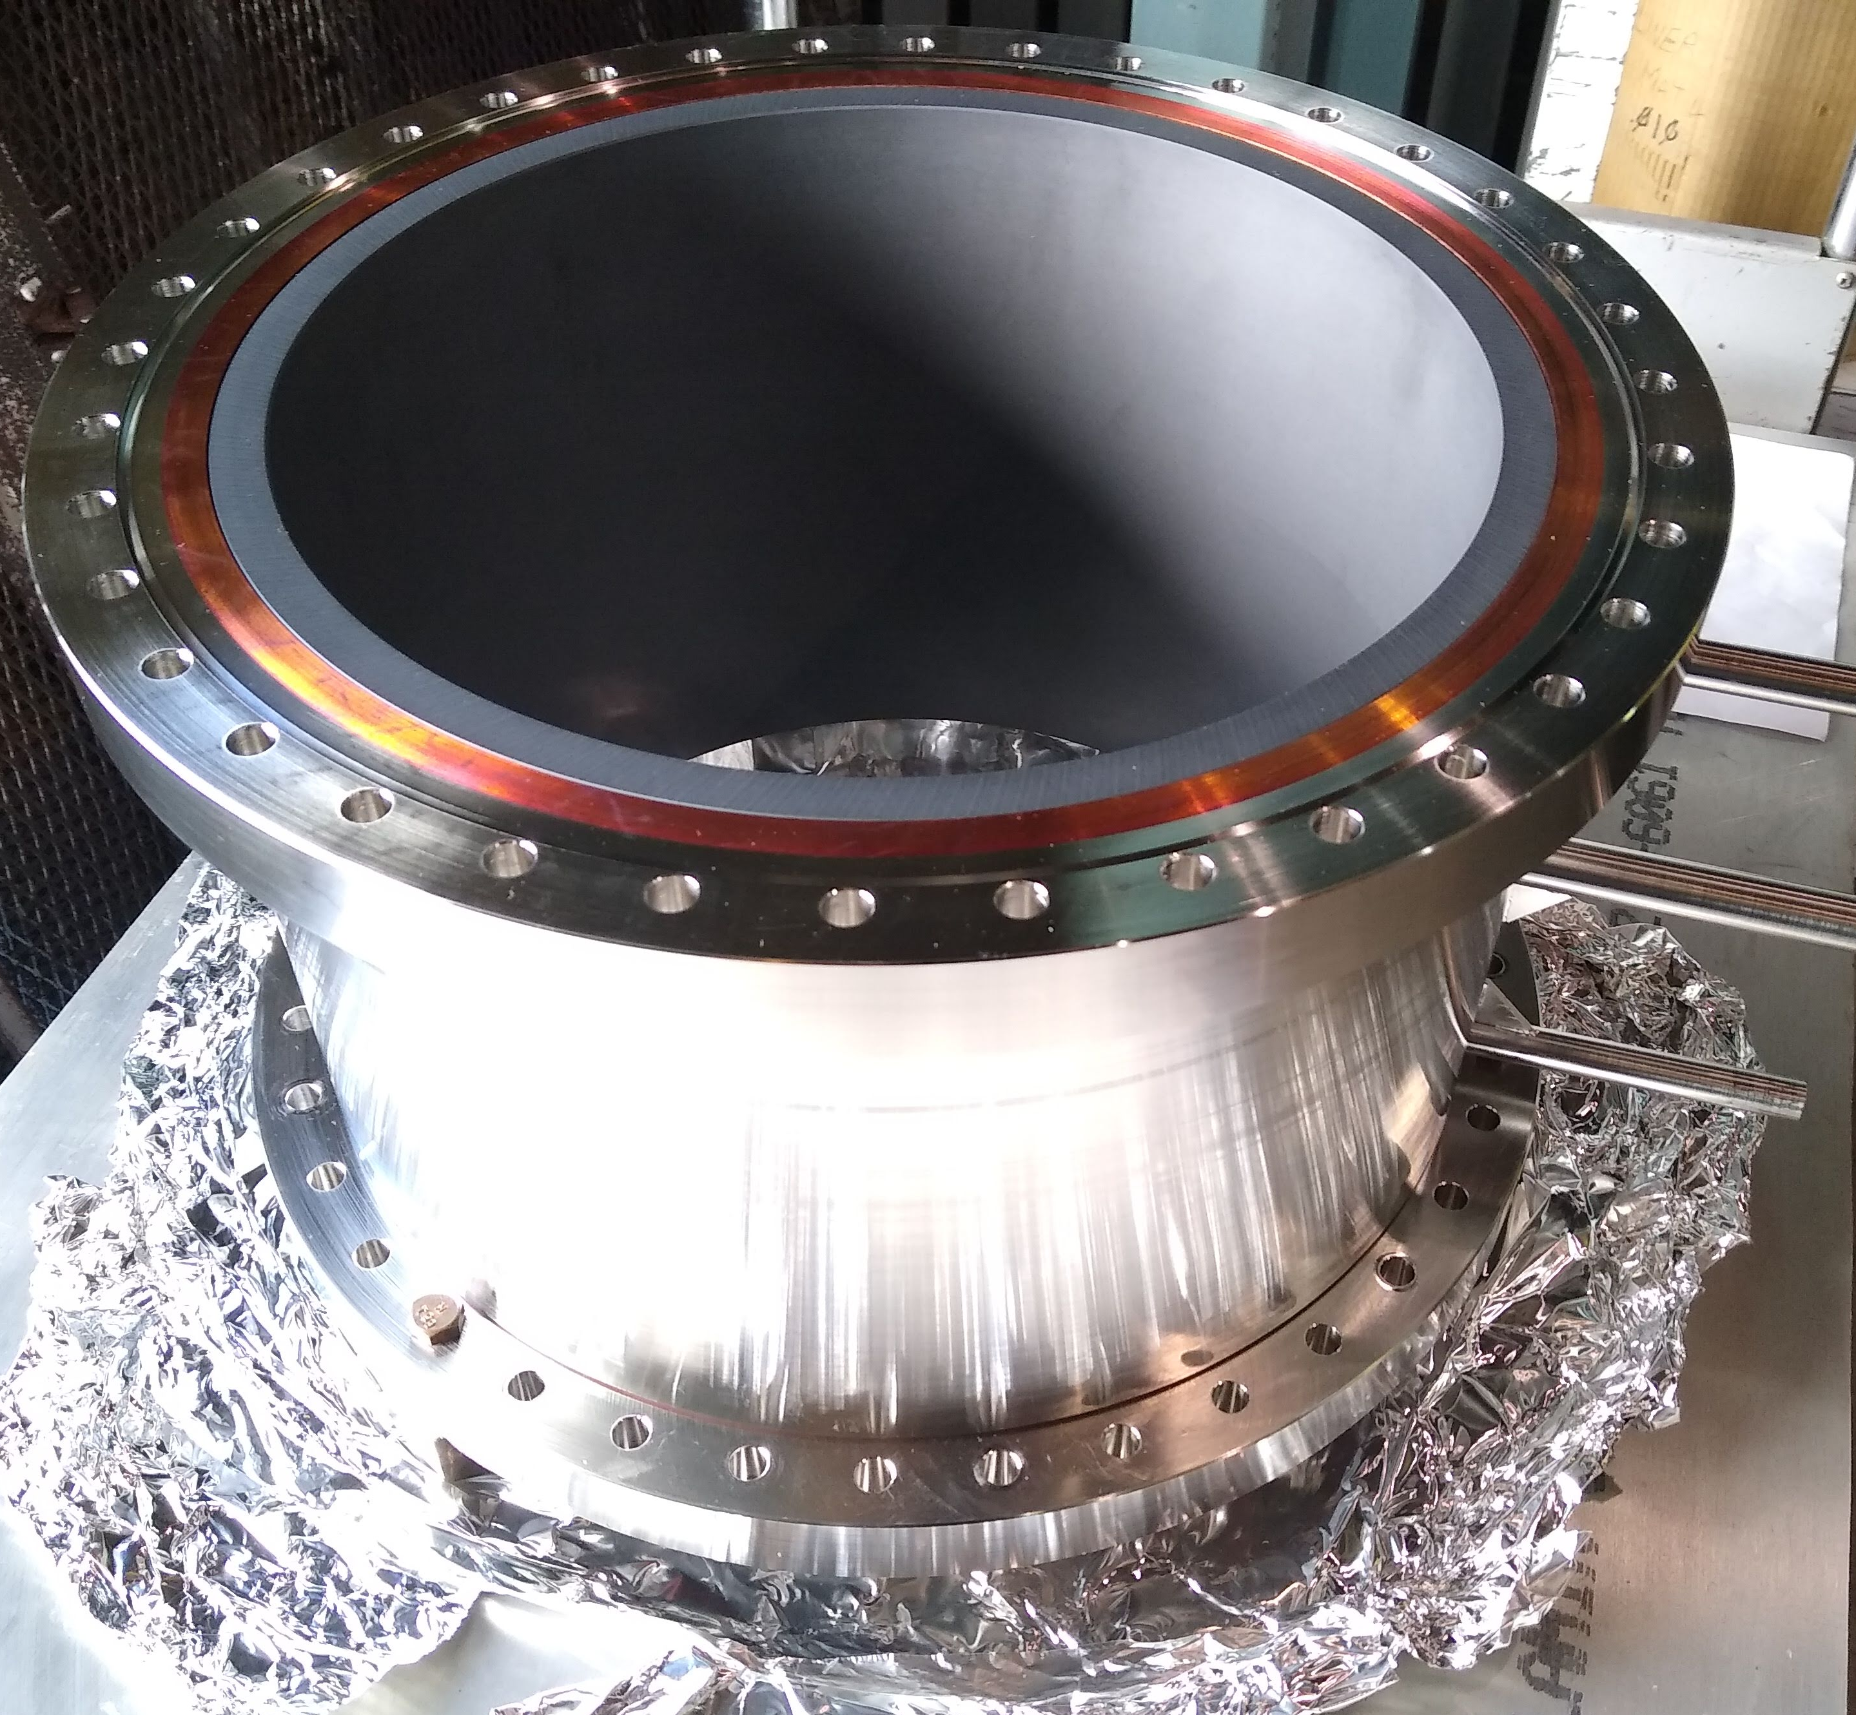
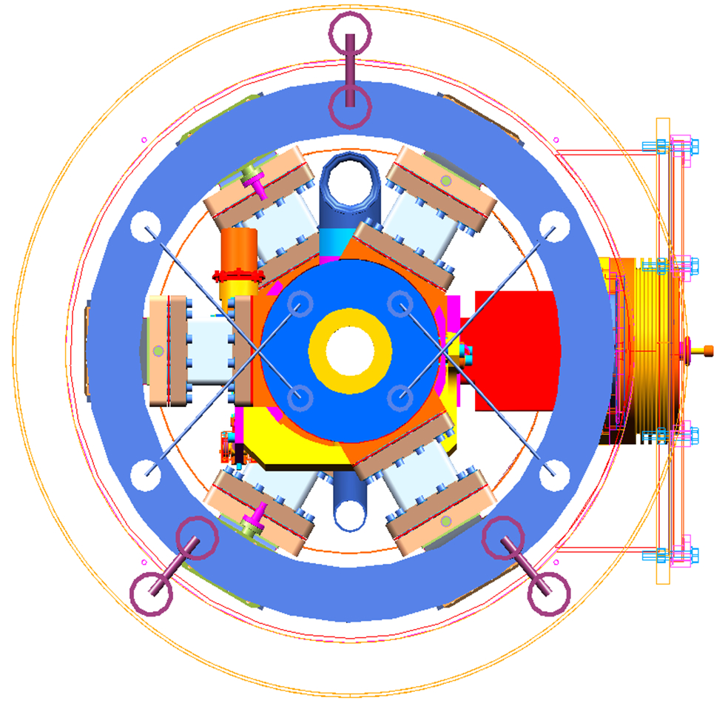
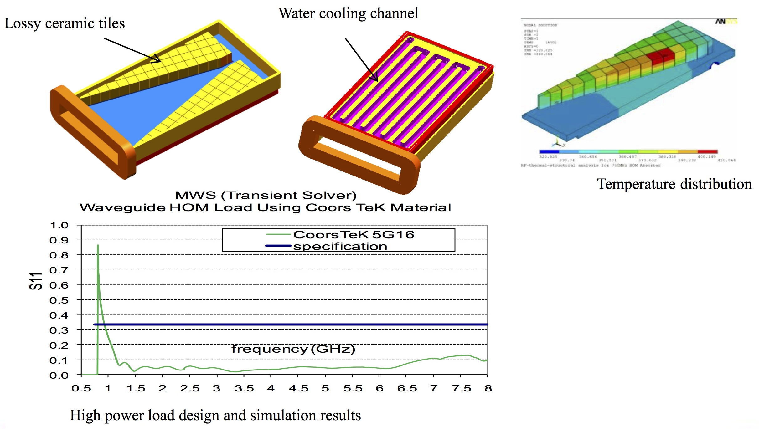
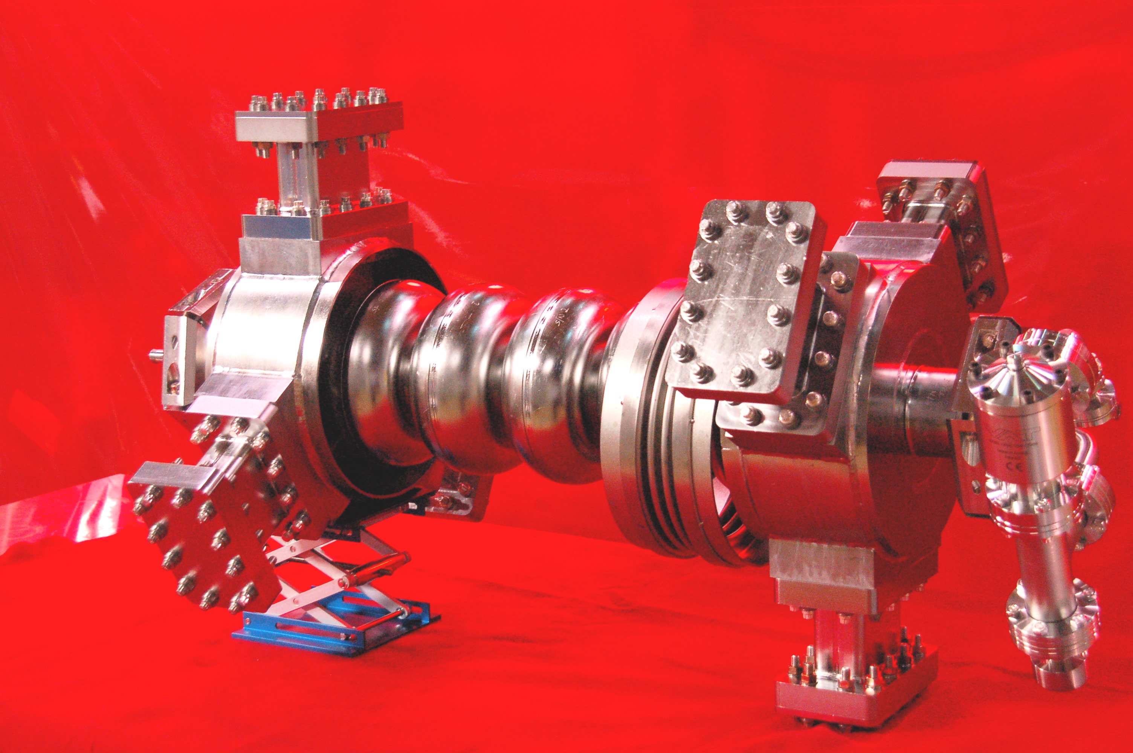
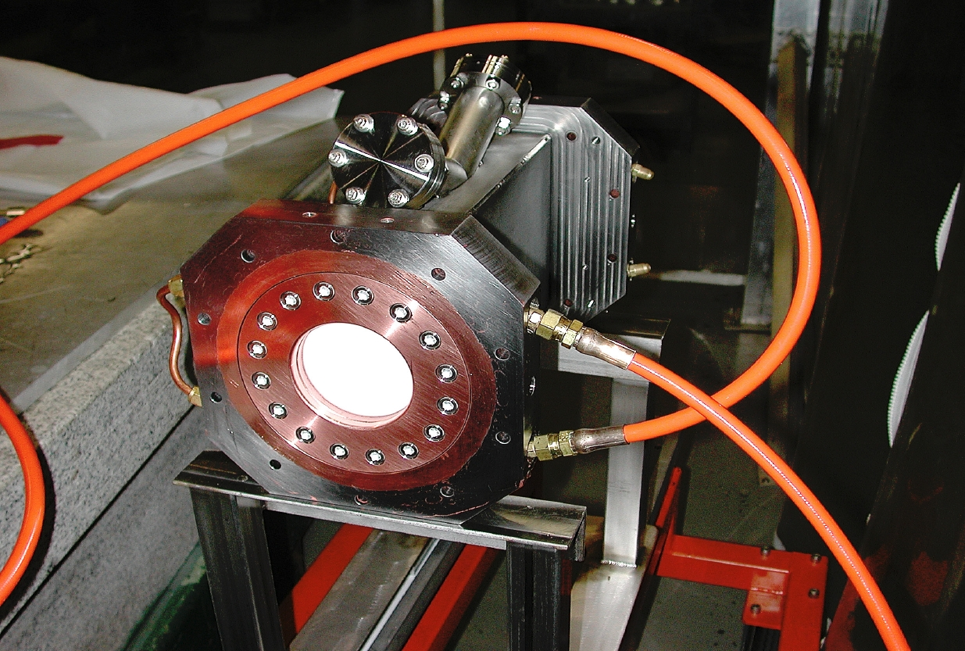
Example of ERL specific cavity and cryomodule design
Beam line HOM absorber
JLAB UPGRADE AND HIGH CURENT CAVITY DEVELOPMENTS Proceedings of SRF2009, Berlin, Germany MOOBAU02
J. Preble, J. Hogan, F. Marhauser, R. A. Rimmer, H. Wang, Jefferson Lab, Newport News, VA 23606 U.S.A.

Slide 9
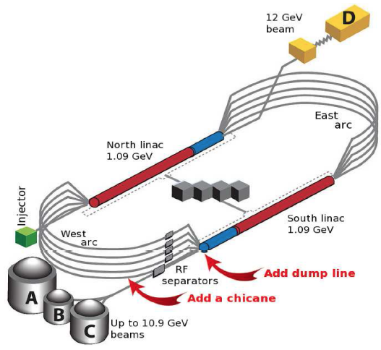
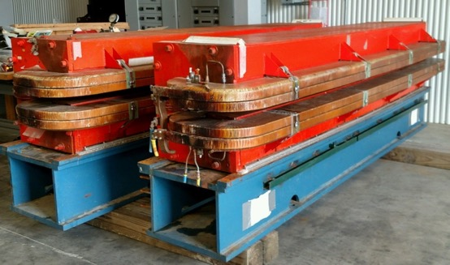
Energy Recovery in CEBAF: the ER@CEBAF Experiment
JLAB expertise:
  GeV scale ERL, single pass @CEBAF (2003)
  1.3 MW circulated power ERL @LERF
  Basis for our contribution to EIC ERL e-cooling
Next: multi-pass high-energy ERL experiment at CEBAF
  highest-energy, largest installed SRF ERL demo
  Collaborations with BNL since 2015, Daresbury since 2019
  JLab PAC conditionally approved in 2016
  JLAAC 2019 green light to start planning
Motivated by
  ERL scaling and physics questions
  JLab ERL physics core competency
  high-energy ERL long-term interest
    LHeC, FCC-ee ERL concept
  Complementarity to high-power ERL demonstrators (e.g. CBETA, PERLE)
2020-21: develop plans to install dipoles for recirculation chicane
Current beam dynamics studies:
  Multi-pass linac optics design using Genetic Algorithm (PhD thesis of Isurumali Neththikumara, ODU in collaboration with Arthur Vandenhoeke, Univ. of Brussels)
  Longitudinal matching and mitigation of phase-space distortion (PhD thesis of Gus Perez, Univ. of Liverpool in collaboration with Peter Williams, Daresbury)
Cornell CESR
dipoles for chicane – at JLab

Slide 10
What still needs to be done?
Cavities designed specifically for ERLs, ERL injectors ✔
Demo of energy recovery with gain (beam power > RF power) ✔
Demo of LLRF running with high Qext ✔
Demo of high energy (~1 GeV) ✔
Demo of multi-pass ✔
Demo of FEL beam quality ✔
Demo of reliable gun ?
Demo of high current (>100 mA) X
Demo of user/industrial application X
Demo of reliable high-current multi-pass ERL using optimized cavities with physics quality beam (PERLE)

Slide 11
Where do we go from here?
Many low-power ERLs have been demonstrated
Many large ERL’s have been proposed
Much technology has been developed, JLAB, Alice, C-ERL, CBeta
High energy 5-pass demonstration in CEBAF planned
New materials e.g. Nb₃Sn at 4K?
Need a convincing high-power demonstration: PERLE
Need compelling applications
  Light source? (Lithography?)
  Isotopes?
  High-energy electron cooling in EIC
  Electron-Hadron Collider?

Slide 12
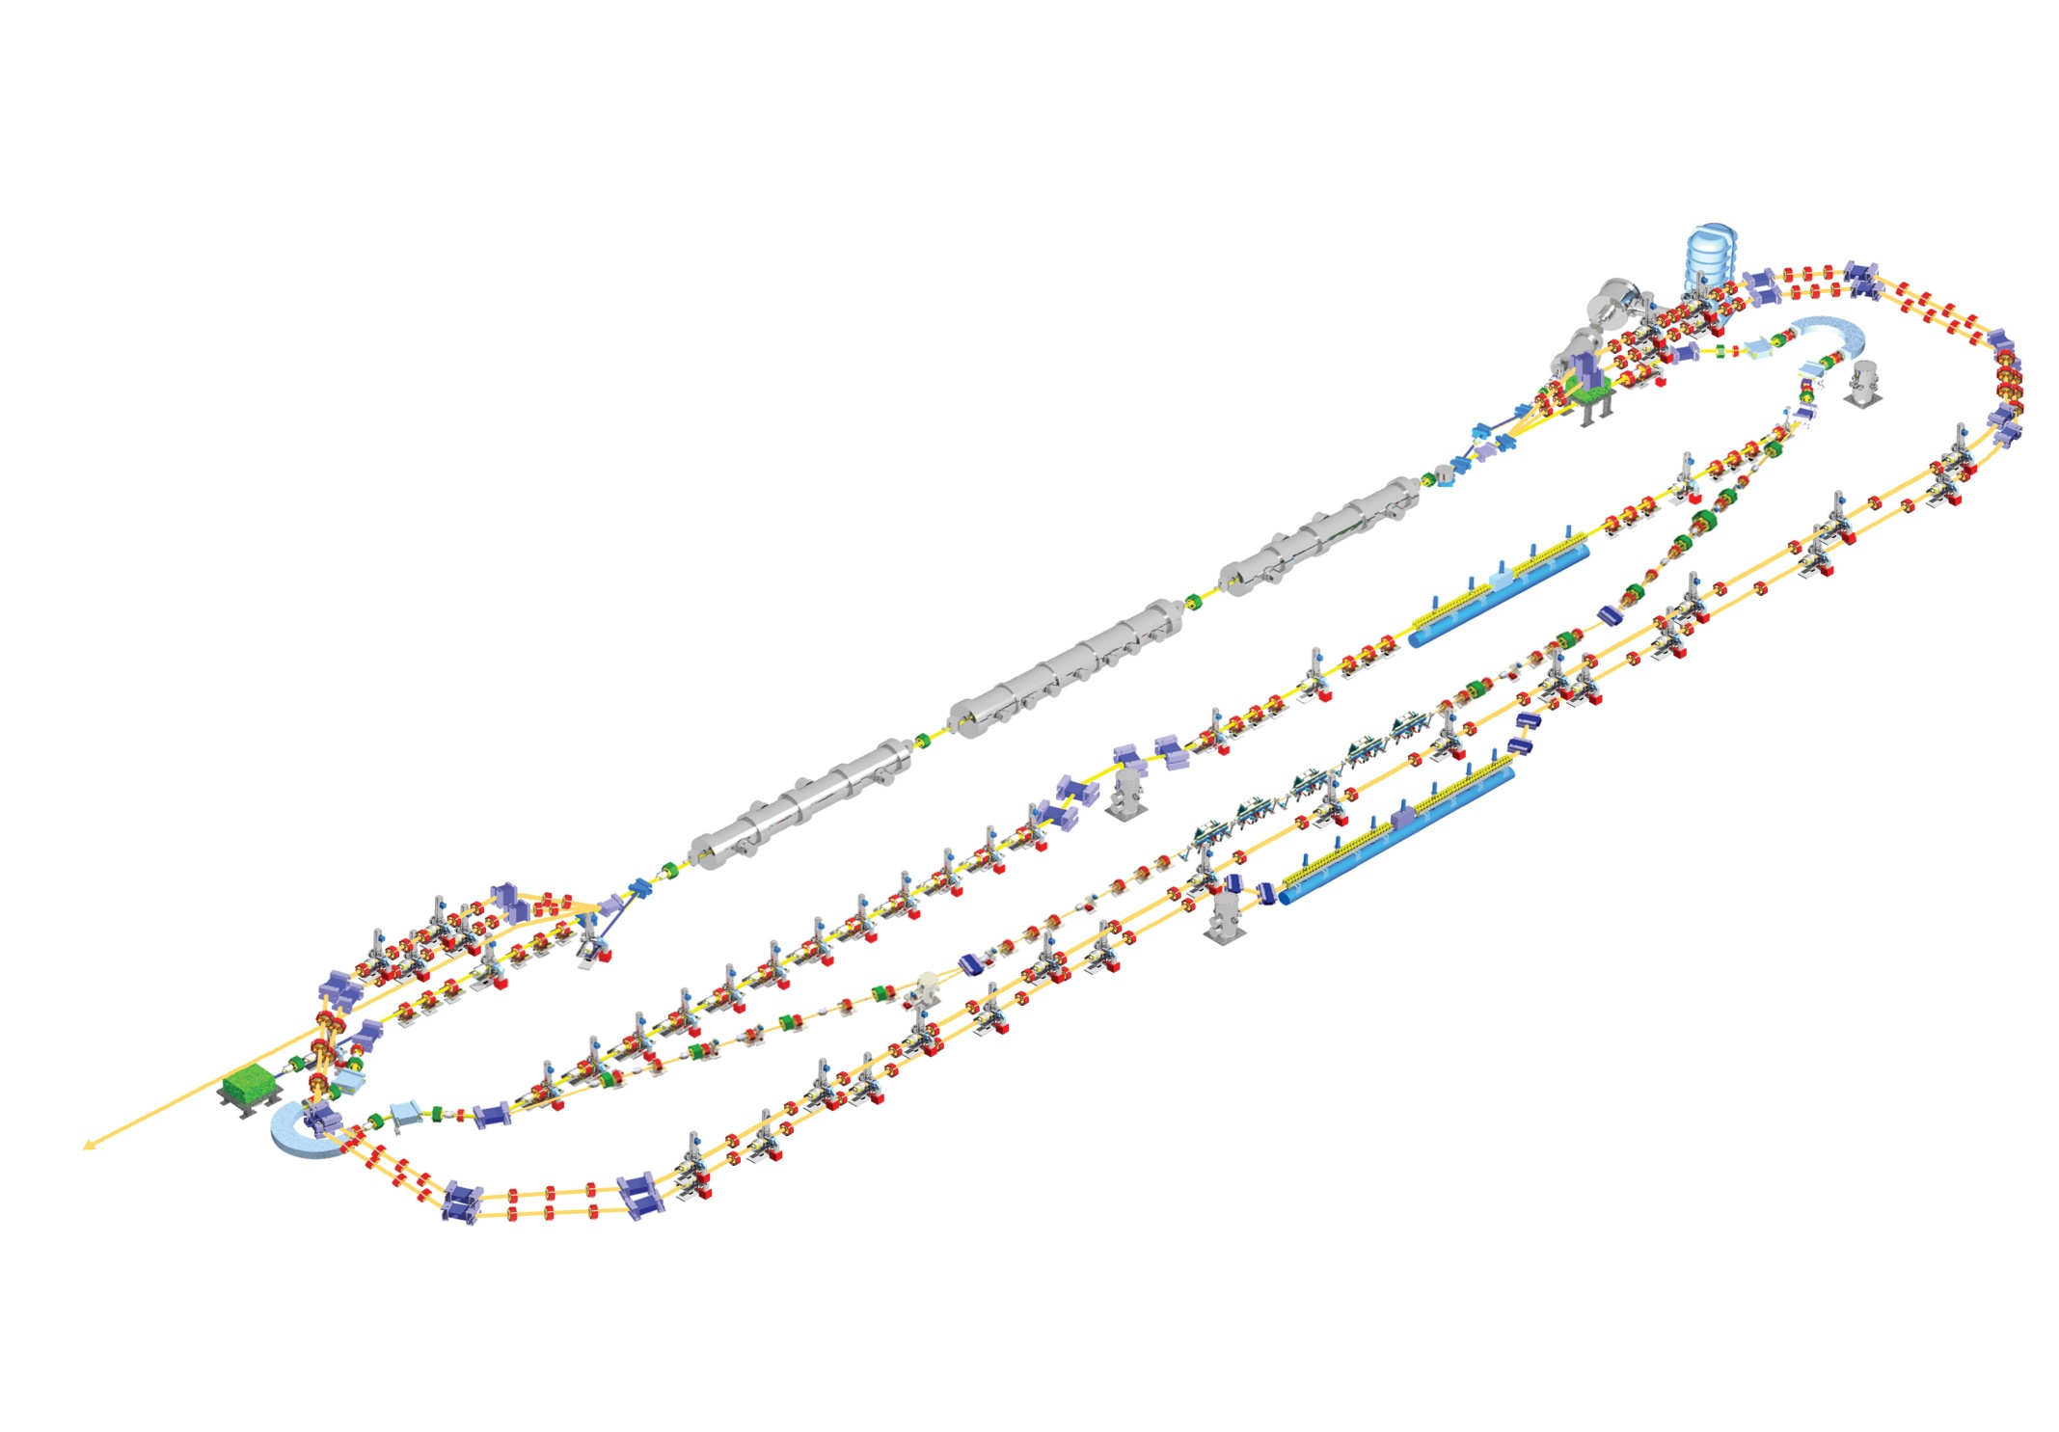
Proposed JLAMP FEL at Jlab (declined)
Offered unparalleled average brightness in the soft X-ray region
600 MeV, 2 pass acceleration
200 pC, 1 mm mrad injector
4.68 MHz CW repetition rate
Incorporates recirculation and energy recovery
10 nm fundamental output, 10 nm/H harmonic
Baseline: seeded amplifier operation using HHG
HGHG and oscillator capability
THz Wiggler for synchronized pump/probe
Test key accelerator technology for hard X-ray User facility
High gradient cryomodule
Recirculation
High brightness CW injector

Slide 13
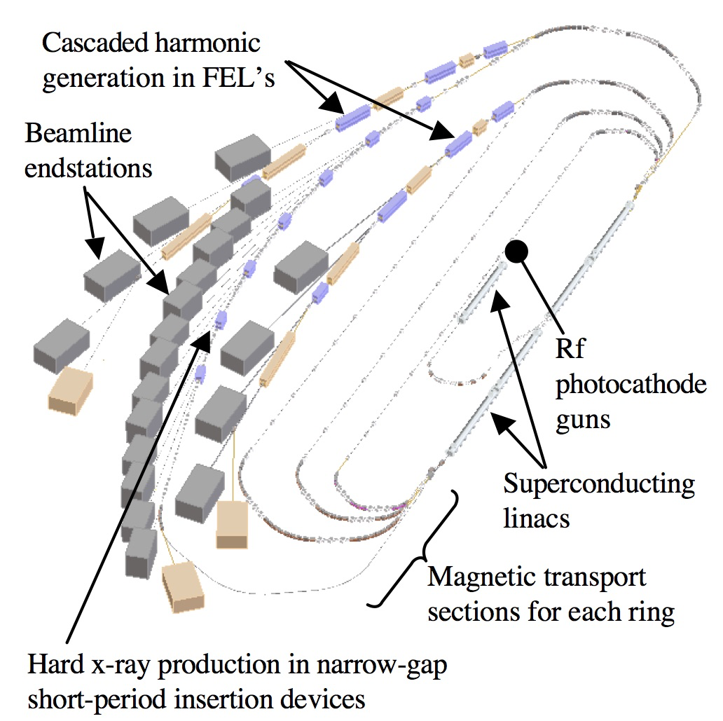
ERL and hybrid light source proposals
LUX at LBNL
APS ERL Concept
Made OBSOLETE by diffraction limited storage rings!
UK Daresbury ERL Photon Source Concept
CORNELL/CESR ERL Concept

Slide 14
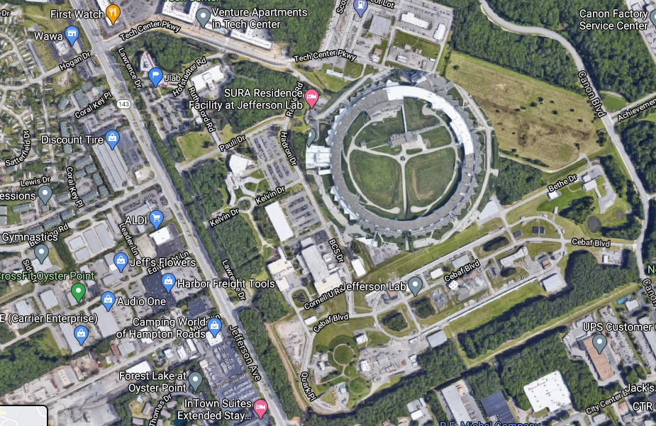
What if? Light source at Jlab?
XFEL
XFEL
XFEL
XFELO

Slide 15
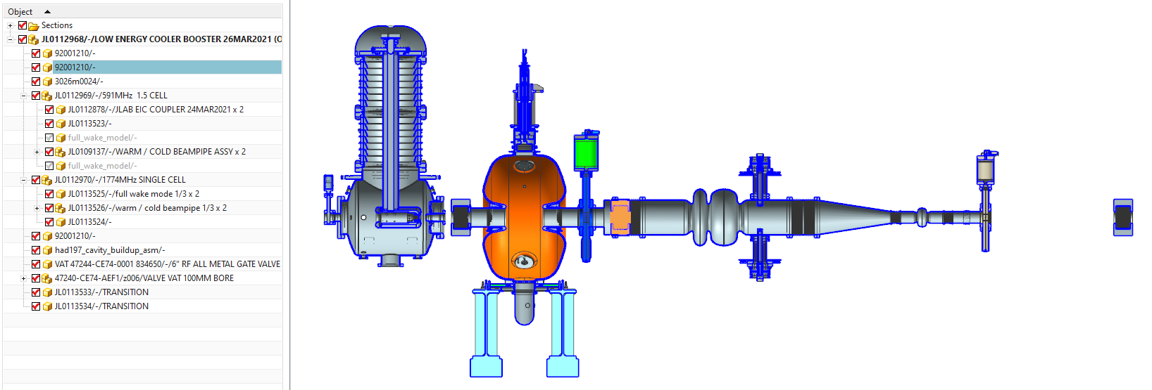
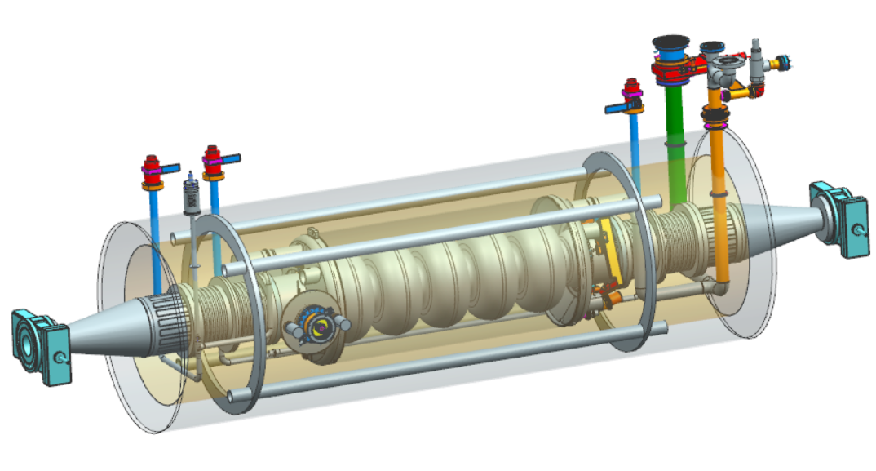
EIC high energy electron cooling
Single Pass 150 MeV ERL, 98.5 MHz bunch frequency
8 x 591 MHz, 5-cell elliptical + 1.77 GHz third harmonic
Maximum 180 MV installed voltage, Eacc 15.8 MV/m
8 x 591 MHz, 65 kW CW, SSA RF Power Amplifiers
1 nC per bunch, ~100 mA single pass current
Injector: DC photocathode gun, 197 MHz buncher, 591 MHz acceleration, 1.77 GHz linearizer.
Injector
“The accelerator design progress for EIC strong hadron cooling”, E. Wang et. Al., TUPAB036 Proc. IPAC21, Brazil.
Cooler- 591 MHz ERL cavity

Slide 16
Conclusions
ERL concept is well proven
ERL technology is well developed
Many demos worldwide with increasing sophistication
Need a final demo with all features simultaneously (PERLE)
  Technology demonstrator/test bed
  High-current
  Multi-pass
  Optimized cavities and cryomodules
  Physics quality beam
  Operated as a user facility
Need compelling applications
  Compact light sources (Lithography?)
  High-Energy electron cooling
  eh Collider

Slide 17
Thank you!

Slide 18
Back up

Slide 19
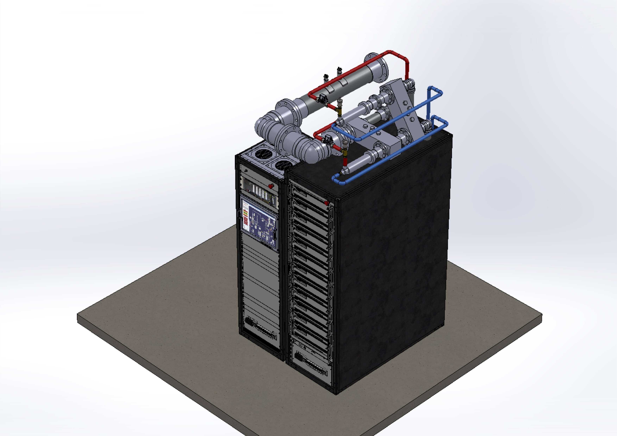
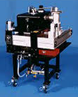
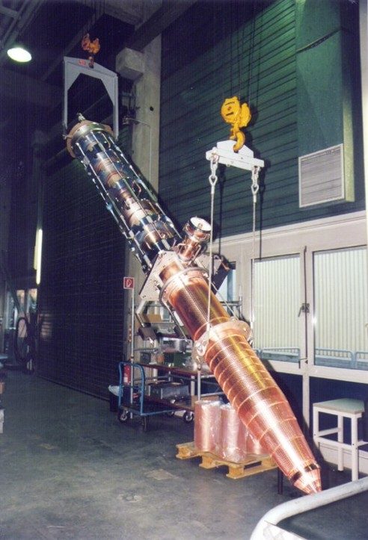
RF power options
Klystrons
  Limited vendors, high cost, low efficiency
IOT’s
  Better efficiency, becoming obsolete
SSA’s
  High efficiency
  Reliability and redundancy
  Costs falling, supply growing
IOT
MW klystron
50 kW SSA module

