Slide 1
Introduction Networking Pillar Activities
Prof. Manjit Dosanjh (SEEIIST)

Slide 2
General Assembly
SEEIIST (Chair) S. Damjanovic
1 representative per Party
External Scientific Advisory Board
Advisory Board for ethical/legal/industrial issues
Coordinator
Sandro Rossi (CNAO)
Deputy Coordinator
Maurizio Vretenar (CERN)
Central Project Office
Technical Project Board (coordinator + pillar coordinators)
NA: M. Dosanjh (SEEIIST) – TNA: M. Durante (GSI) – JRA: M. Vretenar (CERN)

Slide 3

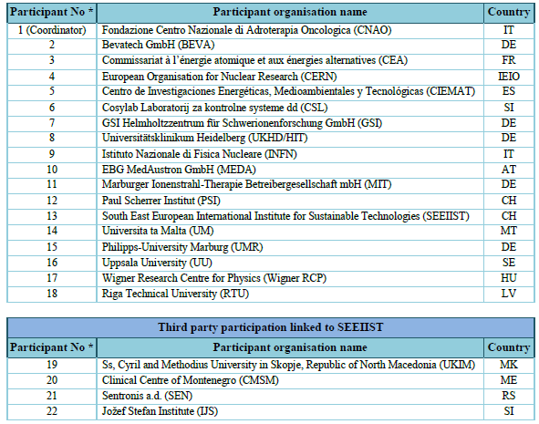
22 Institutes
(4 HT centres, 10 research
institutions, 5 universities,
3 SMEs)
14 European Countries

Slide 4











Fondazione Centro Nazionale di Adroterapia Oncologica (CNAO)
Bevatech GmbH (BEVA)
Commissariat à l’énergie atomique et aux énergies alternatives (CEA)
European Organisation for Nuclear Research (CERN)
Centro de Investigaciones Energéticas, Medioambientales y Tecnológicas (CIEMAT)
Cosylab Laboratorij za kontrolne systeme dd (CSL)
GSI Helmholtzzentrum für Schwerionenforschung GmbH (GSI)
Universitätsklinikum Heidelberg (UKHD/HIT)
Istituto Nazionale di Fisica Nucleare (INFN)
EBG MedAustron GmbH (MEDA)

Slide 5












UniversitatsKlinikum Giessen und Marburg gmbh (UKGM)
Paul Scherrer Institut (PSI)
South East European International Institute for Sustainable Technologies (SEEIIST)
Universita ta Malta (UM)
Philipps-University Marburg (UMR)
Uppsala University (UU)
Wigner Research Centre for Physics (Wigner RCP)
Riga Technical University (RTU)
Ss, Cyril and Methodius University in Skopje, Republic of North Macedonia (UKIM)
Clinical Centre of Montenegro (CMSM)
Sentronis a.d. (SEN)
Jožef Stefan Institute (IJS)

Slide 6
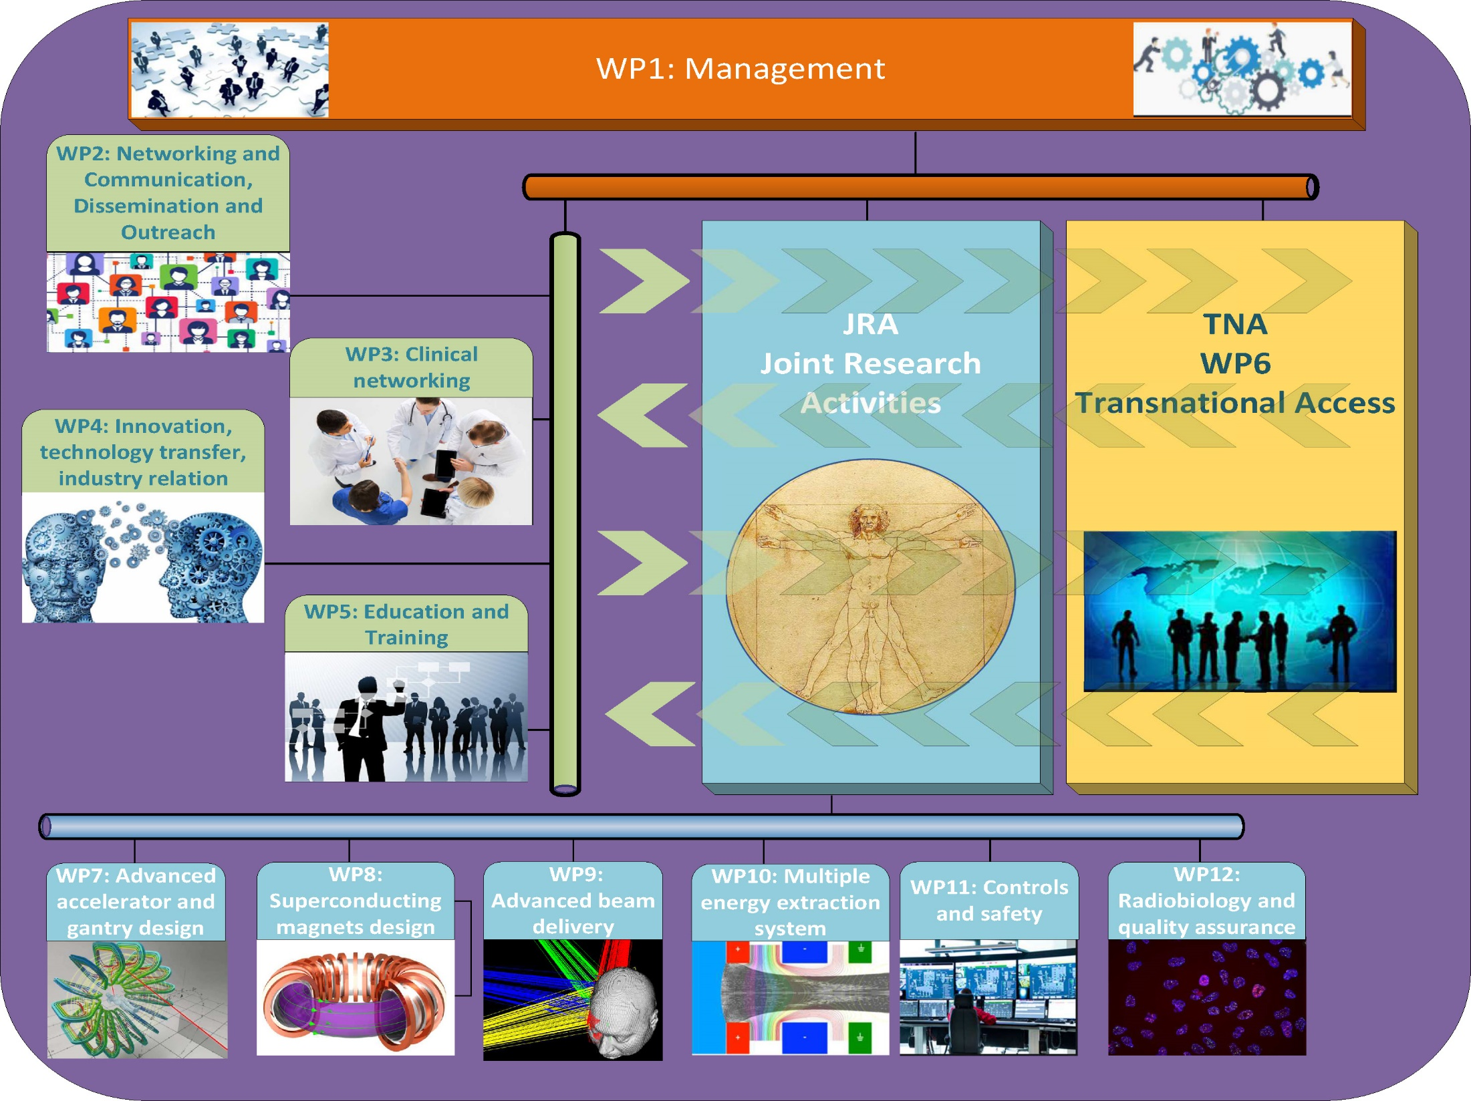
Notes:
Maximum

Slide 7
HITRIplus Overall Objectives

Slide 8
NA (Networking Pillar): Manjit Dosanjh, SEEIIST
To promote and communicate outcome of research activities among all HITRIplus partners
To catalyse the collaboration between the different scientific communities (oncologists, physicists, radiobiologists, biomedical engineers…..), necessary for successful development and improvements in hadrontherapy at the project and European level
To promote hadron-therapy to the research community all over Europe and beyond
To increase the awareness of HT to general public and the research and medical communities
To highlight new possibility for cancer patients of this treatment
To promote transnational access and access to beam time from HITRIplus
To develop training courses for student, personnel working at the facilities and training of “end-users” (researchers that want to use the facility)

Slide 9


Networking Activities: WP2-WP5 Coordinators
WP2: Communication and Networking: Manjit Dosanjh, SEEIIST
WP3: Clinical Network: Piero Fossati, MedAustron
WP4: Innovation, Technology, Industry: Manuela Cirilli, CERN
WP5: Education and Training: Nicholas Sammut, Uni of Malta

