Slide 1

WP7: Advanced accelerator and gantry design with focus on Task 7.2 (the Synchrotron)
Elena Benedetto, SEEIIST

Slide 2
WP 7 – Management structure
(*) cfr. MV presentations
@ WP7 Kickoff meeting, 19/4/2021 and
@ HITRIplus Kickoff meeting, 13/4/2021
WP Coordinator: M. Vretenar, CERN
Deputy WP Coordinator: E. Benedetto (SEEIIST)
Task Leaders:
 | Task | Task Leader
7.1 | Coordination and communication | M. Vretenar, CERN
7.2 | SC Synchrotron and advanced components design | E. Benedetto, SEEIIST
7.3 | Operational modes, beam transport and instrumentation | M. Sapinski, SEEIIST
7.4 | Injector linac design | U. Ratzinger, Bevatech
7.5 | Integration of an innovative superconducting gantry | M. Pullia, CNAO

Slide 3
WP7 – The Consortium
2 large scientific laboratories
2 particle therapy centres
1 (new) research institution
1 university
1 SME
from 6 European countries
Excellent blend of competences and expertise
7 partners:
CERN: WP Coordination, contribution to synchrotron, gantry and linac design
SEEIIST: Task leader for synchrotron design and beam transport, contribution to linac and gantry design
CNAO: Task leader for gantry design, contribution to synchrotron and beam transport design
Bevatech GmbH: Task leader for linac design
MedAustron: contribution to synchrotron, beam transport, and gantry design
Riga Technical University: contribution to gantry mechanical design
GSI: internal communication and support to coordination
duration:
3.5 years
GSI, CNAO and MEDA contribute with internal resources only (no EC contribution)

Slide 4
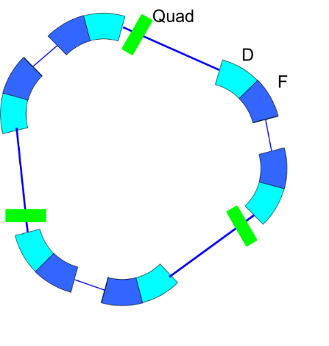
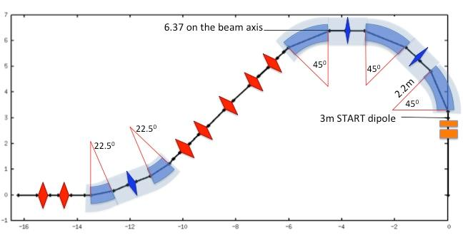
WP7 Objectives
advanced SC-magnet synchrotron: compact, innovative & reference for EU industry
higher beam intensity
To design solutions that could improve performance of the existing accelerators for heavy ion research and therapy: multiturn injection for higher beam intensity, improved extraction and beam transport – in particular for new FLASH therapy modality, and new linac injector for higher intensity and parallel production of isotopes for research and therapy.
To combine these accelerator solutions with the superconducting (SC) magnets developed in WP8 to develop the advanced conceptual design of a compact and innovative SC heavy ion synchrotron for cancer research capable of operating with multiple ion species, from protons to argon as required for research projects, particularly helium, carbon and oxygen.
To propose a simplified version of this compact SC accelerator (with single- or double-ion operation at fixed parameters) as the reference for a new generation of compact ion therapy accelerators to be built by European industry to address the global ion therapy market.
To convert the most promising of the existing conceptual designs for superconducting gantries into a detailed technical design integrating all components including diagnostics and beam delivery, and prepare for a final industrialisation and production phase by European industry.
SC-magnet gantry

Slide 5
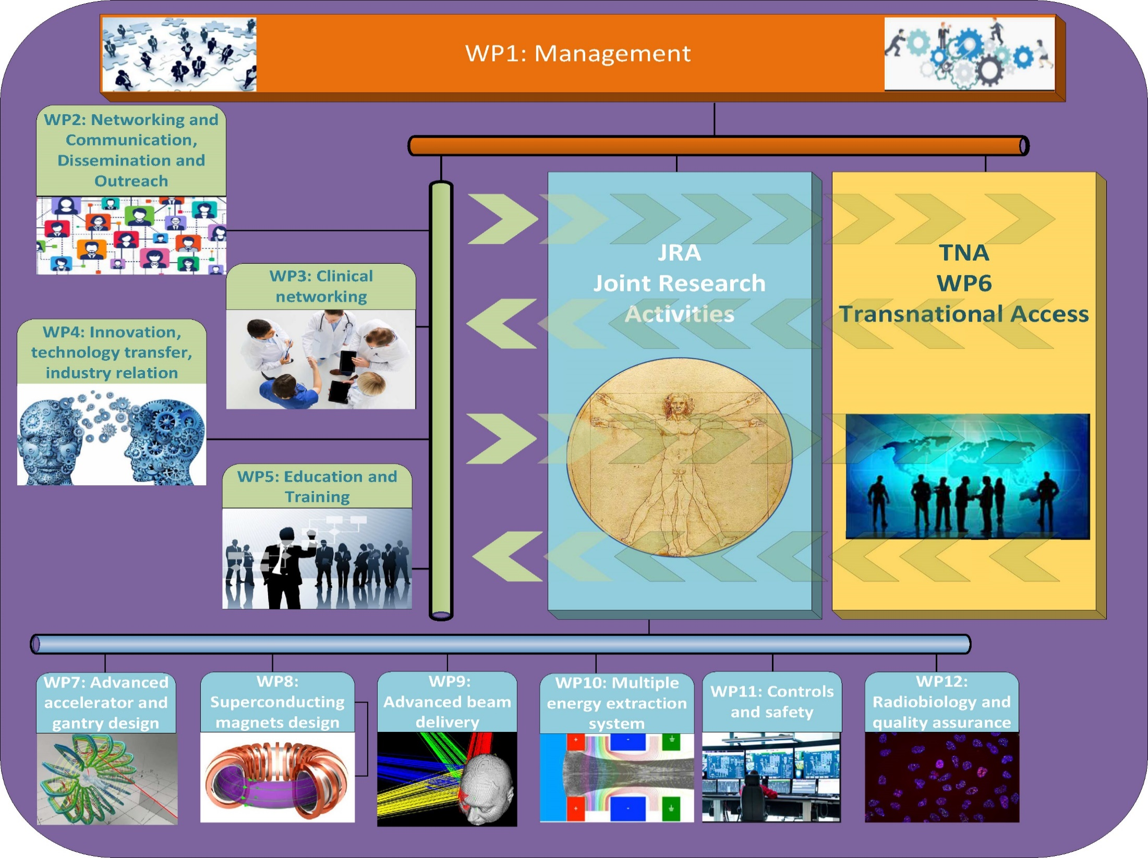

Interactions between the HITRIplus JRA’s
Improvements to present facilities
Improvements to radiobiological experiments
Multi Energy Extraction implementation in future facilities
Improvements to future facilities
field quality requirements
magnet parameters
adapting controls and safety to future systems

Slide 6
Task 7.2 - SC Synchrotron and Advanced Components Design (SEEIIST, CERN, CNAO, MEDA) – Task Leader: E. Benedetto
Focus on SC-magnet synchrotron, but lot of R&D on improvement of “conventional” synchrotrons on
optics, higher intensity and extraction: multi-energy & FLASH
Sub-Task 7.2.1, Lattice for a SC synchrotron: definition of an appropriate lattice using the SC magnet design defined in WP8, including modelling of magnets and particle tracking for long-term stability (SEEIIST, CERN).
Sub-Task 7.2.2, Multi-turn injection in resistive and SC synchrotrons: conceptual design of the multi-turn injection of 10¹⁰ ions per pulse into a reference synchrotron with resistive magnets, and in the SC synchrotron (SEEIIST, CERN, CNAO).
Sub-Task 7.2.3, Extraction and beam transport: conceptual design of slow and fast extraction for different treatment options and for experimental research, in coordination with beam transport and delivery teams, for a synchrotron with resistive magnets and with SC magnets (SEEIIST, CERN, CNAO).
Sub-Task 7.2.4, Longitudinal and transverse beam dynamics studies and assessment: preliminary analysis of acceleration, collective effects, space charge, intra-beam scattering and collimation (SEEIIST).

Slide 7
Task 7.3 - Operational modes, beam transport and instrumentation (SEEIIST, CERN, CNAO, MEDA) – Task Leader: M. Sapinski
(fast & safe) switch between therapy and research
what you cannot see you cannot control
Sub-Task 7.3.1, Operational modes: identification of specific requirements and challenges in operation due to switching between therapy and research operation modes (for the sources, injector linac, ring and transfer lines) (SEEIIST, CNAO, MEDA).
Sub-Task 7.3.2, Beam transport lines: definition of improved layouts of the transport lines to the experimental and clinical treatment areas, with special attention to safety due to switching between the 2 modes, e.g. beam-dump, shielding (SEEIIST, MEDA, CNAO).
Sub-Task 7.3.3, Beam instrumentation and QA: identification of advanced beam instrumentation options and of their possible application to present and future medical synchrotrons (SEEIIST, MEDA).

Slide 8
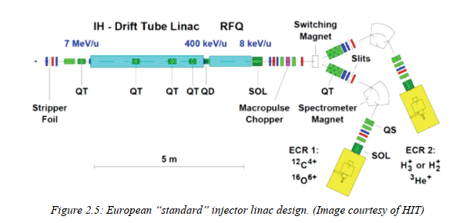
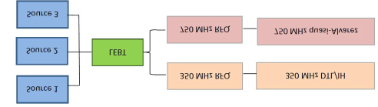
Task 7.4 - Injector Linac Design (BEVA, CERN, SEEIIST).
Task Leader: U. Ratzinger
Mariusz contributing
Compact, cheaper and reaching higher current
analysis of heavy ion source options for high ion intensity and selection of new designs to improve performance of present and future ion therapy and research infrastructures;
conceptual design of a 325 MHz 10 MeV/u multiple ion injector: stripping energy optimisation, RFQ energy, RF system design, accelerating structure design and preliminary beam optics design. Comparison with layout, cost and performance of a 217 MHz injector with improvements against the existing standard injector;
detailed design of the preferred option (325 MHz or 217 MHz), with final beam optics design and overall design of RF accelerating structures, of amplifier system, and of instrumentation layout. Analysis of the impact on the design of a double operation mode, for injection into the synchrotron and using additional beam pulses for production of experimental radioisotopes for imaging and therapy.

Slide 9
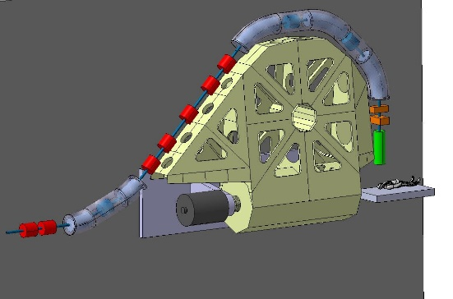
Task 7.5 - Integration of an innovative superconducting gantry: optics, mechanics, beam delivery (CNAO, CERN, SEEIIST, MEDA, RTU). Task Leader: M. Pullia
Elena contributing
The «SIGRUM» SC gantry by TERA&CERN
Examination and comparison of the different existing conceptual gantry designs and selection of the most promising option.
Sub-Task 7.5.1, Basic structure and mechanical design: After having identified the baseline conceptual design, the mechanical structure and the technical solutions of the beam transport and the magnets will be investigated in detail. This sub-Task will start from a general mechanical and optics design of the gantry to integrate actual magnet designs, beam instrumentation, dose delivery, cryogenics aspects, etc. into a detailed mechanical design. (CNAO, RTU, CERN).
Sub-Task 7.5.2 Simulation of optics, scanning techniques: Global simulation and optimisation of the gantry considering optics, magnets, power converters, beam diagnostics, mechanics, dose delivery. The design shall be flexible enough to adapt the gantry optics to the existing and future facilities, and to be easily industrialised and reproduced in several units.
SC technology + innovative support to reduce weight and dimensions (and price)
~40tons Vs. 600tons(!) HIT gantry

Slide 10
WHAT I’m up to…
  Set-up a Working Group of Field Quality for Curved Magnets (joint WP7+WP8)
    beam dynamics, magnet design and measurements
    our second meeting on Tue 8th June
  Documentation on SIGRUM and TERA Gantries for hand-over to Task 7.4
    done, now regular exchanges
  Identified best energy for injection into the synchrotron → specs for the new linac (Task 7.2)
    done, yesterday! ;D (need to document)
  Review of layout options for SC ring
  Supervision (and co-supervision) of Students: extraction, optics and magnets
  Closing the “DLR Contract” Report on injection&extraction
    2nd year of activities in preparation of SEEIIST

Slide 11
HOW DO WE WORK
  Collaboration with experts from EU medical facilities and CERN colleagues
  Tight synergies with CERN NIMMS activities
    CERN Doctoral student on Extraction (“slow” conventional and FLASH) from Imperial College
    collaborations with UK, U.Melbourne (several PhD studs available)
    interest from Belgium and Spain (with students and engineers)
    trainees from the SEE region (U.Sarajevo, IAEA fellows,…)
Need to grow participation from SEE countries
CAPACITY BUILDING is key!!!

