Slide 1




Particle therapy (interes and knowledge)
SEEIIST
01.06.2021
Andrej Studen, Matjaž Vencelj

Slide 2
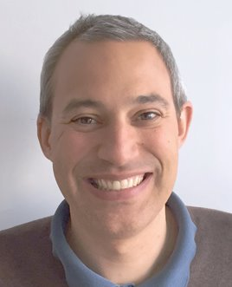
Andrej Studen
Assistant Professor, Faculty of Mathematics and Physics, University of Ljubljana​,
Researcher, Jožef Stefan Institute
Areas of research:
Nuclear Medicine instrumentation
Development of new image analysis methods
Clinical research
​

Slide 3
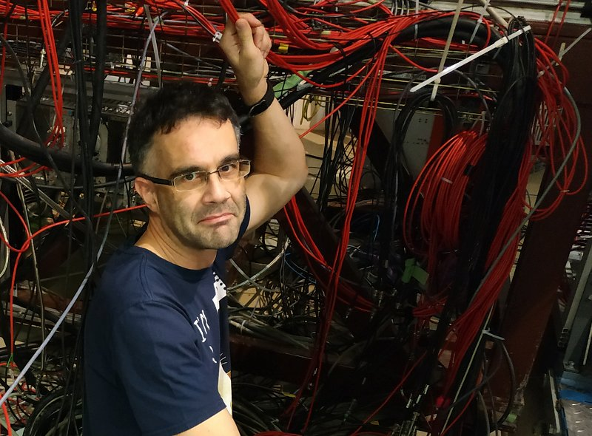
Matjaž Vencelj
Researcher, Jožef Stefan Institute
Areas of research:
Nuclear Medicine instrumentation, Atomic physics

Slide 4
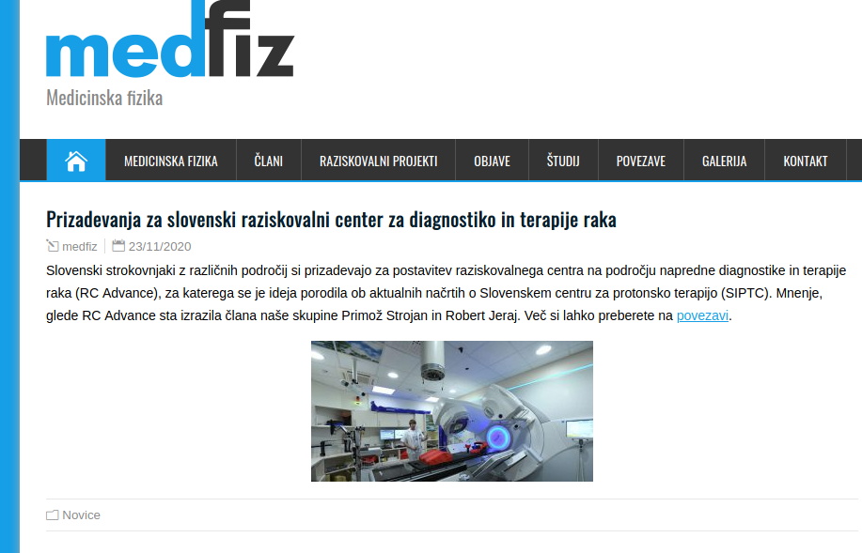
Medical physics research group
www.medfiz.si

Slide 5

Medical physics research group
Focused on patient benefit
Modeling of diseases and treatment
New instrumentation development
Immunotherapy, prostate cancer
Bio-medical optical imaging group
PET instrumentation development
Development of new biomarkers
Personalized medicine
Breast screening,
Conformal radiotherapy
TECANT, somatostatin antagonist, quantitative imaging biomarkers (DORA, immunotherapy, cervical cancer)

Slide 6
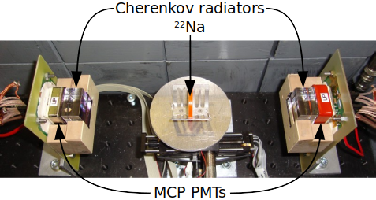
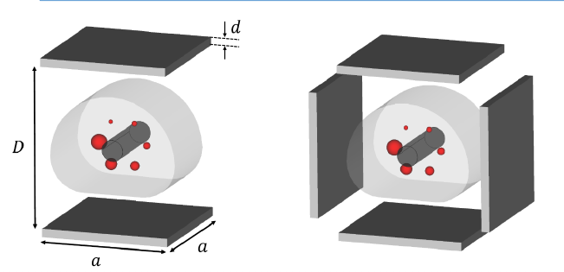
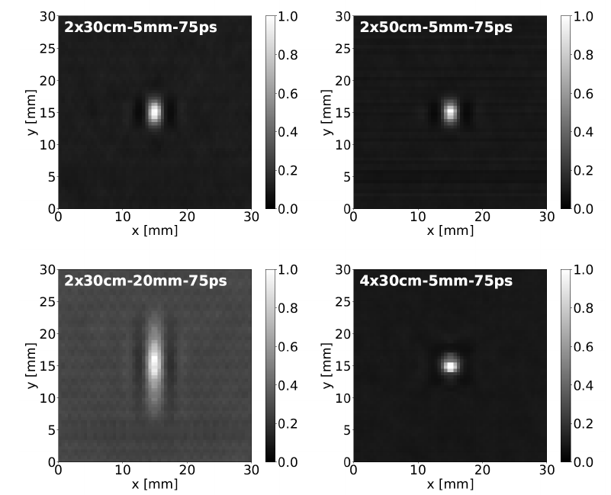
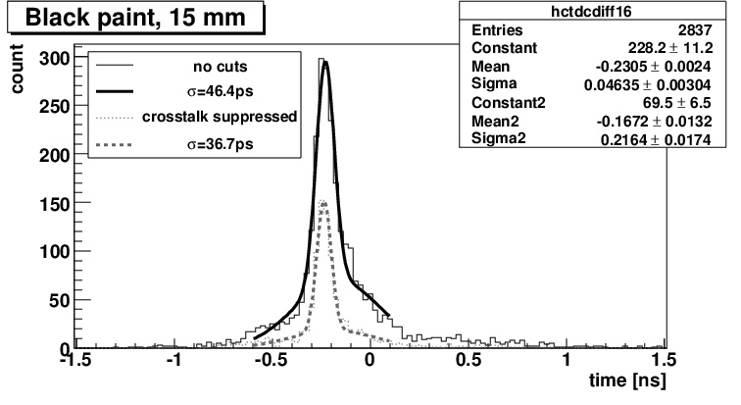



Challenges – PET instrumentation
Cherenkov radiation provides excellent timing resolution for future PET imagers
New geometries using TOF PET
Partners:
FBK Trento, CNM Barcelona, Caltech, MGH

Slide 7
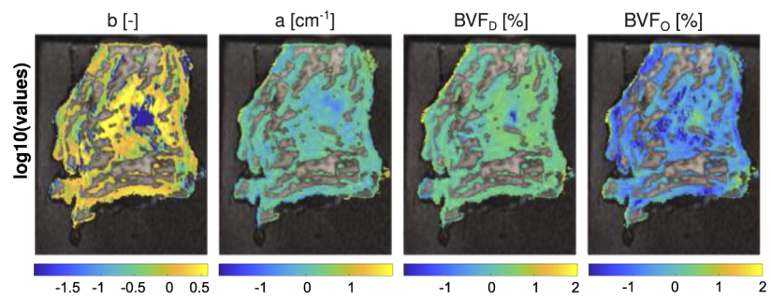
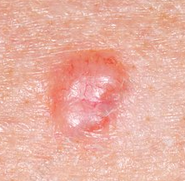
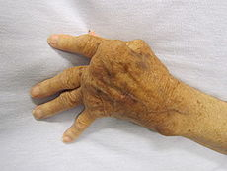
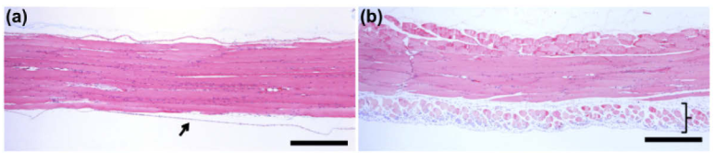
Challenges – biomedical imaging
Clinical challenges
Microscopy system
Determination rf relevant microscopic and macroscopic tissue parameters
Modelov developments that associate micro- and macroscopic tissue properties
Inflamatory diseases: phyisical and physiological properties
Arthrities (Clinic for arthriries, UMCL): GCA, animal inflamation models
Dermatology (Dermatology, UMCL; Chair of pathology, MF UL): skin infection, skin tumors
Oncology (OIL): human tumor models, DORA
Laser therapy (Fotona, Plastic surgery UMCL): laser epilation

Slide 8

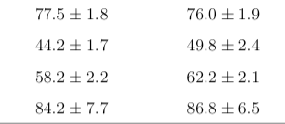
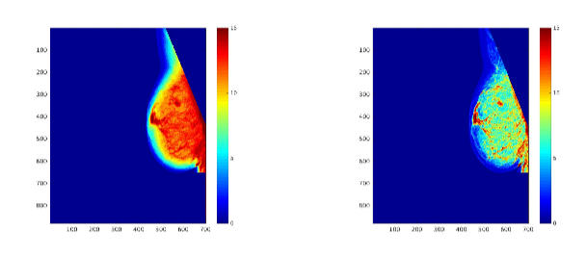

Challenges – breast screening
Personalized breast screening requires risk assessment.
Estimating breast density as an independent risk factor in DORA (> 100k mammography scans anually):
- 50k annotated images used as input
Correct estimates
Raw Processed
BIRADS1
BIRADS2
BIRADS3
BIRADS4
Of particular importance is the BIRADS4 group with significant increase in risk.
comparison of density score for raw and processed image
Partners: OIL, KU Leuven

Slide 9
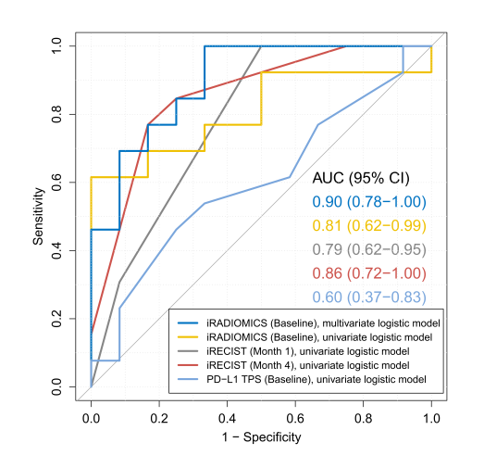
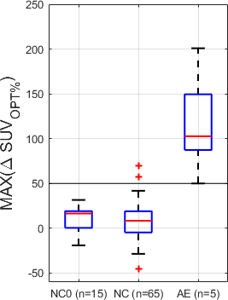
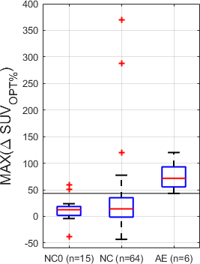
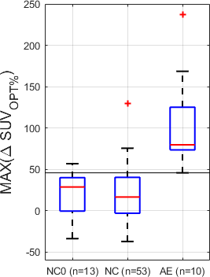
Challenges - Immunotherapy
Adverse effect in metastatic melanoma
Quantitative analysis of change in tissue uptake on sequential images
Patient selection in NSCLC
Quantitative image analysis prior or during treatment
Partners: OIL, UW Madison
pneumonitis
colitis
tiroditis
Z. Klaneček, D. Huff, N. Hribernik, M. Reberšak et al.
D. Valentinuzzi et al. Rad and Onc. 2020

Slide 10

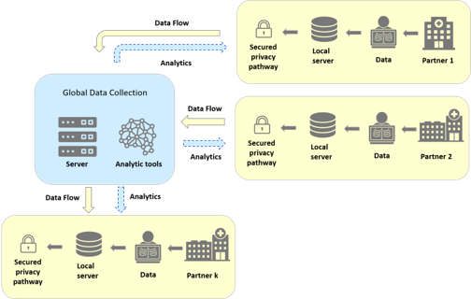
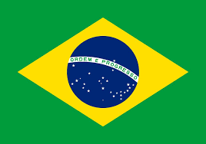

Challenges – data management
Network of excellence in imaging (NIX, nix-alliance.org) promotes harmonized collection, management and global sharing of data
Medical data is very sensitive - NIX provides strategies for mitigating international security concerns.
Within NIXLJU, Ljubljana node, four sub-nodes are in place at partner institutions (UMCL, OI, labkey-public and merlin) and are vital in providing data and analysis for science projects.
Typical information flow
Partners: Universidad Sao Paolo, UWA Perth, UW Madison, Hospital San Raffaele, Hospital de la Santa Creu i de Sant Pau Barcelona,...

Slide 11
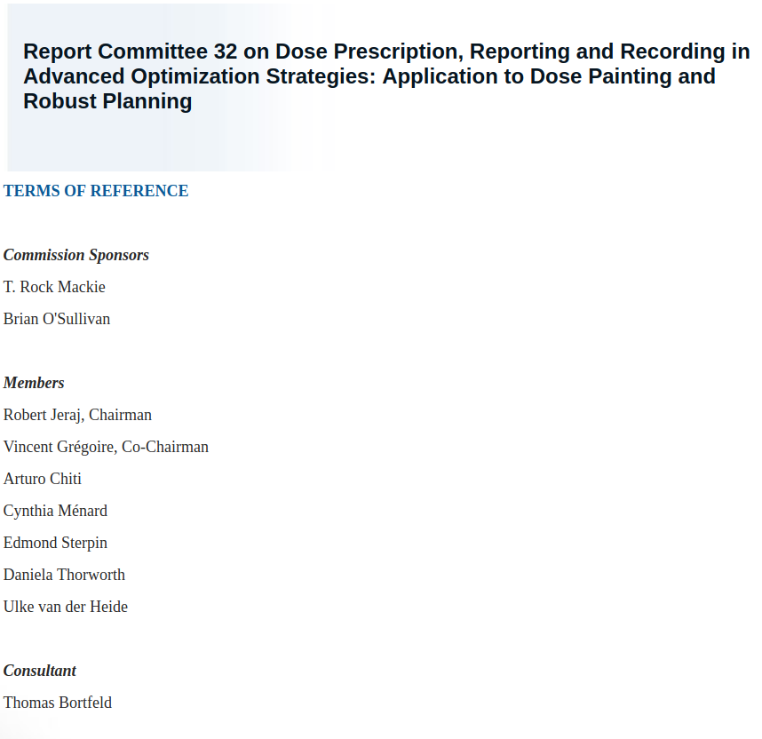
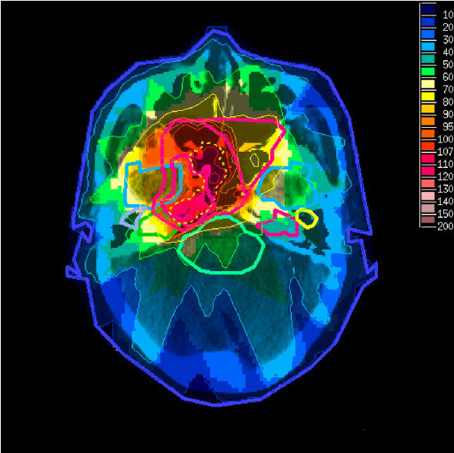

Challenges – conformal radiotherapy
Dose painting doesn't fit GTV/CTV/PTV paradigm.
Highly personalized approach to treatment.
New committee formed to answer the needs

Slide 12
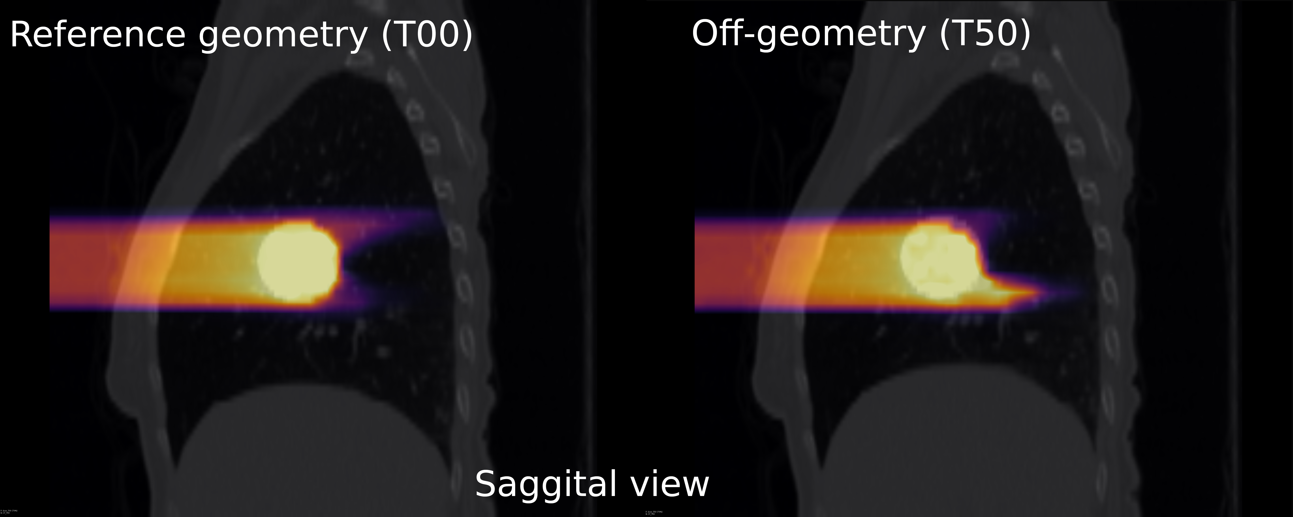
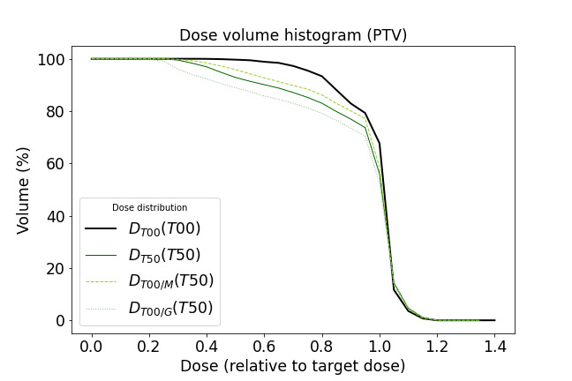




Adaptive treatment
G. Razdevšek et al. ANIMA 2019
Is adaptive treatment required?
a naïve motion-less approach to proton irradiation.
Plan dose on the inhale phase.
Simulate actual dose (MCNP).
Compare on-reference and off-reference dose.
Significant deviation in dose delivery that violates standards seen.
Slovenian researches initiators of the RAPTOR collaboration, funded by the EC 2020 MSC/ETN call, with collaborators from leading HR centers.

Slide 13
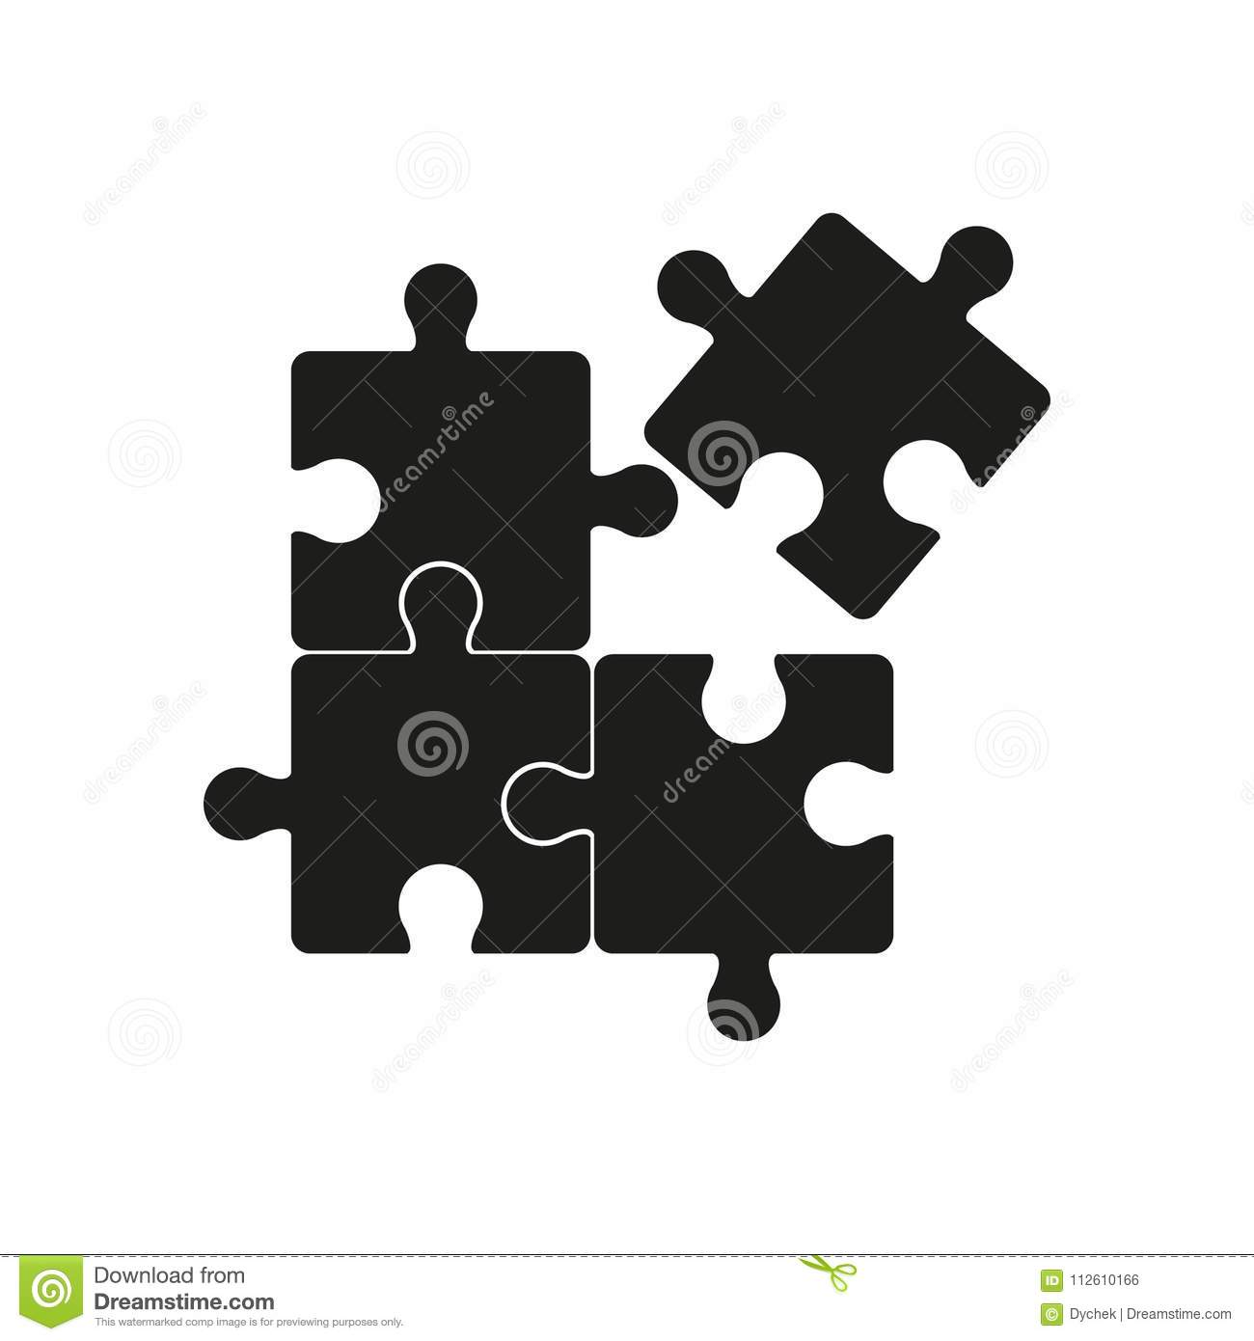
Future studies
Medical physics group
is building a puzzle of advanced diagnostic and therapy monitoring procedures and algorithms.
New facilities (such as RC-Advance) add important pieces and contribute to our overall goal of patient benefit.

