Slide 1
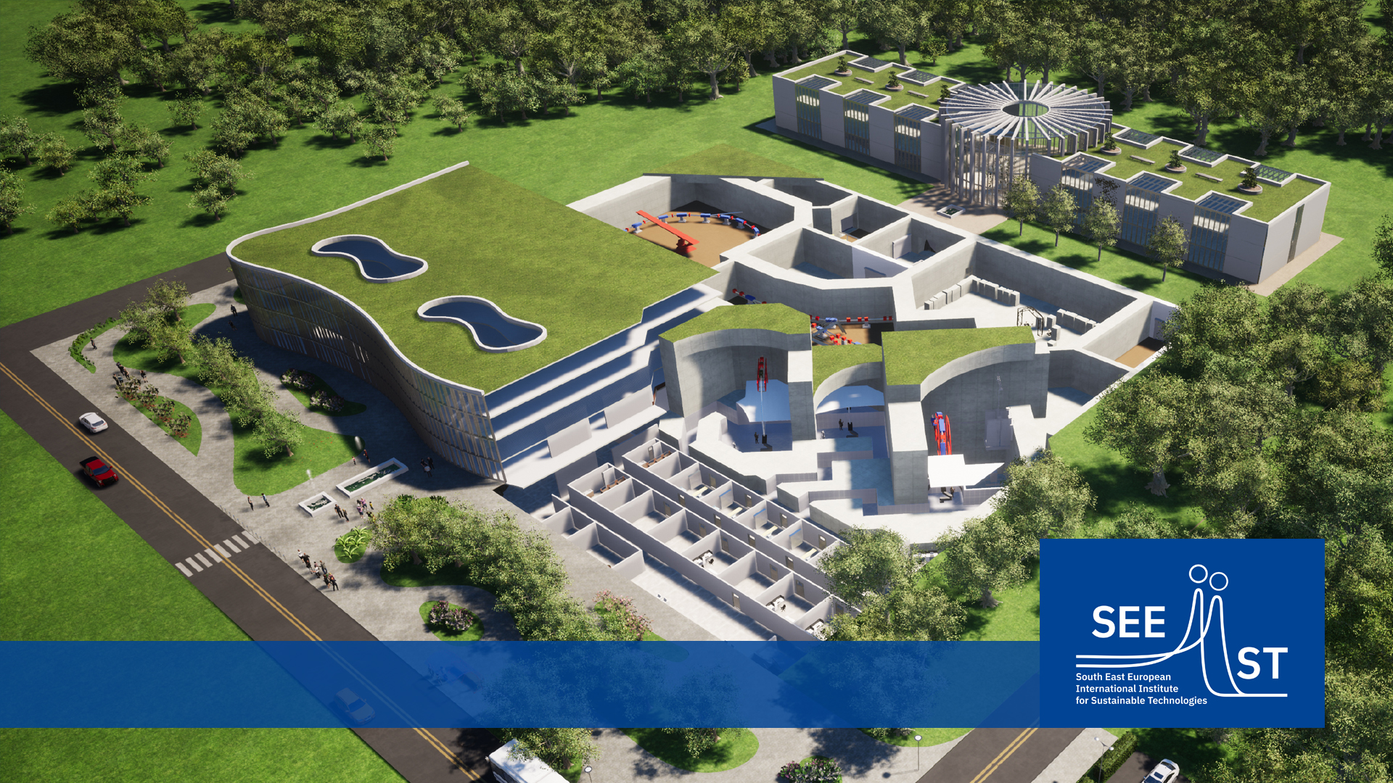
WP 5 Education and training
KCCG (Prof. Todorovic)
TITLE FOR PRESENTATION
Dr. Luka B. Uskokovic / March 2021
SEEIIST HITRI plus – kick off Meeting June 2. 2021.

Slide 2
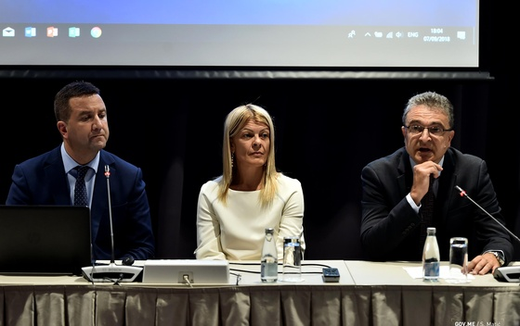
SEE Meeting on Western Balkan Regional Network for Radiotherapy and Oncology - Podgorica, Montenegro
7 th and 8 th September 2018.
Hotel Verde Complex , Podgorica
Organizers Ministry of science, Government of Montenegro
Clinical Center of Montenegro
Participants and lecturers from 6 countries
Montenegro, North Macedonia, Serbia,
Bulgaria, Albania, Bosnia and Hercegovina

Slide 3
SEE Meeting on Western Balkan Regional Network for Radiotherapy and Oncology - Podgorica, Montenegro
Challenges in management of cancer in Emerging countries Prof. dr Vladimir Todorovic Montenegro
Multidisciplinarity and quality of cancer care Prim. dr sci.med. Zorica Tomasevic , Serbia
Regional Radiotherapy and Oncology Network in SEE countries Dr. Salmin Salkovic, Montenegro
Oncology situation in Albania Dr. Lediu Bregu , Albania
Advanced and innovative radiotherapy techniques at IMC Radiotherapy Center Banja Luka Dr. Slavica Maric, Bosnia and Hercegovina
Montenegrin initiative for European scientific projects related to Hadron Cancer therapy Dr sci. med. Aleksandar Celebic, Montenegro
The National Cyclotron Center at INRNE BAS: Medical and Scientific Applications Dr Mladen Mitev , Bulgaria
Academic vs Private Oncology in Balkan region Prof. dr Vlada Kovcin , Serbia
Collaboration of UCRO and IAEA in modernization of radiation oncology services in Macedonia Dr Nikola Vasev , North Macedonia
Implementing new radiotherapy techniques at Oncology Institute of Vojvodina Dr Dusanka Tesanovic , Serbia

Slide 4
What should be done ? In the fight against Cancer
Together….. Initiatives…AROME, SEEROG, SEE Regional Network ….2018. SEEIIST….
Investment in primary and secondary prevention programmes
Multidisciplinary boards – better outcomes
Cancer registres
Population education – better understand the problem of cancer
National cancer plans - action
Investment in cancer diagnostics
Investment in surgery – crucial and with great pharmacoeconomics ratio
Investment in radiation oncology – every EUR invested will be amplified by 6 times – Heavy ion research and treatment…trials and guidelines
Investment in systemic, innovative treatments

Slide 5
SEEIIST – Oncology society
BUDVA SEEIST MEETING 2019. Ministy of Science, Government of Montenegro – very high level -Prime Minister of Montenegro
AROME MONTENEGRO Budva october 2019. participants from 17 countries, more than 200 oncologists - Chairs J. Gligorov, V. Todorovic, Mati Aapro
plenary lecture S. Damjanovic – SEEIIST
INVITATION LETTER FOR COOPERATION AND SUPPORT - ONCOLOGY SOCIETY – DECLARATION
SIGNED BY 5 parties – Montenegro, BiH, Kosovo, Albania, North Macedonia,
lot of effort but no signed support (Oncology Institute Ljubljana, IORS Serbia…)
SEEIIST activities- Montenegro - Radiation oncologist 3, Physicist 3, Medical 3 surgion 1
SC SEEIST - Prof. M. Scepanovic physicist and Prof. V. Todorovic oncologist
Clinical center of Montenegro - Surgion dr V. Dobricanin

Slide 6
WP 5 Education and Training
In this moment no education program or training for Heavy ions application or treatment in cancer patients
Expanding knowledge in our SEE region – there is no infrastructure
Program for education – for doctors, physicists and information for patients
Participants from region – students young oncologists
Bridge between science and clinics (from bench to bedside)
From trials to guidelines - translation
… better treatment for our patients…efficacy-toxicities- outcomes

Slide 7
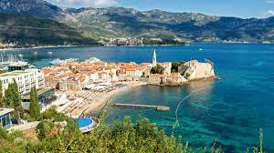
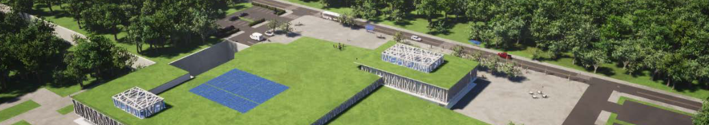
Thank you for you attention.
Contact:
Name Surname
name.surname@seeiist.eu
+382 67 249 700

