Slide 1
WP5 - Education and Training
Mimoza Ristova
02/06/2021
1

Slide 2
Tasks (UKIM via SEEIIST)
Task 5.1: Specialised courses on heavy ion therapy research and infrastructure
Task 5.3: Provide e-learning course material on heavy ion therapy
Deliverables
D5.1: Delivery of Specialised Learning Courses
D5.3: Provision of e-learning courses ???
Milestones
M5.1: Specialised Courses and Masterclass Content Definition (SEEIIST)
WP5 – Education & Training
3

Slide 3
Task 5.1 – Specialised Courses
- Led by SEEIIST
- Two 1-week schools
- targeting new generation of researchers – postgraduate students, postdocs, academic researchers, industrial researchers, oncology practitioners
- from a wider multidisciplinary community or who are not directly in the field
- topics: - heavy ion therapy concepts
- clinical practice
- accelerator technology
- beam physics
- radiobiology and medical physics
- min 20 participants per school
- heavy ion therapy data platform
- safety aspects
- compliance
- commissioning certification
WP5 – Education & Training
6

Slide 4

Task 5.3 – e-learning Material
- led by UM
- conversion of task 5.1 and 5.2 into e-learning courses
- guarantee sustainability
- study existing e-learning resources and choose most appropriate tool
- record course material
- illustration by multimedia content
WP5 – Education & Training
9

Slide 5
Training in Particle therapy – WEB RESEARCH-Organizations
I. PTCOG https://www.ptcog.ch/index.php/events-conferences (no details available)
II. ESTRO https://www.estro.org/Courses/2021/Particle-Therapy
ESTRO Target group:
Individuals either directly involved in a clinical PT project, already practice PT or desire to update their knowledge in PT.
ESTRO Course Content
Physics and biology: image guidance techniques, dosimetry and quality assurance
Medical Physics: image guidance techniques, dosimetry and quality assurance
Clinical Studies: Clinical indications, anti-cancer effects, toxicity, challenges &limitations of PT
Roadmap for a particle therapy project
Protocol and journal club about latest clinical and physics developments
Guided tour of particle therapy facility
Cost: 500-900 Euros
III. ENLIGHT https://enlight.web.cern.ch/events (workshops)

Slide 6
Training in Particle therapy – WEB RESEARCH - Institutions
IV. NYPC (USA) –Announced 2019 and 2020 (no details available)
https://www.nyproton.com/new-york-proton-center-proton-therapy-training-program/
Target group: physicians, physicists, dosimetrists, therapists and administrators.
V. Samsung (S. Korea)
https://www.samsunghospital.com/gb/language/english/education/advancedProgram.do?sub=proton
Target Group: Physician, Physicist, Dosimetrist, Radiotherapist
Lectures: Short review of Basic proton therapy physics, Dosimetry tools used for proton therapy QA
Practicum: Planning: selected cases for brain, CSI, H&N, lung, liver treatment (wobbling and line-scanning method), Dosimetry: daily, monthly, annual QA and patient specific QA, Clinical practice: CT simulation, image guidance, respiratory motion management.
VI. UPENN-Pennsylvania (USA)
https://www.xrt.upenn.edu/AnnualCourseonProtonTherapy.html#
Target group - Radiation oncology physicians, physicists and administrators who are interested in learning about proton therapy.
VII. PSI -Winter School (Switzerland)
https://www.psi.ch/en/protontherapy/training-and-education
Target audience: Radiation oncologists, medical physicists, physicists, engineers, radiation technologists and dosimetrists. No previous knowledge of proton therapy is necessary

Slide 7
Training in Particle therapy – WEB RESEARCH - Virtual
VIII. ONCOLINK
https://www.oncolink.org/healthcare-professionals/oncolink-university/proton-therapy-professional-education/oncolink-proton-education-modules
14 modules: Physics, Radiobiology, Clinical, Simulations, Pediatrics
Training in Carbon Ion therapy – WEB
IX. CHIBA & GUNMA (JAPPAN)
https://www.antm.or.jp/ITCCIR/welcome.html

Slide 8
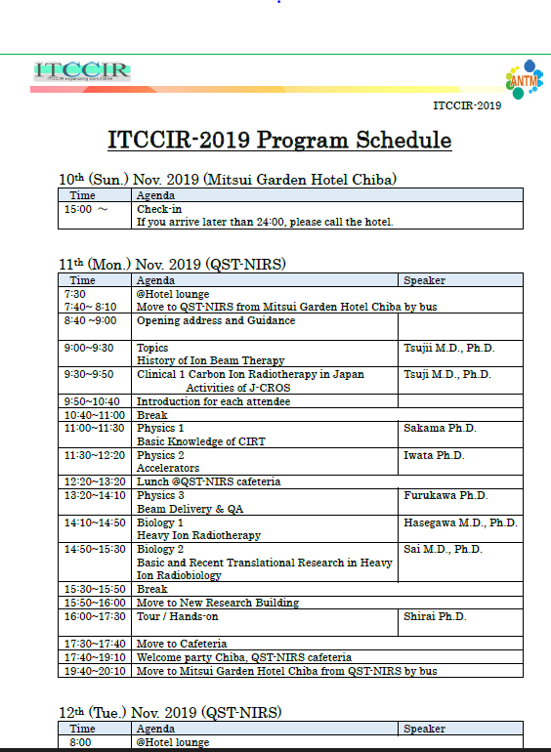
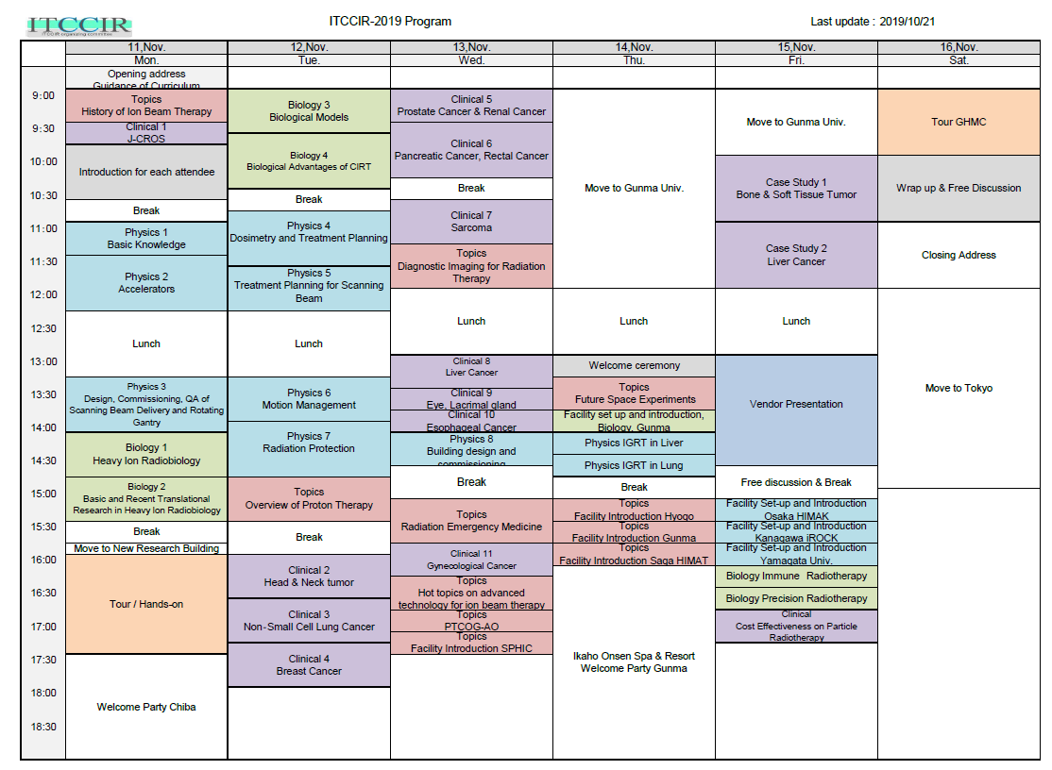
Carbon Ion (Chiba-Japan)

Slide 9
https://ec.europa.eu/health/non_communicable_diseases/subgroup_protontherapycentres_promotionprevention_en
https://legionhp.com/
https://legionhp.com/education/

