Slide 1
Wide-bandgap material Silicon-Carbide (SiC) as high-rate particle detector
Philipp Gaggl

Slide 2
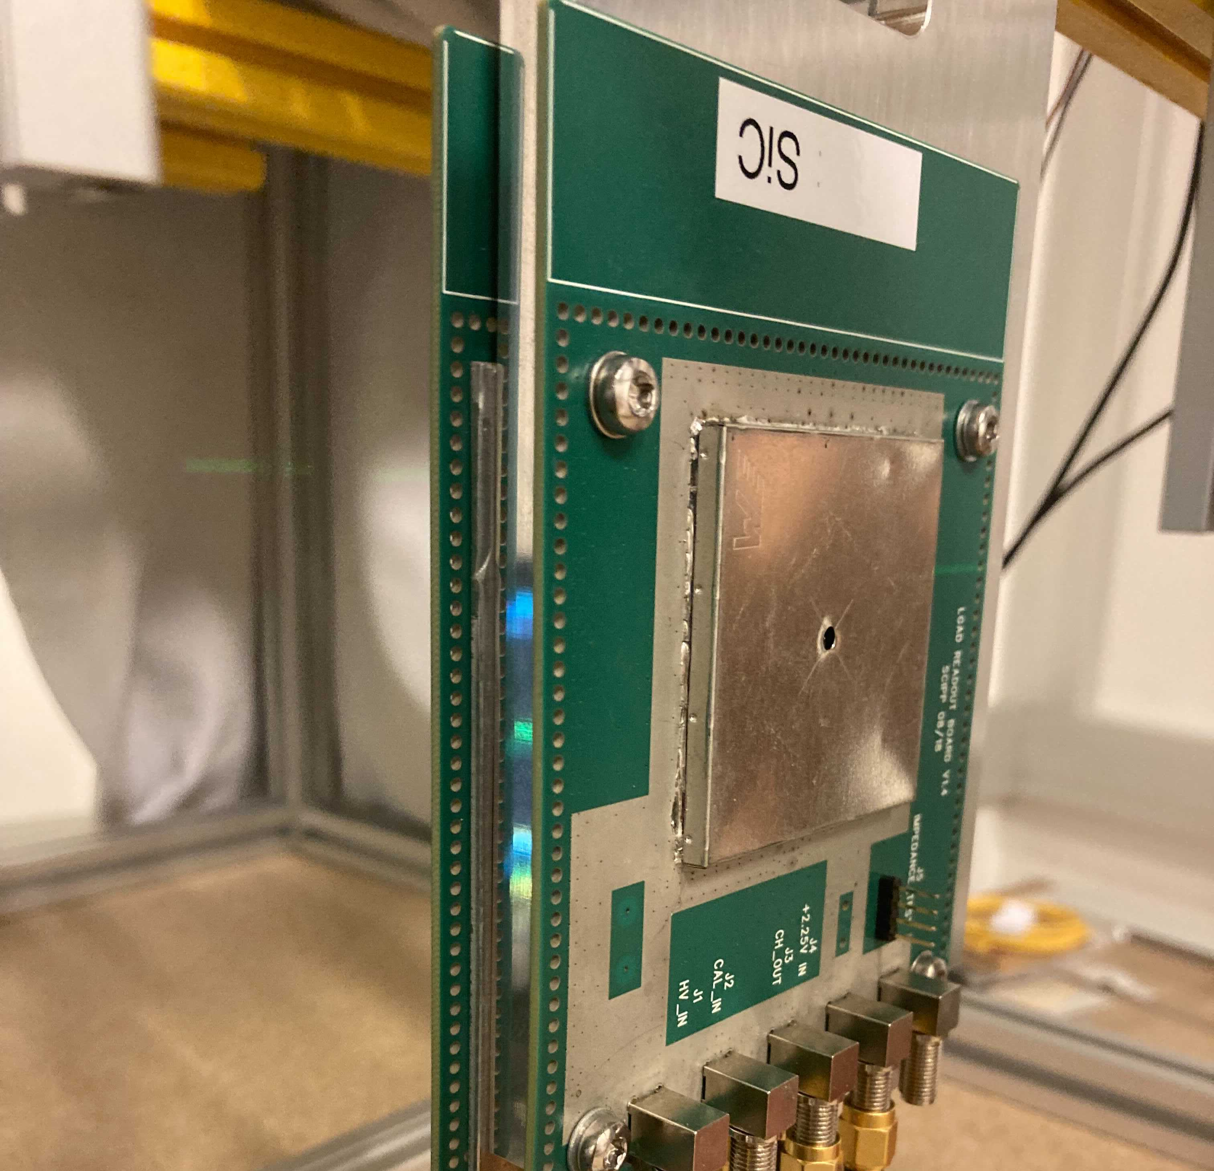
Overview
Introduction
  Why (4H)-SiC?
  SiC-samples
  Readout
  Signal analysis
Measurements on SiC samples
  UV-TCT measurements on irradiated SiC
  Experiments at ion beam facility
SiC-LGAD
  Challenges
  Simulation
  Prototype production
  Application
Readout
  Single particle mode
  Integration mode
  Dual application
Summary

Slide 3
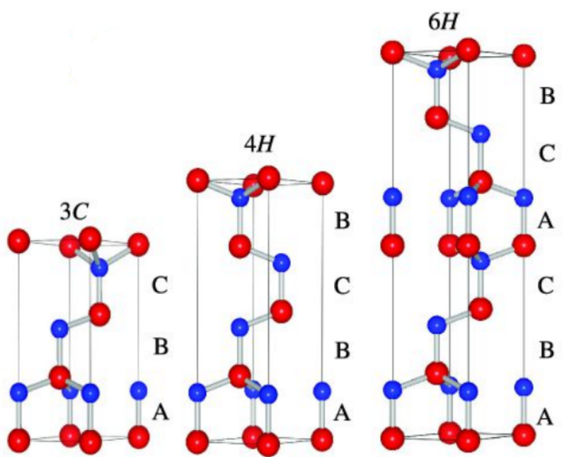

Introduction: Why (4H-)SiC?
  Research profits from recent interest of power electronics in SiC
  Various SiC polytypes with different properties
  Characterized by the bonding stacking order of a lattice layer
  Focus on 4H-SiC → Promising candidate for durable single
  particle detection at high luminosity environments
Property | Si | 4H-SiC | Advantage
Bandgap [eV] | 1.12 ^{[1]} | 3.27 ^{[1]} | Low dark current levels, room temperature
Saturation electron velocity [10⁷ cm/s] | 1.0 ^{[1]} | 2.0 ^{[1]} | High intrinsic time resolution
Breakdown field [MV/cm] | 0.3 ^{[1]} | ⊥: 4.0; ∥: 3.0 ^{[1]} | High operation voltages
Atomic displacement threshold [eV] | 13-20 ^{[1]} | 22-35 ^{[1]} | High radiation resistance
Thermal conductivity [W/cmK] | 1.5 ^{[2]} | 5.0 ^{[2]} | Good cooling properties
[3]

Slide 4
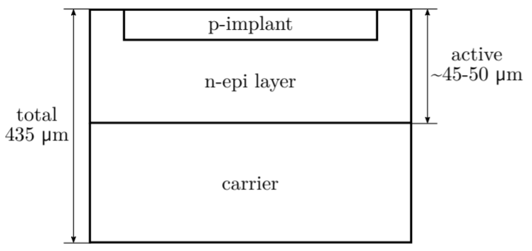
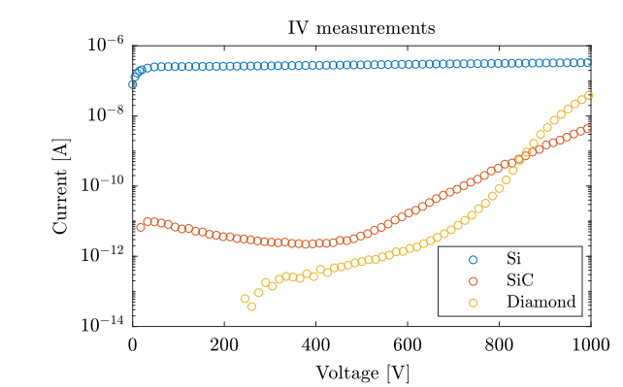
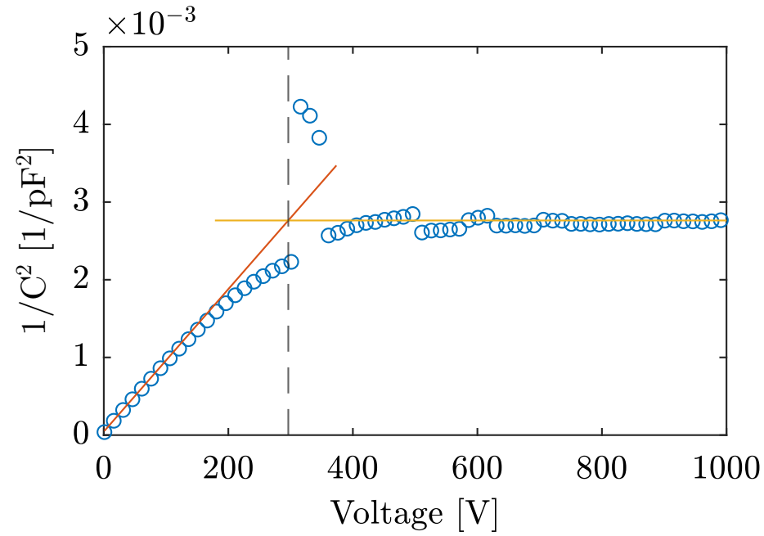
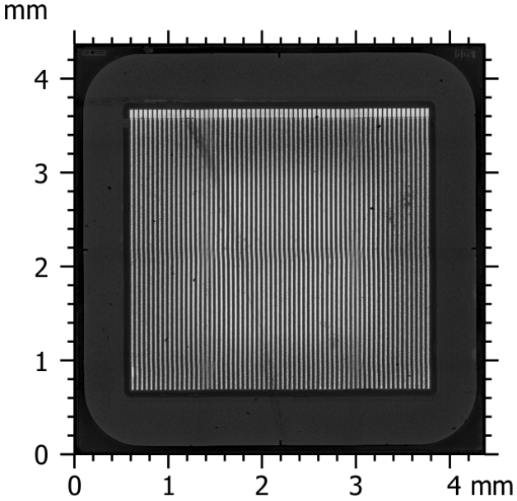
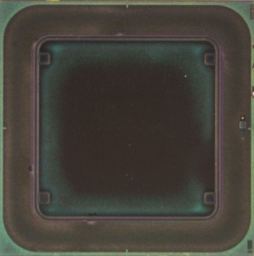
Introduction: SiC samples
  Provided by CNM (Centro Nacional de Microelectronica, Spain) for evaluation purposes
  3x3 mm p-on-n diodes with 45-50 μm epi-layer
  Planar diodes and strip sensors (64 strips, 50 μm pitch)
  Preceding simulations (Weightfield, Synopsis, Corryvreckan)
  Extensive experiments in-lab and at ion-beam facility
[2, 3]

Slide 5
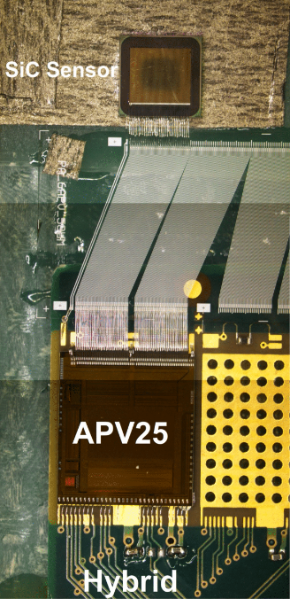
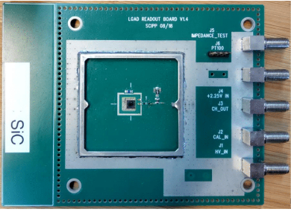
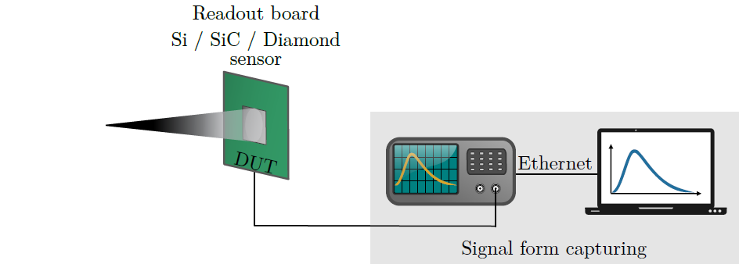
Introduction: Samples readout
  Planar Diode
UCSC-LGAD-board
Single channel testboard
for different devices
(Si, SiC, LGAD, diamond)
Widely validated and used
  Strip sensor
APV25 readout chip
(128 channels)
Readout chain originally
developed for the Belle-II
silicon vertex detector
Source
[2, 3]

Slide 6
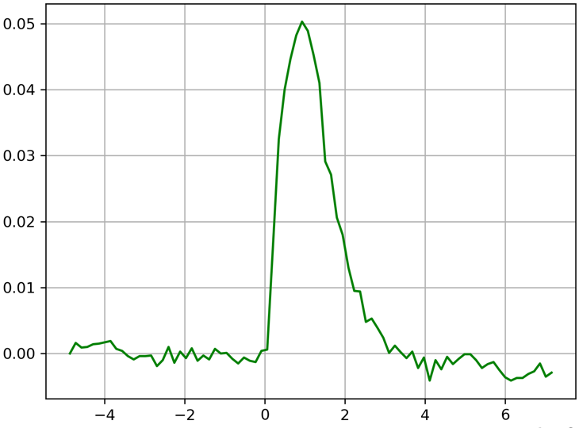
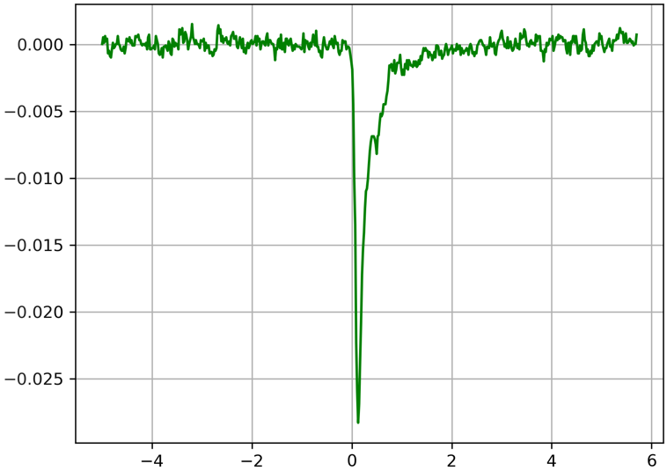
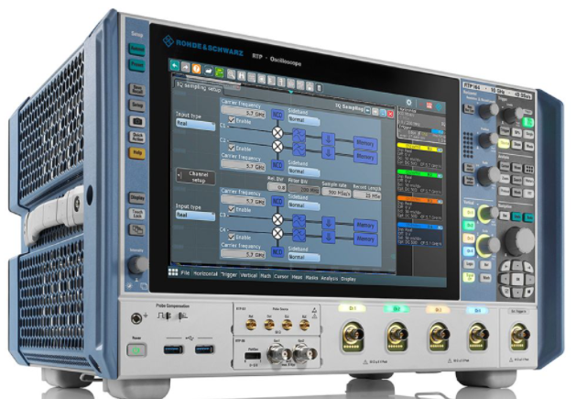
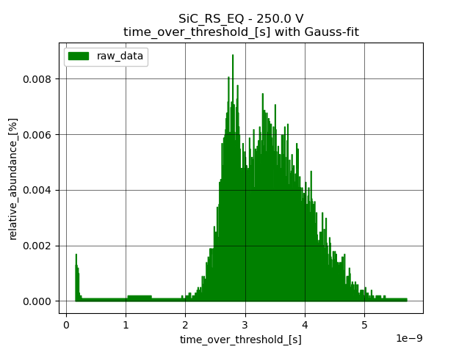
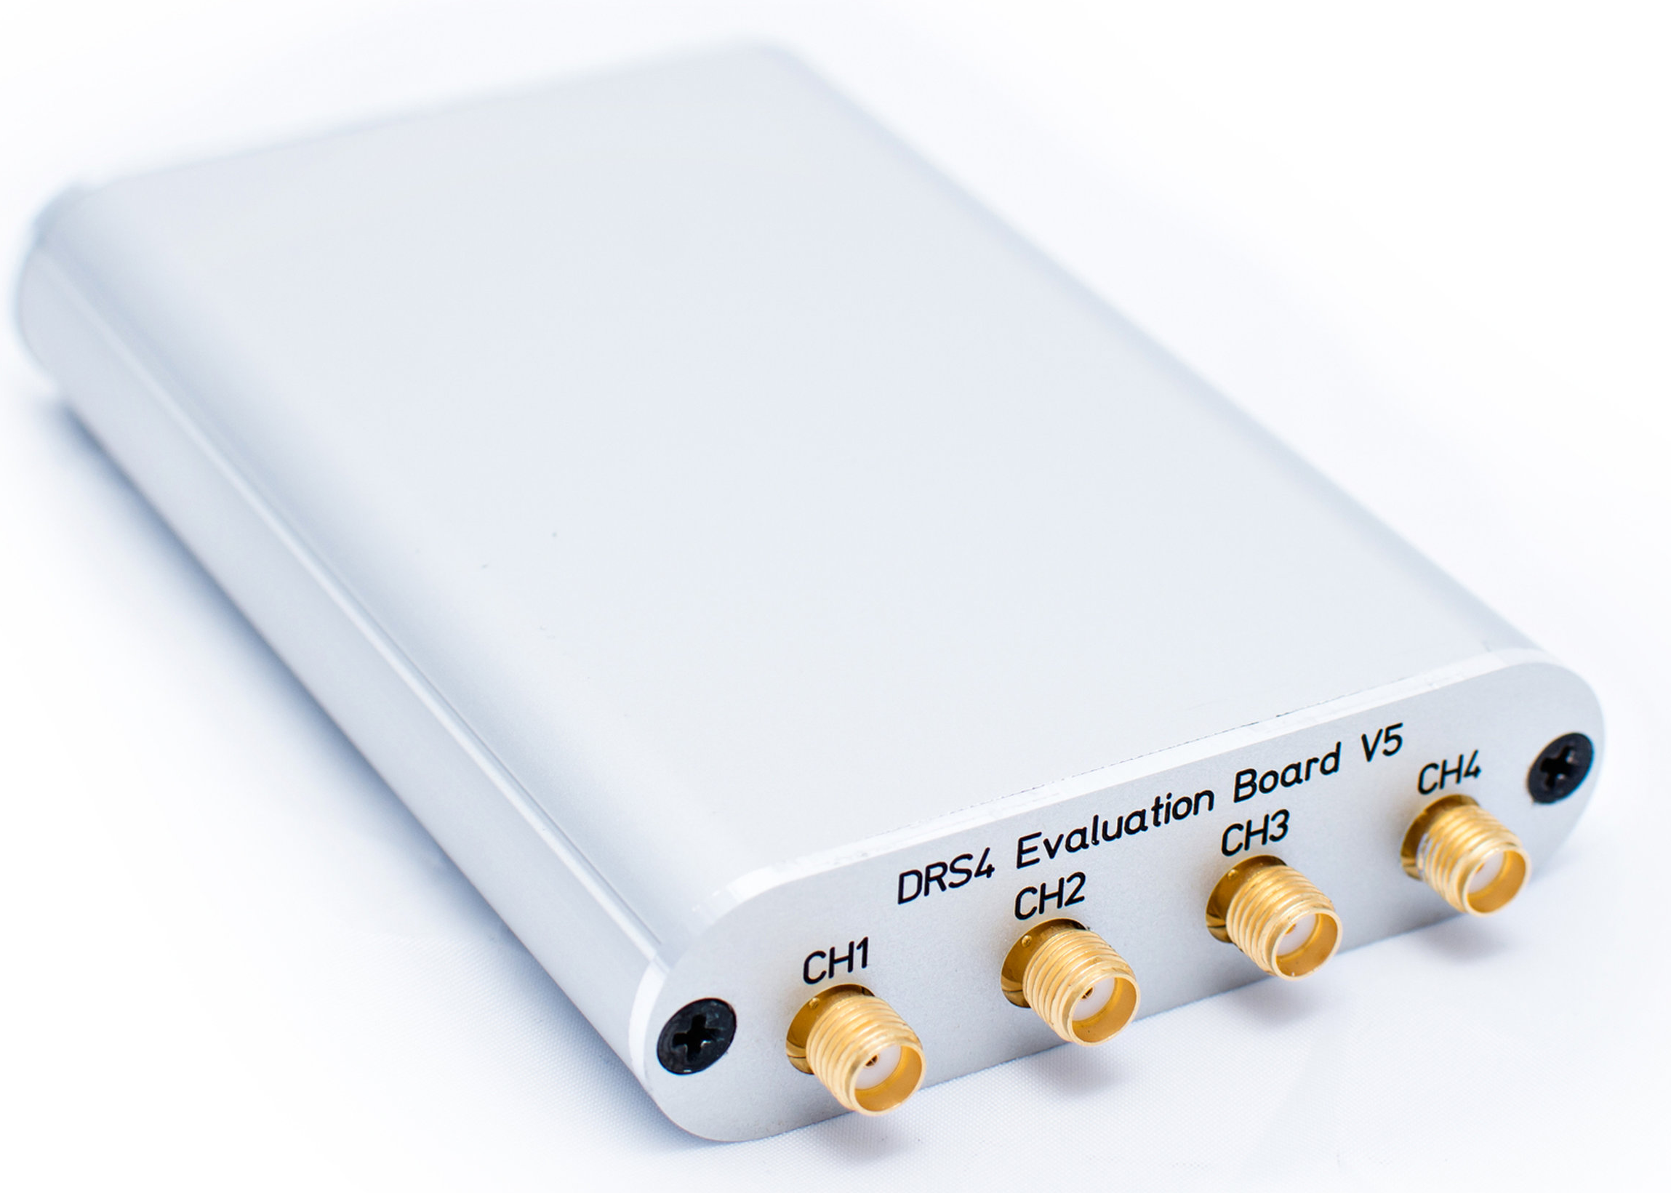
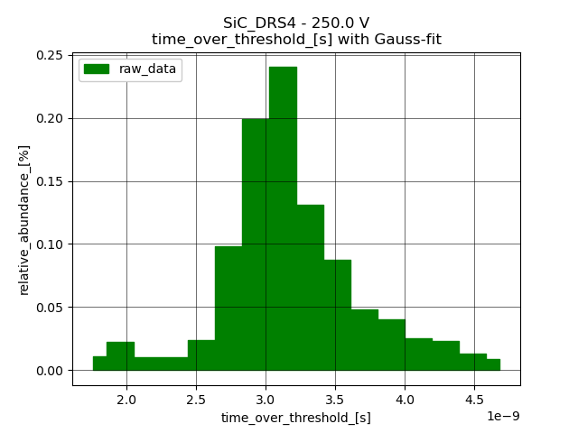
Single channel readout
  Epitaxial layer thickness is limited by increasing defect density (< 100 μm)
  Low charge generation per
  μm and MIP SiC: 57; Si: 80 - 90
  Short signal pulses
  Sufficient readout hardware required
Si-planar
SiC-planar
output voltage[V]
time 10⁻⁸ [s]
ToT-hist
R&S
ToT-hist
DRS4
  Rohde & Schwarz
  Costs ≈ 200.000 €
  40 Gsamples / s
  16 GHz
  DRS4 test board
  Costs ≈ 1.000 €
  5 Gsamples / s
  700 MHz

Slide 7
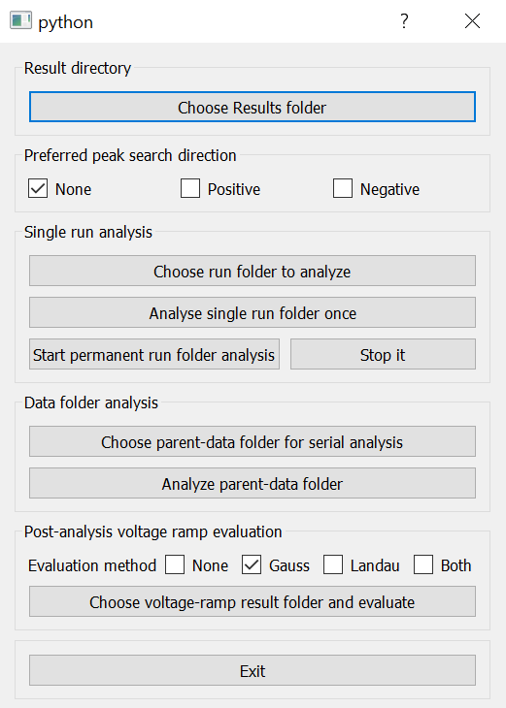
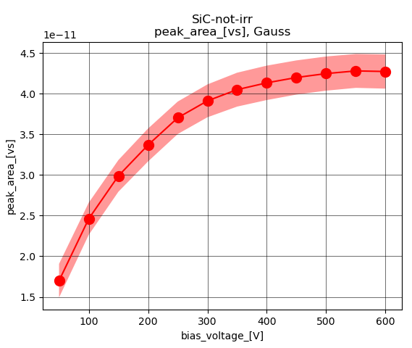
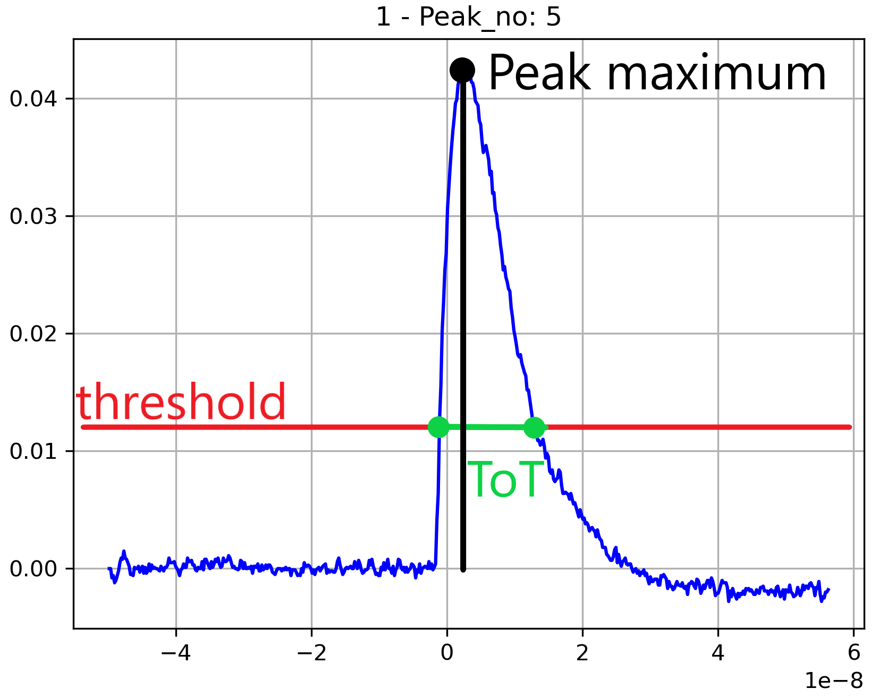
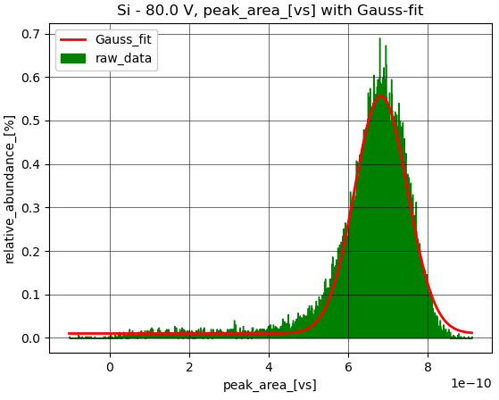
Introduction: Signal analysis
  Developed a Python framework for automated detector analysis
  Peak finding/analysis algorithm to obtain statistics of peak parameters
  → area, maximum, time over threshold, SNR
  Individual noise level calculation, user friendly GUI’s
  Gauss/Landau fitting of histograms for voltage ramp evaluation
  <
[5]

Slide 8
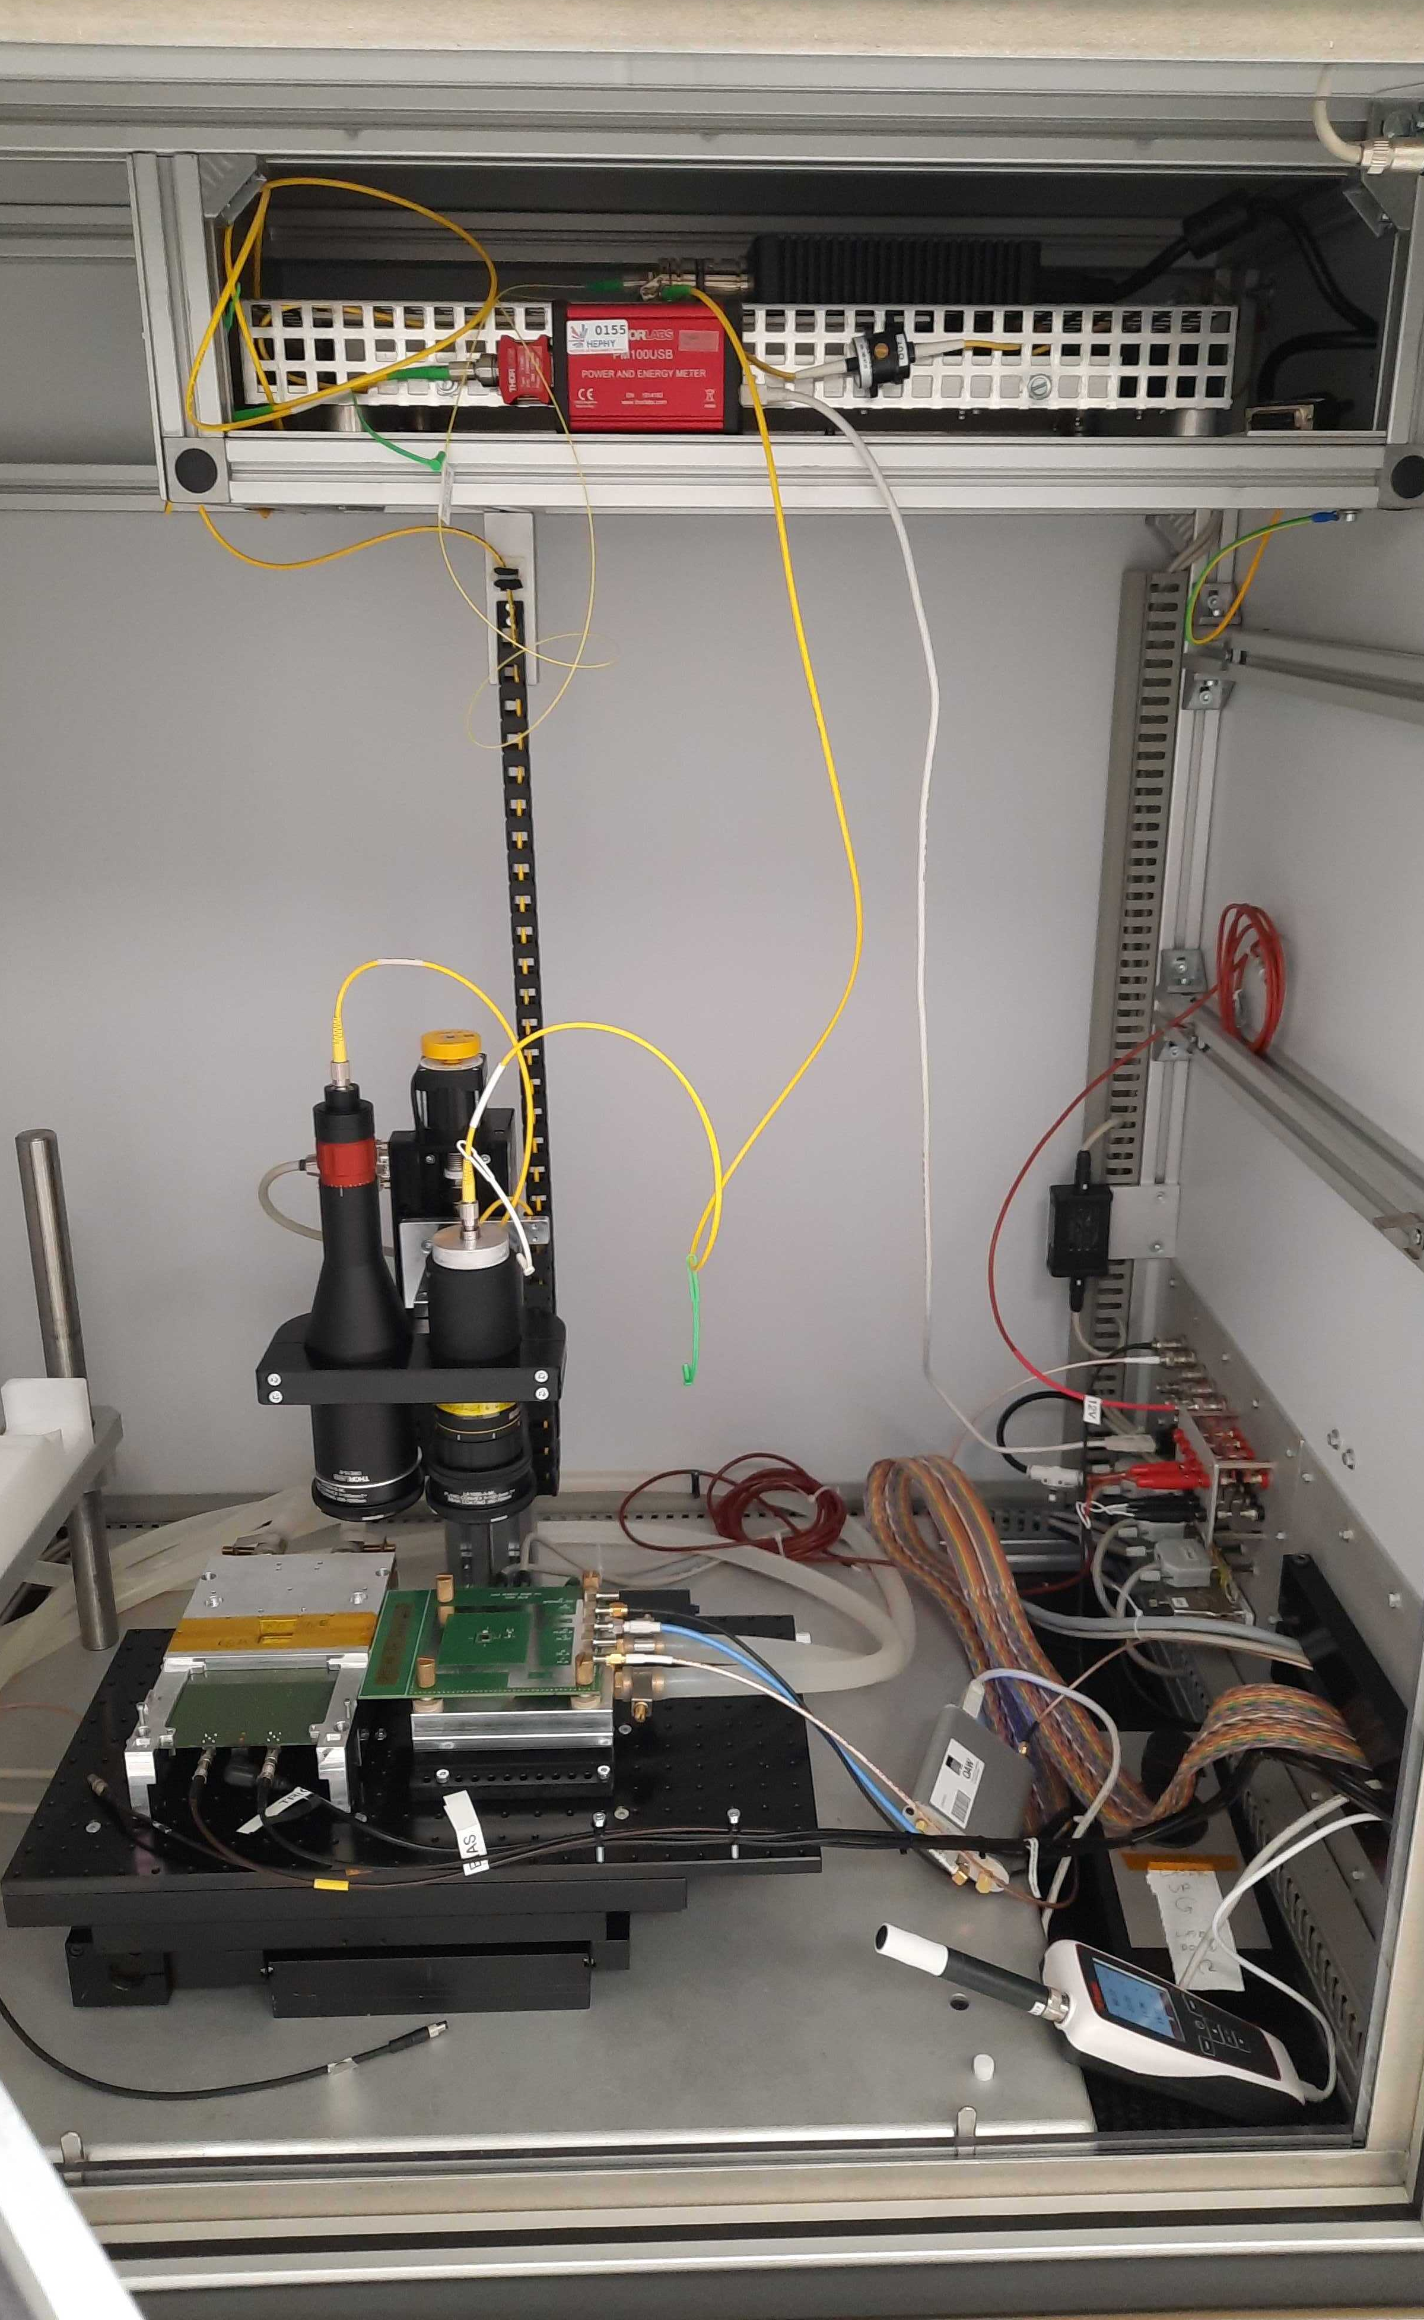
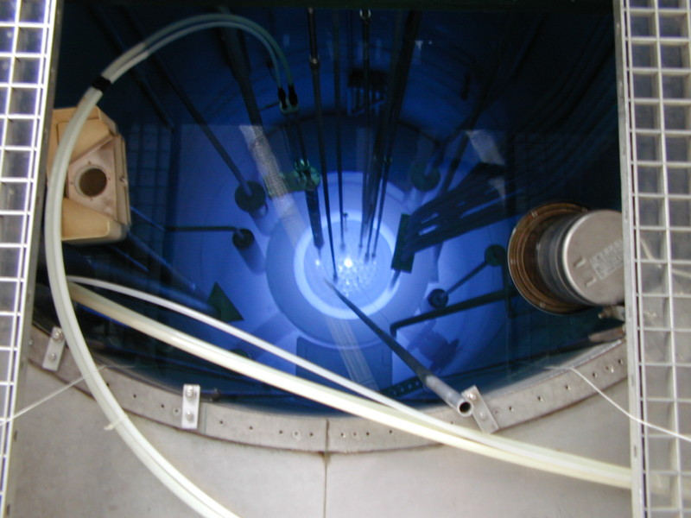
Measurements: UV-TCT
  UV-TCT (Transient Current Technique) at HEPHY-lab
    Imitation of traversing particle through short laser pulses
    Short pulses (< 60 ps) at constant high intensity
    UV-laser (NKT): λ ≈ 375 nm→ Sufficient for SiC bandgap
    Efficient triggering
  Samples neutron irradiated
  at TRIGA Mark-II research reactor
  (Technical University of Vienna)
  Investigated fluences [cm⁻²]: 5∙10¹⁴ / 1∙10¹⁵ / 5∙10¹⁵ / 1∙10¹⁶
[7]
Notes:
UV betonen → bandgap

Slide 9
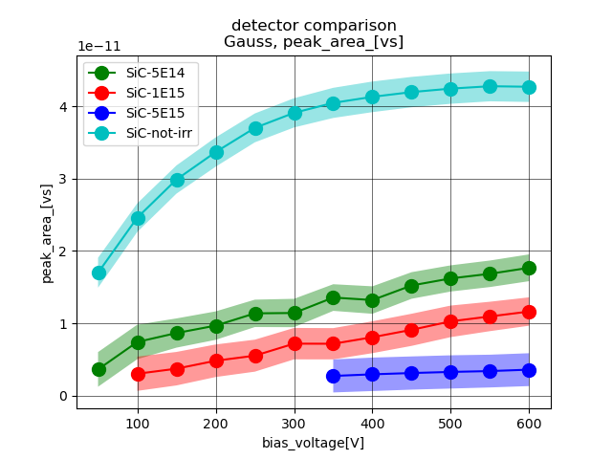
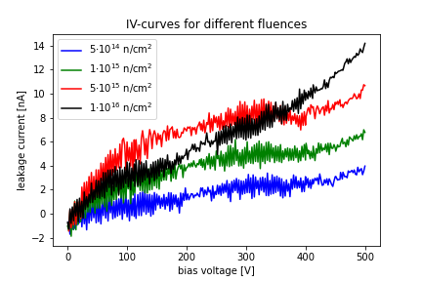
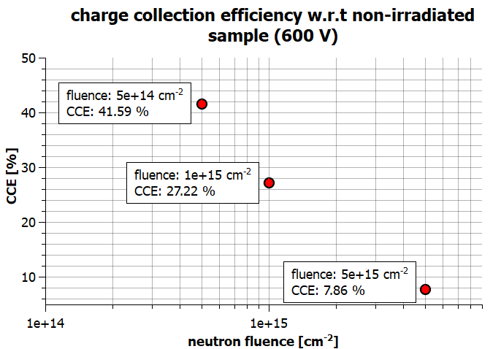
Measurements: UV-TCT
  Analyzed peak area → proportional to collected charge
  Non-irradiated sample saturates at about 500 V
  No saturation for irradiated samples up to 600 V
  Decent efficiency for fluence of 5∙10¹⁴ & 1∙10¹⁵ cm⁻²
  Increasing leakage current
  with irradiation, but
  remains at low level

Slide 10
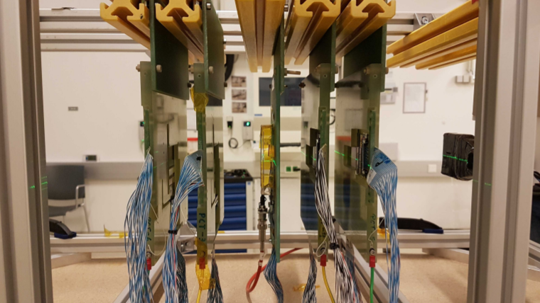
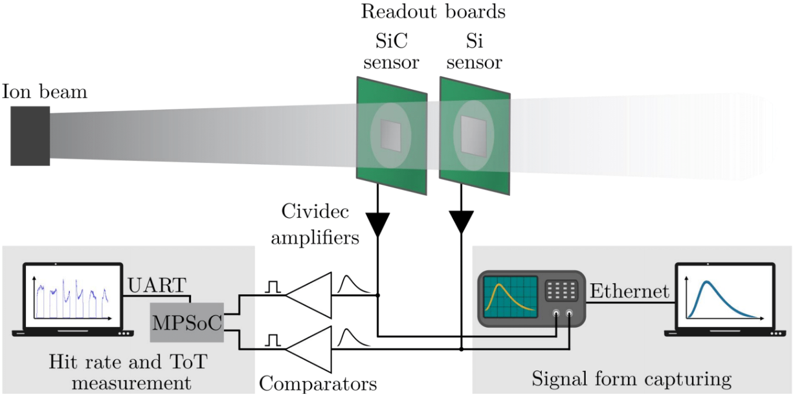
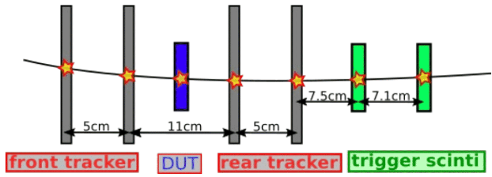
Measurements: Ion Beam
  Planar Diode
SiC signal triggered by Si signal
Signals discriminated by comparator
Counted by an FPGA
  Strip sensor
Telescope setup
  Si sensors for output comparison
  Scintillators for event-triggering
[2, 3]

Slide 11
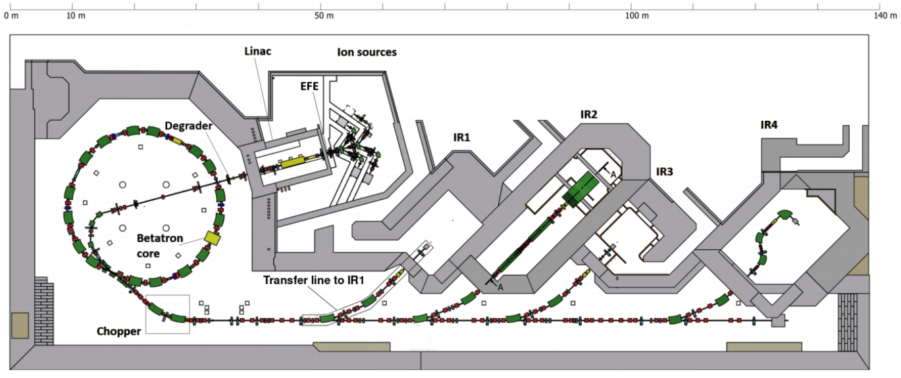
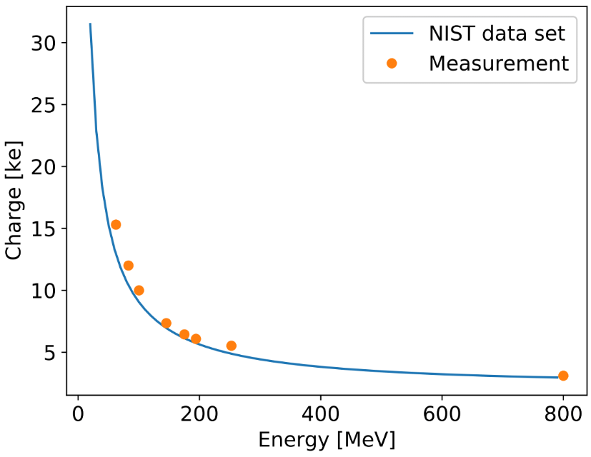
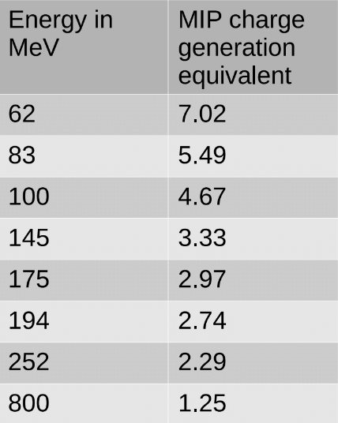
Measurements: Ion Beam
  Conducted at MedAustron (Wiener Neustadt)
  Cancer treatment center exploiting the
  Bragg-peak of protons and Carbon ions
  Available flux settings between 10³ - 10⁹ / s
  Accessible particle energies
  up to 800 MeV
  Allows for experiments at various
  energy depositions
[2, 3, 8]

Slide 12
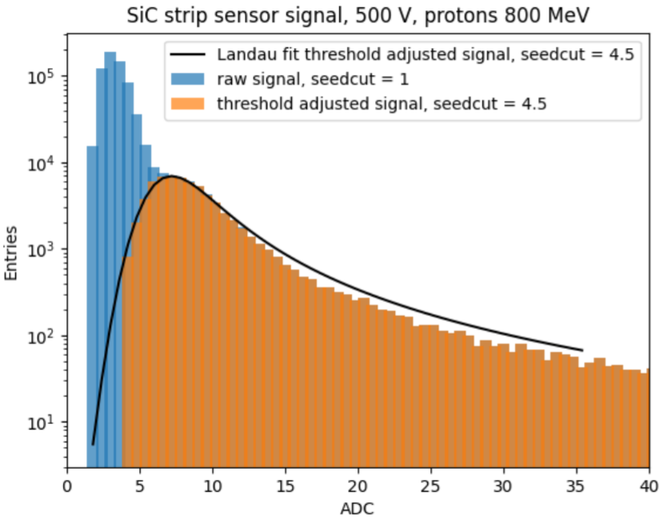
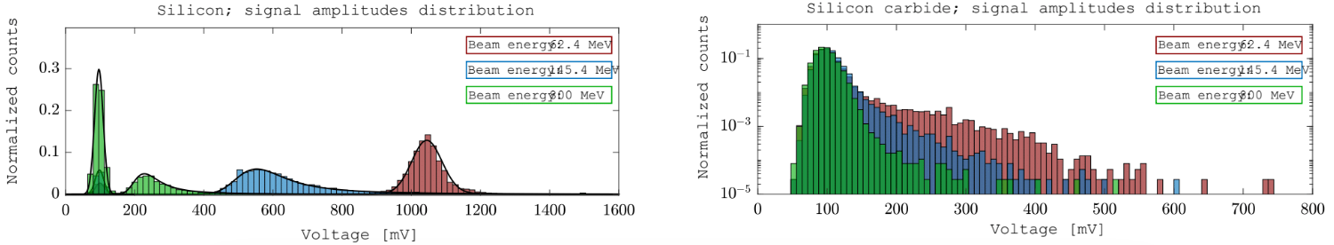
Measurements: Ion Beam
  Small signal amplitudes of SiC overlap with noise
    → Effective filtering using minimal samples above threshold
  Ionization energy determined via comparison with Si-results
    → 5.85 eV; literature: 5 - 8 eV ^{[9, 10, 11]}
  Results normalized to sensor thickness and
  MIP-charge generation equivalent
    → One MIP generates 57.1 e/h pairs per μm SiC; literature: 55 ^{[12]}
1.25 MIP
7.02 MIP
1.25 MIP
3.33 MIP
[2]

Slide 13
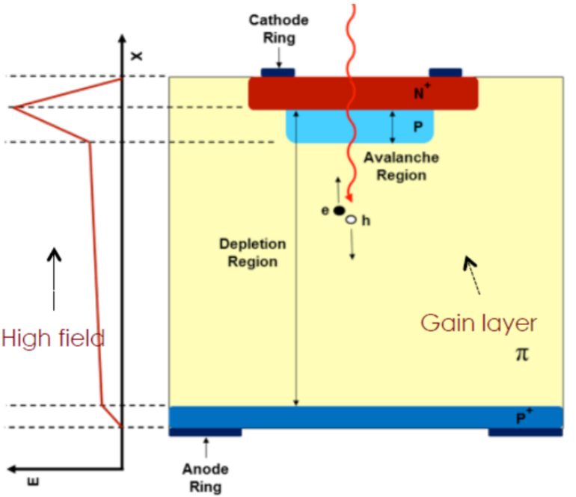
SiC - LGAD: Challenges
  Strong field region realized by additional gain layer → Avalanche effect
  Higher signal amplitudes and improved time resolution
  Produce SiC-LGAD prototypes in cooperation with CNM
Challenge: Low doping activation rate of SiC
Inefficient implantation of doping layers | Edge termination structures via annealing not feasible
Use epitaxial growing
Apply bevel edge termination instead
High energy ion implantation
Epitaxial growing
Ion implantation + long annealing
Bevel edge termination
Gain layer
Gain layer
Gain layer
JTE
Gain layer
Silicon
4H-SiC
Silicon
4H-SiC
[6]
Notes:
JTE

Slide 14
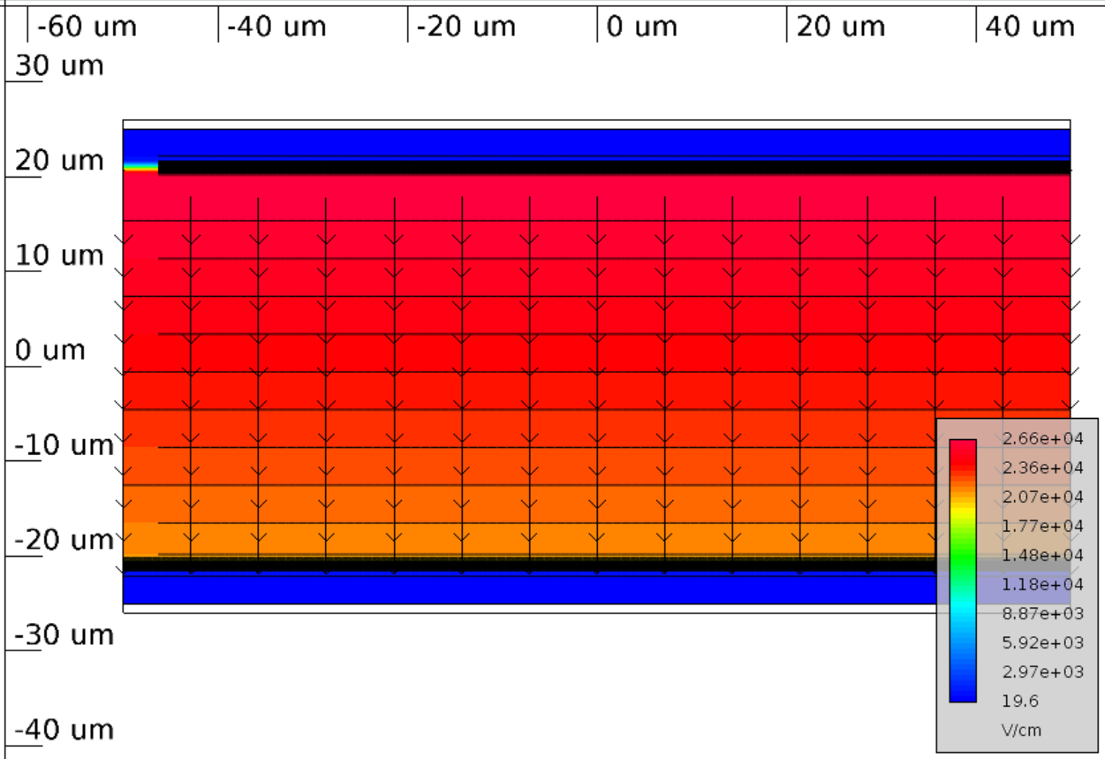
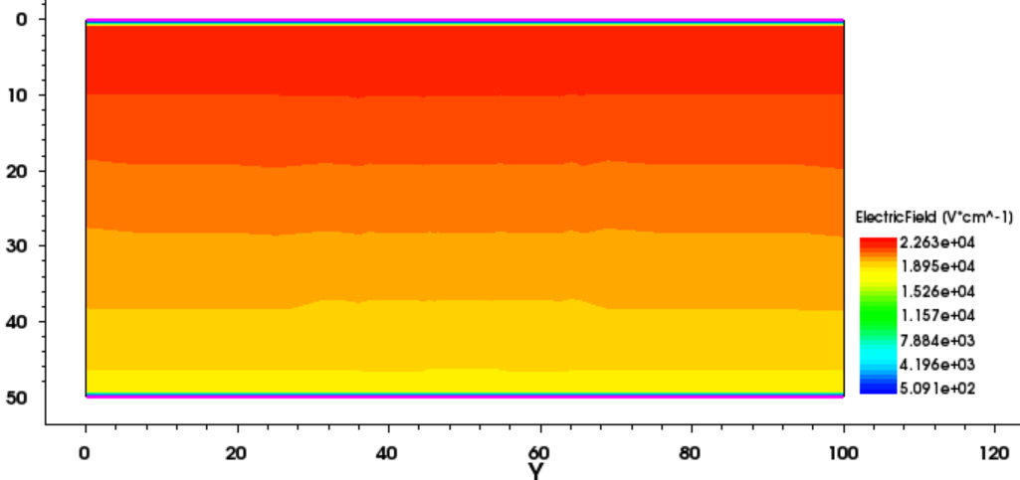
SiC - LGAD: Simulation
Single device
Synopsis, GTS
Signal output
Synopsis, Weightfield
Experimental setup
Geant4, Allpix²
  Approach using a combination of different simulation tools
  Obstacles regarding simulation of SiC:
    SiC poorly implemented in most material databases
    Insufficient adaption for drift diffusion and impact ionization
    Convergence issues for due to low current densities
    → Floating point precision is essential
    Active cooperation with Global TCAD Solutions (GTS^{[13]})
    to improve software regarding SiC simulation
GTS
Synopsis

Slide 15
Application of SiC sensors
  Fast tracking sensors
Strip or pixel detectors
Short pulse lengths
At lower beam rates sufficient for particle beam monitoring
Standard: Si detectors
  High intensity monitors
Integrating collected charge to monitor beam rates and properties
Operation at wide ranges of particle rates and energies (e.g., MedAustron)
Radiation hard material
Standard: Diamond
SiC-LGADs could be used for both purposes, provided
sufficient readout-electronics

Slide 16
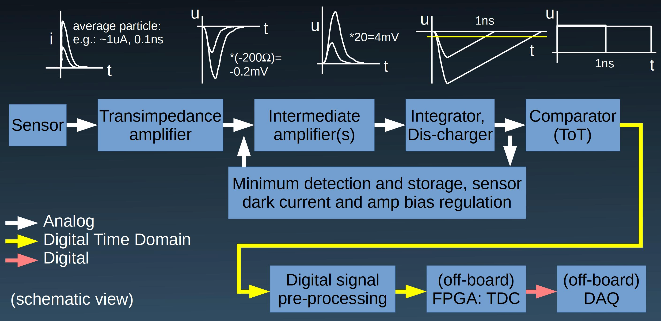
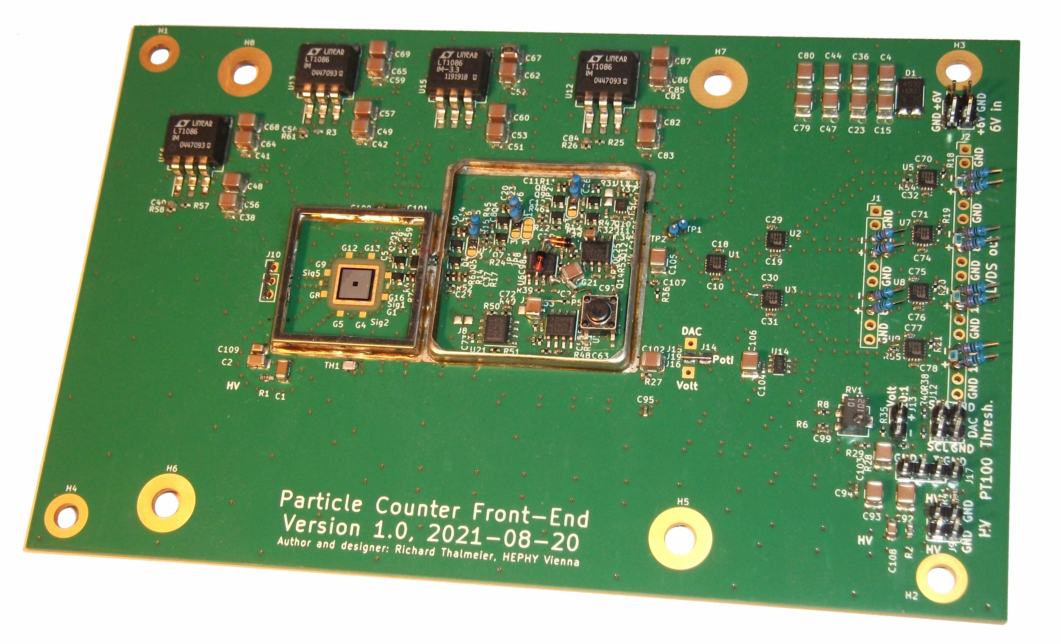
Readout: Single particle mode
  Prototype for beam monitoring at MedAustron
    One single channel
    Continuous detection of single particles up to „GHz“
    Detection of pile-ups up to about 50 particles
    A few seconds pause after each „spill“
  Adapt-able for different sensors
    Silicon, silicon carbide, diamond, LGAD, ...
  Amplifier chain built using discrete components
    Fully DC coupled from sensor to comparator
  Tested using an oscilloscope for time measurement
  Later per FPGA or ASIC (e.g., vernier TDC)
  Currently in optimization phase
  Later an integration into an ASIC is intended

Slide 17
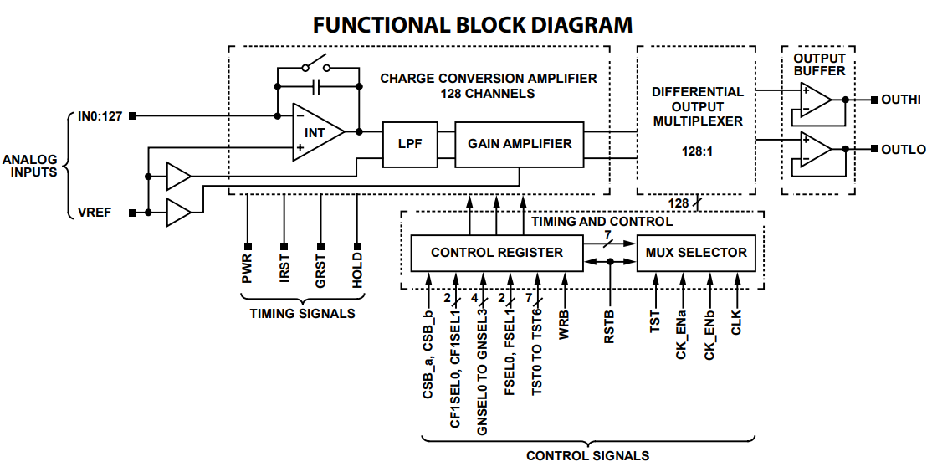
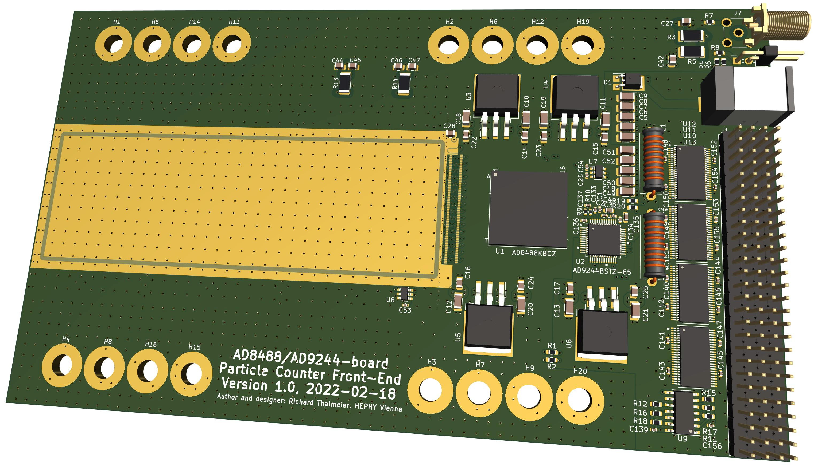
Readout: Integration mode
  Prototype designed to measure up to 128 channels of high luminosity particle rates
  Exploiting a commercial X-ray imaging
  front-end chip
    Each channel integrates the current of one detector strip into an individual capacitor for 12µs; all channels do that simultaneously
    A multiplexer then reads out the storage capacitors sequentially within 15µs;
    the setup is “blind” meanwhile
  Analogue data sequence is converted by an ADC and passed on to an external FPGA board
  To study the suitability of integrating amplifiers
  Currently in production

Slide 18
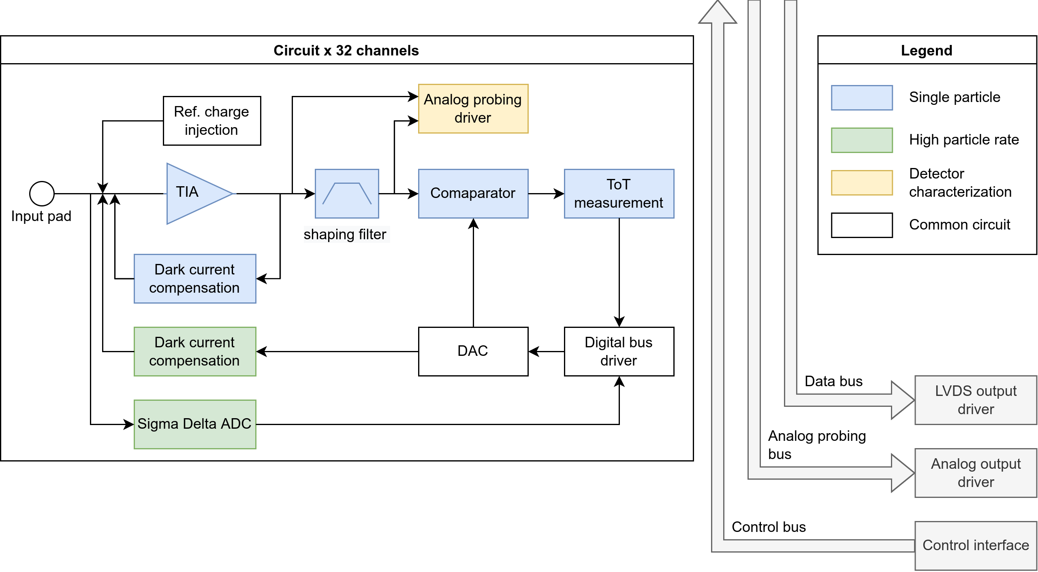
Dual application
  Current objectives:
  Integrate both readout
  options into an ASIC
  Develop an FPGA suitable to
  exploit the characteristics of
  SiC-LGADs
Preliminary ASIC-design and layout

Slide 19
Summary & Outlook
  Promising detector material:
    More accessible due to recent advancements in power electronics
    Fast signal pulses
    Low dark current (also after radiation)
    Potentially higher radiation hardness
  Benchmark of samples using measurements in-lab and at MedAustron, also irradiated
  But: Limited sensor thickness; lower charge generation → low signal amplitudes
  SiC-LGAD:
    TCAD simulations challenging for SiC (adapted models and materials, floating point precision)
    Collaboration with GTS to adapt TCAD software for SiC
    Development of prototypes
  Two-fold electronic readout approach for studying devices (single particle, integrating)
  Implementation into ASIC and development of FPGA
Notes:
Later->how to cover large areas, tiling, because of defect density, now cheaper

Slide 20
Sources
[1]: Silicon carbide and its use as a radiation detector material, F. Nava, G. Bertuccio, A. Cavallini and E. Vittone, doi: 10.1088/0957- 0233/19/10/102001
[2]: Siliziumkarbid Materialstudie zur Verwendung in positionsempfindlichen Teilchendetektoren, Maximilian Tomaschek, Diploma thesis
[3]: 4H-Silicon carbide as real time monitor for high-intensity ion beams, Manuel Christanell, Diploma thesis
[4]: An Introduction to Ultra Fast Silicon Detectors, M. Ferrero, R. Arcidiacono, M. Mandurrino, V. Sola, N. Cartiglia, ISBN: 978-0-367-64629-5
[5]: Preliminary Device Performance of 4H-SiC LGAD, Tao Yang, Qing Liu, Yuhang Tan, Suyu Xiao, Kai Liu, Jianyong Zhang, Ryuta Kiuchi,
Mei Zhao, Boyue Wu, Jianing Lin, Weimin Song, Hai Lu, Xin Shi, The 39th CERN RD50 workshop
[6]: Low Gain Avalanche Detectors Technology Overview, Richard Bates, University of Glasgow
[7]: https://www.tuwien.at/en/trigacenter/trigareactor
[8]: https://www.medaustron.at/
[9]: M. V. S. Chandrashekhar, Christopher I. Thomas, and Michael G. Spencer, Measurement of the mean electron-hole pair ionization energy in 4H SiC, Applied Physics Letters 89.4 (July 2006), p. 042113, doi: 10 . 1063 / 1 . 2243799, url: https://doi.org/10.1063/1.2243799
[10]: Alessandro Lo Giudice et al., Average energy dissipated by mega-electron-volt hydrogen and helium ions per electron-hole pair generation in 4H-SiC, Applied Physics Letters 87.22 (2005), p. 222105, doi: 10.1063/1.2135507. url: https://doi.org/10.1063/1.2135507
[11]: A. A. Lebedev, Radiation Resistance of SiC and Nuclear-Radiation Detectors Based on SiC Films, Semiconductors 38.2 (2004), p. 125, doi: 10.1134/1.1648363, url: https://doi.org/10.1134/1.1648363.
[12]: Silvio Sciortino, Stefano Lagomarsino, and F. Nava, Silicon Carbide for High Signal to Noise Ratio MIPs Detection From Room Temperature to 80C, Nuclear Science, IEEE Transactions on 56 (Sept. 2009), pp. 2538 –2542, doi: 10.1109/TNS.2009.2023848
[13]: https://www.globaltcad.com/

