Slide 1
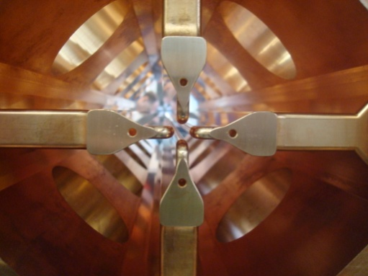
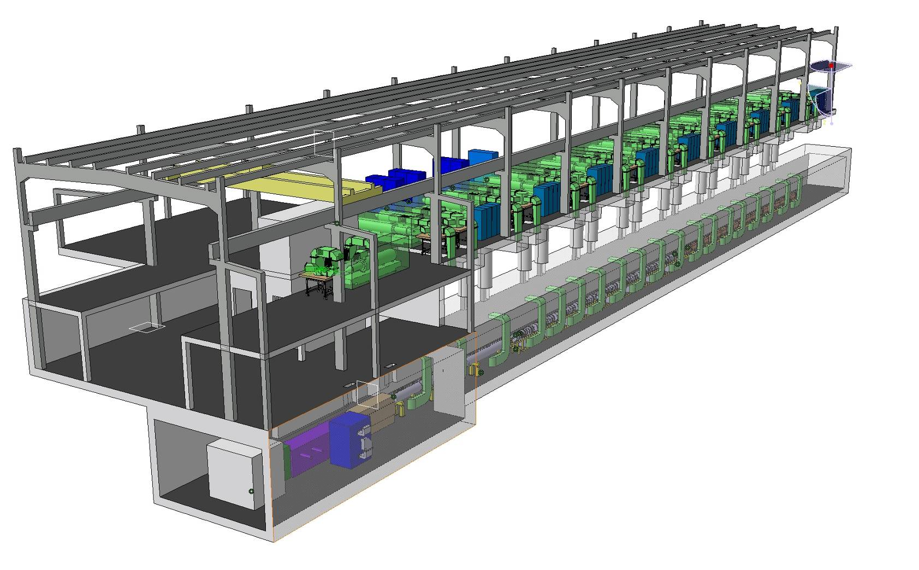
Linac4 Status
M. Vretenar
16.07.2010
Notes:
Looking from this point and with a bit of imagination you can already see the LHC…

Slide 2
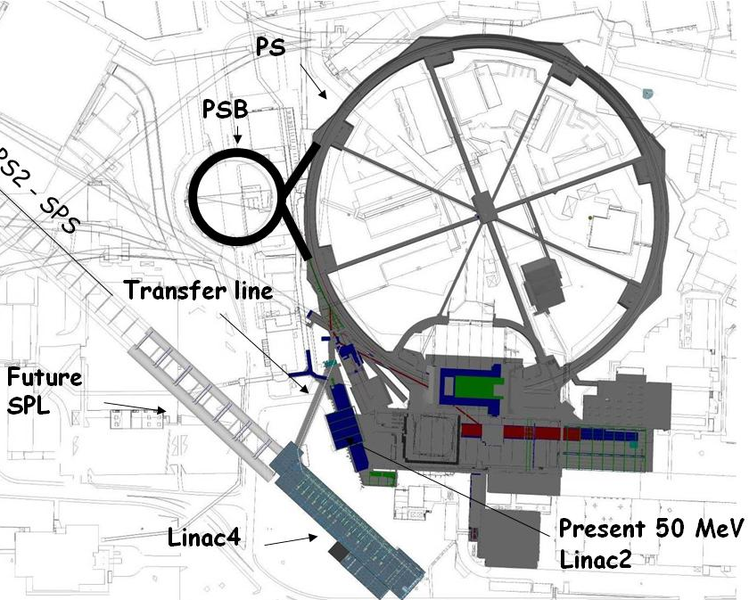
Linac4 - Description
Linac4 is a new
160 MeV H¯ linear accelerator,
which will inject into the PS Booster (PSB) replacing Linac2. It could be later extended into the SPL.
Project started in 2008 (White Paper), completion foreseen for 2015.
Linac4 because 4th linac built at CERN.

Slide 3
Linac4 - Motivations
Linac 4 is the 1st step of a programme aiming at increasing LHC Luminosity. First limitation (“bottleneck”) for increased intensity from LHC injector chain = space charge induced tune shift at 50 MeV injection in the PSB → need to increase injection energy.
Linac2 giving serious reliability/sustainability worries: persistent vacuum problems, obsolete RF tube design → instead of an intensive consolidation program, replace with a new linac.
Increase intensity for other PSB (and PS) users: ISOLDE,...
Implement at CERN modern technologies for improved injection and reduced losses (chopping, H- charge exchange injection).
Prepare for a possible evolution towards higher intensities → Linac4 is compatible with 50 Hz operation and as injector to a high- duty cycle SPL (Superconducting Proton Linac).

Slide 4
Linac4 – Main Parameters
Energy of 160 MeV giving a factor 2 in βγ² with respect to Linac2 (50 MeV) → space charge tune shift (limiting accumulated intensity in PSB) ΔQ~ N/βγ² → with twice the energy, double N keeping the same tune shift.
RF frequency 352 MHz, as old LEP RF system → can recuperate some klystrons and RF components from the LEP surplus.
Repetition frequency 2 Hz: 1.1 Hz present PSB limit, margin for some upgrade.
Beam current 40 mA in 400 μs: provide >2 present PSB maximum number of particles.

Slide 5
Linac4 Parameters
H⁻ particles + higher injection energy (160/50 MeV, factor 2 in βγ²) → same tune shift in PSB with twice the intensity.
Ion species H⁻
Output Energy 160 MeV
Bunch Frequency 352.2 MHz
Max. Rep. Rate 2 Hz
Max. Beam Pulse Length 1.2 ms
Max. Beam Duty Cycle 0.24 %
Chopper Beam-on Factor 65 %
Chopping scheme:
222 transmitted /133 empty buckets
Source current 80 mA
RFQ output current 70 mA
Linac pulse current 40 mA
N. particles per pulse 1.0 × 10¹⁴
Transverse emittance 0.4 π mm mrad
Max. rep. rate for accelerating structures 50 Hz
Re-use 352 MHz LEP RF components: klystrons, waveguides, circulators.
Chopping at low energy to reduce beam loss at PSB.
Structures and klystrons dimensioned for 50 Hz.
Power supplies and electronics dimensioned for 2 Hz.
Infrastructure (cooling, electricity) dimensioned for 2 Hz.

Slide 6
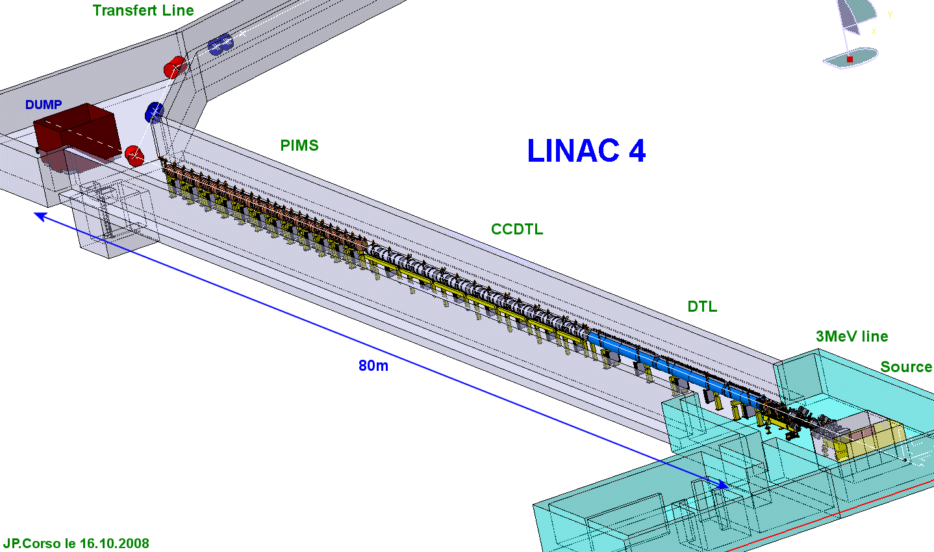
Linac4 layout
Standard (normal-conducting) linac layout, based on:
pre-injector (source, magnetic LEBT, 3 MeV RFQ, chopper line)
Three different types of accelerating structures, matched to the specific energy range (max. shunt impedance, easy access and maintenance, minimum construction cost).
Beam dump at linac end, switching magnet towards transfer line – PSB.
Beam measurements at linac end and at PSB entrance.
Transfer line to PSB
160 MeV
100 MeV
50 MeV
Linac length ~ 80 m

Slide 7
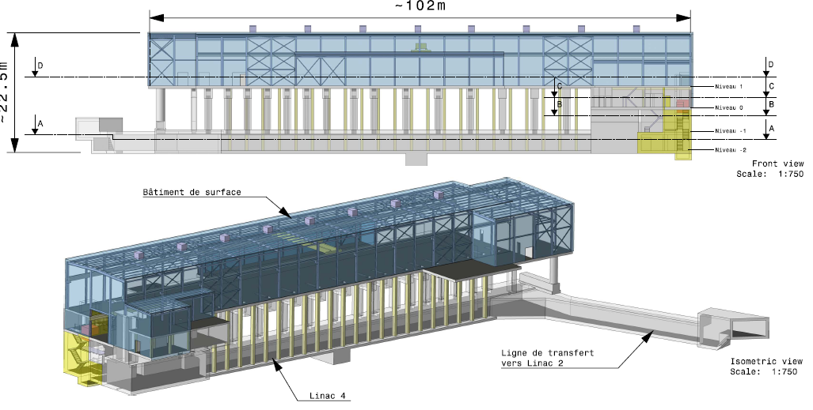
Linac4 building
ground
Overall floor surface of Linac4 installations = 3’305 m2 (over 4 levels)

Slide 8
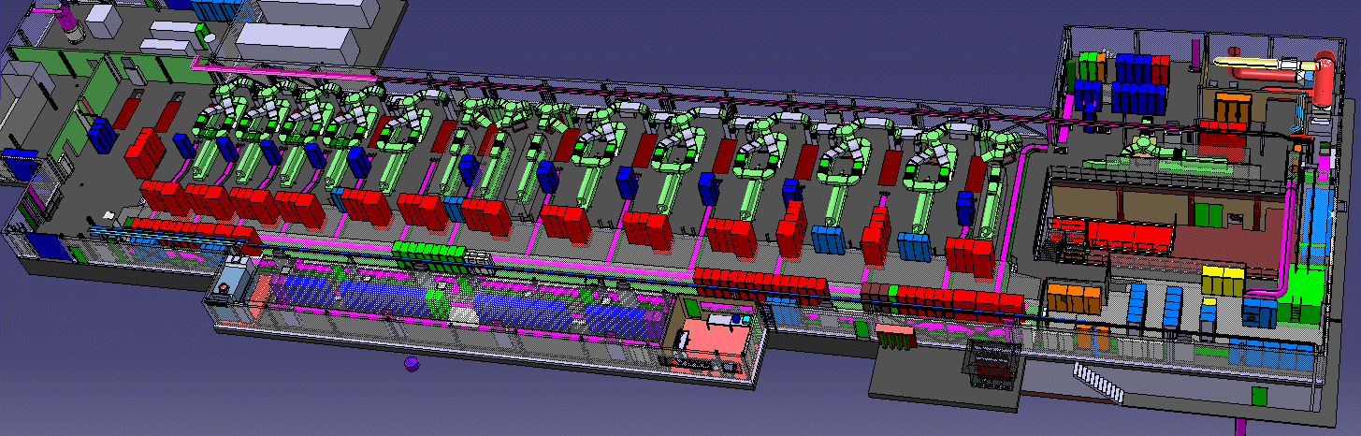
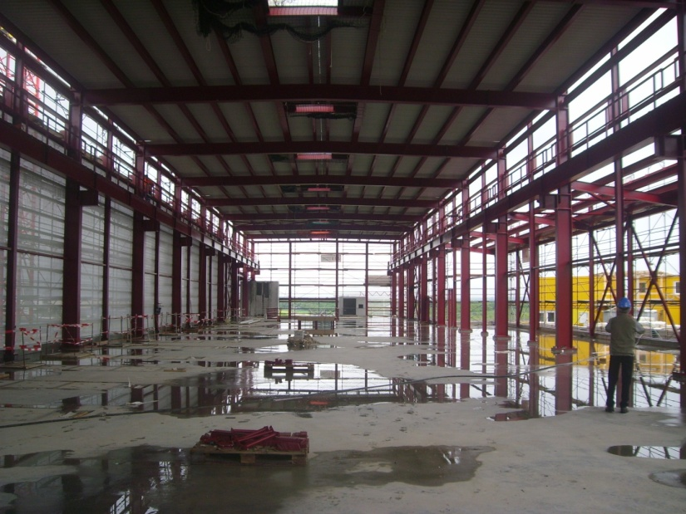
Linac4 – equipment hall
Radio Frequency:
13 klystrons from LEP (1.25 MW) + 6 new klystrons (2.8 MW, pulsed) feeding 23 cavities.
In the long term, pairs of LEP klystrons will be replaced by new klystrons (at end of life).

Slide 9
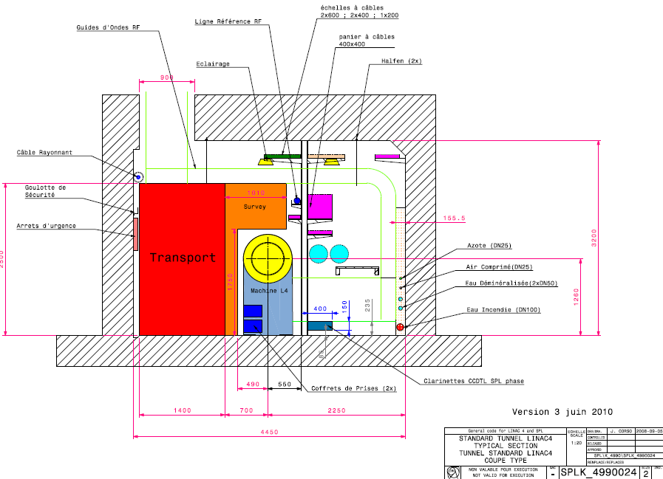
Linac4 – accelerator tunnel

Slide 10
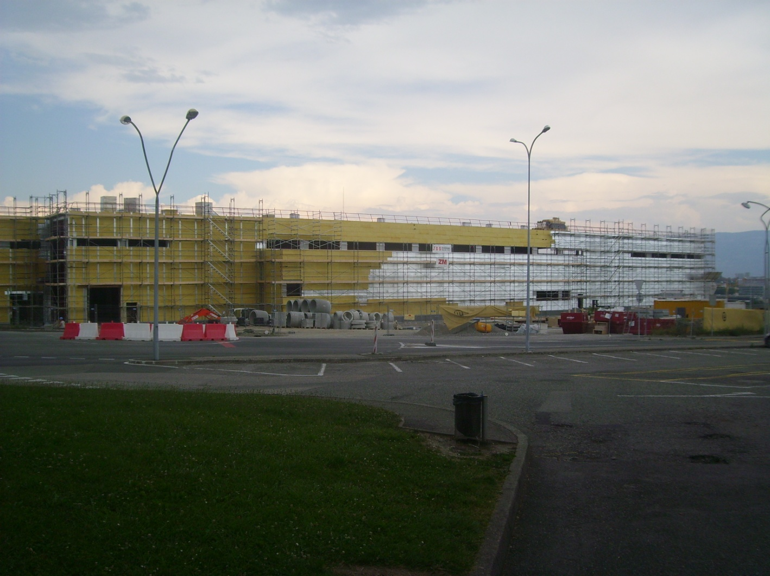
Linac4 construction
Civil engineering on schedule.
Finishing during summer, delivery foreseen for mid October.
Photo 29.6.2010

Slide 11
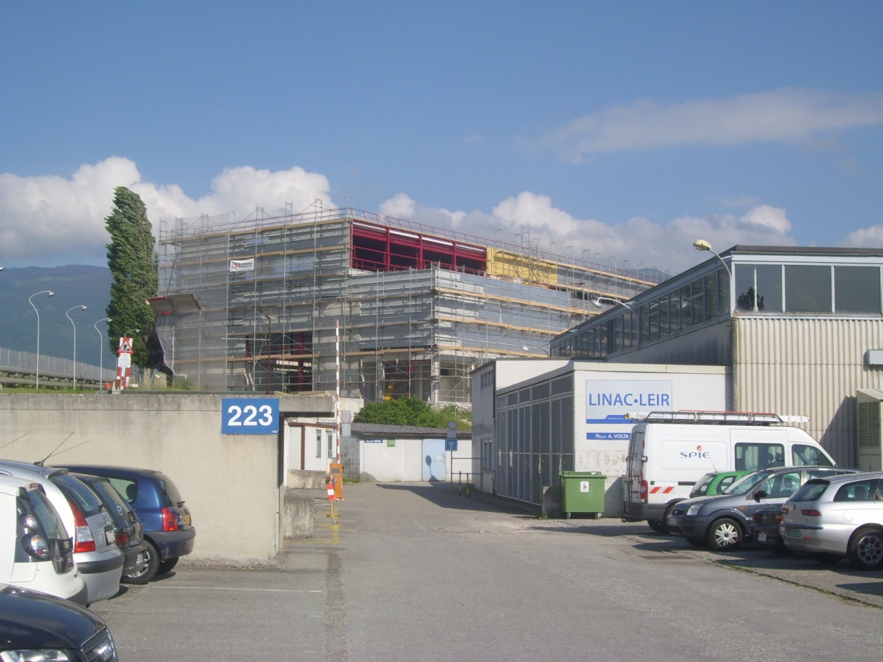
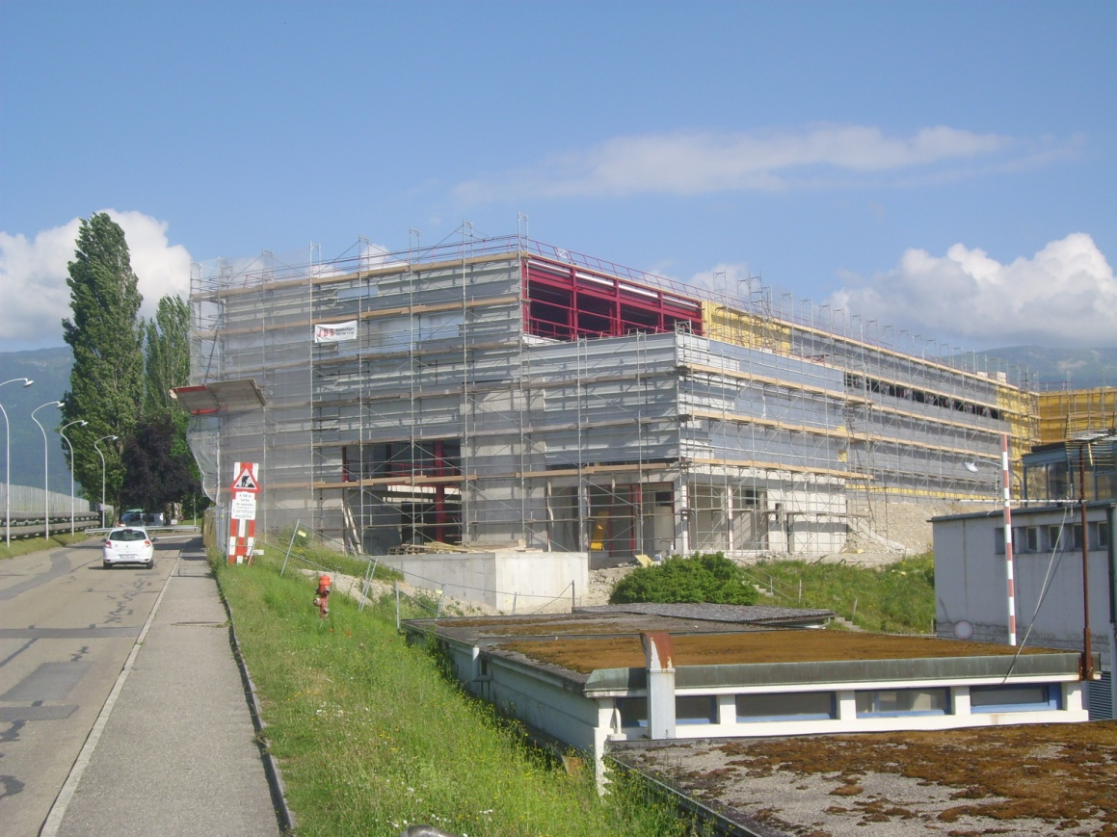

Slide 12
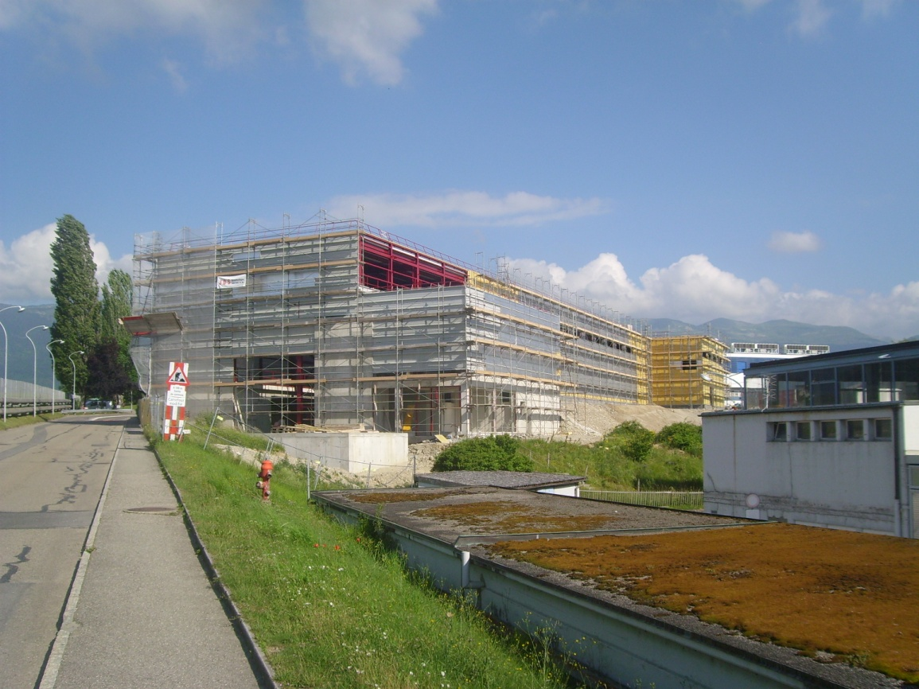
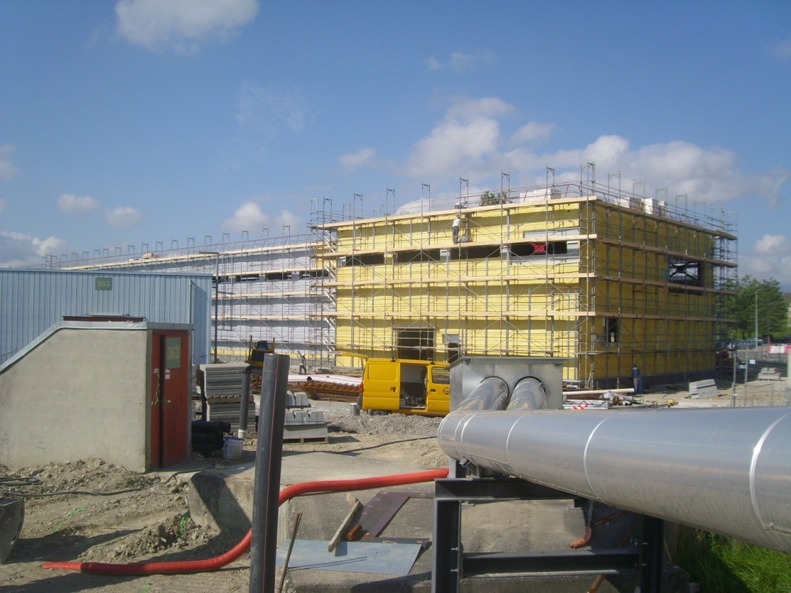

Slide 13
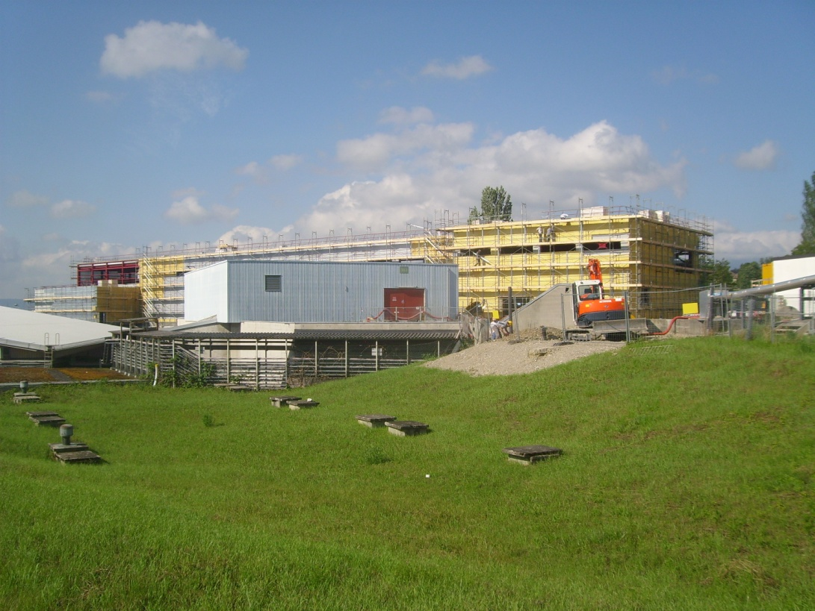
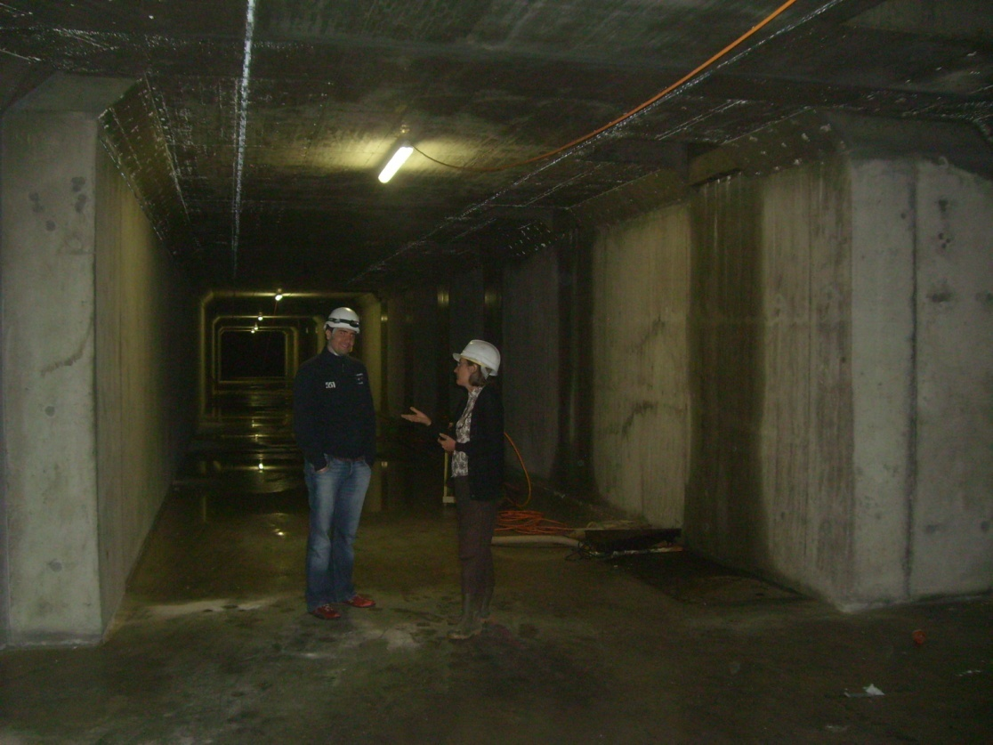

Slide 14
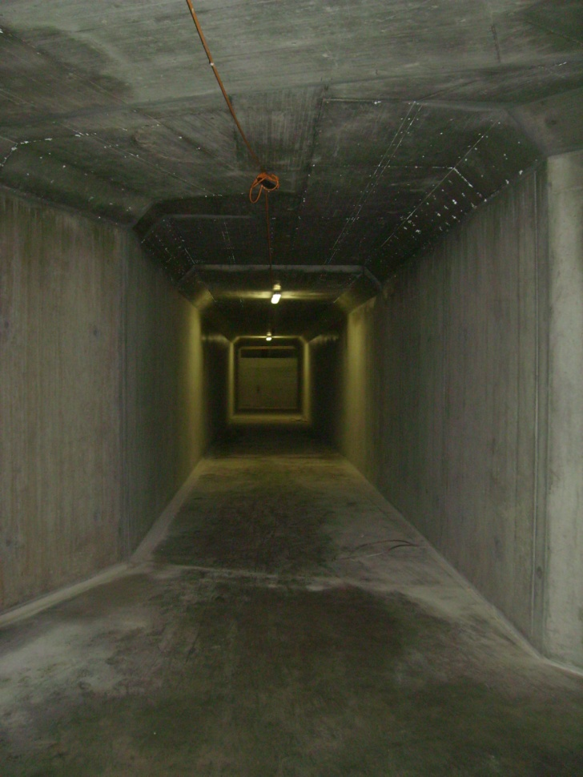


Slide 15
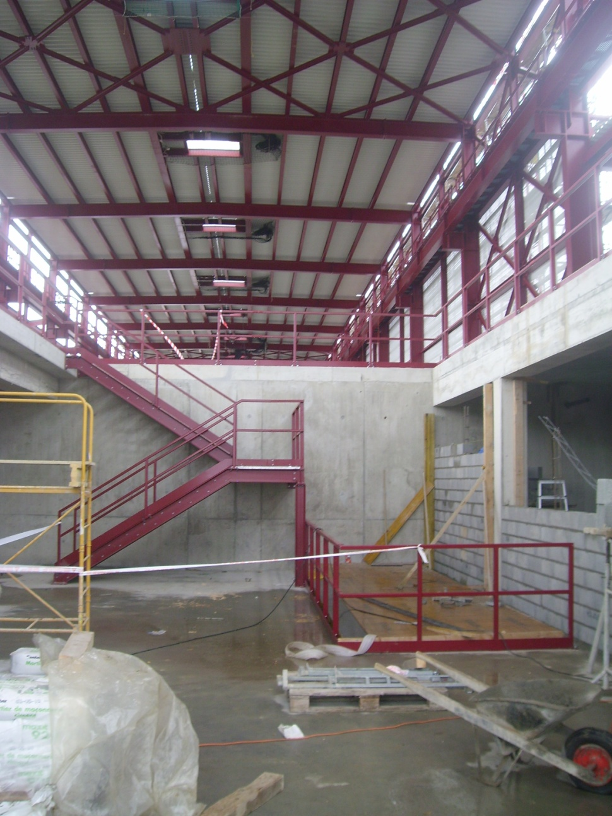
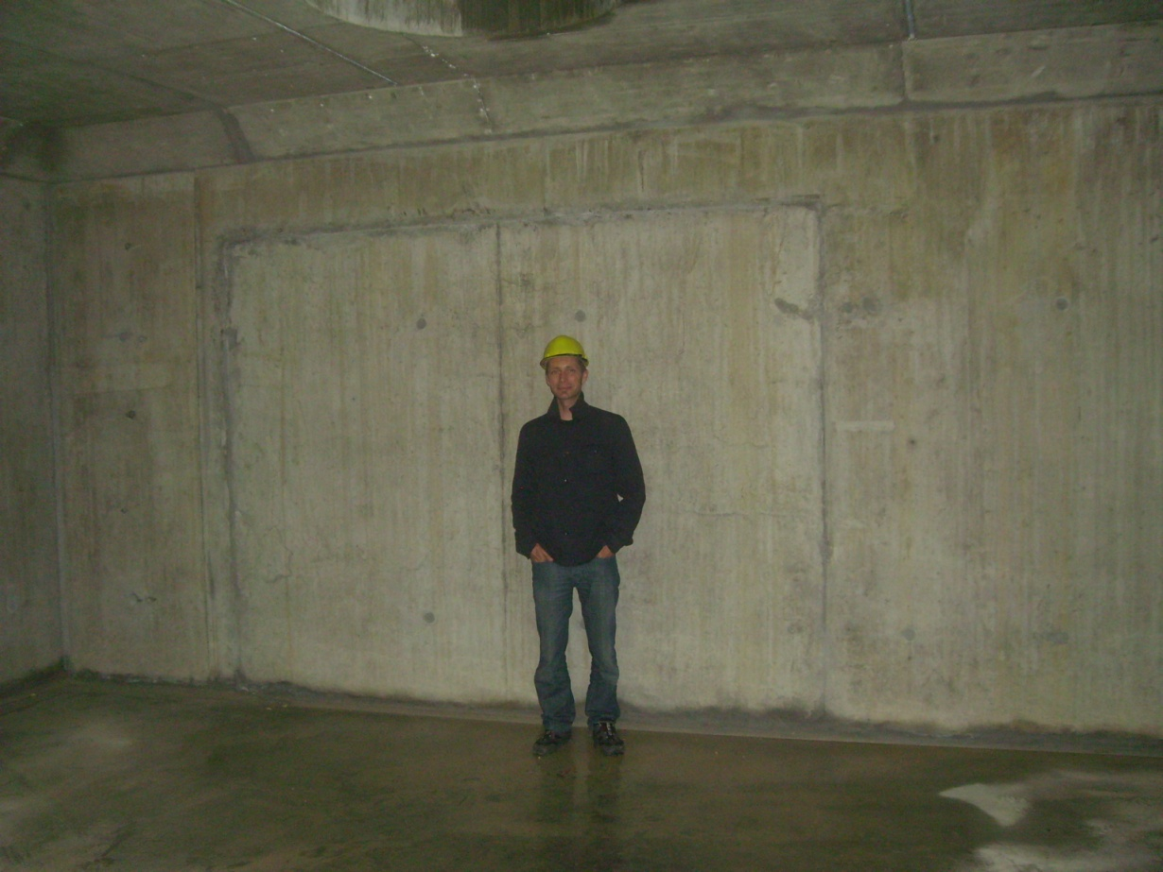

Slide 16
Linac4 – Main technical challenges
Low-energy section: ion source, RFQ, chopping
Accelerating structures (DTL, CCDTL, PIMS)
PSB injection and beam optics
Linac beam dynamics
Reliability
Notes:
…and how we are going to face them

Slide 17
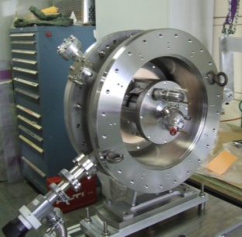
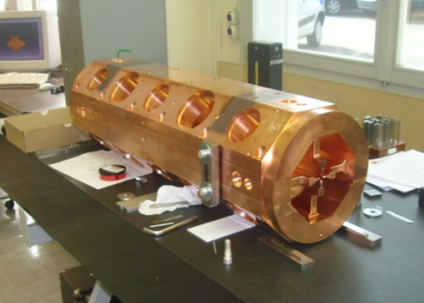
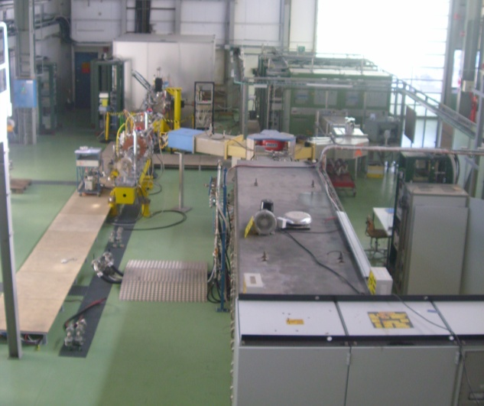
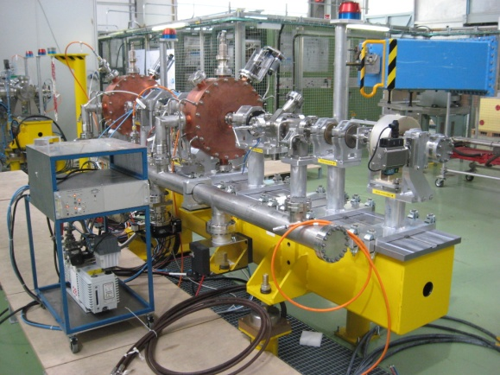
Linac4 – Low energy
3 MeV TEST STAND in the PS Hall:
Ion source completed, first beam in July 2009, presently improving current.
Magnetic Low Energy Beam Transport in construction.
Radio Frequency Quadrupole being built at CERN, to be delivered in early 2011.
Chopping line built and tested (w/o beam).
LEP klystron (+ modulator) installed and tested in pulsed mode.
Early characterization of the low energy beam is essential for a linac project!

Slide 18
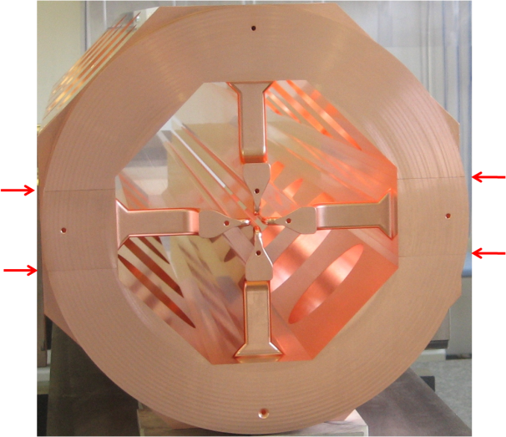
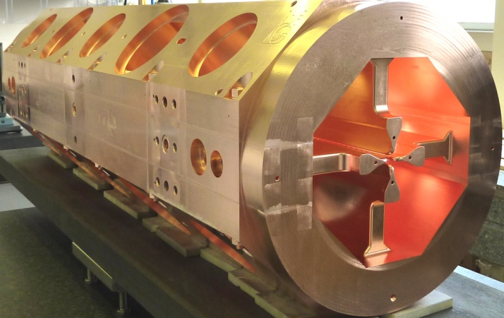
Brazing of the 1st RFQ Module
On May 3rd the first (out of 3) 1-m long module of the Linac4 RFQ went successfully through the critical horizontal brazing step. Deformations <25 μm (tolerance 30 μm).

Slide 19
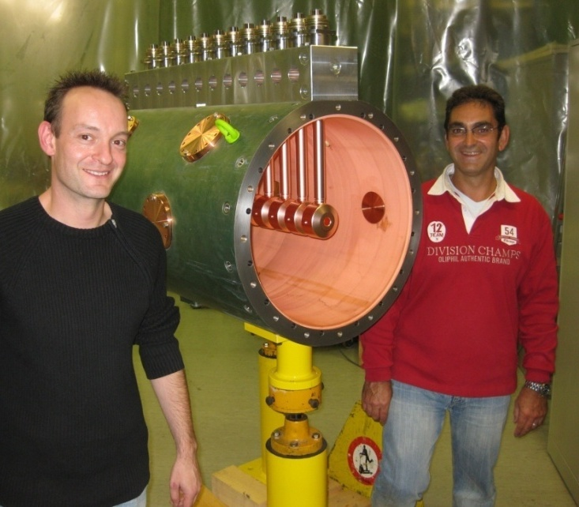
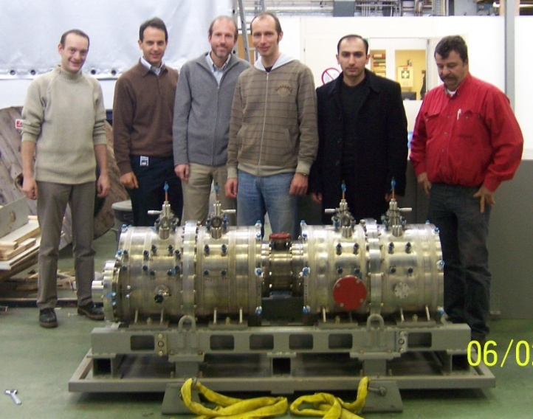
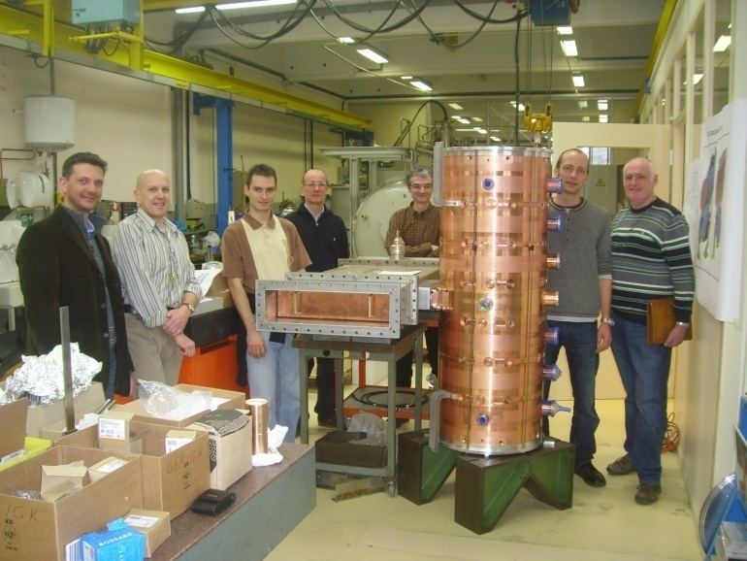
Linac4 – Accelerating structures
Three structures of new design:
DTL (Drift Tube Linac): complete revision of mechanical design w.r.t. other projects.
CCDTL (Cell-Coupled DTL): new structure, first time built for a linac.
PIMS (Pi-Mode Structure): new structure, first time built for a linac.
DTL prototype, 2009
CCDTL prototype, 2008
R&D since 2003.
Prototypes built (and tested at high RF power) for the three structures.
All constructions are starting in 2010.
PIMS prototype, 2010

Slide 20
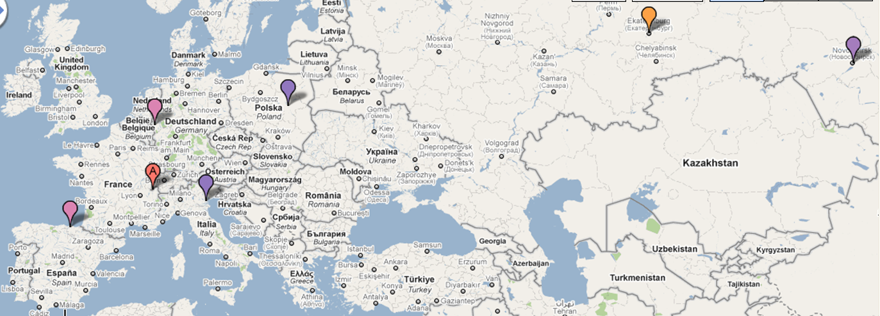
Accelerating structures for Linac4
Construction of the Linac4 accelerating structure – an European enterprise (and beyond…)
Drift Tube Linac (DTL):
prototype from INFN/LNL (Italy), drift tubes from ESS-Bilbao (Spain), tanks and assembly at CERN
Cell-Coupled DTL:
tanks from VNIIEF (Snezinsk), drift tubes and assembling from BINP (Novosibirsk)
PI-Mode Structure (PIMS): tanks from Soltan Institute (Poland), EB welding from FZ Juelich (Germany), assembly and final EB welding at CERN.
Notes:
Distribute the work but keep control… integration at the component level.

Slide 21







Linac4 – External Contributions
Network of agreements to support Linac4 construction – updated June 2010
RFQ RF design, RF amplifiers, modulator construction from French Special Contribution. agreed and started.
Prototype modulator, RF tuners, couplers, waveguides from India, in progress
Agreement with DESY to access drawings of H- source
completed
45 keV 3 MeV 50 MeV 90 MeV 160 MeV
Transfer line vacuum chambers and supports from Pakistan, agreed
H
-
LEBT
RFQ
chopper line
DTL
CCDTL
PIMS
transfer line to PSB
source
352 MHz
704 MHz
80 m
Chopper line built in a EU Joint Research Activity
completed
Construction of CCDTL in Russia, via an ISTC Project
agreed and started
Participation of ESS-Bilbao in DTL construction,
agreed and started
Collaboration agreement with Soltan Institute (Poland) and FZ Julich (D) for PIMS construction, in preparation.

Slide 22
Linac 4 – Status July 2010
Ion source built, improving intensity.
RFQ in construction at the CERN workshop, 1st module brazed.
Chopper line completed, tested without beam.
DTL prototype tested, starting construction of all 3 tanks (drift tubes in July 2010).
CCDTL started construction in Russia. 1st module (of 7) to be delivered at end 2010.
PIMS prototype completed. High power tests in August, construction start Jan. 2011.
Design of dump, measurement lines and transfer line completed.
PSB equipment in construction.
RF layout defined, klystron contract placed, major orders in preparation.
RF modulator prototype1 tested, prototype2 in construction, order in preparation.
Orders for major components placed or in preparation.

Slide 23
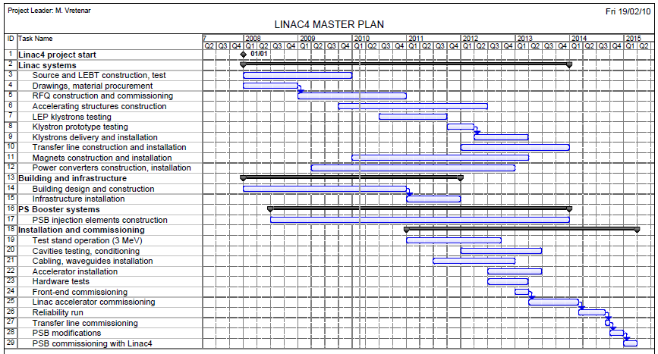
Schedule – official after Chamonix 2010
1. Construction
2. Linac installation, commissioning
3.
Reliability run (6 months)
4. Connection and PSB commissioning (7 months)
GOAL: connection of Linac4 to PSB during the long shut-down 2014/15

Slide 24
Linac4 connection to PSB
Overall duration of LHC proton shut-down for Linac4 connection to PSB: 8 months.
Note that we can accelerate ions in the injector complex during the Linac4 shut-down. The LHC stop can be reduced by carefully interfacing with an ion run.

Slide 25
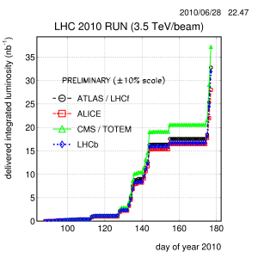
CERN accelerator programs
The LHC is now running smoothly (t.w.) at 3.5 TeV/beam. Luminosity has been recently increased to 8x10²⁹ cm⁻²s⁻¹, corresponding to 10¹¹ p/bunch.
The present run will continue w/o interruption until end of 2011.
In 2012, the LHC will be stopped (~15 months) for 2 activities: consolidation of the splices and installation of new collimators.
A 2-year run at 7 TeV/beam is expected in 2013/14. Luminosity will be slowly increased to the LHC nominal (10³⁴).
In 2015, is foreseen a 12-month shut-down for 2 activities: connection of Linac4 to the accelerator complex and upgrade of PSB energy to 2 GeV. This will allow in 2016-18 to increase luminosity to ultimate and beyond.
Construction of LP-SPL will be re-considered only after this period. For the moment, the SPL study is continuing aimed at a high-power version for neutrino physics (in collaboration with the European Spallation Source in Sweden).
A Working Group at CERN has started to look at options for a High-Energy LHC after 2020: ~14 TeV/beam !
Notes:
Nominal 10E34, ultimate 2.5*10E34

Slide 26
CERN Accelerator complex performance with Linac4
LHC INJECTORS WITH LINAC2 |  | Nominal LHC Double Batch | Expected Maximum Double Batch
PSB out (ε* ≤ 2.5 μm) | ppr | 1.62 x10¹² (1bunch/ring) ↓ (6 bunches, h=7) | 1.8 x10¹² (1bunch/ring) ↓ (6 bunches, h=7)
PS out, per pulse | ppp | 9.72 x10¹² | 10.8 x10¹²
PS out, per bunch (ε* ≤ 3 μm) | ppb | 1.35 x10¹¹ (72 bunches) ↓ 15% loss | 1.5 x10¹¹ (72 bunches) ↓ 15% loss
SPS out | ppb | 1.15 x10¹¹ | 1.27 x10¹¹
Comparison Linac2 – Linac4
injecting into the PSB
(25 ns bunch spacing)
Limitations highlighted in yellow. values to be demonstrated are in italic.
LHC INJECTORS WITH LINAC4 |  | Nominal LHC Single batch | Maximum Single batch | Maximum Double batch | PSB @ 2 GeV Double batch
PSB out (ε* ≤ 2.5 μm) | ppr | 3.25 x10¹² (2bunch/ring) ↓ (6 bunches, h=7) | 3.6 x10¹² (2bunch/ring) ↓ (6 bunches, h=7) | 2.05 x10¹² (1bunch/ring) ↓ (6 bunches, h=7) | 3.2 x10¹² (1bunch/ring) ↓ (6 bunches, h=7)
PS out, per pulse | ppp | 9.72 x10¹² | 10.8 x10¹² | 12.3 x10¹² (PS limit scaled for 206ns bunches) | 19.2 x10¹² (PS limit scaled to 2 GeV)
PS out, per bunch (ε* ≤ 3 μm) | ppb | 1.35 x10¹¹ (72 bunches) ↓ 15% loss | 1.5 x10¹¹ (72 bunches) ↓ <15% loss | 1.7 x10¹¹ (72 bunches) ↓ 20% loss | 2.7 x10¹¹ (72 bunches) ↓ ??% loss
SPS out | ppb | 1.15 x10¹¹ | >1.3 x10¹¹ | 1.37 x10¹¹
Goal: |  | Nominal intensity in single batch: shorter filling time, lower losses and emittance growth. |  | Potential for ultimate intensity out of PS in double batch (33% increase w.r.t. Linac2). | Potential for > ultimate out of PS with PSB @ 2 GeV (factor 1.8 increase w.r.t. Linac2).

