Slide 1

EIC / FCC beam instrumentation
Anke-Susanne Müller (KIT), David Gassner (BNL), Todd Satogata (JLAB) and Thibaut Lefevre (CERN)
12th November 2020, FCC Workshop
The Future Circular Collider Innovation Study (FCCIS) project has received funding from the European Union's Horizon 2020 research and innovation programme under grant No 951754

Slide 2

Outline
EIC and FCC electron beam parameters and Challenges for BI
Proposed Beam Instrumentation work packages (a 1st Draft)
Extra synergies with CERN BI activities
Conclusions

Slide 3
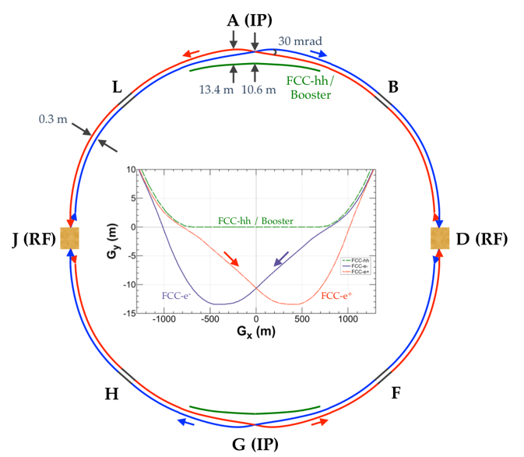
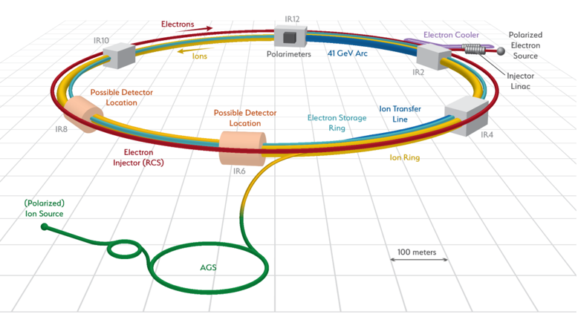
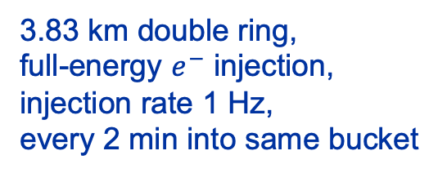
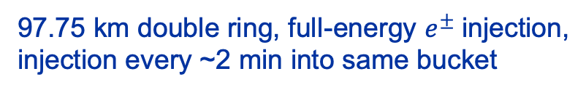
Machine Layout
FCC-ee
EIC
3.83 km double ring,
full-energy $e^{−}$ injection,
injection rate 1 Hz,
every 2 min into same bucket
97.75 km double ring, full-energy $e^{±}$injection,
injection every ~2 min into same bucket

Slide 4
Beam Parameters
 | EIC | FCC-ee-Z
Beam energy [GeV] | 10 | 45.6
Bunch population [10¹¹] | 1.7 | 1.7
Bunch spacing [ns] | 10 | 15, 17.5 or 20
Bunch length, rms [mm] | 10 | 3.5 -12
Beam current [A] | 2.5 | 1.39
RF frequency [MHz] | 591 or 394 | 400
Horiz. geometric emittance [nm] | 22 | 0.27
Vert. geom. emittance [pm] | 1000 | 1.0
SR power / beam /meter [W/m] | 4000 | 600
Critical photon energy [keV] | 9 | 19

Slide 5
Beam Parameters
 | EIC | FCC-ee-Z
Beam energy [GeV] | 10 | 45.6
Bunch population [10¹¹] | 1.7 | 1.7
Bunch spacing [ns] | 10 | 15, 17.5 or 20
Bunch length, rms [mm] | 10 | 3.5 -12
Beam current [A] | 2.5 | 1.39
RF frequency [MHz] | 591 or 394 | 400
Horiz. geometric emittance [nm] | 22 | 0.27
Vert. geom. emittance [pm] | 1000 | 1.0
SR power / beam /meter [W/m] | 4000 | 600
Critical photon energy [keV] | 9 | 19
Highly relevant for
Beam intensity, position, loss and bunch length measurments
High bunch / beam intensities and similar bunch length
→ Similar issues in terms of impedance & beam induced heating

Slide 6
Beam Parameters
 | EIC | FCC-ee-Z
Beam energy [GeV] | 10 | 45.6
Bunch population [10¹¹] | 1.7 | 1.7
Bunch spacing [ns] | 10 | 15, 17.5 or 20
Bunch length, rms [mm] | 10 | 3.5 -12
Beam current [A] | 2.5 | 1.39
RF frequency [MHz] | 591 or 394 | 400
Horiz. geometric emittance [nm] | 22 | 0.27
Vert. geom. emittance [pm] | 1000 | 1.0
SR power / beam /meter [W/m] | 4000 | 600
Critical photon energy [keV] | 9 | 19
Low / Ultra-Low emittances →
Similar challenges in measuring small beam sizes (worse for FCC !)

Slide 7
Beam Parameters
 | EIC | FCC-ee-Z
Beam energy [GeV] | 10 | 45.6
Bunch population [10¹¹] | 1.7 | 1.7
Bunch spacing [ns] | 10 | 15, 17.5 or 20
Bunch length, rms [mm] | 10 | 3.5 -12
Beam current [A] | 2.5 | 1.39
RF frequency [MHz] | 591 or 394 | 400
Horiz. geometric emittance [nm] | 22 | 0.27
Vert. geom. emittance [pm] | 1000 | 1.0
SR power / beam /meter [W/m] | 4000 | 600
Critical photon energy [keV] | 9 | 19
Similar bunch population, bunch length, bunch spacing
Similar design choices in terms of mitigating impedance and beam heating issues
Similar design choices electronic and acquisition system

Slide 8
Beam Parameters
 | EIC | FCC-ee-Z
Beam energy [GeV] | 10 | 45.6
Bunch population [10¹¹] | 1.7 | 1.7
Bunch spacing [ns] | 10 | 15, 17.5 or 20
Bunch length, rms [mm] | 10 | 3.5 -12
Beam current [A] | 2.5 | 1.39
RF frequency [MHz] | 591 or 394 | 400
Horiz. geometric emittance [nm] | 22 | 0.27
Vert. geom. emittance [pm] | 1000 | 1.0
SR power / beam /meter [W/m] | 4000 | 600
Critical photon energy [keV] | 9 | 19
Similar SR Characteristics (at least for FCC ee-Z) →
Similar design choices for absorber, shielding and cooling scheme

Slide 9
Beam instrumentation workpackages
Identify and follow-up design challenges
Concentrate on performance (1st) and cost (2nd) related issues
Define responsibilities with collaborating partners

Slide 10
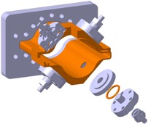
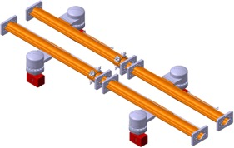
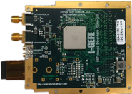
Beam instrumentation work packages
Task 1 - Beam Position Monitoring - Manfred (Student/Fellow) – workforce with EIC
1.1 Design and construction of a low impedance electrostatic Pick-up : Staff / MPA
Electro-magnetic design
Mechanical design compatible with alignment tolerances
EM and heat load simulations
Estimate the need for water cooling
Prototyping and validation tests
1.2 Specifications (and design) of a cost-efficient bunch-by-bunch, turn-by-turn BPM acquisition system with sub-micron resolution : Staffs
Resolution, Accuracy, Dynamic Range, Radiation-Hardness,..
System architecture and implementation (in view of large production: e.g. 6000 BPMs)
  Cost impact – system design – cable/optical fiber
1.3 Injector complex BPMs : e+/e- source, linac and Damping ring : WBS
1.4 Prototyping Collimation BPM – FCC-hh, HL-LHC, SuperKEKb, EIC
Tessa’s table
Eliana’s table

Slide 11
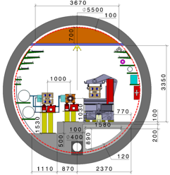
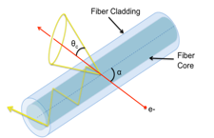
Beam instrumentation work packages
Task 2 - Beam Intensity and Beam Loss Monitoring – Marek / Belen
2.1 R&D on DC Beam Current Transformer : Marek - student
Define specifications : Resolution, Accuracy and Dynamic range
System design and integration : Staff and student
2.2 R&D on fast Beam intensity measurement for bunch-by-bunch, turn-by-turn acquisitions: low priorirty
Define specifications : Resolution, Accuracy and Dynamic range
System design and integration, impedance : Staff
2.3 R&D on a beam loss monitoring systems : Belen and students/fellows (CERN)
Define specifications – Resolution, Dynamic range and Time response (?) – Feasibility Simulations - Fluka
  Design study for identifying losses from different beams (electron/ion, main ring/booster)
Design study for BLM system insensitive to X-rays : optical BLM – MPE/MPA
  Design, Prototyping and Validation tests - Students
2.4 Injector complex BPMs : e+/e- source, linac and Damping ring : WBS

Slide 12
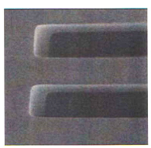
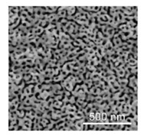
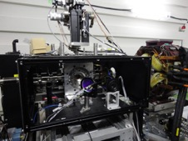
Beam instrumentation work packages
Task 3 - Transverse Beam Size/Profile Monitoring - Stefano
3.1 Updated Specifications
3.2 R&D on Beam Size monitoring system based on Synchrotron Radiation interferometry
Impedance studies
X-ray interferometric system using micro-slits (KEK, Renjung)
X-ray interferometric system using nanoparticles (Alba, CERN)
  Students/Fellows – evolution of the collaboration with Alba / KEK
3.3 R&D on Beam Profile monitoring system based Laser wire scanner (?)
System design and integration (incl. fiber laser technology and laser cavity interaction)
Impedance studies – (equivalent to polarimeter : Russian)
Bunch-by-bunch acquisition
Feasibility study with Collaboration, e.g. RHUL/Oxford
3.4 Design of an energy spread monitoring system based on imaging techniques (KIT)
check if part of FCC-IS
3.5 Injector complex BPMs : e+/e- source, linac and Damping ring : WBS
double slit
Nanoporous
material
LWS at KEK

Slide 13
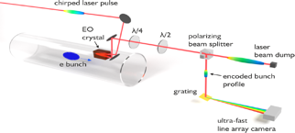
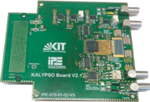
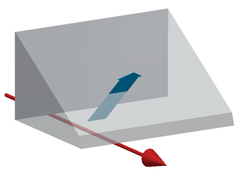
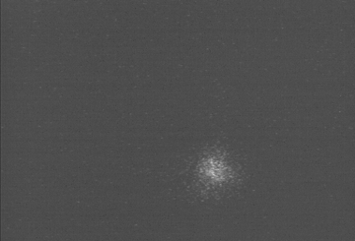
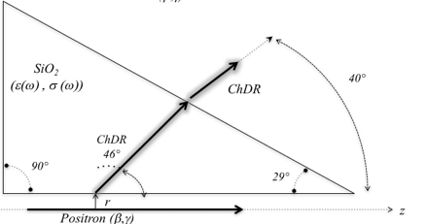
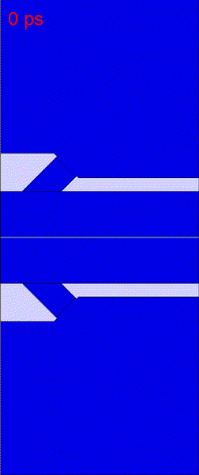
Beam instrumentation work packages
Task 4 - Bunch Length Monitoring - Stefano
4.1 R&D on Bunch Length monitoring system based on Electro-Optical (EO) Spectral Decoding (KIT) : FCC-IS
Design of an in-vacuum, low impedance EO pick-up (KIT, CERN)
Design of a bunch-by-bunch, turn-by-turn acquisition system with sub-picosecond time resolution
4.2 R&D on Bunch Length monitoring system based on Streak camera measurements – CERN - Andreas
Design of radiation source : Synchrotron radiation or Cherenkov Diffraction radiation
Ph.D of Andreas
Cherenkov
Diffraction
Radiation
σ = 4.5ps (1.4 mm)
Charged Particle

Slide 14
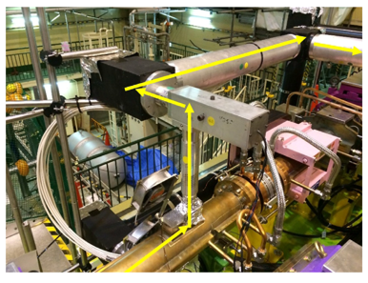
Beam instrumentation work packages
Task 5 Polarisation and Luminosity monitoring : EIC (CERN with experience from Hilumi)
5.1 Design of Polarimeter based on Compton scattering (EIC) (BINP) ? Orsay ?
5.2 Design of Beamstrahlung measurement systems (EIC)
5.3 Design of luminosity monitor based on zero degree calorimeter
implementation at
SuperKEKB

Slide 15
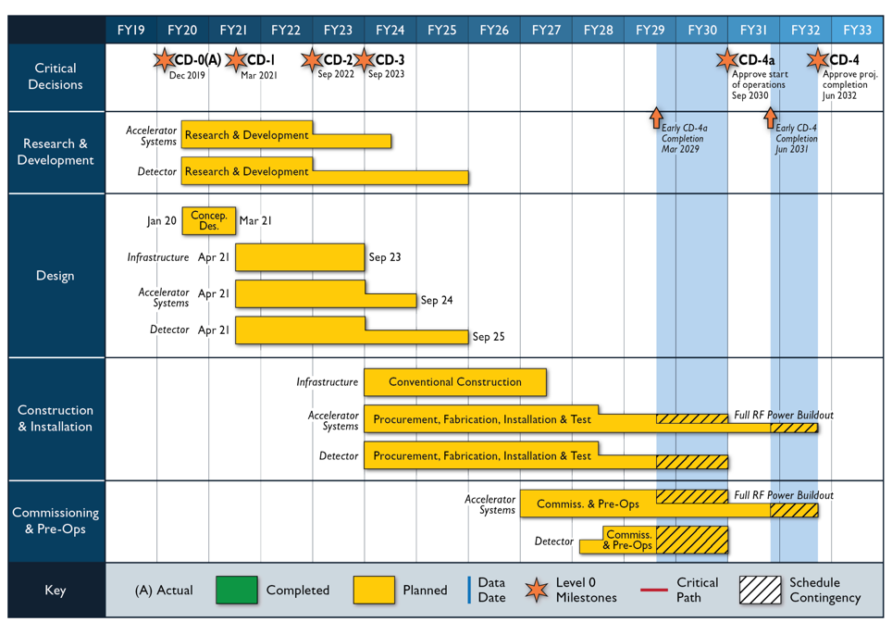
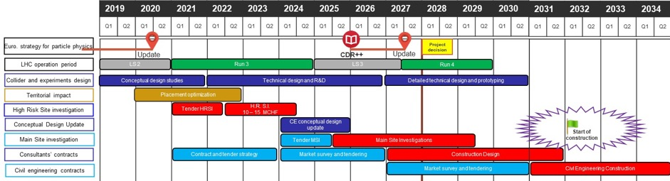
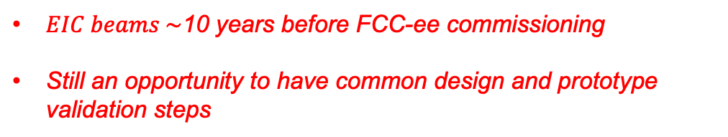
Roadmap
FCC-ee
EIC
$EIC beams \sim$10 years before FCC-ee commissioning
Still an opportunity to have common design and prototype validation steps

Slide 16
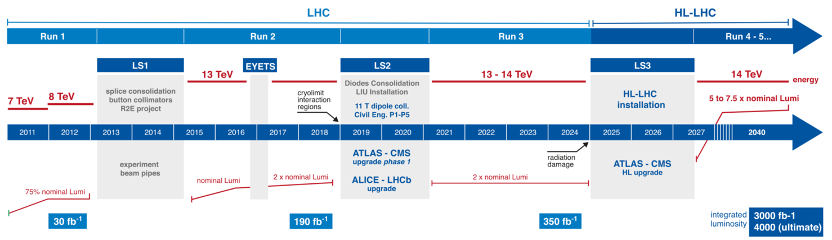
Roadmap
High-Luminosity LHC at CERN
Work on new beam instruments to be operational for Run 4 (2027)
Consolidation of existing LHC beam instrumentation during LS3 (2025) and LS4 (2030)
Could also be considered for possible collaboration topics between CERN & EIC

Slide 17
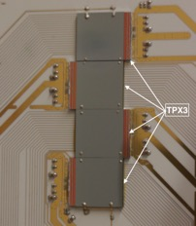
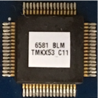
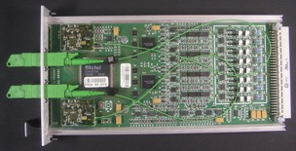

Possible CERN-EIC ‘Ions’ synergies
New beam instruments for Hilumi
  Beam size monitoring using residual gas ionization and modern pixel detectors
  Radiation-hard luminosity monitors based on Cherenkov radiators
  Rad-hard ASIC for Beam loss monitoring
  Schottky monitors
  …
Consolidation of existing beam instrumentation
  New Bunch-by-bunch, turn-by-turn BPM acquisition system with micron resolution
  New acquisition system for Beam loss monitors
  Rad-hard optical links, rad-tolerant FE electronics
  Large production

Slide 18
Conclusions
Strong synergies between FCC-ee and EIC studies open paths to fruitful collaborations in the future
A first draft of Beam Instrumentation work packages have been discussed
Some on-going activities carried out by already identified partners (KIT, KEK, Alba, Uni. Milano, BINP,..) should be strengthened to meet the specific needs of the projects
Welcoming (new) partners to take responsibilities in the proposed work packages / activities
Recent collaboration agreement with CERN Beam instrumentation group providing
  Ionization chambers for the FRIB facility in US
  Wire scanners and Ionization chambers for ESS in Sweden

Slide 19
Many thanks to all people involved
&
Many thanks for your attention !
The Future Circular Collider Innovation Study (FCCIS) project has received funding from the European Union's Horizon 2020 research and innovation programme under grant No 951754

Slide 20
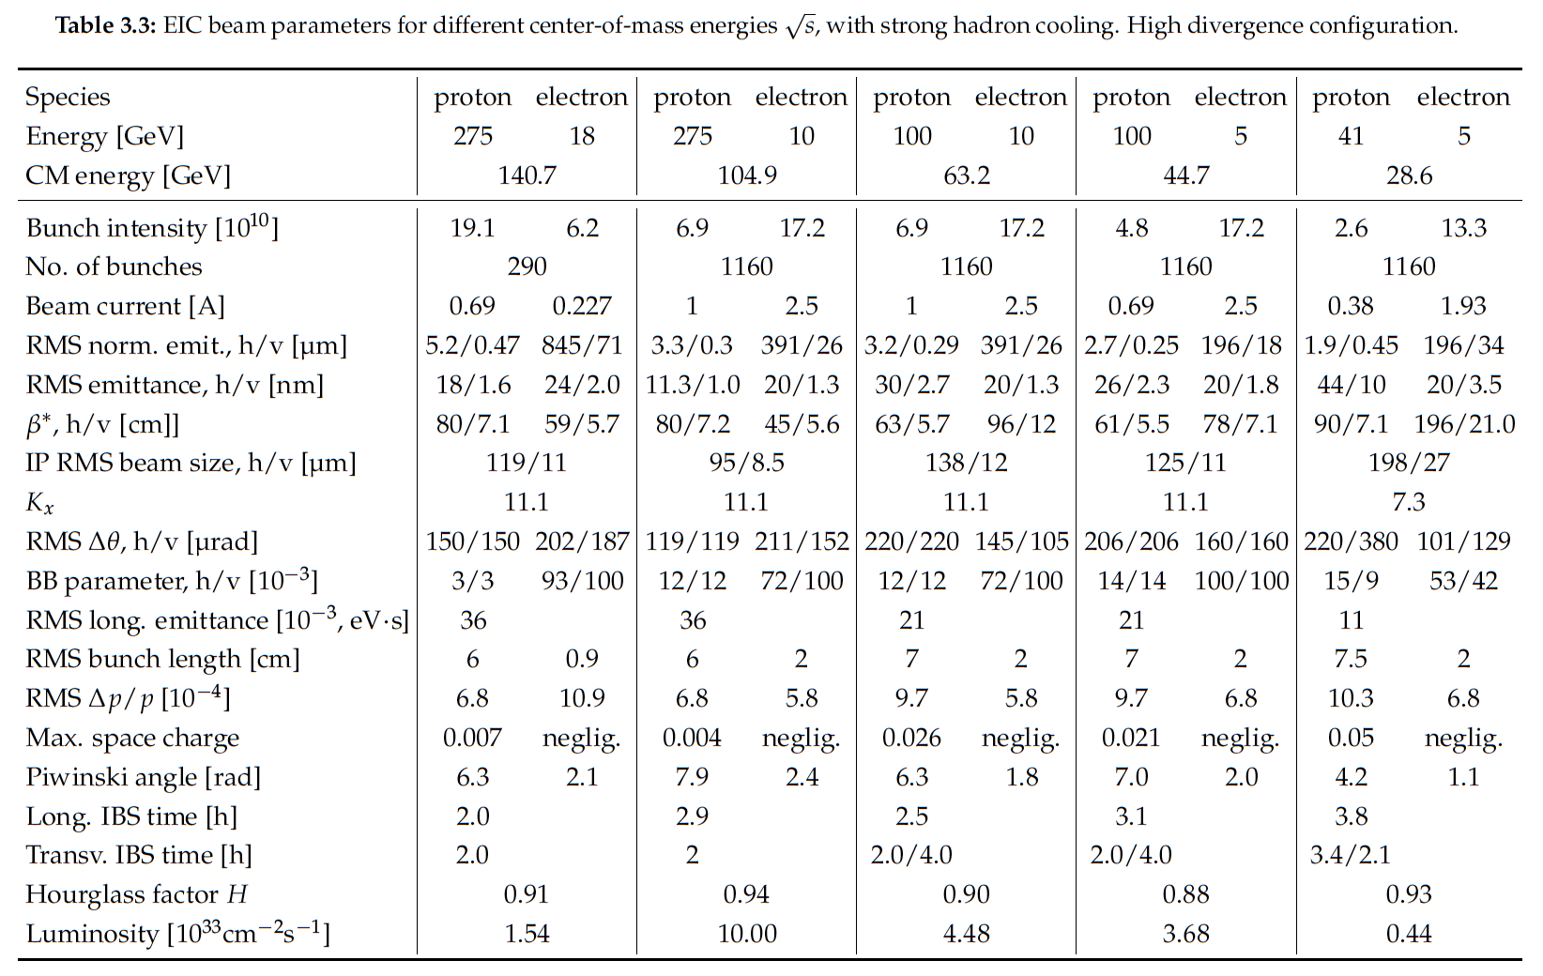

Slide 21
parameter | Z | WW | H (ZH) | ttbar
beam energy [GeV] | 45 | 80 | 120 | 182.5
beam current [mA] | 1390 | 147 | 29 | 5.4
no. bunches/beam | 16640 | 2000 | 393 | 48
bunch intensity [10¹¹] | 1.7 | 1.5 | 1.5 | 2.3
SR energy loss / turn [GeV] | 0.036 | 0.34 | 1.72 | 9.21
total RF voltage [GV] | 0.1 | 0.44 | 2.0 | 10.9
long. damping time [turns] | 1281 | 235 | 70 | 20
horizontal beta* [m] | 0.15 | 0.2 | 0.3 | 1
vertical beta* [mm] | 0.8 | 1 | 1 | 1.6
horiz. geometric emittance [nm] | 0.27 | 0.28 | 0.63 | 1.46
vert. geom. emittance [pm] | 1.0 | 1.7 | 1.3 | 2.9
bunch length with SR / BS [mm] | 3.5 / 12.1 | 3.0 / 6.0 | 3.3 / 5.3 | 2.0 / 2.5
luminosity per IP [10³⁴ cm⁻²s⁻¹] | 230 | 28 | 8.5 | 1.55
beam lifetime rad Bhabha / BS [min] | 68 / >200 | 49 / >1000 | 38 / 18 | 40 / 18

Slide 22


