Slide 1
Calorimeter Clustering with SPVCNN
Alex Schuy

Slide 2
Outline
Particle Detector
  ATLAS detector
  Physics event
  Calorimetry
  Trigger
Machine Learning
  Introduction
  Supervised learning
  Gradient descent
  Neural networks
  Convolutional neural networks (CNNs)
3D Deep Learning Tasks (advanced)
  Semantic Segmentation
  Instance Segmentation
  Panoptic Segmentation
SPVNAS (advanced)
  Motivation
  Concept
  Implementation
We will stop here, but you can read these sections or follow up for more details

Slide 3
Particle Detector

Slide 4
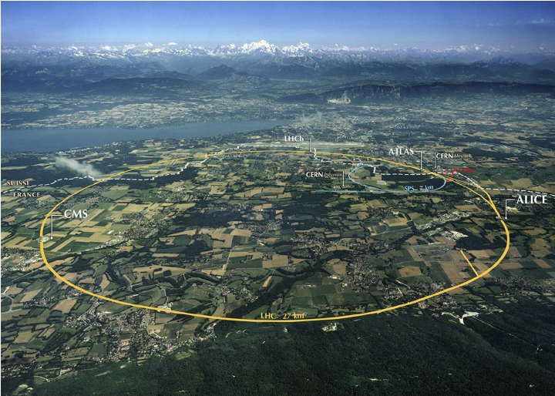

Slide 5
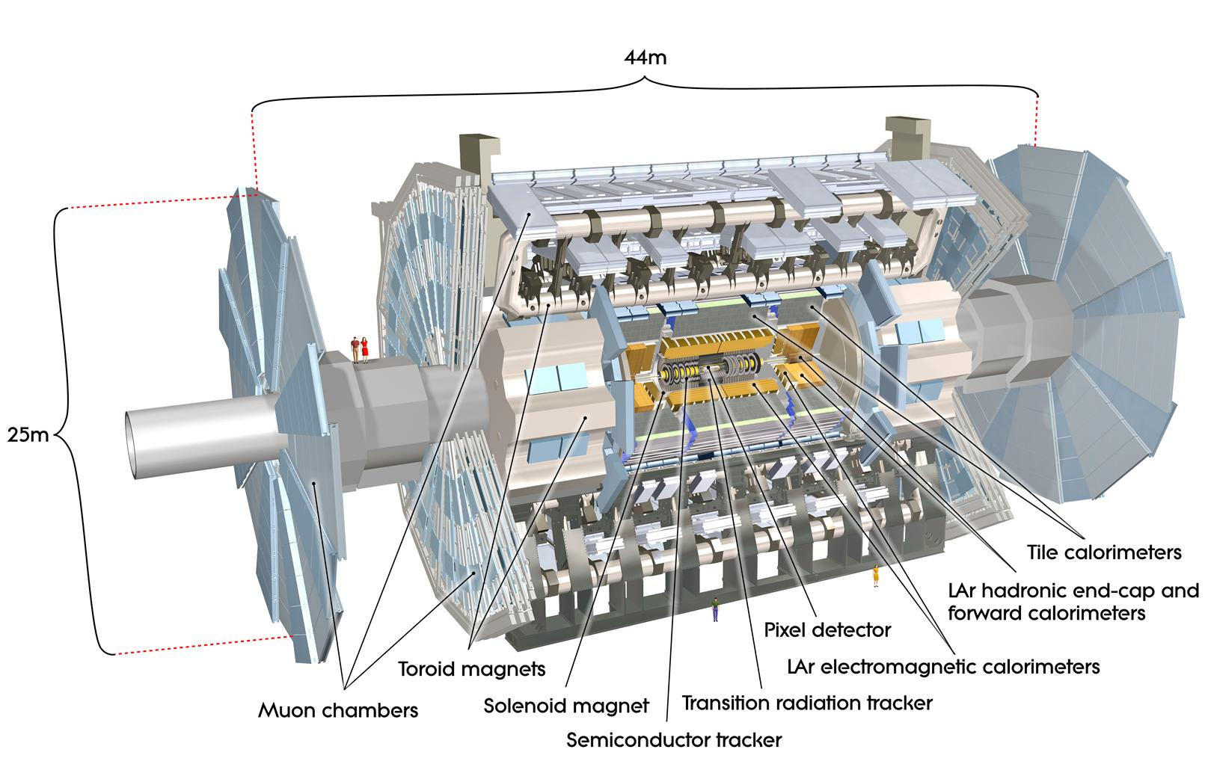
ATLAS Detector

Slide 6
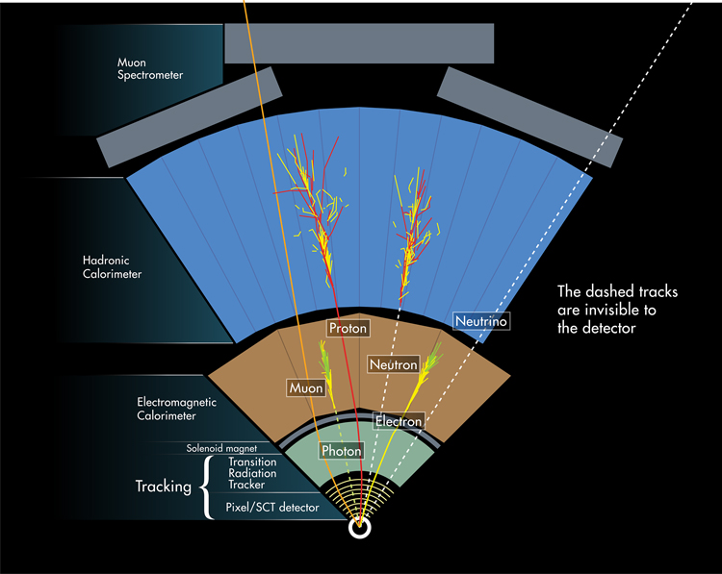
Physics Event
Goal: record properties of the ‘final state’ particles produced in a collision:
  Type (Proton, Electron, Photon, etc.)
  Energy
  Momenta
  Path through the detector (incl. origin: ‘vertex’)

Slide 7
Calorimeter
Goal: record properties of the ‘final state’ particles produced in a collision:
  Type (Proton, Electron, Photon, etc.)
  Energy
  Momenta
  Path through the detector (incl. origin: ‘vertex’)

Slide 8
Calorimeter
Electromagnetic
  Absorbs photons, electrons
Hadronic
  Absorbs protons, neutrons, pions, jets, etc.
  More challenging

Slide 9
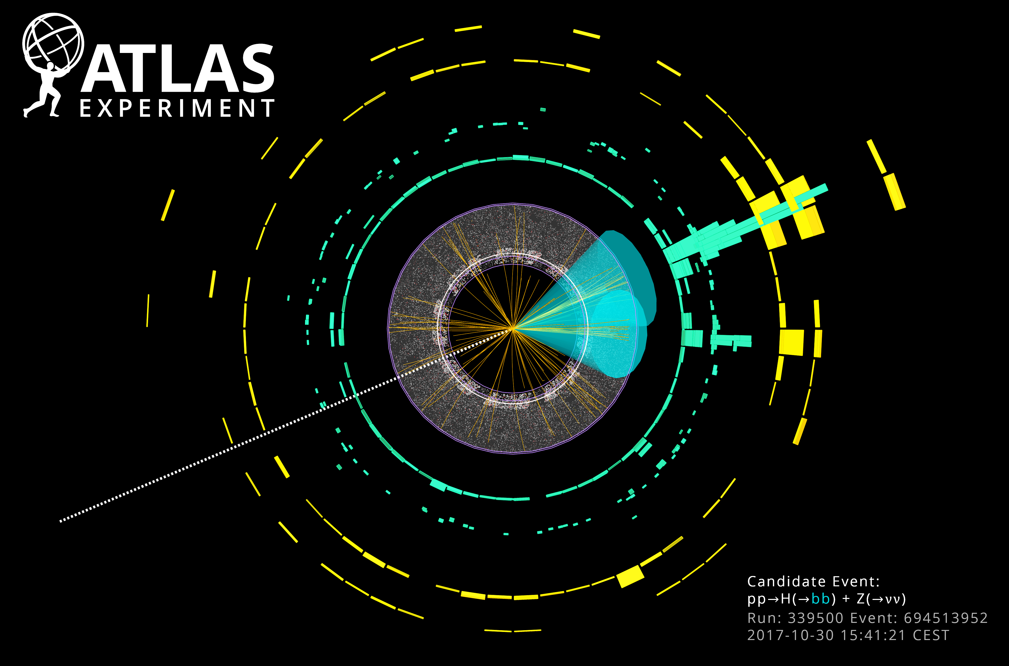
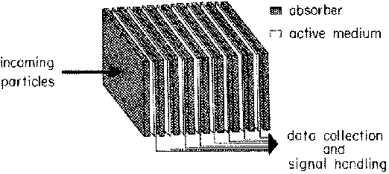
Calorimeter Technology
Goal: record energy of particles
Most common type: sampling
Two parts:
  Passive medium – creates showers of lower energy particles through interactions (e.g., bremsstrahlung + pair production)
  Active medium – ionization / excitation of scintillators -> low energy photons -> photomultiplier tubes -> electric current -> analog-to-digital converters -> digital storage

Slide 10
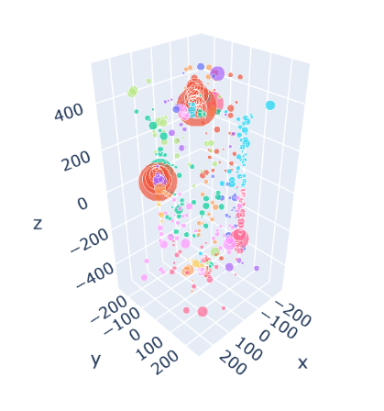
Calorimeter Clustering
Digital readouts are converted into ‘hits’ that look like this…
Multiple hits correspond to a single particle entering the calorimeter (color)
Goal: ‘reconstruct’ energy of original particles by clustering hits
Size of bubble = energy
Color = cluster

Slide 11
Machine Learning

Slide 12
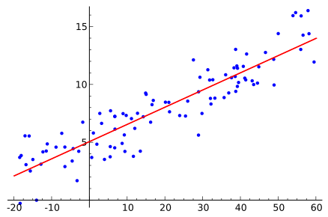
What is Machine Learning?
Machine Learning (ML) is a set of statistical methods that find patterns in data computationally, i.e., without the use of human knowledge.
ML is used actively across the sciences, including in particle physics.
Types of ML:
  Supervised Learning
  Unsupervised Learning
  Reinforcement Learning
Linear regression, a basic ML algorithm.

Slide 13
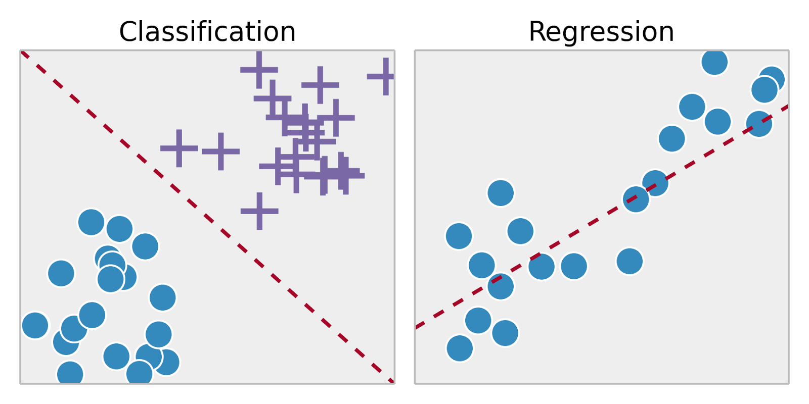
Supervised Learning
Objective: Approximate f: input (features) -> output (labels)
Two types of supervised learning: classification (discrete) and regression (continuous)
Popular techniques:
  Boosted Decision Tree (BDT)
  Random Forest
  Linear/Logistic Regression
  Naïve Bayes
  Support Vector Machine (SVM)
  Neural Network (NN)
    fully-connected, local, convolutional, recurrent
  Many others…
The different types of supervised learning.

Slide 14
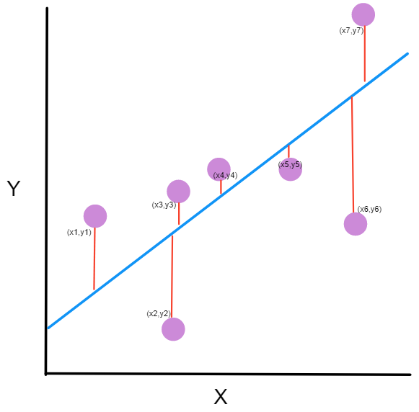
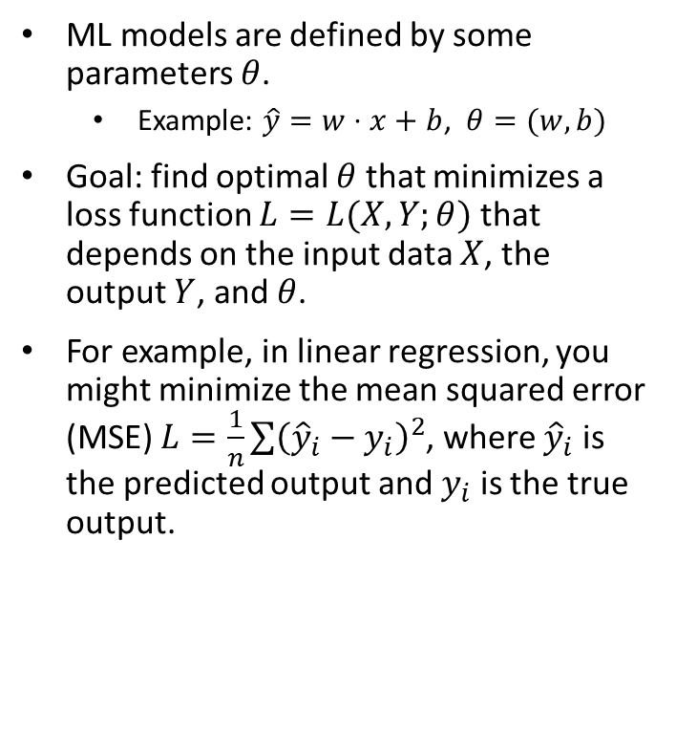
Loss Function
ML models are defined by some parameters $θ$.
  Example: $\hat{y}=w⋅x+b$, $θ=(w, b)$
Goal: find optimal $θ$ that minimizes a loss function $L=L(X, Y;θ)$ that depends on the input data $X$, the output $Y$, and $θ$.
For example, in linear regression, you might minimize the mean squared error (MSE) $L=\frac{1}{n}\sum{{\left({\hat{y}}_{i}−y_{i}\right)}^{2}}$, where ${\hat{y}}_{i}$ is the predicted output and $y_{i}$ is the true output.
Illustration of loss from linear regression (red lines are error, blue line is prediction)

Slide 15
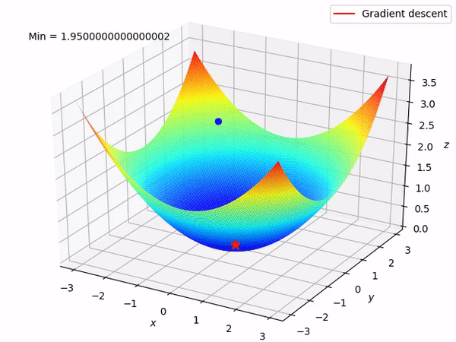
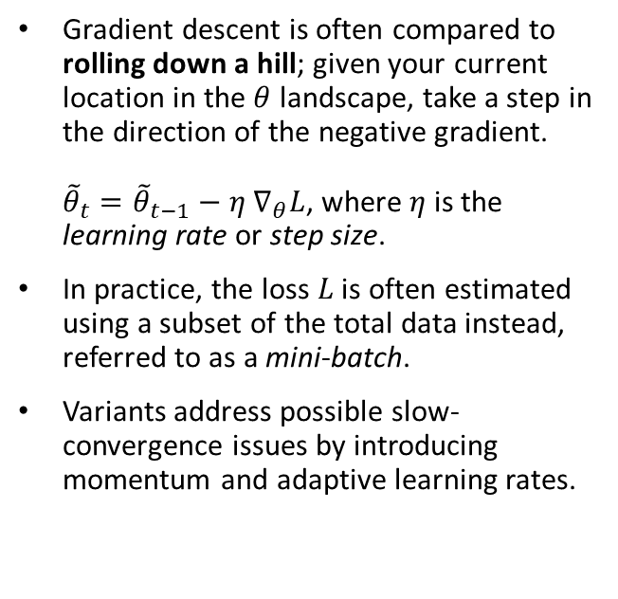
Gradient Descent
Gradient descent is often compared to rolling down a hill; given your current location in the $θ$ landscape, take a step in the direction of the negative gradient.
${\tilde{θ}}_{t}={\tilde{θ}}_{t−1}−η ∇_{θ}L$, where $η$ is the learning rate or step size.
In practice, the loss $L$ is often estimated using a subset of the total data instead, referred to as a mini-batch.
Variants address possible slow-convergence issues by introducing momentum and adaptive learning rates.
Animation of a gradient descent algorithm.

Slide 16
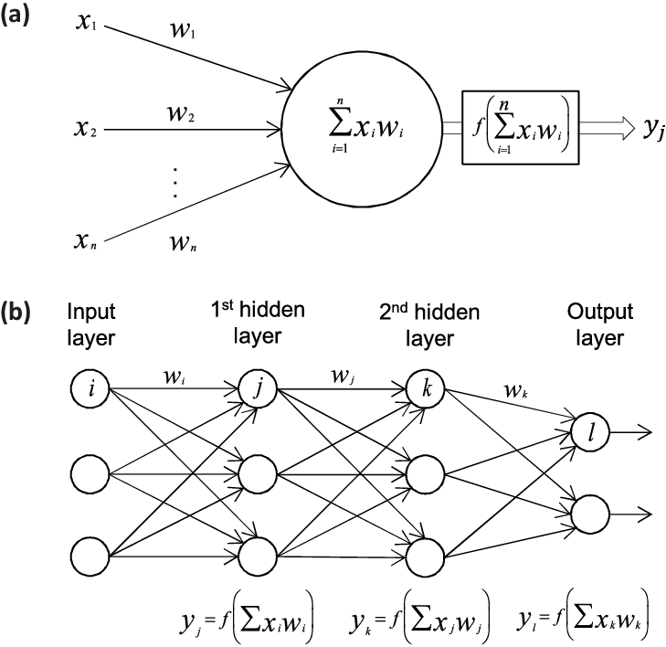
Neural Networks
activation function
The central tool in ‘deep learning’.
Based roughly on the human brain, a neural network (NN) is composed of an input layer, one or more hidden layers, and an output layer.
Each neuron outputs the result of applying an activation function to the weighted sum of the outputs of the previous layer.
If each neuron of a layer is connected to all neurons of the previous layer, that layer is fully-connected (see image). Otherwise, it is local.
If the weights for each neuron in a layer are shared, that layer is convolutional.
weighted sum
Output of a single neuron.
Schematic of a neural network.

Slide 17
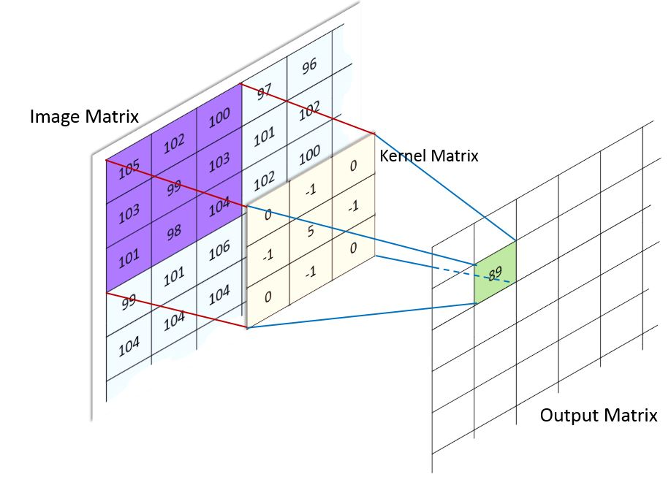
Convolutional Neural Networks
Used when the input can be viewed as an image.
Shared weights lead to dramatically-reduced degrees of freedom.
Takes advantage of spatial locality and translational equivariance.
Example of a convolution.

Slide 18
More on Neural Networks
Useful for problems involving a large amount of data with high dimensionality.
Trained using gradient descent, with the gradient estimated using backpropagation. Slower to train than most other ML techniques but can be dramatically sped up with the use of specialized hardware such as GPUs.
Python is the most popular programming language for ML work. Useful libraries include:
  Numpy
  Pytorch
  Tensorflow

Slide 19
Conclusion
Calorimetry is an important way to estimate the energy of particles and is used in many experiments, including at the LHC.
The design of calorimeters leads to many measurements for each incoming particle; need a clustering algorithm.
Thanks to simulations, can apply supervised machine learning to find a better clustering algorithm than those designed by hand.

Slide 20
Backup (Advanced)

Slide 21
3D Deep Learning Tasks

Slide 22
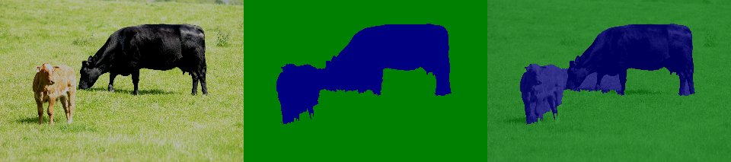
Semantic Segmentation
Given data (point cloud, image, etc.), associate each piece of data (point, pixel, voxel) with one of m pre-determined labels.
Almost a clustering problem, but:
  Number of clusters is fixed.
  Clusters are distinguishable.

Slide 23
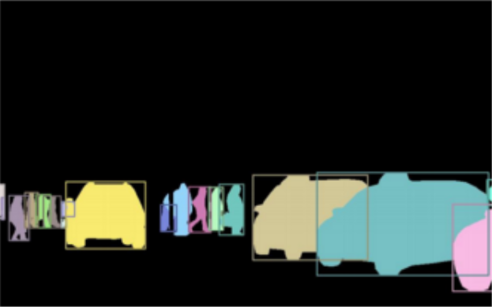
Instance Segmentation
Given data (point cloud, image, etc.), identify the pieces (point, pixel, voxel) that correspond to each of n objects (can vary per sample).
Note that some of the data does not correspond to any object.
Might be exact, or a rough estimate, such as with bounding boxes.

Slide 24
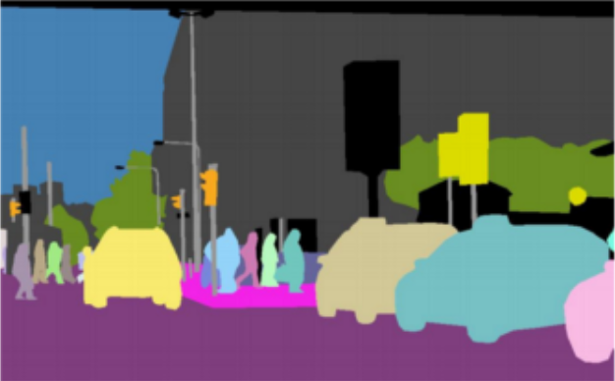
Panoptic Segmentation
Semantic Segmentation + Instance Segmentation
Abstractly, the same as instance segmentation except every piece of data must be labelled. Practically, can lead to different techniques.

Slide 25
SPVNAS Motivation
Need models for 3D tasks with:
  Low latency
  High computational efficiency
  High accuracy
Original motivating problem was driverless cars.
Offline reconstruction in particle physics shares many of the same requirements.

Slide 26
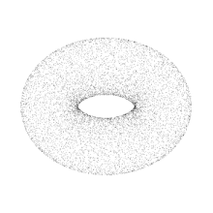
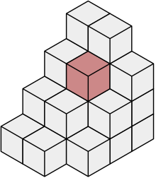
Previous Approaches
Fall into two categories:
  Point cloud models
  Voxel models

Slide 27
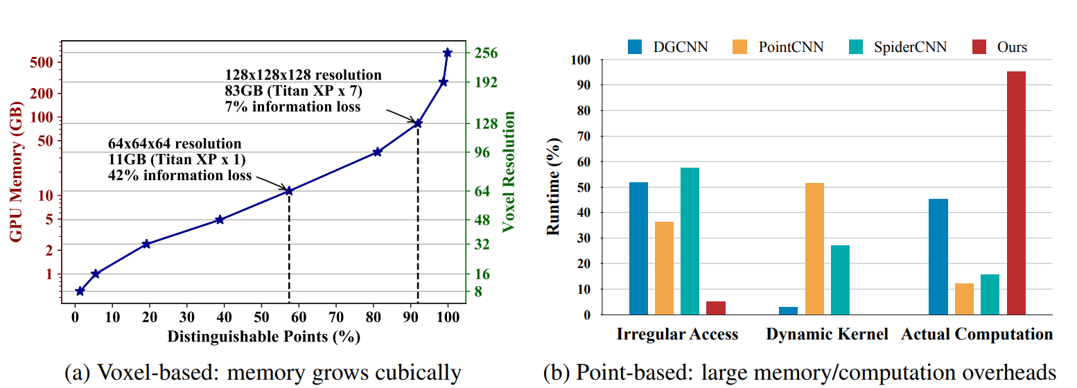
Limitations of Previous Approaches

Slide 28
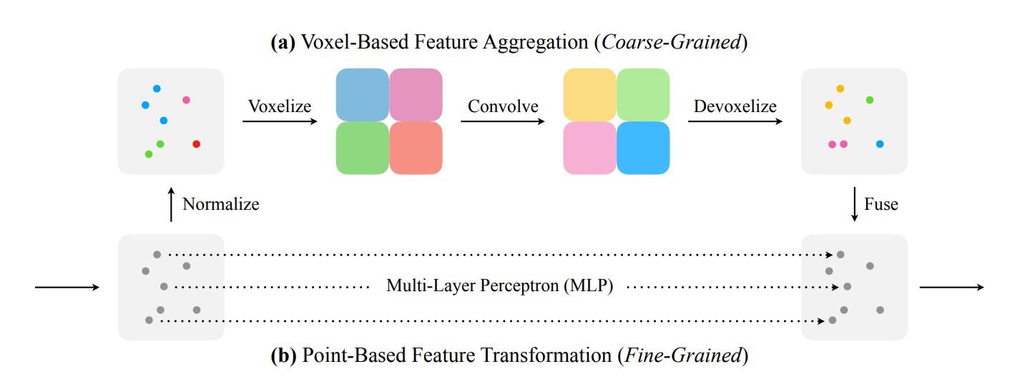
Point-Voxel Convolution (PVConv)

Slide 29
Sparse Point-Voxel Convolution (SPVConv)
Simply replaces upper branch with sparse convolution.
Some details with normalization/voxelization and devoxelization/fusion:
  Hashing, trilinear interpolation

Slide 30
Sparse Point-Voxel Convolution (SPVConv)
Simply replaces upper branch with sparse convolution.
Some details with normalization/voxelization and devoxelization/fusion:
  Hashing, trilinear interpolation

Slide 31
Voxelization
1
2
3
9
9
1
4
1
5
7
1
5

Slide 32
Sparse Point-Voxel Convolution (SPVConv)
Simply replaces upper branch with sparse convolution.
Some details with normalization/voxelization and devoxelization/fusion:
  Hashing, trilinear interpolation

Slide 33

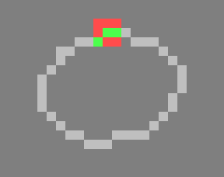
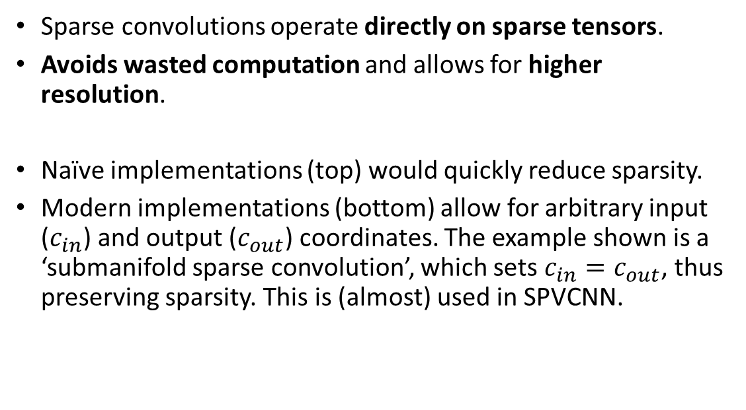
Generalized Sparse Convolution
Sparse convolutions operate directly on sparse tensors.
Avoids wasted computation and allows for higher resolution.
Naïve implementations (top) would quickly reduce sparsity.
Modern implementations (bottom) allow for arbitrary input ($c_{in}$) and output ($c_{out}$) coordinates. The example shown is a ‘submanifold sparse convolution’, which sets $c_{in}=c_{out}$, thus preserving sparsity. This is (almost) used in SPVCNN.

Slide 34
Devoxelization
Simply replaces upper branch with sparse convolution.
Some details with normalization/voxelization and devoxelization/fusion:
  Hashing, trilinear interpolation

Slide 35




Linear Interpolation
To devoxelize, need to find value at arbitrary point, but only know values at fixed points (center of voxels).
Solution: use linear interpolation from known points.
$$x_{1}$$
$$P$$
$$x_{2}$$
$$f\left(P\right)=\frac{x_{2}−P}{x_{2}−x_{1}}f\left(x_{1}\right)+\frac{P−x_{1}}{x_{2}−x_{1}}f\left(x_{2}\right)$$

Slide 36
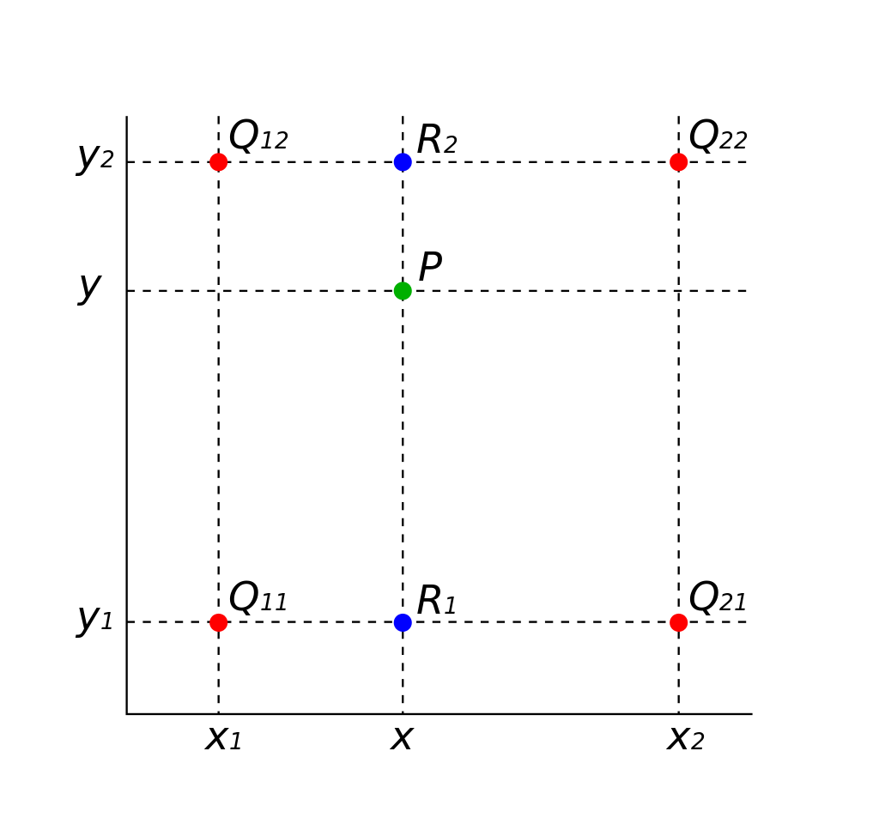
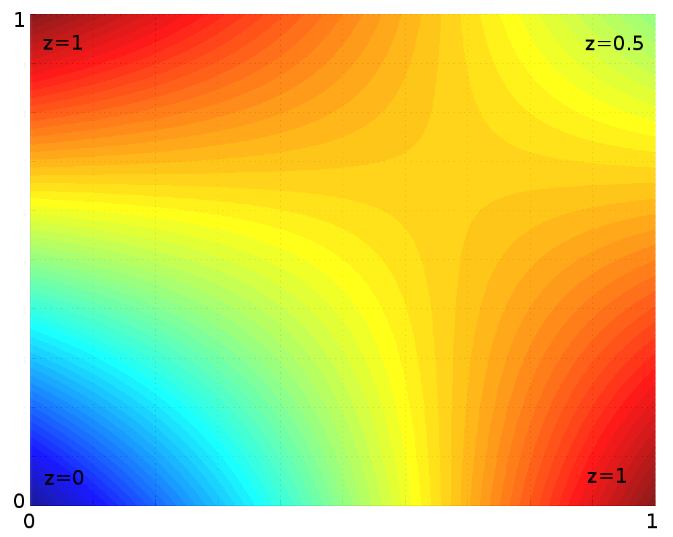
Biilinear Interpolation

Slide 37
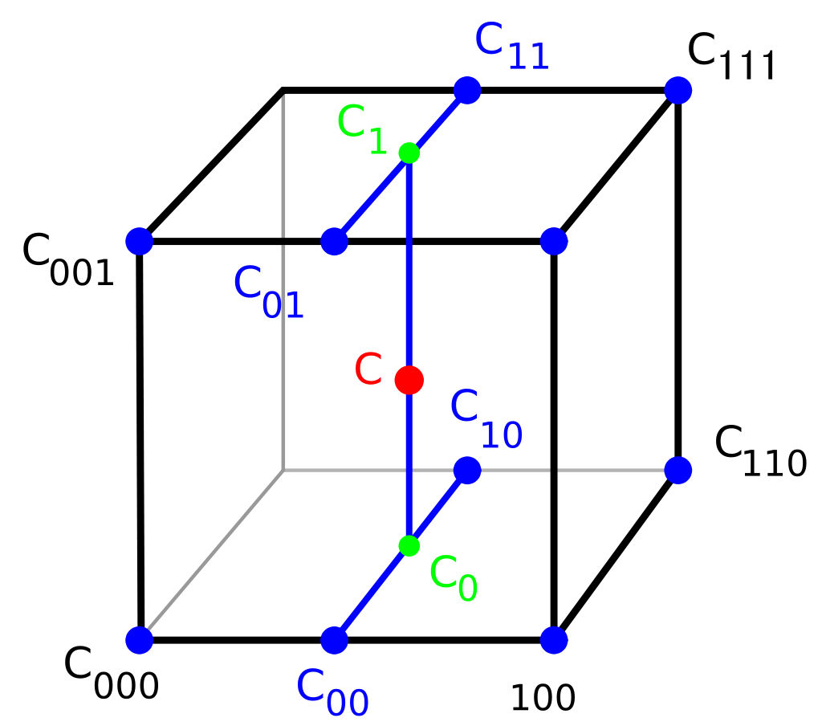
Trilinear Interpolation

Slide 38
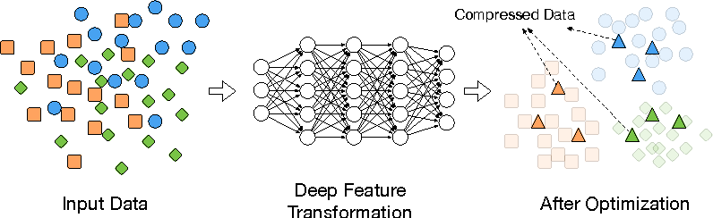
Metric Learning
Goal: learn a distance function to distinguish objects from the same cluster
Exploit this to handle data with variable number of clusters & arbitrary ordering of clusters.

Slide 39
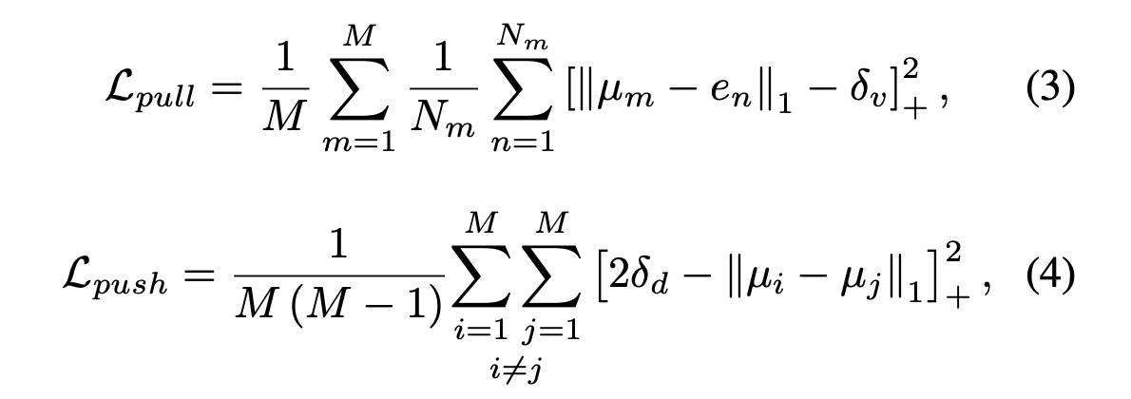
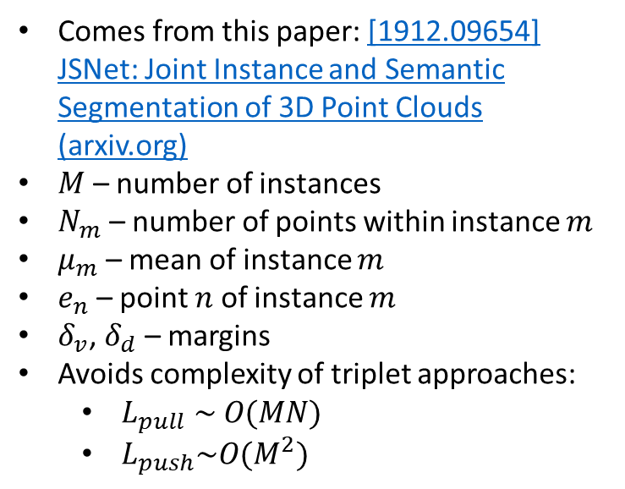
Centroid Loss
Comes from this paper: [1912.09654] JSNet: Joint Instance and Semantic Segmentation of 3D Point Clouds (arxiv.org)
$M$ – number of instances
$N_{m}$ – number of points within instance $m$
$μ_{m}$ – mean of instance $m$
$e_{n}$ – point $n$ of instance $m$
$δ_{v}$, $δ_{d}$ – margins
Avoids complexity of triplet approaches:
  $L_{pull} \sim O(MN)$
  $L_{push}\sim O(M^{2})$

Slide 40
Mean Shift Clustering
Mean shift clustering is a two-part process, designed to cluster given points without knowing the exact number of clusters in advance.
First, apply ‘mean shift’ procedure iteratively, to update cluster centers.
  Initial cluster centers determined by voxelization given bandwidth.
  Near-duplicate cluster centers removed by post-processing filtering.
Second, apply nearest-neighbor search to map points to cluster centers.

Slide 41
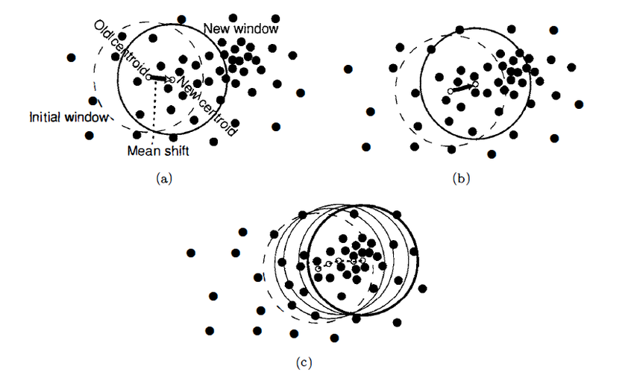
Mean Shift
Initial region of interest
Take weighted mean of points inside circle (radius given by bandwidth) to find new region.
By repetition, mean shift gets closer to the denser region which is density local maxima

Slide 42
Links
Code available at: https://github.com/mit-han-lab/calo-cluster
SPVNAS paper: https://hanlab.mit.edu/projects/spvnas/papers/spvnas_eccv.pdf

