Slide 1
Machine Learning Energy Regression for Hadrons
By: Adithya Suresh

Slide 2
Outline
What are Pions?
  Types of Pions
  Pion Decay
What is a Calorimeter?
  EM Calorimeter
  Hadronic Calorimeter
Pion-Induced Hadronic Showers
Machine Learning Energy Regression

Slide 3
What are Pions?
Pions are a the lightest type of meson (made up of a quark and antiquark)
  Quarks are an elementary particle that is the fundamental constituent of matter
  Quarks combine to form hadrons (composite particles)
There are three types of pions: 𝛑⁺, 𝛑⁻, 𝛑⁰
  Charged pions decay due to nuclear force
  Neutral pions decay due to electromagnetic force

Slide 4
Types of Pions
𝛑⁺ : Made up of an up quark and down antiquark
𝛑⁻ : Made up of an up antiquark and down quark
𝛑⁰ : Made up of
  An up quark with an anti-up quark
  A down quark with an anti-down quark

Slide 5


Pion Decay
Decay of Charged Pions (𝛑⁺, 𝛑⁻)
  Decay due to weak nuclear force
  Most Common Method: Leptonic Decay to Muon and Muon Neutrino
Decay of Neutral Pions (𝛑⁰)
  Decay due to electromagnetic force
  Most Common Method: 2 Photon Decay

Slide 6
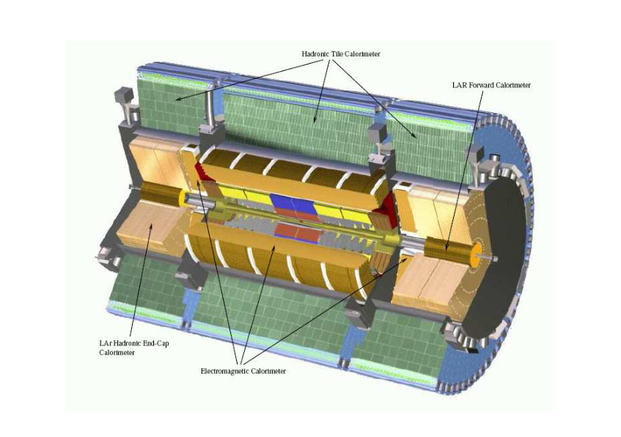
What is a Calorimeter?
In particle physics , a calorimeter is an experimental device that measures the energy a particle loses as it passes through.
Calorimeters are where the energy of absorbed particles are transformed into a measurable quantity.
  A signal detected by a calorimeter is proportional to that deposited energy.
Most particles enter the calorimeter and initiate a particle shower and the particles’ energy is deposited in the calorimeter, collected, and measured.

Slide 7
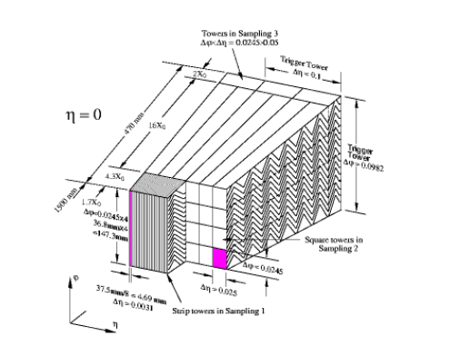
Electromagnetic (EM) Calorimeter
Electromagnetic calorimeters are used to measure the energy of electrons and photons as they interact
The ATLAS electromagnetic calorimeter is a sampling calorimeter with accordion geometry absorbers immersed in Liquid Argon
  Sampling calorimeter consist of alternating layers of an absorber, a dense material used to degrade the energy of the incident particle, and an active medium that provides the detectable signal
Pre-sampler corrects for energy loss of particles in inactive material before those particles enter the calorimeter
Three samplers have boundaries which are determined by acquiring electronic signals of each sample

Slide 8
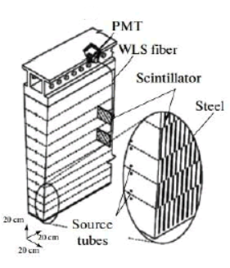
Hadronic Calorimeter
Hadronic calorimeters are used to measure mainly hadrons through their strong and electromagnetic interactions
Hadrons can deposit energy in matter through a series of successive interactions
  Hadrons are relatively massive and lose their energy mainly through multiple nuclear collisions
Atlas Hadronic Calorimeter is a sampling calorimeter using iron as absorber material and scintillating tiles as active material

Slide 9
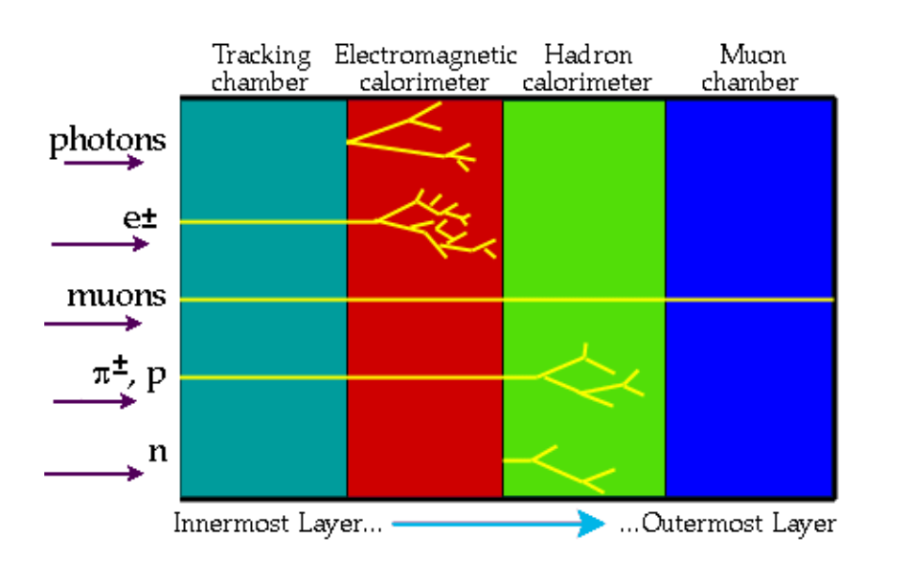
Hadronic Showers (Pion-Induced)
In the Large Hadron Collider, a pion impinges on the hadronic calorimeter to produce secondary hadrons of lower energies
The produced lower energy hadrons can produce other hadrons to form the shower
Due to 𝛑⁰ decaying into photons, some pion-induced showers produce showers in the EM calorimeter

Slide 10
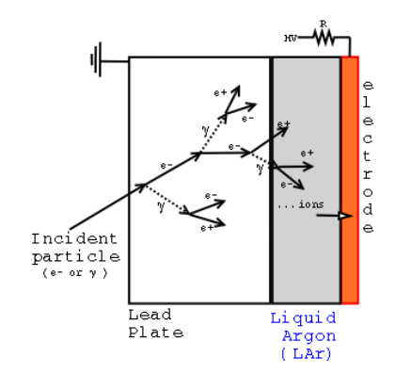
Electromagnetic (EM) Showers
The produced photons from neutral pion decay travel and perform pair production at high energies
Then, the new particles undergo Bremsstrahlung (electrons) or pair production (photons)
This process continues until ionization becomes the dominant process which is when photons are at lower energies
  Occurs when energy of particle < critical energy E₀

Slide 11
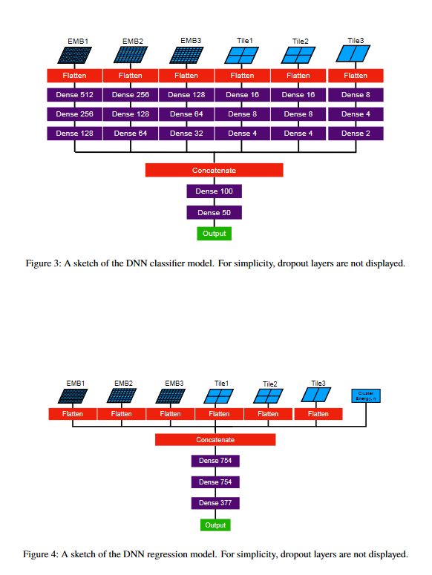
ML Energy Regression
Calibrating the pion energy response is a core component of reconstruction in the ATLAS calorimeter
Deep learning approaches outperform the classification applied in the baseline local hadronic calibration
Deep learning techniques have shown the best energy resolution for a wide range of particle momenta
  Deep Learning performs especially well for low energy pions

Slide 12
ML Energy Regression
Ongoing Projects
Utilizing Mixture Density Networks (MDNs), it is possible to estimates the associated energy resolution for each individual pion
  This enables the resolution to be quantified on a per pion basis for the first time
    Resolution is defined as (measured energy - true energy ) / true energy
Pion charge classification to separate showers created by 𝛑⁺, 𝛑⁻ from 𝛑⁰ can be done through Classification and Regression techniques

Slide 13
Sources
http://cdsweb.cern.ch/record/2724632/files/ATL-PHYS-PUB-2020-018.pdf
https://www.sciencedirect.com/science/article/pii/S0168900202014900
https://www.stathis-stefanidis.com/the-em-calorimeter/
https://indico.cern.ch/event/781244/contributions/3251933/attachments/1782461/2902499/HadronicPhysics.pdf
https://www.nevis.columbia.edu/reu/2010/CherstonReport.pdf
https://core.ac.uk/download/pdf/44194418.pdf
https://indico.cern.ch/event/817555/attachments/1865535/3087442/L5_solid_calo_pid_riegler.pdf
https://www.radiation-dosimetry.org/what-is-calorimeter-definition/

