Slide 1
CERN Basketball Club
Accounting report season 2020/2021
Jeronimo ORTOLA
General Assembly 2nd July 2020

Slide 2
https://espace.cern.ch/CERN-Basketball-club/

Slide 3
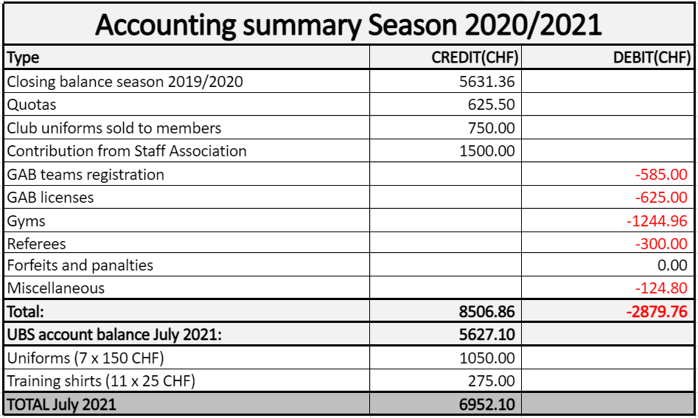
QUOTAS:
21 transferred to next season: 1957 CHF
3 reimbursed: 390 CHF
8 donated: 625.5 CHF

Slide 4
Conclusions
The club is still in good health
  Balance UBS account: 5627.10 CHF
  Uniforms on stock: 7 x 150 CHF = 1050 CHF
  Training shirts on stock: 11 x 25 CHF: 275 CHF
  TOTAL BALANCE 20/21: 6952.10 CHF
Only 32 members compared to 40 in 19/20
We have -584.26 CHF regarding last season. (TOTAL BALANCE 19/20: 7536.36 CHF)
UBS account maintenance fees : 59.20 CHF.

Slide 5
Budget 2020/2021
Back to normal amount of club members (40-45)
Basketball backboard: ~ 2000 CHF
UNIFORMS to be purchased
Foreseen end next season:
  TOTAL BALANCE: 5375 CHF (-1576.12 compared to last season)

Slide 6
