Slide 1
CERN Basketball Club
General Assembly
15th June 2021

Slide 2
Agenda
Last season report (President)
Financial state of the club (Treasurer)
Planning for next season (President)
Discussion

Slide 3
2020-2021 Committee
Borja Fernandez Adiego – President/CERN1R
George Iakovidis – Vice President
Pedro Felix Lopez Macia – Member/CERN1R
Jeronimo Ortola Vidal – Treasurer/CERN2R
Manuel Gonzalez Berges – Secretary/CERN2R
Haroon Rafique – Coach / Member
Francois Boyer – Member

Slide 4
2020-2021 Status
Members
  CERN 1: 11 players
  CERN 2: 19 players
  Only trainings: ~17 person paid
Gyms
  Tuesdays: Chavanne
  Wednesdays: Bude
  Thursdays: Saint Genis Diamanterie
Competitions – GAB
  CERN 1 - League Cobalt / Cup
  CERN 2 - League Titane / Cup
COVID’19
  CERN BBC stopped the activities on the 23/10/2020
  GAB stopped all competitions on the 23/10/2020

Slide 5
2020/21 Championship
Championship/cup was suspended on the 23/10/21
Season 2021/22 will be based on the results of the season 2019/21:
  CERN1 will play again in league “Cobalt”
  CERN2 will play again in league “Titane”

Slide 6
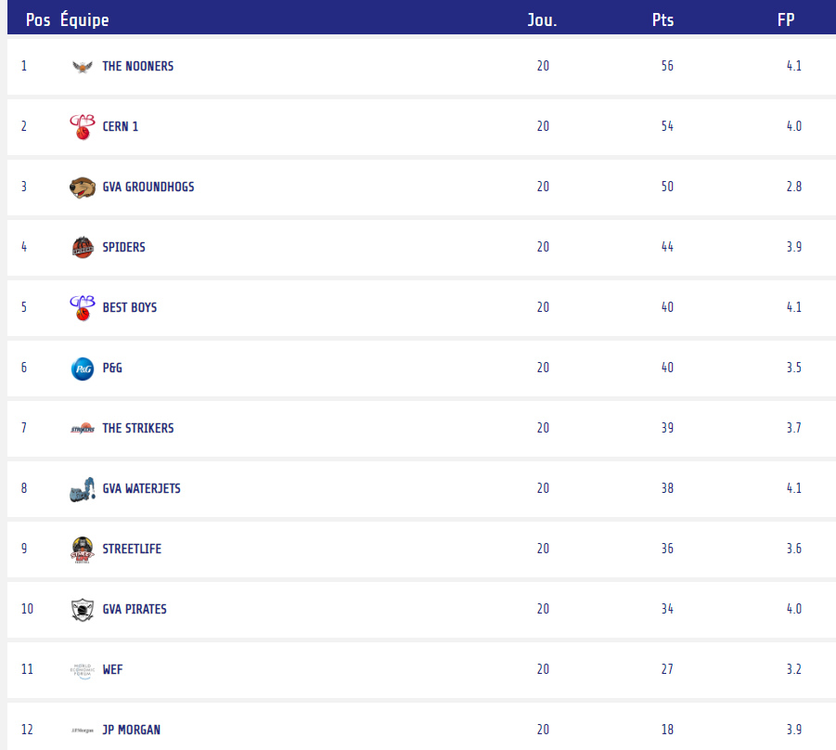
CERN1 2019/20 Championship

Slide 7
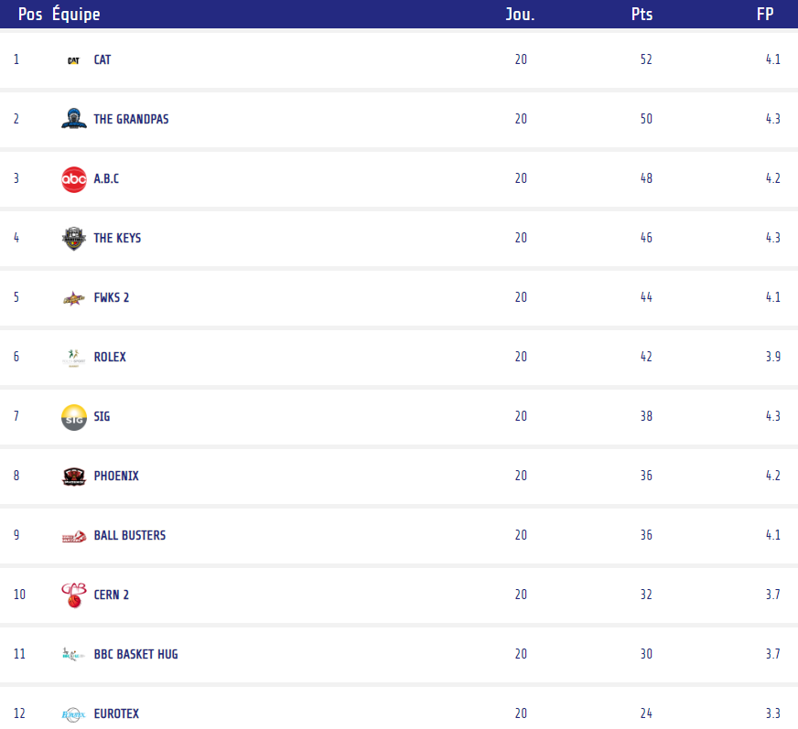
CERN2 2019/20 Championship

Slide 8
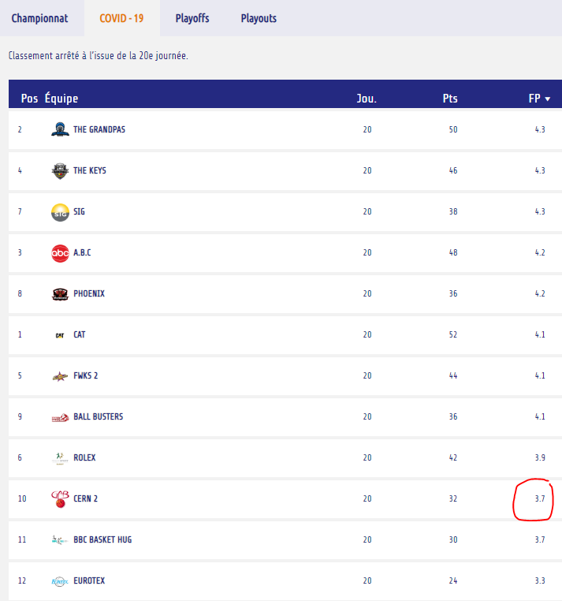
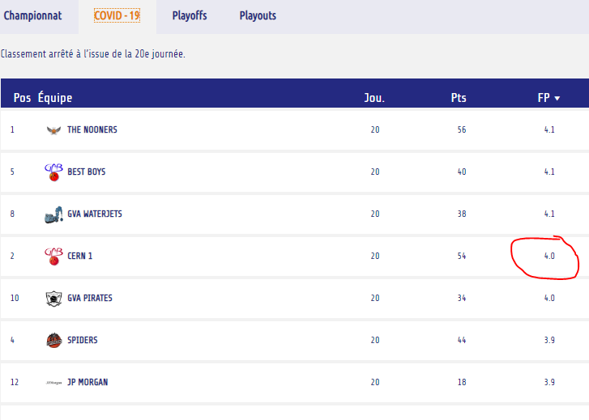
CERN1/2 2019/20 Fair-Play
No fair-play ranking for 2020/21

Slide 9
Social events
No social events

Slide 10
Thanks coach!
Trainings, CERN1 and CERN2 coach and member of the committee!

Slide 11
Thanks to all the people in the committee and everyone in the club

