Slide 1
FCC-ee Injector Review
REVIEWERS : Deepa Angal-Kalinin (CI), Ralph Assmann (DESY), Günther Dissertori (ETHZ, Chair), Andrew Hutton (JLAB), Kazuro Furukawa (KEK), Marc Ross (SLAC), John Seeman (SLAC)
official release by end of this week
Michael Benedikt, Paolo Craievich,
Frank Zimmermann,
FCC-ee injector working group, 17 June 2021

Slide 2
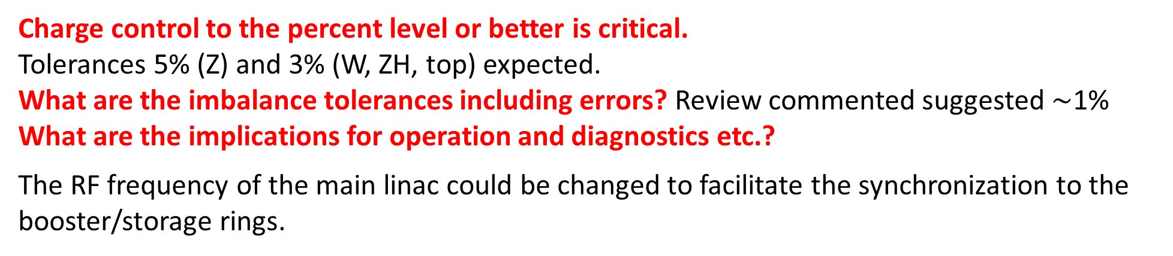
general
Charge control to the percent level or better is critical.
Tolerances 5% (Z) and 3% (W, ZH, top) expected.
What are the imbalance tolerances including errors? Review commented suggested $\sim$1%
What are the implications for operation and diagnostics etc.?
The RF frequency of the main linac could be changed to facilitate the synchronization to the booster/storage rings.
layout
Many different FCC-ee injector layouts were shown in the review that have been worked on over that past year. Results of start to end simulations for the various options were not presented to the committee for assessing the achievable performances of those schemes.
If the electrons need to be damped in the damping ring as well as the positrons, then the injector complex and overall operating modes become more complicated.
Recommendation:
Develop a methodology for a cost comparison to contrast the various injector layouts.

Slide 3
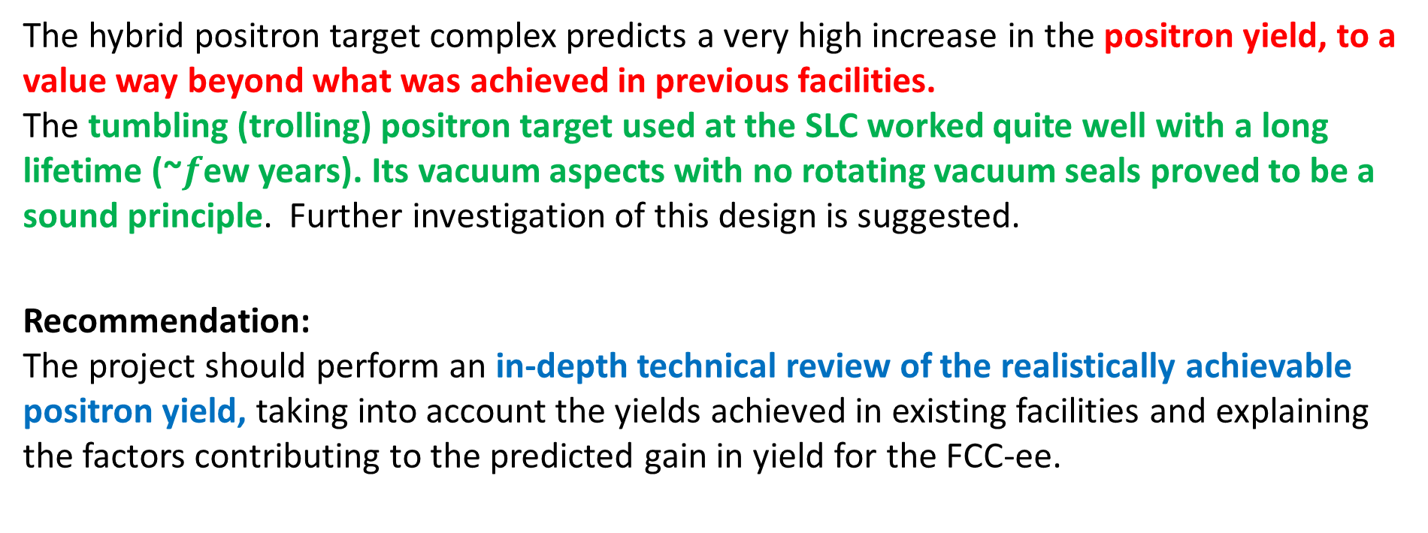
e⁺ source
The hybrid positron target complex predicts a very high increase in the positron yield, to a value way beyond what was achieved in previous facilities.
The tumbling (trolling) positron target used at the SLC worked quite well with a long lifetime (~$f$ew years). Its vacuum aspects with no rotating vacuum seals proved to be a sound principle. Further investigation of this design is suggested.
Recommendation:
The project should perform an in-depth technical review of the realistically achievable positron yield, taking into account the yields achieved in existing facilities and explaining the factors contributing to the predicted gain in yield for the FCC-ee.

Slide 4
multibunch operation mode
With multi-bunch injection operation of more than two bunches, the linac(s) must be un-SLEDed to keep the energies of the injected bunches equal due to longitudinal loading. Operating un-SLEDed would significantly increase linac length(s) and thus the injector cost.
The efforts of the FCC team to rely as much as possible on conservative solutions and to build on technology paths demonstrated in other facilities are supported. The multibunch operation is more demanding than a few bunch operation - in terms of linac operation, including bunch intensity control for top off, for the positron source and capture linac, and for the damping ring design. Approach to avoid multibunch operation is supported if the few-bunch operation scheme meets the requirements.
Recommendation:
The multibunch operation scheme should only be considered if it is needed in order to guarantee the target performance of the collider. Otherwise an optimized design based on a conservative approach with only a few bunches per pulse, like at the SLC and SuperKEKB, should be preferred.

Slide 5
Linac4 and PBR
Recommendations:
Do a study of the optimum tradeoff of the peak linac energy (6 to 40 GeV) including the beam stability/emittance issues and costs. Define a comparison metric including technical and beam issues.
Redo the study on emittance growth in the linac with BNS damping properly included. A numerical simulation with realistic random imperfections and beam correction is recommended in addition to the analytic investigation.

Slide 6
comments from our side

Slide 7
General Requirements:
Seen from the collider, we would like to have a factor of 2 margin with respect to the maximum requirements in the case of 4 IPs, and for all modes of operation. This should be defining the minimum necessary performance of the injector.
The two-bunch operation meets this requirement (talk by K. Oide)

Slide 8
→ guidelines for the future studies
1. adopt new layout for 6 GeV with only one energy in each linac & e+ production at 6 GeV
1.b linac RF frequency should be chosen to be an appropriate multiple of the FCC-ee collider RF frequency to make potential future injection operation much easier to perform
2. check the acceptance of the booster ring in terms of emittance because this parameter will greatly influence the injector itself, i.e. RF guns and damping ring
3. carry out start-to-end simulations for the new baseline layout
4. rough relative cost comparison for new and old layout (probably only marginal differences)
7. concentrate on 2 bunch per pulse conservative scheme as recommended by review, with e+ target inspired by SLC’s
5. study of 6-to-20 GeV linac, including rough cost estimate; e+ source performance at e- energy of 20 GeV
8. consolidation and confirmation of e+ yields expected at 6 and 20 GeV
9. preparation of PSI e+ experiment based on a target compatible with FCC 2 bunch operation

