Slide 1
WP1 report e+/e- 6 GeV Injector Linacs
Alexej Grudiev on behalf of WP1
17/06/2021

Slide 2
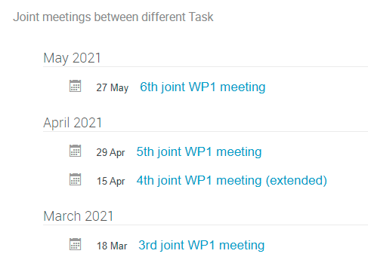
Joint WP1 meetings since last general meeting: 11/03/2021
Preparation for the review

Slide 3
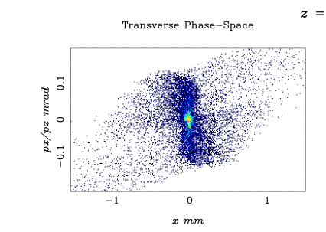
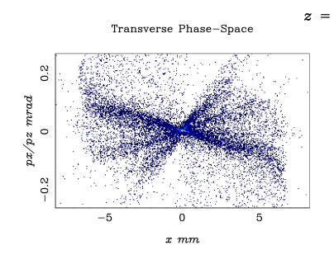
Summary Task 1.1
PHIN gun
Task 1.1 Electron source and pre-injector design
  Design is in progress following to options for the electron source:
    Photo cathode RF gun
    Thermionic gun + buncher
  Preliminary results have been presented indicating feasibility of both options
  Latest results show that Photo cathode RF gun can provide ~5mm*mrad normalized emittance for 5 nC bunches.
  If this emittance is preserves though the linacs it gives a hope to avoid necessity for DR for electron bunches even for injection ot BR (vert. norm emittance < 8mm*mrad)
Thermioninc gun

Slide 4
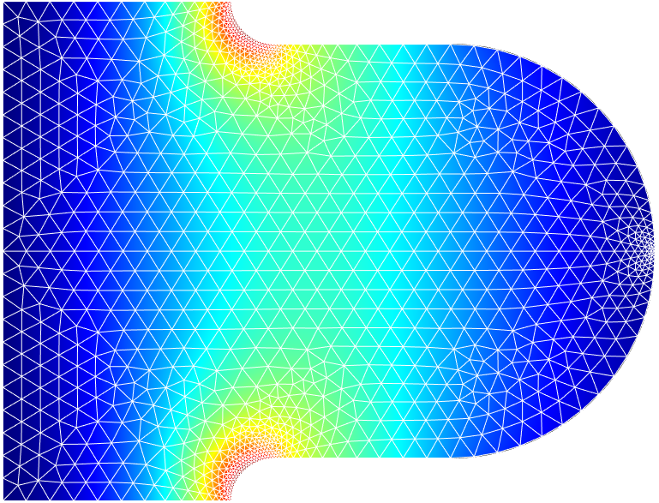
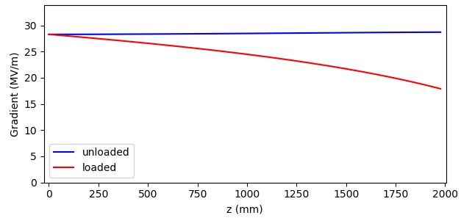
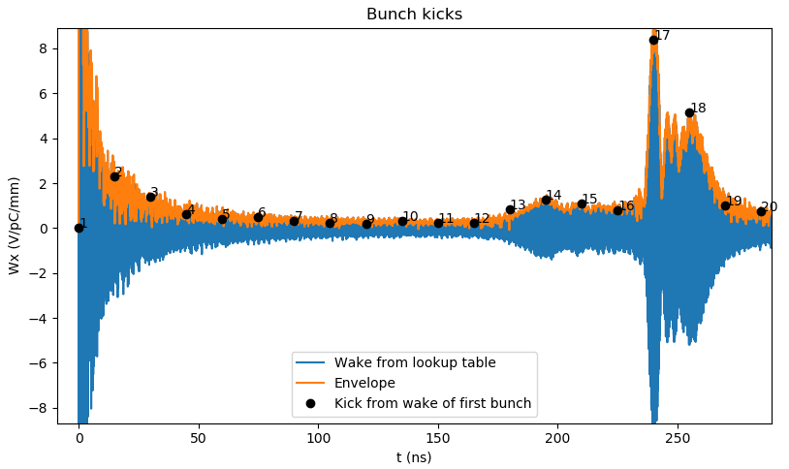
Summary Task 1.2
Task 1.2 RF design of linacs
  Tools for RF design and optimization of linacs have been developed including
    Calculation of fundamental mode parameters in the accelerating structure as a function of gradient, frequency, aperture, structure length, etc
    Calculation of monopole and dipole HOMs: first 20 modes
    Calculation of long-range dipole and monopole wakes for the whole train of bunches from 2 to any number of bunches for arbitrary bunch spacing
  The development is almost complete and is ready for application to linacs design following the beam dynamics specifications for aperture and dipole kick on the second bunch

Slide 5
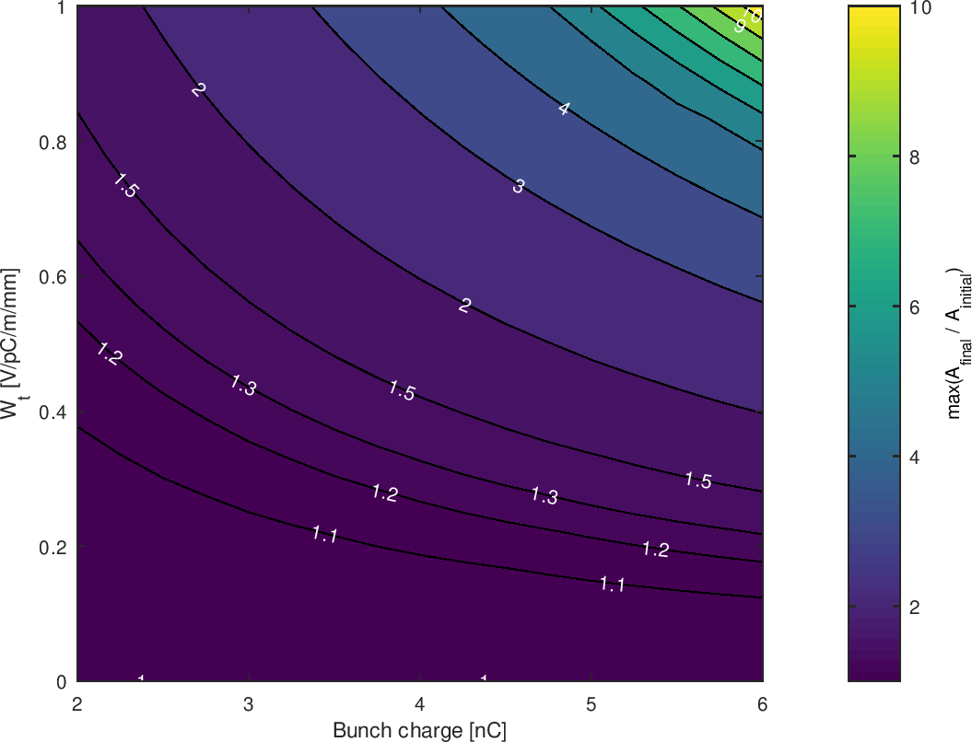
Summary Task 1.3
Task 1.3 Beam dynamics design of the linacs
  For the review preparation several examples of beam dynamics simulations have been prepared demonstrating that the tools are available.
  This examples indicate that for the electron beams there is not issues but in-depth optimization together with RF design is required
  This will start a soon as a new postdoc will arrive
  The positron acceleration still must be looked at. This will be the starting point of the linacs optimization:
  LINAC1: positron parameters for design and optimization
    8000 mm.mrad emittance
    8% energy spread
    charge up to 7 nC
    RF frequencies: 2 - 3 GHz
    RF Gradients: 15 - 30 MV/m
    Aperture: a/lambda: 0.1 - 0.2
Linac 1, electrons, 2nd bunch

Slide 6
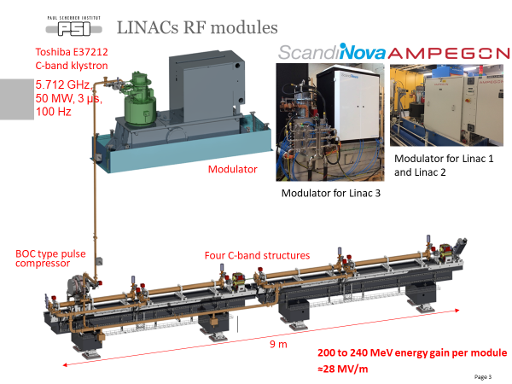
Summary Task 1.4
Task 1.4 RF module design and cost
  Review of possible RF module layouts
  In depth analysis of available commercial RF power sources in S- and C- band range with target parameters for FCCee- injectors linacs
  Evaluation of possible cost model for linacs optimization

