Slide 1
Pandora calorimetry and leakage correction
Peter Speckmayer

Slide 2
Motivation
Calorimeter depth limited (cost, technical reasons)
  some shower will leak longitudinally
  harms PFA:
    E from tracks and E from calorimeter inconsistent
      → leads to errors in the clustering
    E of (leaking) neutral particles wrong

Slide 3
Calorimetric energy in Pandora
Basically just ...
  multiply cell energies with factor (different for EM and hadronic clusters)
  sum up cell energies

Slide 4
Leakage correction in Pandora
if muon hits in the barrel
  standalone muon clusters:
    scale muon hits by a factor
  cluster has no tracks (neutral hadrons)
    add fixed amount of energy
  cluster has tracks:
    add fixed amount of energy if chi2 between E in tracks and E in calorimeter is improved

Slide 5
Envisaged improvements
make leakage correction dependent on cluster properties
  has to be a fast algorithm (energy correction functions are called often)
  should work all over the detector
    different coil thicknesses seen by shower
      depends on angle of cluster
    in EndCap no coil at all
  robust
    not affected by overlapping clusters or split up particles
  a simple formula probably the best

Slide 6
Implemented: interaction length from IP to calorimeter hits
want to get info about seen coil thickness
implemented “poor man’s” solution
  probably good enough for now (had. showers are not that precise)
  implemented as well GEAR distance properties which uses TGeo implementation.
    much more accurate
    no additional material parameters needed
    probably too slow
      can be solved with some caching of theta, phi-maps of int. lengths

Slide 7
Ad hoc formula
tried ad hoc formula(s)
does improve resolution slightly
but parameter scan is tedious
... and phase space for formulas is large (one has to be lucky to find the best one “ad hoc”)
full reconstruction with photon clustering:
uds91 : mean : 89.601 sE/E : 3.7437+-0.0481189
uds200: mean : 197.131 sE/E : 2.96368+-0.0380083
uds360: mean : 354.555 sE/E : 3.00459+-0.0426365
uds500: mean : 491.187 sE/E : 3.21821+-0.041141
full reconstruction with photon clustering and leakage correction:
uds91 : mean : 89.5951 sE/E : 3.73874+-0.0480552
uds200: mean : 197.125 sE/E : 2.9658+-0.0380356
uds360: mean : 354.525 sE/E : 2.97281+-0.0423393
uds500: mean : 490.949 sE/E : 3.18088+-0.0406637
slight improvement

Slide 8
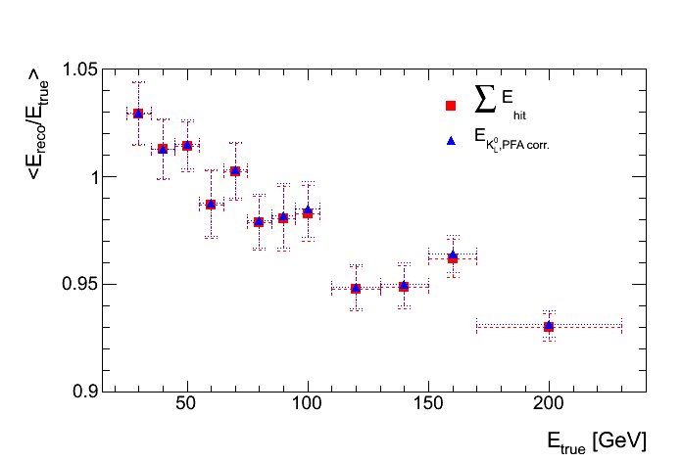
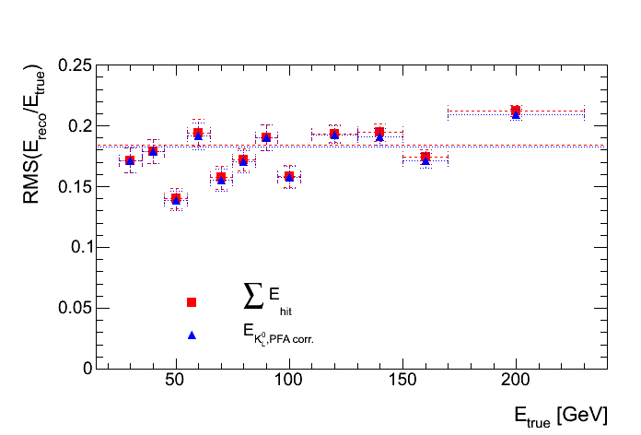
Pandora on K_{L}
tried: Look at single K_{L} → derive energy corrections → apply on clusters of jets
Linearity
Resolution
slope from leakage
(will show later)
not the known energy
resolution curve

Slide 9
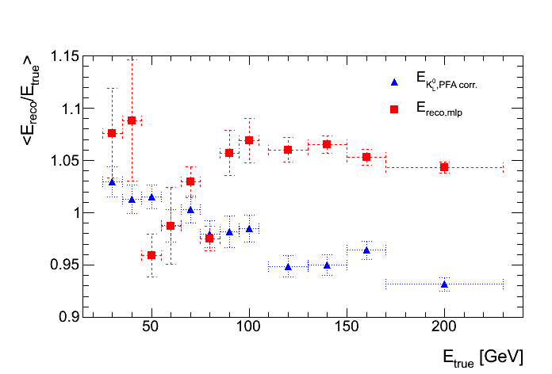
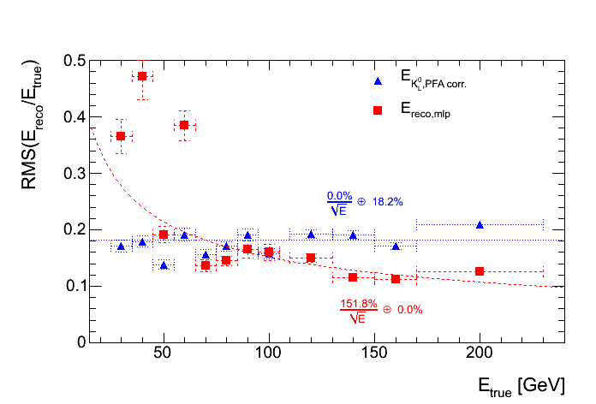
K_{L} Pandora reconstruction vs. Neural network reconstruction
(using only a few variables)
tried: Look at single K_{L} → derive energy corrections → apply on clusters of jets
→ while improvement of resolution for K_{L} : application on jets fails completely
Linearity
Resolution
NN curve more “as expected”

Slide 10
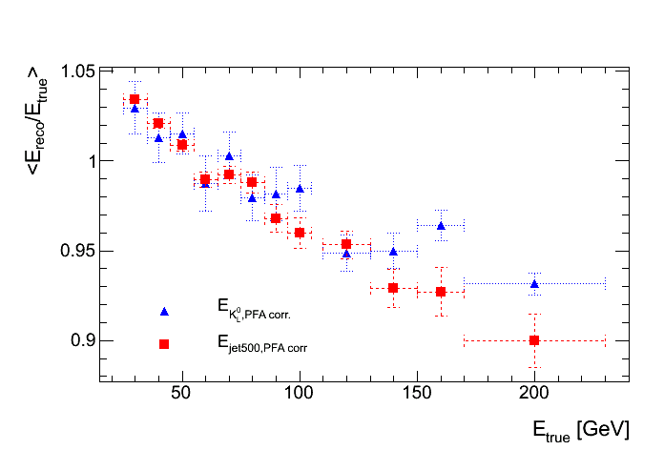
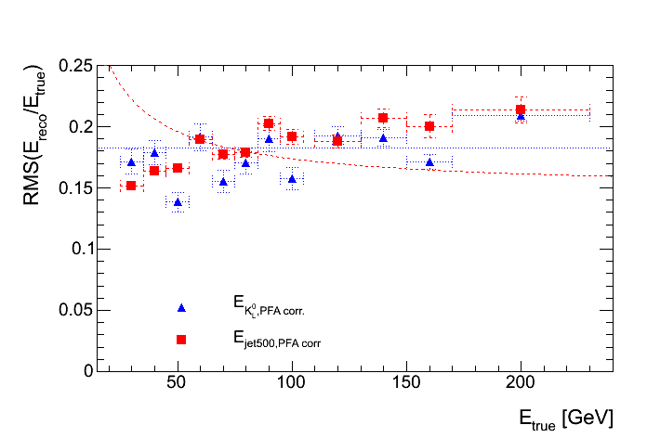
K_{L} – jj (uds 500GeV)
jets are “perfectly reconstructed”,
take calorimetric energy (no track information used)
Linearity
Resolution
no large difference in energy resolution and linearity between K_{L} and jets

Slide 11
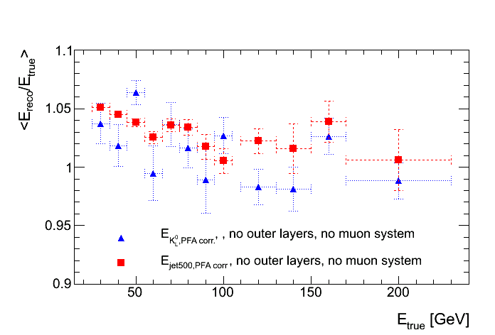
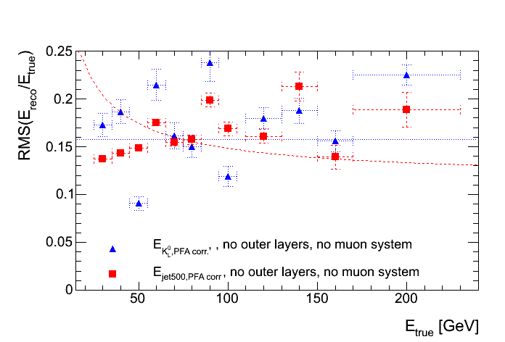
jets, perfect reconstruction
K_{L} – jj (uds 500GeV)
clusters with hits in the HCAL outer layers or in the muon system are suppressed
shows impact of leakage
jets have higher energies (took hadronic E instead of em-Energy), resolution similar
Linearity
Resolution

Slide 12
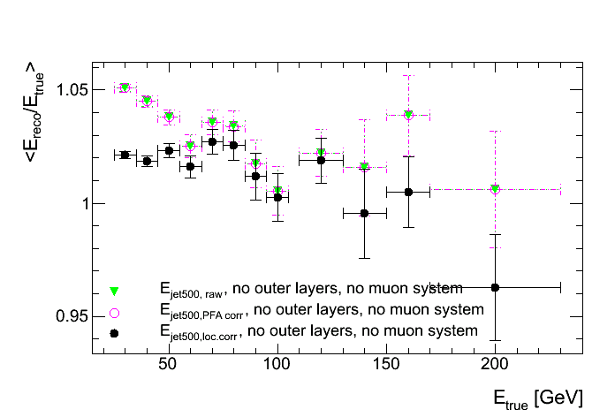
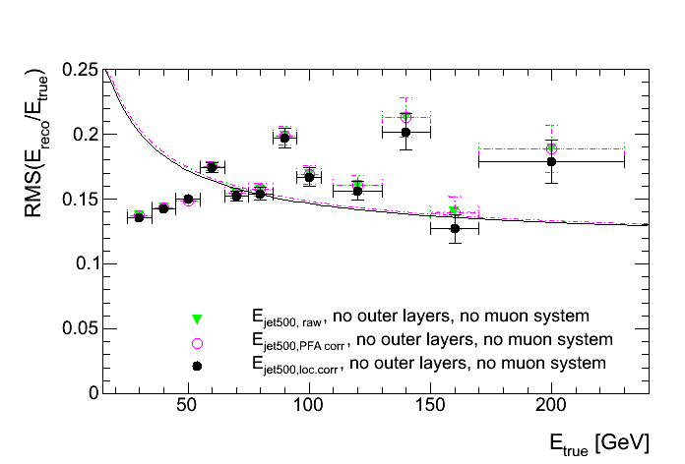
Sum of E_{hits}/Pandora corr./local corr.
local correction: correction based on hit energy and energy surrounding the hit
compute average corrections
does not lead to big improvements, but I think this can be done better
Linearity
Resolution
clusters with hits in the HCAL outer layers or in the muon system are suppressed
(to remove the impact of leakage on corrections)

Slide 13
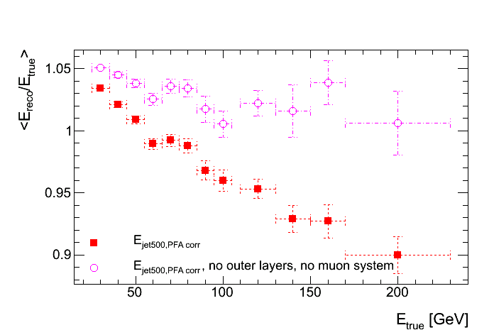
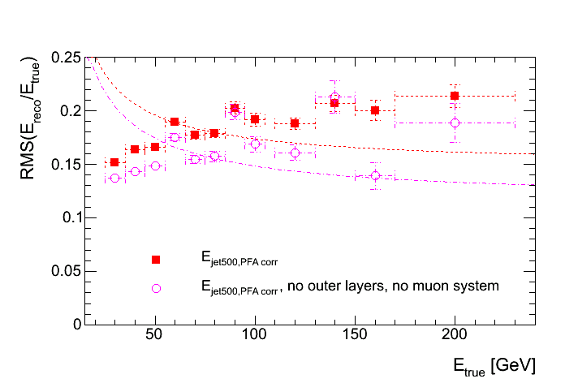
Impact of leakage
Linearity
Resolution
slope from leakage

Slide 14
Conclusions and outlook
Energy correction:
  OK for low energies
  potential improvements for high energies
Leakage correction:
  will derive corrections from perfectly reconstructed jets
    try neural net first
    approach to NN solution with a formula

