Slide 1
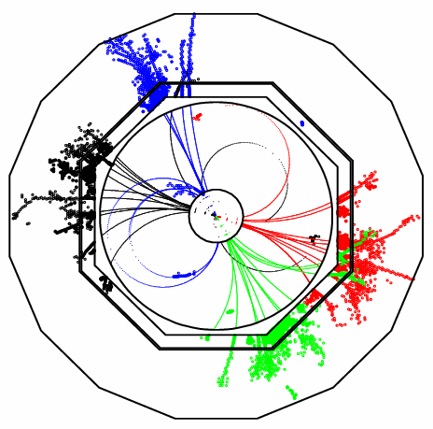
Pandora PFA Recent Changes
John Marshall,
University of Cambridge
LCD-WG2, September 1 2010

Slide 2
Recent Changes
This talk will discuss two areas of recent Pandora PFA development:
1. Forced clustering
  This concerns the behaviour of the reconstruction when the reclustering identifies a poor track-cluster match, which cannot be resolved by use of new clustering algorithms/parameters.
  In this case, we know the original reconstruction is poor, so we try to enforce a solution; hits closely associated with the track are identified and added to a new cluster until the cluster and track energies match.
  This is a solution that we never actually want to use, but which will in reality prove important until we have a number of new and suitably different clustering algorithms.
2. Detector gap treatment
  The gaps in the HCal, between staves and at θ=90°, cause a number of problems for the Pandora muon identification. Gaps in the clusters lead to failure of cuts searching for constant energy deposition.
  The topological association algorithms (used to stitch cluster fragments together) can also be confused, as the distance between the cluster fragments can be large.
  In this talk, will discuss new additions to the Pandora framework, allowing client applications to specify gap volumes in the active detector medium. Clusters can then be queried as to whether they cross a gap.

Slide 3
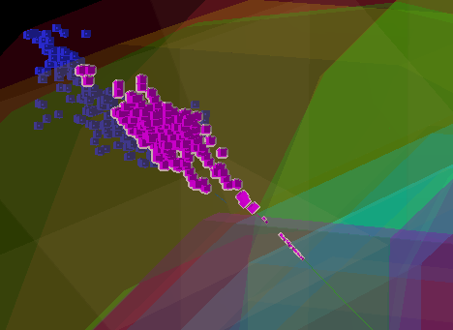
Forced Clustering
In the new Pandora framework, forced clustering can be implemented by simply adding a new entry to the list of clustering algorithms used in the reclustering phase.
  The Pandora framework ensures that the input to this algorithm (the “current” lists) will automatically be the poorly matched track and the constituent hits of the poorly matched cluster.
The algorithm works as follows:
  The track helix fit is extrapolated into the calorimeters and the distance between the propagated track and each available hit is calculated.
  A new track-seeded cluster is created (the “forced cluster”) and the distance-ordered hits are added to the cluster until the cluster energy matches the track energy.
  Any remaining hits are clustered using a further instance of the standard clustering algorithm.
Forced cluster
Remnant neutral cluster
Track
Track E = 46.9GeV
Original Cluster E = 89.6GeV

Slide 4
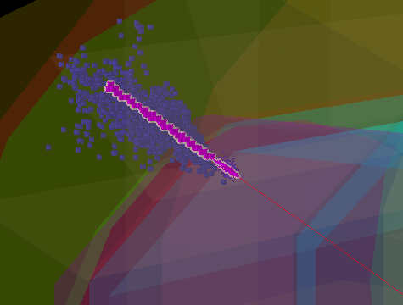
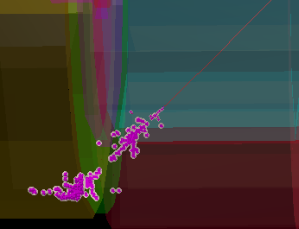
Forced Clustering
There are two use-cases for the forced clustering algorithm:
  The original cluster energy is much greater than the track energy. In this case, hits remaining after the creation of the forced cluster are grouped using the standard Pandora clustering algorithm.
  The original track energy is much greater than the cluster energy. In this case, the parent reclustering algorithm must identify likely fragments near the original cluster. These are typically clusters lying in a cone along the track direction, but without any track associations. The additional clusters are added to the reclustering list, so their constituent hits are available to the forced clustering algorithm.
Track E = 150GeV
Cluster E = 325GeV
Track E = 39.7GeV
Cluster E = 29.0GeV
Two separate clusters merged, but still insufficient energy
Forced cluster driven through original cluster
1 . ClusterE > TrackE
2. TrackE > ClusterE

Slide 5
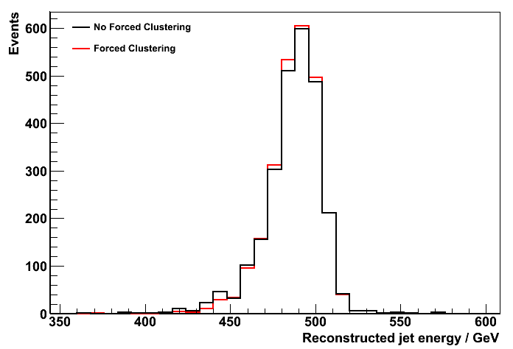
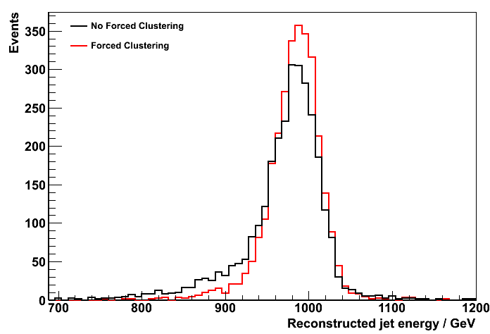
Forced Clustering - Performance
Performance tests using MC samples of Z → uds generated with the Z decaying at rest, show that the forced reclustering is very important for CLIC_ILD.
The addition of new (suitably “different”) clustering algorithms should be a priority task.
E_{j} = 250GeV
E_{j} = 500GeV
E_{j} | 45GeV | 100GeV | 250GeV | 500GeV
PandoraPFANew, No Forced Clustering, rms₉₀(E_{j}) / E_{j} | 3.56 ± 0.11 | 2.94 ± 0.08 | 3.00 ± 0.07 | 3.97 ± 0.09
PandoraPFANew, Forced Clustering, rms₉₀(E_{j}) / E_{j} | 3.56 ± 0.11 | 2.94 ± 0.08 | 2.88 ± 0.07 | 3.01 ± 0.07
Performance is quoted in terms of rms₉₀, the rms in the smallest range of reconstructed energy containing 90% of the events. The total energy is reconstructed and the jet energy resolution obtained by dividing the total energy resolution by √2. A cut on the polar angle is applied to avoid the barrel/endcap overlap region: |cos θ| < 0.7

Slide 6
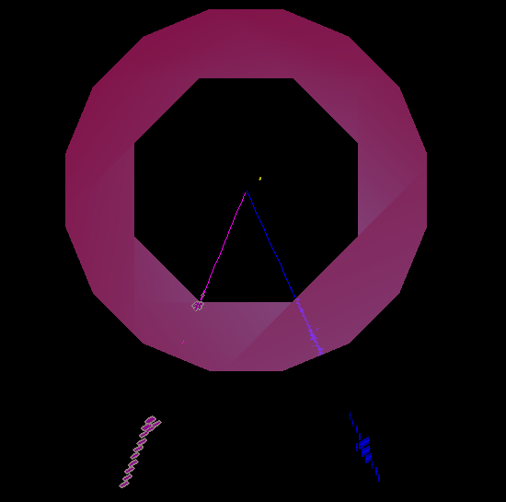
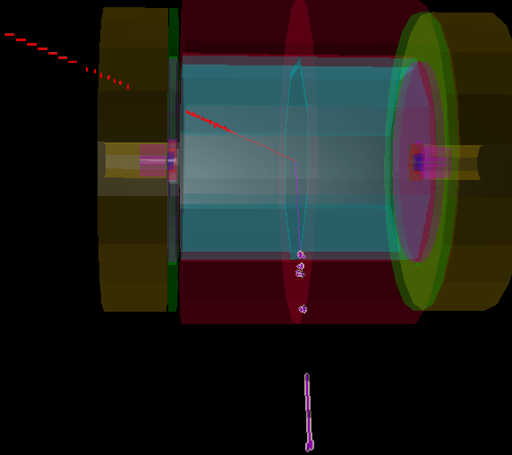
Detector Gaps
Quick reminder of the problems caused by HCal gaps in smuon events (high energy muons):
HCal barrel gaps
GAP region
Identified as Pi+
Mu+ passes through GAP
Identified as Pi-
Barrel stave gap
θ=90° gap

Slide 7
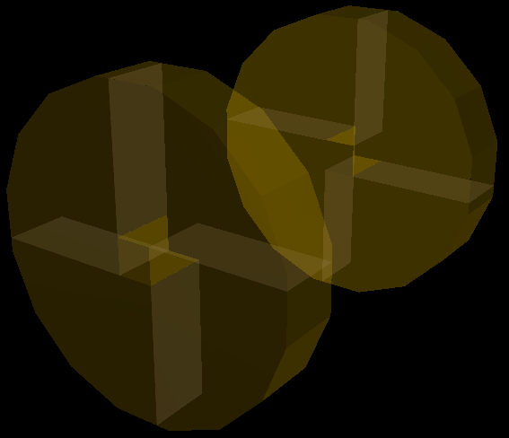
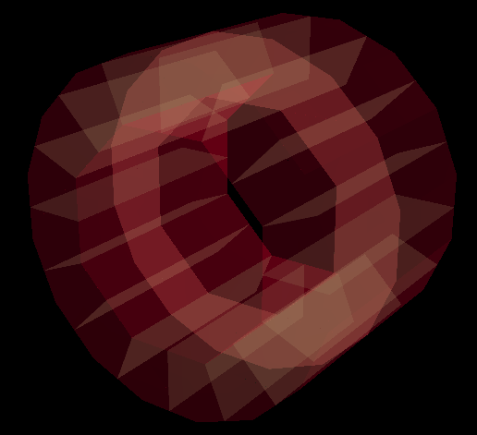
Detector Gaps
A Pandora client application can now specify the positions of BoxGaps and ConcentricPolygonGaps.
  BoxGaps require specification of vectors describing a vertex and three sides meeting the vertex.
  Concentric polygon gaps are assumed to lie along Z axis and require specification of inner and outer symmetries, radii and phi0 coordinates, together with inner and outer Z positions.
The defined interface means that each Gap class must answer whether a specified position lies within the gap. For concentric polygon gaps, this is answered via a polygon “winding” algorithm.
Positions of HCal gaps (for ILD LoI design 1) have been implemented in MarlinPandora for ILD-like detectors.
ILD HCal
EndCap Gaps
ILD HCal
Barrel Gaps

Slide 8
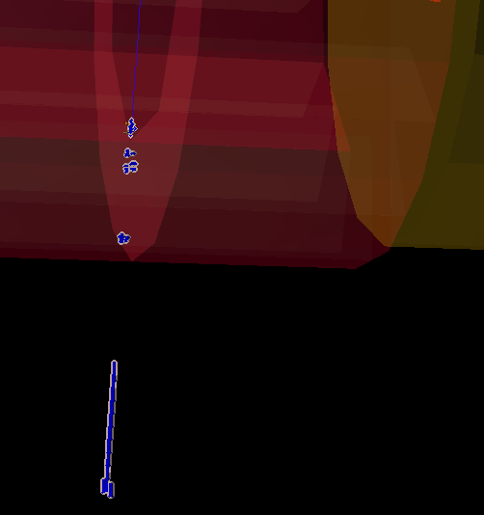
Detector Gaps - Usage
A number of ClusterHelper functions have been provided to make using the gap information as simple as possible.
These functions answer questions such as “Does a cluster cross a gap region?”, “Does a linear fit intersect a gap region?” Manipulation of the function arguments allows for more complex queries.
This is only a first implementation and these functions are potentially quite slow. Some refinements may follow.
So far the functions have only been used in the muon identification and in the broken-tracks topological association algorithm to recover the correct behaviour if specific cuts have been failed:
Muon Identification
  If a candidate cluster fails the cut on the minimum number of layers, but still contains yoke hits, the cluster can be recovered if it is declared to cross a gap region.
Broken-tracks algorithm
  If parent and daughter candidate clusters fail the proximity cuts, successful cluster merging can be recovered if fits to the end of the parent cluster (and the start of the daughter cluster) are declared to cross a gap region.
  A further improvement is to re-fit and re-use the parent candidate cluster if it has been used successfully. This is vital if there are chains of fragments to join to the same parent.
θ=90° concentric polygon gap
Muon passes through registered gap, and is recovered.

Slide 9
Summary
Forced clustering
In the past few weeks, the Pandora reconstruction has been extended and improved to deal with cases where reclustering is unable to fix poor track/cluster matches.
This forced clustering proves very important, but is only intended to be used as a last resort.
The addition of new and suitably different clustering algorithms should allow more of the track/cluster matches to be fixed properly.
Detector gap treatment
A framework for specifying Box and ConcentricPolygon Gaps in the detector has been implemented. This allows algorithms and helper functions to query whether a position lies in a gap region.
The first (simplistic) use of this information in the muon identification and broken-tracks topological association algorithm allows muons to be recovered and cluster fragments to be correctly merged.

