Slide 1
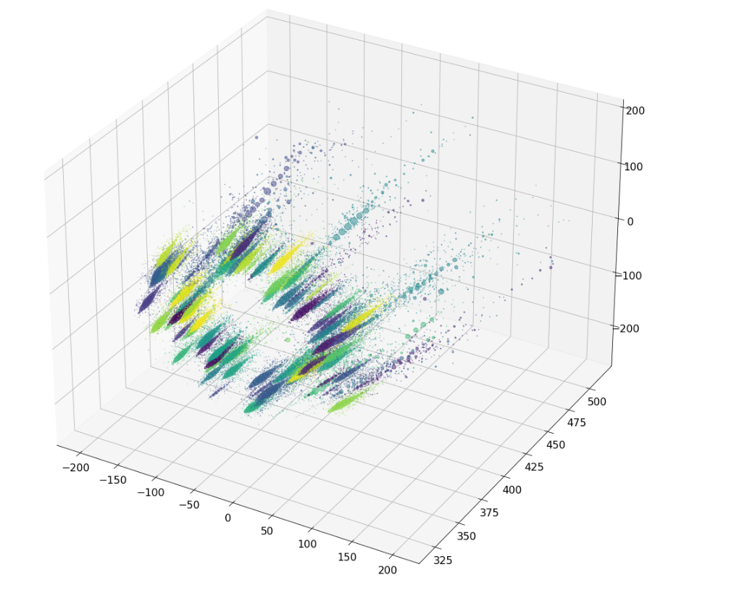
Cern Paratrack Hackaton
Jorge Cruz, Mart Hagedoorn, Shiqi Liao

Slide 2
Problem Description
Detecting particles
Clustering problem in 3D data
Data exploration
  (Un)supervised data
  Limited features
  Non-linear clustering
  Limited developing time

Slide 3
Data exploration
Each event contains indexed points with the following features
  Index
  Coordinate in 3D space
  Time when point was detected, most are missing
  Layer where point was detected
  Radial coordinates
  Enegry detected
  True labels, corresponding tracksters for each point and their fraction
Spacial coordinates, energy, and radial coordinates are candidate features.

Slide 4


Options
Method | Unsupervised approach | Works with limited features | Non-linear clustering | Implemented in a short period | Fit once, predict multiple times
K Means
Neural Network
Gaussian Mixture

Slide 5
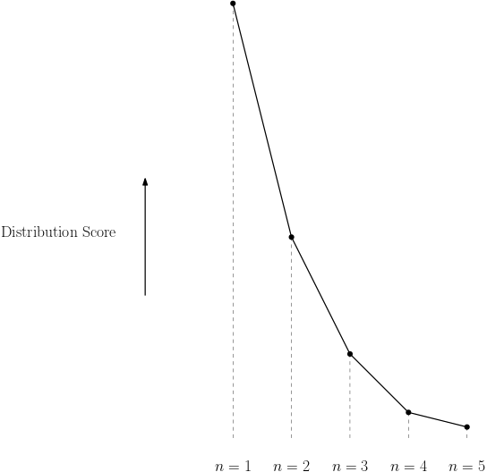
Implementation
Gaussian Mixture
Radial coordinates (ρ, η)
Determining cluster size
  Elbow method

Slide 6
Results
Four particle data set
Efficiency | 0.12
Purity | 172
over-shooting rate | 0.6275

Slide 7
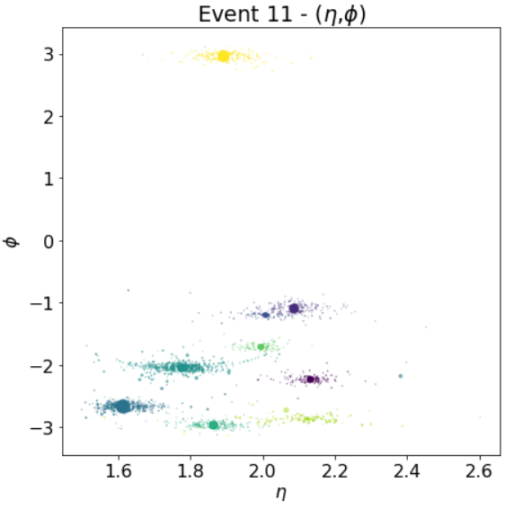
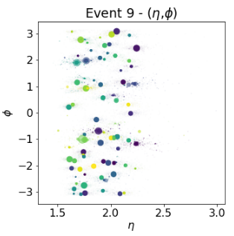
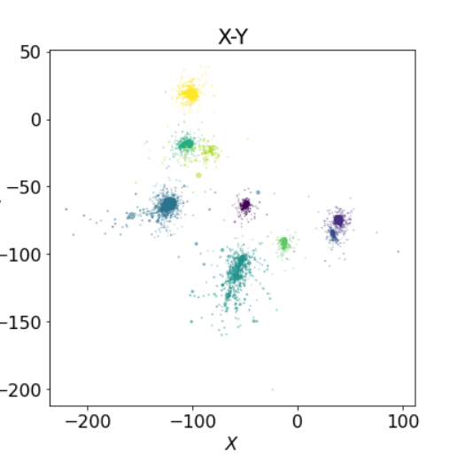
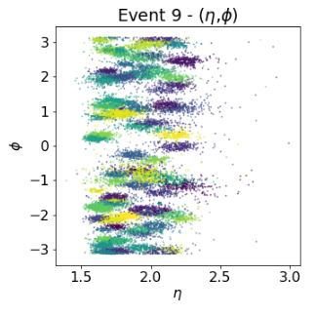
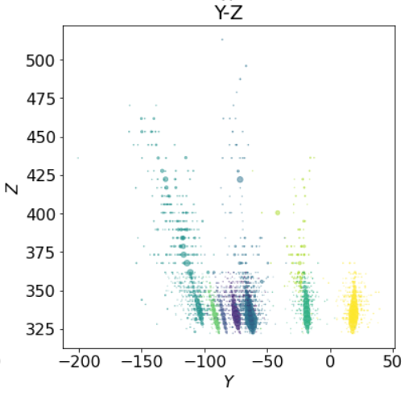
Future work
Warm start based on energy values:
First, fit using points with higher energy values
Then, fine tune using all points
Ensemble approach based on majority voting
Model 1
Model 2
Majority voting
clusters
*
*
*
Model n

