Slide 1
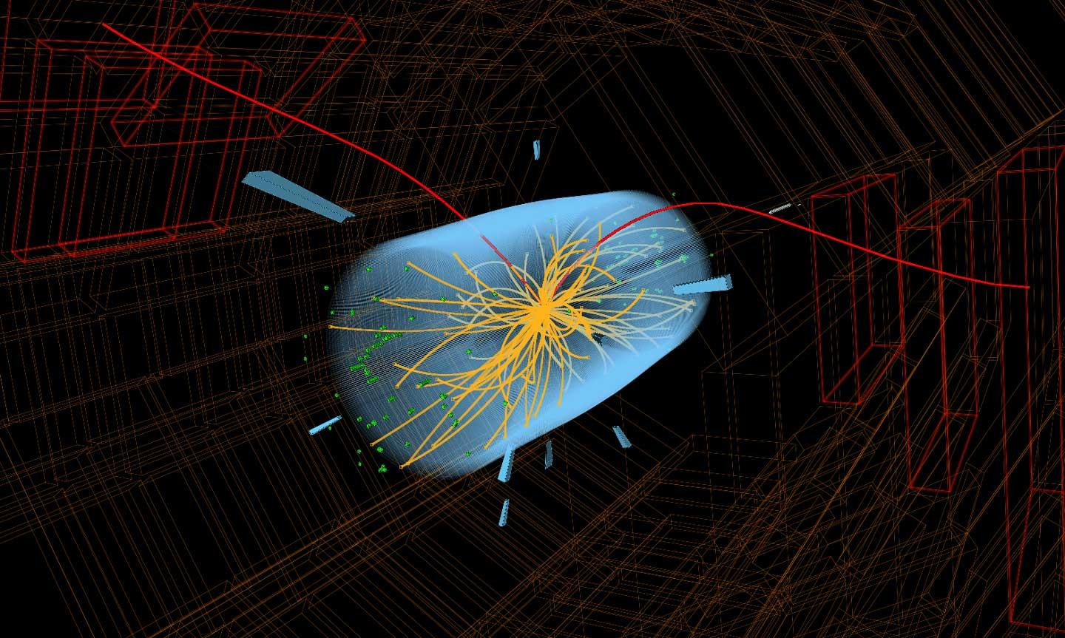
9th CERN Patatrack Hackathon @TU/e
CMS Particle Trajectory Reconstruction
Auditorium 14 Group

Slide 2
CMS DETECTOR
Layer=n
Layer=1

Slide 3
Motivation
Energy is important, but not as a dimension.
KMean : allows for weights.
HDBScan: better in multiple particle scenarios.
  density based
  does not require number of cluster
Results are comprehensible.

Slide 4
Determine the number of clusters in a layer
HBDScan
KMeans with elbow method
Layer=1

Slide 5
determine the number of clusters in a layer
cluster points on each layer
KMeans
Layer=1

Slide 6
determine the number of clusters in a layer
cluster points on each layer
Layer=1
determine the centroid of the clusters
KMeans

Slide 7
cluster the centroids according to particle
HBDScan
using euclidean distance to assign outliners to clusters
Layer=1...n

Slide 8
Trajectory Mapping:
Translate the centroid labelling to all the positions
Layer=n
Layer=1

Slide 9
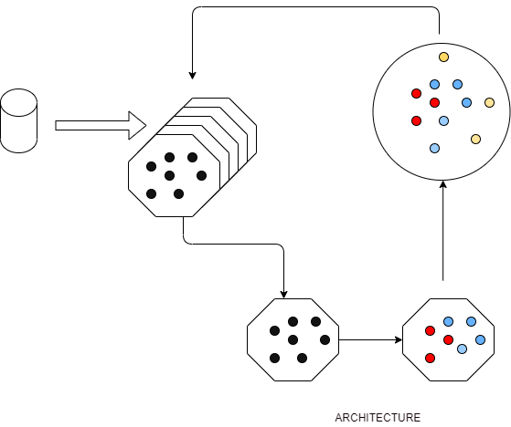
Weighted Unsupervised Parallelized Spatial Clustering (WUPSC)

Slide 10
Future Possible Improvements
Automatically select the appropriate methods(HDBScan/Elbow method) for choosing the number of clusters (k) instead manually
Including pos_z when doing layer level clustering, considering the discrepancy of the distances between the layers
Using grid search for the hyper parameter tuning
Using weighted(energy) HDBscan
Considering multiple particles contribution (energy fraction) to a layercluster

