Slide 1
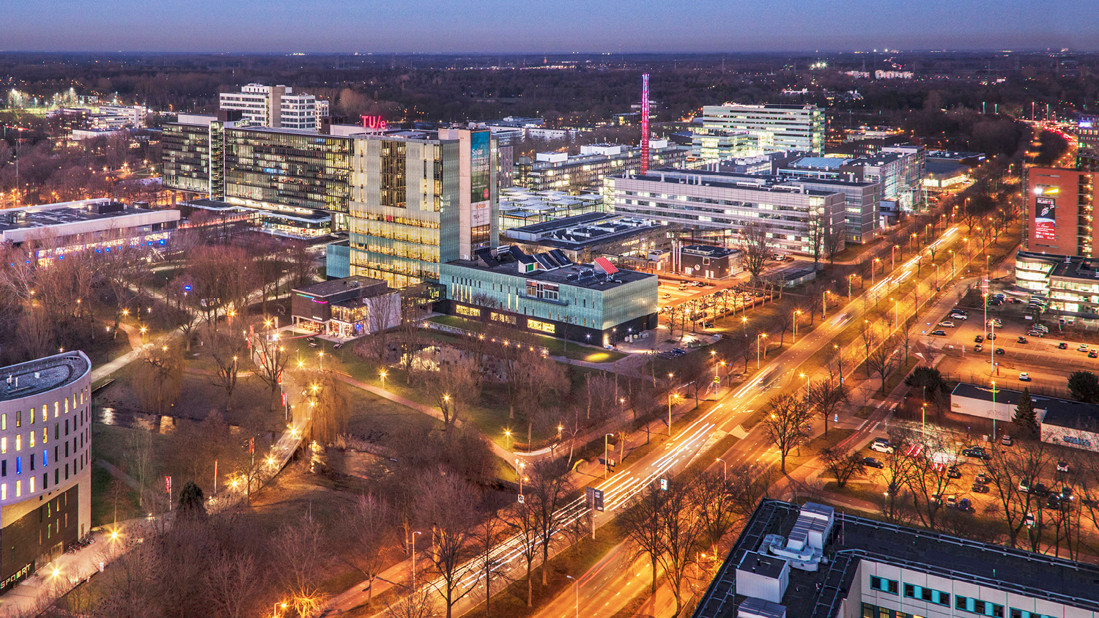
9th CERN Patatrack Hackathon @TUE
Group 3, 14 July 2021
Luis Roma Barge, Mees Willem Bieling, Ngoc Quan Pham
Department of Hacking

Slide 2
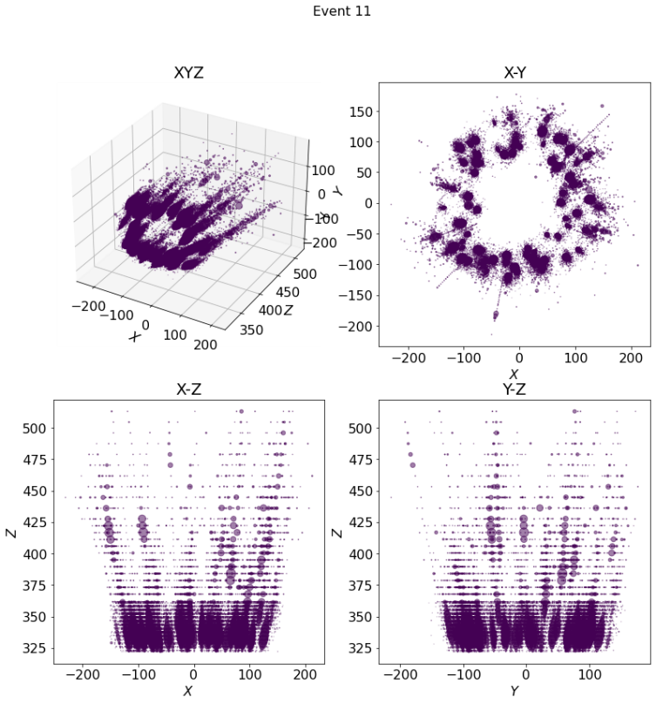
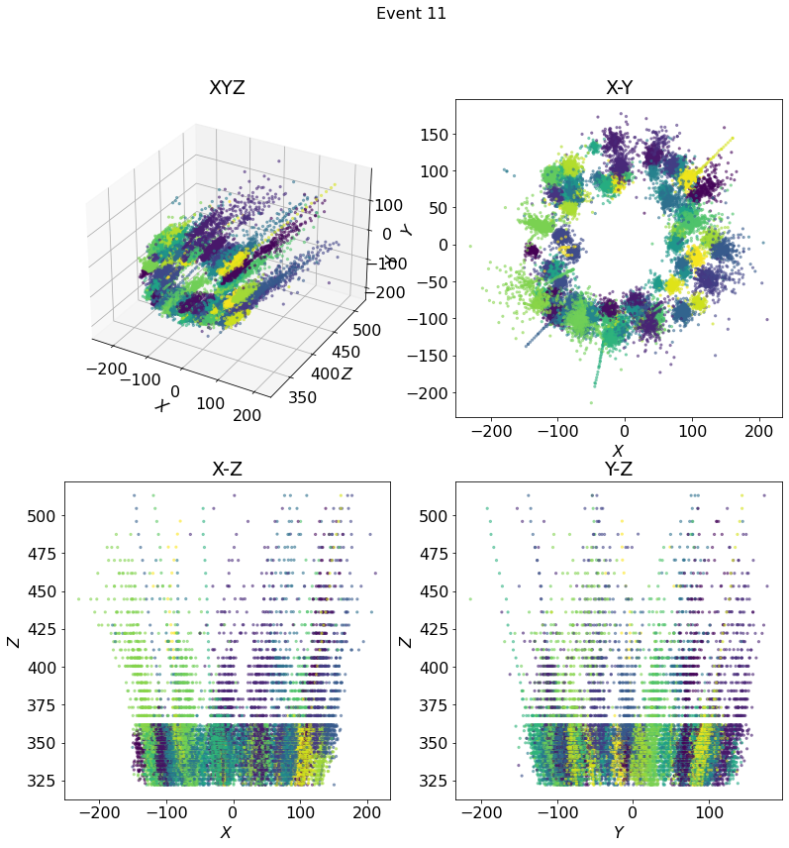
Goal
Identifying tracksters and the points belonging to them

Slide 3
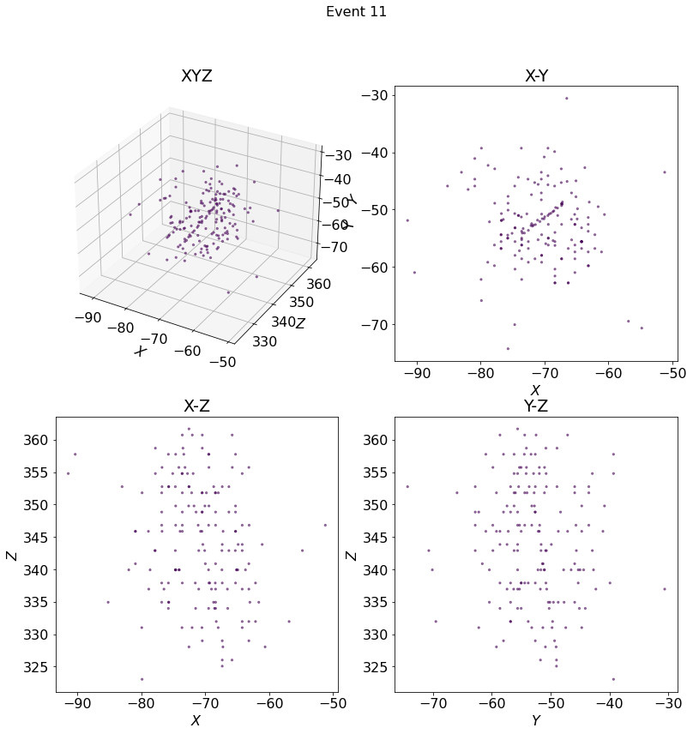
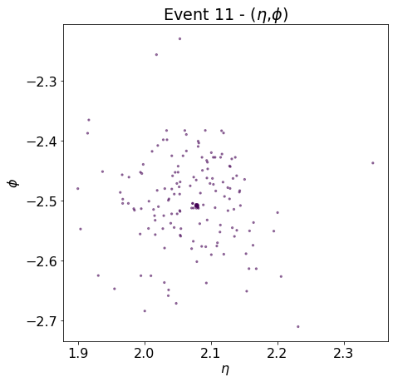
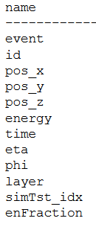
Datasets
Contains information about positions, energy, time, and layers
Intuitively, there are areas that are more densely populated
Some pattern intuition involving Z

Slide 4
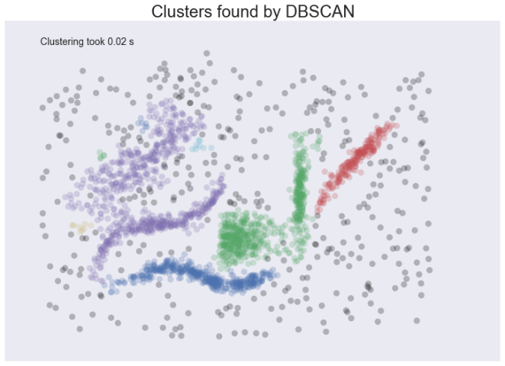
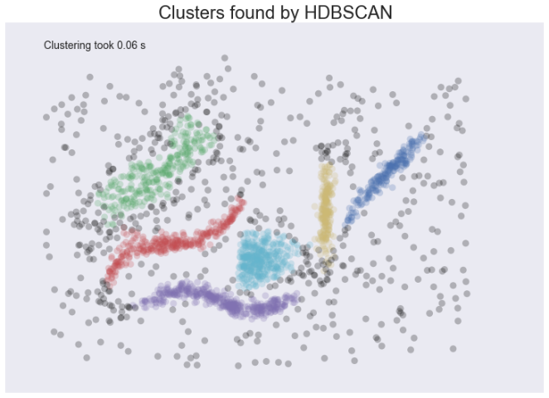

Main idea
Focusing on density-> DBSCAN algorithm
DBSCAN uses core samples to build the clusters around them -> More energetic points
HDBSCAN = DBSCAN + varying density clusters
Source

Slide 5

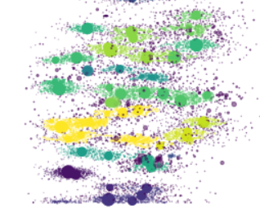
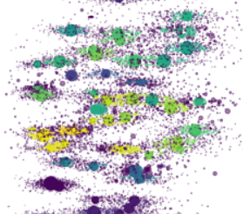


Findings
Clustered on density based on η and ɸ
You can fine-tune HDBSCAN with these parameters
  min_cluster_size and min_samples -> # to consider a cluster
  cluster_selection_epsilon -> minimum separation between clusters
ε=0.02
ε=0.002

Slide 6
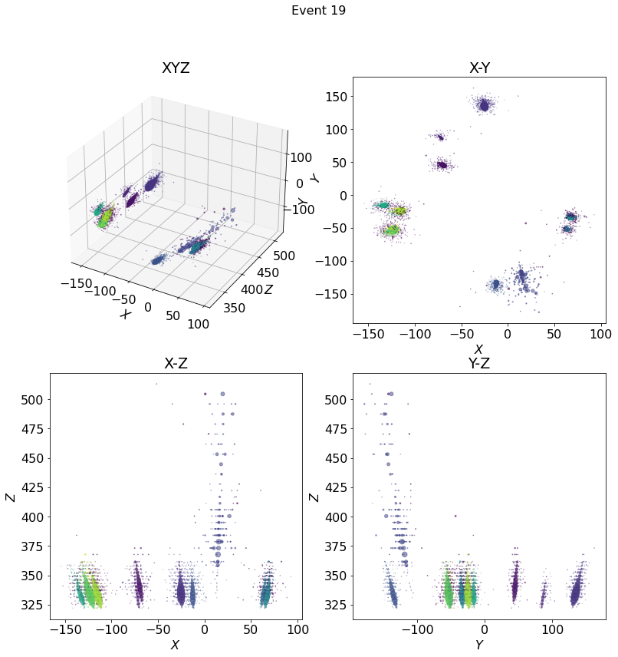
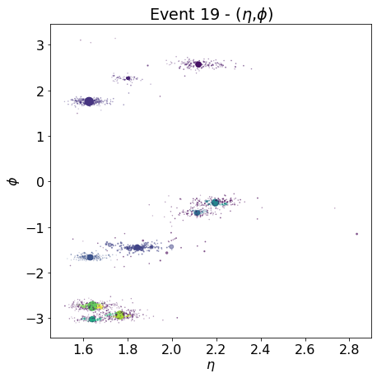
Results (I)

Slide 7
Classifying outliers
KDTree on the classified points
For the not classified:
    Find the nearest point in the classified tree
    Take the cluster from that point
    Assign that cluster to the unclassified point

Slide 8
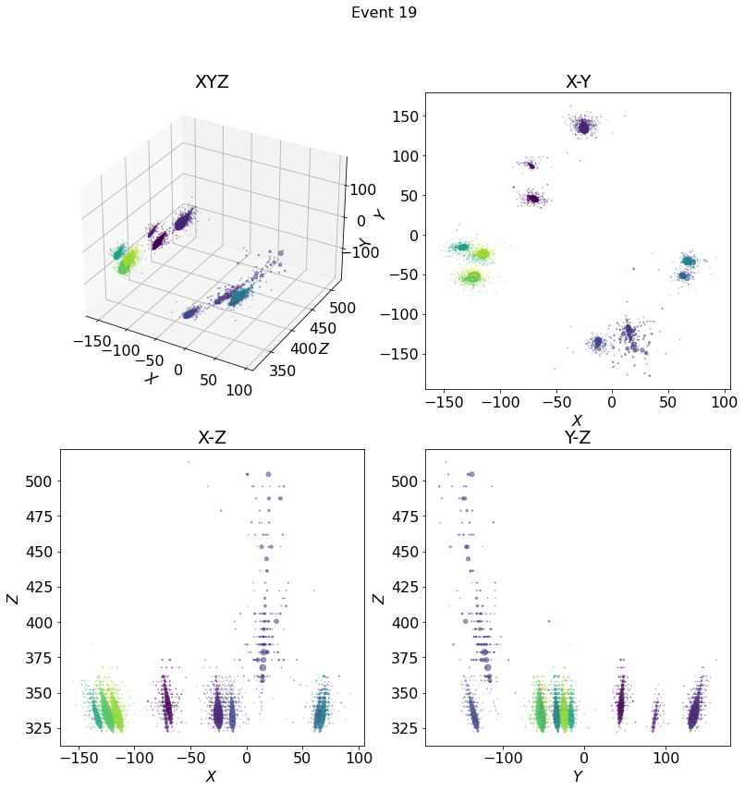
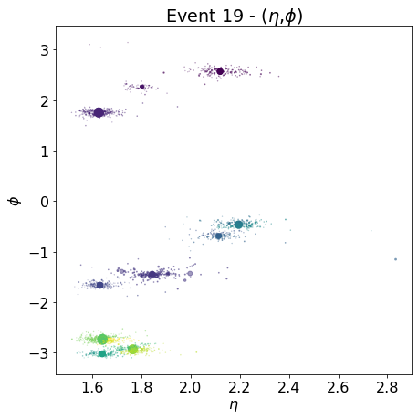
Results (II)

Slide 9
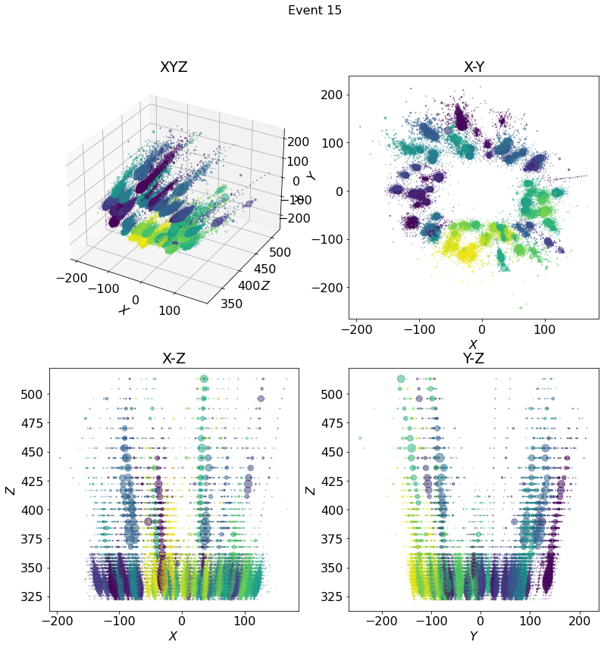
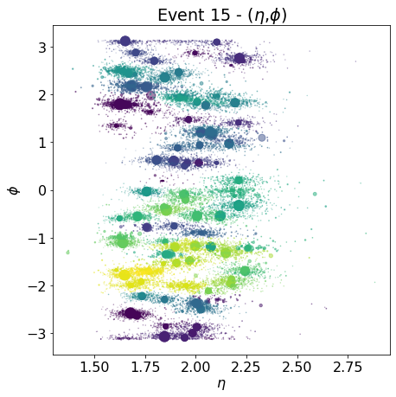

Results (II)

Slide 10
Future possible improvements
Best approach is raw clustering to get the number of clusters following with precise (density-based) clustering method such as:
Flatten the image in each clusters' angle and use a stricter cluster algorithm based on the energy density
Use HBDSCAN to create a tree based on energy density and pick the appropriate level contour that matches to expected energy of the particles
Create circles around points and expand until it includes n points, the radius of each circles corresponds whether it is a core point, boundary point or noise point (the outliers)
Extra: Use temporal dependencies to distinguish different particle showers for files with overlapping showers

