Slide 2




The 2021 BL4S playground

Slide 3
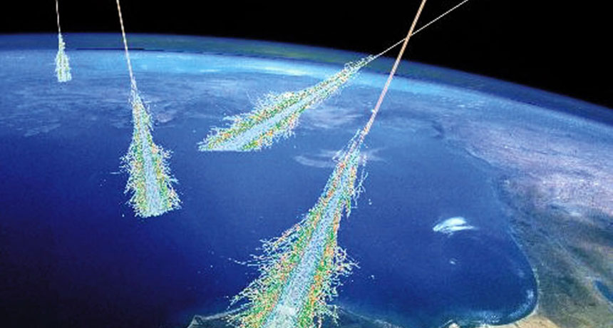
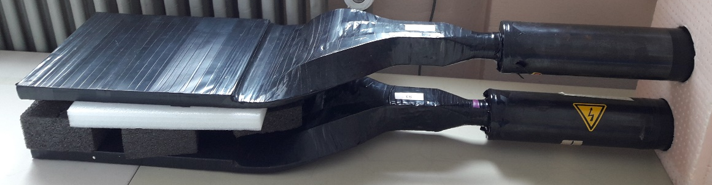
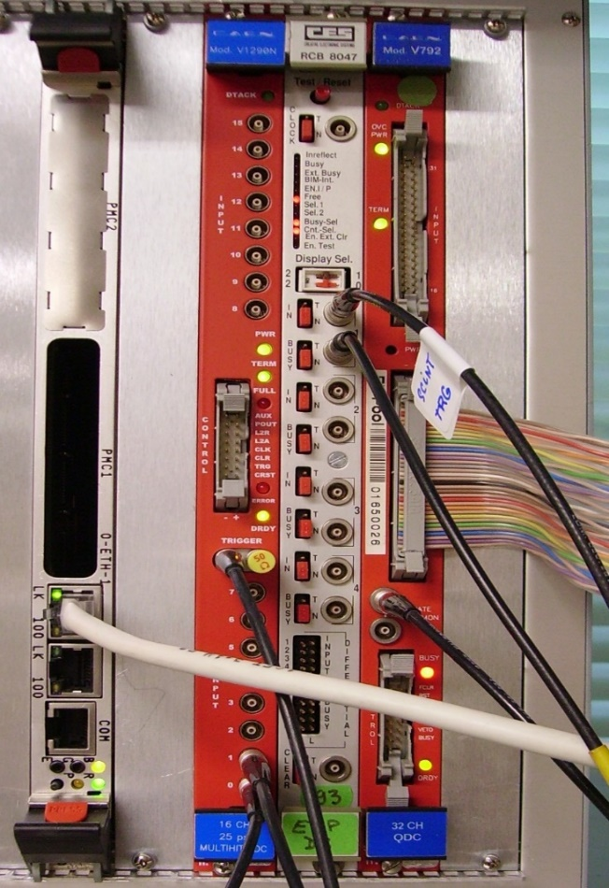
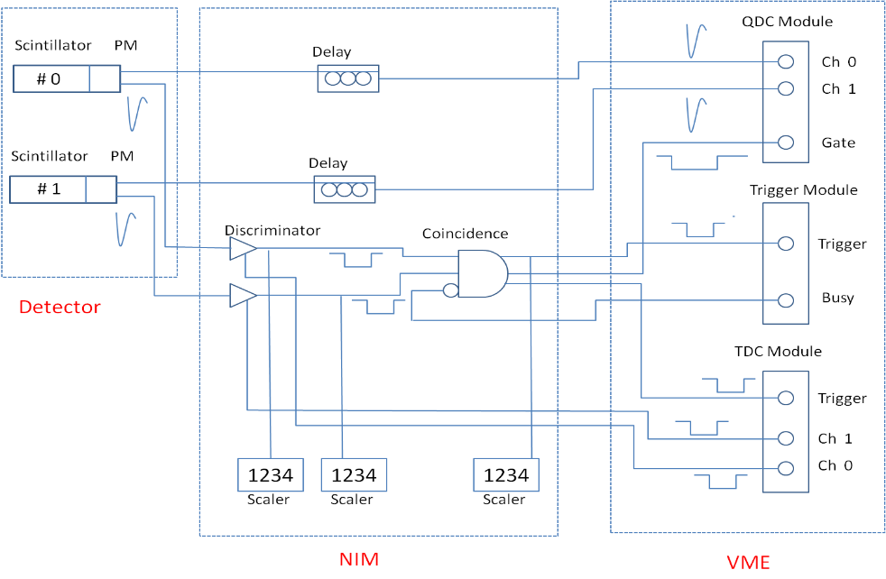
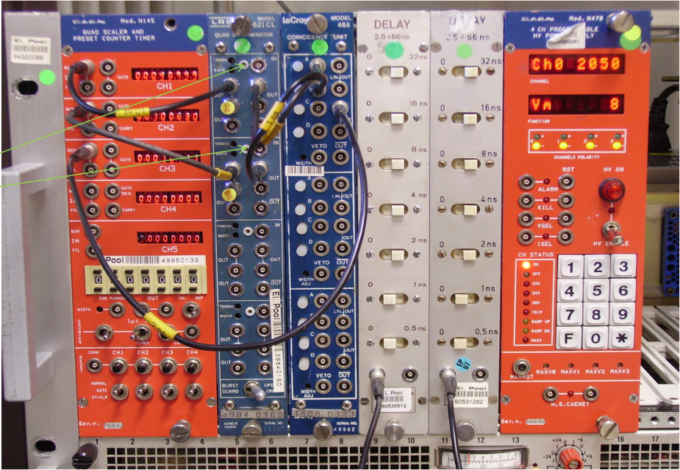
Seriously……..

Slide 4

What is it?
There is a set of detectors and electronics modules that is very similar to what we have in the control room
  But you can play with it (under my supervision)
  Learn how the components of a data acquisition system work
  Set up a trigger
  Detect cosmic muons
  Develop (if you have the energy) a simple data acquisition system yourselves
    This includes some C-programming and reading technical documents
  There is also a competition and you can win a prize

Slide 5
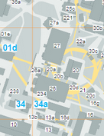
How is it organized?
Opening hours: By appointment
Maximum occupancy: 4 students
Location: Building 26
Your priorities:
Data taking shifts
Data analysis
Having fun (e.g. sight seeing in Hamburg)
Coming to the playground

