Slide 1
General information
G. Iadarola
ABP Computing Meeting – 11 Jun 2021

Slide 2
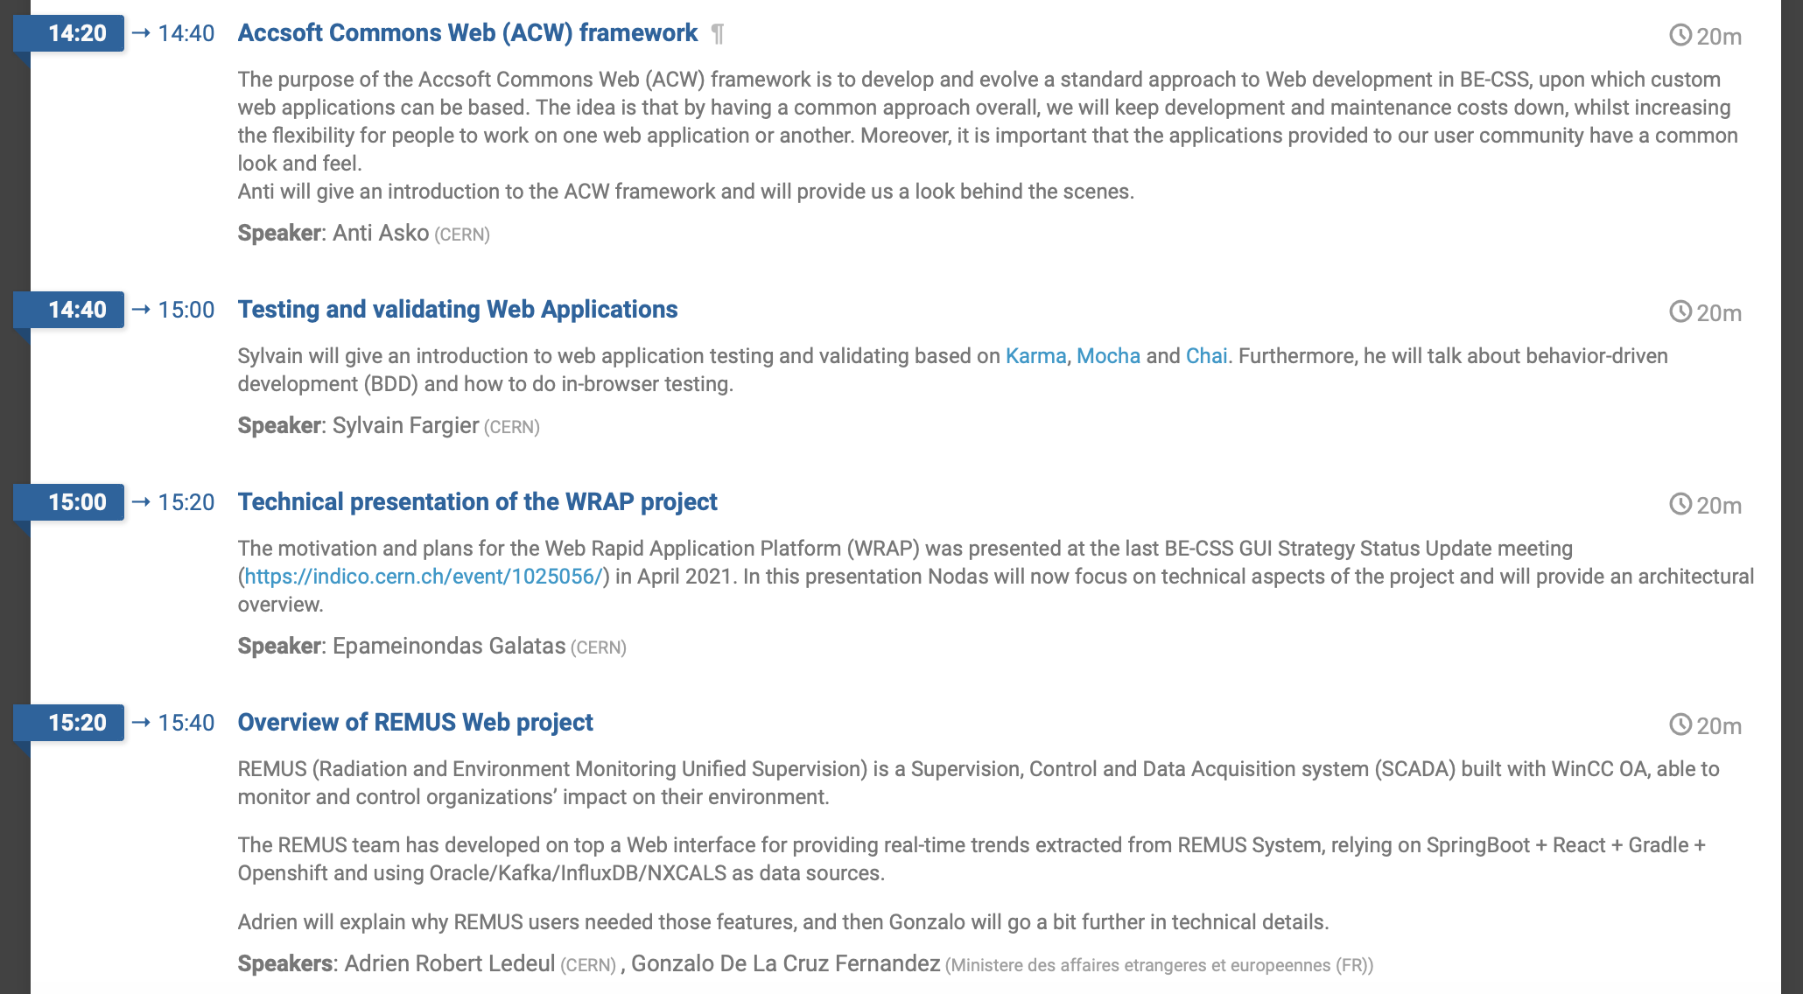
General information
A Web Development Technical Exchange meeting organized by BE-CSS will take place on Thursday, June 24
  You are welcome to participate in case of interest
  https://indico.cern.ch/event/1046226/
2

Slide 3
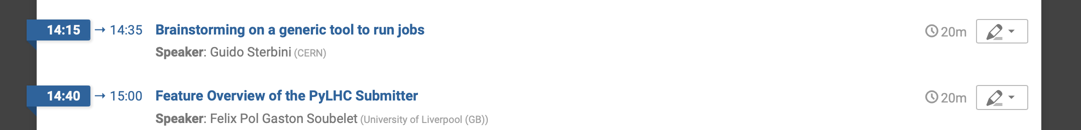
General information
The next computing meeting (18 June) will be devoted to tools for HTCondor submission and management.
“ABP Computing day” will take place towards the end of the year.
  Main goals:
    Discuss the progress on software development activities in ABP
    Present the strategy and objectives for 2022+
  Tentative date Thu 18 Nov 2021
  Agenda to be drafted early enough to allow for proper preparation
  Proposals on possible topics and contributions are very welcome
3

Slide 4
Thanks for your attention!

