Slide 1
Diversity & Inclusion Programme
Induction 2021
diversity-and-inclusion.web.cern.ch
Notes:
https://diversity-and-inclusion.web.cern.ch/

Slide 2

CERN Core Value
Diversity & Inclusion at
CERN is based on the three principles of :
appreciating differences, fostering equality,
promoting collaboration
CERN's Diversity value

Slide 3
Diversity = No.1 most appreciated workplace attribute
Mission/ Scientific Contribution
Pride
Benefits and
Remuneration
Diversity
Diversity | 256
Mission/Scientific Contribution | 251
Other | 187
Colleagues and Collaboration | 132
The work itself | 131
Work environment | 83
Challenges | 78
Technologies | 63
Benefits and Remuneration | 57
Pride | 32
Technologies
Other
Challenges
Colleagues
The work
itself
CERN Staff Survey 2019

Slide 4
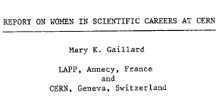

1983
1992
1996
Creation of an Equal Opportunity Office
First E.O and non discrimination statement published
History of
D&I at CERN
2010
Introduction of Code of Conduct
Creation of the Ombuds role
Professionalization of the Harassment resolution process
Diversity Office and Policy created
2012
2019
Diversity & Inclusion Programme

Slide 5
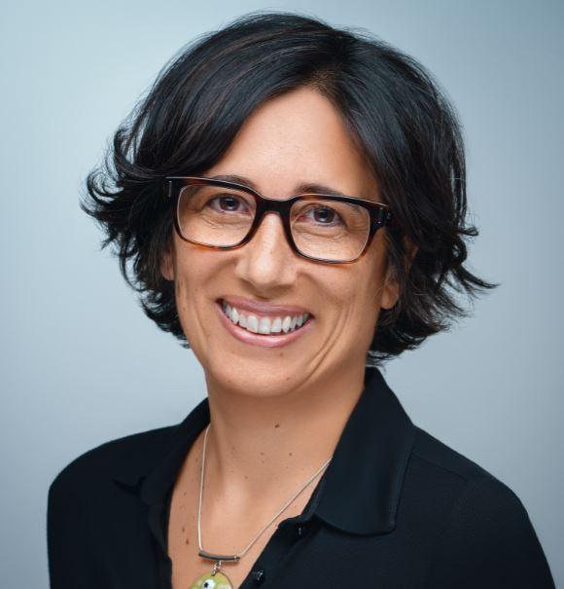
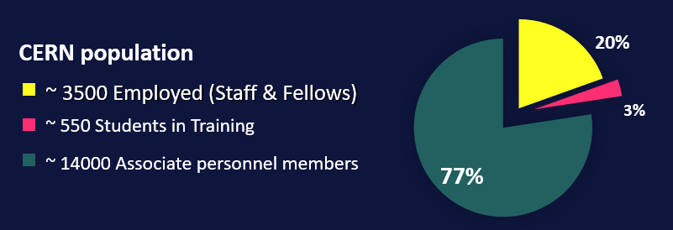
The D&I Team
Under
Recruitment
Louise Carvalho
D&I Programme Leader (50%)
Legal Adviser (50%)
D&I Analyst (100%)

Slide 6
The Diversity & Inclusion Programme aims to
enable, inspire and motivate our diverse personnel to create an inclusive and collaborative work culture.

Slide 7
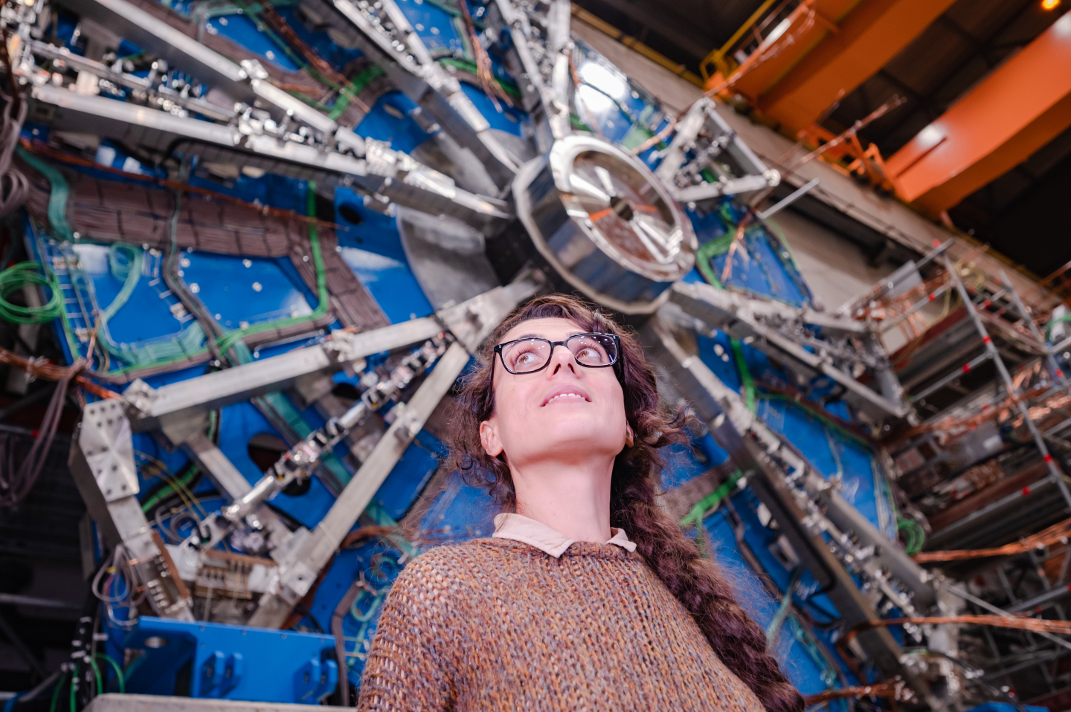
The Diversity & Inclusion Programme
25 by ’25
Diversity Roundtable
Inclusive workplace
Spouse / Partner support
Notes:
We have an advisory role within the Organization

Slide 8
Trends & Challenges
« Paternity leave at CERN is much too short in this era »
« Women don’t even like STEM jobs! »
« If I file a complaint, my career is over »
« My co-workers see neurodiversity
as a disability.
But it’s an asset! »
« CERN should keep stats on race »
« I lie about my sexual orientation
just to fit in »
« I identify as non-binary. There are no WC or shower facilities here
for me »
« CERN is doing very well as it is. Why change? »
« Thank you for selecting me, but my husband won’t move here without a job »

Slide 9



“We commit to
placing the principles of
equality, diversity & inclusion
at the heart of all the
physics community’s
activities.”
- ESPP 2020 update
OUR VISION
scientific excellence through diversity and inclusion
OUR GOAL
to increase the nationality and gender diversity
of Staff & Fellows (MPE) population by 2025
The STRATEGY
GENDER target
NATIONALITY indicator
(aspirational)
Leadership-led
Leverage existing progress: gender balance increased in Senior Management
25% as an average across MPE population (not per Department)
Diversity & inclusion in recruitment (and talent pipelines), promotion, training, communications
Sustainable actions toward long-term gender parity
(not a cap, not a quota)
GOAL:
With a particular focus on women in STEM:
GOAL:
With a particular focus on under-represented MS and a more balanced return by 2025:
from 21%
in 2020
address nationality clusters
> 25%
25% in 2025
and increase our conscious efforts toward nationality diversity in recruitment & retention

Slide 10
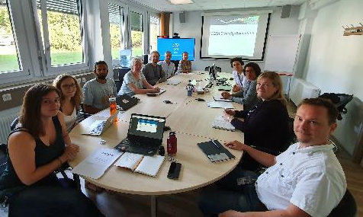

The Diversity Roundtable
Diversity Roundtable Recommendations “wholeheartedly” approved by the
DG 2020
Making CERN’s Science Gateway accessible and inclusive.
Gender-inclusive language for Staff Rules and Regulations.
Extension of Fellow’s employment contract following maternity leave.
ATLAS, ALICE, CMS, LHCb
LGBTQ Network
Women in Technology Network
Disability Network
TH Diversity & gender representative
International Relations taskforce
Staff Association
Chaired by D&I Programme
Notes:
Barriers: D&I Reporting, bring the activists to the table

Slide 11

Disability inclusion
Inclusion
Short-term internship for STEM students with disabilities
“This was an excellent experience. We have benefited not only from a smart and very productive student but also from integrating a co-worker with special needs into the team. It was a good change for the team (even though they might not have noticed) and definitely a good challenge for me.”
- Supervisor, Experimental Physics

Slide 12


Visible, tangible change
NEW official CERN lanyard
Moving, vibrant, merging particles reflecting diversity & inclusion at CERN
Available in building 55.

Slide 13
Spouse / partner support
Partner
support
Spouse Welcome brochure
*Staff, Fellows, Administrative, Technical and Doctoral students
International Dual Career Network (IDCN)
https://diversity-and-inclusion.web.cern.ch/spousesupport

Slide 14



What you can expect from IDCN
Partner
support
An ally in your professional Swiss journey.
Help decoding Swiss job market and culture.
Enhance your visibility to top employers in the region.
To be in contact with other spouses in your same situation.
Opportunity to volunteer.
Find a job for you.
Do networking for you.
Website: www.idcn.info
LinkedIn: IDCN Lake Geneva Region

Slide 15
Anti-Harassment Support Structures
Anti-Harassment
Handling your concern in full confidentiality | Contact Information Building-floor-office location | Listening | Mediation | Advice &/or Guidance | Receipt of formal complaint; Investigation; Disciplinary action
Ombud’s Office | ombuds@cern.ch 500-1-04 |  |  | 
Social Affairs Service | social.affairs@cern.ch 33-1-38 |  |  | 
Medical Service | medical.service@cern.ch 57-1 |  |  | 
HR Adviser (Staff) or HR Coordinator (Fellows, Trainees, Students) | cern.ch/hr/hr-key-contacts 5-1 & 5-2 |  |  | 
Staff Association | staff.association@cern.ch 64-R-010 |  |  | 
Your Department Head, or Head, Human Resources | (name)@cern.ch, or hr-dept.head@cern.ch |  |  |  | 
Harassment Investigation Panel (HIP) | HIP Chairperson HIP.Chair@cern.ch |  |  |  | 
All members of personnel (incl. Users)
Staff, Fellows, Trainees,
Students*
*Students: TECH, ADMIN, DOCT, Short-Term
Internship programmes coordinated by CERN HR

Slide 16
Additional Resources
Ombuds Office
HR Key Contacts
Anti-Harassment Policy
Social Affairs Service
Medical Service
Psychologist
LGBTQ CERN
Disability Network
Staff Association
D&I Newsletter
Mission/ Scientific Contribution
Pride
Benefits and Remuneration
Diversity
Tech- nologies
Other
Challenges
Colleagues
The work itself

Slide 17
Thank you!

