Slide 1
The CERN Scientific Program
A tour around the laboratory
CERN is the largest laboratory in the world for particle physics
CERN has the world’s highest energy accelerator (the LHC)
CERN has a very broad scientific program
Experimental Physics Department (EP)
Manfred Krammer

Slide 2
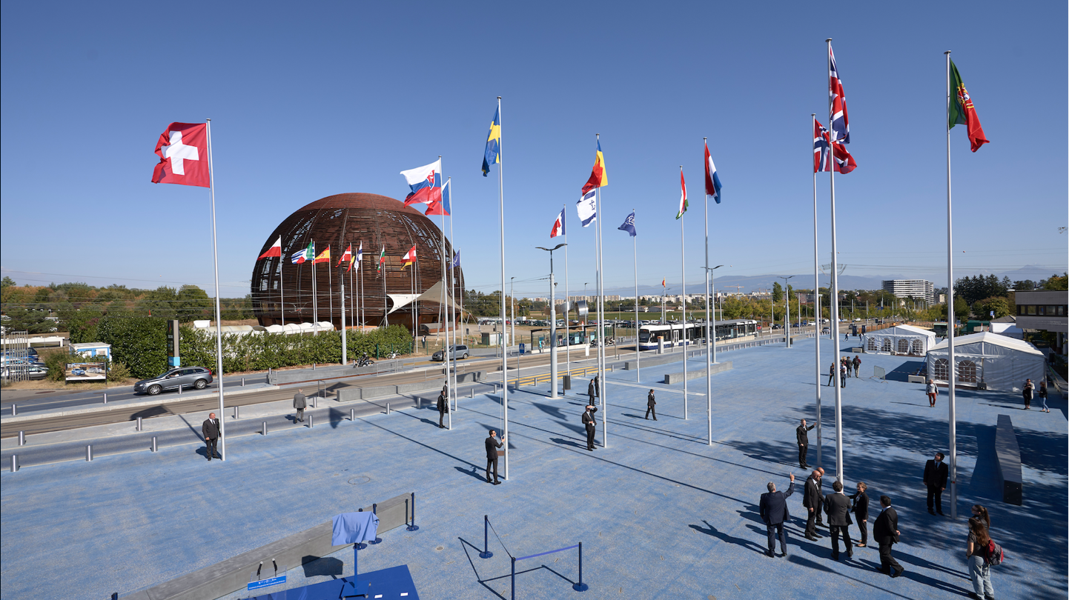
CERN was founded 1954: 12 European States
“Science for Peace”
Today: 23 Member States
~ 2600 staff
~ 1800 other paid personnel
~ 12500 scientific users
Member States: Austria, Belgium, Bulgaria, the Czech Republic, Denmark, Finland, France, Germany, Greece, Hungary, Israel, Italy, the Netherlands, Norway, Poland, Portugal, Romania, Serbia, Slovakia, Spain, Sweden, Switzerland and the United Kingdom
Associate Member: Croatia, Cyprus, Estonia, India, Latvia, Lithuania, Pakistan, Slovenia, Turkey, Ukraine
Observers to Council: Japan, Russia, United States of America; JINR, European Commission and UNESCO

Slide 3
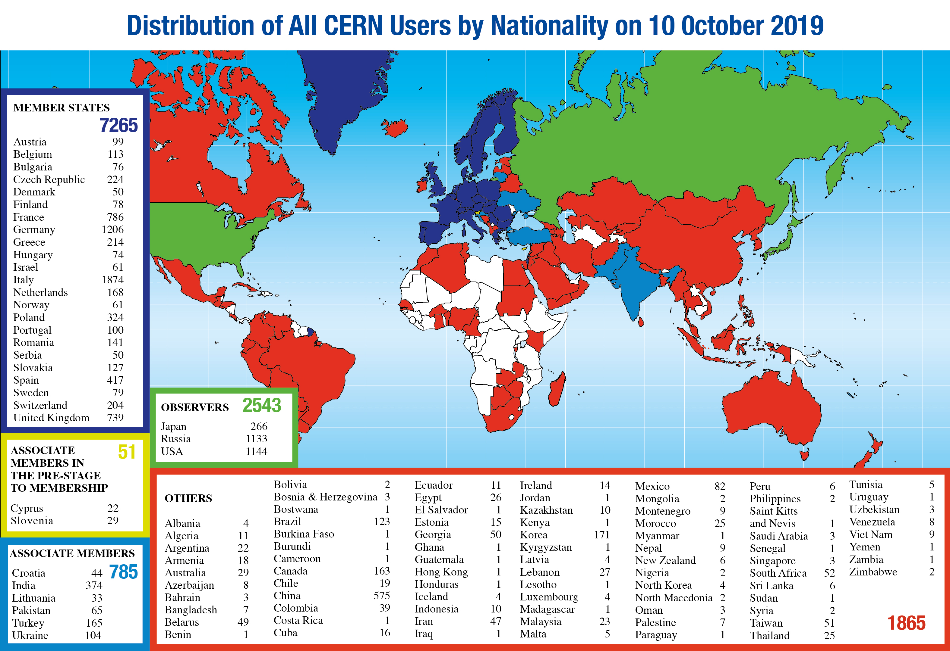
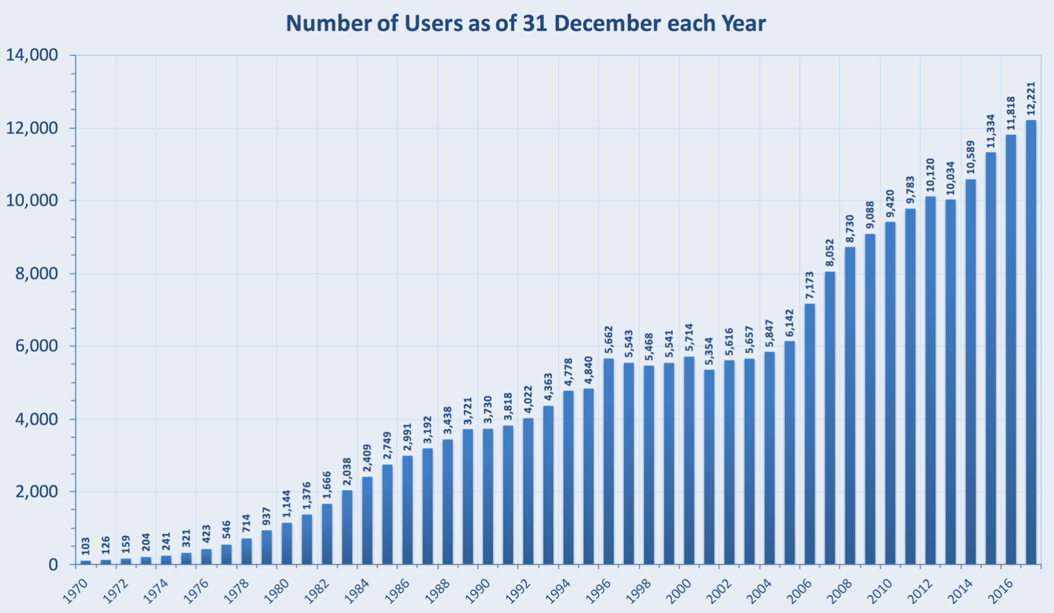
CERN attracts scientists from all over the world
~ 12.500 Users with 116 nationalities

Slide 4
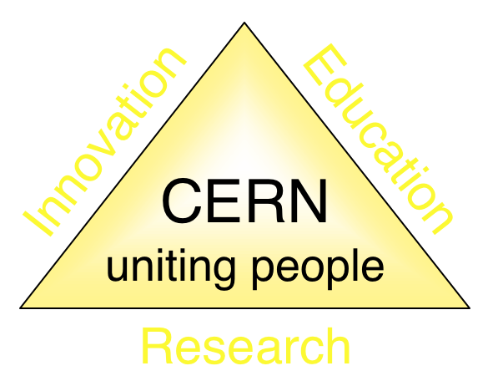
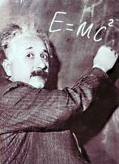
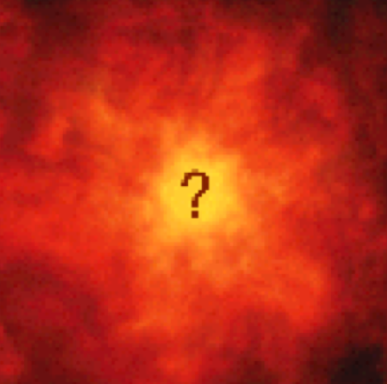


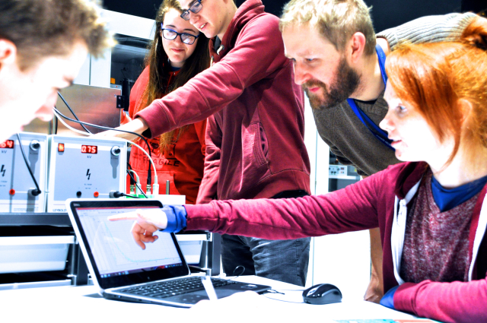
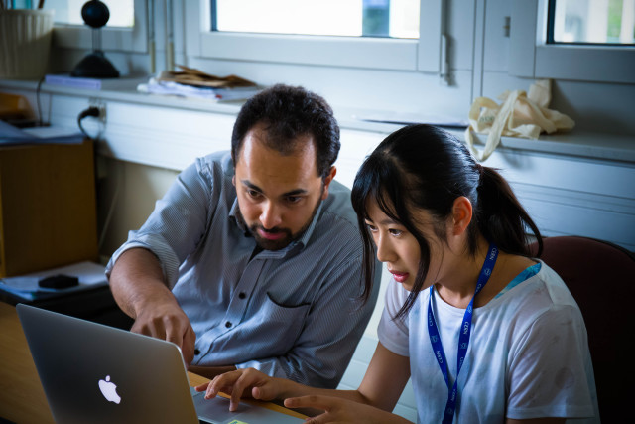
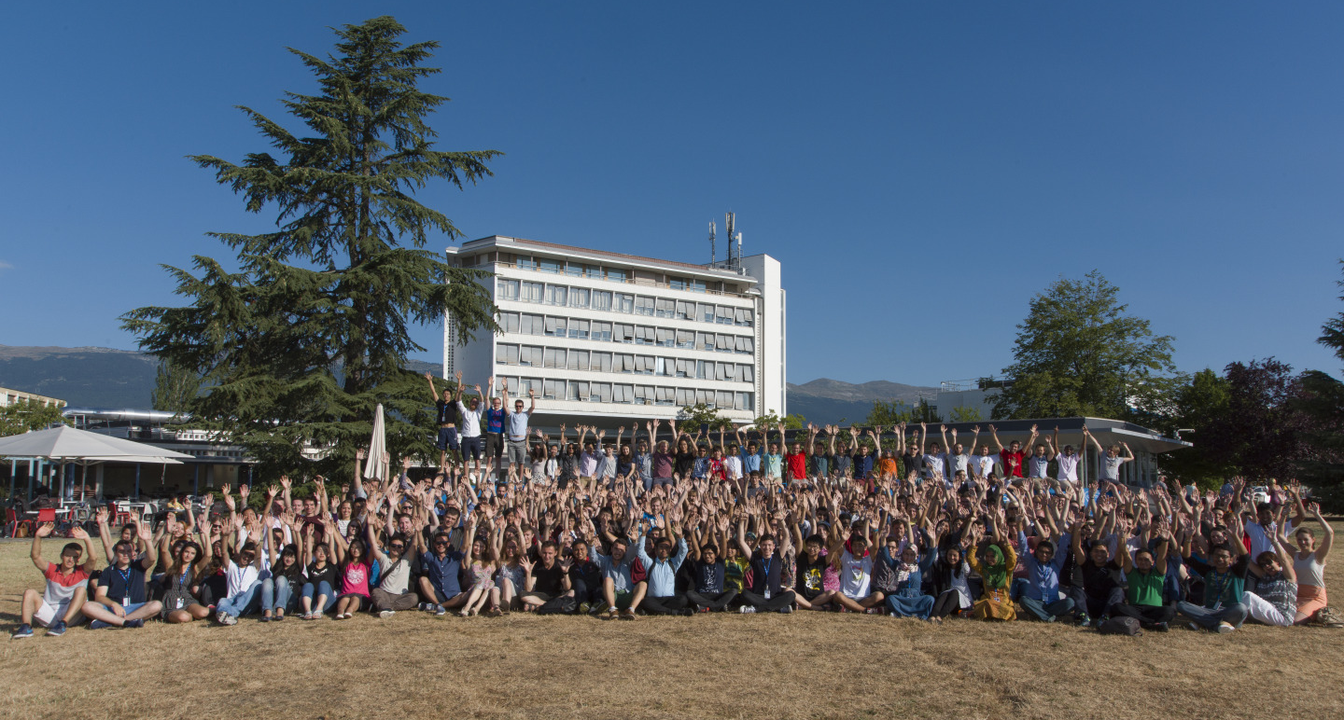
The mission of CERN
Push back the frontiers of knowledge
Studying the structure of matter on the smallest distances/highest energies… what was the matter like in the first moments of the Universe’s existence?
Develop new technologies for accelerators and detectors
Benefits for society: e.g. accelerator technology, detectors for medicine, the WWW and the GRID
Train scientists and engineers of tomorrow
Unite people from different countries
and cultures
Notes:
4

Slide 5
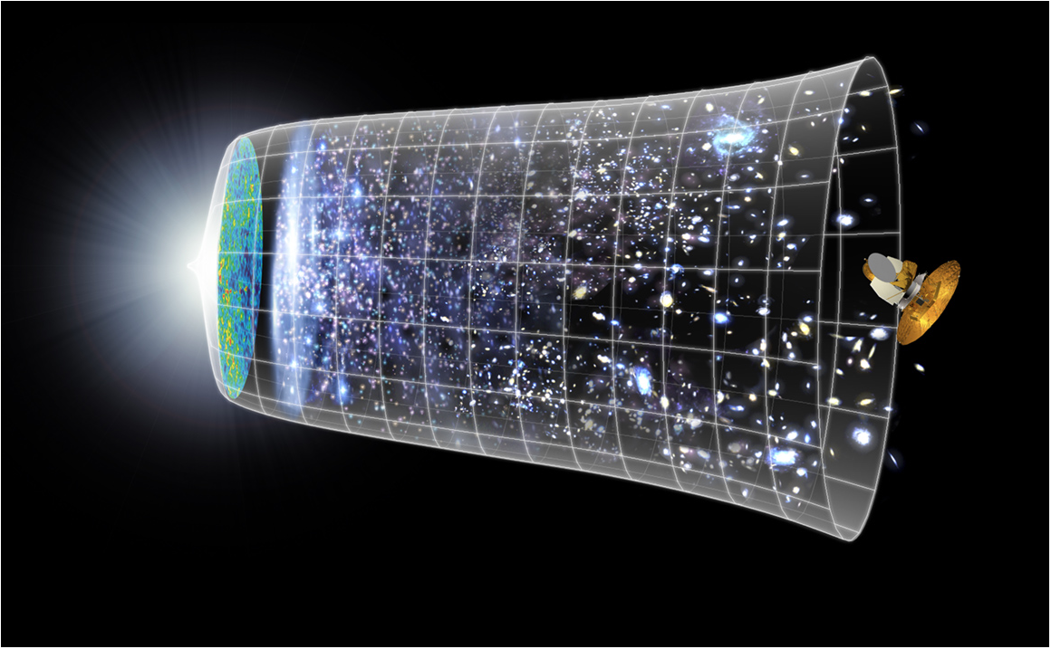
Physics at CERN:
Understanding the Universe
Big Bang
13.7 billion years
Today
10²⁸ cm
380,000 years
Atoms are generated and the universe becomes transparent
Germany and CERN | May 2009

Slide 6
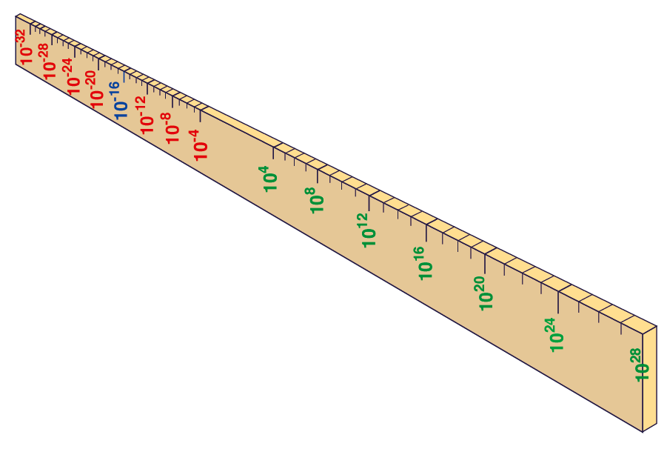
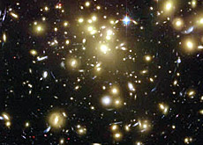


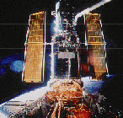

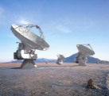

From the smallest to the largest Structures
Big Bang
Proton
Atom
Radius of Earth
Earth to Sun
LHC
Radius of Galaxies
Universe
Accelerators act as super-microscopes
cm
Study laws of physics at first moments after Big Bang
Increasing symbiosis between Particle Physics,
Astrophysics and Cosmology
Hubble
WMAP
ALMA
Germany and CERN | May 2009
VLT
Notes:
6
60 Grössenordnungen

Slide 7
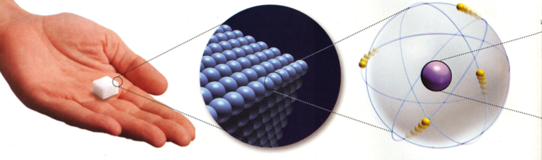
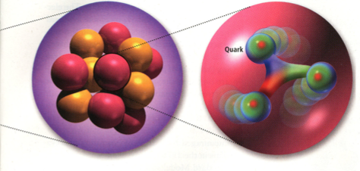
Composition of Matter
All matter built from Atoms
Atoms consist of a Nucleus and Electrons
The Nucleus consist of Neutrons and Protons
Neutrons and Protons consist of Up and Down Quarks
Fundamental Matter Particles: Electrons, Up Quarks, Down Quarks

Slide 8

The Standard Model of Particle Physics
Fermions (spin ½) quarks and leptons: the building blocks of matter
Bosons (integer spin) carry the forces: electromagnetic (Photon), weak force (W, Z) and strong force (Gluons)
Higgs Boson (spin 0), gives mass to particles
Sufficient to explain the matter around us
Plus antimatter partners of each particle.

Slide 9
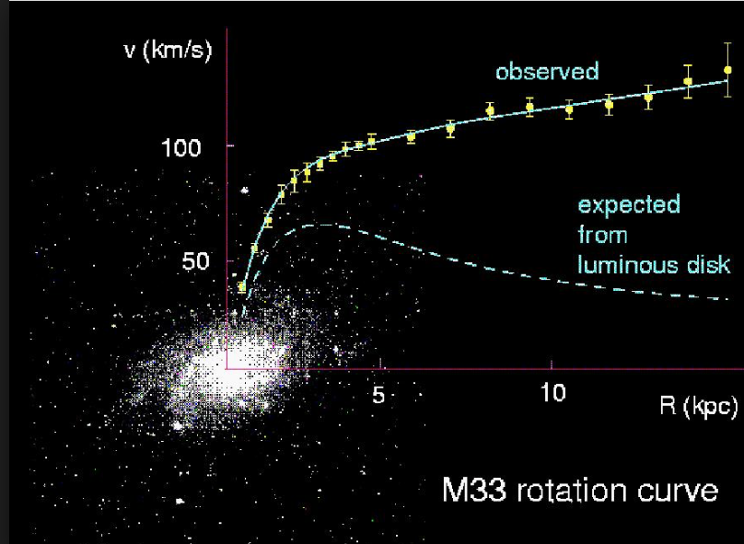
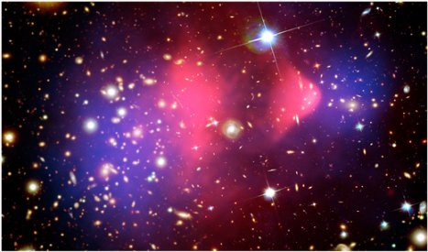
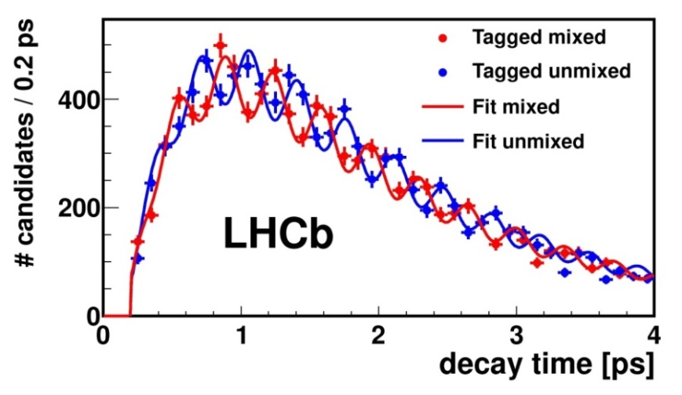
What is missing?
Several observations and mysteries point to the fact that the Standard Model is not the final theory:
Dark matter (as “seen” in Astrophysics) not explained: need new particles? 5x more dark matter than “standard” matter.
Matter Antimatter asymmetry: Why is the Universe made of matter, when matter and antimatter would be equally produced in the Big Bang?
Mass of the neutrinos not explained by the SM: 3 different “flavour” of neutrinos – changing flavour, hence have to have mass.
…
And finally, inclusion of Gravity in the final theory.
Still a lot to explore, to measure and to collect Nobel prizes!

Slide 10
Research in Particle Physics needs:
Theories
Accelerators - Engineering
Experiments - Computing
People
People
People
People

Slide 11
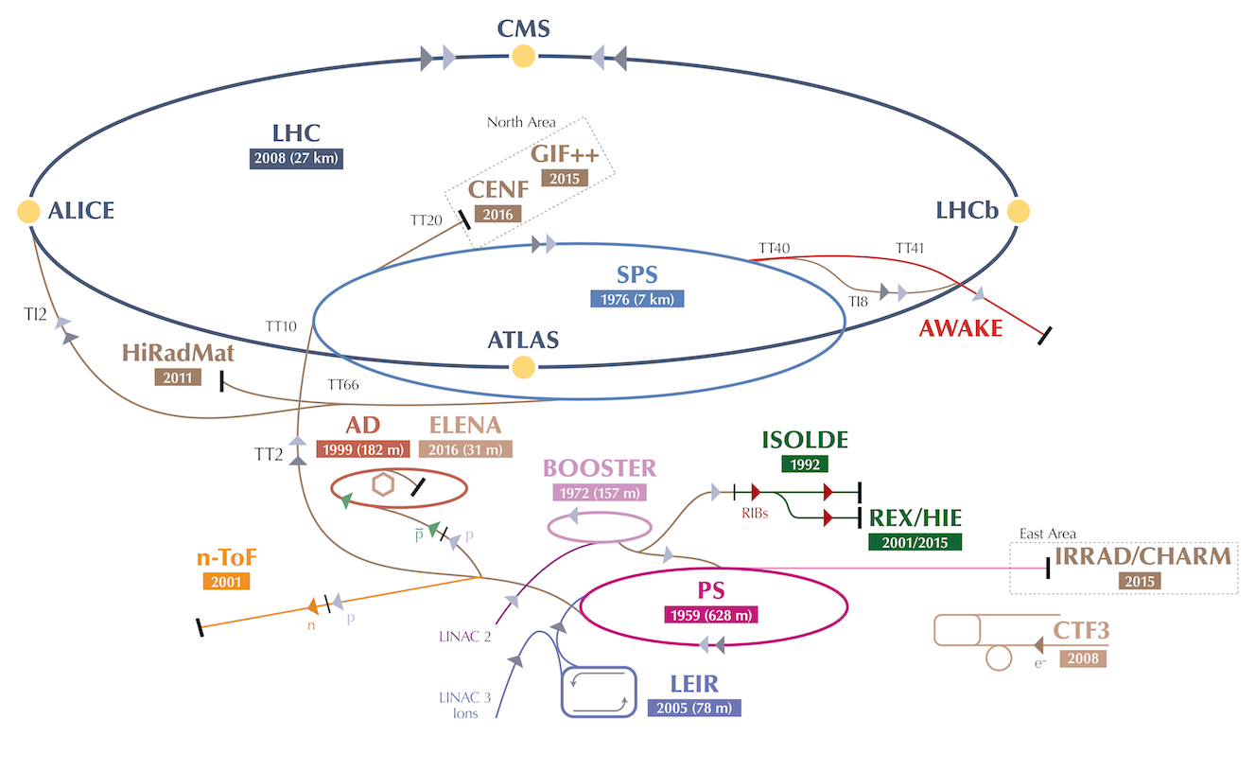
CERN Accelerators

Slide 12

The Large Hadron Collider
Search for the Higgs Boson, study Standard Model particles and search for physics beyond the Standard Model
Exploration of a new energy frontier in p-p and Pb-Pb collisions

Slide 13
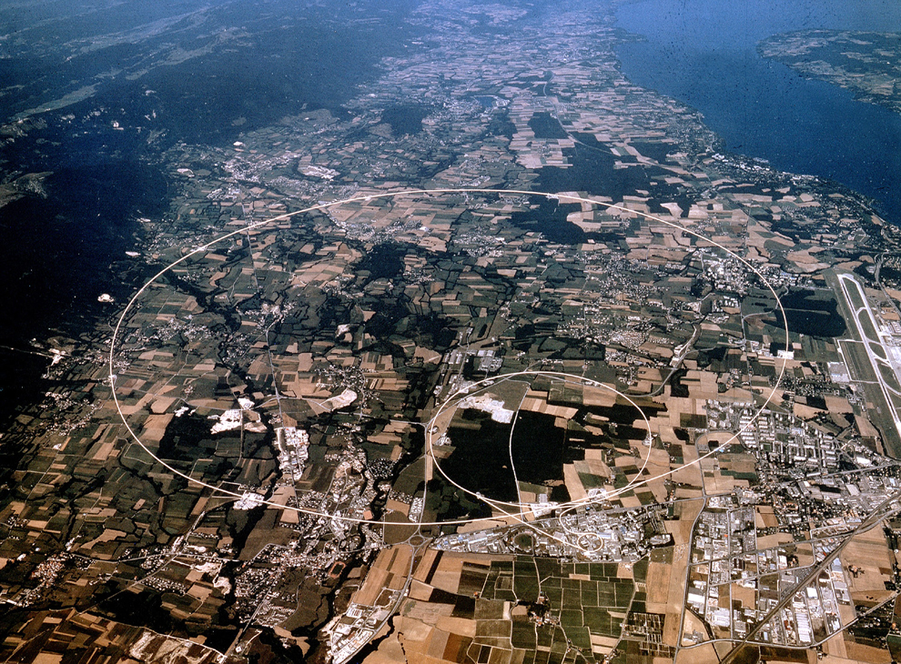
Experiments at the LHC
CMS
LHCb
ALICE
ATLAS
New! Approved in March 2021
+ TOTEM, LHCf, MoEDAL, FASER, SND@LHC
SND@LHC

Slide 14
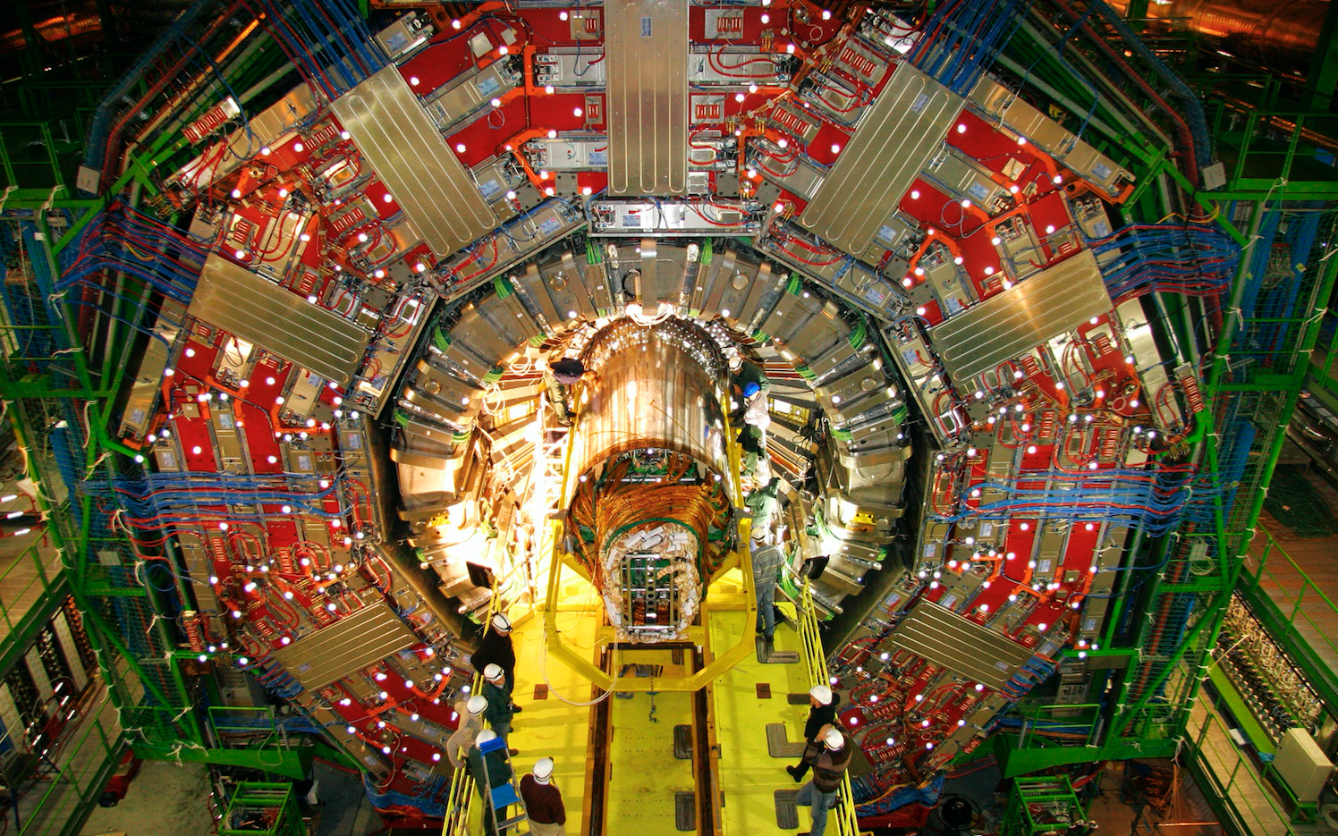

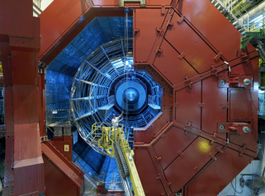
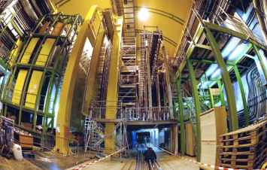
Experiments at the LHC
Four major experiments
CMS
ATLAS
ALICE
Dedicated to heavy ion physics
~ 1 month/year
Pb-Pb collisions
LHCb
Dedicated to flavour physics (b and c quarks)
Notes:
14

Slide 15
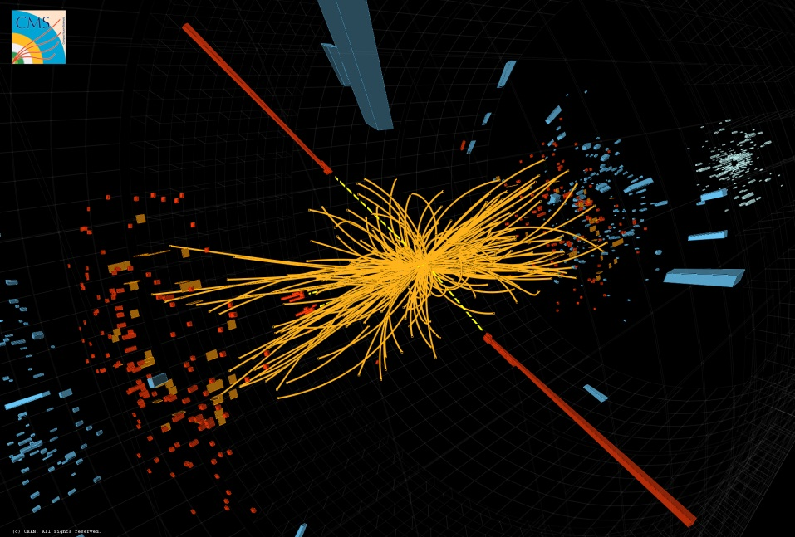
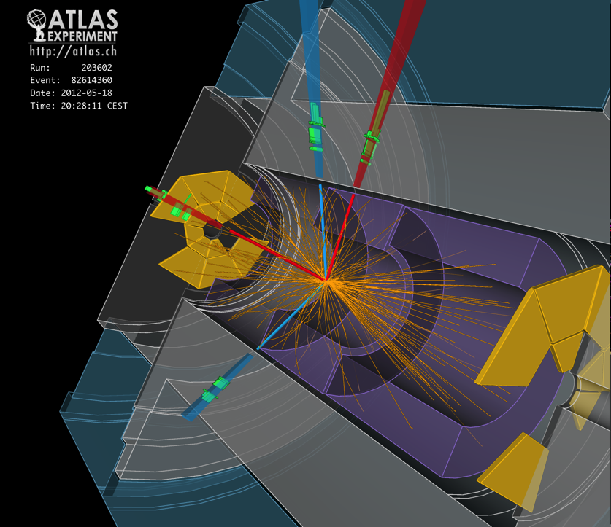
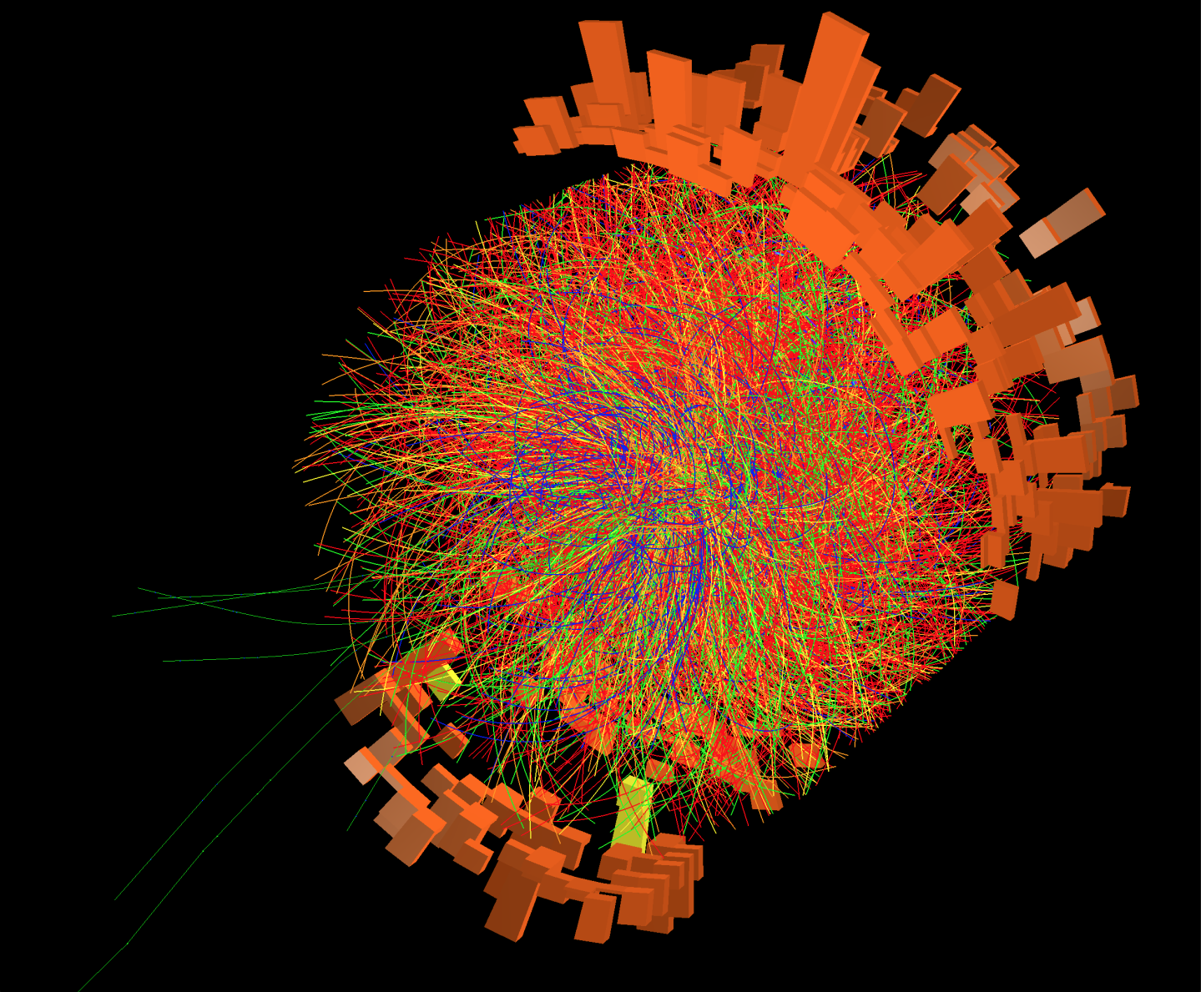
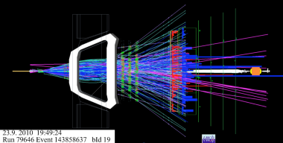


Experiments at the LHC
Brilliant performance of the LHC, the experiments and the Grid computing: Run1 2011-2012: E_{cm} = 7– 8 TeV Run2 2015-2018: E_{cm} = 13 TeV
Preparing for Run3 2022-2024: E_{cm} = 13 -14 TeV (to be determined)
LHC operation approved until 2037
CMS
ATLAS
ALICE
LHCb

Slide 16

H ➔γγ
candidate

Slide 17
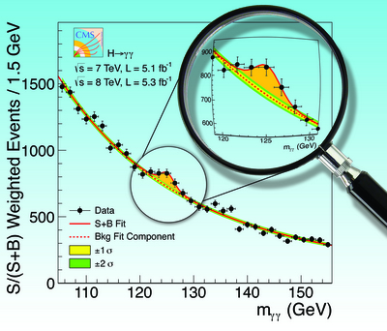
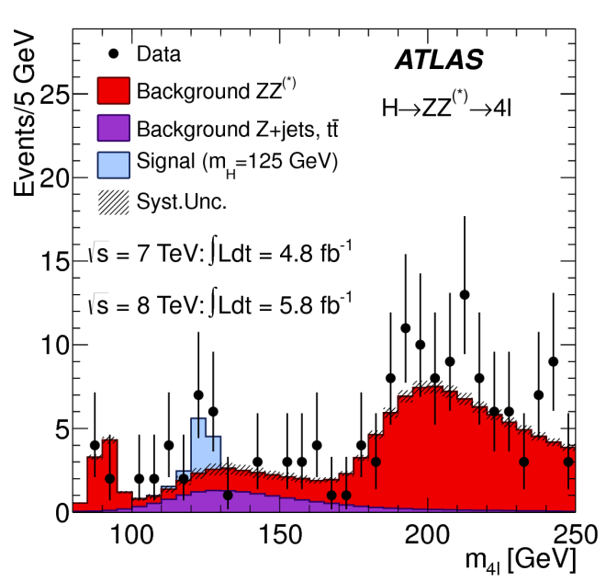

July 2012: “ATLAS and CMS observe a new particle compatible with the Higgs Boson”

Slide 18
CERN is not only the LHC !

Slide 19
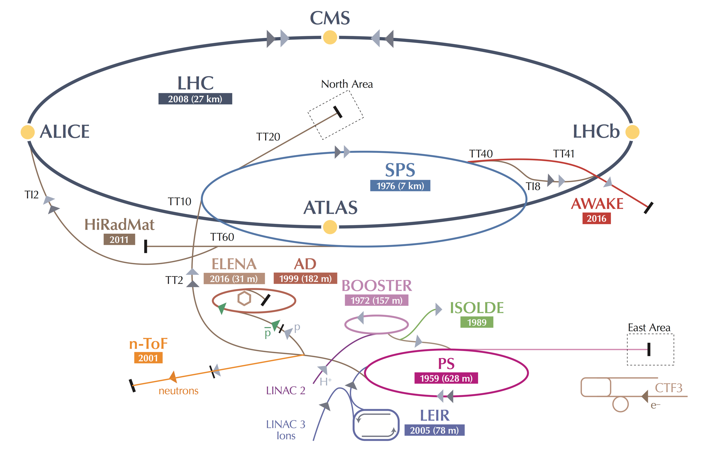
SPS: Injector for the LHC and accelerator for experiments in the North Area
In CERN Prévessin

Slide 20
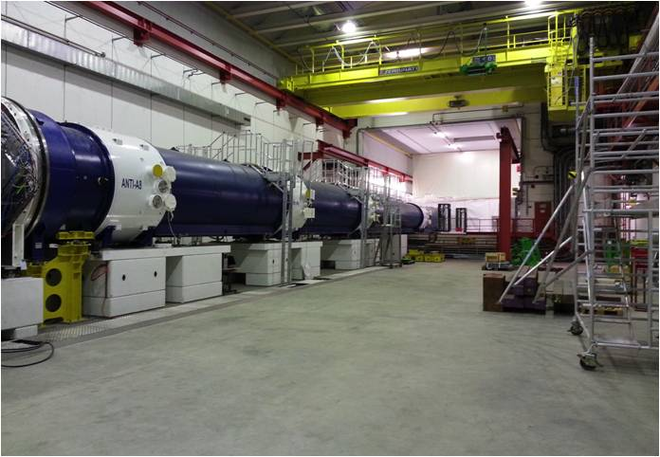
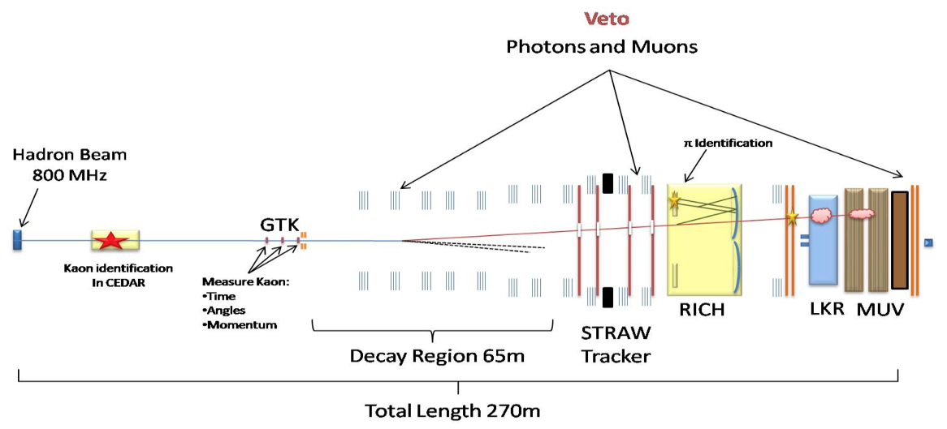
Fixed Target Physics
Lower energy experiments at PS or SPS (in 1 - 400 GeV range) allow precision measurements and comparison with theory. Deviations can be sign of new physics at higher energies.
6 approved experiments:
NA58 (COMPASS): muon spin physics, hadron spectroscopy
NA61 (SHINE): strong interaction, quark gluon plasma, neutrino and cosmic ray program
NA62: rare K decays BR(K⁺ → π⁺νν)
NA63: electromagnetic processes in strong crystalline fields
NA64: search for dark sectors in missing energy events
NA65 (DsTau): study of ν_{τ} production
-
Example NA62:
COMPASS in North Hall
(60 m long)

Slide 21
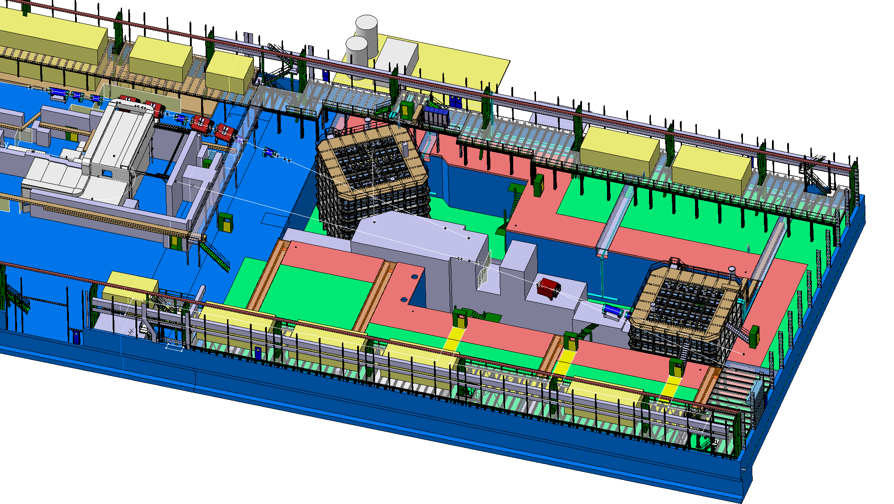
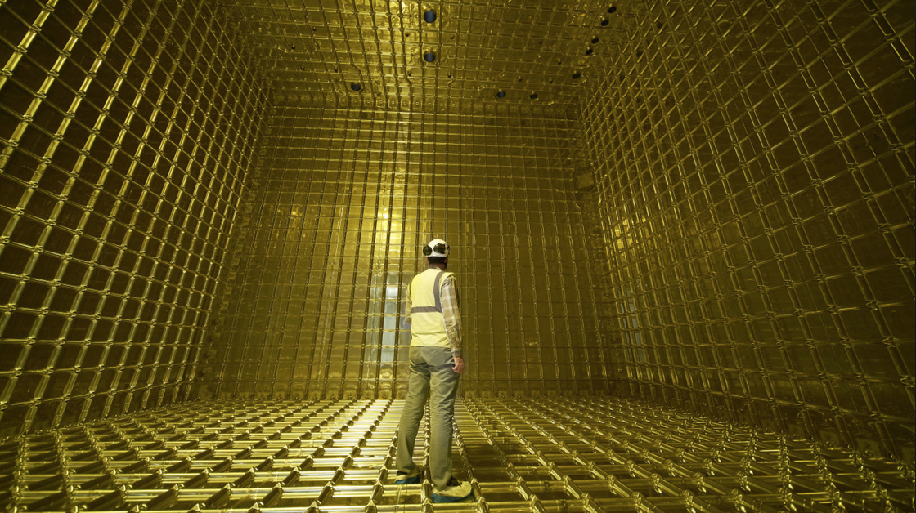
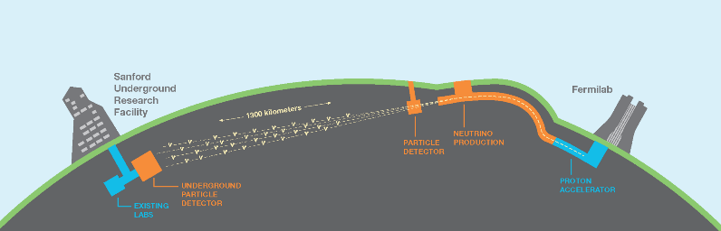
Neutrino Platform (new extension of North Area)
Like quarks, neutrinos exist in different flavors ν_{e} ν_{μ} ν_{τ}
but their flavour oscillates ν_{μ}⇔ ν_{τ} ν_{μ}⇔ ν_{e}
Has been studied with ν_{μ} beam sent from CERN to Gran Sasso in Italy (CNGS).
Neutrino platform as a test area with charged beams for neutrino detectors (e.g. R&D for large liquid argon detectors). The experiments will take place in the US and Japan.
LBNF/DUNE in the US:

Slide 22
ISOLDE and nTOF

Slide 23
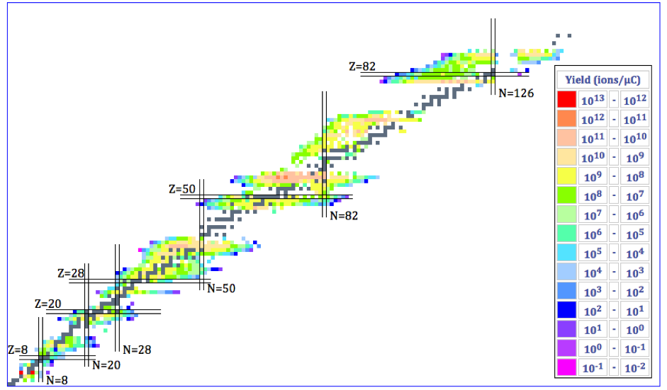
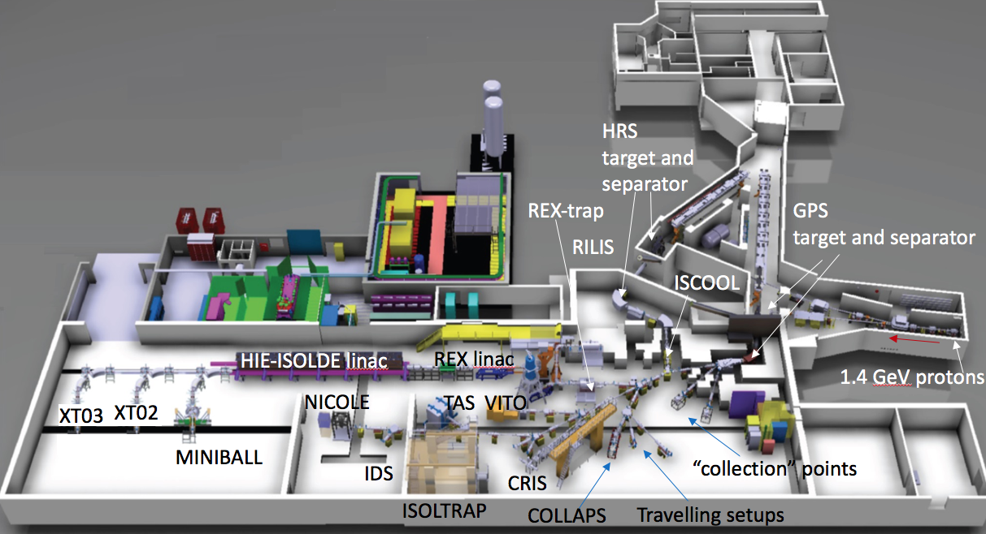
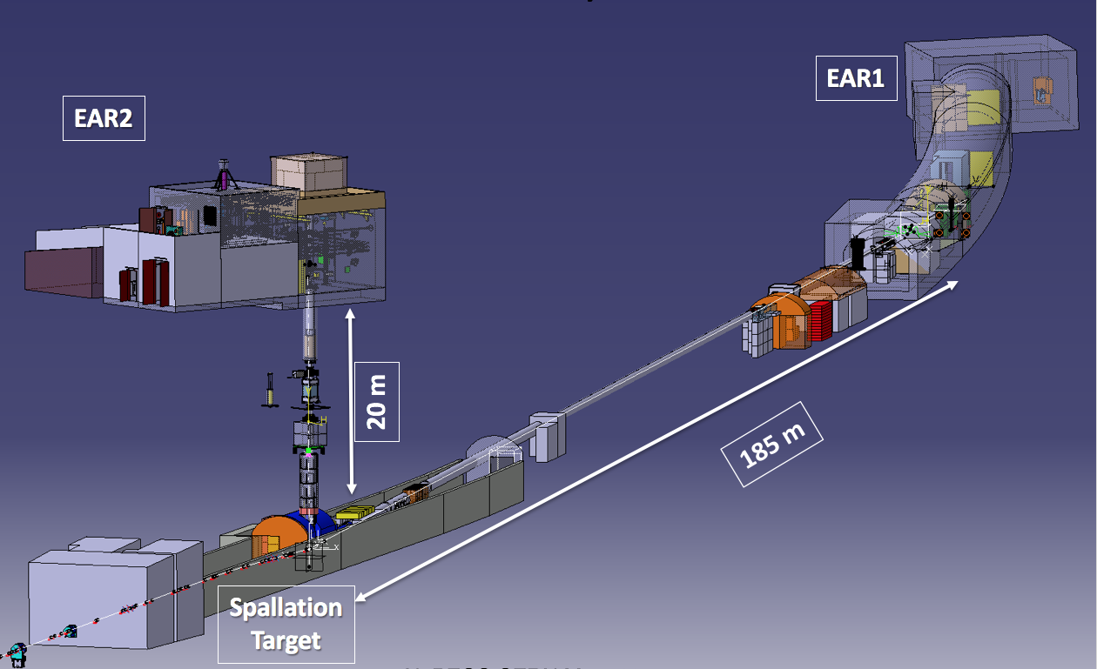
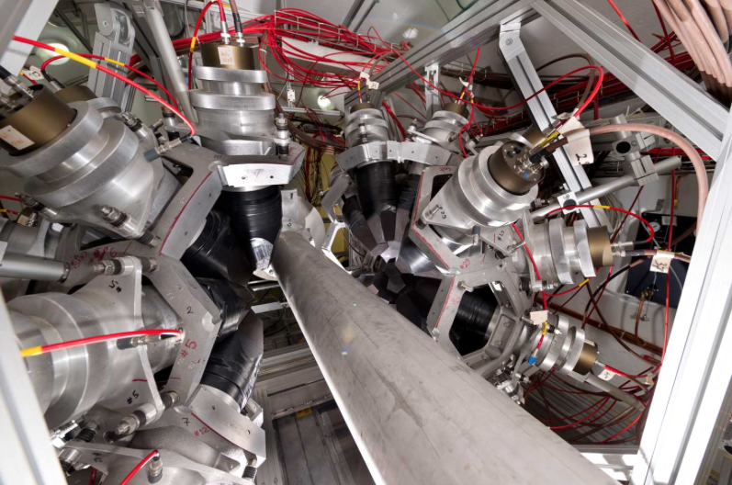
Nuclear Physics: ISOLDE & nTOF
ISOLDE: radioactive ion beams
1000 nuclides of over 75 elements produced, about 50 experiments every year
Nuclear physics
Fundamental interactions
Nuclear Astrophysics
Applications (Medicine, Material Science)
MEDICIS
Over 20 Target materials:
carbides, oxides, solid metals, molten metals
and molten salts (U, Ta, Zr, Y, Ti, Si, …)
3 types of ion sources: surface, plasma, laser
HIE-ISOLDE (post acceleration up to 10 MeV/nucleon)
nTOF (neutron time-of-flight)
Neutron cross-section measurements
Astrophysics
Nuclear Physics
Medical Applications
Nuclear Waste Transmutation

Slide 24
Antiproton & Antihydrogen Physics

Slide 25
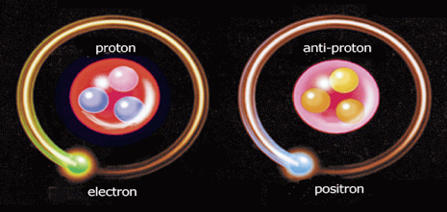
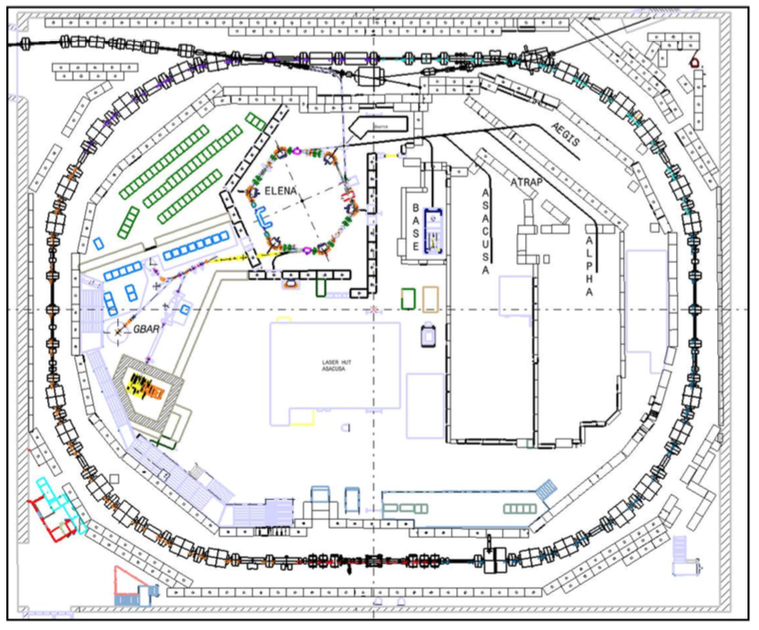
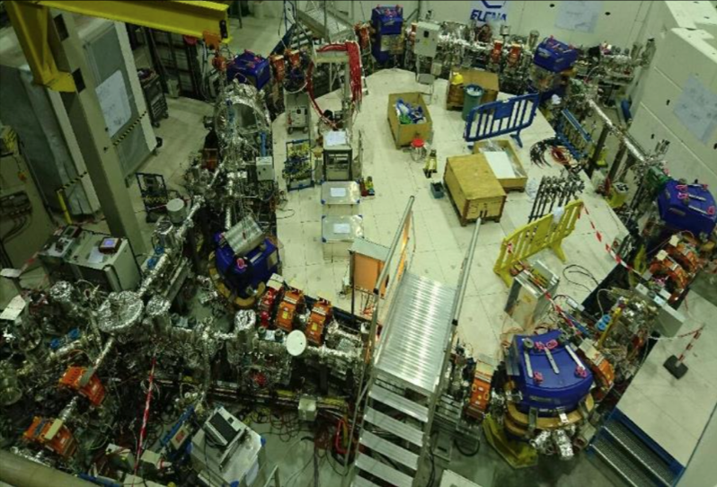
Antiproton & Antihydrogen Physics
Matter-Antimatter comparison
Test CPT invariance, the most fundamental Symmetry in relativistic quantum field theory
Test of the Weak Equivalence Principle by measuring the gravitational behavior of antimatter
Measurements of “antihydrogen”-like systems: antiprotonic helium, positronium, protonium
The Antiproton Decelerator (AD): antiprotons at 5.3 MeV
ELENA
H
H
ELENA (Extra Low Energy Antiprotons)
Reduces energy of antiprotons to 100 keV
→10-100 x larger trapping efficiency
→ Parallel running of experiments

Slide 26
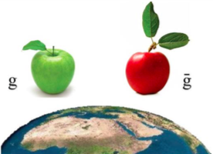
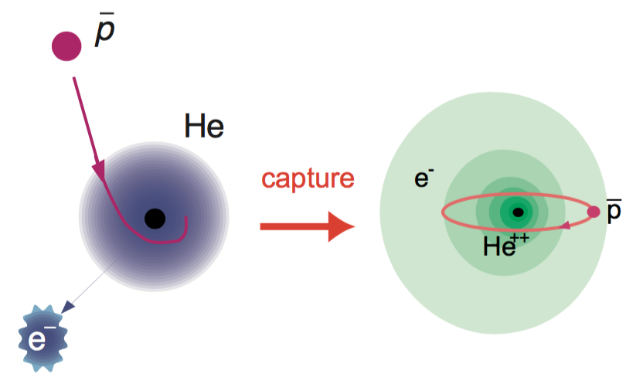
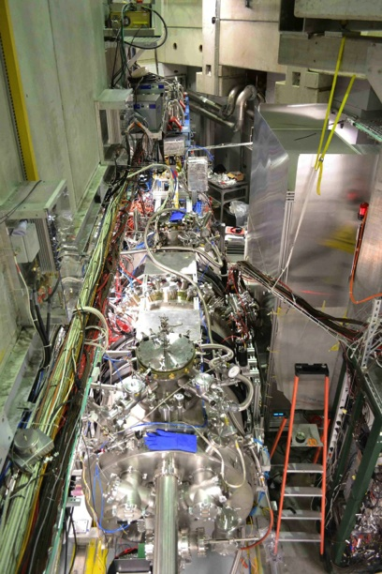
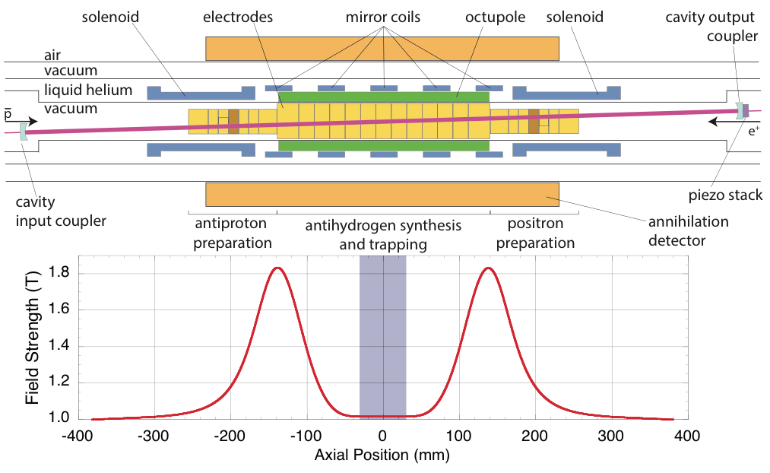
Antiproton & Antihydrogen Physics
Matter-Antimatter comparison
Fundamental in the current theory
of physics: m = m, g = g
6 experiments:
ASACUSA spectroscopy of exotic atoms
(antiprotonic Helium), and nuclear
collision cross section
BASE magnetic moment of the antiproton
ALPHA/ALPHA-g spectroscopy and gravity
AEgIS spectroscopy, antimatter gravity
experiment
GBAR antimatter gravity experiment
PUMA transporting antiprotons from the AD to ISOLDE
ASACUSA
AEgIS
AEgIS
PUMA
New! Approved in March 2021
ALPHA

Slide 27
PS East Hall

Slide 28
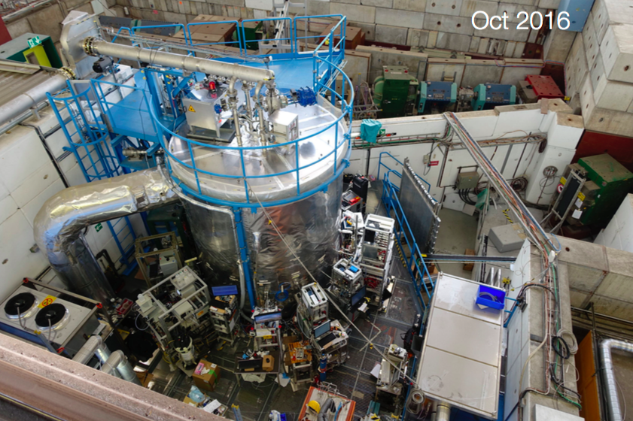
Environmental Physics
CLOUD - Study effect of cosmic rays on cloud formation
Clouds created in a large climatic chamber
Study influence of natural and man made aerosols on the development of clouds, cosmic rays “simulated” by PS beam,
CLOUD breakthrough:
Cloud formation was higher
than expected in pre-industrial times and influenced by cosmic rays.
Result important to reduce uncertainties in current climate model.

Slide 29
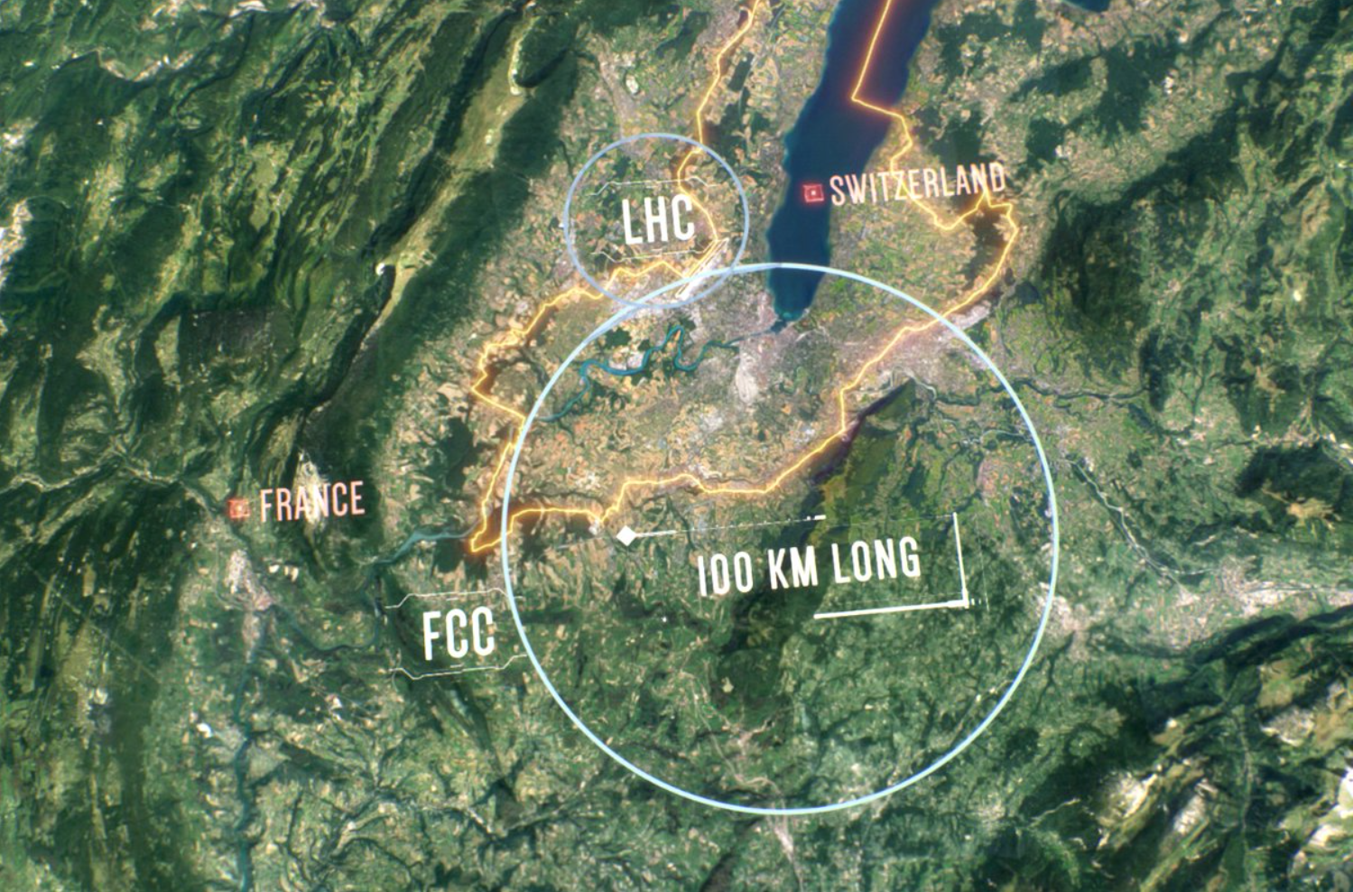
Future accelerators and experiments at CERN
LHC, and its upgrade to higher luminosity,
is central to CERN program for next decade(s)
But need to prepare for what will come after.
Following the Update of the European Strategy for Particle Physics in June 2020, continue with two studies:
FCC – Future Circular Collider
Feasibility study for a 100 km circumference machine
Possible first stage as an e⁺e⁻ collider (90-365 GeV, Higgs factory) followed by a pp collider at >100 TeV.
Physics beyond Colliders
Study to explore possibilities using the
non-collider part of the CERN accelerator
complex

Slide 30
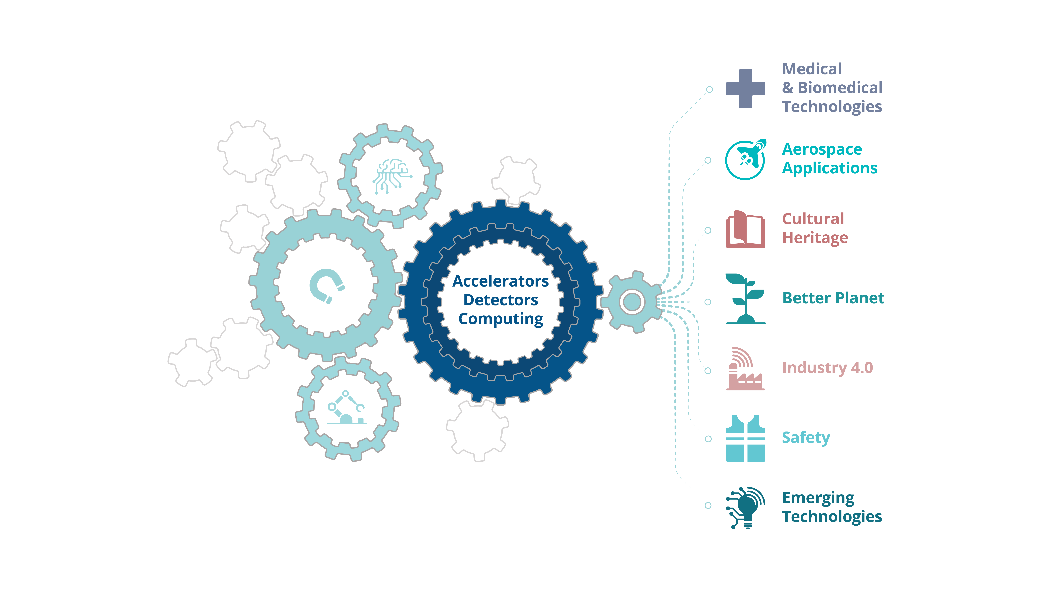
CERN’s mission extends beyond science
Notes:
CERN’s mission extends beyond science: it also aims to advance the frontiers of technology, to train the next generation of scientists and engineers, and to bring nations together.
Society can benefit from the result of CERN’s research and know-how which demonstrates the importance of investing in basic research (also with a view to future, larger projects)
[Illustration]
CERN's expertise builds broadly on three technical fields: accelerators, detectors and computing.
Behind these three pillars of technology, lies a great number of areas of expertise: from cryogenics to ultra-high vacuums, from particle tracking and radiation monitoring to superconductivity and many more.
These technologies and know-how associated with them translate into positive impact on society in diverse fields ranging from medical and biomedical technologies, aerospace applications, cultural heritage and safety.

Slide 31




Examples of CERN technologies with a positive impact on society
CERN partnered with Lausanne Hospital to develop innovative electron radiotherapy installation
Global air monitoring network to detect pollution built using CERN data acquisition framework
New 3D colour
human X-rays made possible by CERN Medipix3 technology
CERN’s Timepix particle detectors used to unravel the secret of a long-lost painting by the great Renaissance master, Raphael
Notes:
[From left to right]
1) New 3D colour X-rays made possible with CERN detector technology (Medipix3 is a CMOS pixel detector readout chip designed to be connected to a segmented semiconductor sensor): https://home.cern/news/news/knowledge-sharing/new-3d-colour-x-rays-made-possible-cern-technology
2) CERN partnered with a local hospital to develop an innovative radiotherapy facility (FLASH radiotherapy with electrons) based on Compact Linear Collider (CLIC) technology: https://home.cern/news/news/knowledge-sharing/cern-and-lausanne-university-hospital-collaborate-pioneering-new-cancer
3) CERN’s Timepix particle detector, microchips developed for detectors at the LHC, helped unravel the secret of a long-lost painting by the great Renaissance master, Raphael (The Madonna and Child): https://medipix.web.cern.ch/news/news/timepix/cern-technology-helps-rediscover-lost-painting-raphael
4) A global air monitoring network which aims to provide an end to end solution to generate, validate, analyze and record air quality data made possible with the help of a data acquisition framework developed at CERN. The project's ambition is to provide city and public health administrators, industry as well as citizens with accurate, timely and easy to understand information about air quality: https://kt.cern/article/cern-air-quality-data-analysis-spin-raises-12-million-euros-funding

Slide 32




CERN's Knowledge Transfer group can help you...
Contact: kt@cern.ch
Find out more: kt.cern
Notes:
A dedicated Knowledge Transfer (KT) group in the Industry, Procurement and Knowledge Transfer Department facilitates knowledge transfer at CERN. The group aims to engage with experts in science, technology and industry in order to create opportunities for the transfer of CERN’s technology and know-how.
If your work could be applied outside of particle physics, do not hesitate to contact the KT group: kt@cern.ch
CERN’s Knowledge Transfer group can help you:
take your technology from the laboratory to the market
navigate your start-up journey beyond CERN
11 Entrepreneurship Meet-Ups in 2020
9 Business Incubation Centres (BICs) in CERN Member States
6 start-ups accepted into BICs in 2020
Entrepreneurship training programmes
train in business, entrepreneurship and intellectual property
A variety of training courses to help CERN personnel in their knowledge transfer journey are organised by the KT group e.g. 'Finding Happiness in Patent Information Databases', 'Introduction to Knowledge Transfer Tools' , 'Drafting Clearer Contracts'
find resources to develop projects with a positive impact on society
KT and Medical Applications funds for CERN personnel:
~ 1.3 MCHF/year |
10 projects funded in 2020
100 projects since 2011
Learn more about knowledge-transfer by visiting kt.cern

Slide 33
Summary
  The CERN scientific program is:
  Rich and diverse
  Covers a wide range of energies from atomic physics to the highest energy frontier
  Strong in transfer of technology, education and relevance to issues in wider society (information, health, climate, energy, …)
  CERN’s success is built on its personnel
  Welcome, to join the adventure! Bienvenu!

Slide 34


Thank you for your attention !

