Slide 1
Development of a ChDR BPM for the AWAKE experiment - Status
Eugenio Senes
for the BI AWAKE & Cherenkov teams
… with many thanks to CLEAR OP for the support !

Slide 2
Outline
Outlook on the tests
Test of ø6 and ø15 mm buttons
Horn antennas vs waveguide transitions
Waveguide transition tests & status
Lessons learned
Transition design status
Conclusions

Slide 3
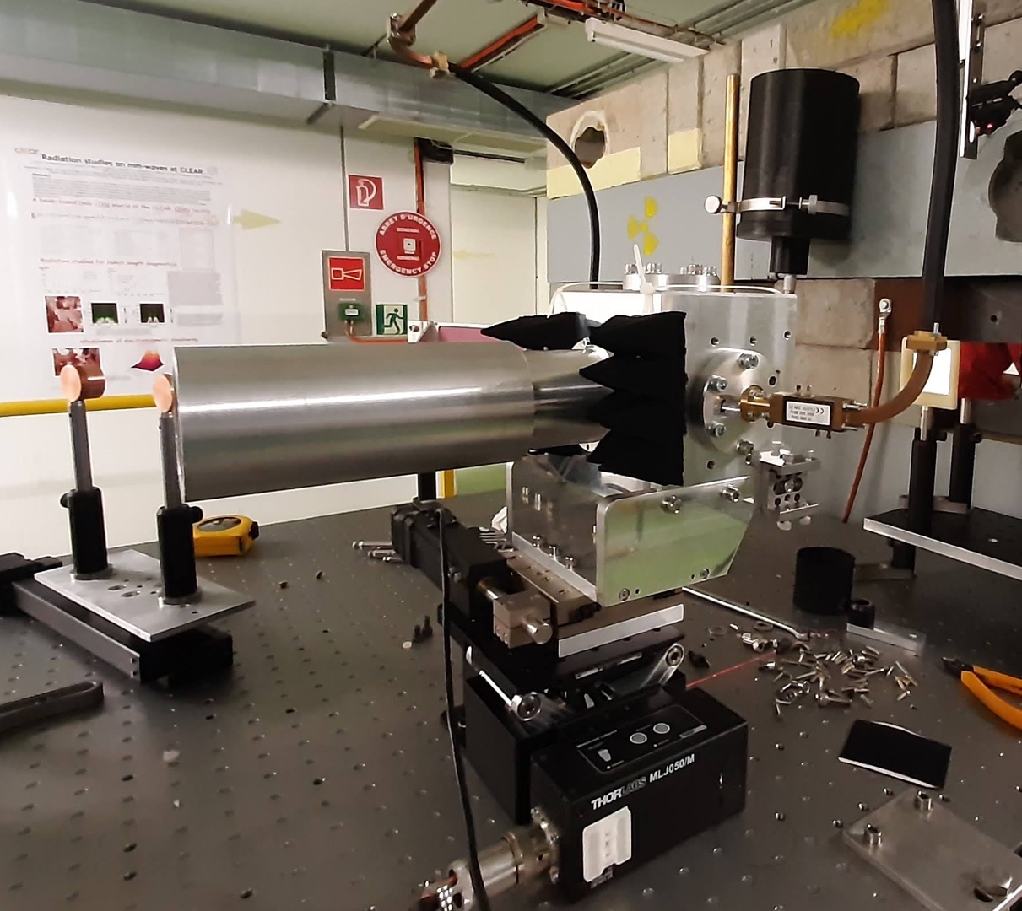
April 2021 test campaign at CLEAR
The initial plan
Detection in the bunker
PRO: short waveguides
CON: inaccessible

Slide 4
April 2021 test campaign at CLEAR
The initial plan
Detection in the bunker
Too difficult to access and fix ….
Needed a lot of fixing …
PRO: short waveguides
CON: inaccessible
Final solution
Detection in the klystron gallery
PRO: accessible, troubleshootable
CON: >10 dB attenuation

Slide 5
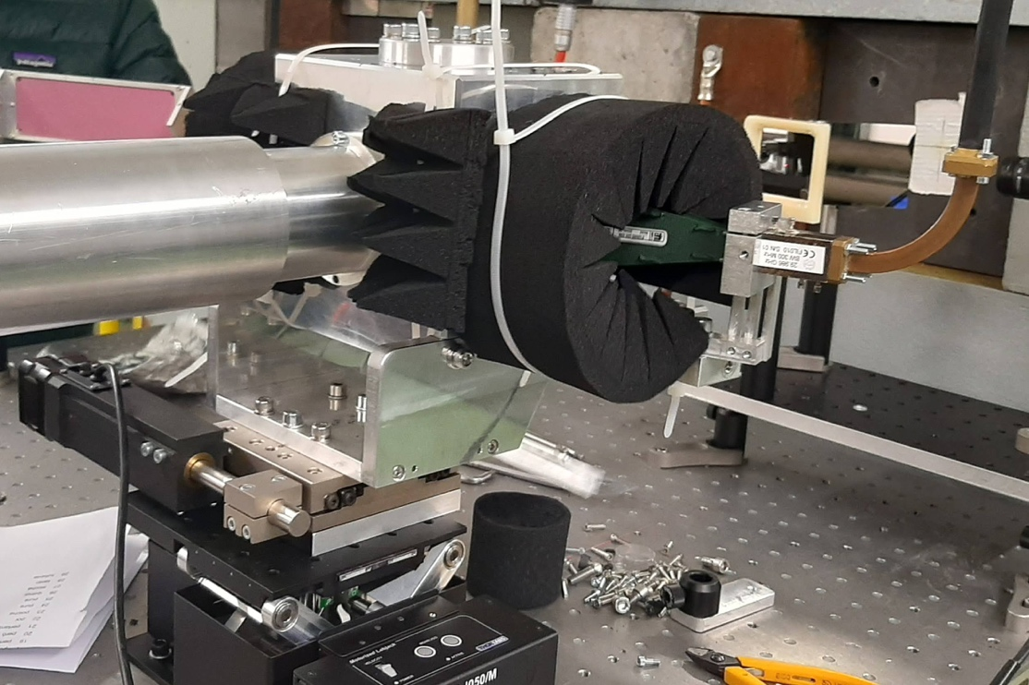
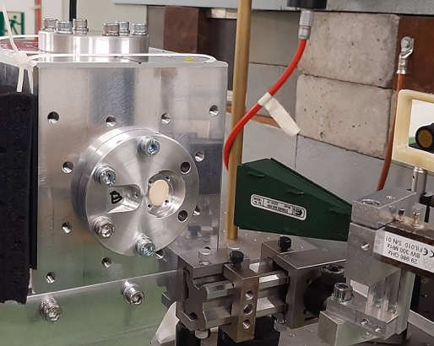
Detection scheme: horns
BUNKER
Detection with horn antennas
BEAM
PRO: - Simple(r)
CON: - Hard to align
- Requires RF shielding
ø6mm button
Horn
antenna
f₀ 29.986 GHz
BW 300 MHz
Waveguide
network
15m
10 dB
OSCILLOSCOPE
Tektronix
6 GHz
28 dB
500 MHz
Schottky diode
zero-bias

Slide 6
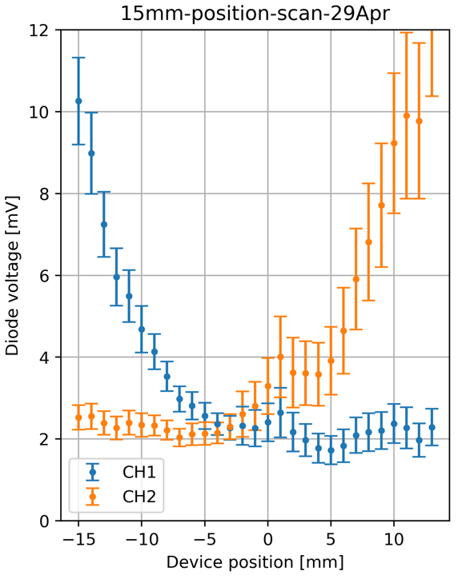
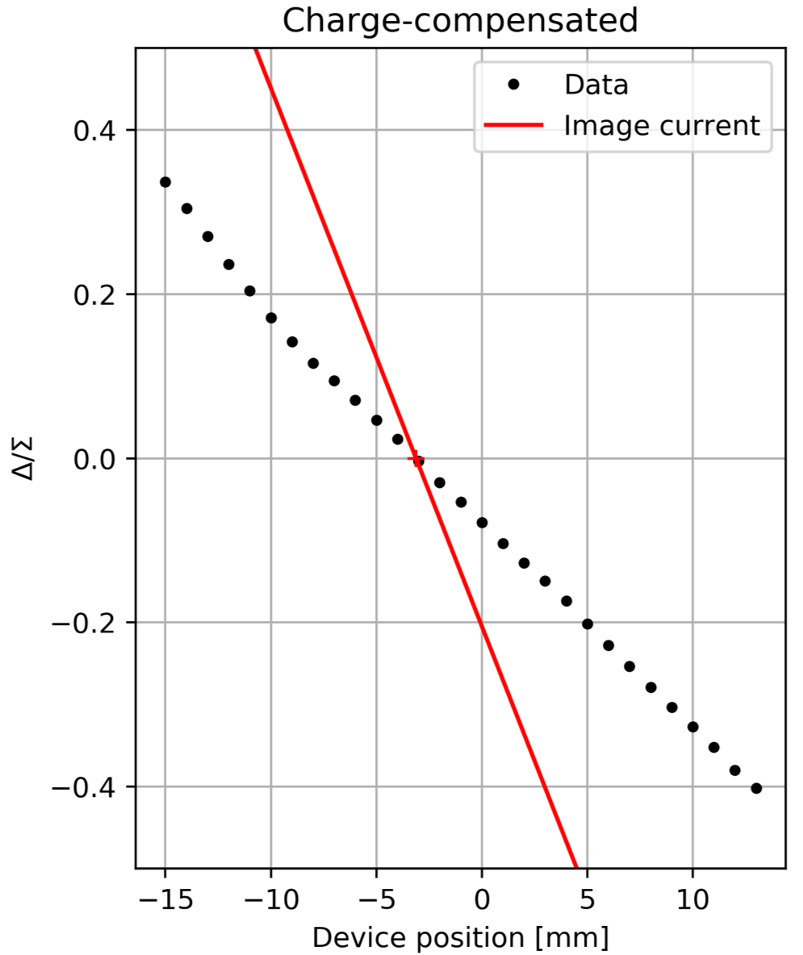
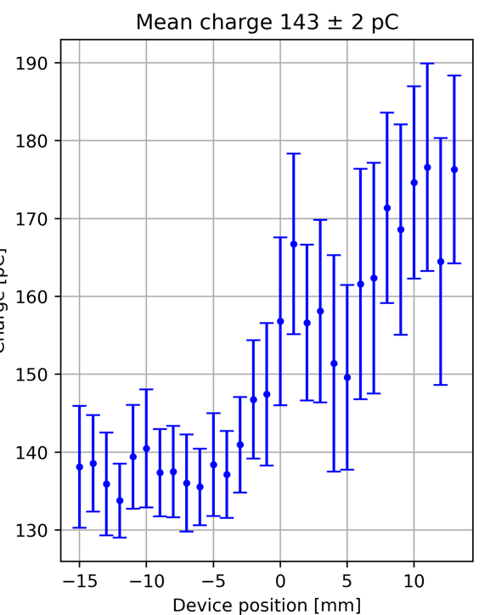
Test description
Both ø6 and ø15 mm radiators were tested
Mostly charge 80-140 pC
Different bunch lengths
Very different attenuations from the two buttons
  0.3 dB difference @30GHz in WG
  Buttons, transitions …
  Diodes …
A ’sweet spot’ in the configuration exists … however charge drift is also a problem
σ = 3.8 ps
143 ± 2 pC
~3 dB total
Response after charge
compensation

Slide 7
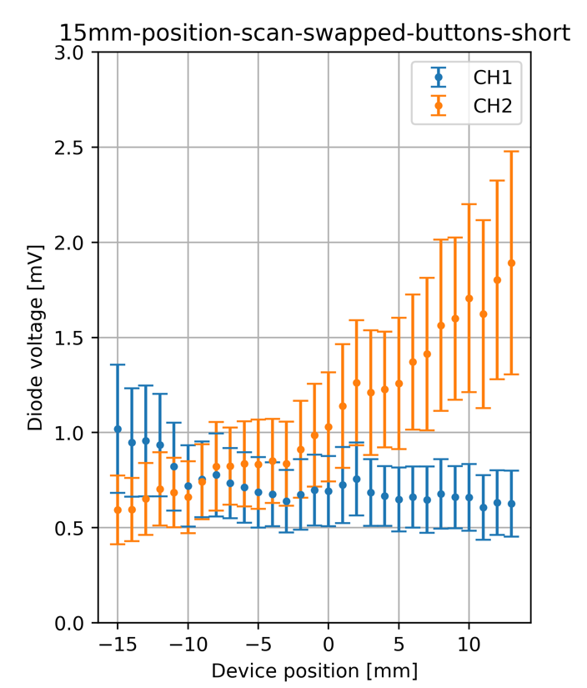
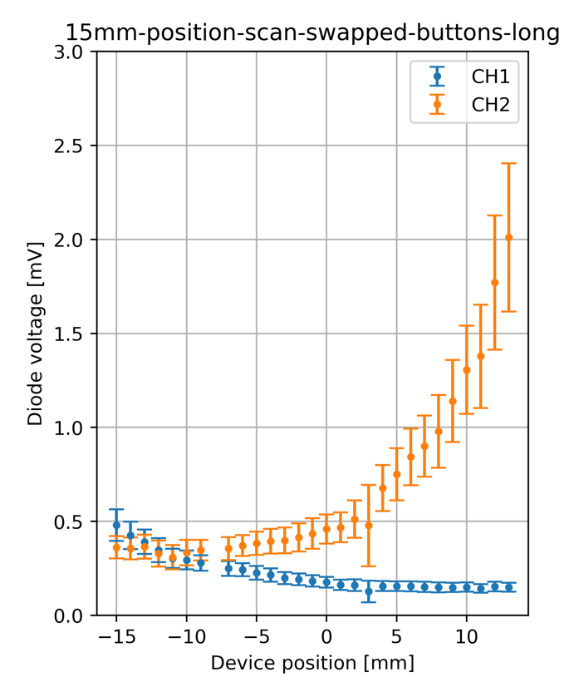
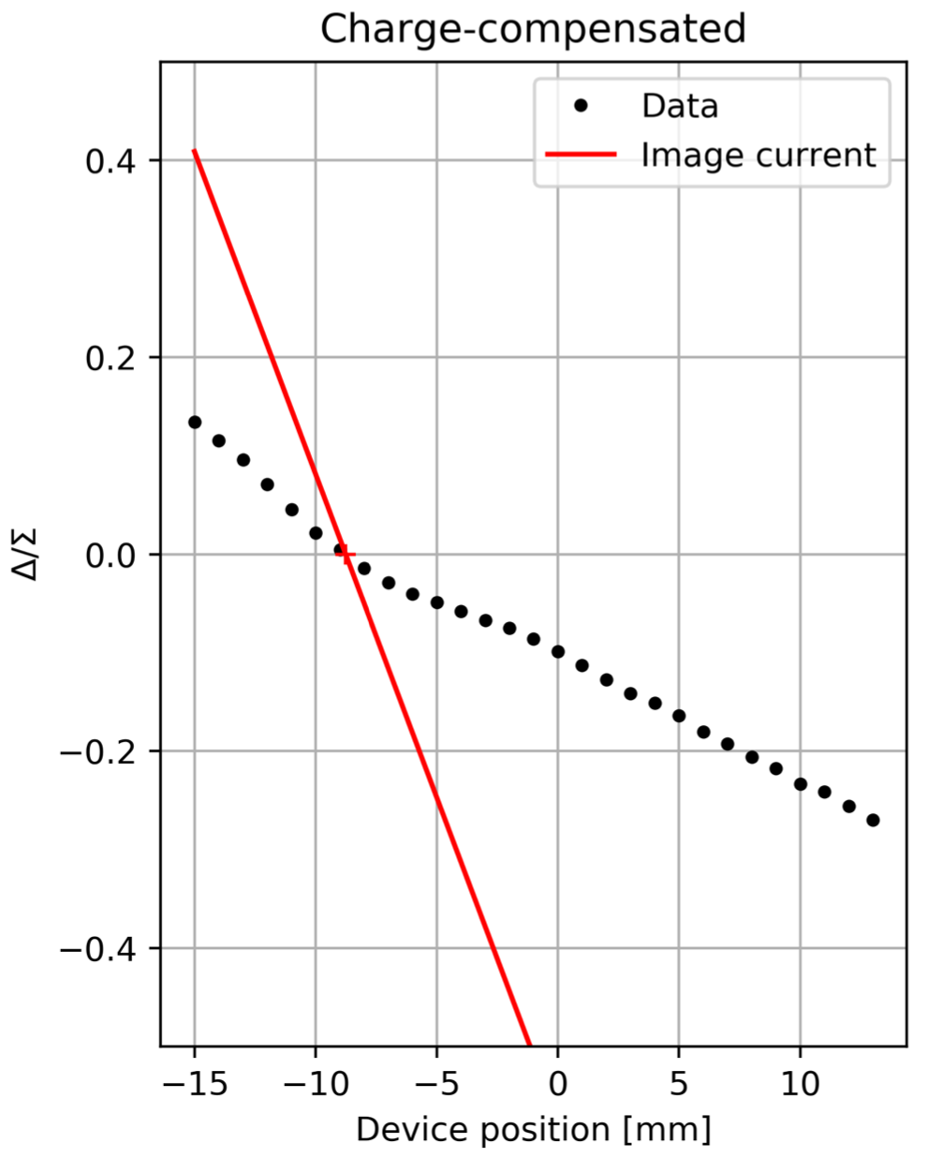
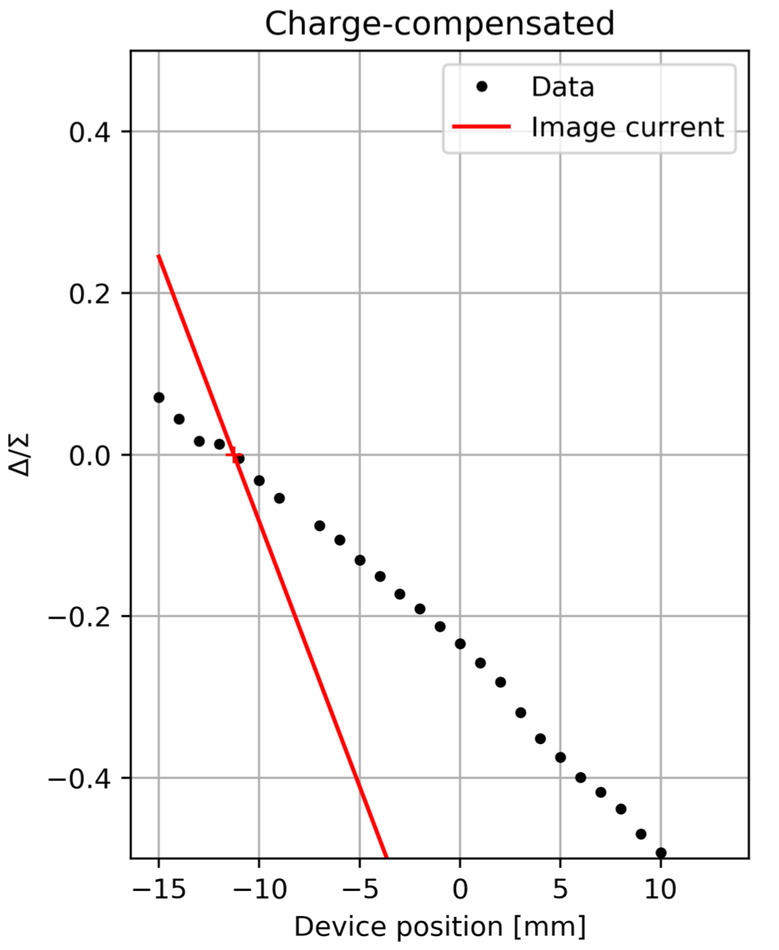
Response to long and short bunches
SHORT BUNCH
RESPONSE
Raw signal
Raw signal
LONG BUNCH
RESPONSE
σ = 1.1 ps
81 ± 3 pC
σ = 4.8 ps
89 ± 3 pC
15 mm buttons.
Expectation for Gaussian bunches
- 32% signal for long bunch

Slide 8
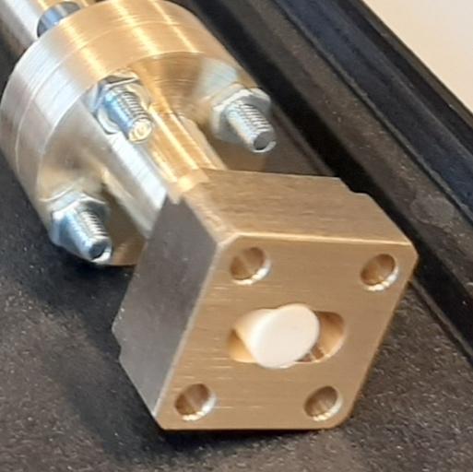
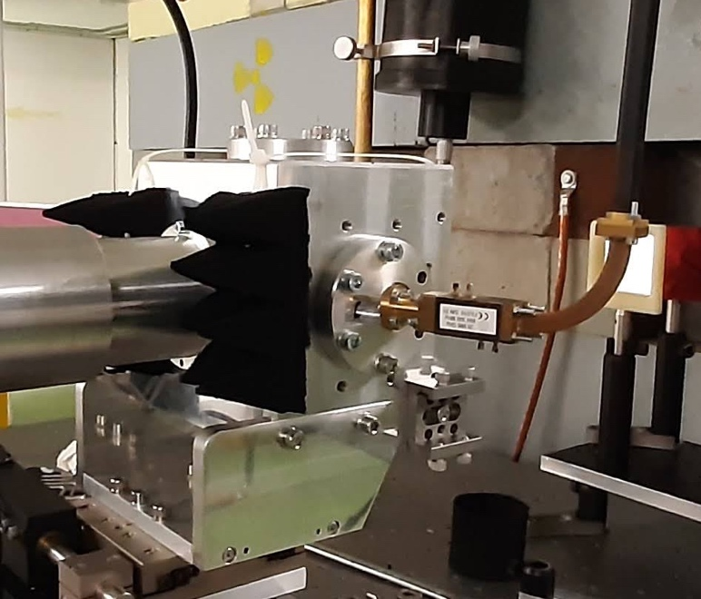
Detection scheme: transitions
BUNKER
Detection with transitions
BEAM
PRO: - Intrinsically shielded
- Couples larger signal
CON: - Custom part
- Early prototype
Waveguide
network
15m
10 dB
ø6mm button
Transition
ø6 mm – WR28
f₀ 29.986 GHz
BW 300 MHz
OSCILLOSCOPE
Tektronix
6 GHz
28 dB
500 MHz
Schottky diode
zero-bias
Alumina-loaded circular
waveguide ø6 mm
to WR 28 transition

Slide 9
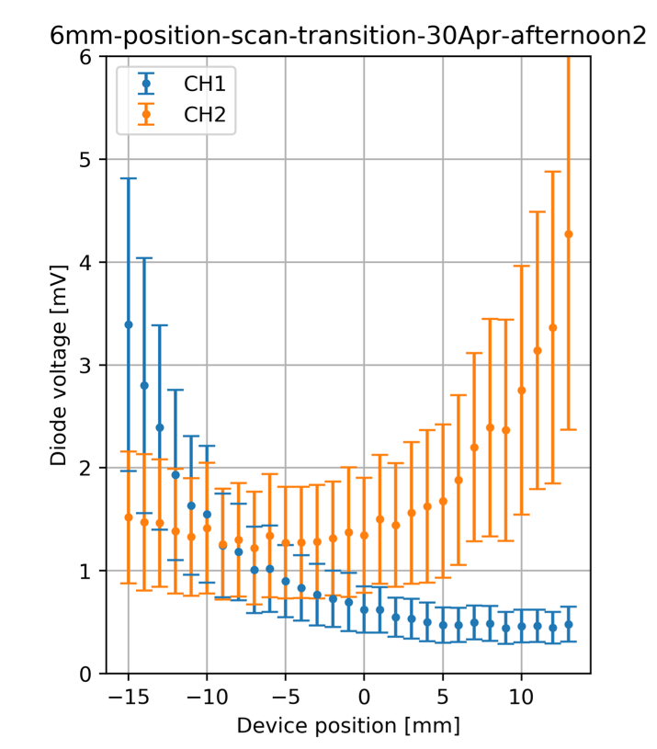
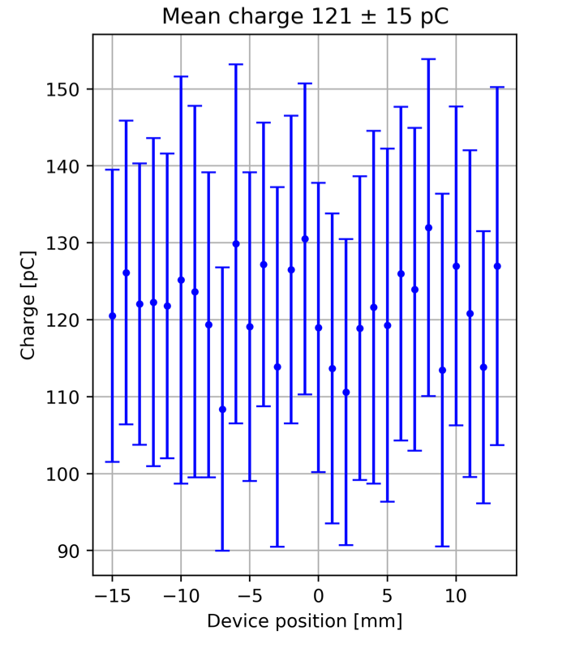
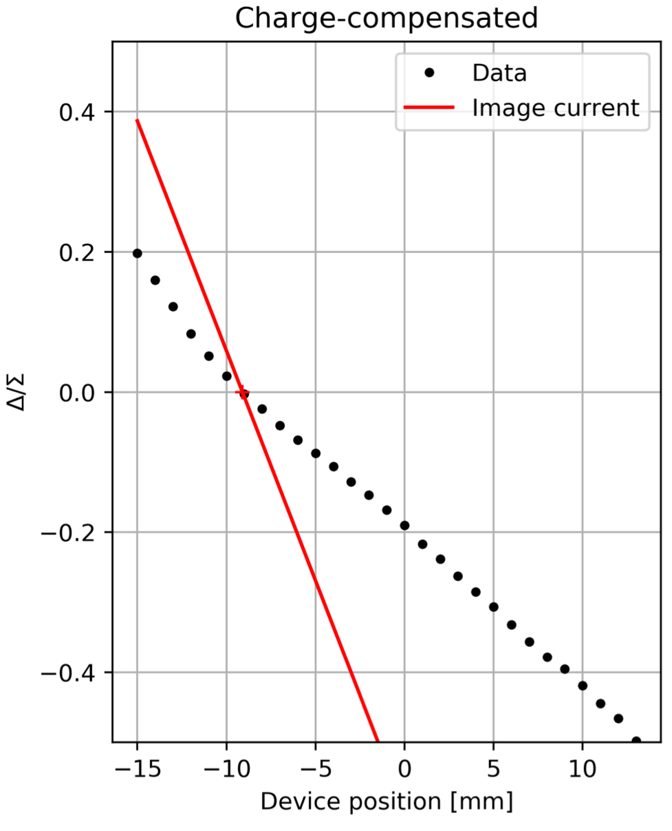
Test description
Transition available only for radiators ø6 mm
Mostly charge 80-120 pC
σ = 3.8 ps
121 ± 15 pC
Response after charge
compensation

Slide 10
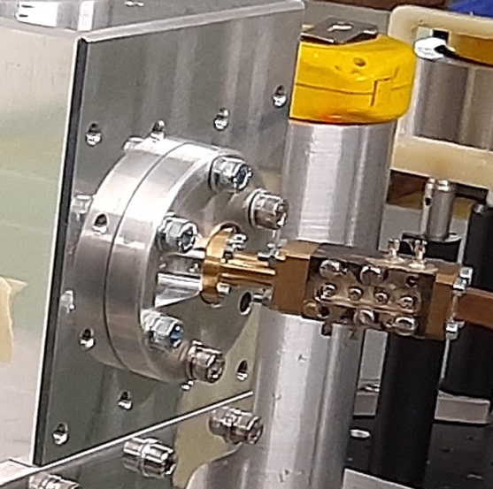
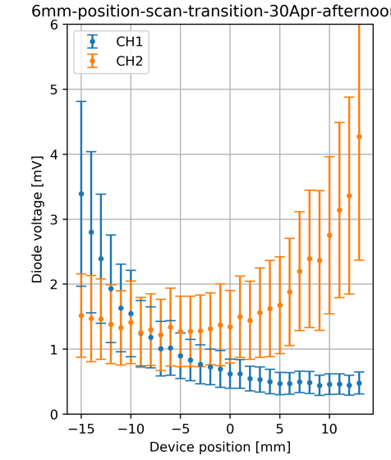
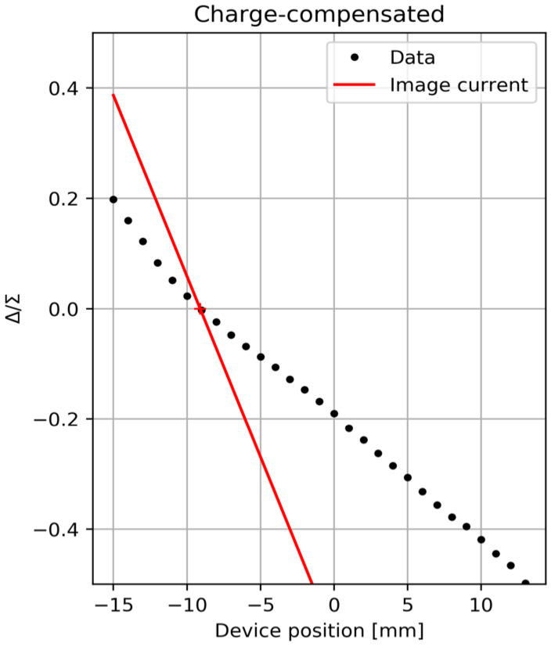
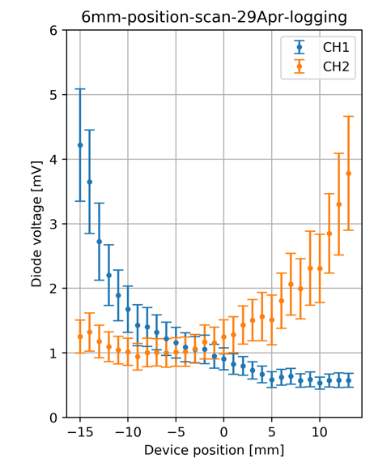
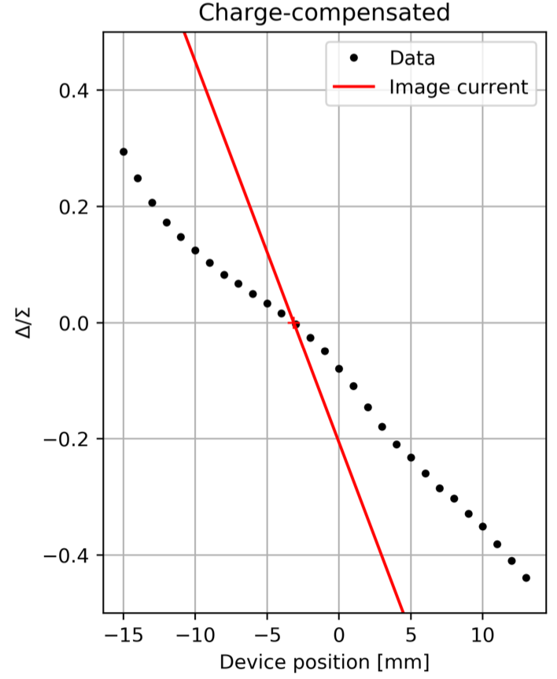
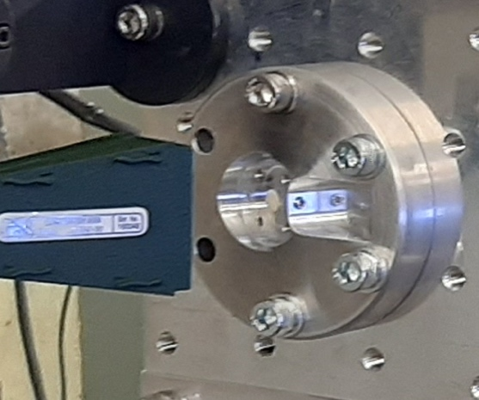
Horn antenna vs transition
To get similar
output voltage
WAVEGUIDE
TRANSITION
121±15 pC
HORN
ANTENNA
429±65 pC

Slide 11
Lessons learned
Different channels might present rather large attenuation differences
  Buttons asymmetry
  Transitions asymmetry
  Waveguide length difference
  Unknown assembly tolerances
Reduced dependence on bunch length
  Expected 32% difference in power
  Bunch shape might play a role
Dramatic signal increase with transitions
  Compared to horn antennas, same signal with factor ~4 charge difference
  Early transition prototype, still reflecting ~40% of the power

Slide 12
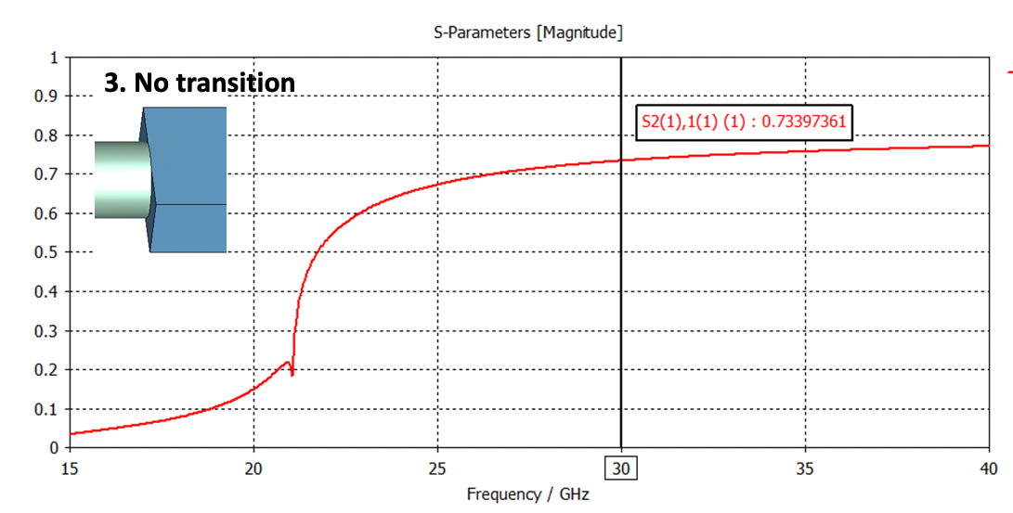
Transition designs
Large simulation work done by Collette
Just showing worst case, details in a separate talk of Collette
Level
0
No transition
P_{tra} = 53%
CST Studio Suite 2020
1
Single dielectric
P_{tra} = 64%
2
Multiple dielectrics
P_{tra} = 99%

Slide 13
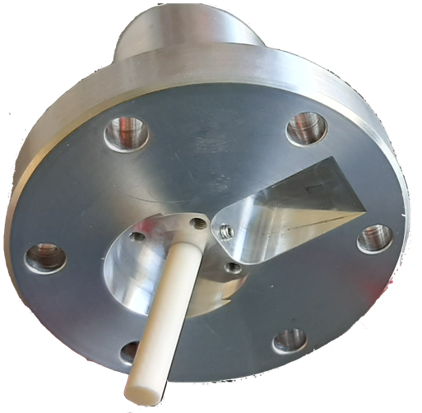
Conclusions
A design with waveguide transition is desirable
  Alumina buttons ø6 mm are the preferred choice
  Button + alumina is vacuum tight
Brazed collar
Important effort in transition R&D
  Modular design: the transition slides onto the alumina, outside the vacuum
  Large efforts to understand the impact of tolerances
Studies pending
  Possible additional test campaign at CLEAR for stability studies

Slide 14
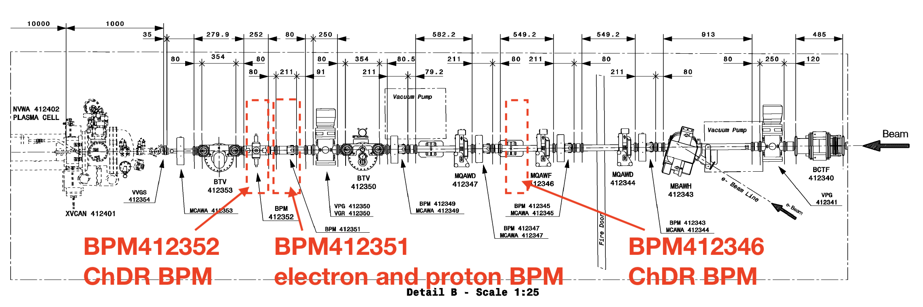
ChDR BPM project summary

Slide 15

ChDR BPM project summary
BPM412346 (ChDR #1)
  Beampipe resizing done
  Support in manufacturing
  (end of June)
  Body installation once tested with buttons
  Buttons final design pending (end of June)
BPM412352 (ChDR #2)
  Body installed
  Buttons final design pending (end of June)

Slide 16

ChDR BPM project summary
BPM412351
  Will detect both p⁺ and e⁻
  Discussions pending for signal splitting

Slide 17
40 GHz buttons option
In the past the use of high frequency buttons was discussed
CST simulations showed satisfactory performance with respect to ChDR BPM
CST studio
M. Wendt
This is an alternative, additional R&D project, and not a fallback solution
Mitigate the risk on ChDR BPM project
Compare the two technologies
Electrons 100 pC, 4 ps-σ

Slide 18
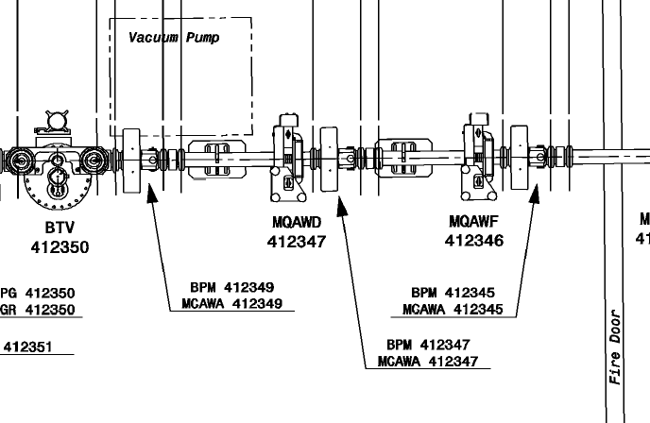
40 GHz buttons option
This is an alternative, additional R&D project, and not a fallback solution
Valid quote for the buttons for 2 more weeks
Body to be designed
HF BPM
ChDR BPM #1
Proposal:
Procure min 5 buttons and 1 body
Install in the other free drift close to fire door
Cost in the order of 50kCHF
Minimum 12 months before installation

Slide 19
Thanks for your attention !

