Slide 1
11T New Task Force – Team 2 – QA QC
Deliverable 1 – WINDING
Outcome MEETING#1 May-5, 2021
R. Principe, on behalf of the team
https://indico.cern.ch/event/969681/

Slide 2
Deliverable 1 – WINDING
Team Chair
TE-MSC-LMF: R. Principe
Team Members
TE-MSC-CMI: F. Savary;
TE-MSC-LMF: B. Arias, R. Berthet, N. Bourcey, O. Housiaux, S. Luzieux;
TE-MSC-SMT: F. Lackner, A. Musso;
EN-MME : D. Perini.
Also present:
TE-MSC-LMF: A. Milanese;
TE-MSC-SMT: H. Felice,
EN-MME : S. Sgobba, B. Bulat.

Slide 3
Schedule TEAM2
Subject | Discussion focusing on | Date | Status
Winding | Fabrication and control procedures, components, tooling, acceptance criteria and NC | 05.05.2021 | Done
Curing | Idem | 12.05.2021 | Done
Reaction | Idem | 26.05,2021 | Done
Impregnation | Idem | 09.06.2021 | Done
11T collaring | Idem | 23.06.2021 | 23.06.2021
MQXF coil pack and assembly | Idem | 23.06.2021 | 23.06.2021
Diagnostics, statistics and improvement axes | Statistics, review of NC by families, learned lessons, proposals. | 30.06.2021 | 30.06.2021

Slide 4
Discussed subjects 1/2
  The Winding process, including
    Applicable documentation and evolutions
    Components
    Tooling
    Differences in the 11T and MQXF production strategy
    Non conformities during production
    Adopted mitigations following major NCR
    Outcomes after cold tests inspections
    Future proposed improvements

Slide 5
Discussed subjects 2/2
  2. 11T and QXF SC cable insulation process, including production and sampling
    Observed NC’s on CERN site related to the braiding uniformity
    Feedback from CERN QC control of braiding thickness
    Established production process/procedures at CGP for the different production lines
    The procedure for the 6 m sample preparation at CGP
    QC hardware and established QA at CGP
    Documentation and reporting
    Feedback and experience from CGP on the contract B1505 with CERN
    Visit of production line
    Conclusion and identification of mitigation/action items

Slide 6
Outcome MEETING#1 May-5, 2021
QA system
    Appears to be sufficient to cover the production step.
    Appears flexible enough to cover future evolutions (updates of control procedure / Follow-up / MIP).
Component
    NCs do not seem to have an impact on the functionality of the coils.
    The geometry of the winding keys and spacers can be analysed for improvement (relation with frequent pop outs)

Slide 7
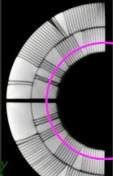
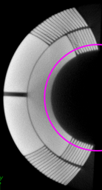
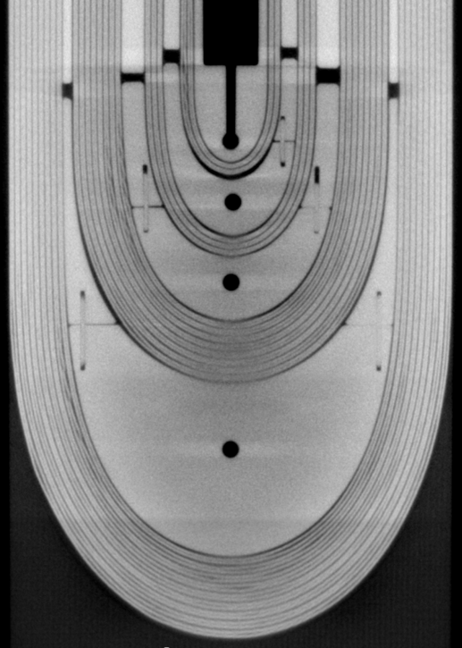
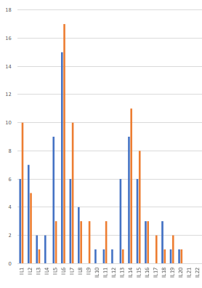
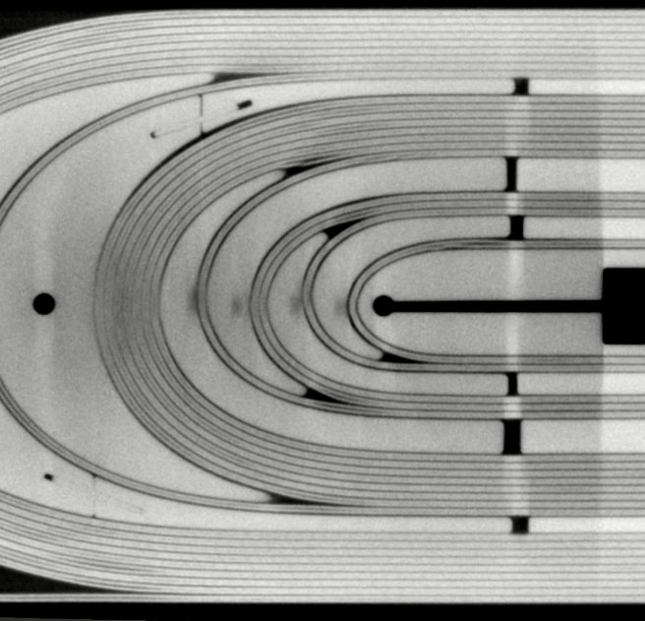
Winding keys and spacers (outcomes after cold tests)
  Cable on inner layer (Tomography, courtesy of Dr S. Sgobba and B. Bulat)
GE11, Connection side
GE15, Non Connection side

Slide 8
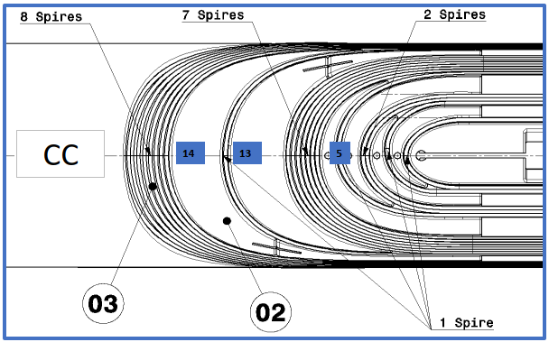
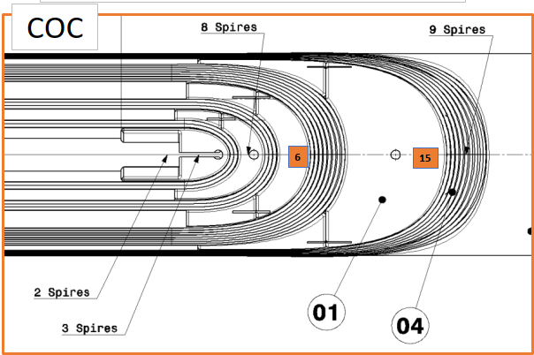
Winding keys and spacers (outcomes after cold tests)
  Pop out during winding, QAQC team statistics on inner layer

Slide 9
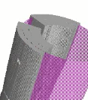
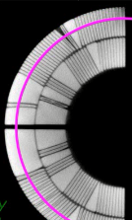
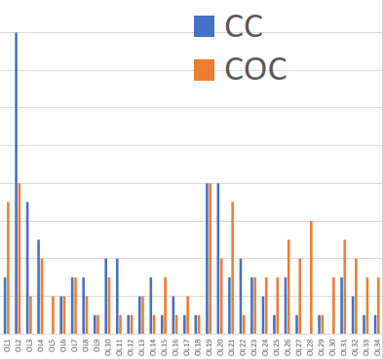
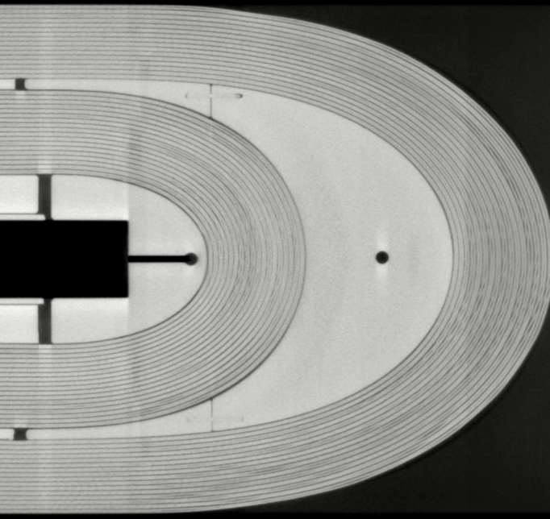
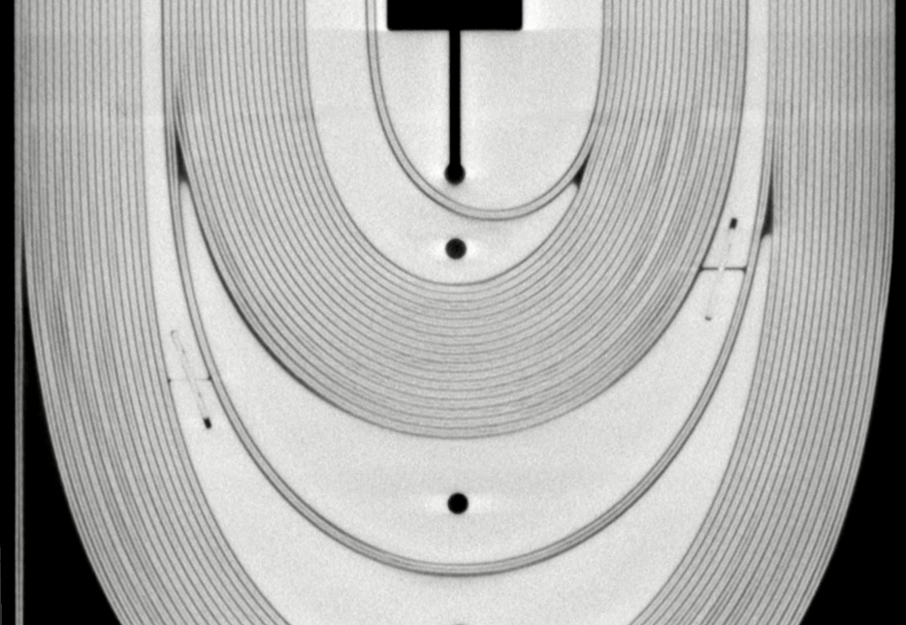
Winding keys and spacers (outcomes after cold tests)
  Cable on outer layer (Tomography, courtesy of Dr S. Sgobba and B. Bulat):
GE11, Connection side
GE15, Non connection side
16
14
12
10
8
6
4
2

Slide 10
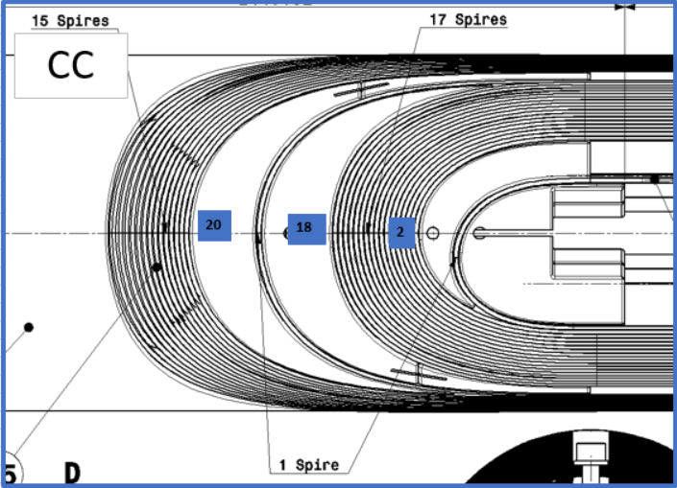
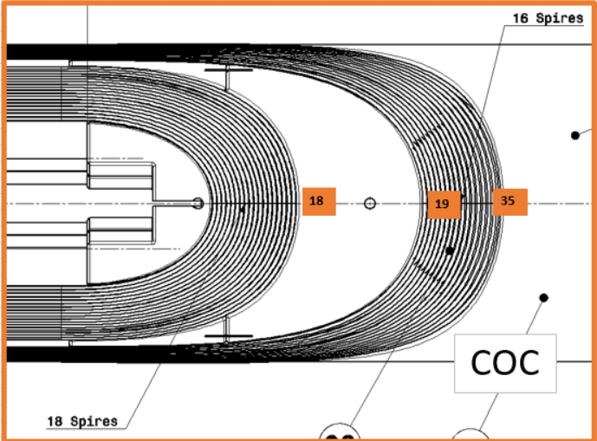
Winding keys and spacers (outcomes after cold tests)
  Pop out during winding, QAQC team statistics on outer layer
16
14
12
10
8
6
4
2

Slide 11
Outcome MEETING#1 May-5, 2021
Correlation cable pop outs / coils tomographies
    The correlation between the observation of cable pop-outs registered during winding and coils tomographies is interesting.
    To be checked if this can be an indicator of defects after the future tomography of coil candidate GE27 (not reacted coil).
    A tomography on GE27 (not reacted coil) is proposed to determine if the defects observed on reacted coils are present since the winding or if they are generated later.

Slide 12
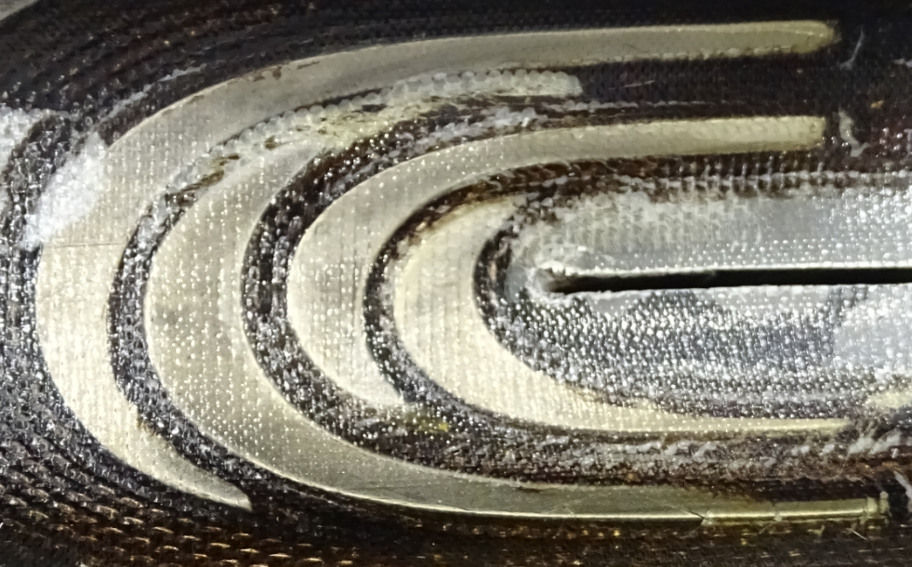
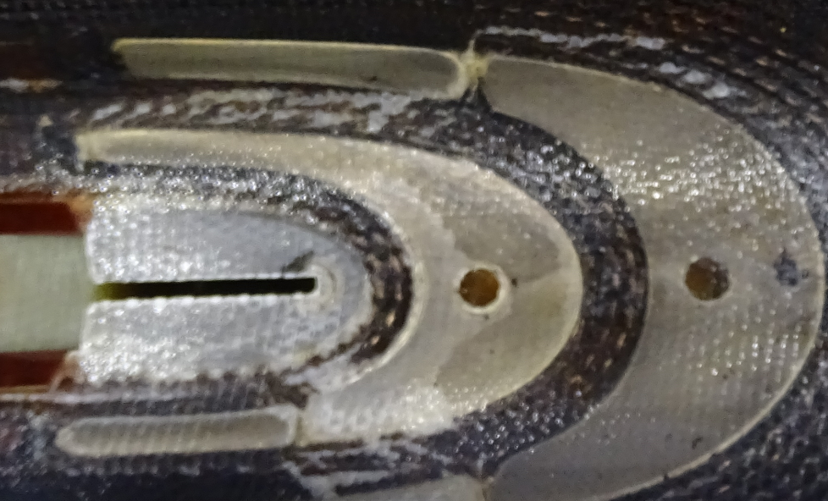
Non conformities and defects (outcomes after cold tests)
  Cracks on the first turns on both sides (GE15):

Slide 13
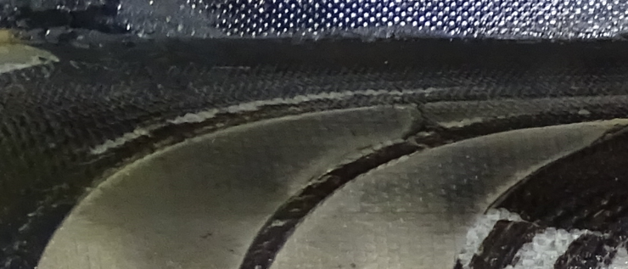
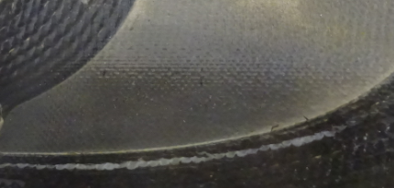
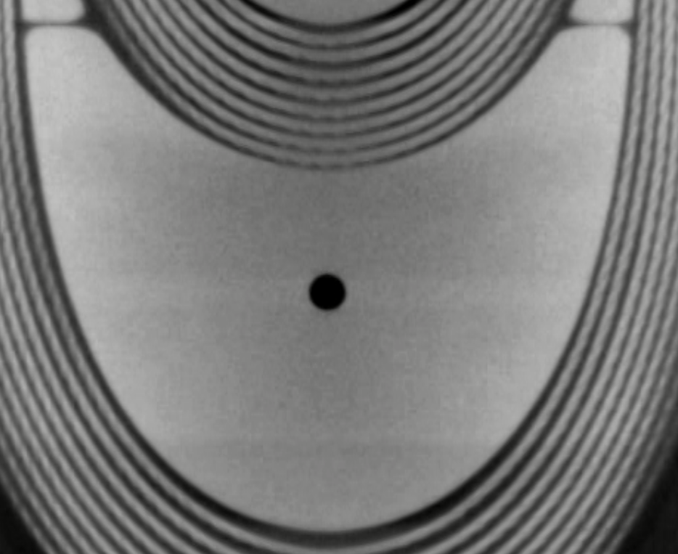
Non conformities and defects (outcomes after cold tests)
  Cracks on the between turns 14th and 15th on both sides:
  Interesting compare with the model by Cedric G.
Courtesy of Dr S. Sgobba and B. Bulat

Slide 14
Outcome MEETING#1 May-5, 2021
Procedure evolution
  Check before inner layer curing if gaps between spacers and cable of the inner layer are deeply filled with fiberglass (no more access to the inner layer after this production activity).
  The sandblasting of the winding keys can be carried out if the production resumes.
QC improvement: cable insulation thickness measurement
  Following the visit to the supplier, the insulated cable samples used for the cable insulation thickness measurement appear not representative for MQXFB. A new control method at CERN is under discussion (see F. Lackner presentation available at EDMS 2578996).

Slide 15
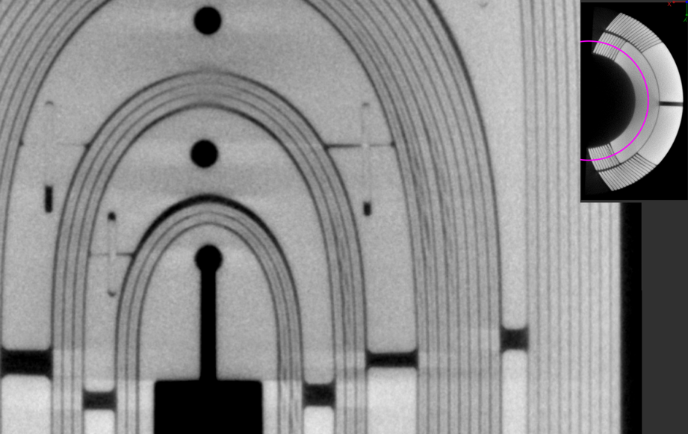
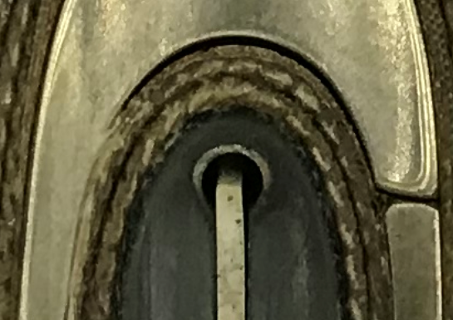
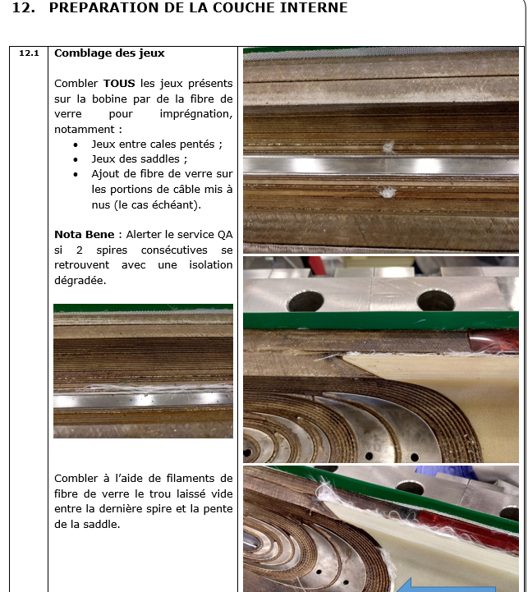
Gaps between spacers and cable
  On inner layer, empty spaces on non connection side (GE15).
  The gaps are filled with fiberglass before impregnation.
Does the fiberglass fill entirely the void (in depth)?

Slide 16
Outcome MEETING#1 May-5, 2021
Procedure evolution
  Check before inner layer curing if gaps between spacers and cable of the inner layer are deeply filled with fiberglass (no more access to the inner layer after this production activity).
  The sandblasting of the winding keys can be carried out if the production resumes.
QC improvement: cable insulation thickness measurement
  Following the visit to the supplier, the insulated cable samples used for the cable insulation thickness measurement appear not representative for MQXFB. A new control method at CERN is under discussion (see F. Lackner presentation available at EDMS 2578996).

Slide 17
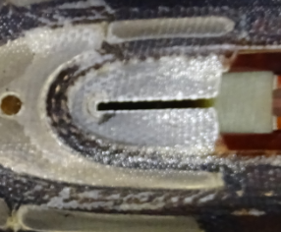
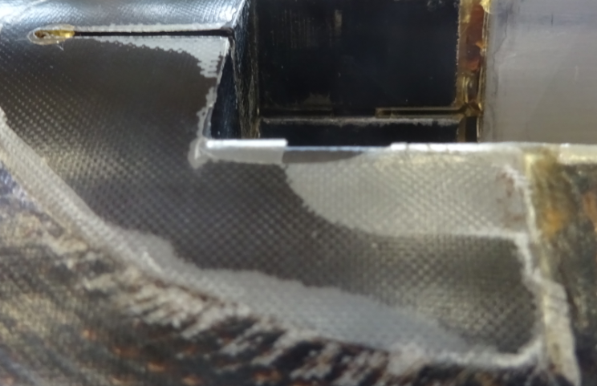
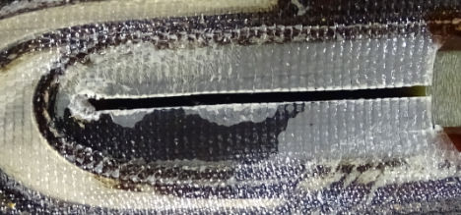
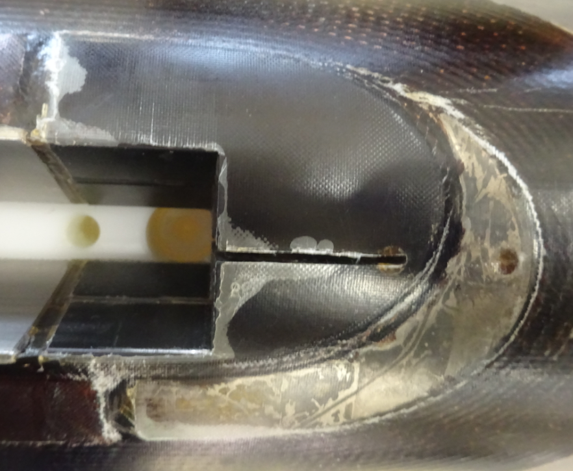
Outcomes after cold tests inspections
  Outcome from inspections after dismantling on GE02, GE03, GE08,GE09, GE10, GE12, GE14, GE15 and GE16.
  Recurent defects detected: delamination on winding keys (both outer and inner layers):
  Rediscussed at the IMPREGNATION

Slide 18
Outcome MEETING#1 May-5, 2021
Procedure evolution
  Check before inner layer curing if gaps between spacers and cable of the inner layer are deeply filled with fiberglass (no more access to the inner layer after this production activity).
  The sandblasting of the winding keys can be carried out if the production resumes.
QC improvement: cable insulation thickness measurement
  Following the visit to the supplier, the insulated cable samples used for the cable insulation thickness measurement appear not representative for MQXFB. A new control method at CERN is under discussion (see F. Lackner presentation available at EDMS 2578996).

Slide 19
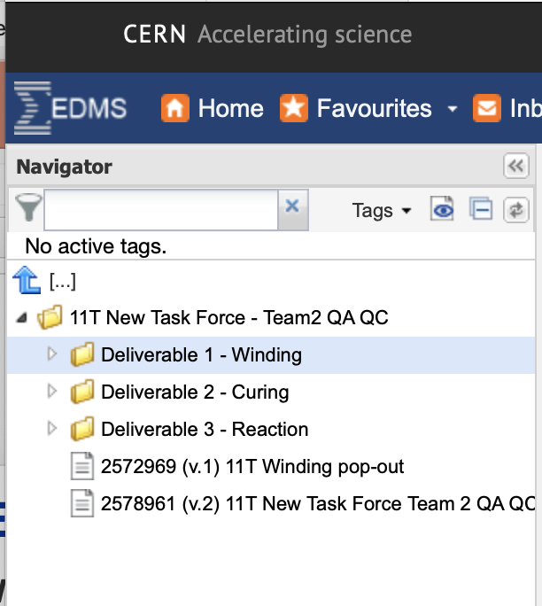
Outcome MEETING#1 May-5, 2021 1/2
DELIVERY 1 – WINDING
    Docs related to DELIVERY 1 available at CERN-0000217839
    EDMS 2578995, production step 1 – WINDING
    EDMS 2578996, 11T and QXF cable insulation, production and sampling
    EDMS 2578997, 11T New Task Force Team2 Deliverable 1- Outcome session may 5.

Slide 20
Thank you

