Slide 1
BLonD and its application to MC RCS RF system
Ivan Karpov and Heiko Damerau
Acknowledgements:
J. Scott Berg, Elias Metral
MC RF WG meeting #3: RF for HEC

Slide 2
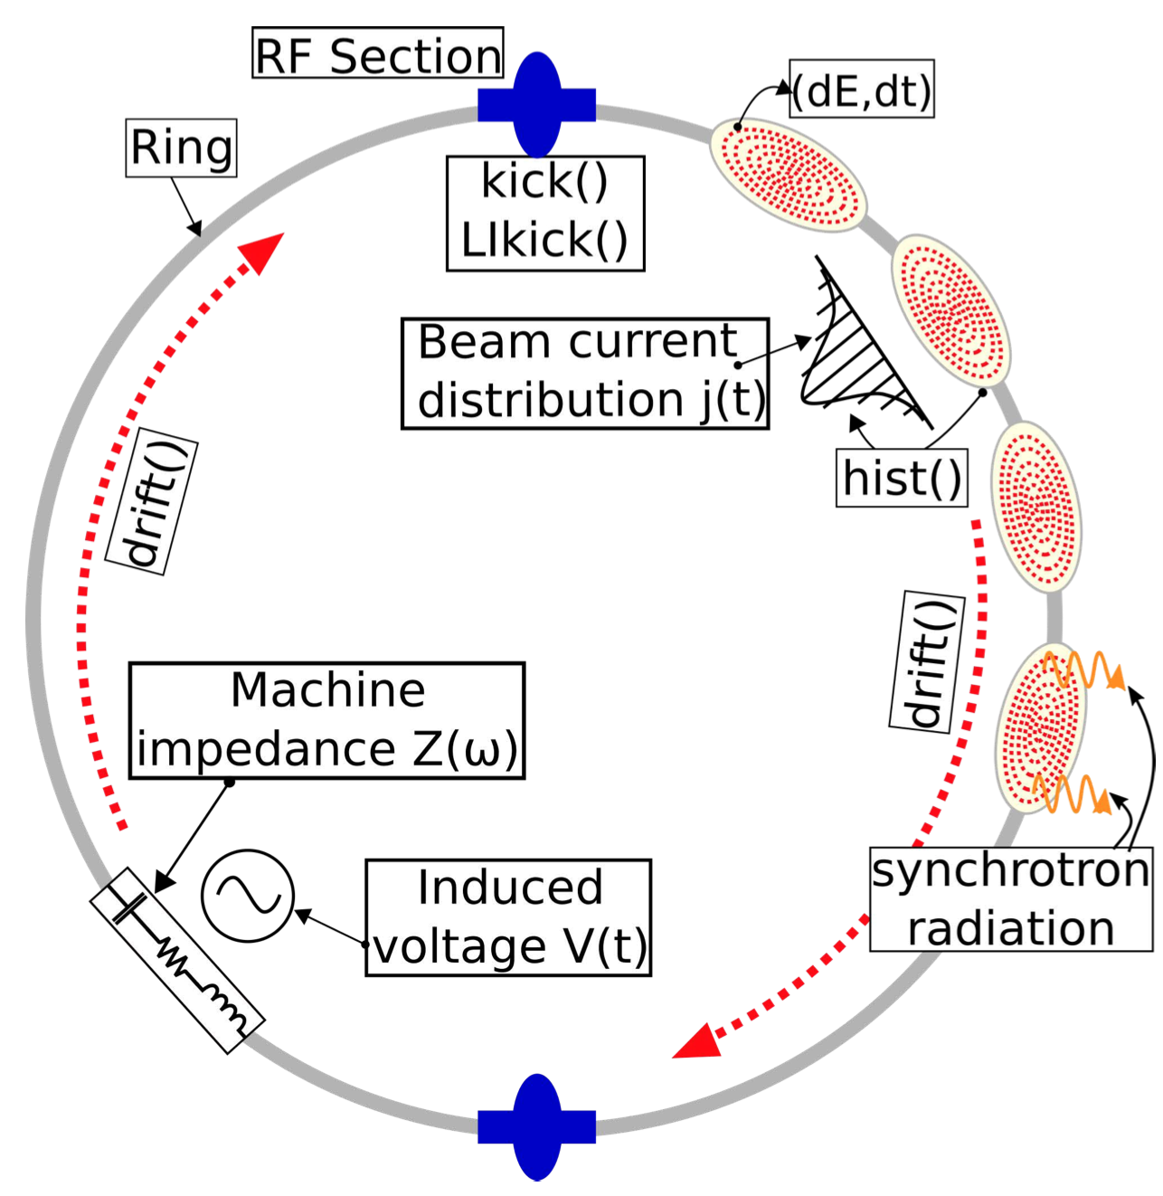
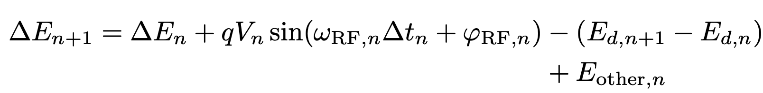
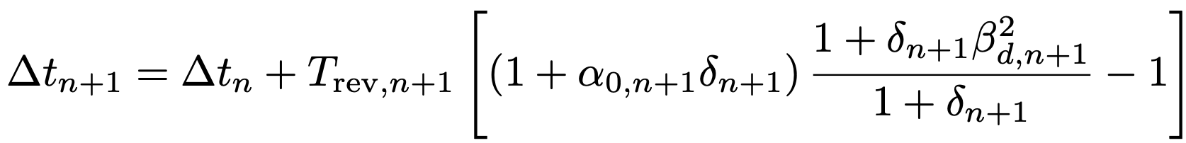
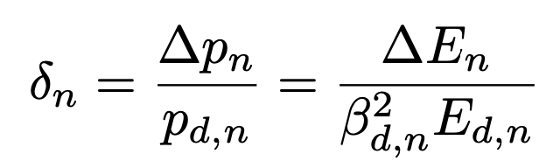
Beam Longitudinal Dynamics - BLonD
BLonD macro-particle tracking code has been developed at CERN since 2014
Kick and drift equations:
Turn number
Plot from K. Iliakis et.al, BLonD++: Performance Analysis and Optimizations for Enabling Complex, Accurate and Fast Beam Dynamics Studies
Optimized and tested for various applications with a single RF station
$→$ Multiple RF stations are required in MC RCS due to a large energy change per turn

Slide 3

Multiple RF stations in BLonD
Ring object contains several section and each section has one RF system
Each section applies kick and drift:
First identified issue: the step $n→ n+1$corresponds to one turn, not to one section! Bunch will be immediately lost from the bucket
$→$ Redesign of BLonD modules (e.g., Ring and RF_station) is required

Slide 4
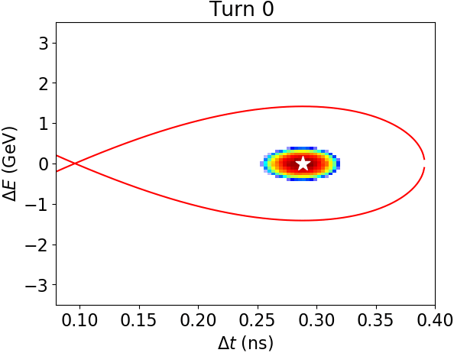
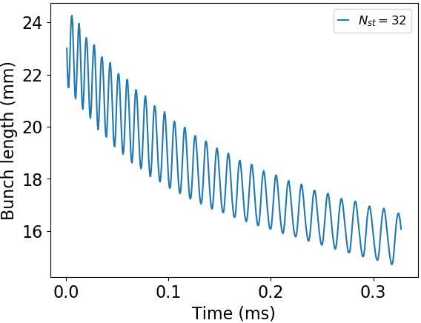
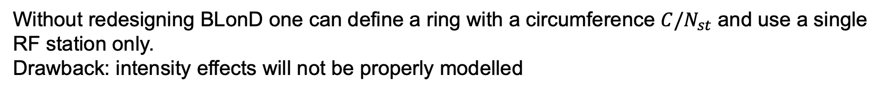
Possible but not realistic solution
Without redesigning BLonD one can define a ring with a circumference $C/N_{st}$ and use a single RF station only.
Drawback: intensity effects will not be properly modelled
Initial mismatch is due assumption of continuous synchrotron motion in the matching routine

Slide 5
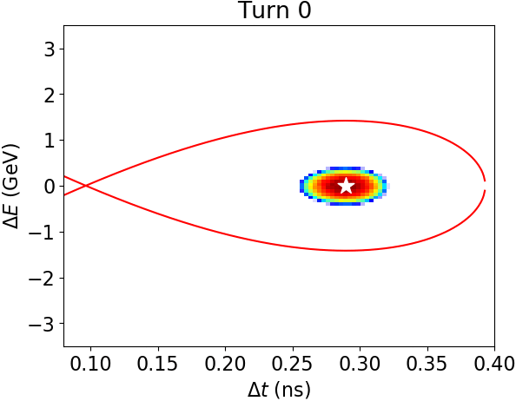
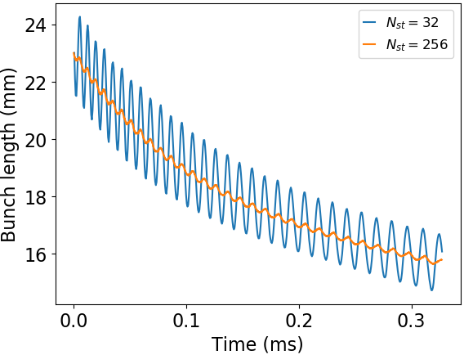
Possible but not realistic solution
Without redesigning BLonD one can define a ring with a circumference $C/N_{st}$ and use a single RF station only.
Drawback: intensity effects will not be properly modelled
Initial mismatch is due assumption of continuous synchrotron motion in the matching routine

Slide 6
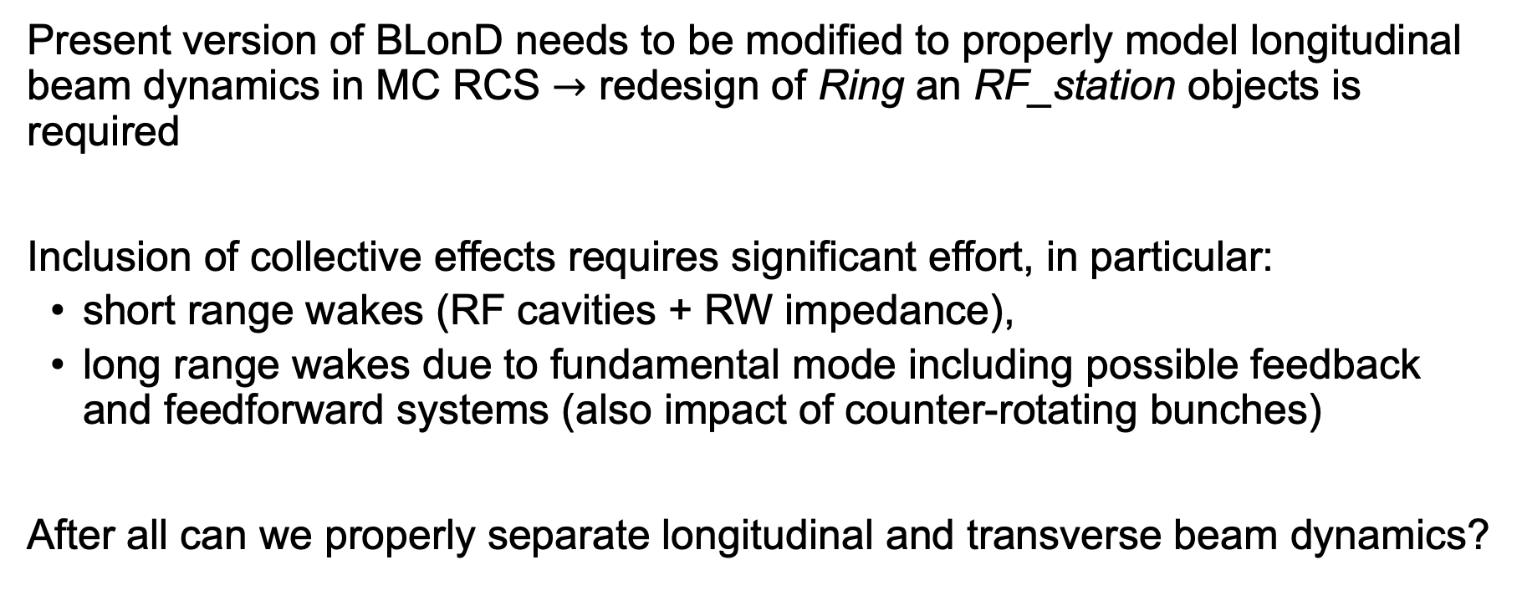
Summary
Present version of BLonD needs to be modified to properly model longitudinal beam dynamics in MC RCS $→$ redesign of Ring an RF_station objects is required
Inclusion of collective effects requires significant effort, in particular:
  short range wakes (RF cavities + RW impedance),
  long range wakes due to fundamental mode including possible feedback and feedforward systems (also impact of counter-rotating bunches)
After all can we properly separate longitudinal and transverse beam dynamics?

Slide 7
Thank you for your attention!

