Slide 2
EP R&D Project on Noble Liquid Calorimetry
High Density Feedthrough Design
Maria Barba, Michel Chalifour, Johan Bremer, Martin Aleksa
Meeting on FCC Noble Liquid Calorimetry
June 17th, 2021
WP3: Calorimetry and Light-based detectors

Slide 3
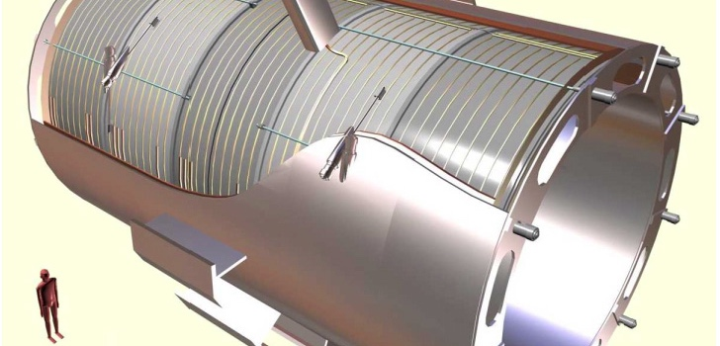
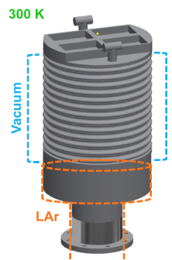
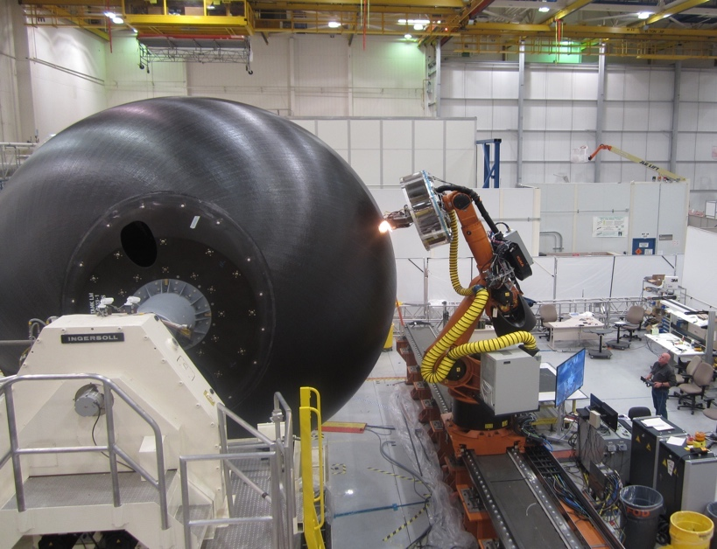
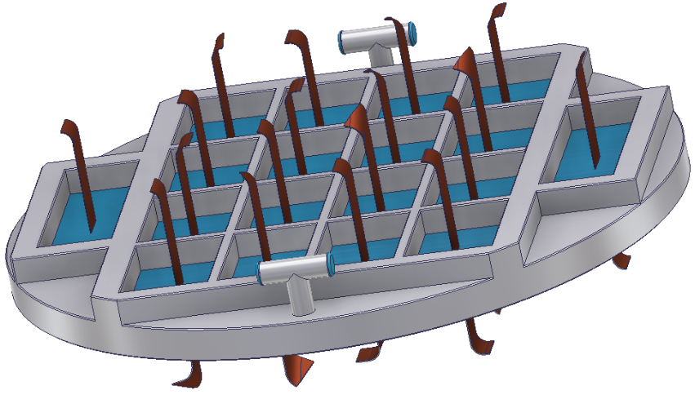
Collaboration WP3 & WP4
WP3 : Calorimetry and Light-based Detectors
WP4 : R&D on Light-weight Cryostats
High-density flange made of different material candidates:
3D-printed plastics
Araldite resins
Fiberglass with epoxy resins
Development and testing of carbon fiber cryostats
87 K
Goal : Development of high-density signal feedthroughs for future LAr calorimeters
Goal : Decrease thickness and material budget of the next generation
of cryostats for HEP

Slide 4
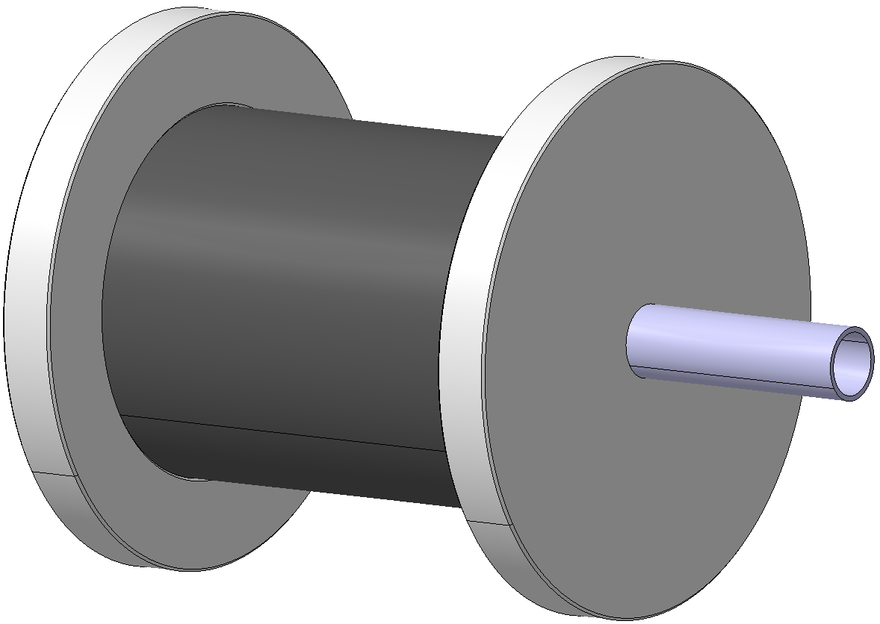
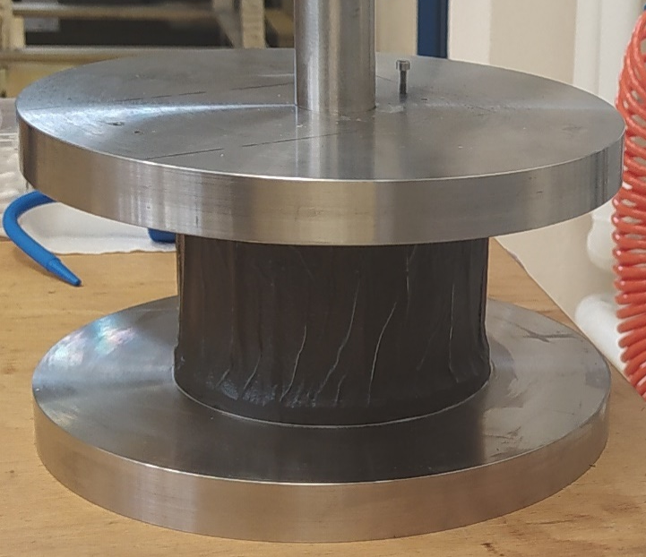
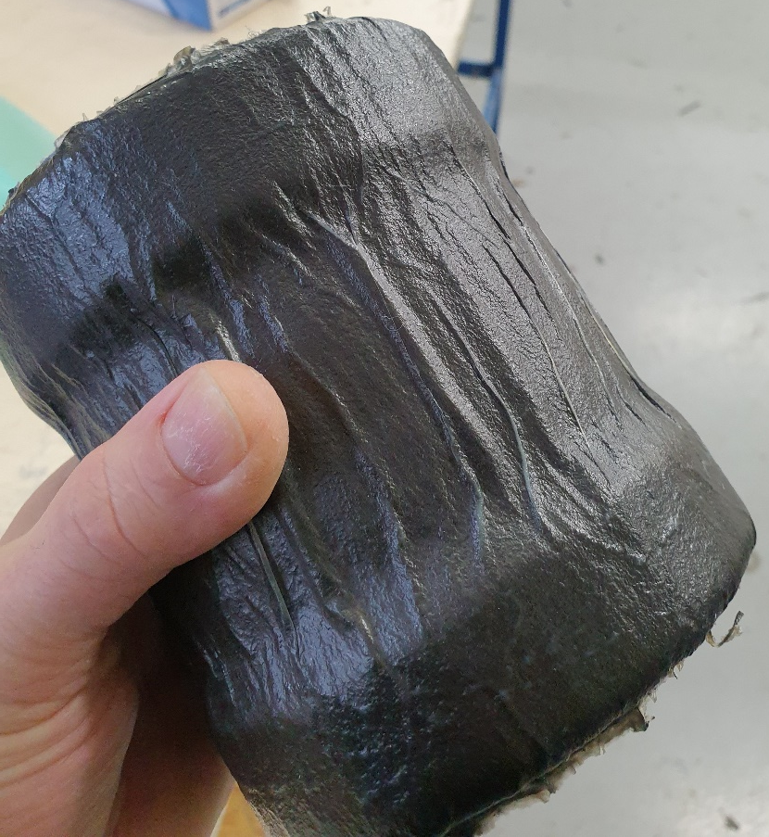
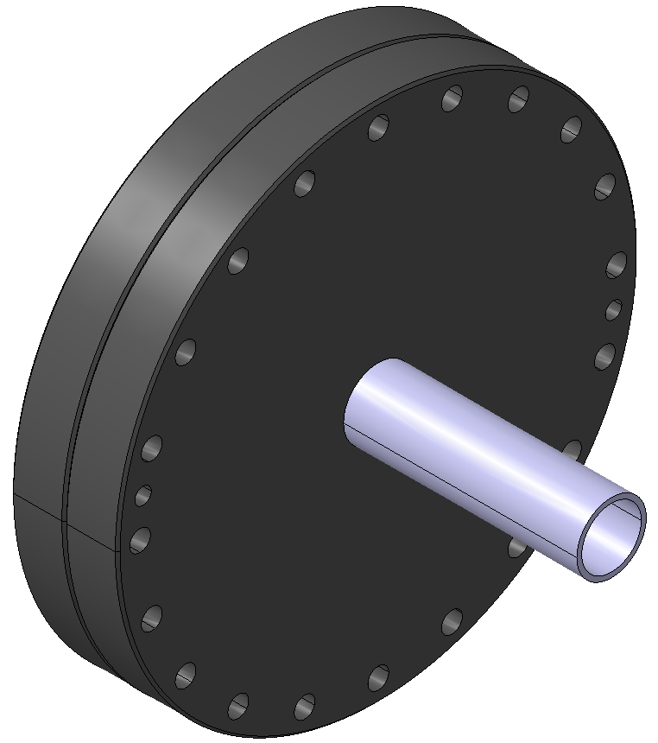
Collaboration WP3 & WP4
WP4 : R&D on Light-weight Cryostats
Prototypes to test:
SS flange
Carbon fiber cylinder
Prototype 2
Prototype 1
10 cm
Prototype 3

Slide 5
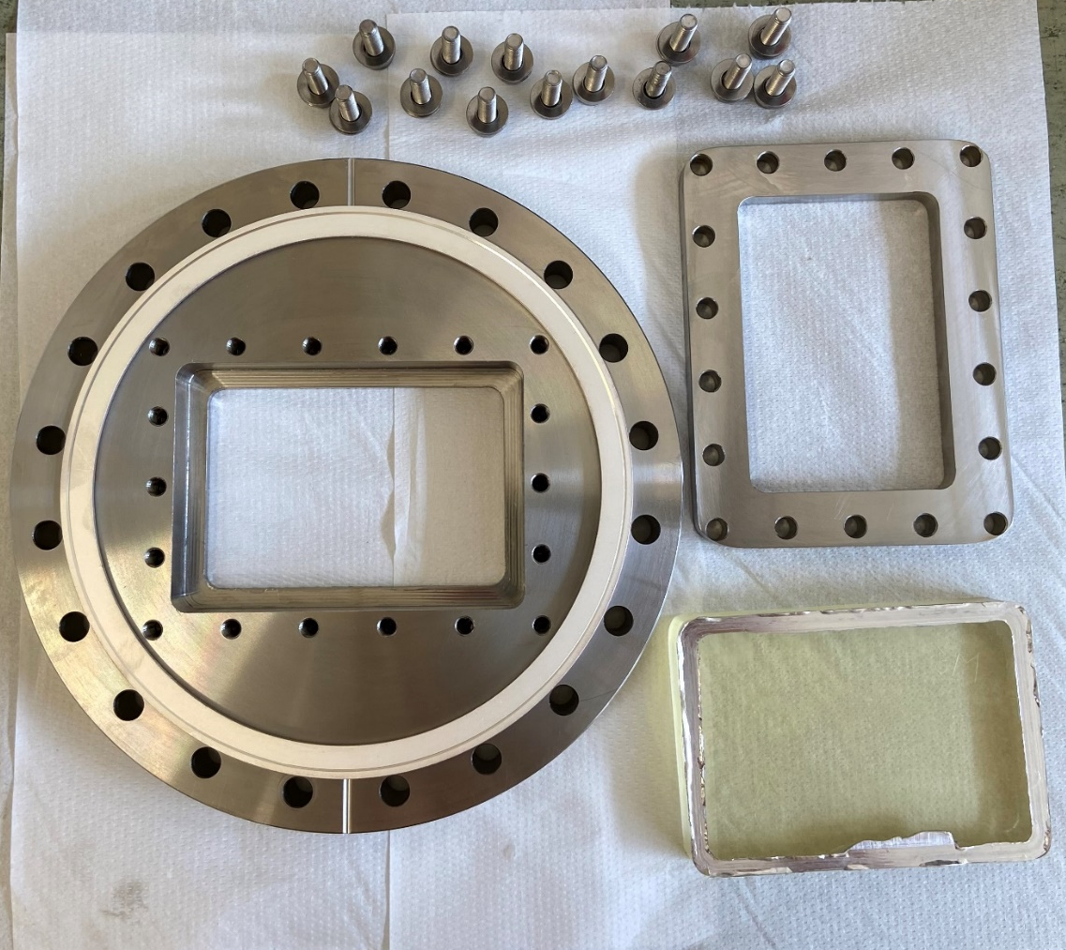

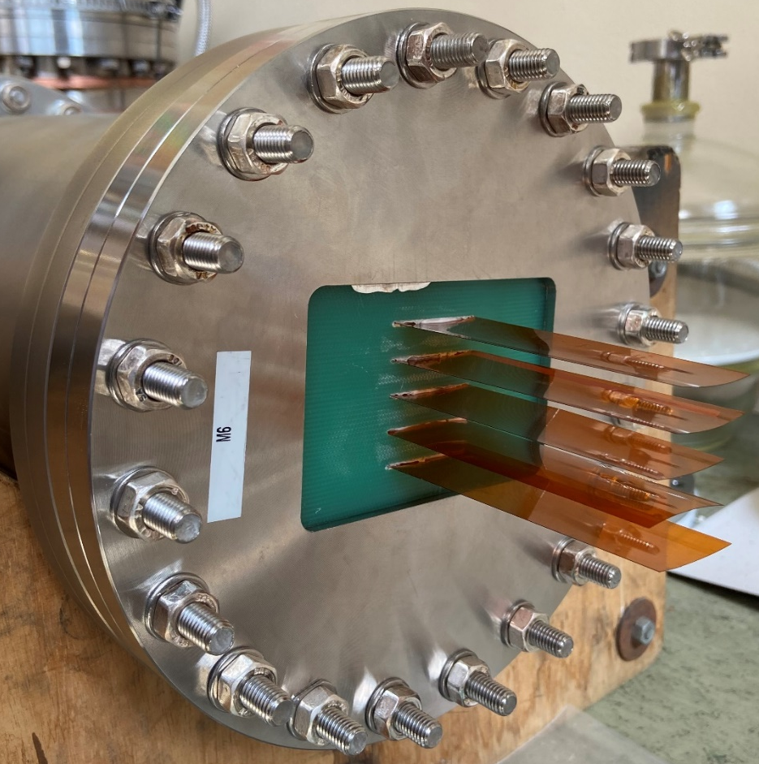
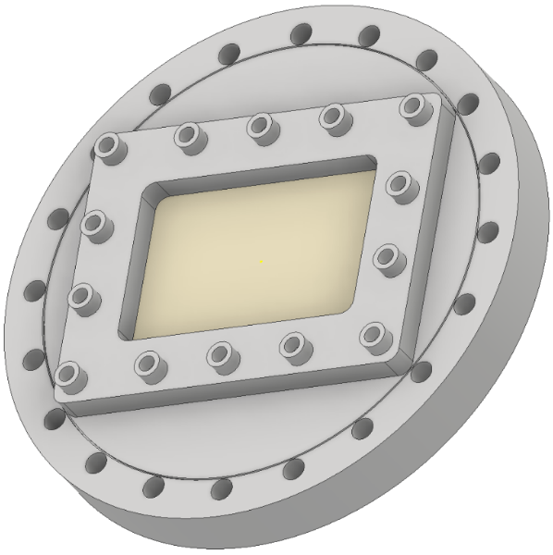
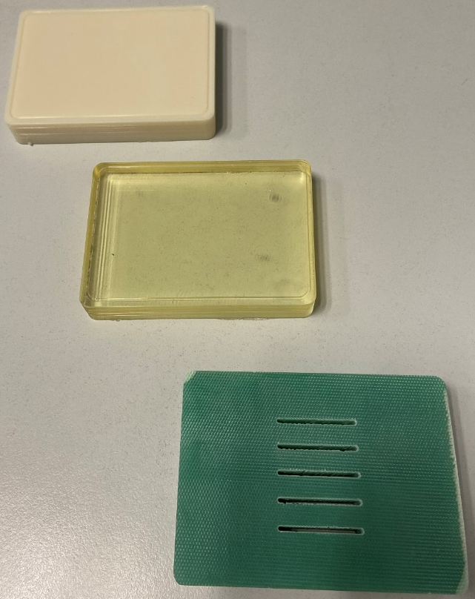
Collaboration WP3 & WP4
WP3 : Calorimetry and Light-based Detectors
Samples to test:
SS compression
plate
Sample 1:
MY750
Indium seal
Accura 25
Flange
MY750
G10

Slide 6
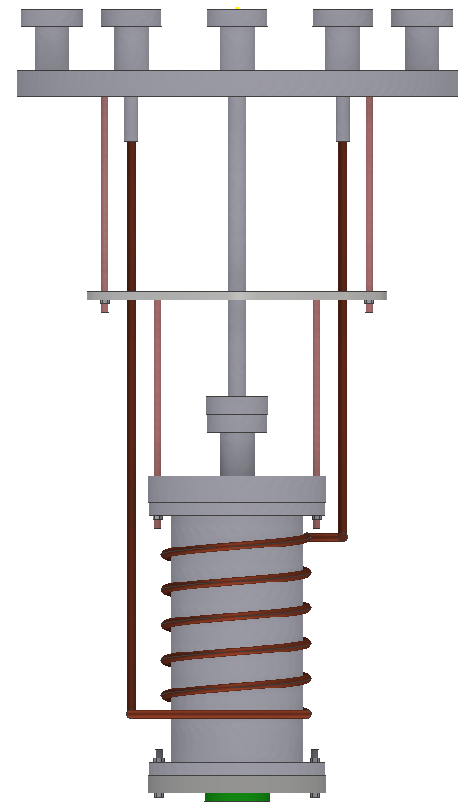
Collaboration WP3 & WP4
Pumping and leak detector
Type of tests:
Pressure (3.5 bar) and leak test at 300 K
Pressure (3.5 bar) and leak test at 80 K
To verify:
Resistance to low temperature
Resistance to high-pressure
Leak-tightness
Same “adaptable” experimental setup to test the feedthrough samples and the carbon fibre prototypes
Test schedule → one sample per week
LN₂
GHe
LN₂
DAQ
Cryostat
Thermal shield (GN₂)
Feedthroughs samples
Sample

Slide 7
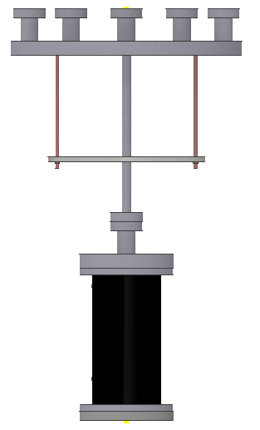
Collaboration WP3 & WP4
Pumping and leak detector
Type of tests:
Pressure (3.5 bar) and leak test at 300 K
Pressure (3.5 bar) and leak test at 80 K
To verify:
Resistance to low temperature
Resistance to high-pressure
Leak-tightness
Same “adaptable” experimental setup to test the feedthrough samples and the carbon fibre prototypes
Test schedule → one sample per week
LN₂
GHe
LN₂
DAQ
Cryostat
Thermal shield (LN₂)
Prototype (cooled by radiation from thermal shield)
Carbon fiber prototypes

Slide 8
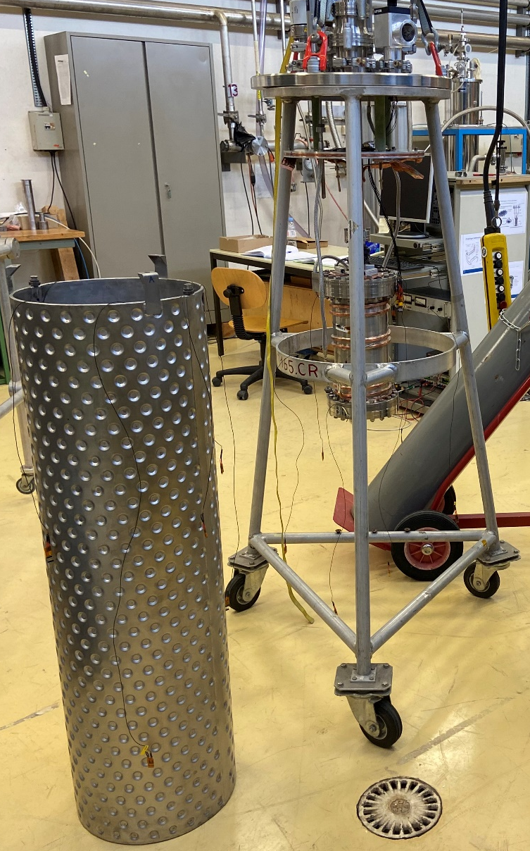
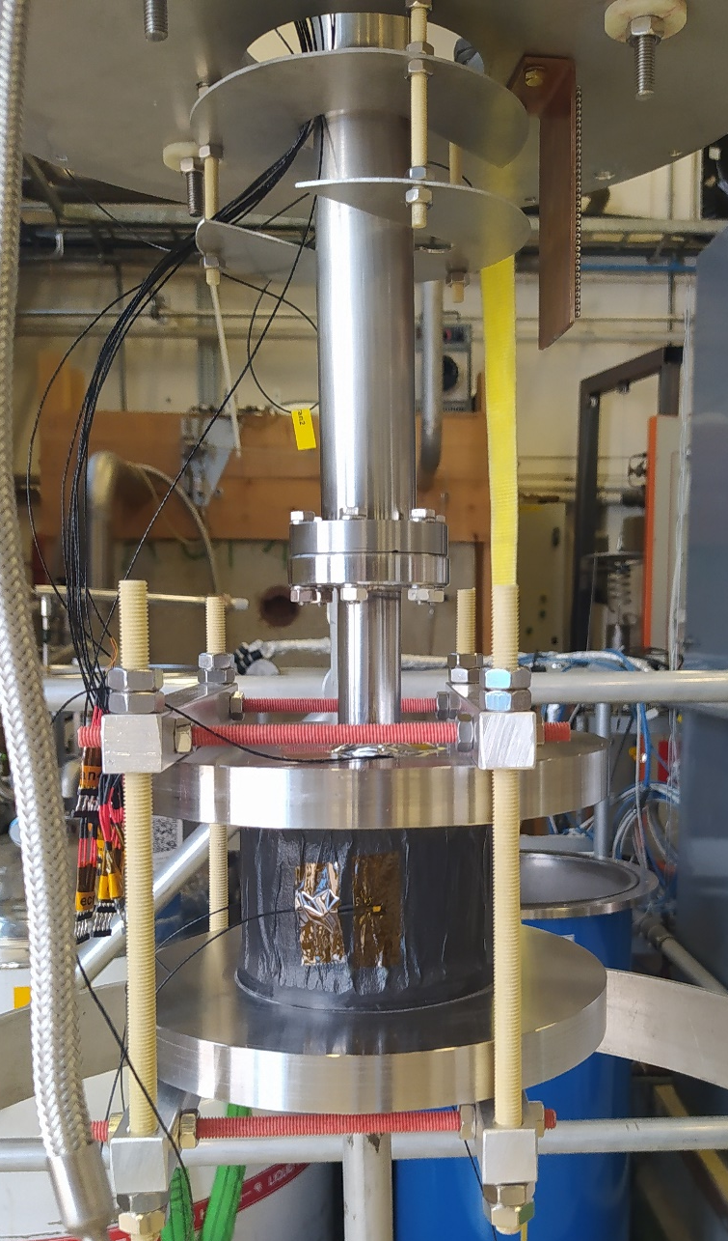
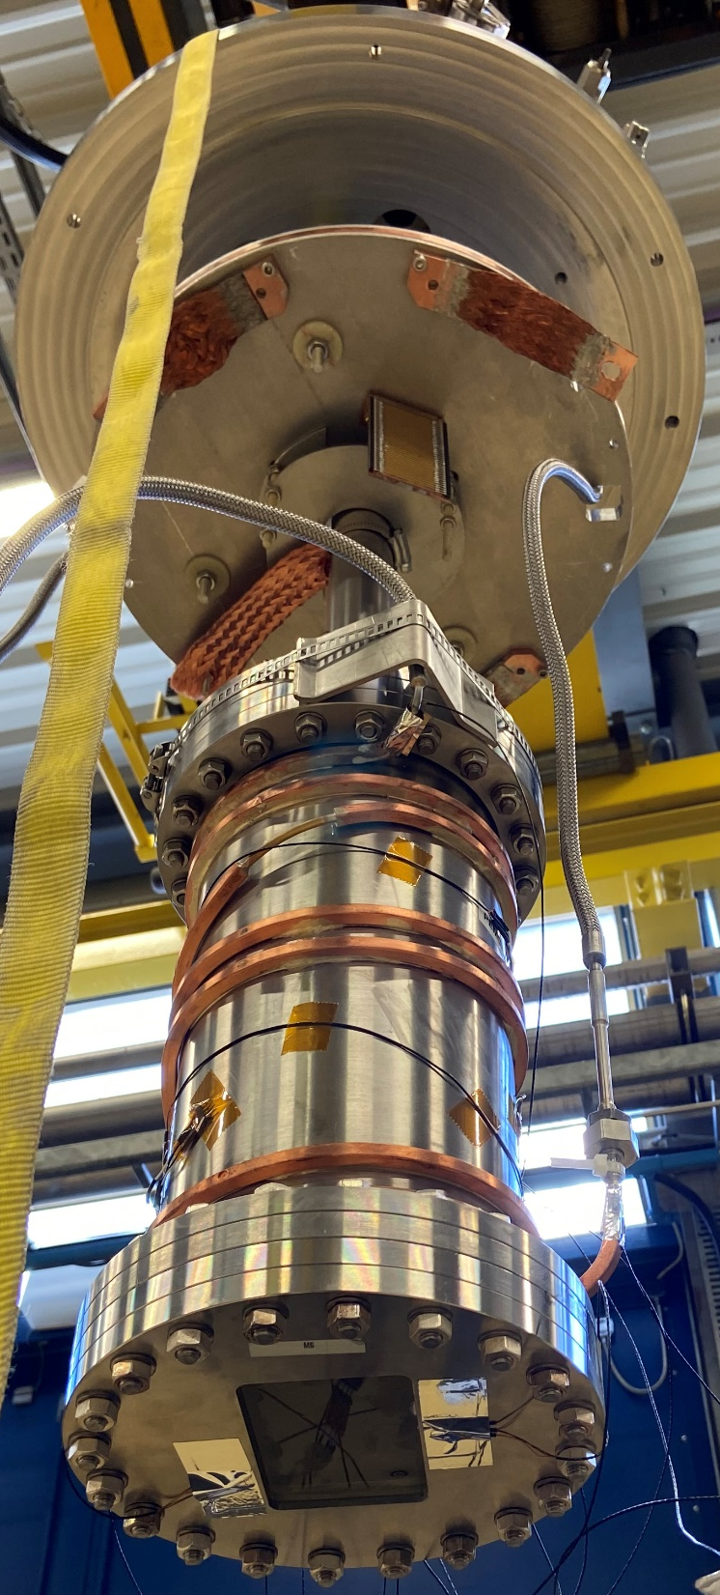
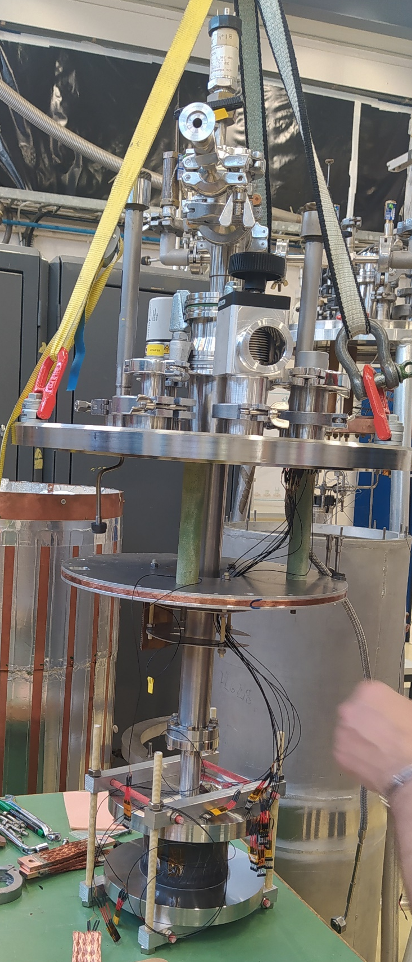
Collaboration WP3 & WP4
WP3 : Calorimetry and Light-based Detectors
WP4 : R&D on Light-weight Cryostats

Slide 9

WP3 : Calorimetry and Light-based Detectors
CTE and thermal conductivity measurements at low temperature ongoing…
CTE of Accura25 between 300 and 77 K (11 mm/m)
CTE of MY750 between 300 and 77 K (10 mm/m)
CTE of Accura25 between 77 and 4.2 K
CTE of MY750 between 77 and 4.2 K
λ of Accura25 between 300 and 77 K
λ of MY750 between 300 and 77 K
λ of Accura25 between 77 and 4.2 K
λ of MY750 between 77 and 4.2 K

Slide 10
Thank you for your attention!
Questions?

