Slide 1


The Large Hadron Collider:
In Search of New Physics
Albert De Roeck
CERN, Geneva, Switzerland
Antwerp University Belgium
UC-Davis California USA
BU, Cairo, Egypt
NTU, Singapore
CERN 18 June 2021

Slide 2

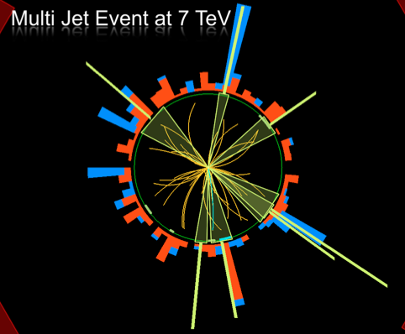
Outline
<- Lecturer today
Introduction: Experimental
Techniques
Higgs discovery
New Physics Searches
@ the Large Hadron Collider
-Dark Matter?
-Supersymmetry?
-Extra space dimensions?
-Black Holes?
-Matter Substructure?
Summary

Slide 3

What is the world made of?
What holds the world together?
Where did we come from?
CERN is the largest research laboratory that provides the tools
for conducting these studies: Particle Accelerators

Slide 4
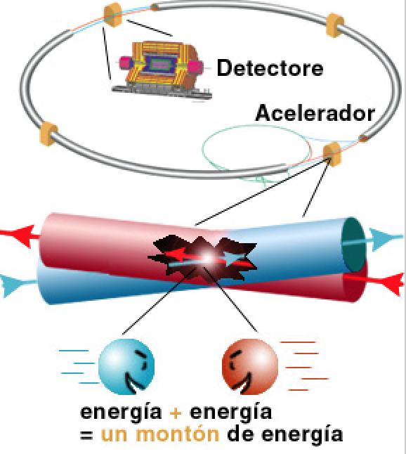

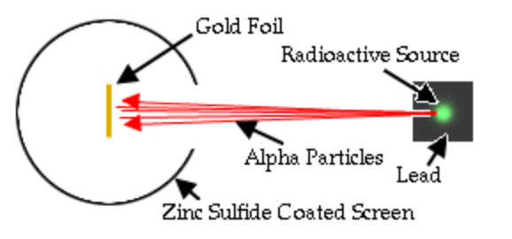
High Energy Physics Experiments
First High Energy Physics
Experiments:
Beam on fixed target!
High Energy Physics
Experiments since mid 70’s:
Colliding beams!
Rutherford experiment (1909)
Centre of mass energy squared s=2E₁m₂
Centre of mass energy squared s=4E₁E₂
…plus secondary beams such as neutrinos…

Slide 5
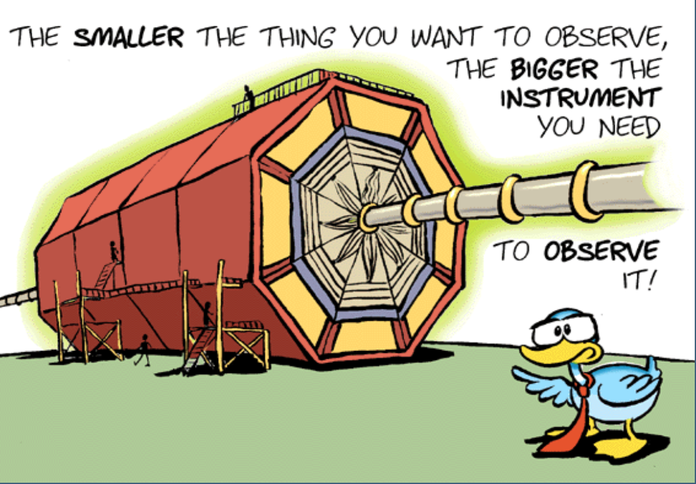
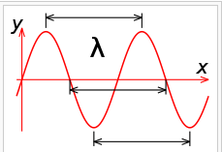
Accelerators are Powerful Microscopes
They make high energy particle beams
that allow us to see small things.
h
p
Planck constant
λ =
momentum
~ energy
wavelength
seen by low energy beam of particles
(poorer resolution)
seen by high energy beam of particles
(better resolution)

Slide 6


We can create particles
from energy
•Two beams of protons collide and generate,
in a very tiny space, temperatures over a
billion times higher than those prevailing at
the center of the Sun.
•Produce particles that may have existed at
the beginning of the Universe, right after the
Big Bang
Notes:
5

Slide 7
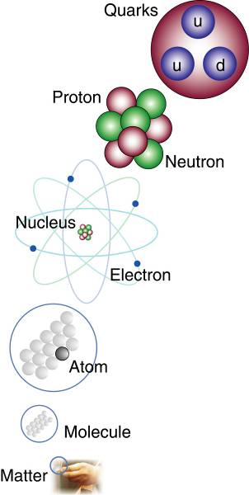
The Structure of Matter
Matter
Quarks and electrons are
the smallest building blocks
of matter that we know
of today.
Are there still smaller
particles?
The Large Hadron Collider
will address this question!

Slide 8
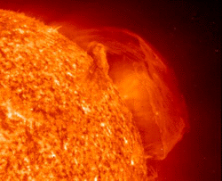
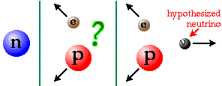
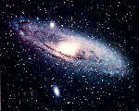
The Fundamental Forces of Nature
Electromagnetism:
gives light, radio, holds atoms together
Strong Nuclear Force:
holds nuclei together
Weak Nuclear Force:
gives radioactivity
together
they make
the Sun
shine
Gravity: holds planets and stars together

Slide 9

The “Standard Model”
Over the last 100 years: combination of
Quantum Mechanics and Special Theory of relativity
along with all new particles discovered has led to the
Standard Model of Particle Physics.
The new (final?) “Periodic Table” of fundamental elements:
Fermions
Bosons
The most basic mechanism of the SM, that of granting mass to particles remained a mystery for a long time
A major step forward was made in July 2012 with the discovery of what could be the long-sought Higgs boson!!
Matter particles
Force particles
Fermions: particles with spin ½
Bosons: particles with integer spin

Slide 10


The Hunt for the Higgs
The key question (pre-2012):
Does the Higgs particle exist?
Where
do
the
masses of
elementary particles come from?
We do not know the
mass of the Higgs Boson
Proton mass: 1 GeV
Massless particles move at the speed
of light -> no atom formation!!

Slide 11
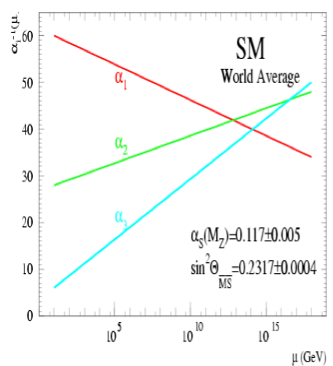
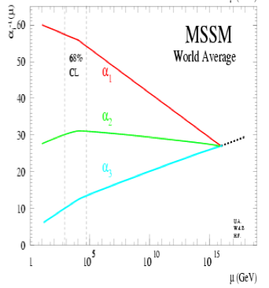
Physics case for new High Energy Machines
Understand the mechanism Electroweak Symmetry Breaking
Discover physics beyond the Standard Model
Reminder: The Standard Model
- tells us how but not why
3 flavour families? Mass spectra? Hierarchy? 19 parameters!
- needs fine tuning of parameters to level of 10⁻³⁰ !
- has no connection with gravity
- no unification of the forces at high energy
- Supersymmetry
- Extra space dimensions
Many other ideas: More symmetry and gauge bosons, composite
Higgs models, L-R symmetry, quark & lepton substructure,
Little Higgs models, Technicolor, Hidden Valleys, Vector-like quarks…
Most popular extensions around 2000
Higgsless models rather disfavoured these days

Slide 12
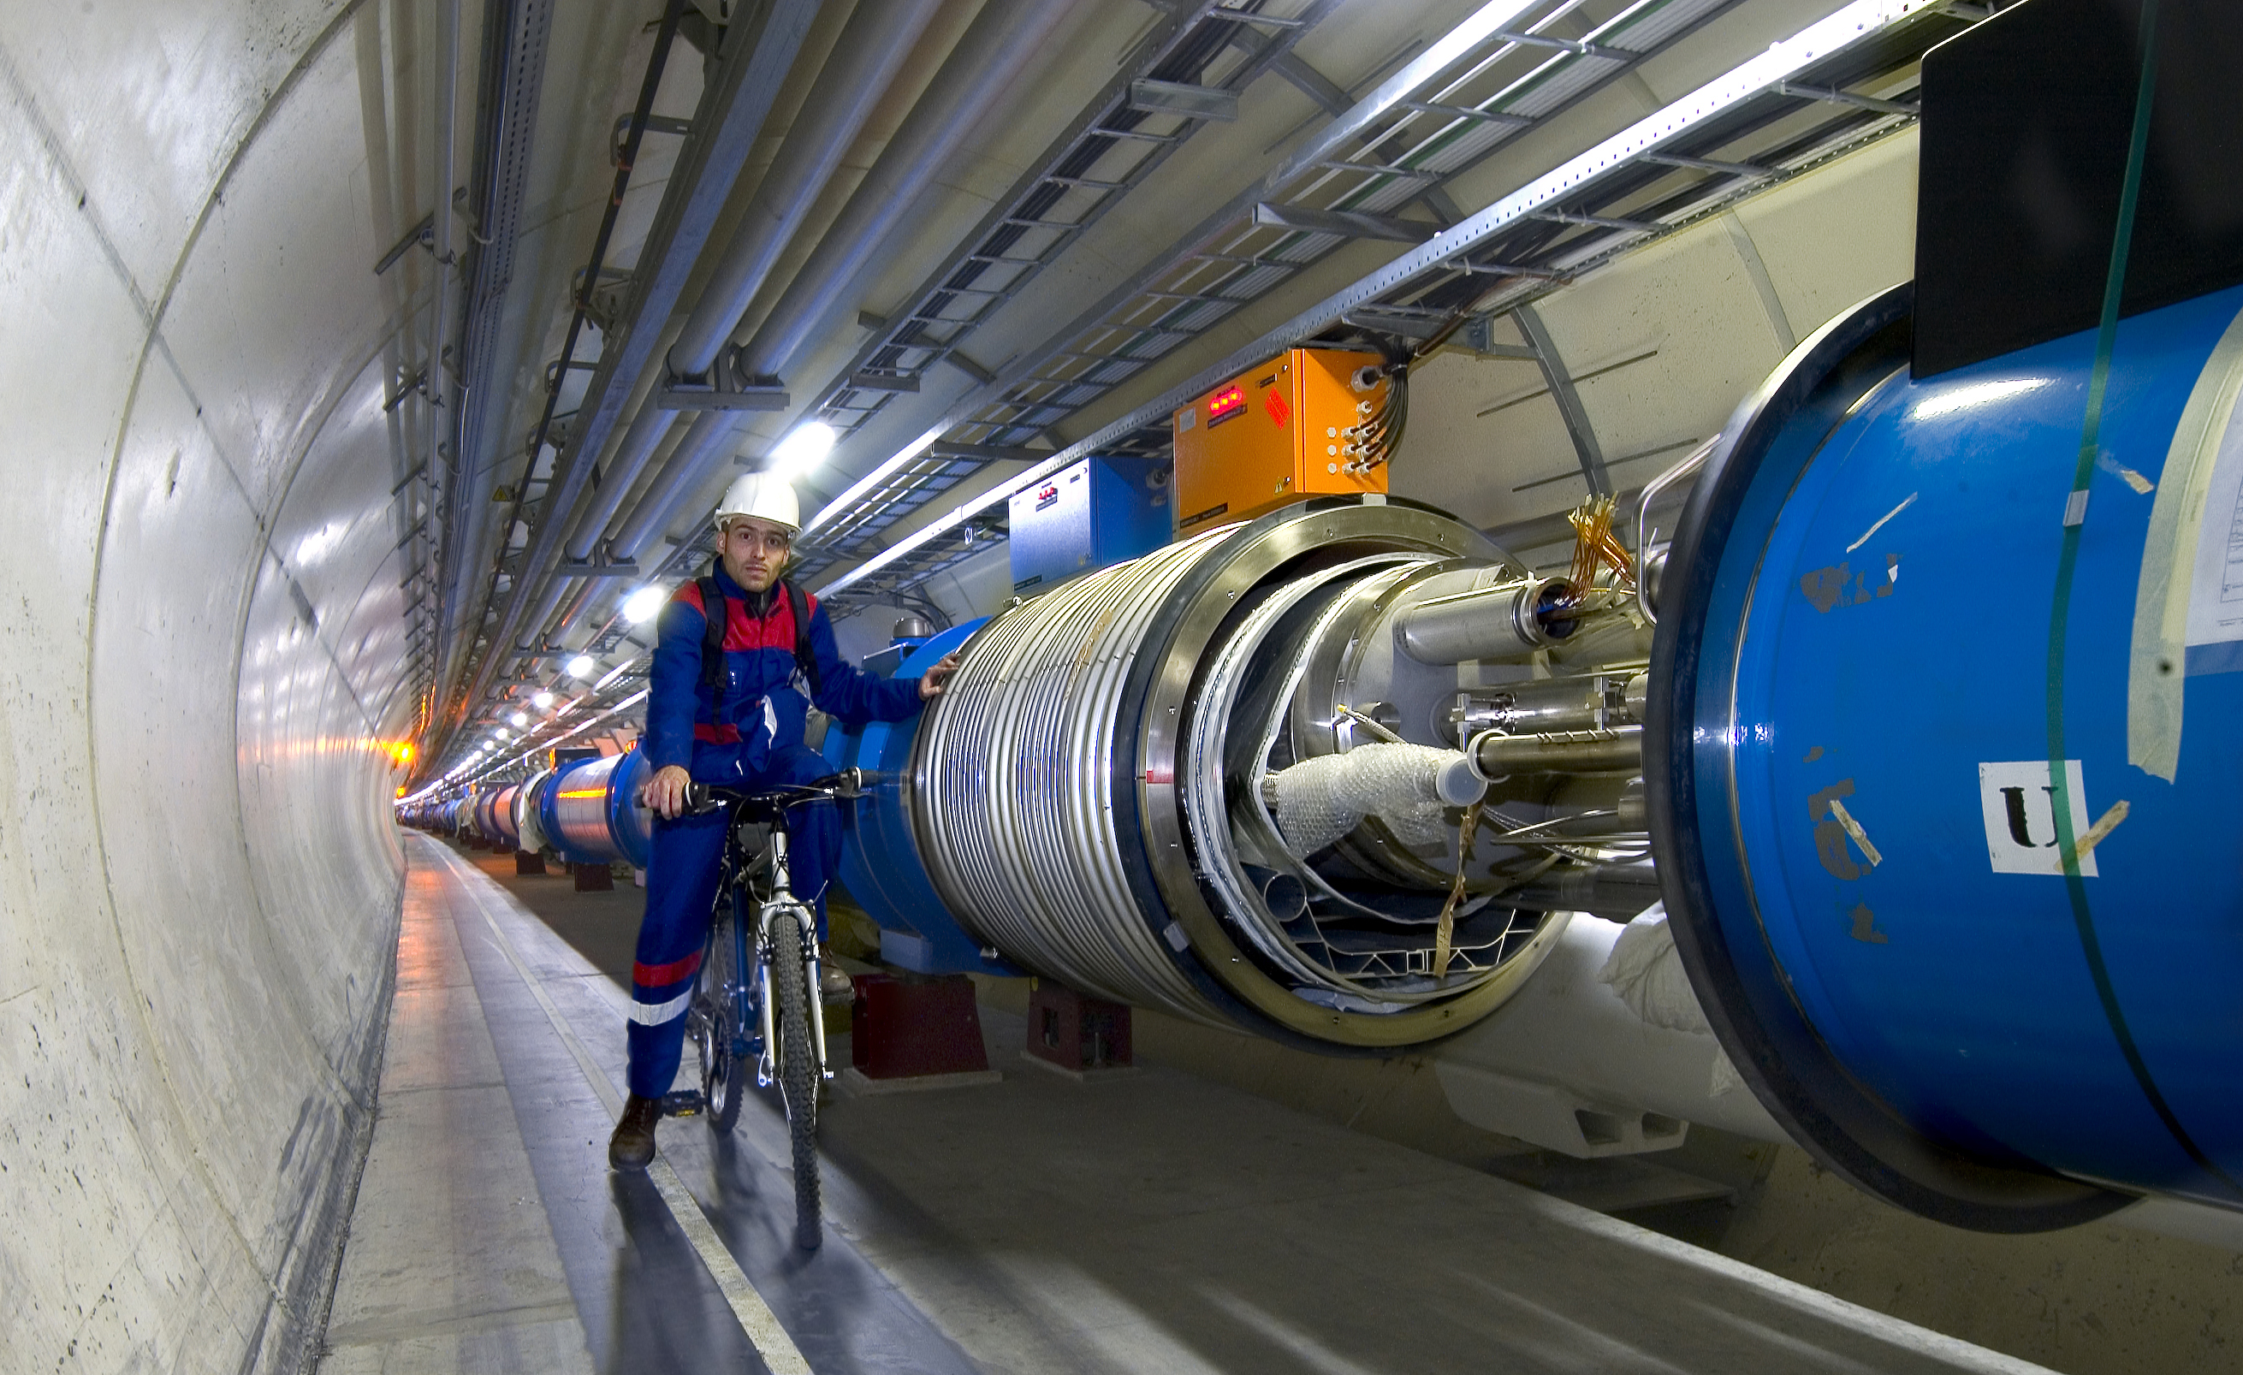
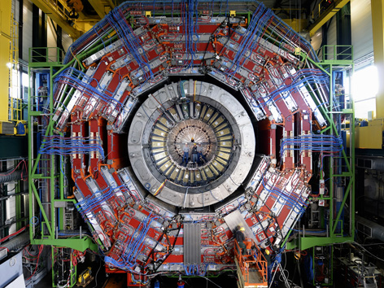

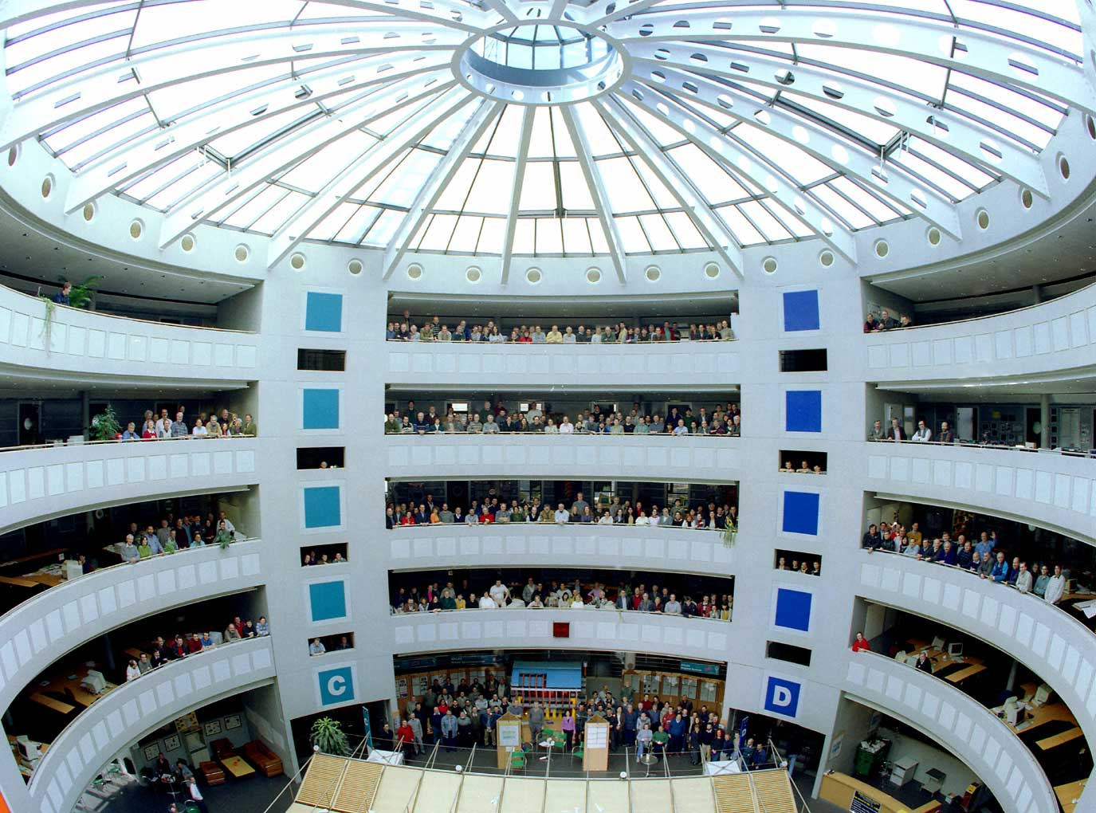
This Search Requires…….
1. Accelerators : powerful machines that accelerate particles to extremely high energies and bring them into collision with other particles
2. Detectors : gigantic instruments that record the resulting particles as they “stream” out from the point of collision.
3. Computing : to collect, store, distribute and analyse the vast amount of data produced by these detectors
4. Collaborative Science on Worldwide scale : thousands of scientists, engineers, technicians and support staff to design, build and operate these complex “machines”.

Slide 13
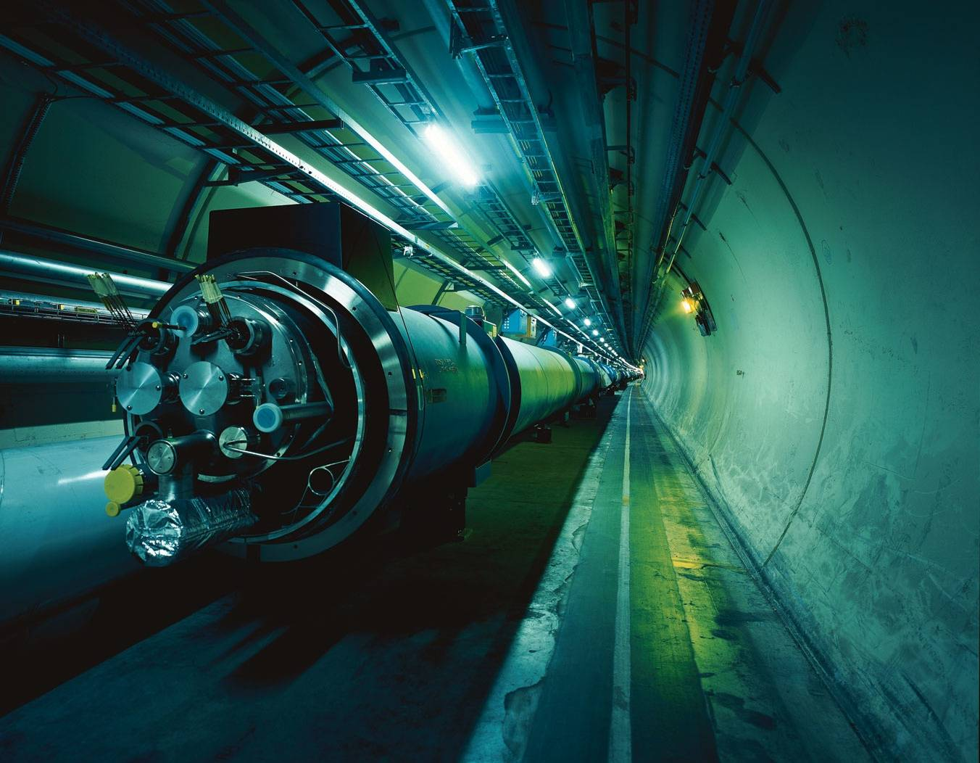

The Large Hadron Collider = a proton proton collider
Also a heavy ion collider
7 TeV + 7 TeV
6.5 TeV + 6.5 TeV
(4/3.5 TeV + 4/3.5 TeV)
Primary physics targets
• Origin of mass
• Nature of Dark Matter
• Understanding space time
• Matter versus antimatter
• Primordial plasma
The LHC is a Discovery Machine
Will LHC determine the future course of High Energy Physics?
Notes:
.999999991 % speed of light
At near light-speed, a proton in a beam will make 11 245 turns per second. A beam might circulate for 10 hours, traveling more than 10 billion kilometers – far enough to get to the planet Neptune and back again.

Slide 14
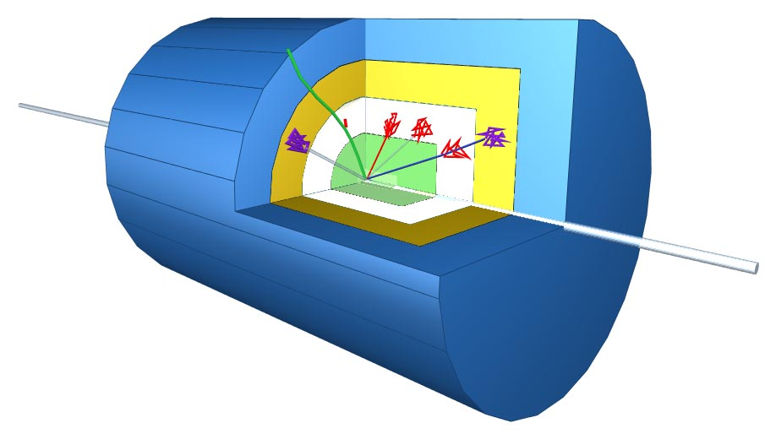
Schematic of a LHC Detector
Physics requirements drive the design!
Analogy with a cylindrical onion:
Technologically advanced detectors comprising many layers, each designed to perform a specific task.
Together these layers allow us to identify and precisely measure the energies and directions of all the particles produced in collisions.
Such an experiment
has ~ 100 Million
read-out channels!!

Slide 15

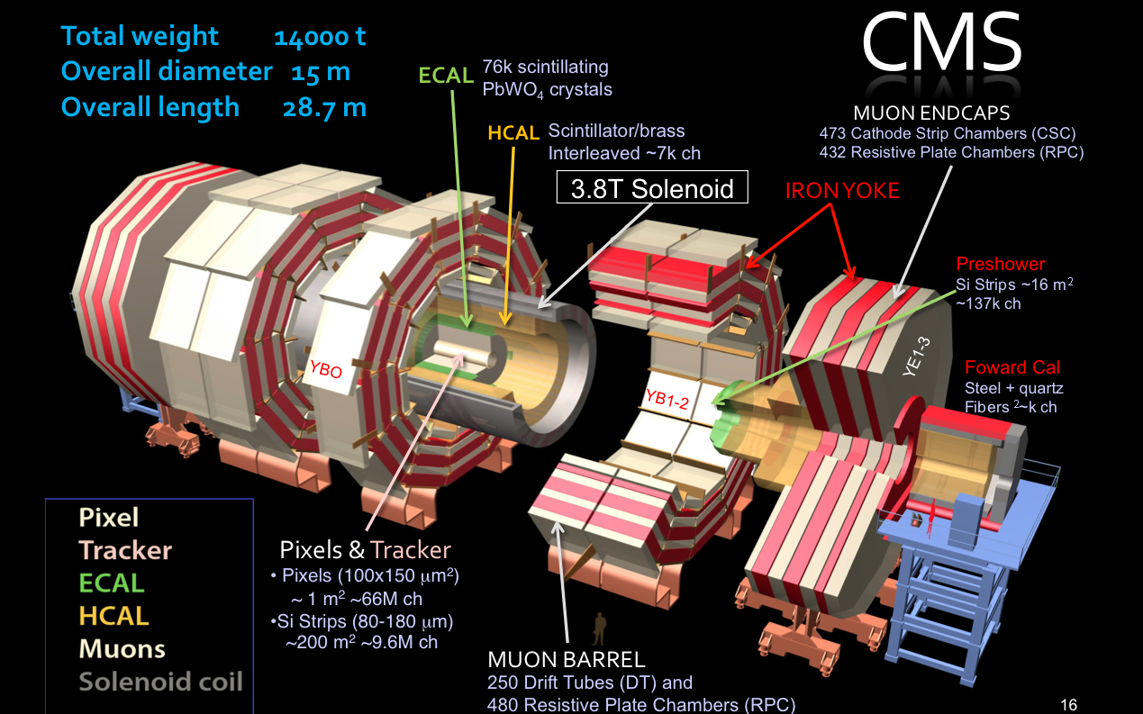
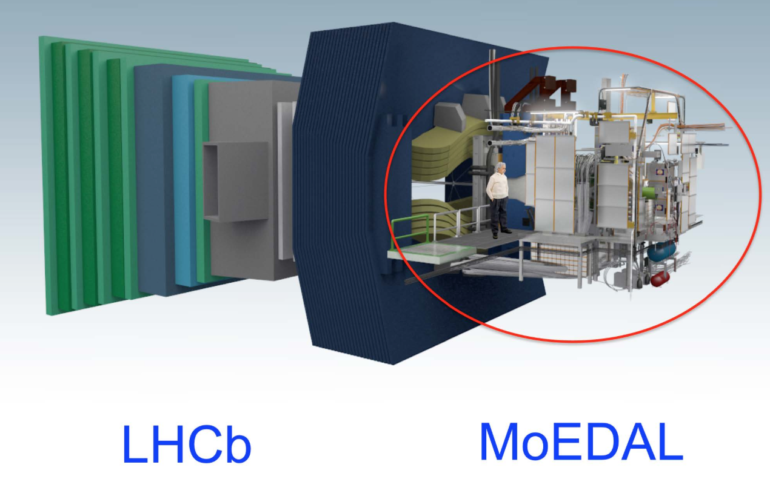
New Physics Hunters @ the LHC
The ATLAS experiment
The CMS experiment
…And also LHCb and MoEDAL

Slide 16


Slide 17
The Compact Muon Solenoid Experiment
In total about ~100 000 000 electronic channels
Each channel checked 40 000 000 times per second (collision rate is 40 MHz)
An on-line trigger selects events and reduces the rate from 40MHz to ~300 Hz
Amount of data of just one collisions ~1 000 000 Bytes

Slide 18
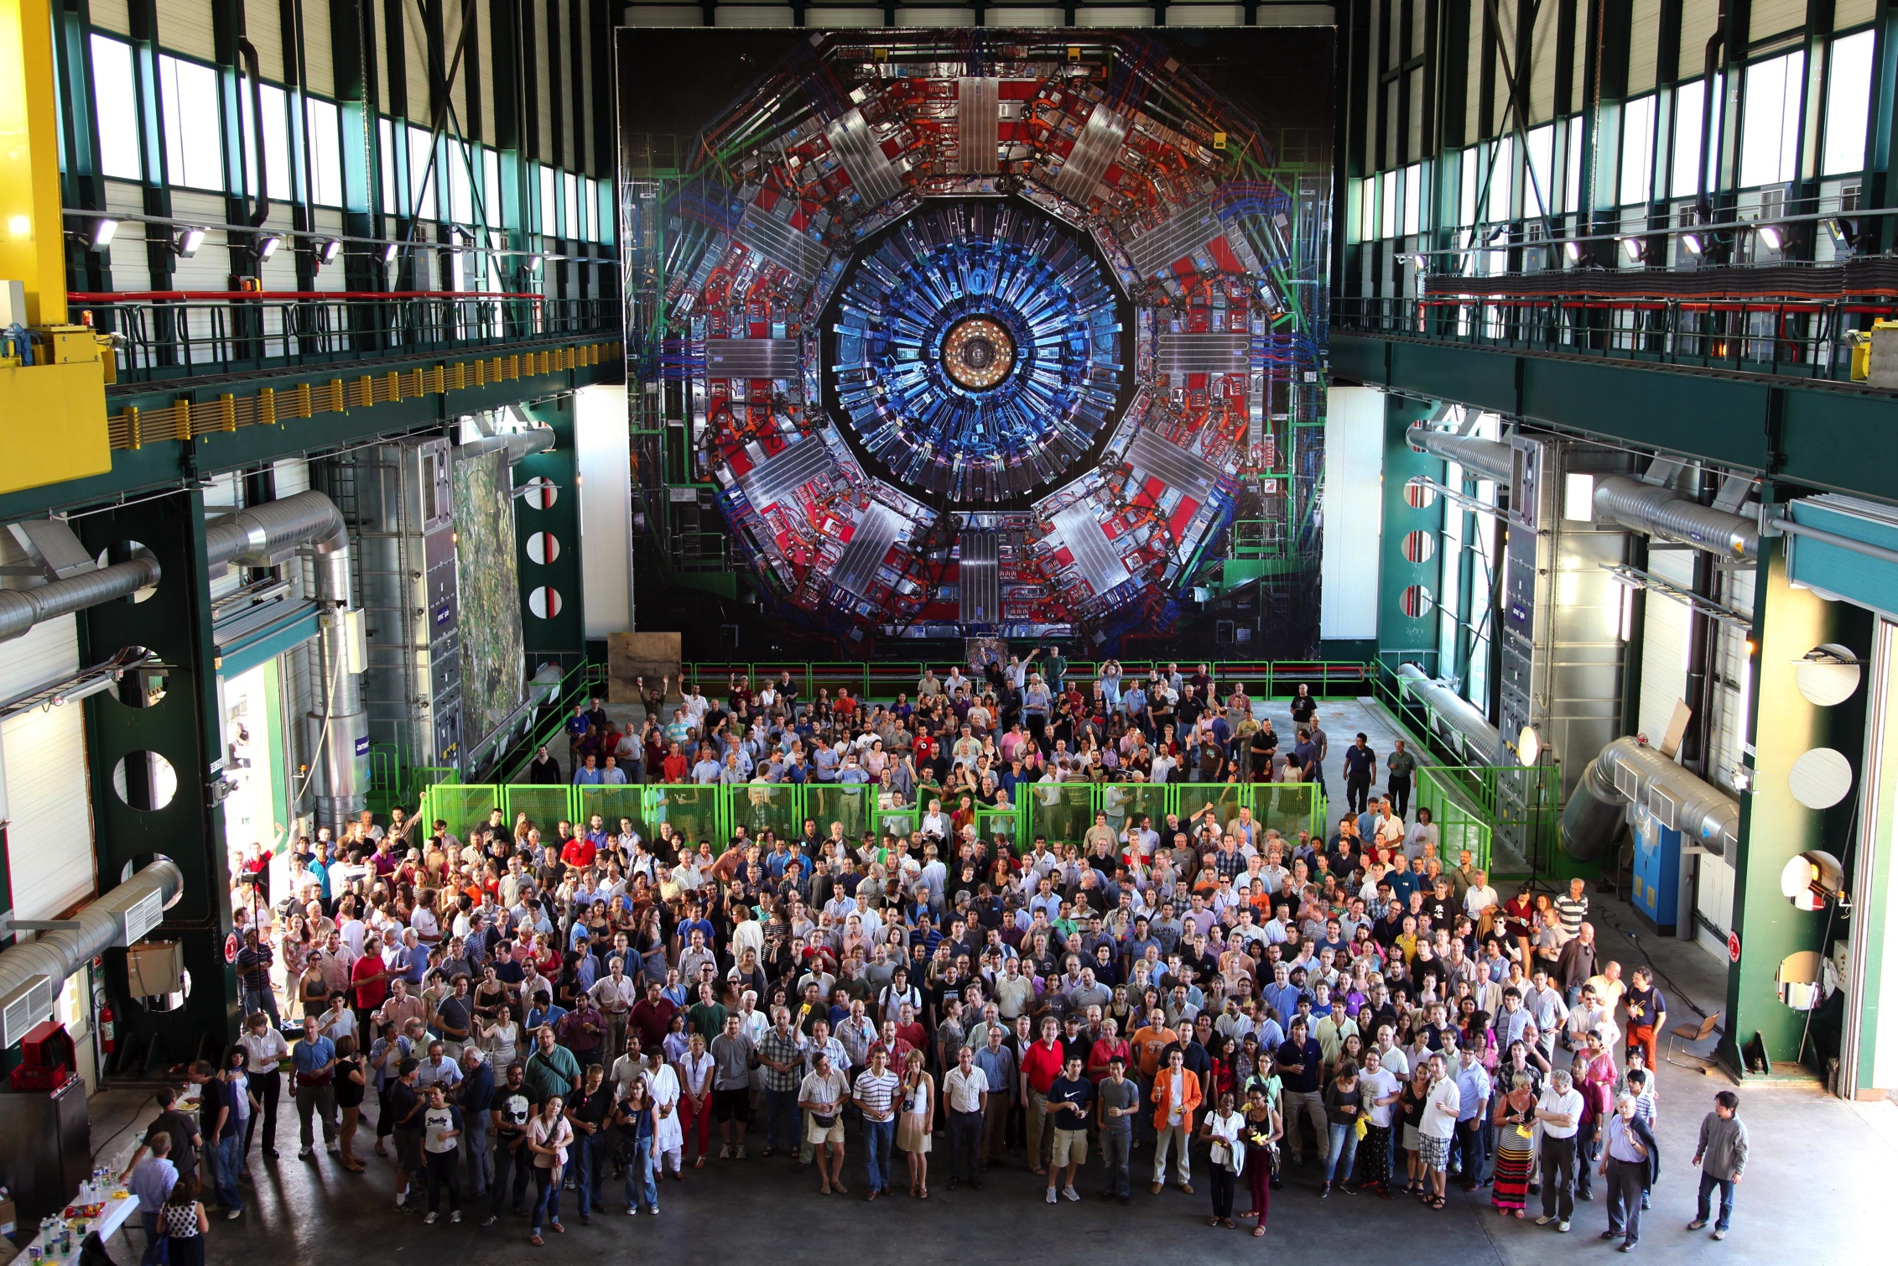
CMS Collaboration June 27, 2012
The CMS Collaboration: >3200 scientists and engineers,
>800 students from 236 Institutions in 54 countries .
About 1/8th of the
collaboration
Singapore not yet a member, but has an agreement with CMS

Slide 19
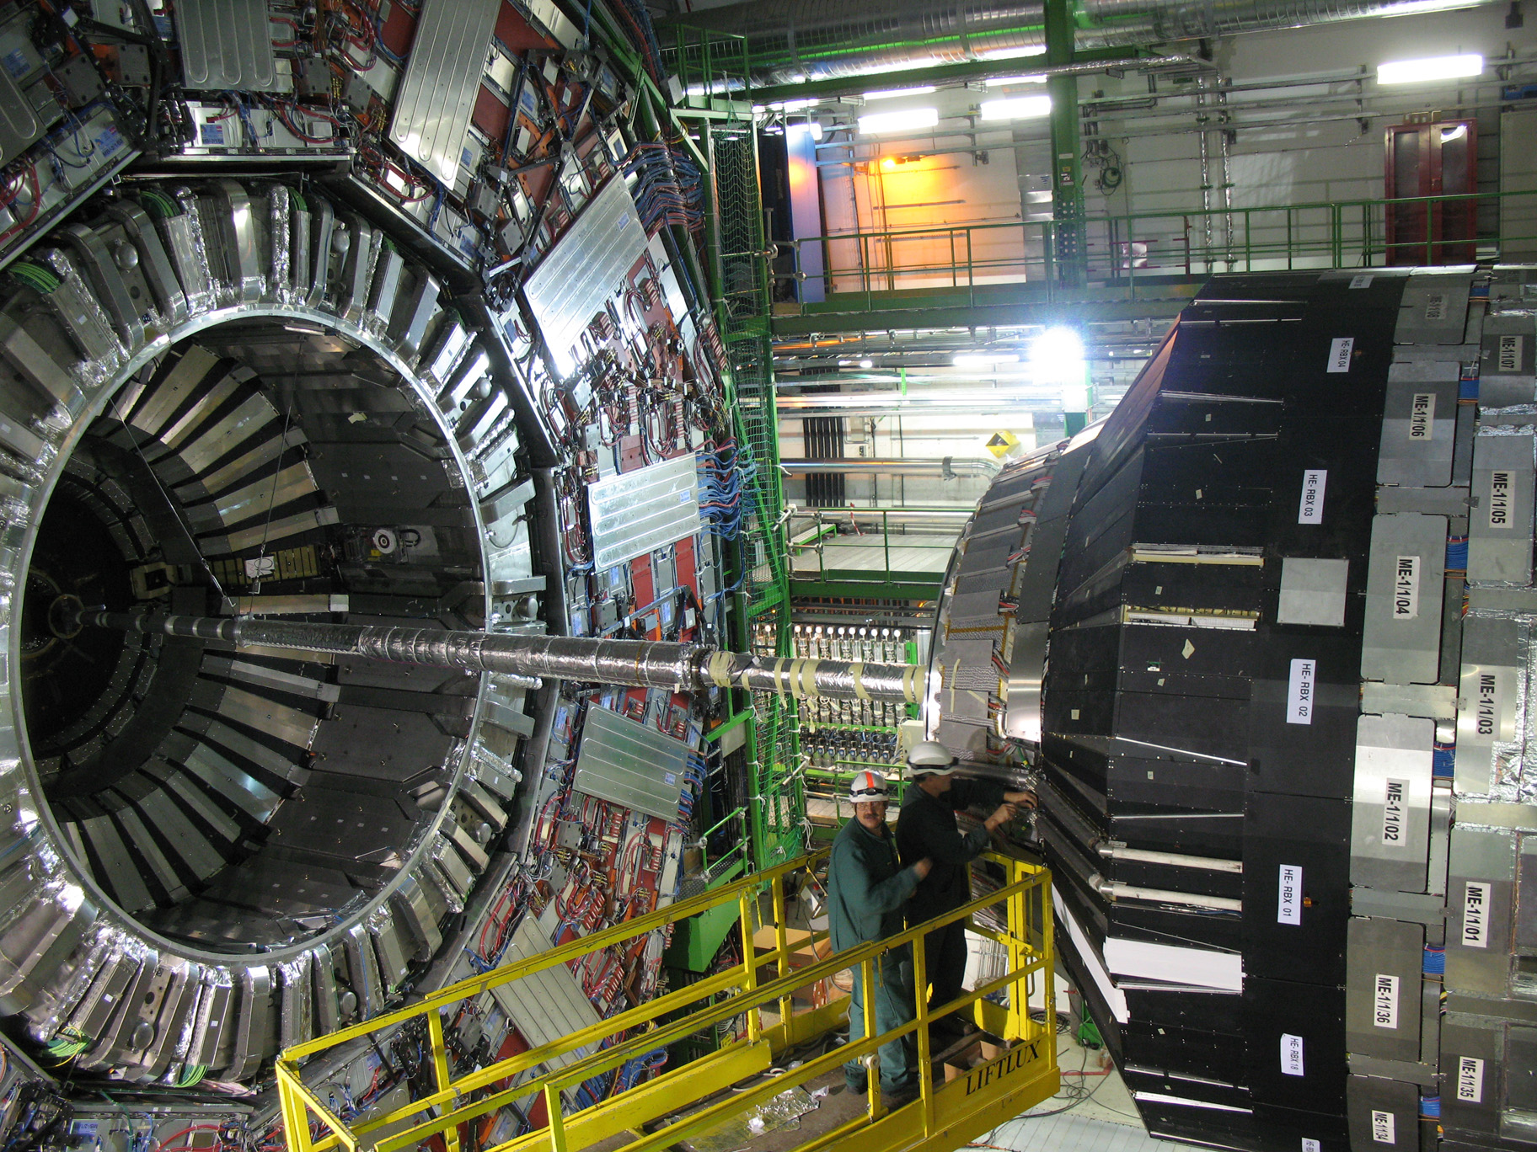
CMS before closure

Slide 20
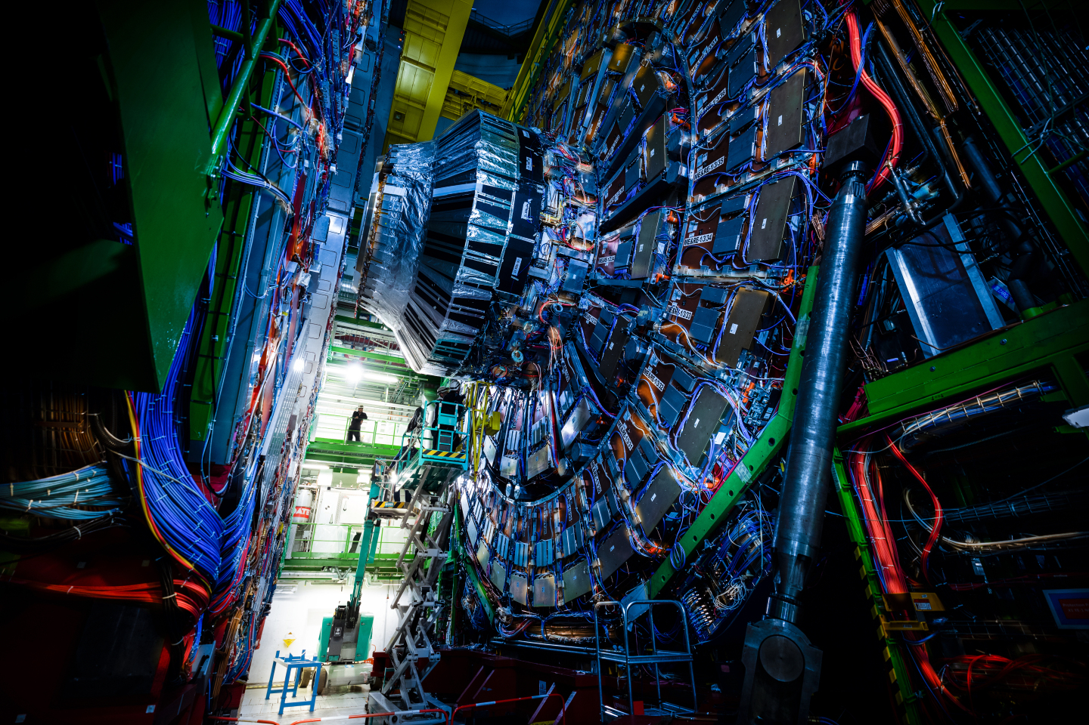

Slide 21
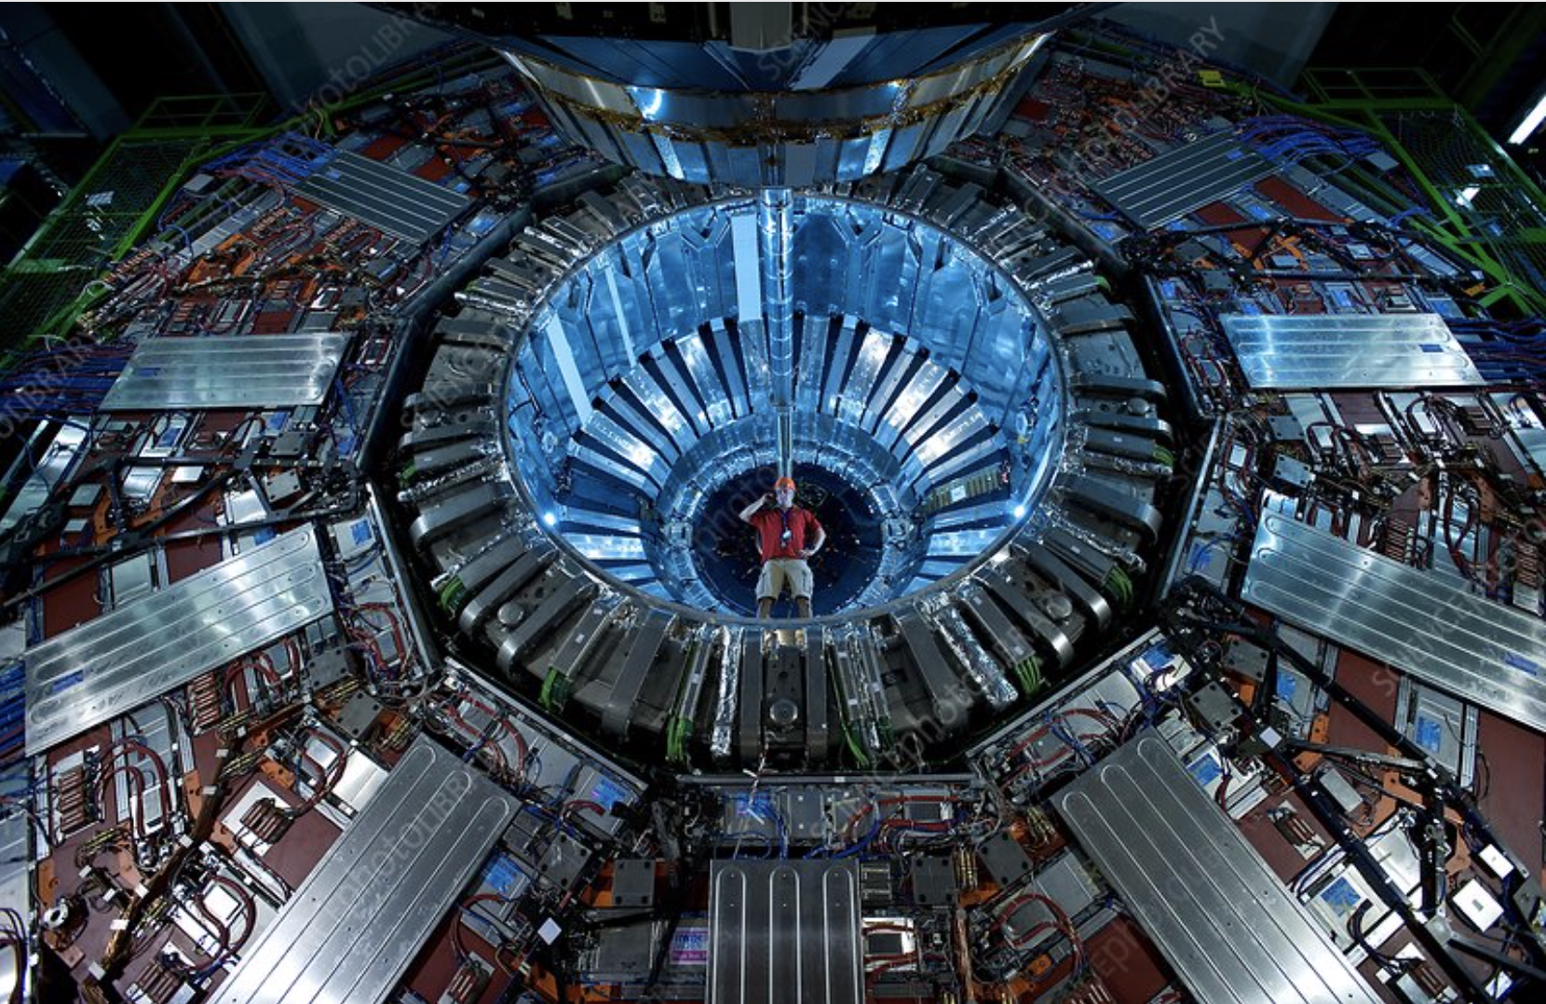
Artistic CMS
Notes:
Now that we have accelerated the particles, let’s collide them!
This is possible only in the 4 points where we cross-over the beams.
The collision point is tinier than a needle head.
Here is the ATLAS detector, the largest of the 4 LHC detectors. Look at the small persons next to it.
It is 50 long, 25m diameter and weights 7’000 tonnes, the same as the Eiffel Tower.
The collision of protons will create new particles in all directions. That’s why the detector often have this cylindrical shape.

Slide 22
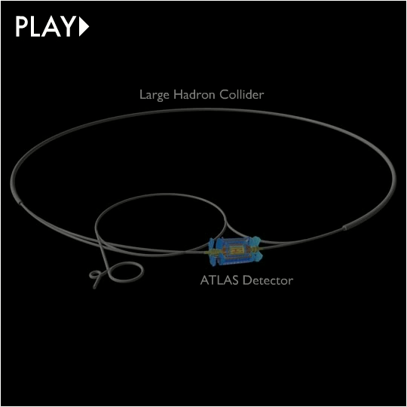

Slide 23

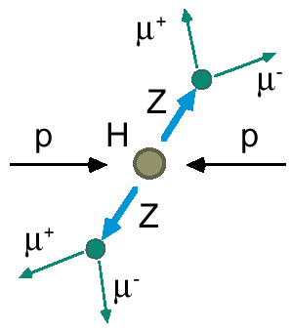
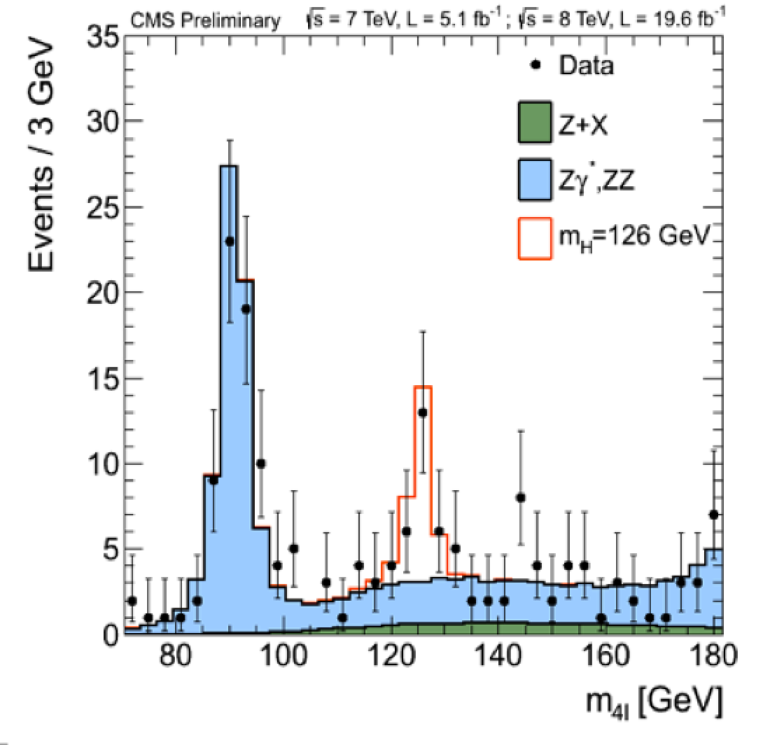

2012: A Milestone in Particle Physics
Observation of a Higgs Particle at the LHC, after about 40 years
of experimental searches to find it
proton
proton
2013
The Higgs particle was the last missing particle in the Standard Model
and possibly our portal to physics Beyond the Standard Model

Slide 24
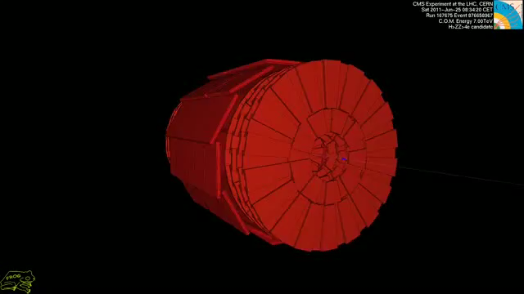
A Higgs Particle Candidate…

Slide 25
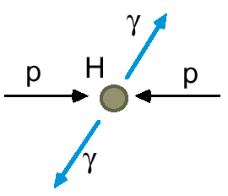
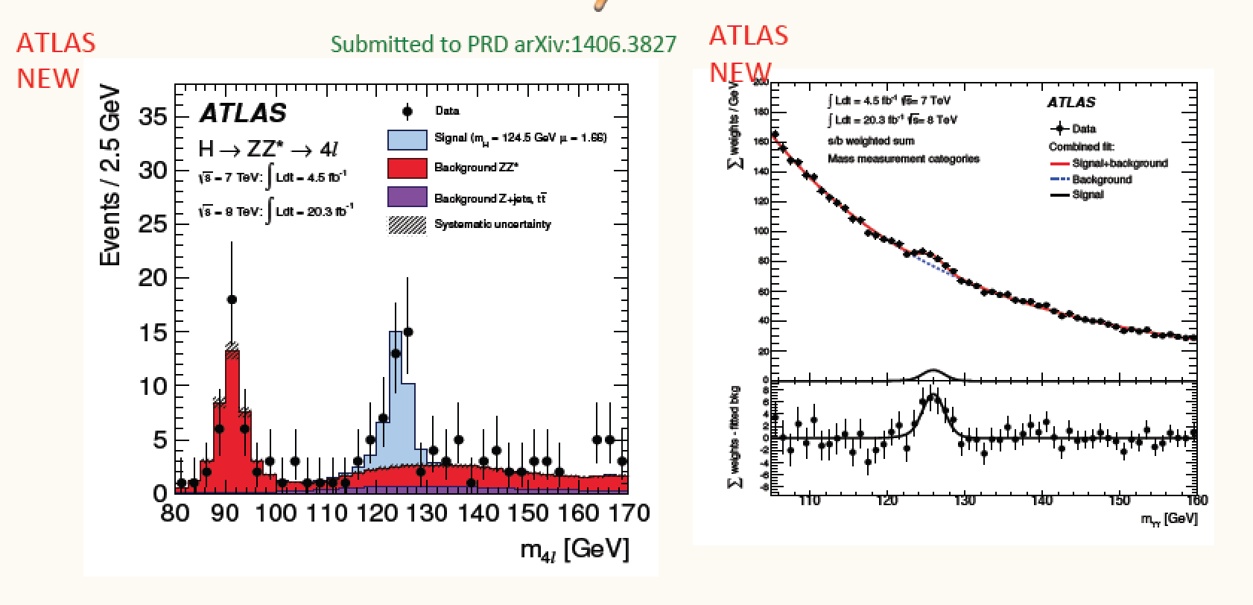
Higgs → ZZ and γγ
Discovery Channels!

Slide 26
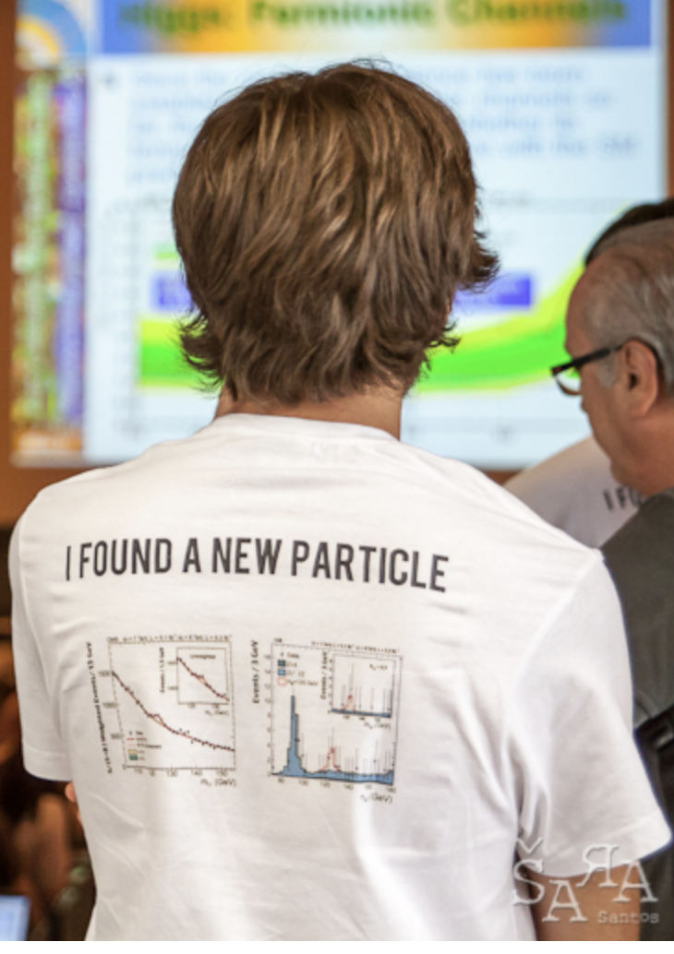
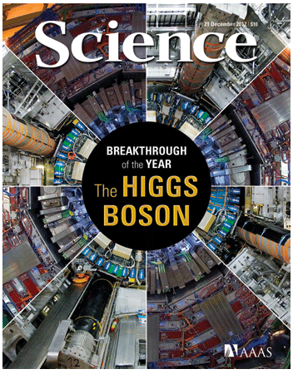

Most Cited LHC Paper so far...
The Higgs Discovery 2012!
Cited more than 12,000 times to date

Slide 27


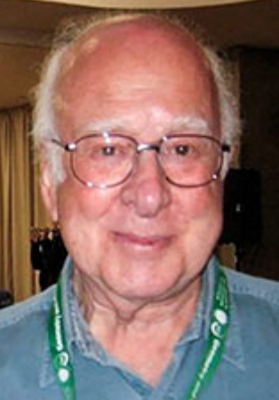
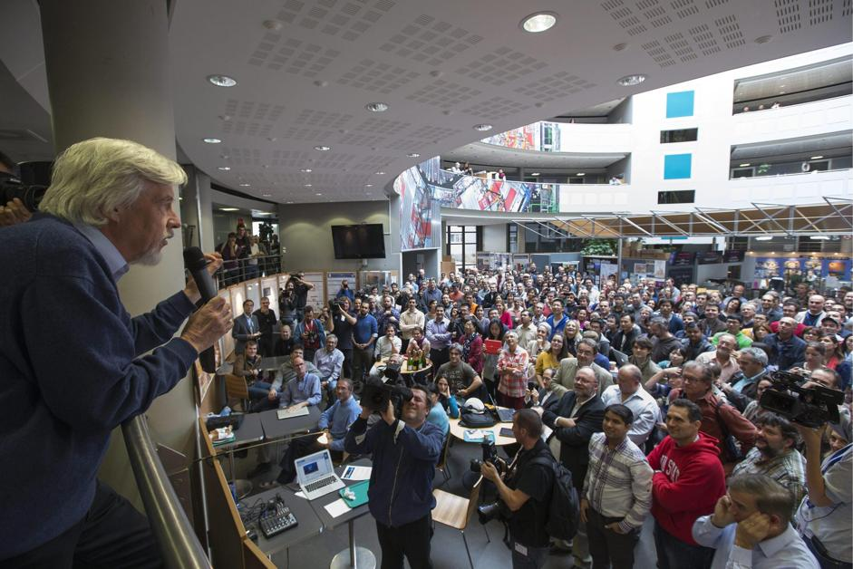


Tuesday 8 October 2013
Francois Englert
Peter Higgs
Congratulations!!!!

Slide 28
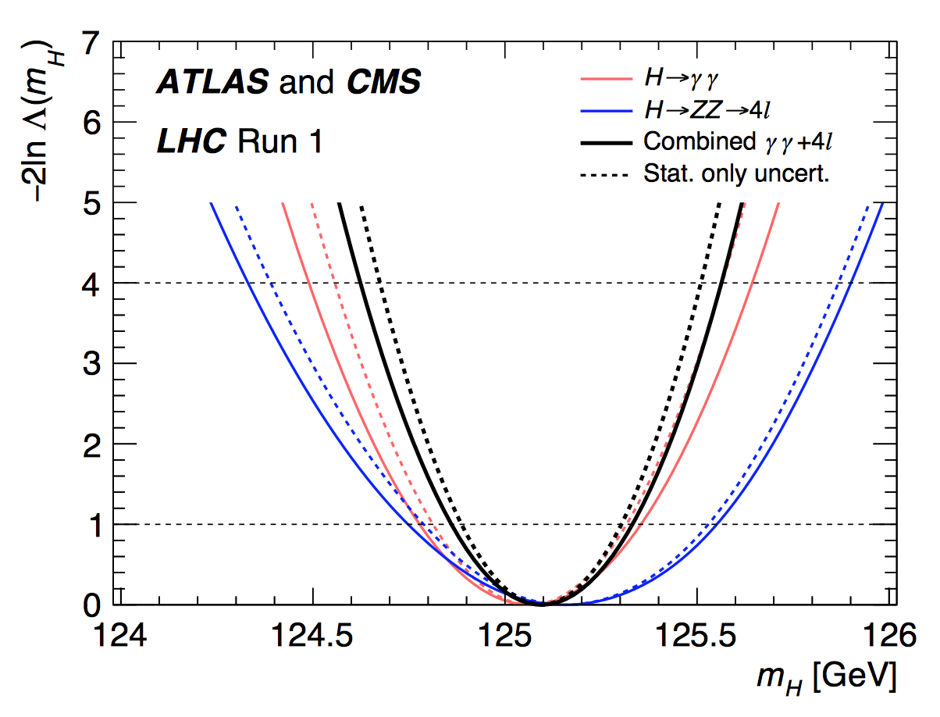
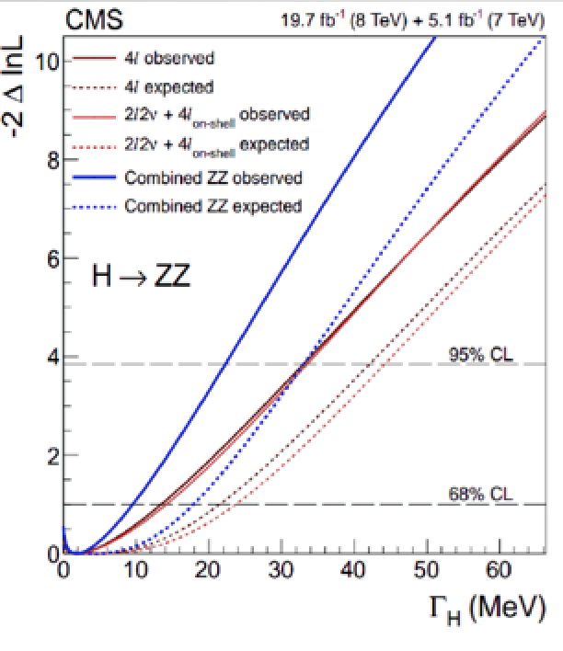
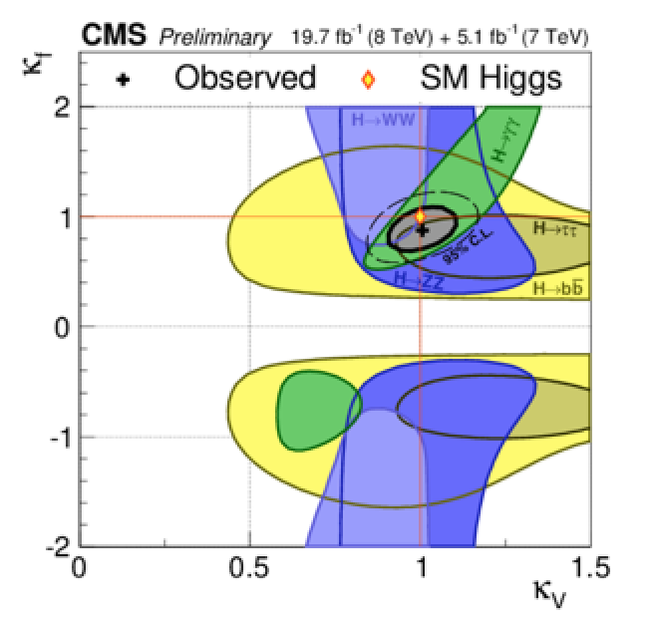
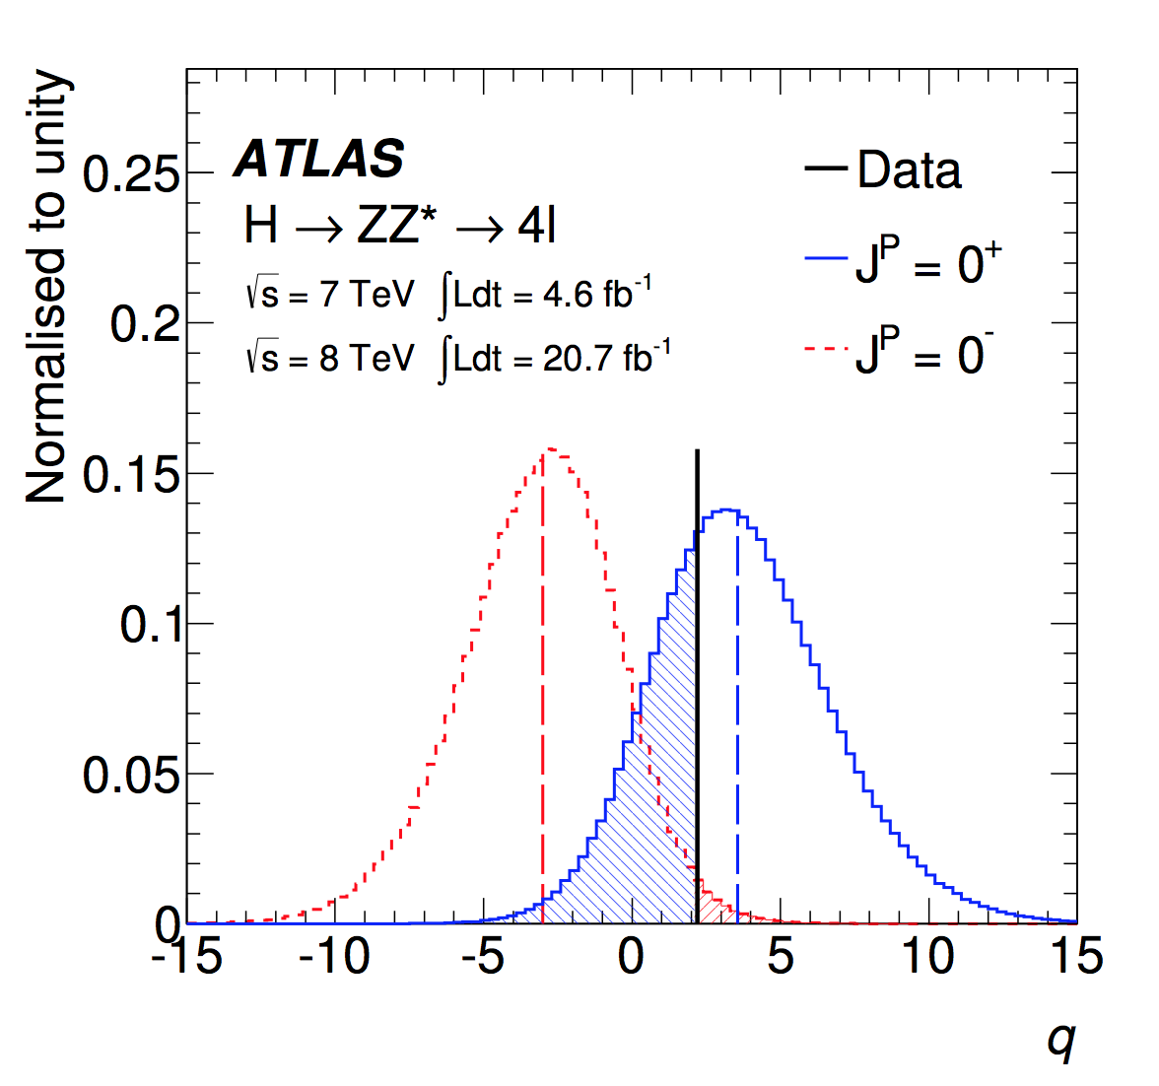
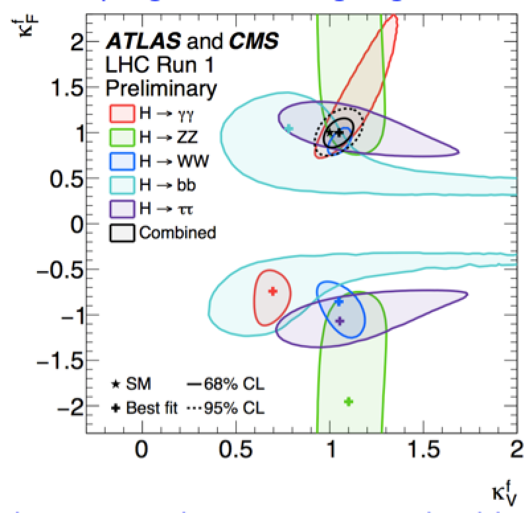

Brief Higgs Summary
We know already a lot on this Brand New Higgs Particle!!
Mass = CMS+ATLAS
125.09 ±0.21(stat)
±0.11(syst) GeV
Width
< 24 MeV
(95%CL)
Couplings are
within ~10-20%
of the SM values
Spin =
0⁺⁽⁺⁾ preferred
over 0⁻,1,2
SM-like behaviour for most properties, but continue to look for anomalies,
i.e. unexpected decay modes or couplings, multi-Higgs production…

Slide 29
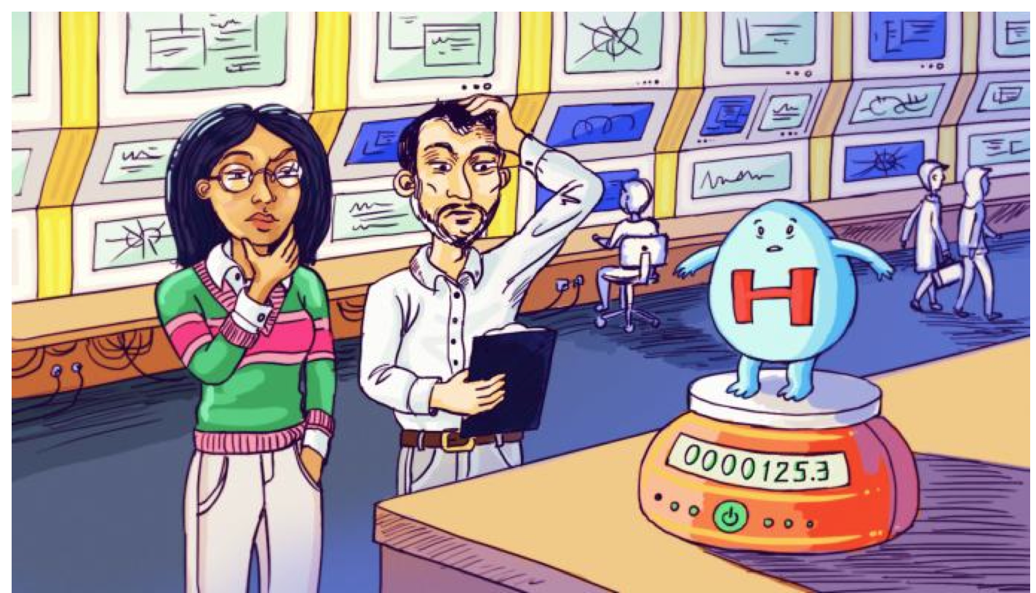
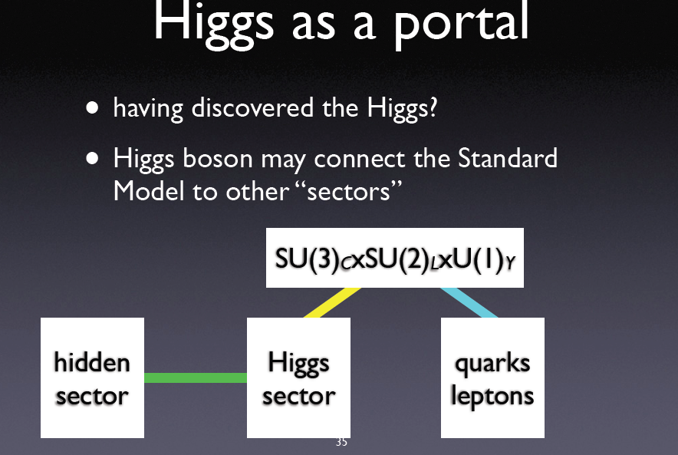
The Future: Studying the Higgs…
•More LHC Data 2015-2023
•LHC upgrade ! 2026-2036
•Experiment upgrades!!
•(Other/new machines?)
Many questions are still unanswered:
•What explain a Higgs mass ~ 125 GeV?
•What explains the particle mass pattern?
•Connection with Dark Matter?
•Where is the antimatter in the Universe?
•…

Slide 30
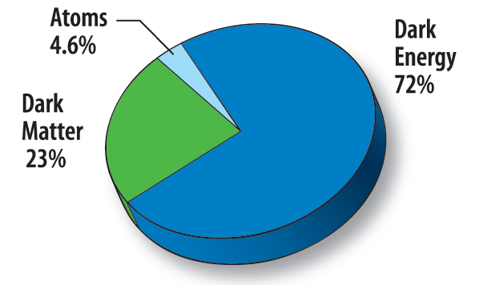
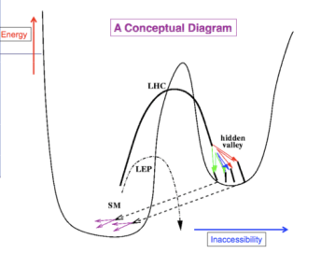
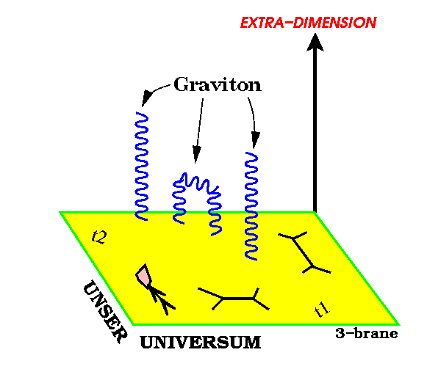
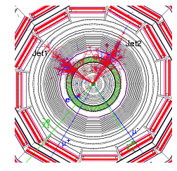
Next LHC PhysicsTargets
Searching for
Supersymmetric
Particles
Searching for
Dark Matter
Searching for
Extra Dimensions
Searching for Exotic
BSM Phenomena
And many more topics…

Slide 31
Dark Matter at the LHC?
Are we Supersymmetric?
Next Questions…

Slide 32
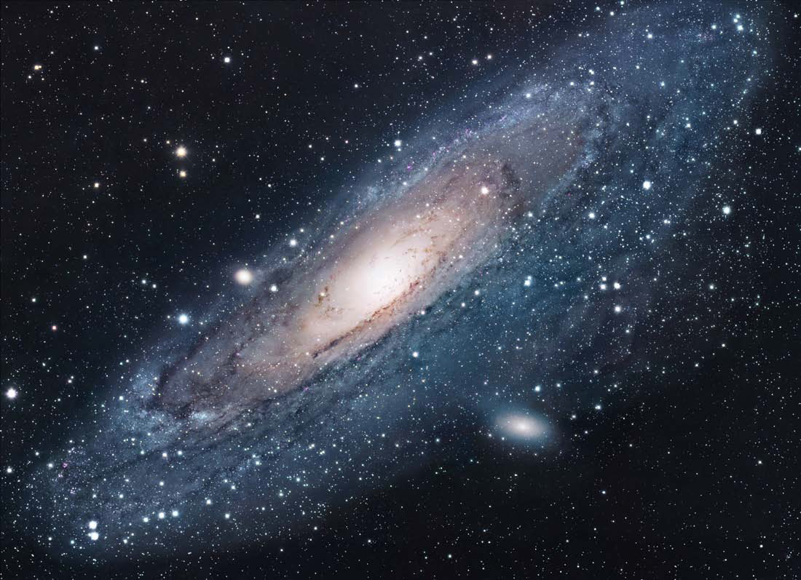
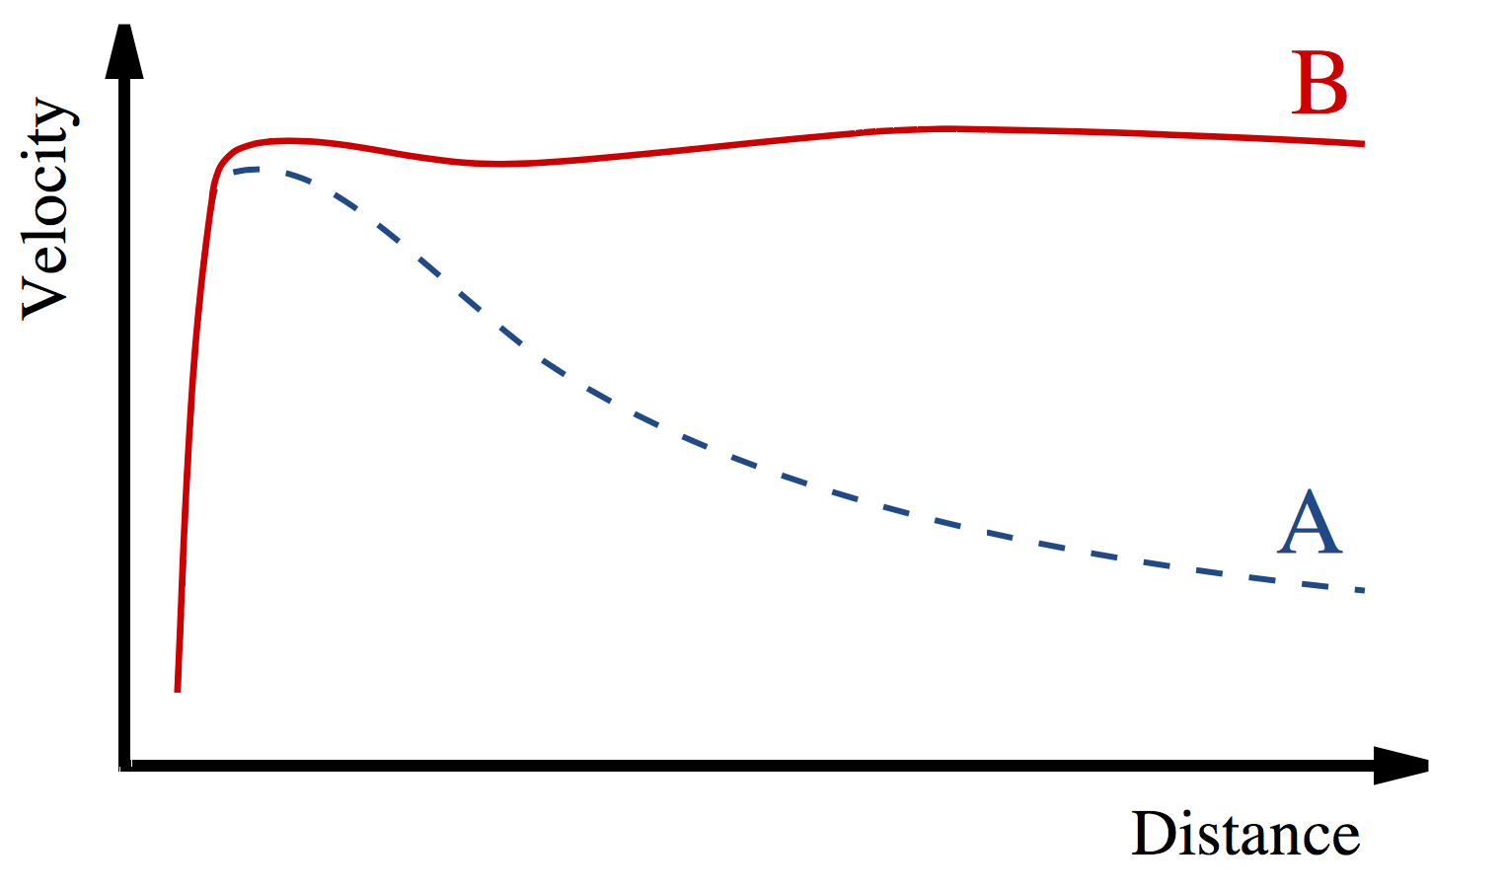
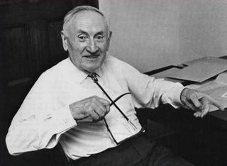
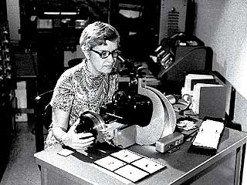
Dark Matter in the Universe
Astronomers found that most of the matter in the Universe must be invisible Dark Matter
‘Supersymmetric’ particles ?
Vera Rubin ~ 1970
F. Zwicky 1898-1974

Slide 33




The Dark World??
Does it mean that there are also….
Dark Forces?
Or even Dark People?
No! We assume some simple interactions
between dark matter particles in their
environment, and a way to detect them

Slide 34
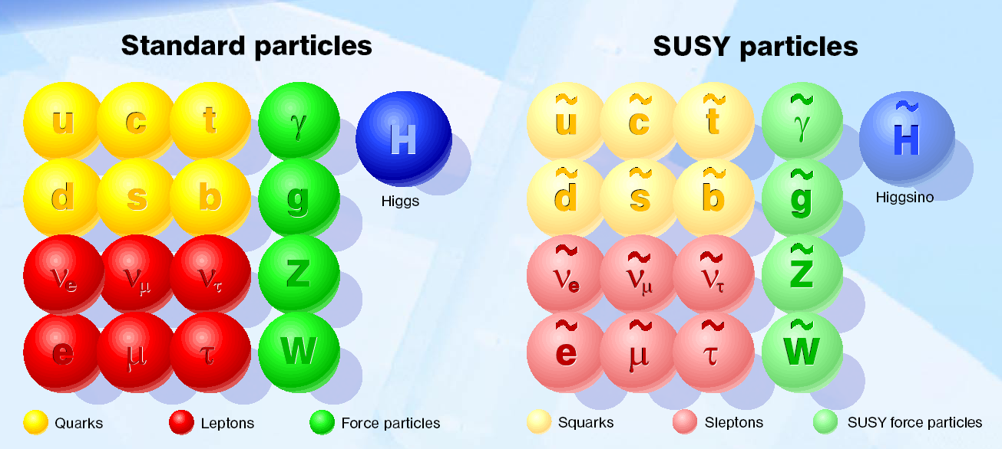
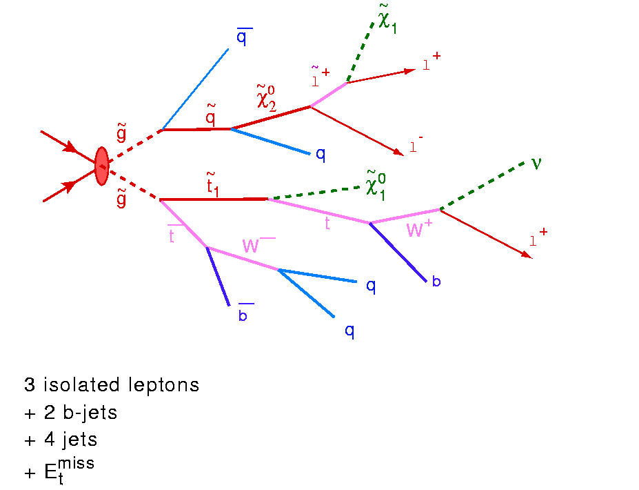
Beyond the Higgs Boson
Supersymmetry: a new symmetry in Nature?
Candidate particles for Dark Matter
⇒ Produce Dark Matter in the lab
SUSY particle production at the LHC
Picture from Marusa Bradac

Slide 35
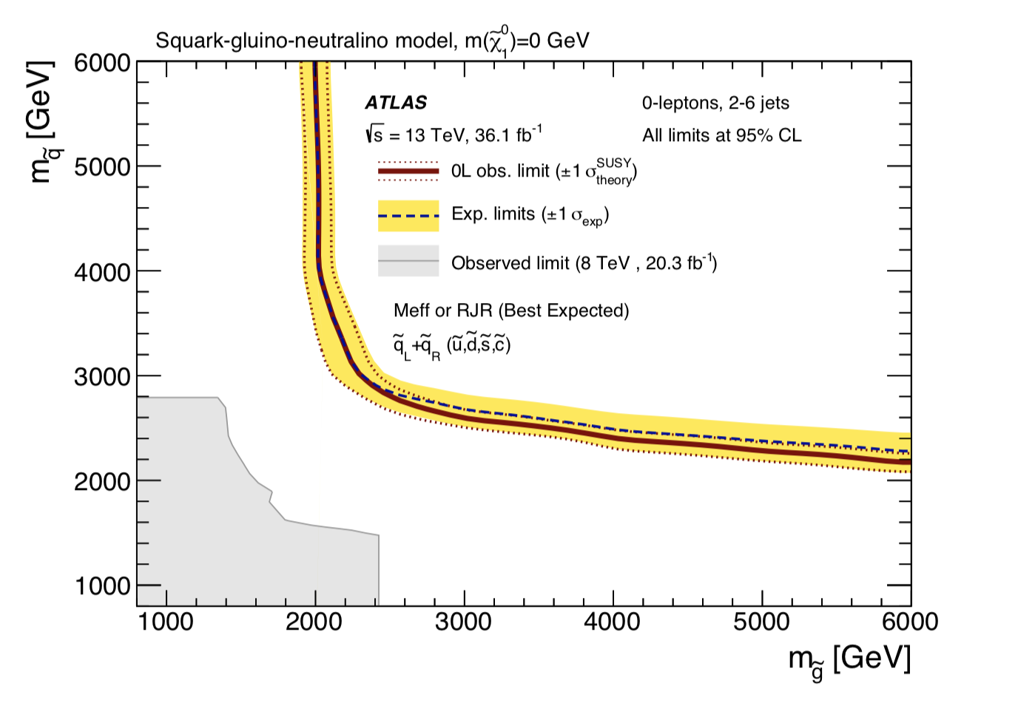


Dark Matter/SUSY: No signal yet to date…
Gluino and
squark
masses
allowed
•So far NO clear signal of
supersymmetric particles
or Dark Matter has been
found yet
•We can exclude regions
where these new particles
could exist.
excluded
Dark Matter
cross section
and mass
excluded
Plenty of Searches ongoing
in the experiments !!
allowed

Slide 36

A High p_{T} Mono-jet event
This is a potential signal for Dark Mattert at the LHC!
Measured event rate so far consistent with Standard Model Processes

Slide 37

Does space have more than 3 space dimensions?
Do Micro Black Holes exist?
New Questions…

Slide 38







Extra Space Dimensions
Problem:
arXiv:1712.02345
Search for monojets
No signal found yet
New Planck scale is
larger than 6-10 TeV
The Gravitational force can become strong!

Slide 39




Quantum Black Holes at the LHC?
Black Holes are a direct prediction of Einstein’s
general theory on relativity
If the Planck scale is in ~TeV region:
can expect Quantum Black Hole production
Quantum Black Holes are harmless for the environment: they will decay within less than 10⁻²⁷ seconds ⇒ SAFE!
real collision
R_{S}
Black holes with mass
Below 10 TeV are excluded
Simulation of a Quantum Black Hole event

Slide 40

Black Holes Hunters at the LHC…

Slide 41





Are Quarks Elementary Particles?
Measurement of the production angle
of the jet with respect to the beam
-> High Energy Rutherford Experiment
Quarks remain elementary particles after these first results

Slide 42
The Physics Program at LHC
Data taking started in 2010
Now we have about 1000 reviewed scientific papers per experiment!
Mostly measurements of the strong and electroweak force at 7/8/13 TeV and Searches
-Are quarks the elementary particles? So far yes
-Do we see supersymmetric particles? Not yet
-Do we see extra space dimensions? Not Yet
-Do we see micro-black holes? No
->The Discovery of a Higgs-like particle!!

Slide 43

Summary of Searches for Exotica

Slide 44





Matter-Antimatter
The properties and subtle differences of matter and anti-matter using mesons containing the beauty quark, will be studied further in the LHCb experiment

Slide 45



Heavy Ions in the Alice Experiment
Lead-lead collisions at the LHC to study the primordial plasma,
a state of matter in the early moments of the Universe
Hundreds of particles
in the detector
Also studies with CMS,
ATLAS and LHCb
J/Ψ suppression
Study the phase transition
of a state of quark gluon
plasma created at the time
of the early Universe to
the baryonic matter we
observe today
LHC
RHIC

Slide 46





MoEDAL: Monopole and Exotics Detector at the LHC
Heavy particles which carry “magnetic charge”
Could eg explain why particles have “integer
electric charge”
Direct Monopole
production
Remove the sheets after some
running time and inspect for ‘holes’

Slide 47

Many Other New Physics Ideas…
Plenty!
  Compositeness/excited quarks & leptons
  Little Higgs Models
  leptoquarks
  String balls/T balls
  Bi-leptons
  RP-Violating SUSY
  SUSY+ Extra dimensions
  Unparticles
  Classicalons
  Dark/Hidden sectors
  Colored resonances
  And more….
Have to keep our eyes open for all possibilities:
Food for many PhD theses!! And Discoveries!!!

Slide 48
Will LHC answer all questions?: Likely not
Some/all New Particles out of mass range?
Need for higher energies at colliders?
Higher precision measurements needed
Need for higher luminosity or e+e-?
Measuring details of the Higgs?
Need for a Higgs factory?
We Expect Answers from the LHC, but…
Many ideas are emerging for new accelerators since June 2012
So far only projects being studied, none is approved yet

Slide 49


Similar machine proposed in China!

Slide 50



Linear Collider Projects
ILC Japan
-Superconducting
cavities
-250 GeV CMS Energy
-Extendable
Future uncertain!
CLIC Project CERN
- Two beam accelerator scheme
- Staged construction. Up to 3 TeV CMS Energy
Higgs Factories!

Slide 51

100 km tunnel infrastructure in Geneva area – design driven by pp-collider requirements
with possibility of e+-e- (TLEP) and p-e (VLHeC)
15 T ⇒ 100 TeV in 100 km
20 T ⇒ 100 TeV in 80 km
e+e- with CM energy of 350 GeV
Notes:
50

Slide 52

Electro-weak phase transition
(Higgs,…)
QCD phase transition
(quark gluon plasma)
LHC studies the first
10⁻¹⁰ -10⁻⁵ seconds…

Slide 53


Summer 2012 the CMS and ATLAS experiment found a new particle, with a mass of 125-126 GeV, which looked like the long sought fundamental scalar boson, postulated in 1964.
This is a brand new fundamental particle, never seen before!
This Higgs boson is ‘very light’ which suggest new physics Beyond the Standard Model will be needed. Supersymmetry? Extra Dimensions? Other? Can we produce Dark Matter at the LHC? We are looking for it!!
The Higgs discovery has launched a new program for new studies: Higgs factories, higher energy pp colliders, high intensity beams…
We are on the verge of a revolution in our understanding of the Universe and our place within it!! We look forward to the 13-14 TeV run of the LHC. Indian scientists can participate in this program!
This is only the beginning!!!
And maybe one day soon

