Slide 1
Electrical safety news for EP
In this talk:
A new electrical safety course for the EP department
How to sign up
Selected highlights
A reminder on AUL testing & electrical modifications.

Slide 2
New electrical safety training course for EP
EP have a long-term request to provide an electrical safety training course adapted to the needs of EP users (MPE/MPA in the EP department).
Current structure of “Habilitation Electrique” is not suited to EP needs:
  Duration is too long (2 days)
  Content is for electricians
  EP will not perform consignation (true for 95+%)
  EP work with HV does not relate to existing course contents
A new course has been produced…

Slide 3
Electrical Safety - Working in EP experiments
½ day training (3 hours) inc. practical elements.
Passing the course will authorise most common electrical tasks performed by EP members at CERN.
Activities are limited to pre-defined list, agreed with HSE.
Anything not included is not allowed.
Habilitation Electrique will still be required for some EP activities/individuals (supervision of electrical works, consignation, live measurements)

Slide 4
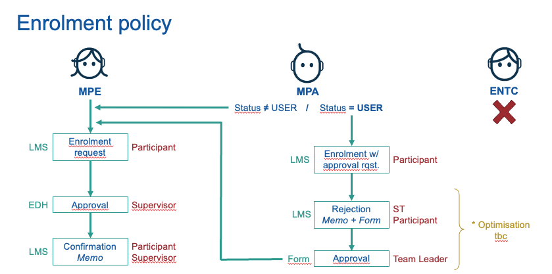
Who can attend this training course?
Only members of the EP department, either MPE (CERN/FELLOWS) or MPA (USERS/ASSOCIATES)
No contractors (country rules apply)
Some prior experience required, supervisor/team leader will decide on attendance.
For Users, a memo will be sent to their home institute.
The memo must be returned, signed by their team leader, before they may complete the training.

Slide 5
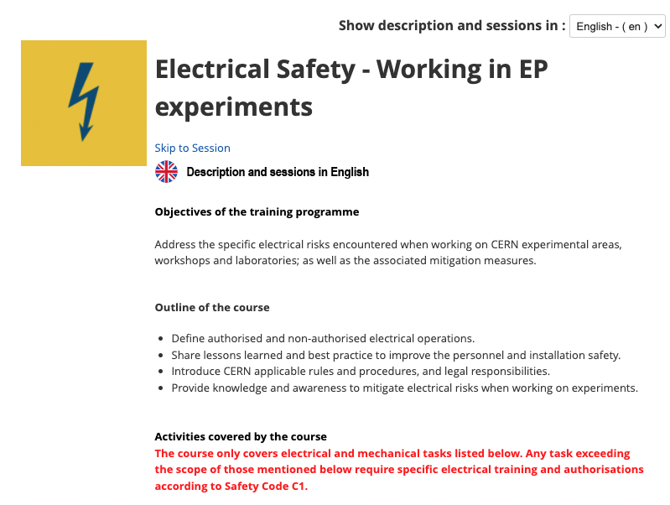
What happens next?
Sessions every Tuesday morning – max 8 places
Custom sessions can be organised if required.
CERN registration (IT account) required to subscribe to the training via learning hub.
Training is not (yet) mandatory for EP zones, but this is planned for the future.
Sign up instructions are here
Sign up now!

Slide 6
What is authorised after the training?
Electrical tasks
Connection, disconnection and operation of equipment at plug sockets up to 63 A.
Install and operate standardised rack mounted electrical equipment in relation to experimental apparatus at CERN within existing racks and the connection of modules and modular power supplies with standardised connectors.
Performance of localised lock-out/tag-out for your own work and for equipment under your responsibility, where the point of isolation is a plug and socket outlet.
Cable installation and termination in an electrical environment, up to 6 mm² for signal cabling and power distribution, and up to 16 mm² for earthing.*
Repair and removal operations on experimental apparatus, when the equipment is disconnected and unplugged. If the operation requires the removal of any housing or protective screens these must be replaced before the equipment is re-powered.
Measurements on live equipment may only be taken in the course of normal operation as part of a written and verified operational procedure and risk assessment.
Design, construction and modification of experimental equipment, which must be subject to inspection before it is energised.
* currently being reviewed,
language of the authroisation will change.

Slide 7
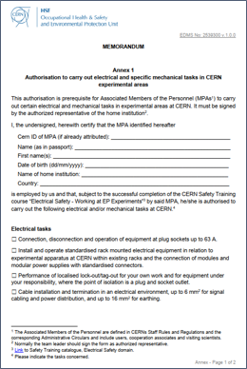
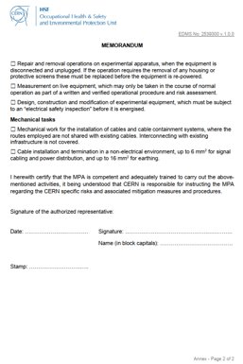
What is authorised after the training?
Mechanical tasks
Mechanical work for the installation of cables and cable containment systems, where the routes employed are not shared with existing cables. Additional authorisation is required if interconnecting with existing infrastructure.
Cable installation and termination in an non-electrical environment, up to 6 mm² for signal cabling and power distribution, and up to 16 mm² for earthing.

Slide 8
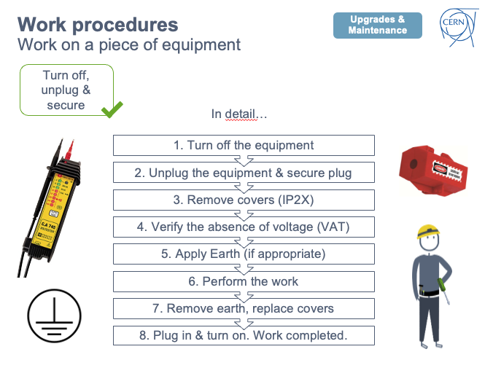
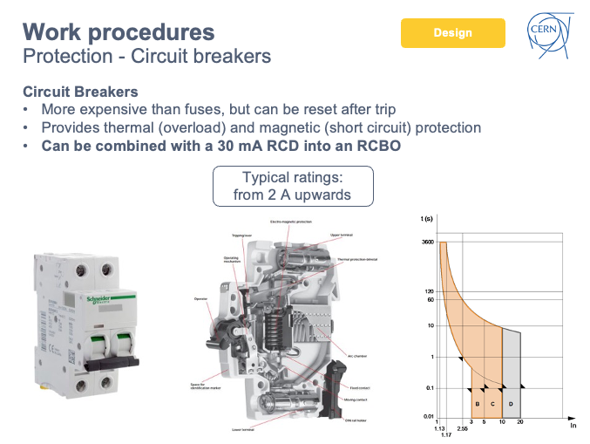
Some highlights from the training…

Slide 9


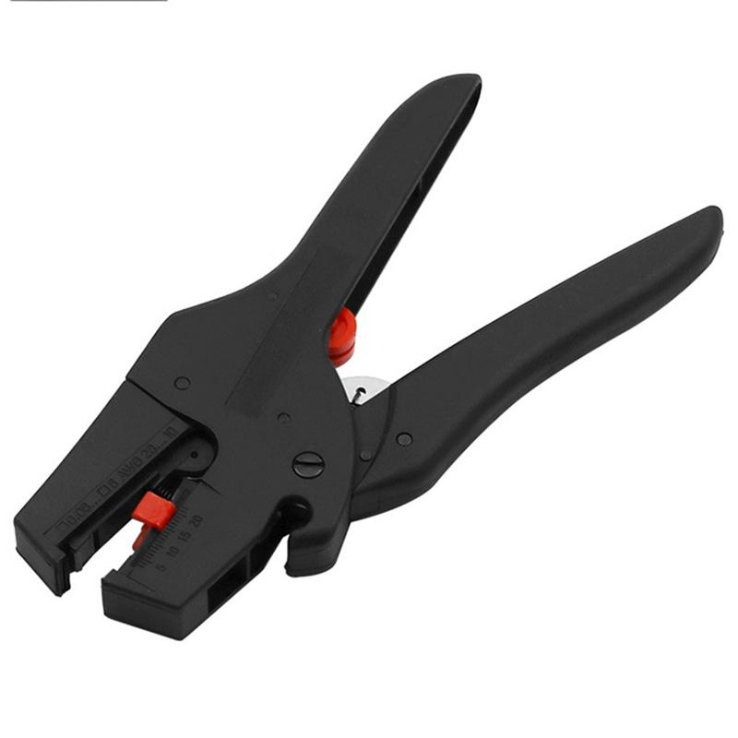
Routine task PPE & tool recommendations:
Mechanical Protection Gloves
EN 388 standard
Safety glasses
EN 166 standard
Avoid exposed blades when trimming cables!
31/03/22
J. Devine | Electrical Safety Officer
Notes:
For any work involving cable manipulation, termination, stripping or connection, you should be wearing gloves and safety glasses in addition to other PPE required depending upon the zone you are in.
This is because there is ALWAYS a risk that bits of plastic or metal will project when you strip, terminate or crimp cables.
Most accidents during electrical work are not electrocution, but cuts.
You can avoid cuts to your hand by 1) Wearing gloves and 2) using the right kind of tool. Open blades are the leading cause of cuts, you will be more efficient AND safer using the right tool.

Slide 10
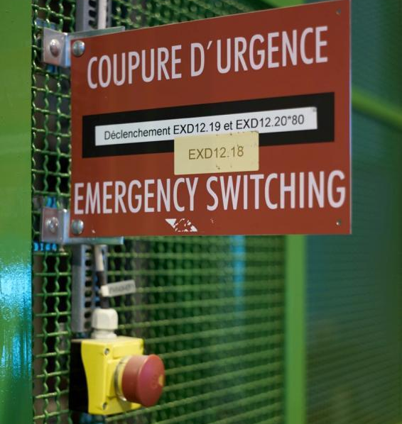
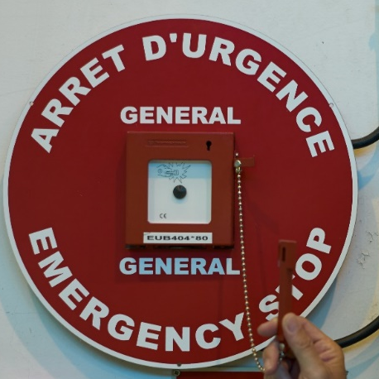


CERN Specifics:AUG & AUL Buttons
AUL - Local Emergency Stop
AUG - General Emergency Stop
Cuts power only locally (room/zone).
Does not call the fire brigade.
Cuts all power in the vicinity and immediately calls fire brigade.
Evacuation alarm
AUE - Equipment Emergency Stop
Triggers evacuation sirens, immediately calls fire brigade.
Does NOT cut electrical power.
Cuts power to a piece of equipment or a single rack.
AUG
Red disc around break glass button
31/03/22
J. Devine | Electrical Safety Officer
AUL
Red open mushroom style button
Notes:
There are three kinds of power cut button:
AUG cuts all power, low voltage and high voltage to a building or arc of the accelerator. In the event of a major incident, for example being trapped in the tunnel after the beam warning or an electrical fire, you should push this button without hesitation.
AUL are local stops, which only cut the power in the local area – such as a room, a beamline zone or a lab. They cut the power to equipment, in some cases the lighting as well. They do not trigger any automated alarms. The AUL is tested annually by the TSO, Territorial Safety Officer.
Some equipment – specific items or workshop tools, may have an AUE, equipment emergency stop. It cuts the machine and should be tested regularly.
Equipment identified with orange stripes is considered critical and therefore is NOT cut by action of the AUG or AUL.
Do not confuse the electrical safety buttons with the evacuation alarm – this has no effect on power supplies, but sounds the alarm and calls the fire brigade. It should be used in the event of a fire or other emergency requiring evacuation.

Slide 11
What can I help you with?
AUL Testing
All AUL (Local Emergency Stop) buttons must be tested annually (IS5).
This is the responsibility of the TSO.
When you perform the test please let me know (jdevine@cern.ch)
If you need assistance with the test, get in touch with me.
Installation visits, inspections by HSE.
If you have questions about your experiment electrical installation.
If you would like advice for modifications and upgrades on your installation.
Electrical installation Safety

