Slide 1
New Cable Rule “SSI-FS-2-1”
Replacing IS 23
EXSO Meeting
A. Henriques – HSE/OHS
31 March 2022

Slide 2
New rule on cables
Objectives:
Replace (outdated) CERN specific standard where possible by state-of-the-art classification in EU → Construction Products Regulation (CPR)
Improve safety and quality of cables → CPR class C_{ca} (mandatory class for underground in F/CH, includes quality assurance)
Facilitate the purchasing of cables → CPR: industry compatible standard
Allow flexibility in the requirements for non-standards cables – e.g. microduct FO cables, signal cables, etc. or in-kind contributions → “Performance-based approach” / equivalent safety level
Improve radiation resistance requirements, based on lessons learnt

Slide 3
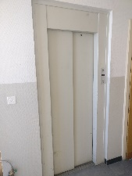
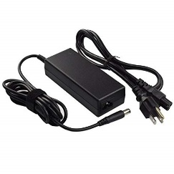
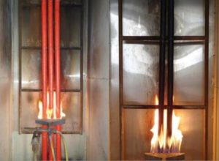
Purpose & Scope
Scope:
Future cables brought on the CERN site.
Requirements linked to:
fire performance (reaction, resistance, halogen content, toxicity,...)
Radiation resistance
…of cables at CERN
added optical fibres
Excluded:
Cables in CE Marked equipment
  Incl. stand-alone short connection cords
Result of ~3 years of stakeholder discussions with organic units purchasing or specifying cables
Connection cords
Lifts (except LHC lifts)

Slide 4
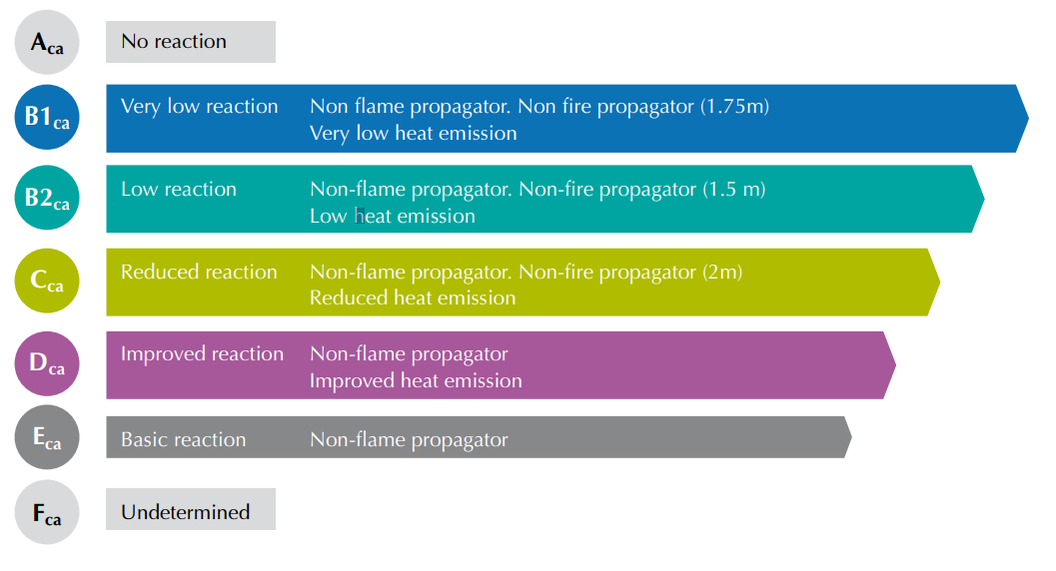



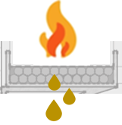
Fire Reaction
EU market:
  Risk-based typology approach for cables classes (EU member state approach)
Align with the EU approach (CPR ) – in force for cables since 2017
For example:
Hostel/creche
Acidity of smoke (i.e. halogen presence)
Underground
Fire reaction (i.e. heat generated)
C_{ca} - s2, d1, a2
Tertiary bldgs.
Temporary installations
Droplets (i.e. fire propagation)
Smoke production (i.e eyesight during evacuation)

Slide 5
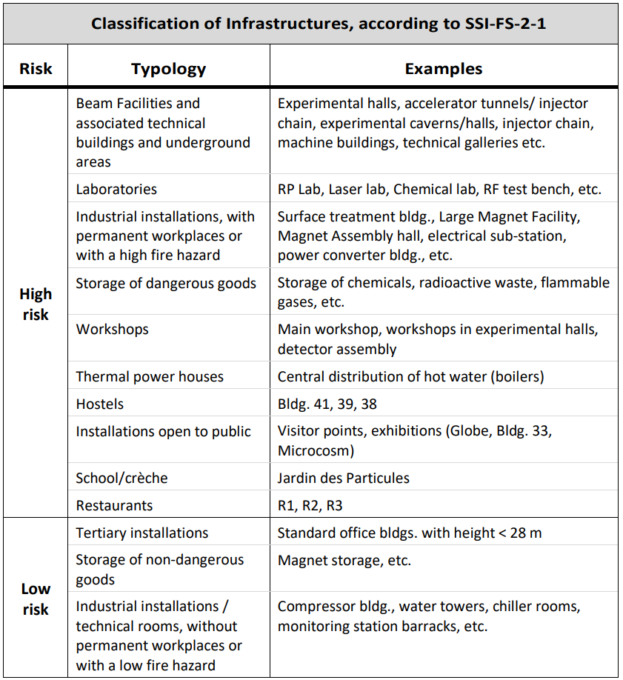
Fire Reaction
Minimum CPR class
Common questions:
Final location of the cables is unknown. Which to choose ?
→ C_{ca} – s2, d1, a2
Safety Guideline SG-FS-2-1-1
‘High-risk’ installation:
C_{ca} - s2, d1, a2
Why C_{ca} class for High-risk inst.?
Regulatory level: in-line with Host States
Technical level: see spare slide
‘Low-risk’ installation:
D_{ca} - s2, d1, a2
Trouble with finding suitable suppliers for in-house purchases ?
Market is still reacting to the CPR. More and more suppliers are performing the necessary tests little-by-little.
Technically incompatible – case-specific risk assessment
or
Risk Assessment
Case-by-case optimization
(e.g. technical incompatibility, certification other than CPR)
What about for in-kind contributions?

Slide 6


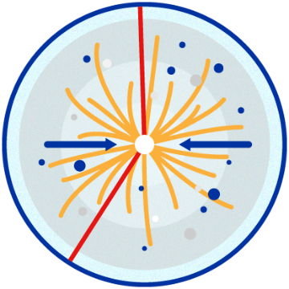
Fire Reaction
OK
Case-by-case Risk Assessment
In-kind contributions from non EEA countries
Missing
Ok
e.g. Large Experiments
Ok
Aim for equivalent performance level
(e.g. US test standards)
Missing

Slide 7
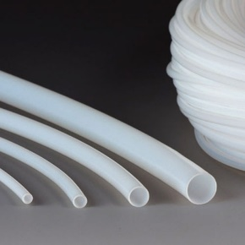
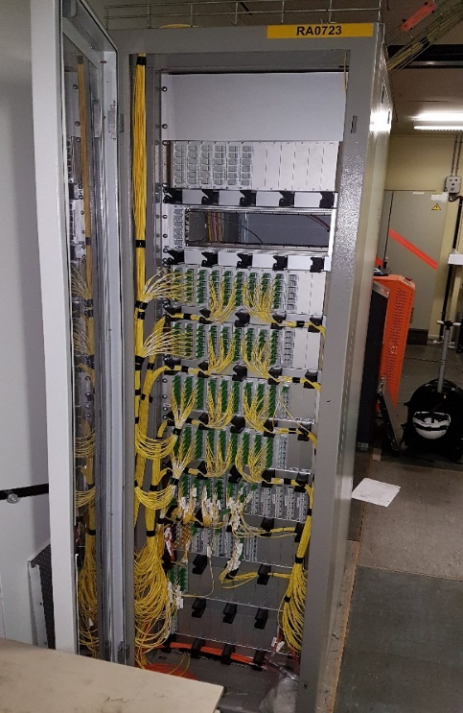
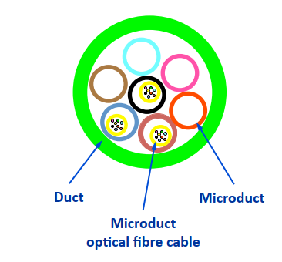
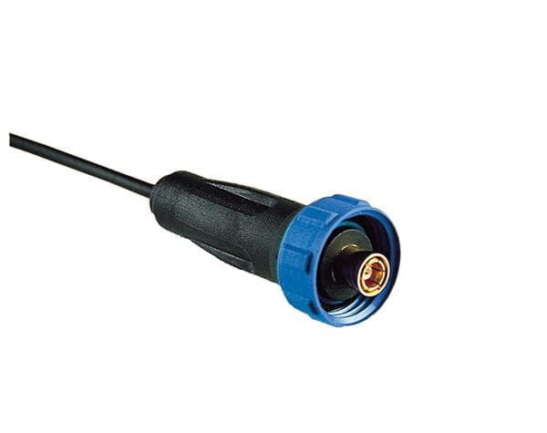
Fire Reaction
Case-by-case Risk Assessment
Technical limitations (special cases)
PTFE sleeves
in low temp.
application
PTFE RF
connectors
No CPR class –
LSZH class required
(necessary tests in the Guideline)
PTFE allowed in minimal quantities - no alternative available

Slide 8
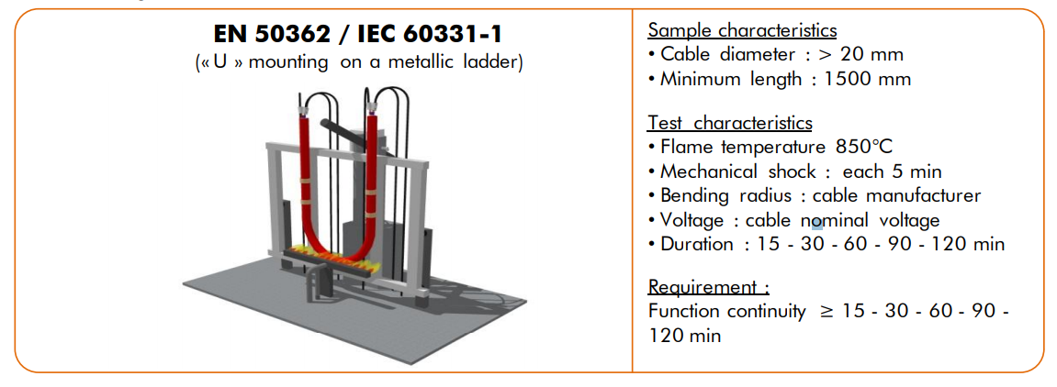
Fire Resistance
Cables that shall maintain their functionally in accidental situations (e.g. fire) for a specific amount of time
Cables powering ‘Safety Systems’ (e.g. emergency lights, fire doors, smoke extraction, etc.)
PH 90
(integrity for 90min)
Default requirement:
Higher or Lower performance may be acceptable:
Risk Assessment

Slide 9
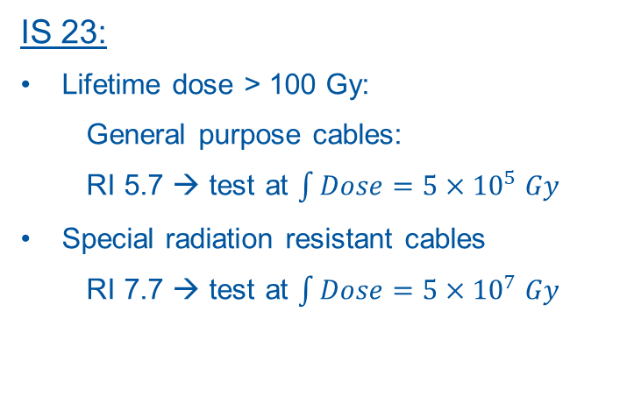
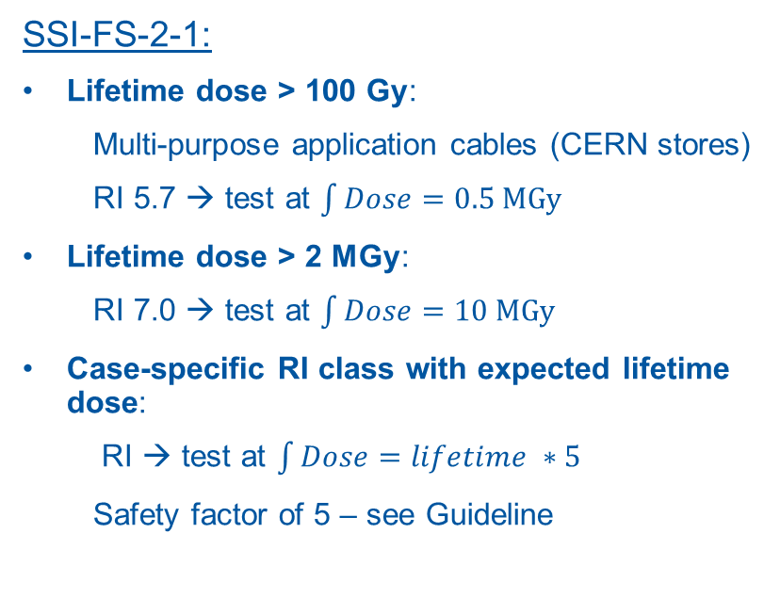
Radiation Resistance
Slight modification to IS23
IS 23:
Lifetime dose > 100 Gy:
  General purpose cables:
  RI 5.7 → test at $\int{Dose}=5×{10}^{5} Gy$
Special radiation resistant cables
  RI 7.7 → test at $\int{Dose}=5×{10}^{7} Gy$
SSI-FS-2-1:
Lifetime dose > 100 Gy:
  Multi-purpose application cables (CERN stores)
  RI 5.7 → test at $\int{Dose}=0.5 MGy$
Lifetime dose > 2 MGy:
  RI 7.0 → test at $\int{Dose}=10 MGy$
Case-specific RI class with expected lifetime dose:
  RI → test at $\int{Dose}=lifetime ∗5$
  Safety factor of 5 – see Guideline
Notes:
Motivation: Retention of functional capabilities of the cable subject to radiation doses / avoid unjustified de-cabling campaigns
DED - dose to equivalent damage
Measured at an elongation endpoint criteria at 50%
DED 0.50
Sample tests Draka cables: SVA3 and SVA3R

Slide 10
Conclusion
Improves safety and quality of cables
Facilitates the purchasing of cables: industrial vs CERN-specific standard
Procurement: impact mainly driven by the market (in force since 2017)
  Extra costs or procurement delays will decrease over time as market adapts
The “risk assessment approach” addresses the flexibility required for non-standards cables or coming from outside the EEA
Radiation resistant requirements improved based on lessons learnt and findings from projects looking at cable aging and deterioration under radiation environments.
Rule comes with a Safety Guideline with additional (technical) information to ease implementation
https://hse.cern/content/safety-rules
Rule: SSI-FS-2-1
Guideline: SG-FS-2-1-1
https://edms.cern.ch/ui/file/2669584/LAST_RELEASED/SSI-FS-2-1_EN.pdf
https://edms.cern.ch/ui/file/2669629/LAST_RELEASED/SG-FS-2-1-1_EN.pdf

Slide 12

New EU regulation on fire reaction of cables
Construction Products Regulation (CPR), compulsory for cables in the EEA open market from June 2017
  IS23 vs CPR
Tests | IS23 | CPR
Fire Reaction/ Propagation | IEC 60332 (EN 60332) | EN 60332 + EN 50339
Smoke production | IEC 61034 (EN 61034) | EN 61034
Droplets | - | EN 50399
Smoke acidity | IEC 60754 (EN 60754) | EN 60754
Toxicity | IEC 60695 | Not by default, only ‘major Safety implications’
CPR = IS23 + EN 50399 tests
EC Decision 2006/751/EC:
EN 50399 provides additional requirements linked to fire reaction and droplets
Only
Low Smoke
Zero Halogen
EU Fire
Safety Strategy
(life safety)
$$≡$$

Slide 13



Proposal class C_{ca}-s2,d1,a2
Technical
Subclasses s2,d1,a2
Class C_{ca} over D_{ca}
Factor 7x lower maximum (peak) heat release rate
Factor 4x slower fire growth rate
…
The minimum level where the impact is measurable
e.g. s2 = smoke production between 0.25 and 1.5 m²/s
s3 = smoke production greater than 1.5 m²/s….
Regulatory
D_{ca} not allowed in underground areas by most EU countries
Minimum subclasses required in evacuation routes: s2,d1,a2
Subclasses required in household, underground tunnels: s1,d1,a1
Quality assurance
D_{ca} : ‘Self-certification’
From D_{ca} to C_{ca} = Large gain in cable quality
Stakeholder discussions: the re-establishment of a Quality Assurance process for the procured cables at CERN is needed
C_{ca} : Certification by notified body + samples tests

Slide 14
Technical data C_{ca}-s2,d1,a2
Subclasses s2, d1, a2
Class C_{ca} v D_{ca}
D_{ca} not allowed in underground areas by most EU countries
performance not measurable ( ‘greater than…’)

Slide 15
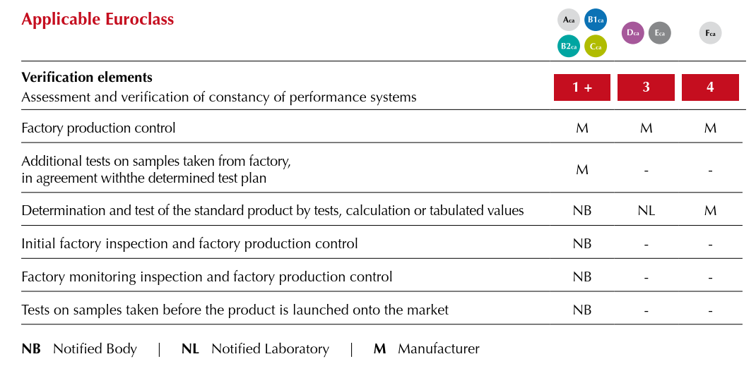
Quality Assurance class C_{ca}
^{[1]} RIACWG Final Report – EDMS N. 1369134
C_{ca} v D_{ca}

Slide 16

EU members sub-classes: s2,d1,a2
s2,d1,a2
Classes allowed in evacuation routes:
Classes allowed by type of infrastructure:
  Household: s1,d1,a1 (C_{ca})
  Road tunnels: s1,d1,a1 (C_{ca})
  Railway tunnels: s1a,d1,a1 (B2_{ca})
Classes allowed by type of infrastructure:
  Evacuation routes: s1,d1,a1
  Underground: s1,d2,a1
  (non egress)
Lower performance than e.g. FR/GE is acceptable due to the occupancy rate in CERN installations w.r.t. road/railway tunnels, apartment blocks, etc.
Notes:
183 total euroclasses
Zero Halogen means HCI (hydrogen chloride) < 0.5 % of combustion gases -> HCL when mixed with water forms Hydrochloric acid which swells the throat

Slide 17
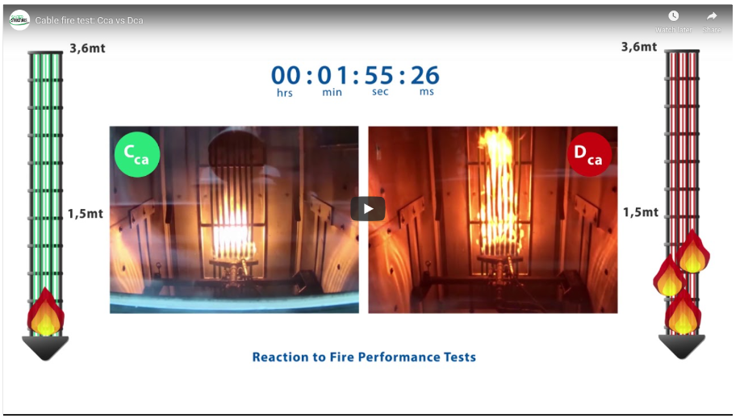
Fire reaction tests Cca vs Dca

Slide 18
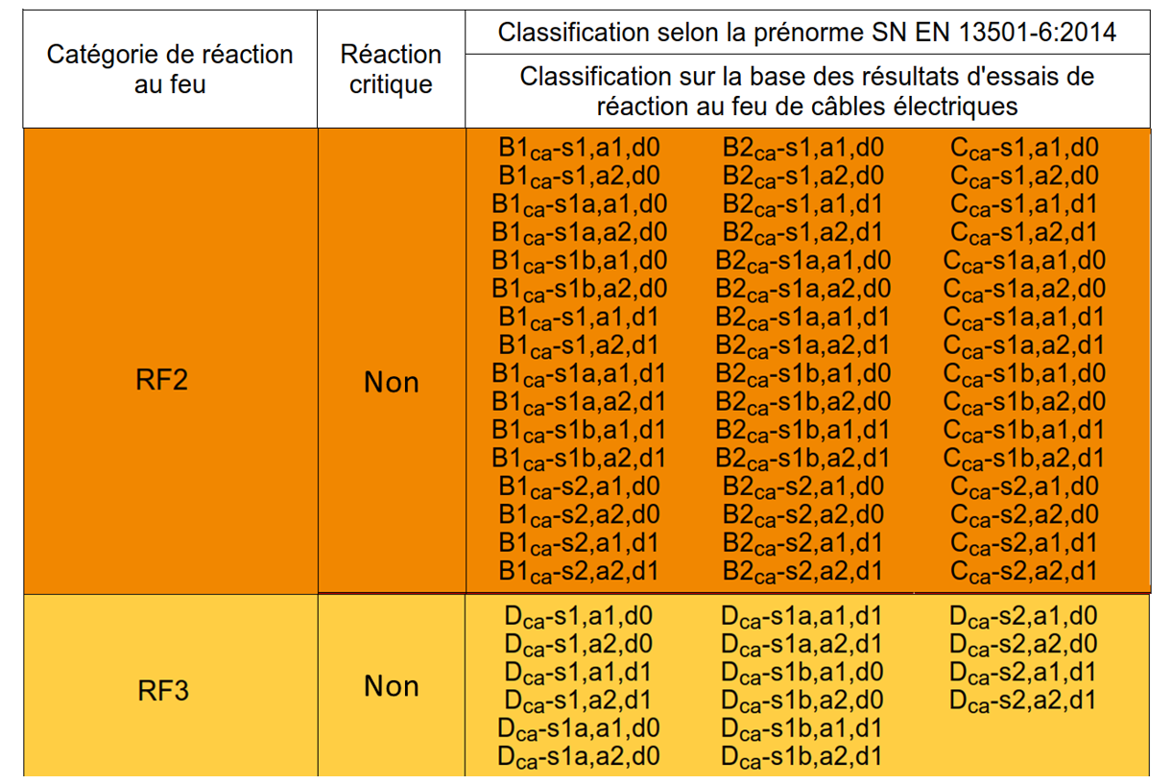
CRP class in Switzerland (egress)
s2,d1,a2
Minimum allowed for egress
Notes:
183 total euroclasses
Zero Halogen means HCI (hydrogen chloride) < 0.5 % of combustion gases -> HCL when mixed with water forms Hydrochloric acid which swells the throat

Slide 19
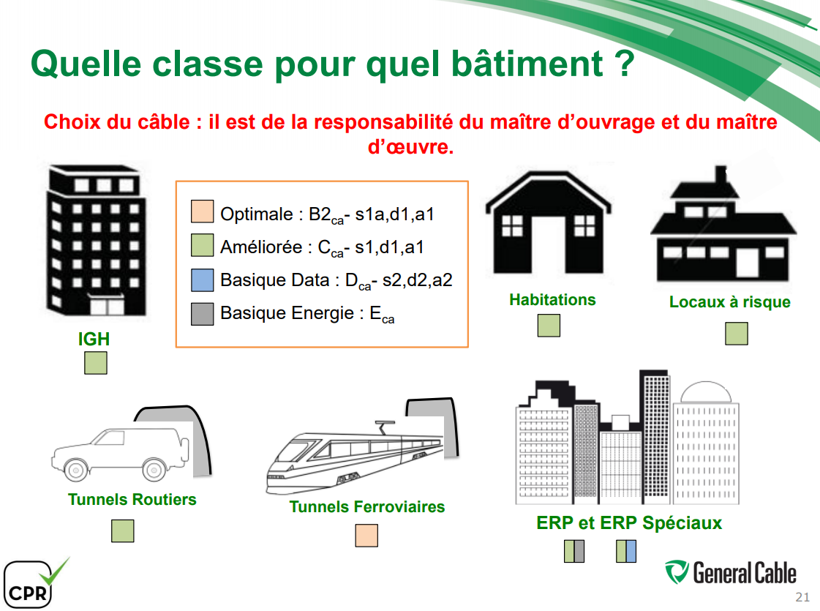
CRP class in France

Slide 20
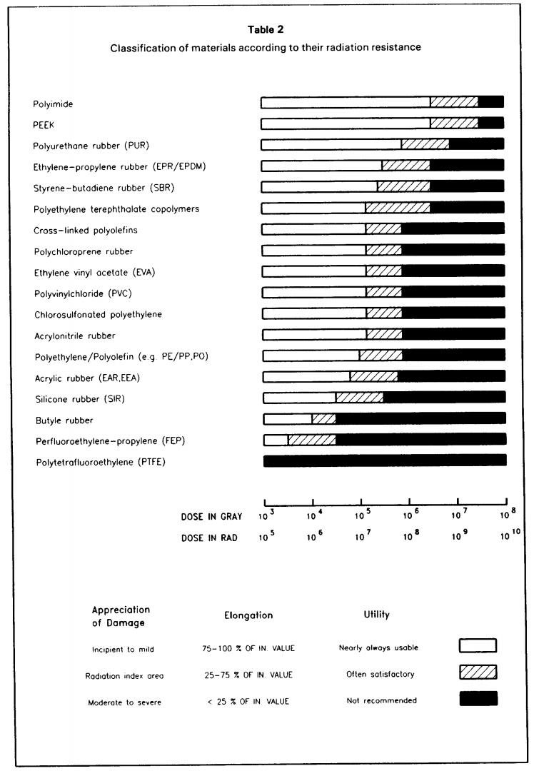
Radiation Resistance – Material table
Mentioned in cable spec*:
EPR
Classification of materials according to their radiation resistance
[Ref] Compilation of radiation damage test data, part 1 2nd edition.: Halogen-free cable-insulating materials; H. Schönbacher, M. Tavlet;
CERN 89-12 Yellow Book
XLPE
Megolon®
*
Template for Technical Specifications - Supply of Cables – EDMS N. 1137965
RIACWG Final Report – EDMS N. 1369134

