Slide 1
CMS Safety Level 2 First Aiders –
Sauveteur Secouriste du Travail (SST)
https://indico.cern.ch/event/1049997/
cmssafety.web.cern.ch/
31/03/2022

Slide 2

CMS and First Aiders
First Aiders “Level 1” (now Life-Saving Action): present within our community.
  People having the basic knowledge in terms of First Aid
  LMS: https://lms.cern.ch/ekp/servlet/ekp?PX=N&TEACHREVIEW=N&CID=EKP000043535&TX=FORMAT1&LANGUAGE_TAG=en&DECORATEPAGE=N
First Aiders “Level 2” (now SST): a certain number of people have received further, level 2 first aid training.
  They are capable of working individually or as a team, using advanced rescue equipment (oxygen therapy systems, burn kit, etc.) and providing emergency first aid pending the arrival of the FRS response team.
  LMS: https://lms.cern.ch/ekp/servlet/ekp?PX=N&TEACHREVIEW=N&CID=EKP000043803&TX=FORMAT1&LANGUAGE_TAG=en&DECORATEPAGE=N

Slide 3
Training programme
Training programme | Duration | Validity | Refresher
First Aid - SST Initial | 14h (2d) | 2y | 7h (1d)
First Aid - SST Initial (Lightened version) | Valid PSC1 + 7h (1d) | 2y | 7h (1d)
Max number of people per session
8 people: if COVID-19 Level 2 Yellow
10 people: if COVID-19 Level 1 Green

Slide 4
First Aiders L2: Needs
A past Memorandum EDMS 983134 “Gestion des moyens de premier secours pour les expériences du LHC Etat actuel et propositions d'amélioration” reports:
“…L'objectif de 10 secouristes niveau 2 par expérience principale est préconisé. Seul ce personnel est habilité à utiliser le matériel d'urgence mis à disposition.”
“…Le département veille à maintenir ce chiffre de 8-10 secouristes niveau 2 surtout au niveau du point 5, point le plus éloigné et sans secouriste formé actuellement.”

Slide 5
Future Training Objectives
New Training program:
CERN Safety Training: new first aiders training programme proposal
Target for Level 2 First Aiders:
Reach a stable number of trained Level 2 First Aiders, potentially present at Point 5:
Reminder… “10 first aider per Large Experiment”…
30 to 40 trained Level 2 First Aiders
for CMS Point 5

Slide 6
CMS and First Aiders
The CMS collaboration ensures that a sufficient number of its members are qualified in level 2 training

Slide 7
Thank you!

Slide 8
Spare Slides
Back up slides and additional information

Slide 9
Trainings Needs
Basics for Access and Work at CMS Point 5:
Safety at CERN / La Sécurité au CERN (online)
Emergency Evacuation / Évacuation en cas d'urgence (online)
Radiation Protection - Awareness / Radioprotection - Sensibilisation (online)
COVID-19 - Health & Safety Measures at CERN / Mesures d'Hygiène et de Sécurité au CERN (online)
Radiation Protection - Supervised Area / Radioprotection - Zone Surveillée (online)
CERN - LHC Large Experiments / CERN - Grandes Expériences du LHC (online)
CMS - Surface and Underground Areas / CMS - Zones de Surface et Souterraine (online)
CERN - Beam Facilities / CERN - Installations faisceaux (online)
Self-Rescue Mask (Classroom)
EDMS 2605306 https://edms.cern.ch/document/2605306

Slide 10
Trainings Needs
Specific for First Aiders Level 2 CMS Point 5:
First Aid - Life-saving actions (Classroom) / 2h - 36 months validity
First Aid - SST- Initial (Classroom)
First Aid - SST - Initial (Lightned version) (Classroom)
+
Emergency Guides (Virtual Classroom/online) / 3h - 36 months validity
Fire Extinguisher (Classroom) / 2h - 36 months validity
Participation in CMS crisis preparedness exercises
EDMS 2605306 https://edms.cern.ch/document/2605306

Slide 11
Access Needs
Access requests on ADaMS:
CMS_S (direct Link)
CMS USC (direct Link)
CMS UXC (direct Link) / (IMPACT needed)
EDMS 2605306 https://edms.cern.ch/document/2605306

Slide 12
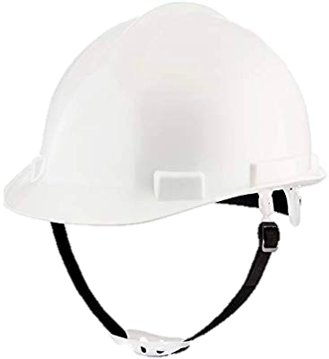

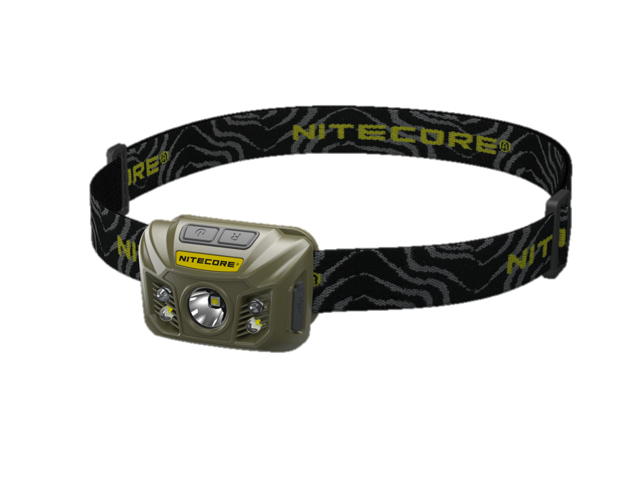
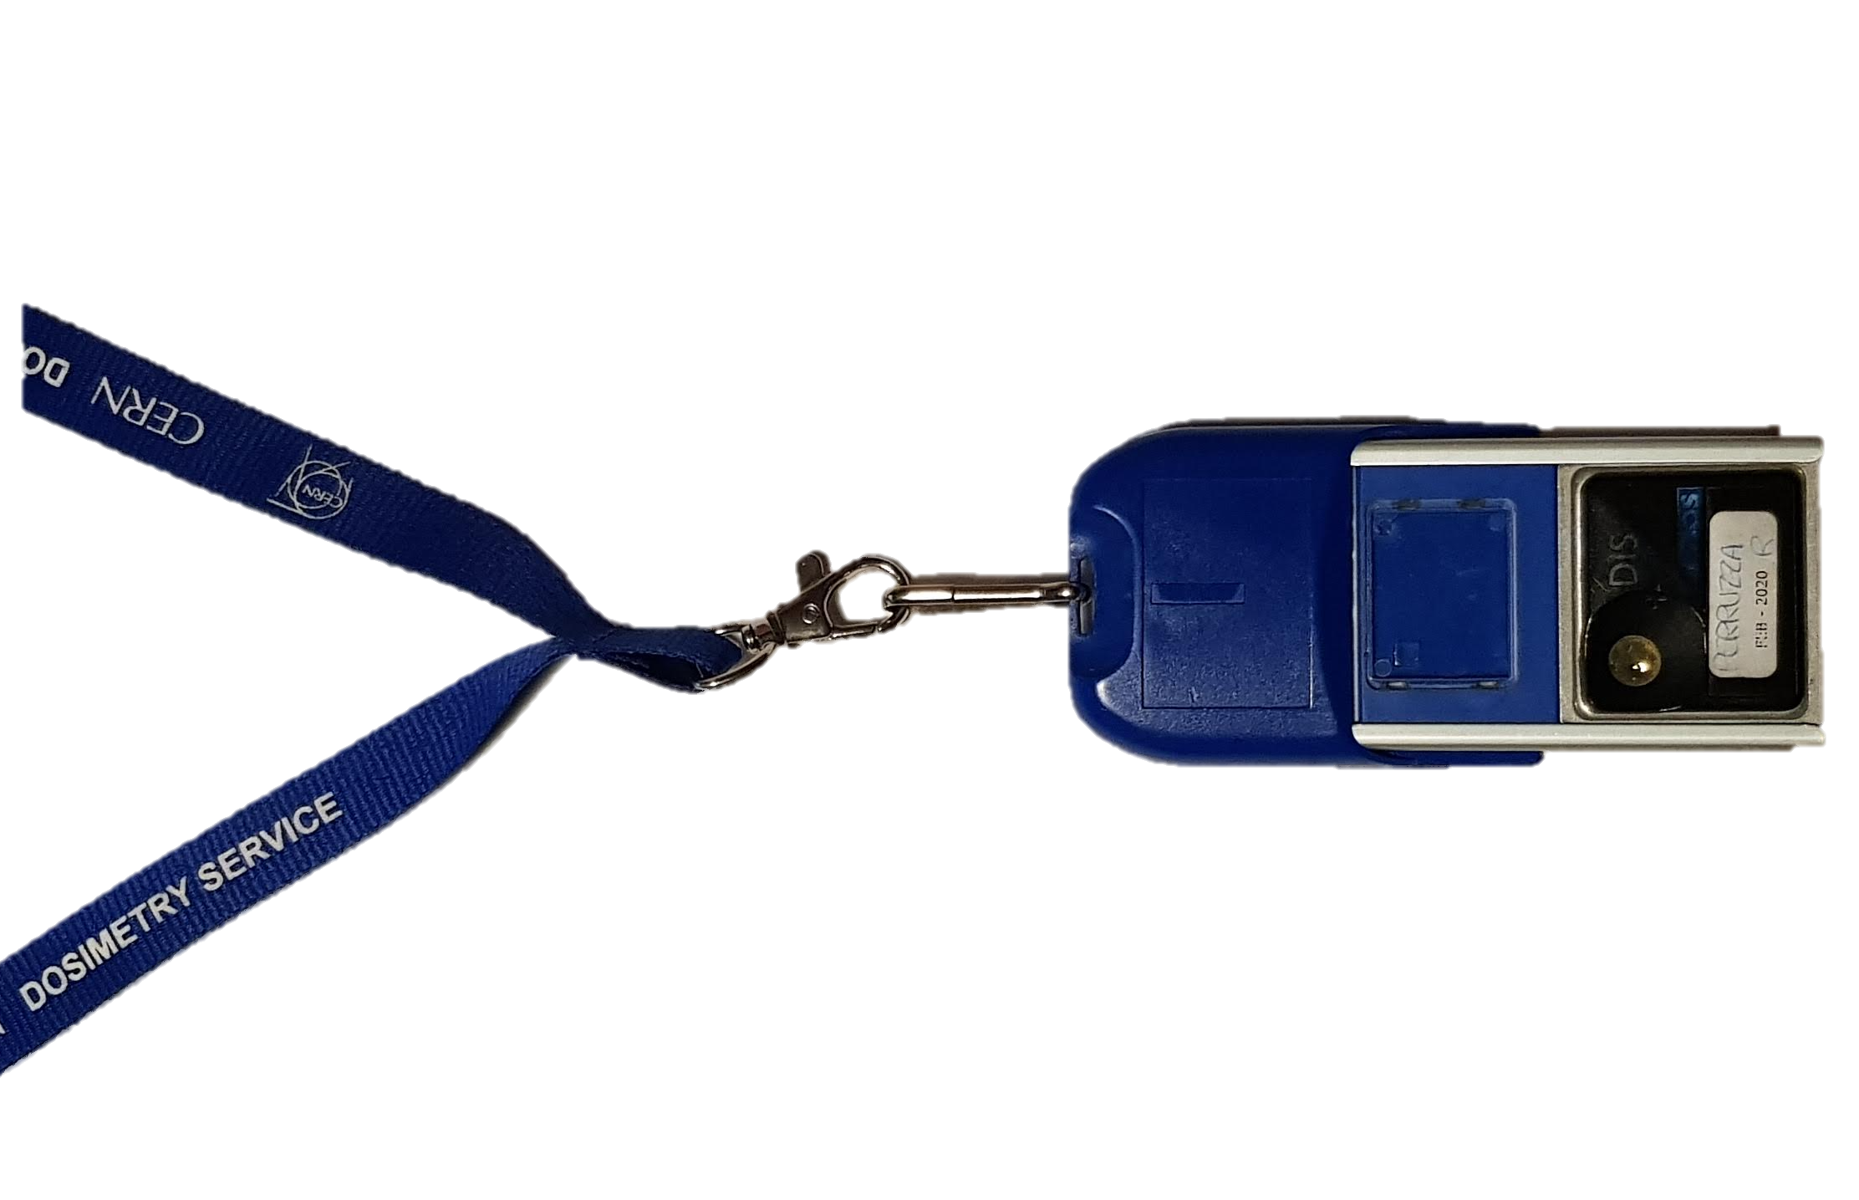

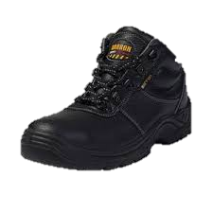
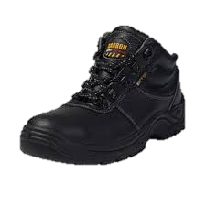
Equipment Needs and Available
Basics:
CERN ID card
Safety Shoes
Safety Helmet with headlamp
Personal Dosimeter (DIS)
Proximeter
+
Stickers with name, first name and telephone number
Yellow "CMS first aid" vests (stored in red cabinets)
EDMS 2605306 https://edms.cern.ch/document/2605306

