Slide 1

Safety Incident Management
EP Department

Slide 2
New SIM Rule and Guideline
New 2021 documents:
SR-SIM Responsibility in matters of Safety Incident Management (SIM) at CERN: https://edms.cern.ch/ui/file/2583792/LAST_RELEASED/SR-SIM_EN.pdf
SG-SIM-0-0-1 Implementation of the Safety regulation SR-SIM (Guideline): https://edms.cern.ch/ui/file/2668488/LAST_RELEASED/SG-SIM-0-0-1_EN.pdf
Definition:
Safety Incident: an unintended event or situation that has non-negligible, negative consequences or potential consequences from the point of view of Safety
Replace the A2 code
i.e. unsafe situations, near misses or accidents

Slide 3
Incident Declaration
From the rule SR-SIM:
Any person that is involved in-, witnessing or that becomes otherwise aware of a Safety Incident shall:
  promptly notify it to the appropriate CERN services if immediate action is required; and
  fill in a Safety Incident declaration form within 24 hours from the occurrence or discovery of the Safety Incident, whichever is the earlier.

Slide 4
Incident Declaration
From the rule SR-SIM:
Any person that is involved in-, witnessing or that becomes otherwise aware of a Safety Incident shall:
  promptly notify it to the appropriate CERN services if immediate action is required; and
  fill in a Safety Incident declaration form within 24 hours from the occurrence or discovery of the Safety Incident, whichever is the earlier.

Slide 5
Incident Declaration
From the rule SR-SIM:
Any person that is involved in-, witnessing or that becomes otherwise aware of a Safety Incident shall:
  promptly notify it to the appropriate CERN services if immediate action is required; and
Call Fire Brigade at +41 227674444 in case of emergency or if immediate action is required
In addition, it is strongly suggested to contact further Safety Officers/services as:
DSO/LEXGLIMOS (very important! We can help you with the coordination of the actions to be done)
TSO
Equipment or Location Responsible
…

Slide 6
Incident Declaration
From the rule SR-SIM:
Any person that is involved in-, witnessing or that becomes otherwise aware of a Safety Incident shall:
  promptly notify it to the appropriate CERN services if immediate action is required; and
  fill in a Safety Incident declaration form within 24 hours from the occurrence or discovery of the Safety Incident, whichever is the earlier.

Slide 7
Incident Declaration
From the rule SR-SIM:
Any person that is involved in-, witnessing or that becomes otherwise aware of a Safety Incident shall:
  promptly notify it to the appropriate CERN services if immediate action is required; and
  fill in a Safety Incident declaration form within 24 hours from the occurrence or discovery of the Safety Incident, whichever is the earlier.
Even if 24h already passed, it is important that the declaration is done ASAP
The incident declaration is done on EDH via the Incident Declaration Form (IDF): https://edh.cern.ch/Document/General/IncidentDeclaration (Attention: IDF is the new A2 form!)

Slide 8
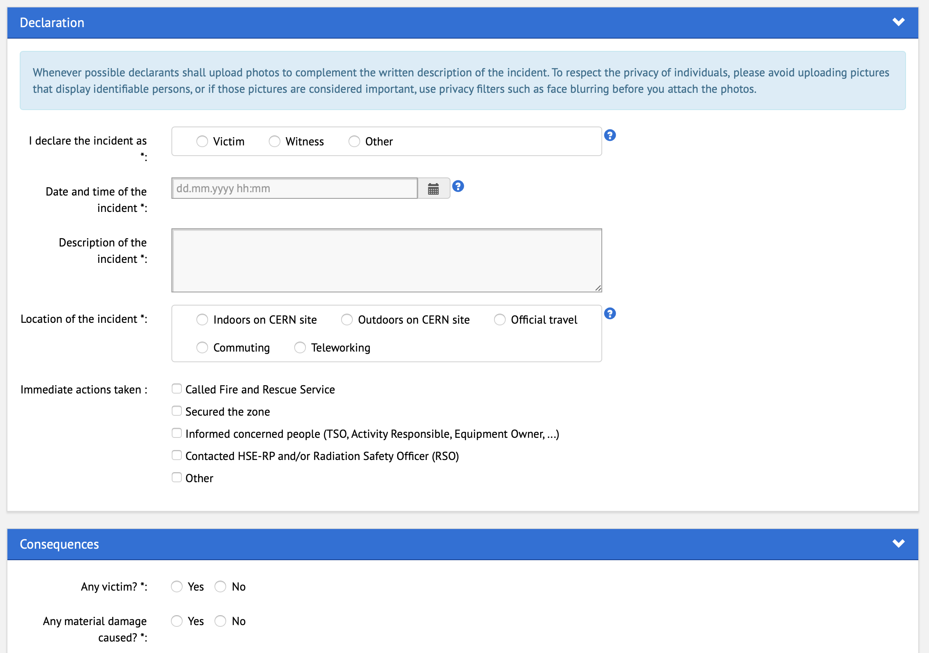
It is good practise to attach pictures or layouts
Contact us if you have any questions about how to fill it!

Slide 9
Classification and analysis
Safety Incidents shall be classified as either minor, serious or major in order to determine the procedure for their analysis and subsequent follow-up. Accidents giving rise to absence from work, trips and falls shall be classified at least as serious.
The classification is done by the related DSO/LEXGLIMOS.
Depending on the classification, a different procedure for the analysis (more/less detailed) will be followed.
A member of the DSO Office or LEXGLIMOS (in the case of Large Experiments) will perform the incident analysis, in collaboration with HSE and the stakeholders involved (according to the specific classification).
It is important that the people involved are available for meetings on site/discussions in order to progress in the analysis and define the appropriate safety measures and actions.

Slide 10
Thank you!
Any questions?

