Slide 1


Gender inequality in the labour market
Academic Training Lecture Regular Programme, CERN
Natalia Soboleva

Slide 2
About me
Natalia Soboleva
PhD in Economic Sociology and Demography from the Department of Sociology, National Research University Higher School of Economics (Moscow).
Senior Research Fellow at the Laboratory for Comparative Social Research and Associate Professor at the Graduate School of Business Higher School of Economics in Moscow.
Research interests: gender role attitudes, work values, life and job satisfaction, subjective well-being.
National Program Director of European Values Study (EVS) in Russia

Slide 3
Lecture plan
Why is it important to reduce gender inequality?
Statistics regarding gender equality. Focus on GGG index, place of Switzerland
Gender gap and COVID-19
Why women earn less? Objective and subjective reasons.
Male and female motivation
How to make gender gap smaller? Not equality but equality of chances

Slide 4
Importance of gender equality
Transition to more egalitarian gender equality attitudes with the process of modernization (Inglehart and Welzel 2005; Welzel 2013)
Many policy measures have been taken to reach gender equality. Work–life balance is one of the key policies of the European Union (Crompton and Lyonette 2006).
In Europe women do not have lower education as compared to men and even achieve better results (Warrington et. al 2000; Duckworth and Seligman 2006; Vantieghem and Van Houtte 2015)
Nevertheless women are often less advantaged in making their career, less often occupy top positions (Figueiredo et al. 2015) and underrepresented in male occupations (Heilman 2012) , Women do most household duties (Hook 2006; Ruppanner and Huffman 2014; Tereškinas 2010).
Insufficient usage of female human capital hinders economic development and reduces gender equality

Slide 5
Different types of gender gap
Gender gap in education, participation in the labor market activity, gender pay gap, women in top management and politics, etc.
Both separate indicators and indices are used

Slide 6
Female to male labor force participation rate, 2019

Slide 7
Female share of employment in senior and middle management (%), 2018, http://datatopics.worldbank.org/world-development-indicators/themes/people.html

Slide 8
Global gender gap index
Subindexes:
Economic participation and opportunity
Educational attainment
Health and survival
Political empowerment
Gender gap closed in subindexes:
Educational Attainment: 95%
Health and Survival: 96%
Economic Participation and Opportunity: 58%
Political Empowerment: 22%
Gender gap closed (total): 68%
Source: Global gender gap, 2021. https://www3.weforum.org/docs/WEF_GGGR_2021.pdf

Slide 9
Gender gap index
Economic participation and opportunity
Labour force participation rate (%)
Wage equality for similar work (survey, 1–7 scale)
Estimated earned income (PPP, int.$)
Legislators, senior officials and managers ( %)
Professional and technical workers (%)

Slide 10
Gender gap index
Educational attainment
Literacy rate ( %)
Enrolment in primary education ( %)
Enrolment in secondary education ( %)
Enrolment in tertiary education ( %)

Slide 11
Gender gap index
Health and Survival
Sex ratio at birth ( %)
Healthy life expectancy (years)

Slide 12
Gender gap index
Political empowerment
Women in parliament (%)
Women in ministerial positions ( %)
Years with female head of state (last 50), share of tenure years

Slide 13
Closed gender gap by region

Slide 14
Regional performance 2021, gap closed, by subindex
 | GGG index | Economic participation and opportunity | Educational attainment | Health and survival | Political empowerment
Western Europe | 77.6 | 70.0 | 99.8 | 96.7 | 43.8
North America | 76.4 | 75.3 | 100 | 96.9 | 33.4
Latin America and the Caribbean | 72.1 | 64.2 | 99.7 | 97.6 | 27.1
Eastern Europe and Central Asia | 71.2 | 73.5 | 99.7 | 97.7 | 14.2
East Asia and the Pacific | 68.9 | 69.6 | 97.6 | 94.9 | 13.5
Sub-Saharan Africa | 67.2 | 66.1 | 84.5 | 97.3 | 20.8
South Asia | 62.3 | 33.8 | 93.3 | 94.2 | 28.1
Middle East and North Africa | 60.9 | 40.9 | 94.2 | 96.5 | 12.1
Global Average | 67.7 | 58.3 | 95.0 | 97.5 | 21.8

Slide 15
Gender gap index
Highest level of gender equality for Iceland (rank 1 for 2020), Finland (rank 2), Norway (rank 3), New Zealand (rank 4) and Sweden (rank 5), then Namibia (rank 6), Rwanda (rank 7), Lithuania (rank 8), Ireland (rank 9) and Switzerland (rank 10)
Lowest level of gender equality for Afghanistan (rank 156), Yemen (rank 155), Iraq (rank 154), Pakistan (rank 153) and Syria (rank 152)

Slide 16
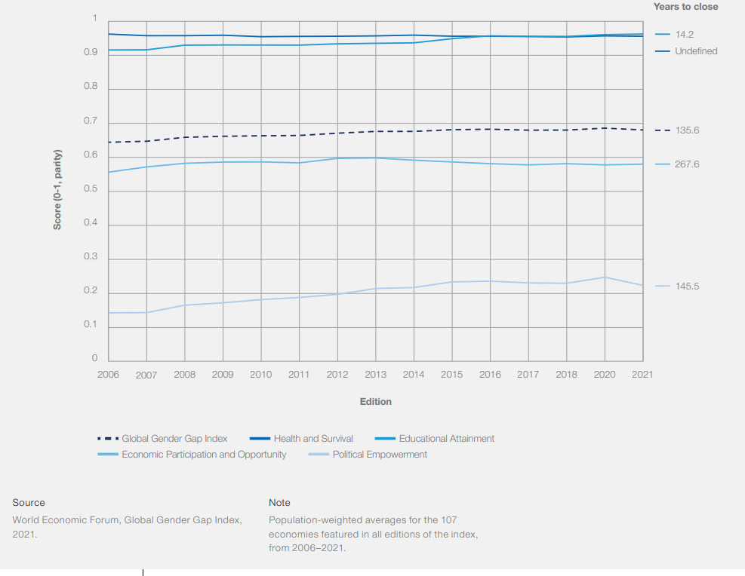
GGG index, dynamics from 2006 to 2021

Slide 17
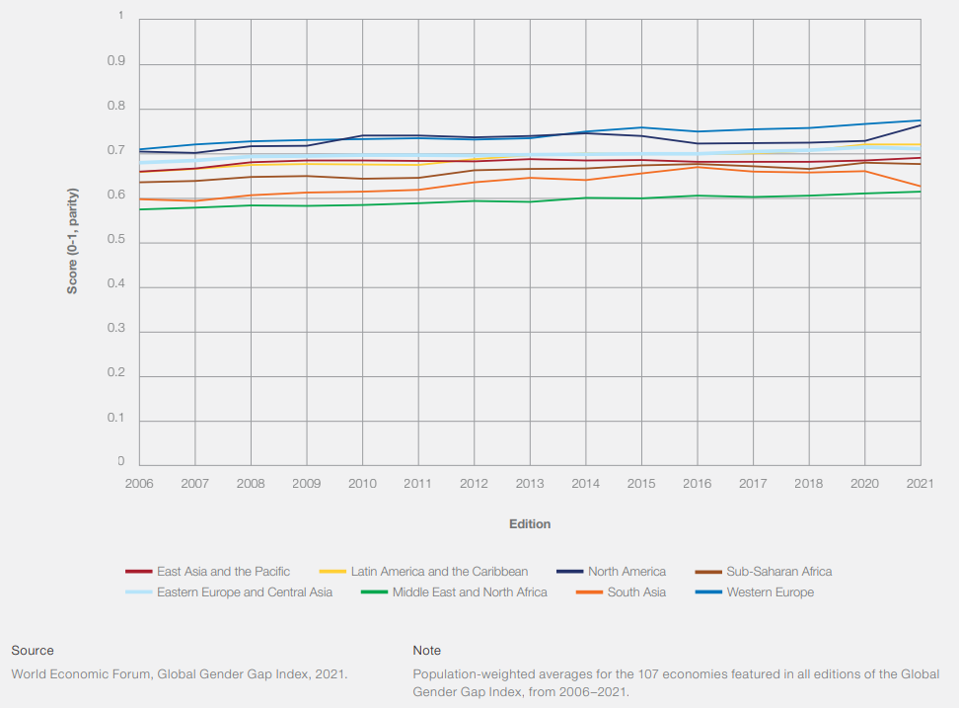
Regional gender gap, dynamics from 2006 to 2021

Slide 18
Switzerland
Global gender gap index: Rank 10, score 0.798(average 0.593)
Economic participation and opportunity: rank 39, score 0.743 (average 0.583)
Educational attainment: rank 80, score 0.992 (average 0.950)
Health and survival: rank 128, score 0.964 (average 0.957)
Political empowerment: rank 12, score 0.494 (average 0.218)

Slide 19
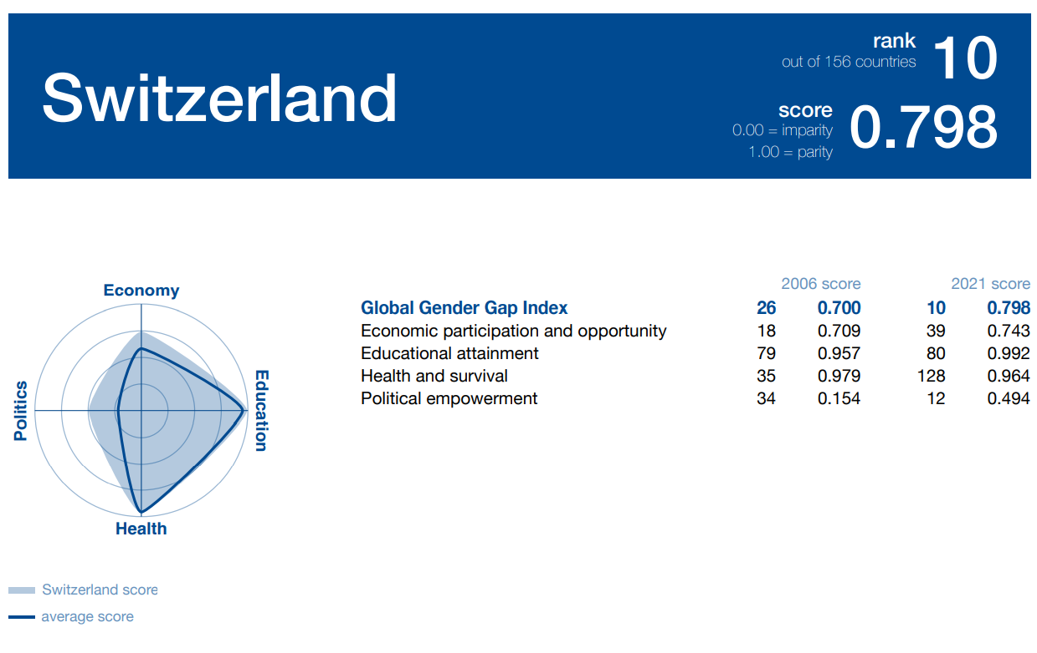
Source: Global Gender Gap report 2021. P.359

Slide 20
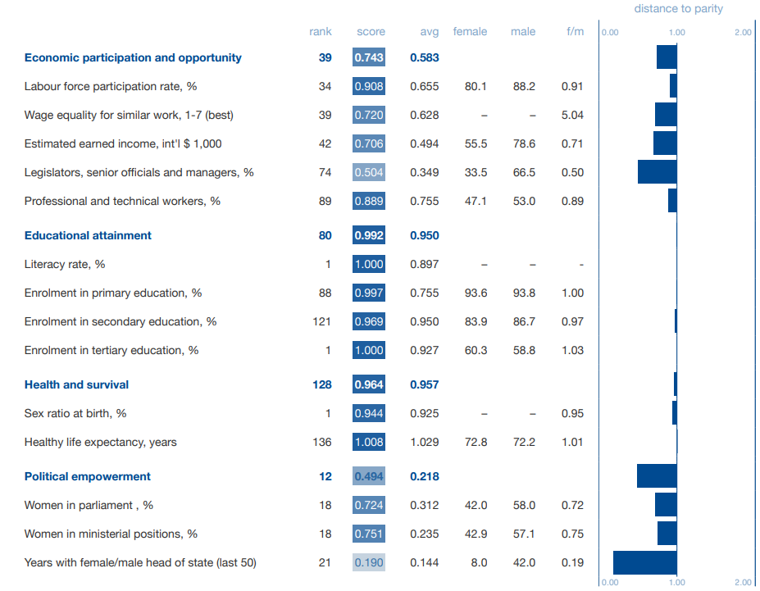
Switzerland
Source: Global Gender Gap report 2021. P.359

Slide 21
Other indices measuring gender gap
gender inequality index: http://hdr.undp.org/en/content/gender-inequality-index-gii
gender development index: http://hdr.undp.org/en/content/table-4-gender-development-index
gender social norms index: http://hdr.undp.org/en/gsni
gender equality index: https://eige.europa.eu/gender-equality-index/2019

Slide 22
What do gender indices not capture?
Disadvantages for men
Time spent at the household
Whether the work is difficult or easy
The quality of positions in the labor market or in the politics

Slide 23
Gender gap and COVID-19
Women suffered more from COVID pandemic: 4.2 per cent of women’s employment was destroyed as a result of the pandemic compared to 3 per cent of men’s employment (ILO, July 2021)
Over-representation of women in the most hit sectors (care work, service sector, manufacturing)
Higher share of women in informal economy
This is also due to the number of hours dedicated to unpaid care work, rise of violence and harassment and limited access to social protection

Slide 24
Gender gap and COVID-19
Different across regions
Highest decline in America: women’s employment by 9.4 percent whereas men’s employment declined by 7 percent
The Arab States: 4.1 percent for women compared to 1.8 for men
Asia and the Pacific: 3.8 per women 2.9 per men
Europe and Central Asia: 2.5 per women and 1.9 per men
Africa: 1.9 per women and 0.1 per men
Source: ILO, July 2021

Slide 25
Objective causes of gender gap
Underrepresentation in leadership. Women less often occupy top positions. Quite often these are more precarious positions that will be affected by the crisis. More often in human resources and financial management , less often in strategic planning. Lower share of women in top management
Segregation in education. Less women in STEM (science, technology, engineering and mathematics) areas. For women who are in these areas it is more difficult to find job.
Segregation by sector. More women in educational and service sector
Working hours. More women in part-time. Less social security, less benefits
Career breaks for childrearing or caring for older relatives.
In developing countries: the access to education and to the labour market is not equal

Slide 26
Gender discrimination at the labour market
glass-ceiling effect: women are less likely to receive higher than certain amount of salary (Johnston and Lee 2012; Yap and Konrad 2009). More widespread in developed countries.
sticky floors effect: women tend to be promoted out of the lowest positions to the next level slower than men (Yap and Konrad 2009). More widespread in developing countries.
glass-cliff effect: women get more precarious positions (Ellemers et al. 2012)
queen bee effect: successful women distance themselves from the other women (Ellemers et al. 2012).
Gender discrimination could be strengthened by other types of discrimination: against migrants, ethnic minorities, disabled

Slide 27
Male and female motivation
Gender paradox: women report more job satisfaction than men although they face material and status disadvantages (Clark et al. 1996)
Women report more intrinsic motivation, whereas men report more extrinsic motivation (Magee 2015). Intrinsic motivation is less dependent upon promotion and wage
Why motivation is different?
Personal or self-concept variables: theories of gender differences in achievement motivation such as women's fear of success on achievement, lower risk-taking behavior, lower academic self-esteem, higher home-career role conflict
Environmental variables: socialization experiences in the family, school and community, parental expectations and support or lack of support for girls and women's achievement and career development (Farmer 1997)

Slide 28
Gender-role attitudes
Gender role attitudes represent a multidimensional concept involving two main aspects (Constantin & Voicu, 2015; Larsen & Long, 1988; Wilcox & Jelen, 1991).
the public sphere: politics, labor market, education
the private one: distribution of gender roles in the family
Traditional GRA: support for specialized roles and responsibilities by gender, with women mainly devoted to childcare and unpaid domestic work and men see as the primary (or only) breadwinner of the household, with social roles in the public sphere.
Egalitarian GRA: support for women’s role in the public sphere as well as the men’s role in the private one (Albrecht et al., 2000; Baxter & Kane, 1995; Cunningham et al., 2005). (Constantin & Voicu, 2015; Larsen & Long, 1988; Wilcox & Jelen, 1991).

Slide 29
Gender-role attitudes
Surveys measure gender-role attitudes. Among others popular in large comparative cross-country surveys: World Values Survey (WVS), European Values Study (EVS), European Social Survey (ESS)
Gender-role attitudes in public sphere.
Examples of questions:
On the whole, men make better political leaders than women do
A university education is more important for a boy than for a girl
On the whole, men make better executives than women do
Countries differ in their progress to gender equality

Slide 30
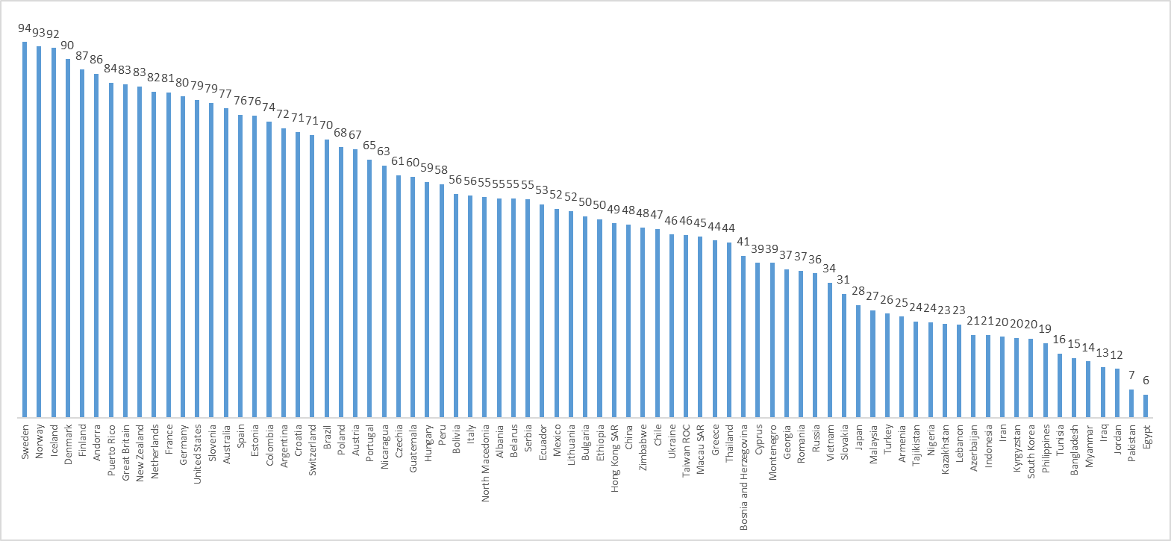
When jobs are scarce, men should have a more right to a job than women (share those who DISAGREE), WVS-EVS 2017-2020

Slide 31
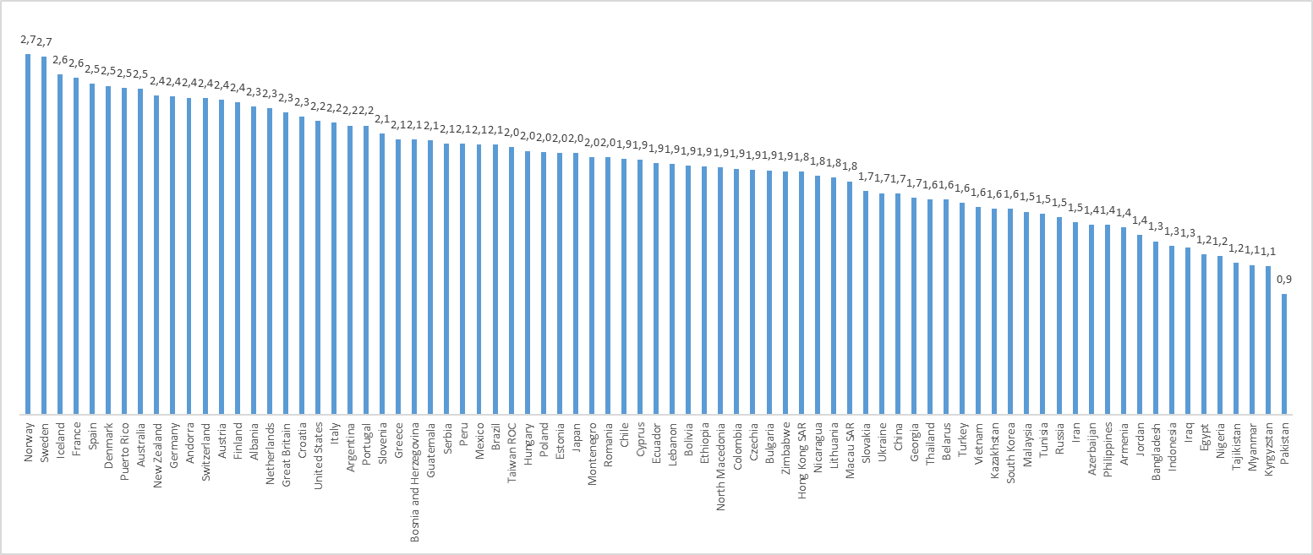
Gender-role attitudes in public sphere: index (0 – traditional, 3 – egalitarian), WVS-EVS 2017-2020

Slide 32
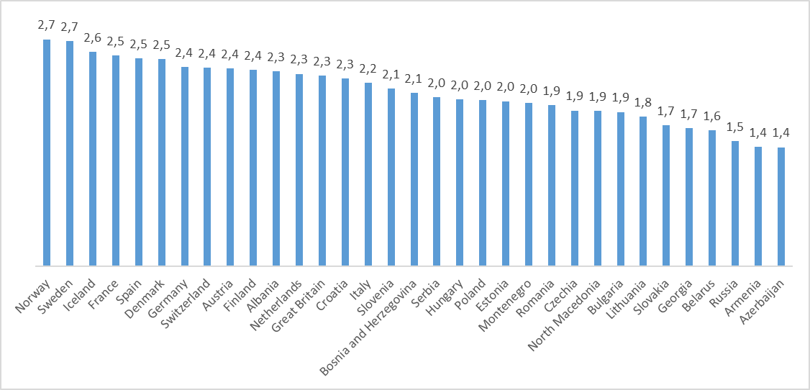
Gender-role attitudes in public sphere: index (0 – traditional, 3 – egalitarian), EVS2017-2018

Slide 33
Predictors of gender-role attitudes
More egalitarian gender-role attitudes
Women
Higher educated
Higher income
Higher occupational status
Younger age (or later cohort)
Less religious
These predictors differ by magnitude by country. In some countries could be not significant.

Slide 34
Gender-role attitudes
Having egalitarian gender-role attitudes is only one step to gender equality. Passive acceptance of gender equality is not sufficient for changing the situation in the society in the labour market. Not all women who support gender equality apply the “gender equality” strategies in practice
Achievement motivation could be regarded as a step toward gender equality because it reflects disposition to become successful in professional life. Achievement motivation means not only acceptance of new social norms but desire to follow them in one’s life
Gender-role attitudes change rather slowly but it is possible to have an impact on them
COVID-19 pandemic can have an impact upon gender-role attitudes in the long run

Slide 35
What to do?
Minimum wage – contra sticky floor
Access of women to decent jobs (decent salary, social security, etc.)
Equal pay across industries and sectors of economy
Transparency pay policies
Wage should be based on the current position and not on the previous pay
Improving the evidence base on gender gaps in the labour market

Slide 36
What to do?
Ensuring non‐standard forms of employment do not weaken
employment rights.
Tackling gender segregation by occupation
Increasing flexibility of hours and place of work
Flexibility regarding sick leaves, holidays
Improving infrastructure for childcare

Slide 37
What to do?
Encourage teleworking of women
Establish mechanisms for the reentering in the labor market. Special support for women (for example, subsidies for female entrepreneurs)
Support women’s livelihood in case of emergency
Measures to prevent domestic violence (domestic violence hotline services)

Slide 38
What to do?
One of the important goals is to promote egalitarian gender role attitudes and equal division of household labor.
It is a difficult goal because it is impossible to control the situation in the household
This is the topic of the next lecture

Slide 39
Conclusion
Narrowing the gender gap is a very important issue of the social policy
It is impossible to close fully the gender gap because men and women are different
We should create the equal opportunities for men and women

Slide 40
Thank you for your attention!

