Slide 1


Gender division of labour in the household
Academic Training Lecture Regular Programme, CERN
Natalia Soboleva

Slide 2
Outline
Statistics. Gender division of labor in the household
Changes within the era of COVID-19
Social policies (maternity, parental leave)
Theoretical explanations of gender differences
Gender-role attitudes in domestic sphere
What to do? Social policies

Slide 3
Gender division of labor
Public sphere: labor market, career, discrimination
Domestic sphere: distribution the role in the housework, children healthcare
The two spheres are closely interrelated.

Slide 4
Division of domestic labor
Although female labour force participation rates have increased significantly in the recent decades, women still bear the brunt of household chores across the globe. The same is true for dual-earner households. (ILO, 2018; Kan et al., 2011)
For example, in the EU 32 % of women were engaged in part-time work, compared with only 10 % of men. 29 % of women employed part-time indicated that unpaid care itself was their main reason for working part-time, compared with only 6 % of men citing the same cause

Slide 5
Care work
Care work = all activities and occupations that directly or indirectly involve care processes and entail ‘the provision of personal services to meet those basic physical and mental needs that allow a person to function at a socially determined acceptable level of capability, comfort and safety’ (Himmelweit, 2007, p. 581).
Gender gap in care work:
In EU: 92% women and 68% = regular carers
81% women and 48% men = daily carers

Slide 6
Care work
Women living in couples with children spend more than double the daily time on care work spent by those living in couples without children (5.3 hours per day compared with 2.4 hours)
Daily time spent on unpaid care is higher in the childbearing age group (those aged 25–49), especially for women, resulting in a higher gender care gap than in the other age categories.
The burden of unpaid care work being higher for women in non-standard and low-paid jobs.
Women in temporary jobs or with no formal contract spend twice the amount of time on unpaid care every day that women employed in permanent jobs do

Slide 7
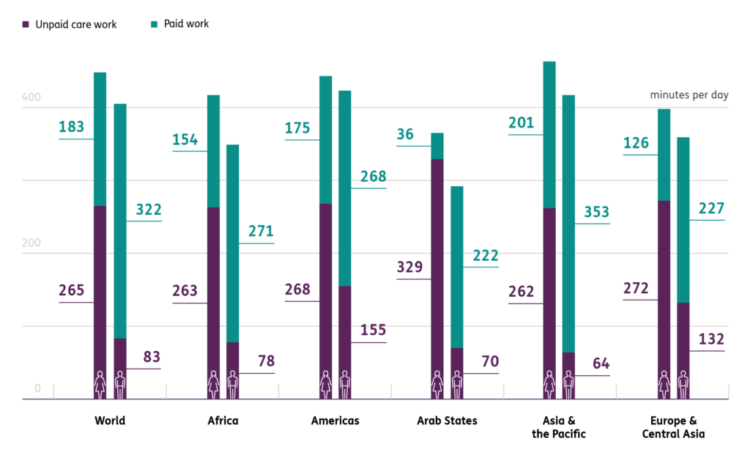
Unpaid care work and paid work across continents (https://ilostat.ilo.org/)

Slide 8
Data on time use in the household
Harmonised European Time Use Surveys (HETUS 2010) (round 2, 2008-2015): conducted in 18 European countries - 15 EU countries, 3 non-EU countries (Norway, Serbia and Turkey).
Representative samples of the population. From 2005 to 40048 respondents by country
Source: https://ec.europa.eu/eurostat/statistics-explained/index.php?title=How_do_women_and_men_use_their_time_-_statistics

Slide 9
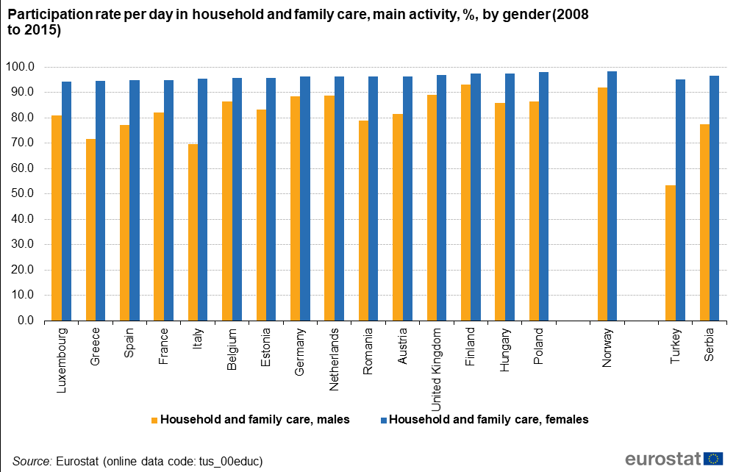

Slide 10
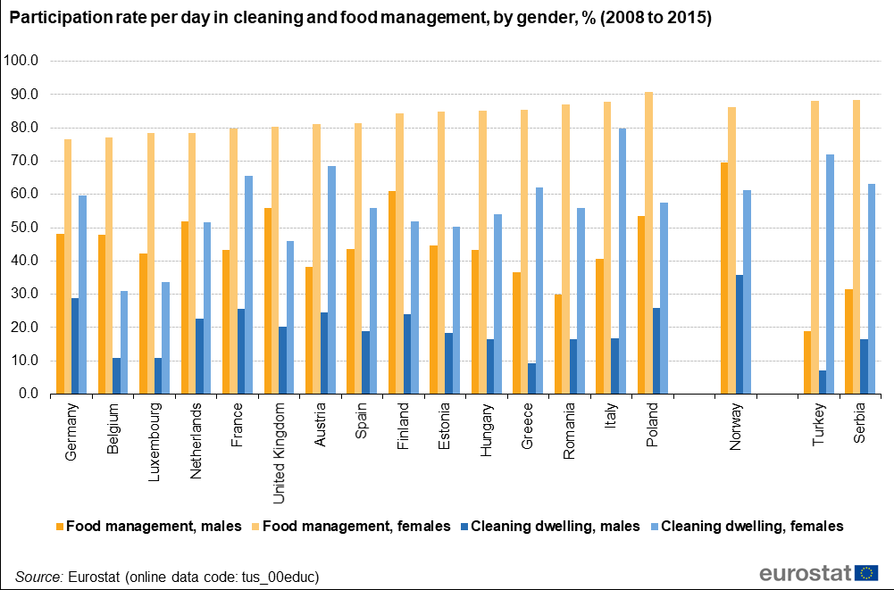

Slide 11
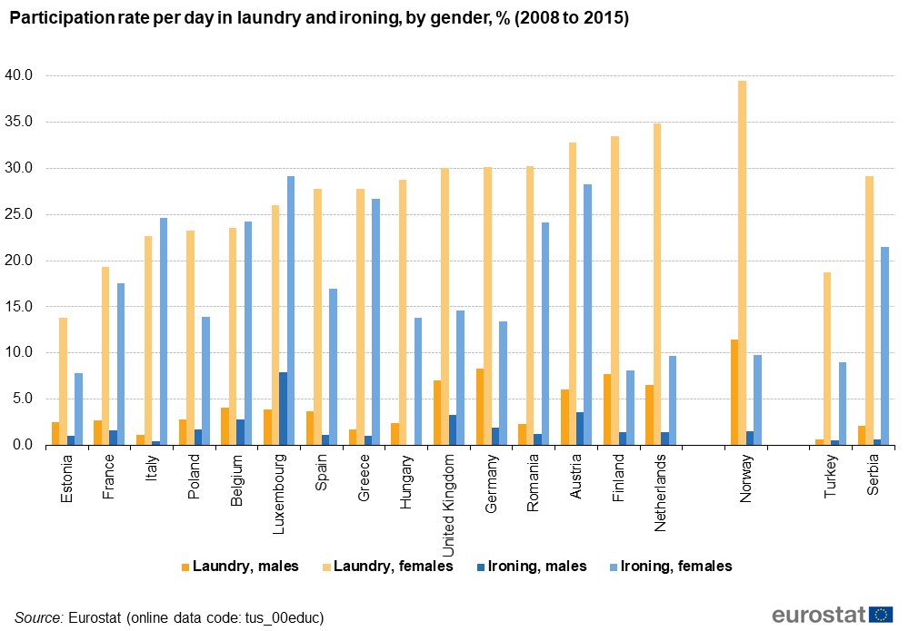

Slide 12
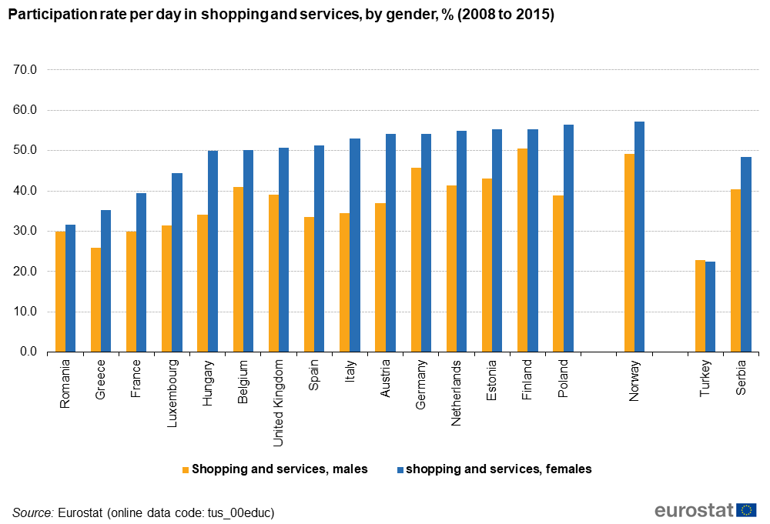

Slide 13
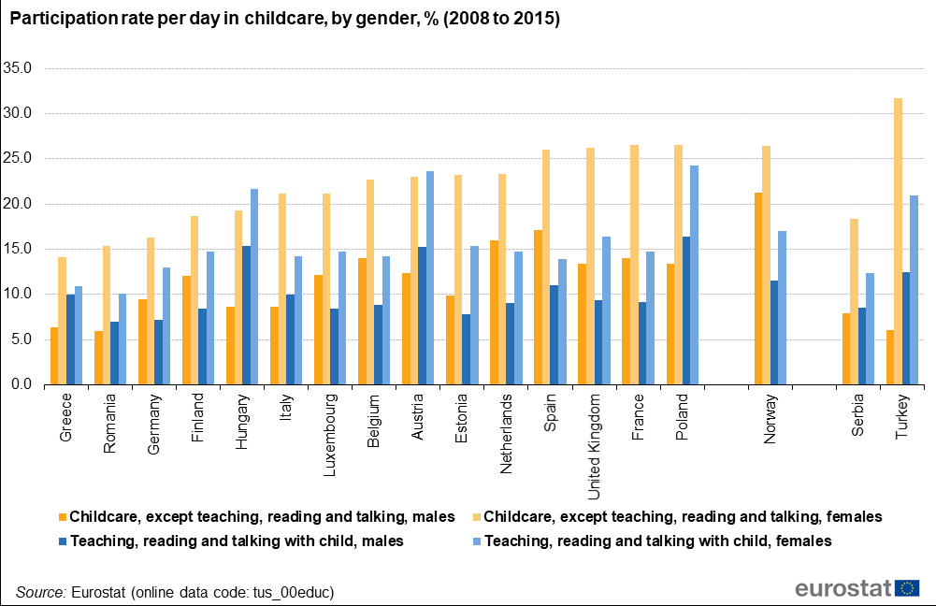

Slide 14
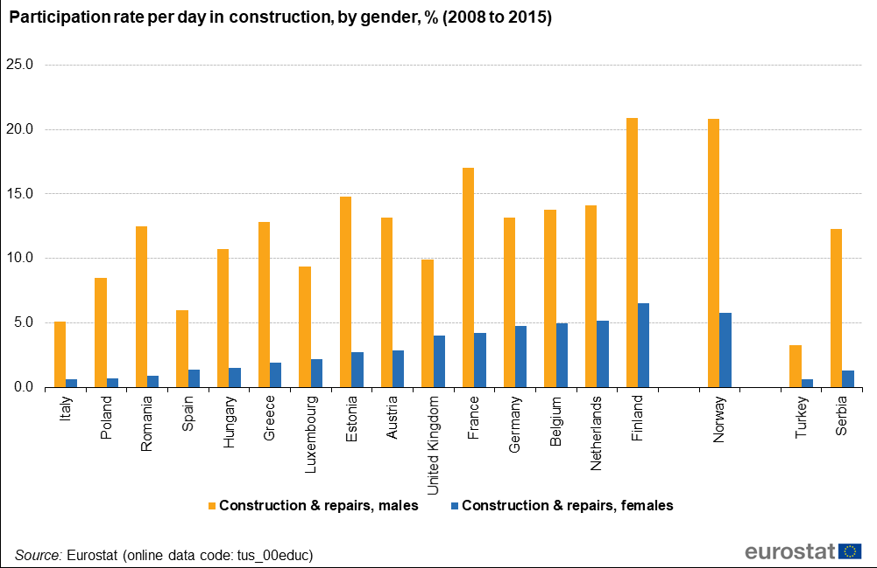

Slide 15
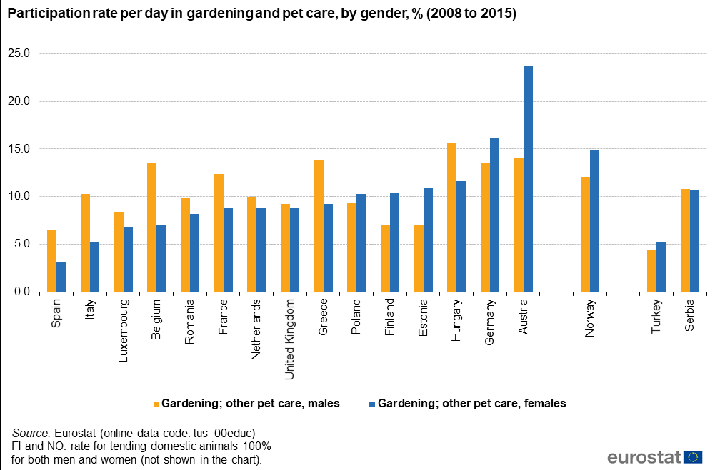

Slide 16
Social policies
Maternity leave
Parental leave
Father-specific leave

Slide 17
Maternity leave (weeks), 2018

Slide 18
Parental leave with job protection (weeks), 2018

Slide 19
Total paid maternity and parental leave (weeks), 2018

Slide 20
Paid father-specific leave (weeks), 2018
Paid father-specific leave refers to the number of paid weeks reserved for the exclusive use of fathers, including entitlements to paid paternity leave, 'father quotas' or periods of paid parental leave that can be used only by the father and cannot be transferred to the mother, and any weeks of paid sharable leave that must be taken by the father in order for the family to qualify for 'bonus' weeks of parental leave
Source: OECD, https://stats.oecd.org/index.aspx?queryid=54760

Slide 21
Housework and COVID-19
Women were affected more than men. They lost employment more often.
Mothers were nearly three times as likely as fathers to report that they took on the majority or all of additional unpaid care work related to school or childcare facility closures: 61.5% of mothers of children under age 12 say they took on the majority or entirety of the extra care work, while 22.4% of fathers report that they did.
Mothers of children under age 12 were the group most likely to move from employed to not employed status between Q4 2019 and Q3 2020, on average across OECD countries.

Slide 22
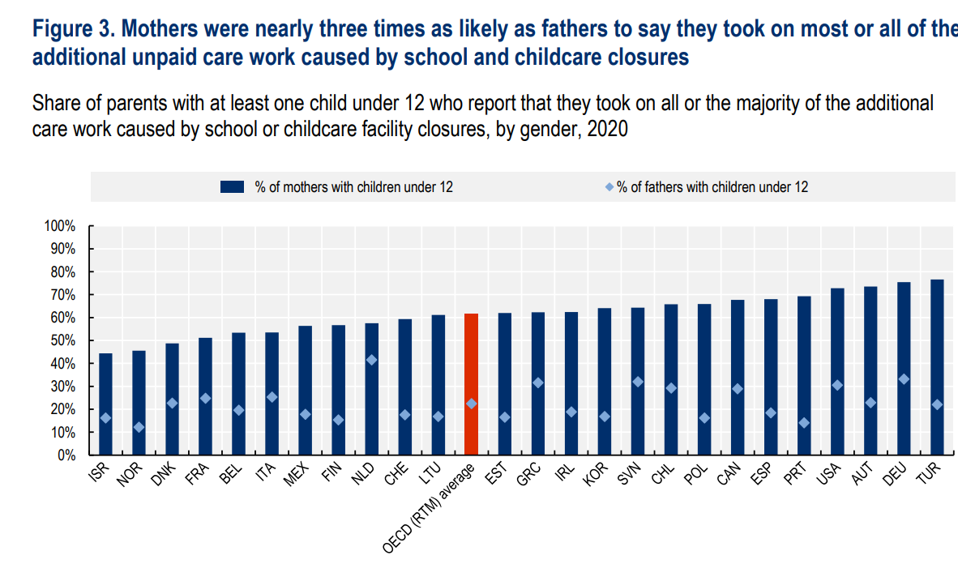
Source: OECD, 2021: https://www.oecd.org/coronavirus/policy-responses/caregiving-in-crisis-gender-inequality-in-paid-and-unpaid-work-during-covid-19-3555d164/

Slide 23
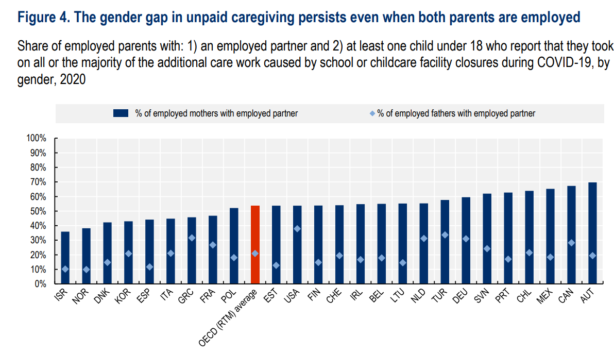
Source: OECD, 2021: https://www.oecd.org/coronavirus/policy-responses/caregiving-in-crisis-gender-inequality-in-paid-and-unpaid-work-during-covid-19-3555d164/

Slide 24
Housework and COVID-19
Mothers and women more often experiences stress and decrease in well-being
Those with small children more claim that they need governmental support
In countries with better family policies the situation is better

Slide 25
Explanations of gender inequality
Sex segregation theory: various tastes, aspirations and skills of men and women (Schultz 1990; Bussey and Bandura 1999; Grusky and Levanov 2008)
Different motivation
Institutional theory: positions of men and women mainly depend upon employment legislation and other social policies (Bonacich 1972)
Differences in external conditions and discrimination

Slide 26
Time allocation in the family: theoretical approaches
relative resources approach: a greater relative resource like education, work status or income, is related to a higher negotiating power on the respective share of unpaid work (Becker 1994, Crompton & Lyonette, 2005; Steiber & Haas, 2009)
gender role theory: individual attitudes towards gender roles, i.e. which partner based on the respective gender should allocate more or less time in work and family domains, shape personal preferences for behavior and influence couples share of paid and unpaid work (Crompton & Lyonette, 2005; Steiber & Haas, 2009)

Slide 27
Time allocation in the family: theoretical approaches
institutional approach: individuals’ behaviors, and couples’ work-family organizations, are nested in and framed by national-level institutional logics such as specific policies and public supports (Thornton et al., 2012; Ruppanner & Maume, 2016).
social role theory: societies are characterized by normative gender roles for men and women that have been institutionalized and became the norm (Eagly, 1987; Eagly & Wood, 2012; Zhao et al., 2017).

Slide 28
Gender-role attitudes
Gender role attitudes represent a multidimensional concept involving two main aspects (Constantin & Voicu, 2015; Larsen & Long, 1988; Wilcox & Jelen, 1991).
the public sphere: politics, labor market, education
the private one: distribution of gender roles in the family
Traditional GRA: support for specialized roles and responsibilities by gender, with women mainly devoted to childcare and unpaid domestic work and men see as the primary (or only) breadwinner of the household, with social roles in the public sphere.
Egalitarian GRA: support for women’s role in the public sphere as well as the men’s role in the private one (Albrecht et al., 2000; Baxter & Kane, 1995; Cunningham et al., 2005). (Constantin & Voicu, 2015; Larsen & Long, 1988; Wilcox & Jelen, 1991).

Slide 29
Gender-role attitudes in domestic sphere
European Values Study (EVS): https://europeanvaluesstudy.eu/
Gender-role attitudes in domestic sphere
When a mother works for pay, the children suffer
A job is alright but what most women really want is a home and children
All in all, family life suffers when the woman has a full-time job
Doesn’t belong to any dimension:
Man's job is to earn money; woman's job is to look after home and family

Slide 30
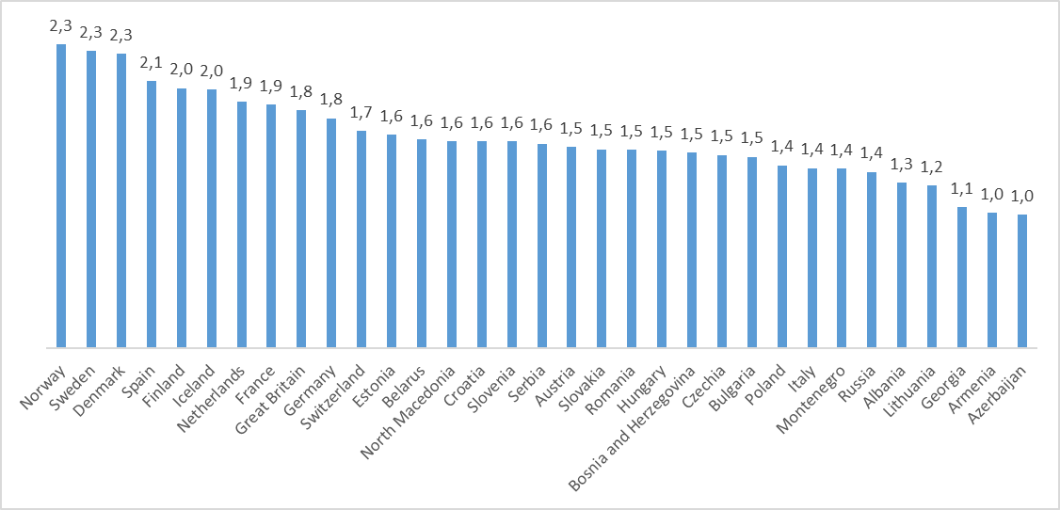
GRA in domestic sphere: index (0 – traditional, 3 – egalitarian), EVS2017-2018

Slide 31
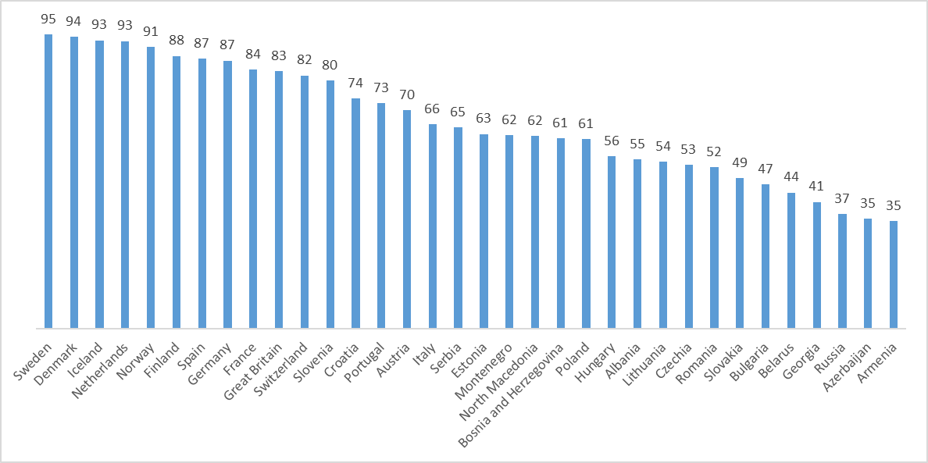
Man's job is to earn money; woman's job is to look after home and family
(%, share of those who disagree), EVS2017-2018

Slide 32
Gender-role attitudes in domestic sphere
World Values Survey (WVS):
https://www.worldvaluessurvey.org/wvs.jsp
Gender-role attitudes in domestic sphere
When a mother works for pay, the children suffer
Being a housewife is just as fulfilling as working for pay
If a woman earns more money than her husband, it's almost certain to cause problems

Slide 33
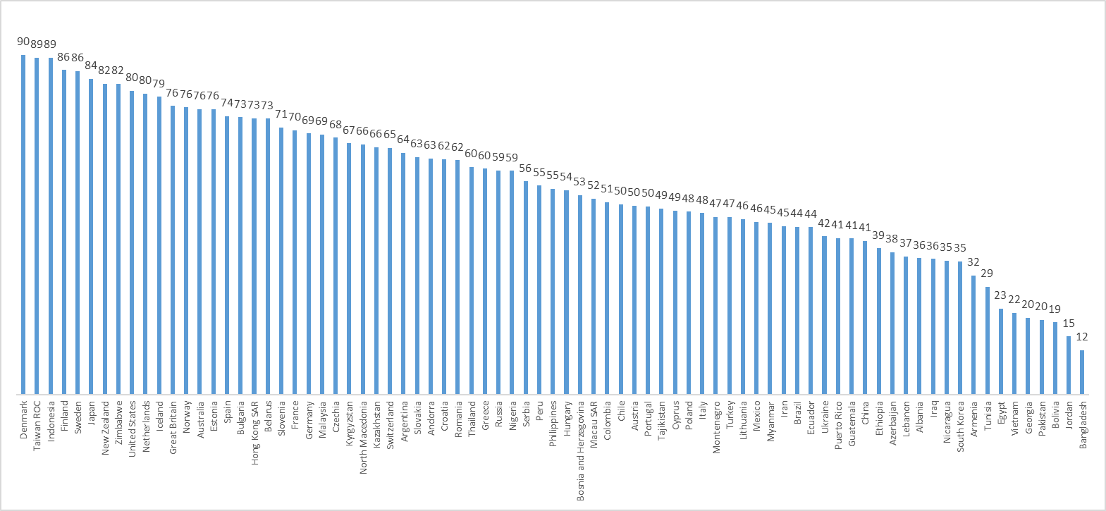
Pre-school child suffers with working mother (share those who DISAGREE), WVS-EVS 2017-2020

Slide 34
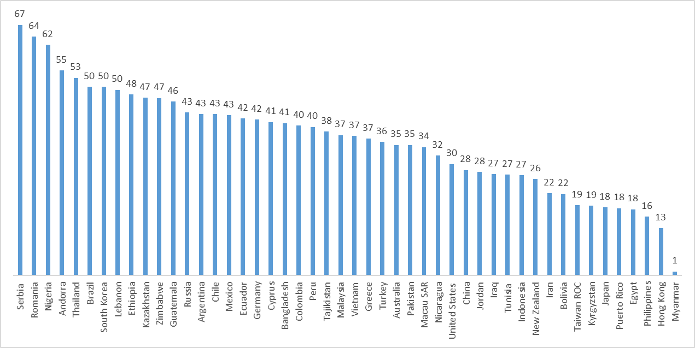
Being a housewife is as fulfilling as working for pay (share those who DISAGREE), WVS 2017-2020,

Slide 35
Problems with GRA
Main focus on female roles. Male roles are largely neglected (Walter 2018; Grunow et al 2019)
Multimensionality is often neglected (Walter 2018; Grunow et al 2019)
Outdated wording: many of the items still keep formulation from the Seventies. This allows over time comparison, but imprint traditional views that are perceived differently across societies (Braun 2008)
Different awareness about gender equality affects item interpretation and mechanisms of social desirability (as in the case of male roles items) (Braun 2008, 2009)
Societies provides different context of opportunities and societal cultural orientations which explain gaps in measurement equivalence (Seddig & Lomazzi 2019)
You never can construct ideal measure or gender-role attitudes but it is necessary for cross-cultural and longitudinal comparisons. Sometimes it is better when the measure is not perfect but is the same across countries and across time.
Countries vary a lot in gender-role attitudes both in public and domestic sphere

Slide 36
Gender-role attitudes in the time of COVID
Not much research. Transformation of attitudes and values is a long process and it is not so easily captured. Coronavirus pandemic affected more behavior than attitudes
Example. Reichelt, Makovi and Sargsyan found for the US, Germany and Singapore that “among couples who had been employed at the start of the pandemic, men express more egalitarian gender-role attitudes if they became unemployed but their partners remained employed, while women express more traditional attitudes if they became unemployed and their partners remained employed” (2021)

Slide 37
How to reduce gender inequality in the household?
More difficult to regulate than the sphere of labor market because it is a closed area that cannot be directly controlled
1st way:
Improving childcare and housework infrastructure: kindergartens, delivery services, laundries, dry cleaners, home help (housekeepers, nurses in charge of children, caregivers)
Managing the household is a difficult and time-consuming task. Usually women are responsible of it
Sandwich generation –middle-aged adults who have to take care of children and old parents
Class of women who work as home help
Does not reduce gender inequality in the household

Slide 38
How to reduce gender inequality in the household?
2nd way: more effective
Involving men in household responsibilities: fathers have to take part of the parental leave (like in Sweden), men working part-time
Men get more involved in childcare and housework.
Change to more egalitarian gender-role attitudes
Not a fast and easy process!

Slide 39
COVID19 and distribution of housework
Coronavirus pandemic led to profound changes in the lifestyle: working and studying from home, closure of many activities. This led to the increasing share of housework. The problem of work-life balance became more acute?
There could be consequences regarding the distribution of household responsibilities, labor market and in future gender-role attitudes.

Slide 40
What to do
Governments should include greater public investments in good-quality childcare, education, and out-of-school supports; increasing the length of, and mandating take-up of, paternity leave, which has implications for fathers’ long-term caregiving behaviour; and normalising the use of telework across men and women, so that women are not penalised for using it.
Invest in strengthening good-quality, widely accessible, and affordable supports. Also available for those with low income potential and especially for mothers
Make telework gender-sensitive

Slide 41
Father’s caregiving
Works differently across countries. Better in European than in Asian context. Depends on cultural characteristics and long-term tradition
Sweden, Norway, Canada, Germany and Spain perform better than Japan and South Korea
In general can strengthen female labor force participation and lead to more egalitarian gender-role attitudes

Slide 42
Findings
Gender gaps during COVID-19 reflect longstanding weaknesses in countries’ social protection systems and their historical reliance on women as a crucial pillar of the social safety net. The gender gap in COVID-19 care work tends to be lower in countries that have historically spent more on family policies like childcare, family allowances, maternity and parental leave, and other cash benefit
It is impossible to achieve equal division of labour but equal opportunities should be created

Slide 43
Thank you for your attention!

