Slide 1

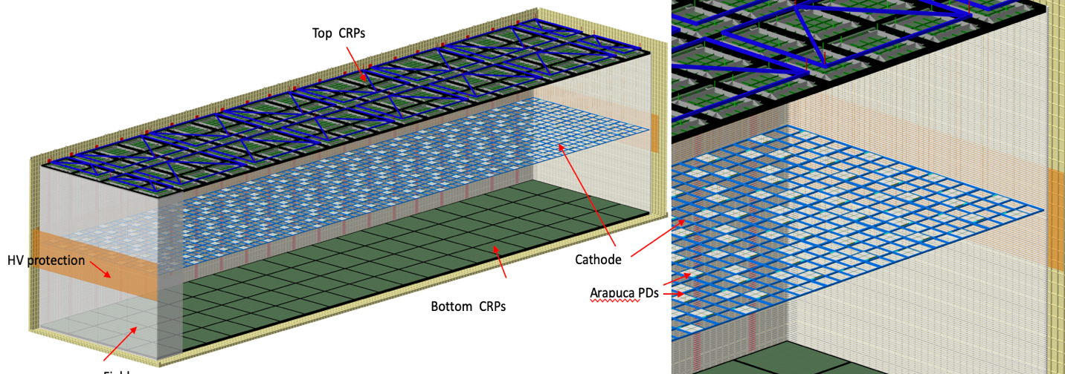
​Vertical Drift: Project Planning
Steve Kettell
Vertical Drift Meeting
17 June 2021

Slide 2
SPVD Calendar
Technical CDReview: PDS 12 April/19 April
Technical CDReview: CRP 20 April
Risk Workshop 21 April
    LBNF/DUNE-US Risk workshop for FD1/2 20 May
LBNC SPVD Technical Review 28 April
LBNC SPVD Simulation Review 10 May
LBNC SPVD Project Planning Review 11 May
Date reserved for possible LBNC wrap-up 26 May
Technical Conceptual Design Reviews May-June
    Bottom electronics 28 May
    Top electronics 4 June
    HV 14 June
    DAQ 18 June
FD2 BCR/CCB (P6 frozen for Dir Rev) ~end of May
Complete BoE (July), NCG Review (~early 2022) July
Post documents for Director’s review 15 July
Post all documents for CD-1rr 15 September
Begin PDReviews Fall-Winter
…
CD-2 Review October 2022

Slide 3
Final LBNC FD2-VD Review Report (edms-2560198 )

Slide 4
Internal Technical Conceptual Design Reviews
PDS 12/19 April
  Presentations: https://indico.cern.ch/event/1026160
  Presentations: https://indico.cern.ch/event/1028534
  Draft Report: not yet
CRP 20 April
  Presentations: https://indico.cern.ch/event/1026162
  Draft Report: https://edms.cern.ch/document/2565930
Bottom Elect. 28 May
  Presentations: https://indico.cern.ch/event/1038739
  Draft Report: not yet
Top Elect. agenda https://indico.cern.ch/event/1038740 4 June
HV draft agenda https://indico.cern.ch/event/1038741 14 June
DAQ draft agenda https://indico.cern.ch/event/1038731 18 June

Slide 5
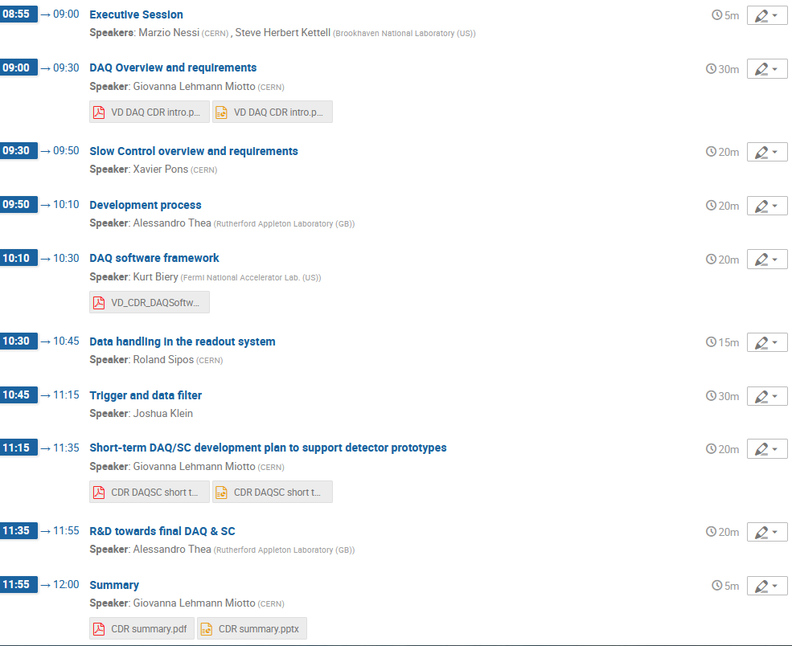
Internal Technical Conceptual Design Reviews DAQ
Tomorrow

Slide 6
SPVD Calendar
Technical CDReview: PDS 12 April/19 April
Technical CDReview: CRP 20 April
Risk Workshop 21 April
    LBNF/DUNE-US Risk workshop for FD1/2 20 May
LBNC SPVD Technical Review 28 April
LBNC SPVD Simulation Review 10 May
LBNC SPVD Project Planning Review 11 May
Date reserved for possible LBNC wrap-up 26 May
Technical Conceptual Design Reviews May-June
    Bottom electronics 28 May
    Top electronics 4 June
    HV 14 June
    DAQ 18 June
FD2 BCR/CCB (P6 frozen for Dir Rev) ~end of May
Complete BoE (July), NCG Review (~early 2022) July
Post documents for Director’s review 15 July
Post all documents for CD-1rr 15 September
Begin PDReviews Fall-Winter
…
CD-2 Review October 2022

