Slide 1
LAr Thermal Fluid and Impurity Simulations Vertical Drift 3 View Detector May 2021 update
https://edms.cern.ch/document/2517361
David Montanari
Work by Erik Voirin
Config 1 → Same as presented in Apr-2021 (x3 electronics head load).
Config 2 → Same as presented in Apr-2021 (x1 electronics head load).
Config 3 → PD added as opaque (zero transparency). ~ 50% overall Cathode transparency.
Config 4 → PD added as opaque (zero transparency) and reduced overall transparency x5. ~ 10% overall.

Slide 2
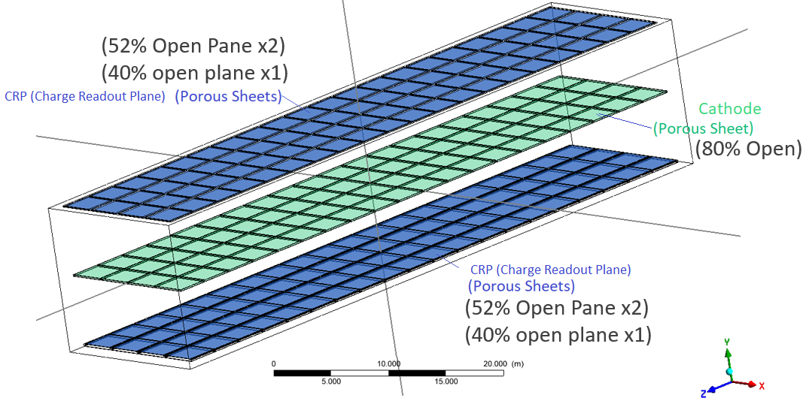
Geometry Dimensions: 62m x 15.1m x 13.44m Liquid depth Origin (0,0,0) in center of Cathode plane. (Geometry Symmetric about XY plane and YZ Plane)
CRP and Cathode frame arranged in 4x20 grid of panels with (X, Z) dimensions of (3.375, 3m)
Inside Surfaces of Top and Bottom CRP frame @ Y = ± 6.525m (Frame is 9cm thick)
Liquid Surface @ Y = 6.865m (25cm above Top of APA frame)
CPA Center @ Y = 0m
Floor @ Y = -6.785m

Slide 3
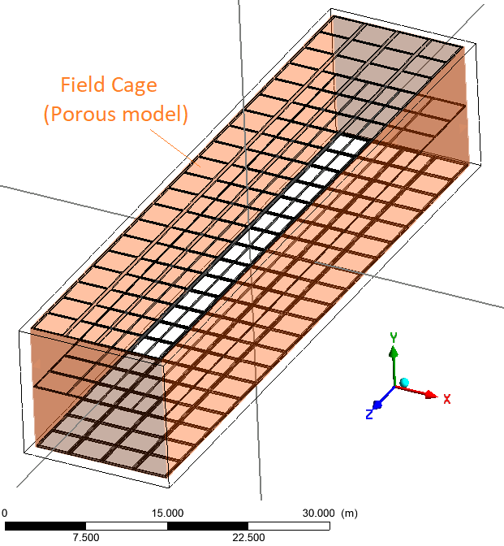
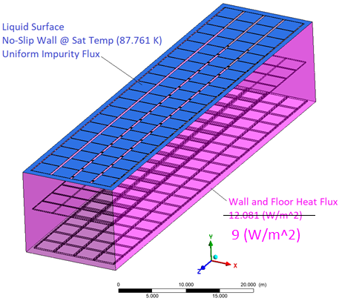
Field Cage around Cathode and CRPs Liquid Surface, and Insulation Heat Flux Boundaries

Slide 4
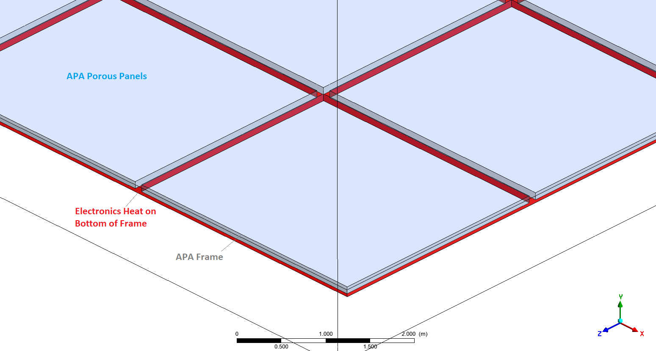
Bottom CRP Frame has Electronics Heat Load around perimeter. 13312 Watts total, Heat Flux of (265.18 W/m^2) CRP and Cathode Frame Panel Size (X, Z) = (3.375m, 3m)
(z,y) = (10cm x 9cm)
(x,y) = (10cm x 9cm)
(x,y) = (5cm x 9cm)
(z,y) = (5cm x 9cm)

Slide 5
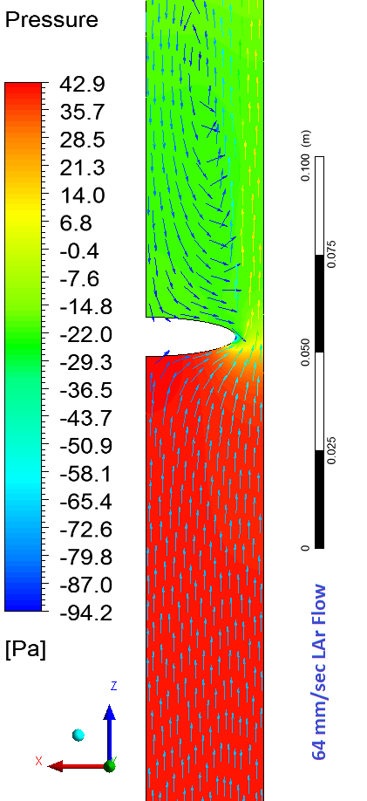
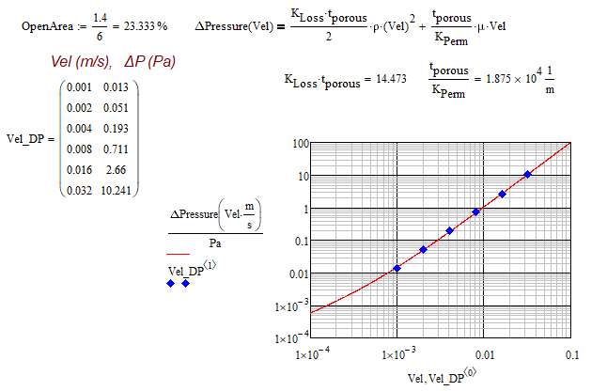
Field Cage: 4.6cm ellipses @ 6cm pitch

Slide 6
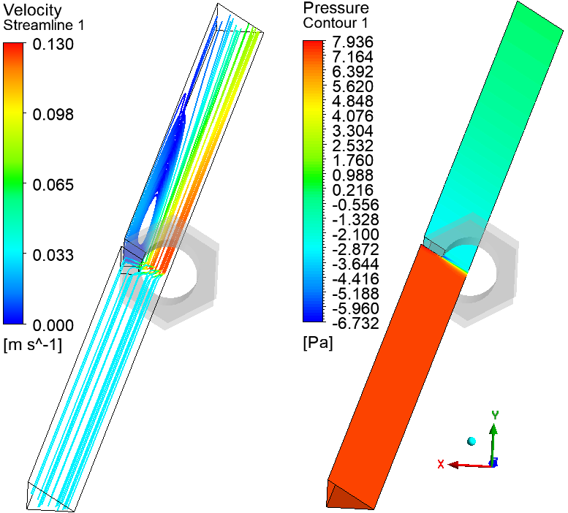
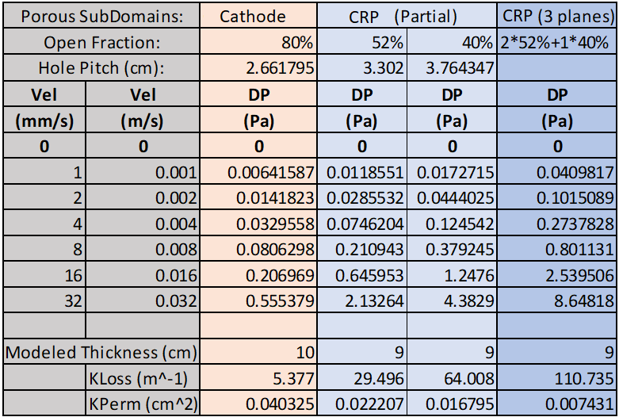

Porous Regions: 2.5mm holes in hexagonal pattern: 3.2mm thick plate (Example sub-model)
Momentum Loss is then modeled as:

Slide 7
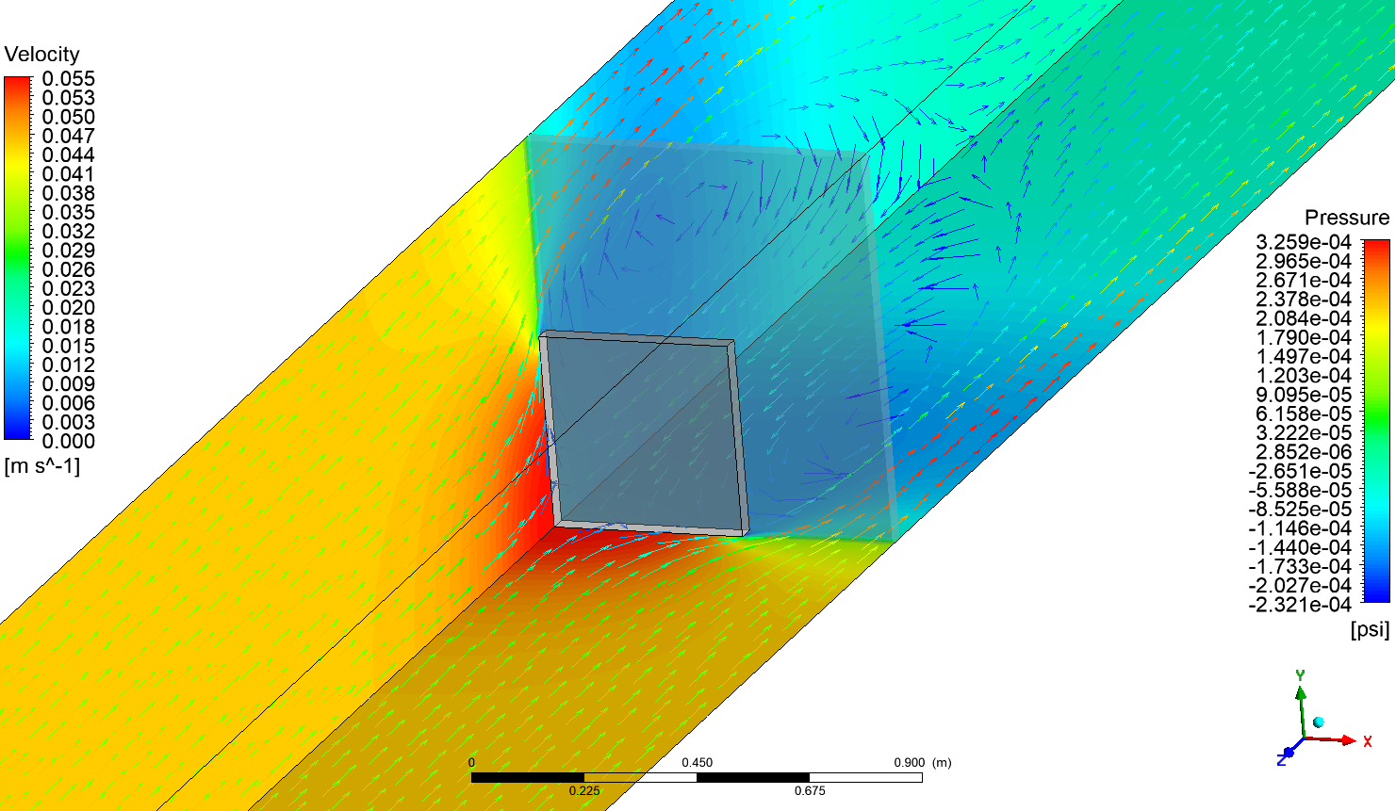
Porous Regions: Addition of Photodiode Panels into Cathode Plane (symmetric representative model)
80% Transparency
Impermeable
Photodetector
Panel

Slide 8
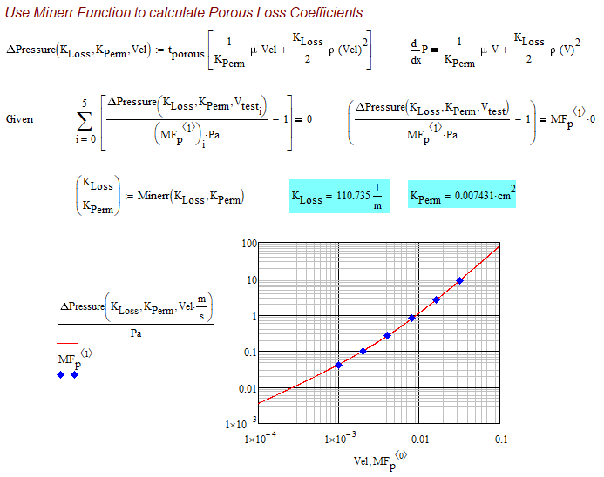
Porous Regions: 2.5mm holes in hexagonal pattern: (Calcs shown for 3 plane CRP: 2x52% Open Planes + 1x40% Open Plane)
Table Data →
Porous SubDomains: |  | CPA | CPA w/ PDs | CPA w/ PDs x5 | APA (Partial) |  | APA (3 planes)
Open Fraction: |  | 80% |  |  | 52% | 40% | 2*52%+1*40%
Hole Pitch (cm): |  | 2.661795 |  |  | 3.302 | 3.764347
Vel | Vel | DP | DP | DP | DP | DP | DP
(mm/s) | (m/s) | (Pa) | (Pa) | (Pa) | (Pa) | (Pa) | (Pa)
0 | 0 | 0 | 0 | 0 | 0 | 0 | 0
1 | 0.001 | 0.00641587 | 0.009883 | 0.049415 | 0.0118551 | 0.0172715 | 0.0409817
2 | 0.002 | 0.0141823 | 0.02187 | 0.10935 | 0.0285532 | 0.0444025 | 0.1015089
4 | 0.004 | 0.0329558 | 0.052789 | 0.263945 | 0.0746204 | 0.124542 | 0.2737828
8 | 0.008 | 0.0806298 | 0.14424 | 0.7212 | 0.210943 | 0.379245 | 0.801131
16 | 0.016 | 0.206969 | 0.44697 | 2.23485 | 0.645953 | 1.2476 | 2.539506
32 | 0.032 | 0.555379 | 1.5331 | 7.6655 | 2.13264 | 4.3829 | 8.64818
Modeled Thickness (cm) |  | 10 | 10 | 10 | 9 | 9 | 9
 | KLoss (m^-1) | 5.377 | 17.429 | 87.145 | 29.496 | 64.008 | 110.735
 | KPerm (cm^2) | 0.040325 | 0.030471 | 0.0060942 | 0.022207 | 0.016795 | 0.007431

Slide 9
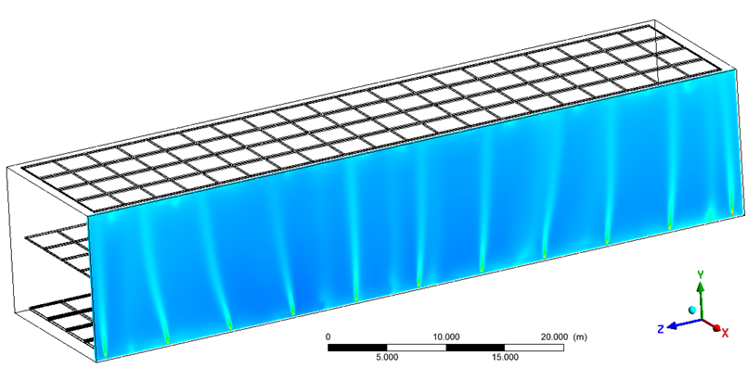
22 Discharge points: 11 along each longitudinal edge. 4 Suction Points near –Z end wall. 140 tonne/hr flow
Even Flow @ All Suction Points and Discharge Points.
T_{Discharge} = T_{Suction} + 0.2[K]
11 Discharge points on each side

Slide 10
Results for 4 Configs. See Report Files for Detailed Figures of 4 Configs
DM Note: Config 1 and 2 are as presented in Apr-2021. Config 3 adds PD panels (completely opaque). Config 4 reduces transparency by x5.
 | Config 1 | Config 2 | Config 3 | Config 4
 | No Photo Detectors (Electronics x3) | No Photo Detector Panels | With Photo Detector Panels | With PD Panels (Cathode DeltaP x5)
Velocity Results [mm/s]
Average Velocity in FC Volume | 19.4508 | 13.0516 | 10.763 | 11.081 | volumeAve(Velocity)@InsideFC / 1[mm/s]
Average Velocity in Full Cryostat Volume | 19.8416 | 14.2003 | 12.1563 | 12.361 | volumeAve(Velocity)@LArDomain / 1[mm/s]
Maximum Velocity inside FC Volume | 80.5568 | 79.7374 | 86.2333 | 77.366 | maxVal(Velocity)@InsideFC / 1[mm/s]
Average Velocity Above Cathode | 19.7872 | 13.9857 | 12.1009 | 12.963 | volumeAve(Velocity)@UpperHalf / 1[mm/s]
Average Velocity Below Cathode | 19.9499 | 14.4554 | 12.2564 | 11.827 | volumeAve(Velocity)@LowerHalf/ 1[mm/s]
Average Velocity Through Cathode | -4.04096 | -3.77764 | -3.58797 | -3.376 | volumeAve(Velocity v)@CPA/ 1[mm/s]
Vertical Force on Cathode Plane (N) | -29.9192 | -24.8568 | -53.3521 | -132.295 | -volumeAve(Pressure.Gradient Y)@CPA *10[cm] *(3.375[m]*4*60[m]) / 1[N]
Impurity Results [m^-3]
Average Impurities in FC Volume | 0.9998 | 0.99899 | 0.99901 | 0.999 | volumeAve(Impurities)@InsideFC / 1[m^-3]
Minimum Impurities in FC Volume | 0.98049 | 0.97963 | 0.97923 | 0.978 | minVal(Impurities)@InsideFC / 1[m^-3]
Maximum Impurities in FC Volume | 1.06154 | 1.07149 | 1.07521 | 1.081 | maxVal(Impurities)@InsideFC / 1[m^-3]
Standard Deviation Impurities in FC Volume | 0.00302 | 0.0033 | 0.00349 | 0.004 | sqrt(volumeAve((Impurities - (volumeAve(Impurities)@InsideFC))^2)@InsideFC) / 1[m^-3]
Average Impurities Above Cathode | 0.99882 | 0.99783 | 0.99767 | 0.998 | volumeAve(Impurities)@UpperHalf / 1[m^-3]
Average Impurities Below Cathode | 1.00008 | 0.99957 | 0.99981 | 1.000 | volumeAve(Impurities)@LowerHalf / 1[m^-3]
Temperature Results [K]
Surface Saturation Temperature | 87.761 | 87.761 | 87.761 | 87.761 | 87.761
Average Temp in FC Volume | 88.2133 | 88.082 | 88.0841 | 88.082 | volumeAve(T)@InsideFC / 1[K]
Minimum Temp in FC Volume | 88.1277 | 88.0233 | 88.0208 | 88.017 | minVal(T)@InsideFC / 1[K]
Maximum Temp in FC Volume | 88.3592 | 88.1433 | 88.1586 | 88.148 | maxVal(T)@InsideFC / 1[K]
Standard Deviation Temp in FC Volume | 0.00521 | 0.00317 | 0.00341 | 0.003 | sqrt(volumeAve((T - (volumeAve(T)@InsideFC))^2)@InsideFC) / 1[K]
Average Surface Temperature of Electronics | 91.1588 | 89.1392 | 89.1362 | 89.217 | areaAve(Wall Temperature)@Electronics / 1[K]
Average Temperature Above Cathode | 88.2137 | 88.0829 | 88.0852 | 88.083 | volumeAve(T)@UpperHalf / 1[K]
Average Temperature Below Cathode | 88.2139 | 88.082 | 88.0837 | 88.082 | volumeAve(T)@LowerHalf / 1[K]
Maximum LAr Superheat in Cryostat | 0.46683 | 0.33419 | 0.34 | 0.333 | maxVal(Local Superheat)@LArDomain / 1[K]
Maximum LAr Superheat in FC Volume | 0.05783 | -0.07782 | -0.07549 | -0.080 | maxVal(Local Superheat)@InsideFC / 1[K]

Slide 11
Results for 4 Configurations:
Config 1
We show:
Superheat Values near the top for Configs 1-4
NOTE: Cooling at liquid surface is not modeled according to the true boiling physics, it is only modeled as a no-slip wall set to saturation temperature.
LAr Temperatures along several vertical lines
At Z= 1.5m
At Z = 18m
Other Result Reports
See Attached Report Files for Figures of Temperature, Velocity, and Impurities on various XY and YZ Planes.
43 figures for each configuration

Slide 12
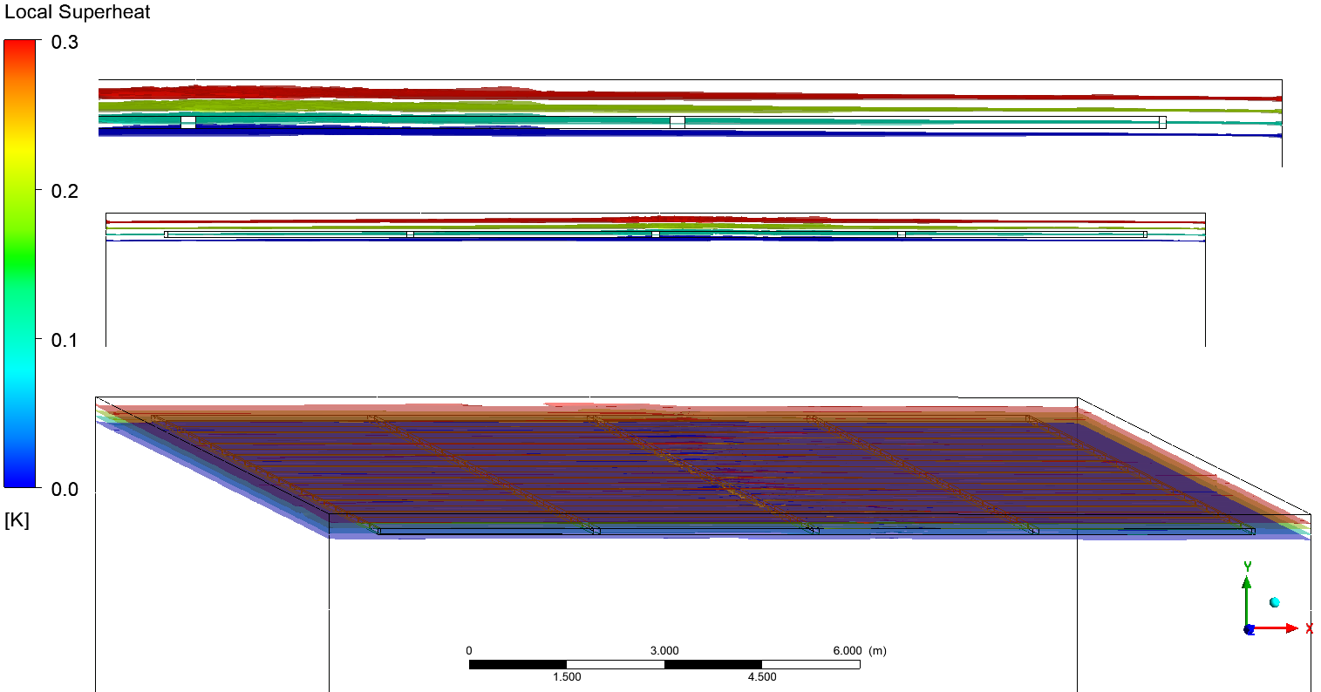
Local superheat above saturation: 0, 0.1, 0.2, 0.3K (Temp - Local T_{sat}) Max = 0.467K
Config 1
Isosurface of Zero K superheat @ average of 37.1 cm below liquid surface
NOTE: boiling not modeled, liquid surface boundary set to Saturation Temperature as zero slip wall.

Slide 13
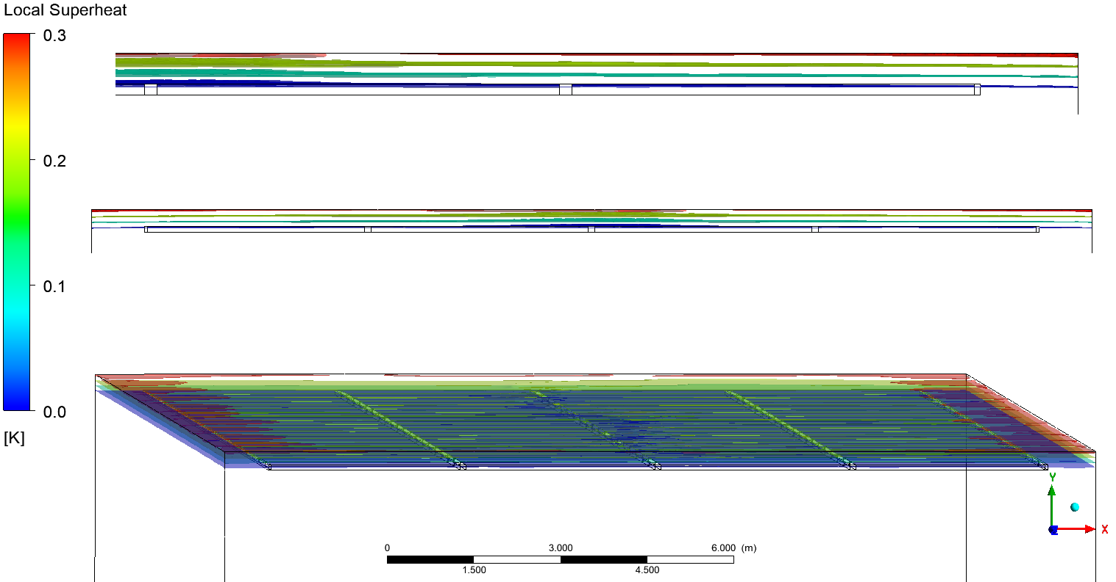
Local superheat above saturation: 0, 0.1, 0.2, 0.3K (Temp - Local T_{sat}) Max = 0.33419K
Config 2
Isosurface of Zero K superheat @ average of 26.2 cm below liquid surface
NOTE: boiling not modeled, liquid surface boundary set to Saturation Temperature as zero slip wall.

Slide 14
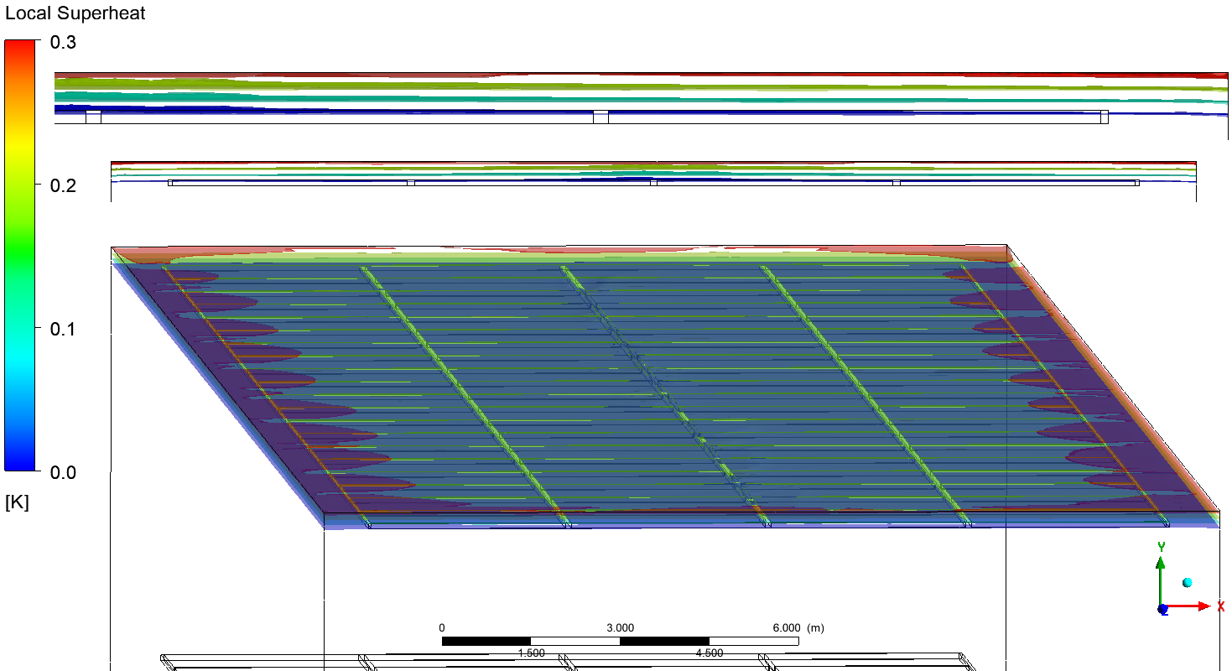
Local superheat above saturation: 0, 0.1, 0.2, 0.3K (Temp - Local T_{sat}) Max = 0.340K
Config 3
Isosurface of Zero K superheat @ average of 26.37 cm below liquid surface
NOTE: boiling not modeled, liquid surface boundary set to Saturation Temperature as zero slip wall.

Slide 15
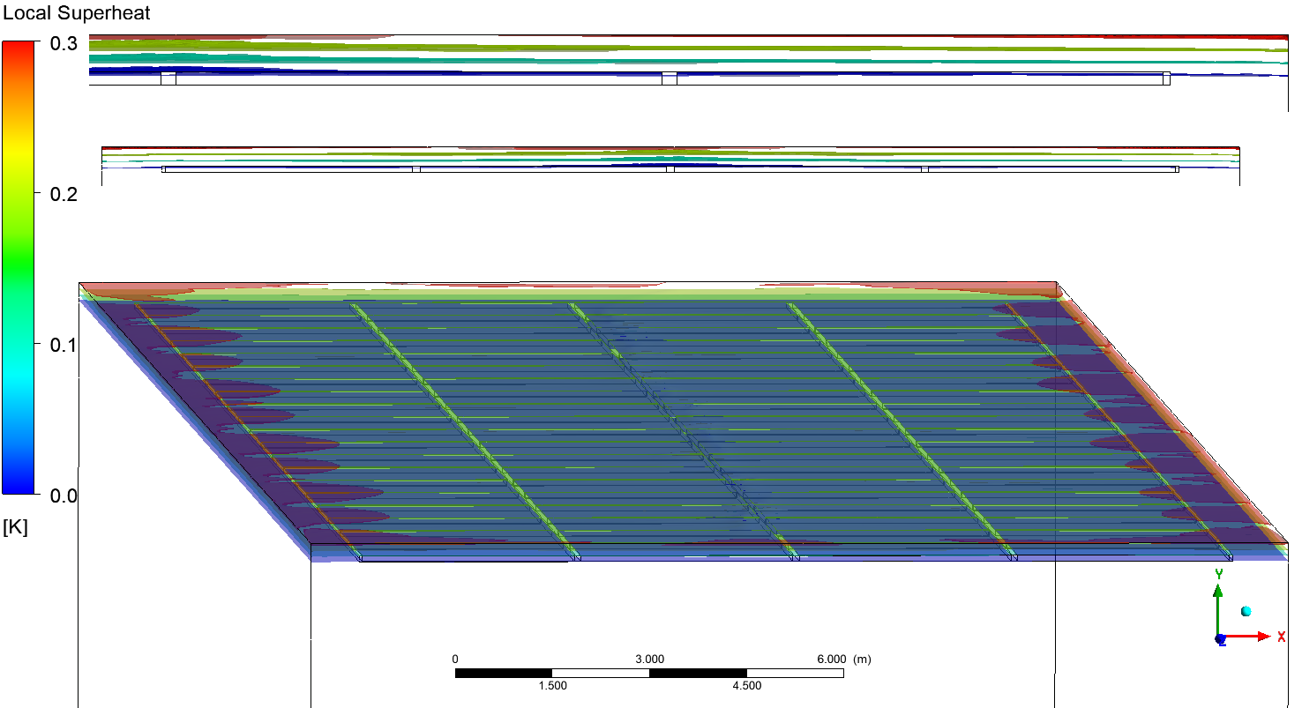
Local superheat above saturation: 0, 0.1, 0.2, 0.3K (Temp - Local T_{sat}) Max = 0.3333K
Config 4
Isosurface of Zero K superheat @ average of 26.2 cm below liquid surface
NOTE: boiling not modeled, liquid surface boundary set to Saturation Temperature as zero slip wall.

Slide 16
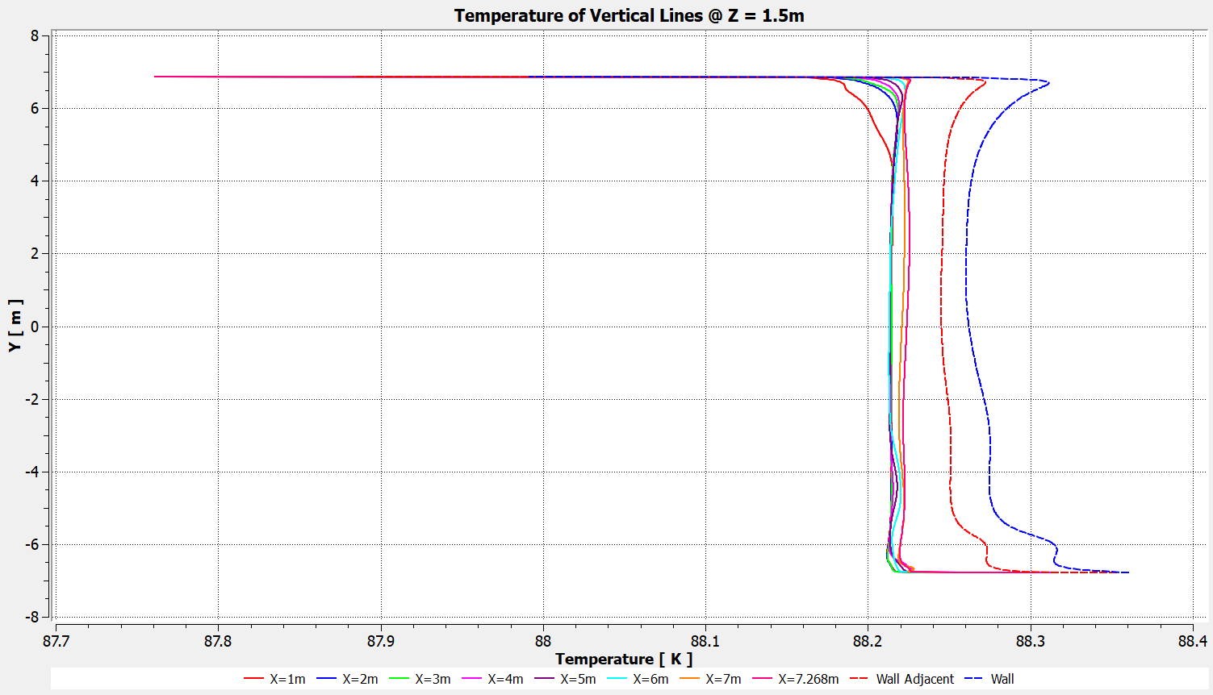
Vertical Line Temperature @ Z = 1.5m
Config 1

Slide 17
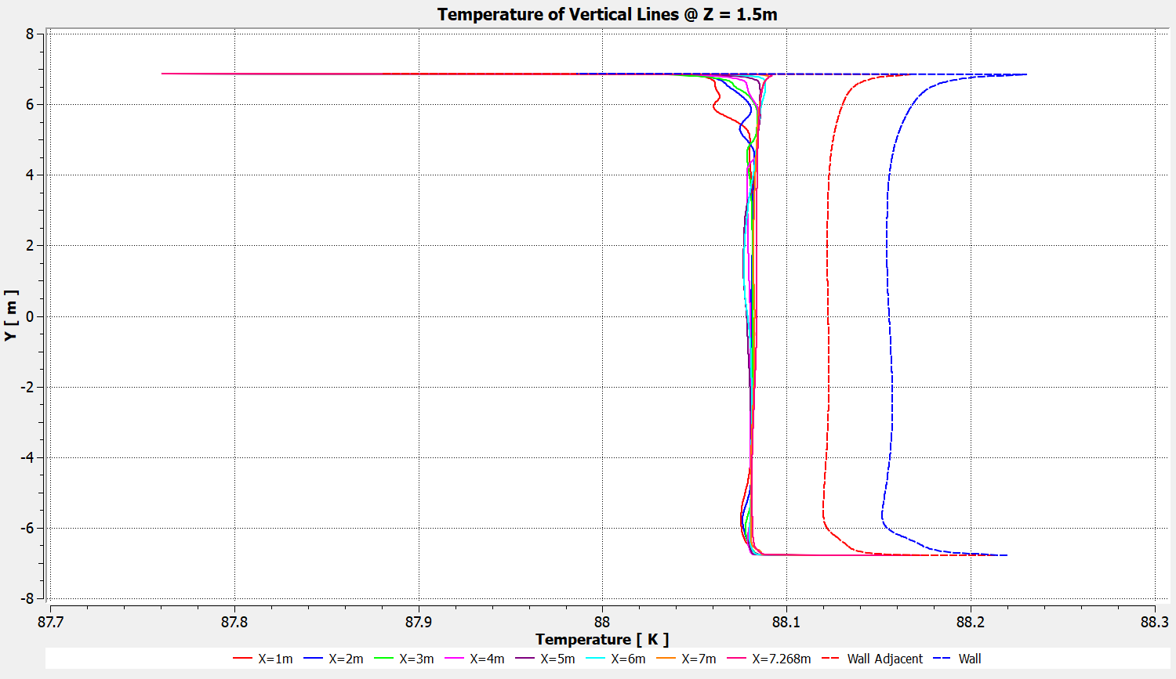
Vertical Line Temperature @ Z = 1.5m
Config 2

Slide 18
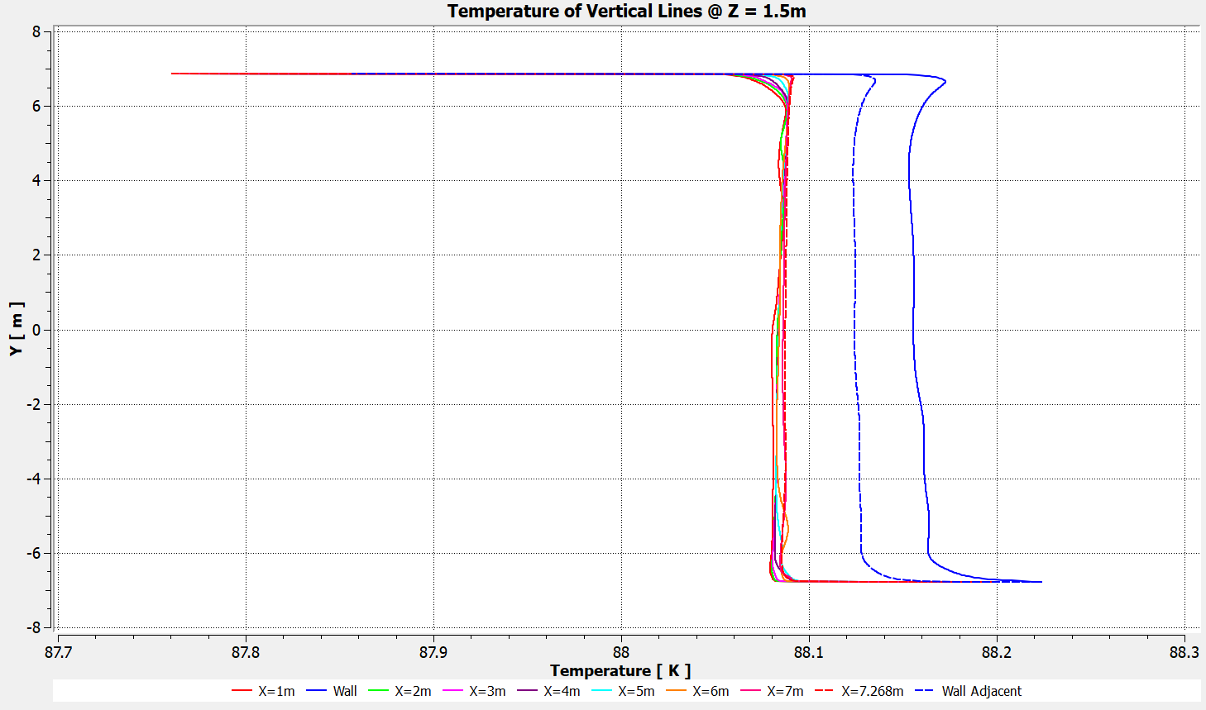
Vertical Line Temperature @ Z = 1.5m
Config 3

Slide 19
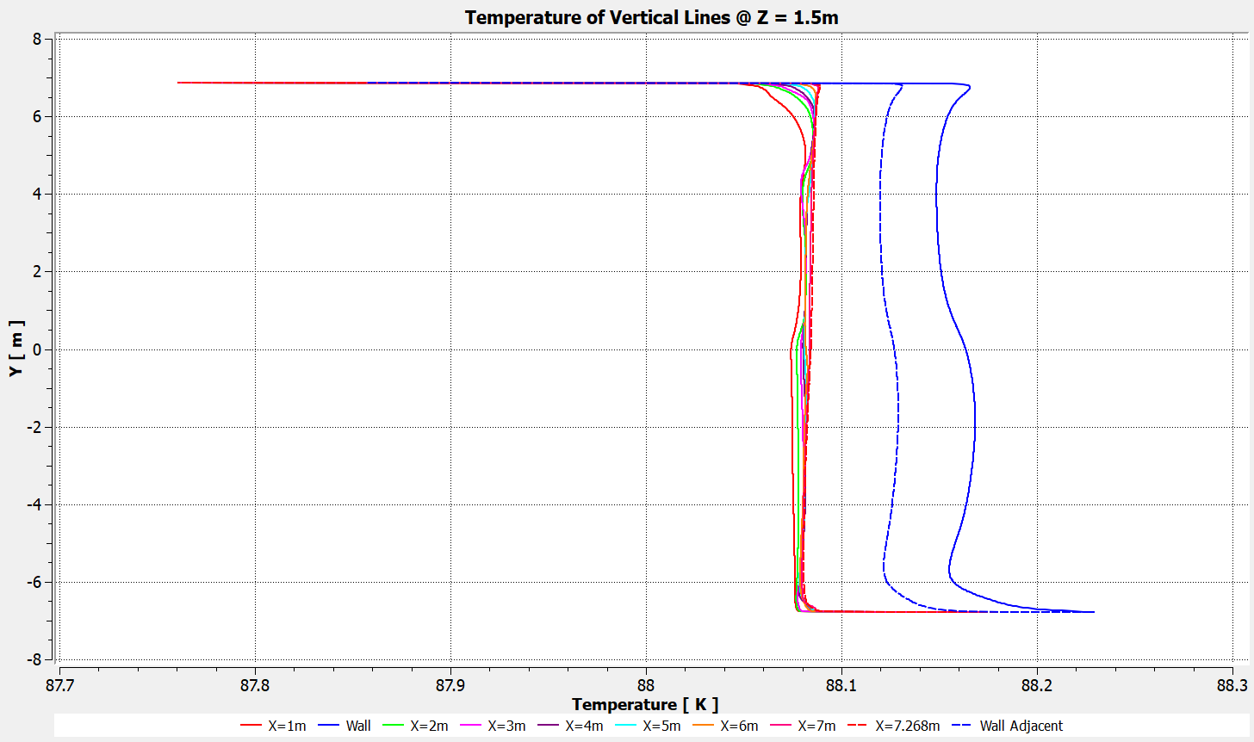
Vertical Line Temperature @ Z = 1.5m
Config 4

Slide 20
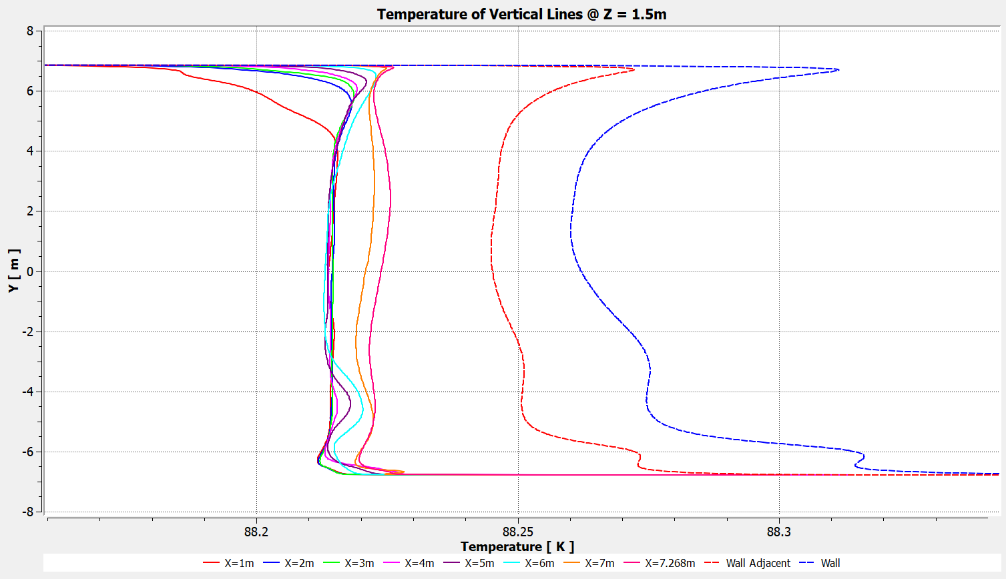
Vertical Line Temperature @ Z = 1.5m (Same data as previous Slides)
Config 1

Slide 21
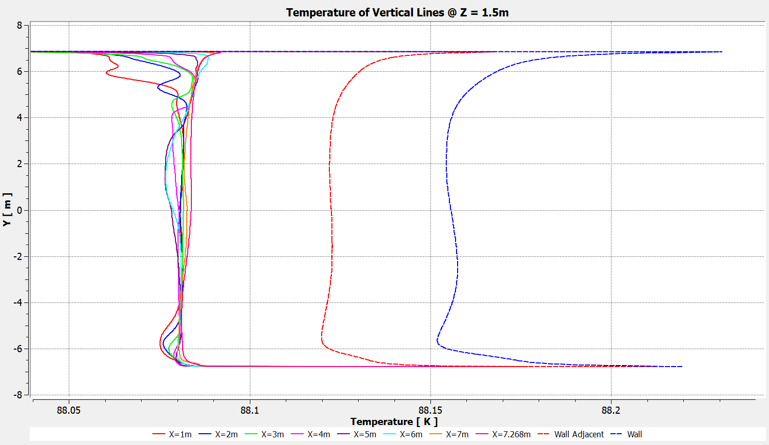
Vertical Line Temperature @ Z = 1.5m (Same data as previous Slides)
Config 2

Slide 22
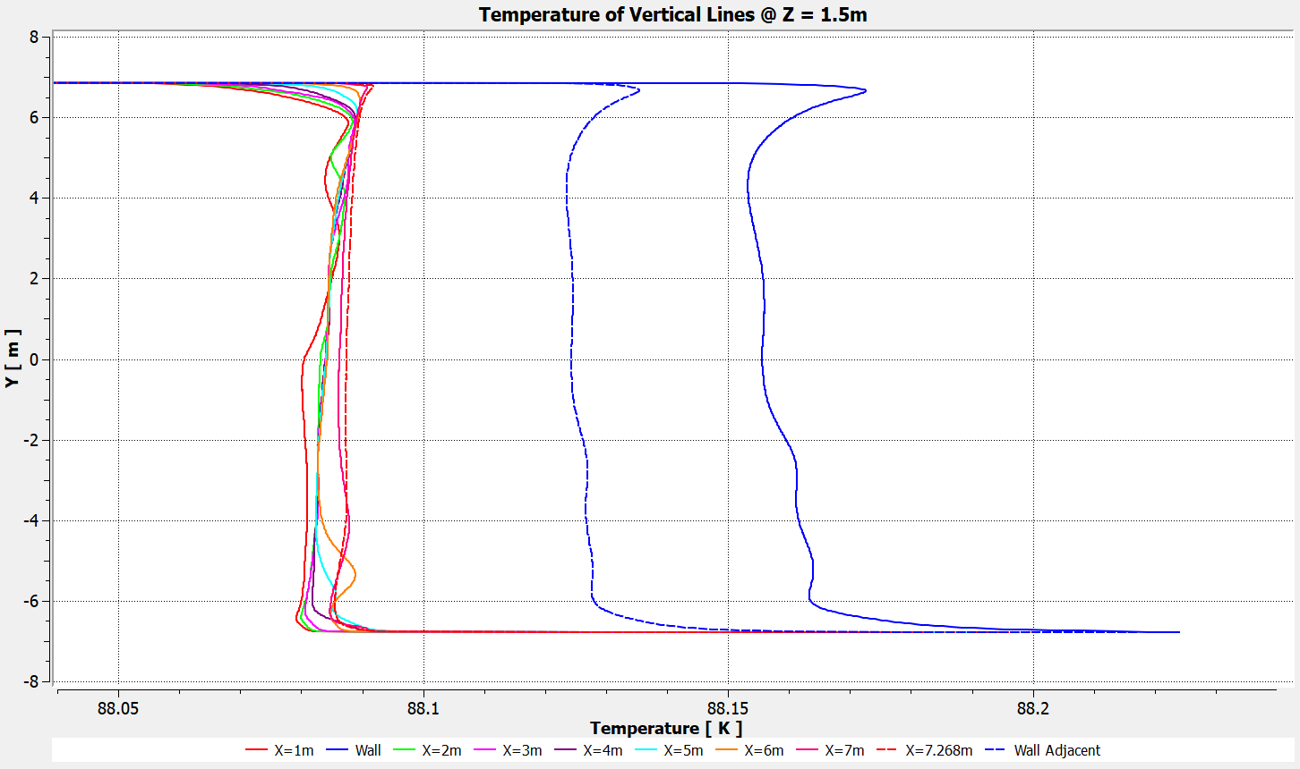
Vertical Line Temperature @ Z = 1.5m (Same data as previous Slides)
Config 3

Slide 23
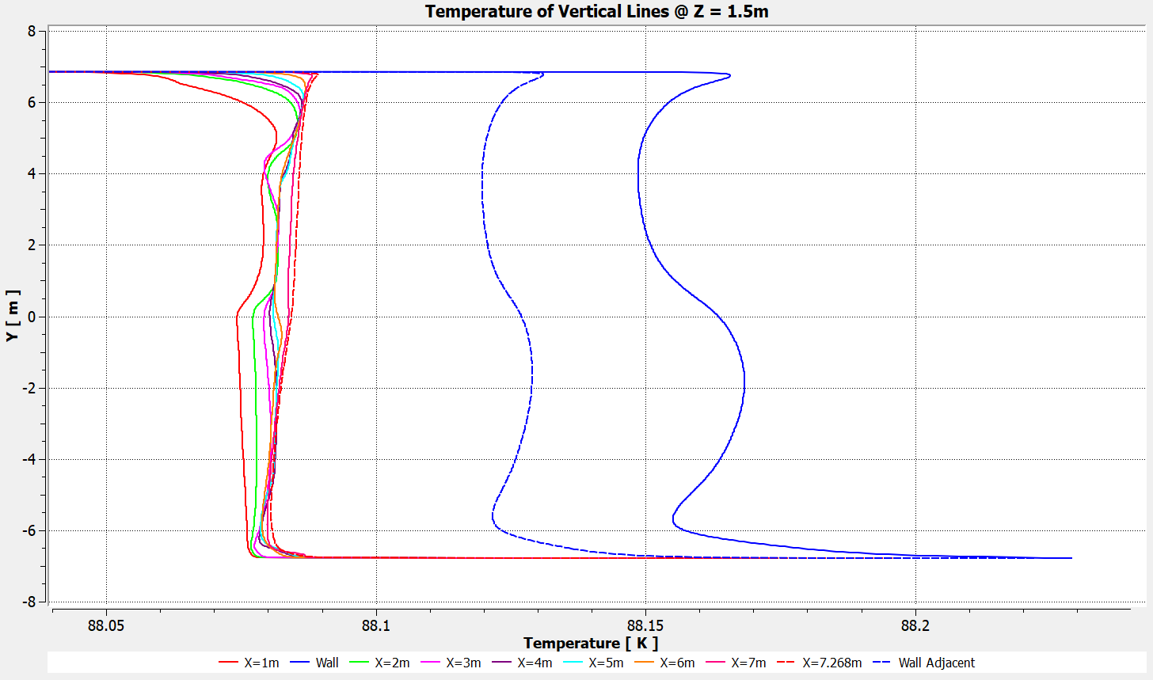
Vertical Line Temperature @ Z = 1.5m (Same data as previous Slides)
Config 4

Slide 24
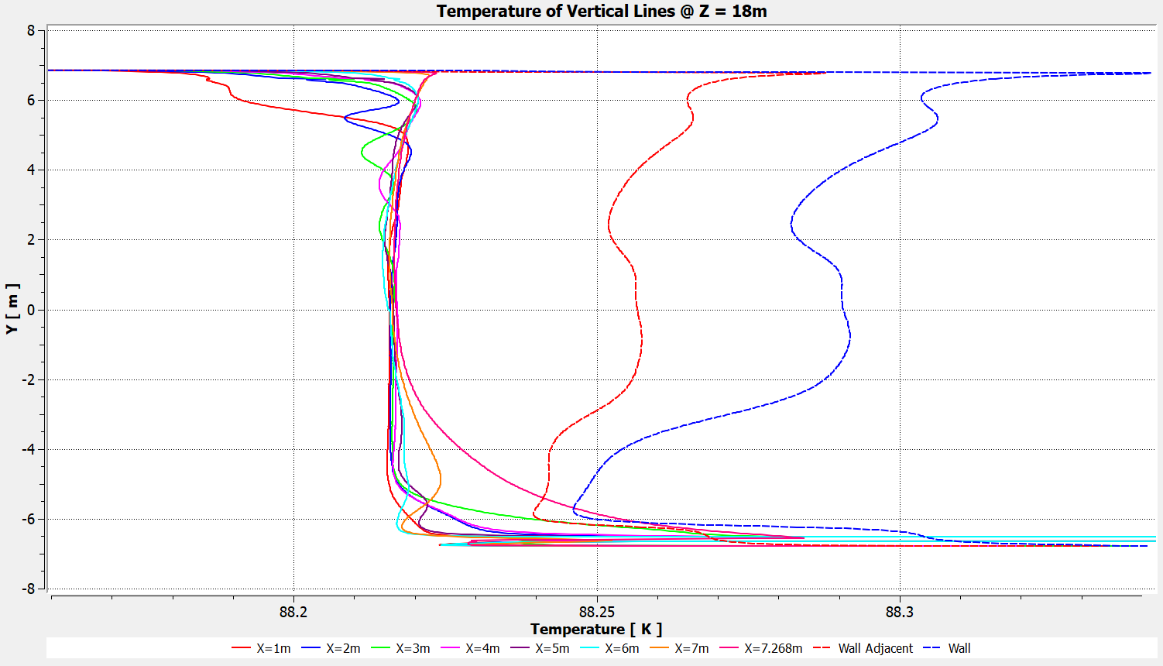
Vertical Line Temperature @ Z = 18m (Through CRP Electronics, and discharge plane)
Config 1

Slide 25
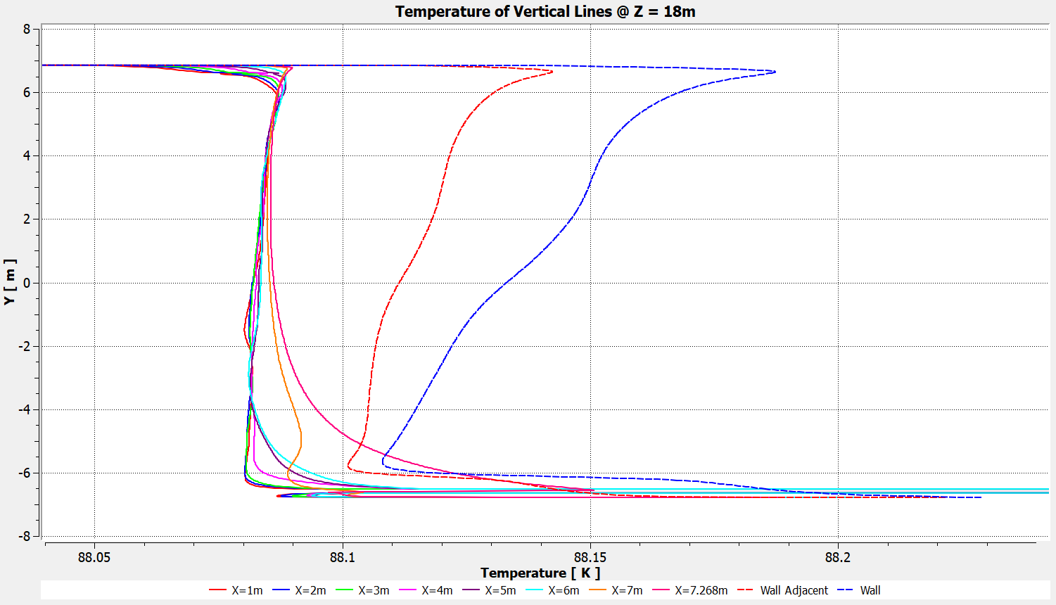
Vertical Line Temperature @ Z = 18m (Through CRP Electronics, and discharge plane)
Config 2

Slide 26
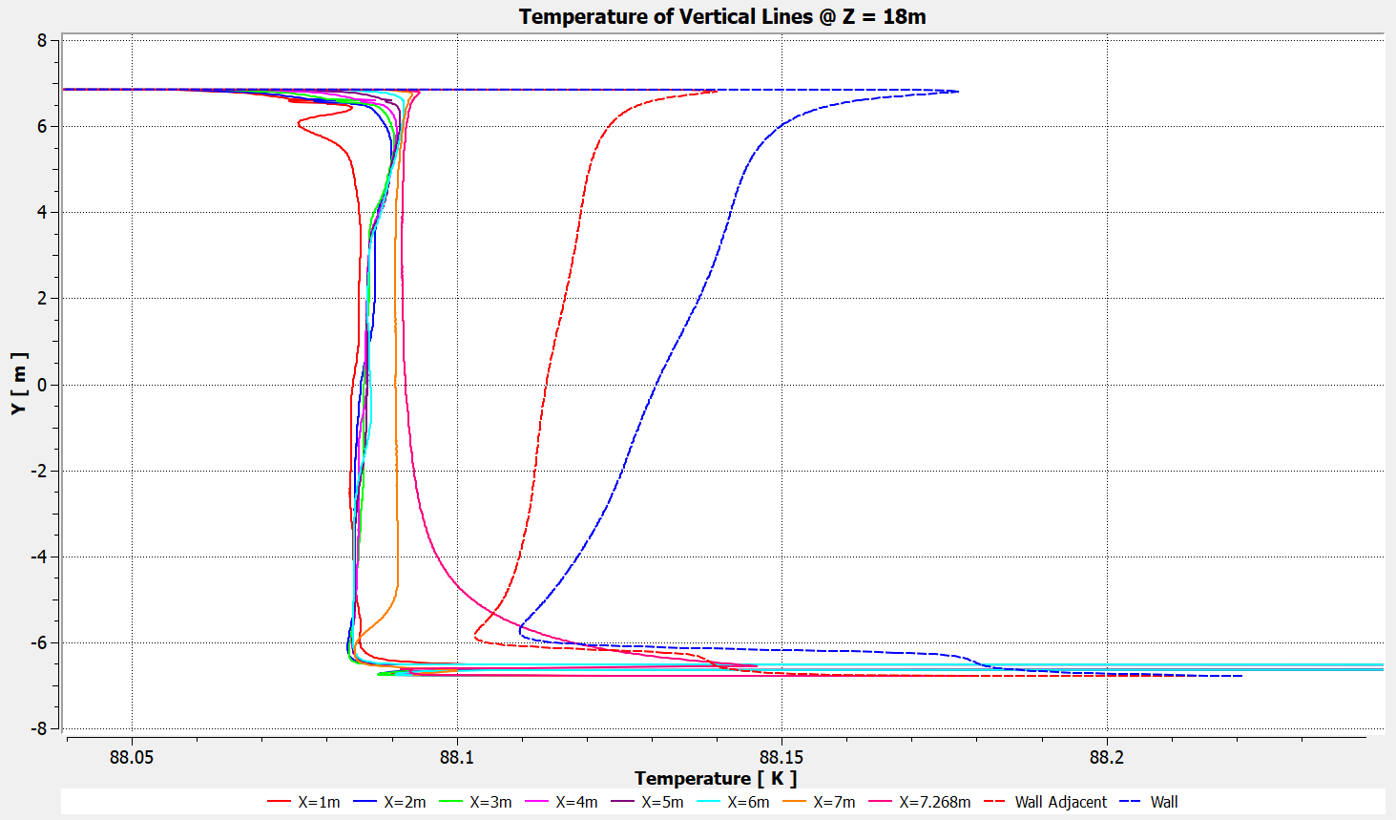
Vertical Line Temperature @ Z = 18m (Through CRP Electronics, and discharge plane)
Config 3

Slide 27
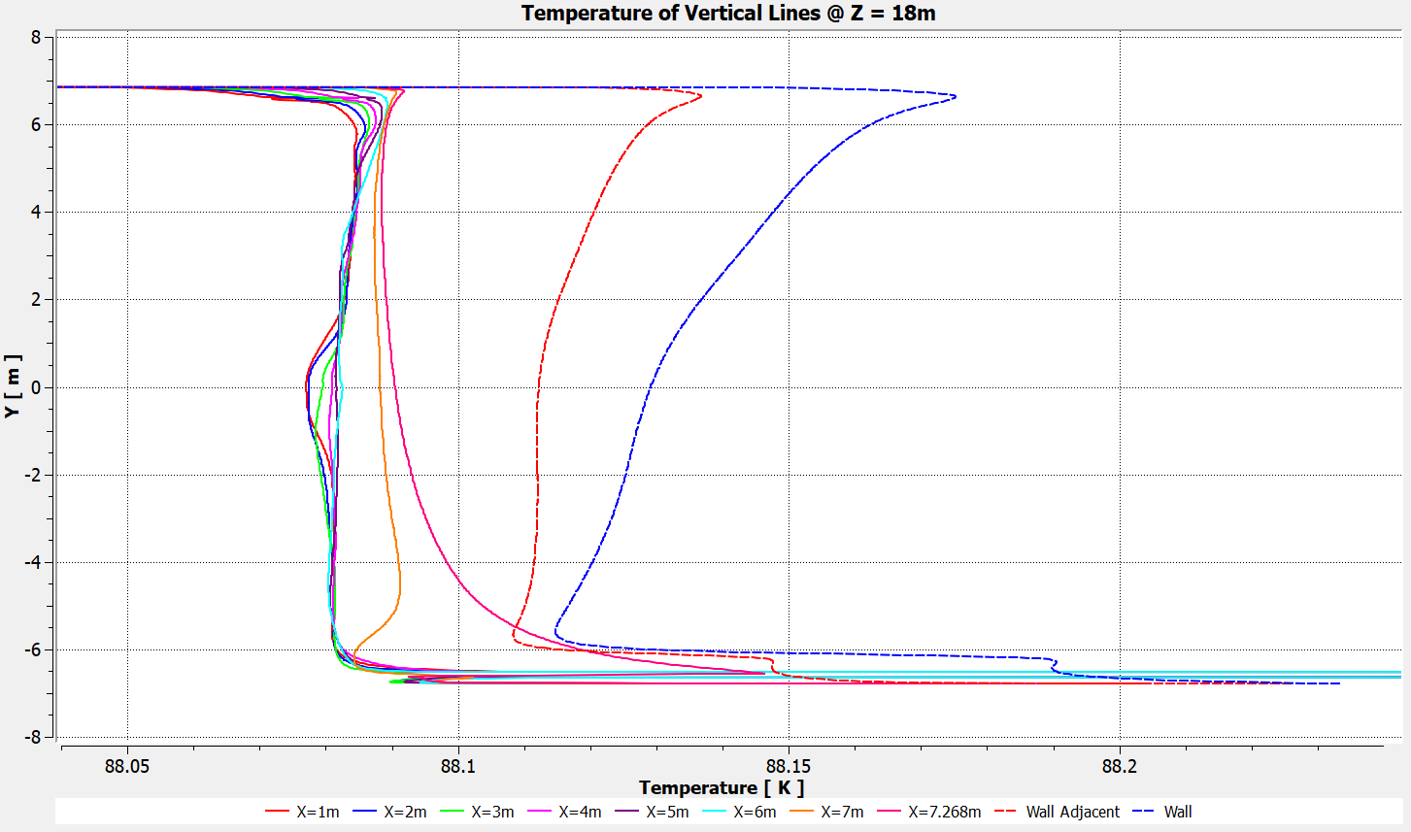
Vertical Line Temperature @ Z = 18m (Through CRP Electronics, and discharge plane)
Config 4

Slide 28
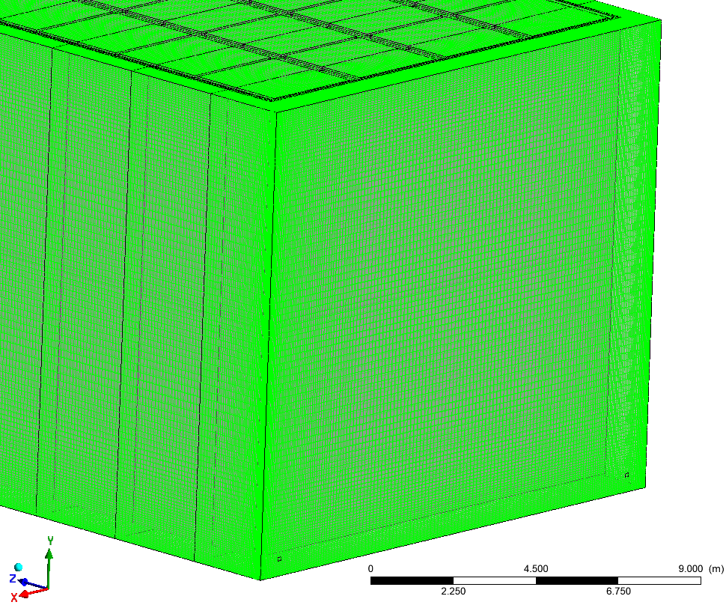
Numerical Grid #1: Fully structured Hex Grid with BIAS sizing. # of cells in (X x Y x Z) = (189 x 142 x 525) = 14.1M Cells (range: 0.96 to 22.4 cm)
Mesh Transforms used to build full numerical model by translating repeated mesh in Z direction @ 3m pitch, and Mirroring the End Mesh across XY Plane:
End Mesh with Z wall and ½ Panel
19 Repeated Mesh translated in Z
(2 half panels each, 3m size)
Another End Mesh mirrored across central XY plane
Mesh structured, orthogonal, conformal, and mapped everywhere.
Repeated Mesh
Repeated Mesh
Repeated Mesh
End Mesh

Slide 29
Detailed Plots for all configurations
https://edms.cern.ch/document/2517361

Slide 30
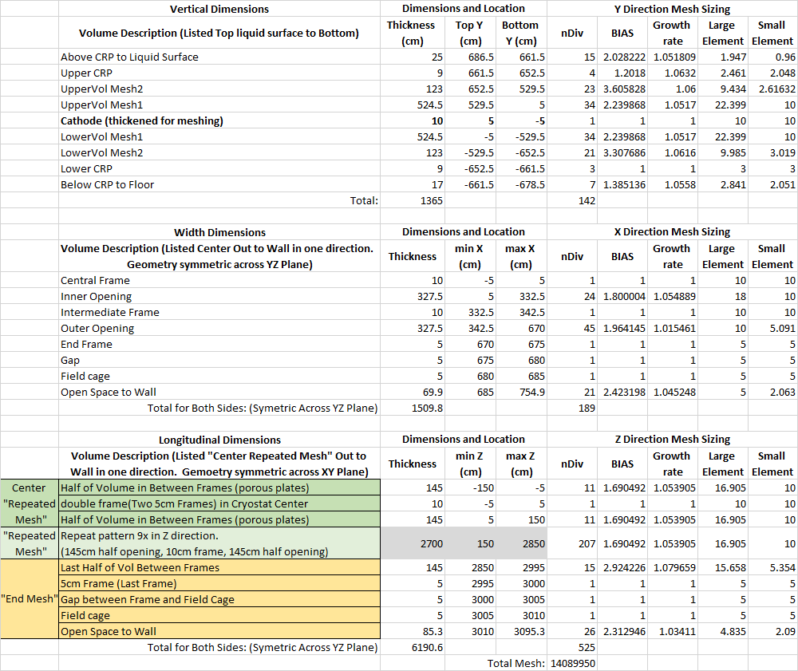
Dimensions and Mesh

Slide 31
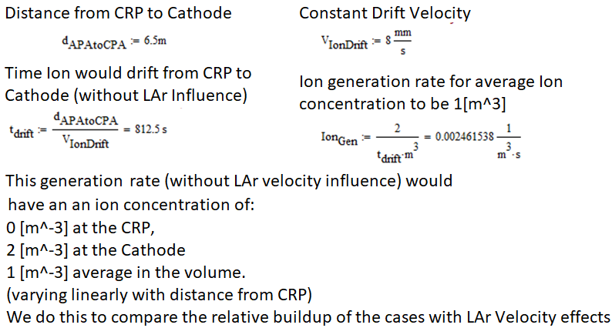
Ion Buildup Model – Not Yet Complete Ion Drift Velocity is the most important input here, and is somewhat unknown?
First order model uses:
Uniform drift velocity of 8 mm/s?? from CRP to Cathode (relative to LAr)
Uniform generation rate inside FC volume
For a spatially uniform Ion generation rate, this rate is arbitrary, and the solution can be scaled linearly. (meaning we don’t need the true generation rate)
We use an arbitrary generation rate for easier comparison purposes
Somewhat unknown? Dependent on field strength.
Is this 4 mm/s? 8 mm/s? Something else?

Slide 32
DM Summary
Sensitivity analysis added 2 more cases:
Cathode with PDs (zero transparency). 50% overall transparency.
Cathode with PDs (zero transparency) and x5 reduced transparency. 10% overall transparency.
Good uniformity among all 4 cases for T, impurities and velocities (FC, above/below Cathode, full cryostat volume).
Depth of local superheat confined within 26 cm of LAr surface (except x3 Config 1, where it is 37 cm).
As expected, Config 1 (x3 electronics load) has higher T, velocities and depth of local superheat. Values still acceptable.
As expected, lower transparency shows higher force on Cathode:
Config 3 (~50% transparency) → -53N. Acceptable?
Config 4 (~10% transparency) → -132 N. Acceptable?
Reduced transparency does not seem to affect results significantly, even at 10%.
If interested in Ion Buildup, Erik could use some input.
Config 1 → Same as presented in Apr-2021 (x3 electronics head load).
Config 2 → Same as presented in Apr-2021 (x1 electronics head load).
Config 3 → PD added as opaque (zero transparency). ~ 50% overall Cathode transparency.
Config 4 → PD added as opaque (zero transparency) and reduced overall transparency x5. ~ 10% overall.

