Slide 1
FD2-VD CDR Update
17 June 2021
Anne, Marvin, Sandro

Slide 2
First drafts are in
First drafts of all subsystem chapters are in. Thank you, chapter PoCs!
Some are still under review/editing by CET this week.
  Coverage of required aspects of design
  Level of detail
  Structure
  Editing for organization, clarity
  Adding in glossary terms, fixing some LaTeX issues
  Adding fixmes for questions or suggestions.
Still to come: Executive Summary and parts of Project Organization

Slide 3
Next Steps
August Directors and CD1-RR review delayed.
July 19 CDR posting date canceled.
We have good momentum, but CDR schedule will likely be extended.
The CET will contact identified reviewers from the collaboration next Monday and give them till July 1. (Listed on next slide)
We’ll provide them a standard format for comments.
Marzio and Steve to conduct live reviews, too? Schedule?
PoCs to review comments and incorporate updates from all reviews (or coordinate with CET to do so).
Share updated version with Jeff Spalding (LBNC) for “preview”?
Review schedule for subsequent drafts.

Slide 4
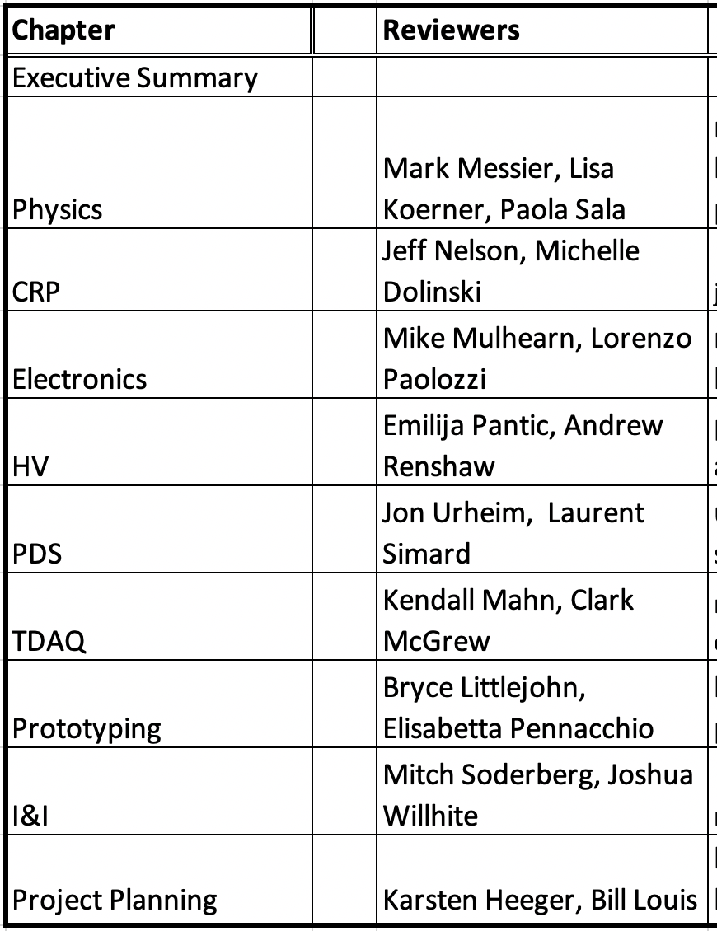
Proposed reviewers by chapter

