Slide 1
Summer Student Lecturs 2021
Q&A - Partical Accelerators
Michaela Schaumann
30.06.2021

Slide 2
What do you consider the most viable long-term future option: linear or circular accelerators?
Asked by Elias

Slide 3
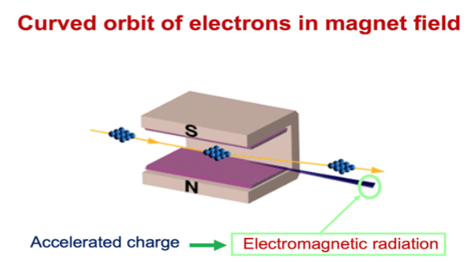
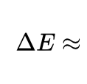
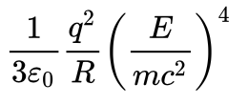
LINAC vs. Storage Ring
All particles pass a LINAC only once.
A storage ring brings the particles back turn by turn.
→ They get another chance to collide again and again potentially over hours.
Charged particles radiate whenever they are accelerated.
energy loss strongly depends on energy and particle mass
for electrons at high energies, the radiation becomes too strong and we might have to go linear.

Slide 4
What do you consider the most viable long-term future option: linear or circular accelerators?
Asked by Elias
It depends on what you want to do!
Discover new particles vs. make precision measurements
Hadron accelerators are discovery machines
  higher collision energies
  not well defined initial state
Electron/Positron accelerators are needed for precision measurements of the newly discovered particles because they provide cleaner collision events.

Slide 5
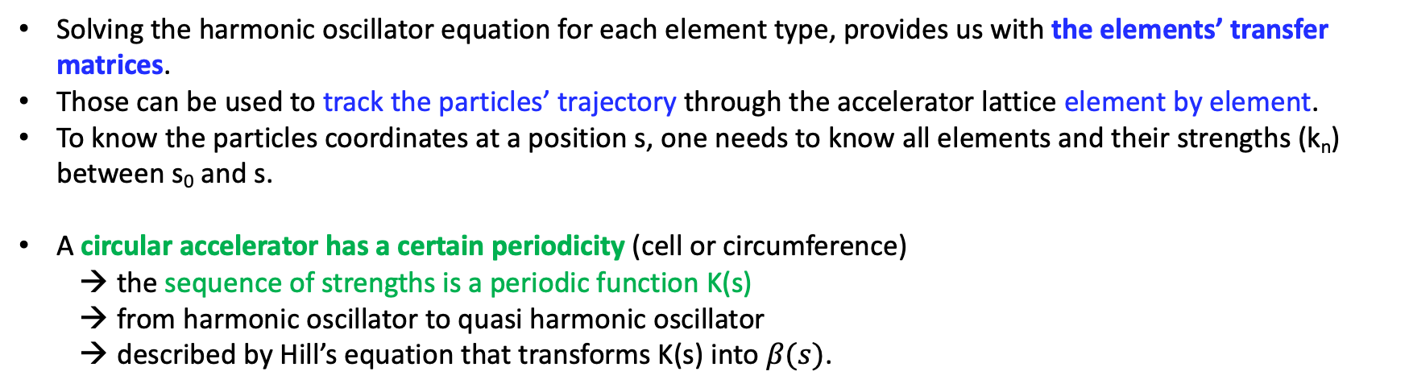
Could you go into some more detail on how the damping coefficient function K(s), when solving Hill's equation, is implemented in the general solution (I presume it is part of the beta function, but how exactly)?
Asked by Julian
K(s) is no damping coefficient but a with position “s” variable focussing force.
Solving the harmonic oscillator equation for each element type, provides us with the elements’ transfer matrices.
Those can be used to track the particles’ trajectory through the accelerator lattice element by element.
To know the particles coordinates at a position s, one needs to know all elements and their strengths (k_{n}) between s₀ and s.
A circular accelerator has a certain periodicity (cell or circumference)
  the sequence of strengths is a periodic function K(s)
  from harmonic oscillator to quasi harmonic oscillator
  described by Hill’s equation that transforms K(s) into $β(s)$.

Slide 6
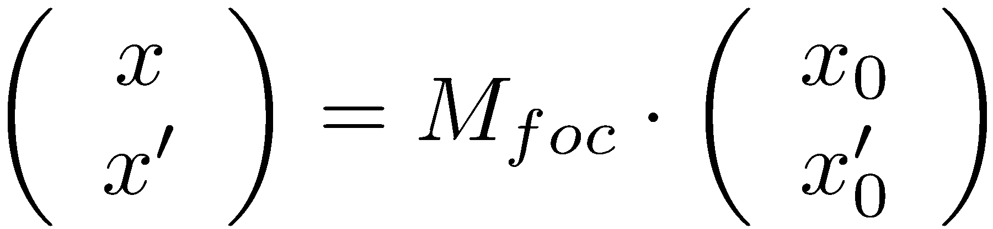
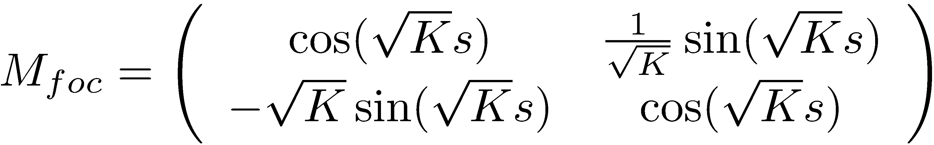

Comparing the two solutions provides the relation between K(s) and the lattice functions
Use matrix formalism:
Focusing Quadrupole
From general solution of Hill’s equation after defining$α\left(s\right), γ(s)$
By knowing the lattice functions $β\left(s\right), α\left(s\right), γ(s)$, and $ψ(s)$, we can compute the single particle trajectories between two locations without remembering the exact lattice structure and strength of each element!

Slide 7
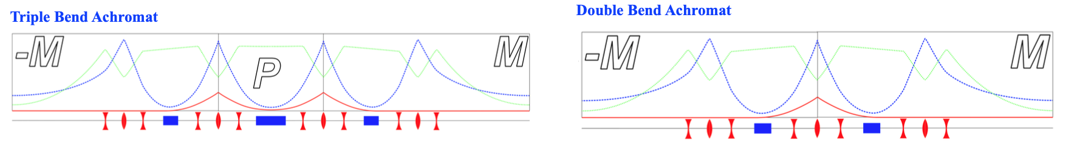
Stressing the optics analogy a little bit more: Is it possible to build something like achromatic focusing magnets?
Asked by Augustin
With “chromatic” we mean a system of magnets (incl. and especially dipoles) that in the end do not show a spectrometric effect → dispersion disappears.
Which is not possible for a single magnet.
It is however possible to find a sequence of magnets (dipoles and quads) that makes the dispersion disappear (in certain locations at least), e.g. double bend achromat, which is a typical lattice for light sources.
horizontal beta-function
vertical beta-function
dispersion

Slide 8
Questions to warm up …

Slide 9
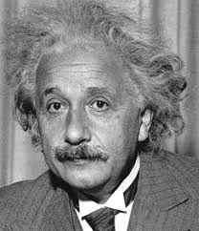
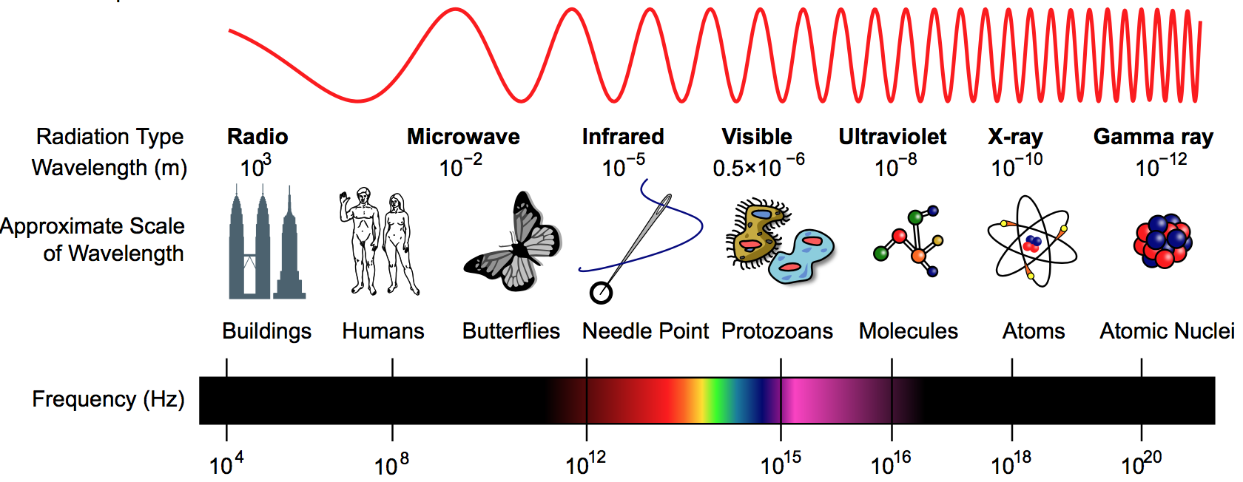
Why do we always desire higher particle energy?
Resolution to study structure of matter
→ 10⁻¹⁸m at LHC
Particle creation
The wavelength of the probe radiation needs to be smaller than the object to resolve.
E = m c²
λ =
h c
de Broglie wavelength
E
Study of particles that do not exist in our natural environment, since they are too heavy or unstable.

Slide 10
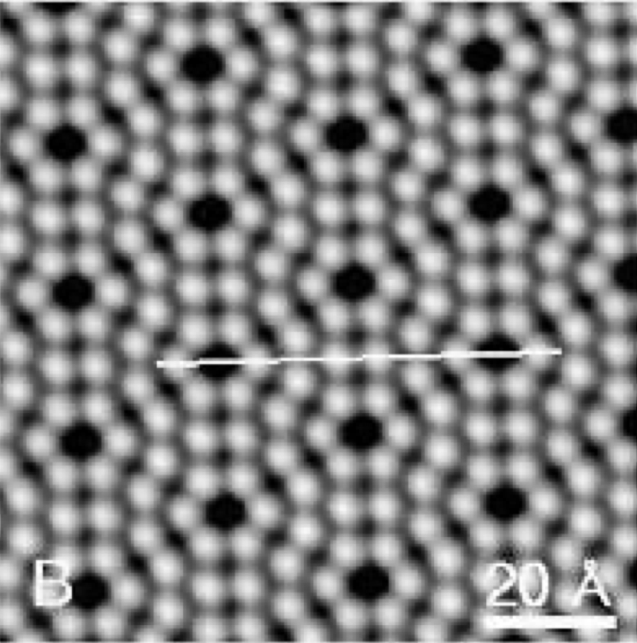
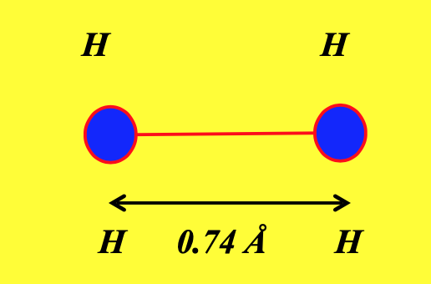
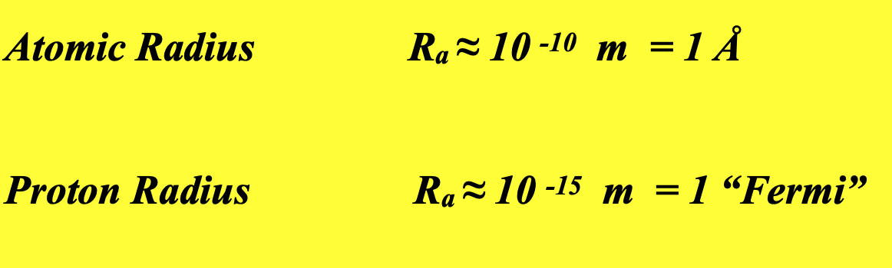
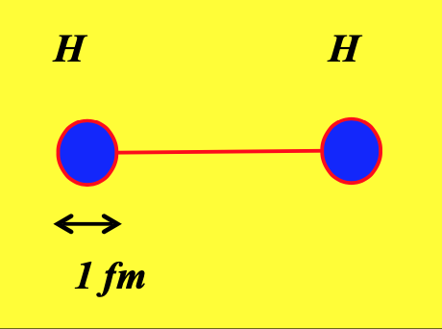
Particle Dimensions
Raster tunnel
microscope
→ 10⁻¹⁸m (LHC resolution) allows us to “see” structures of one permille of the proton dimension

Slide 11

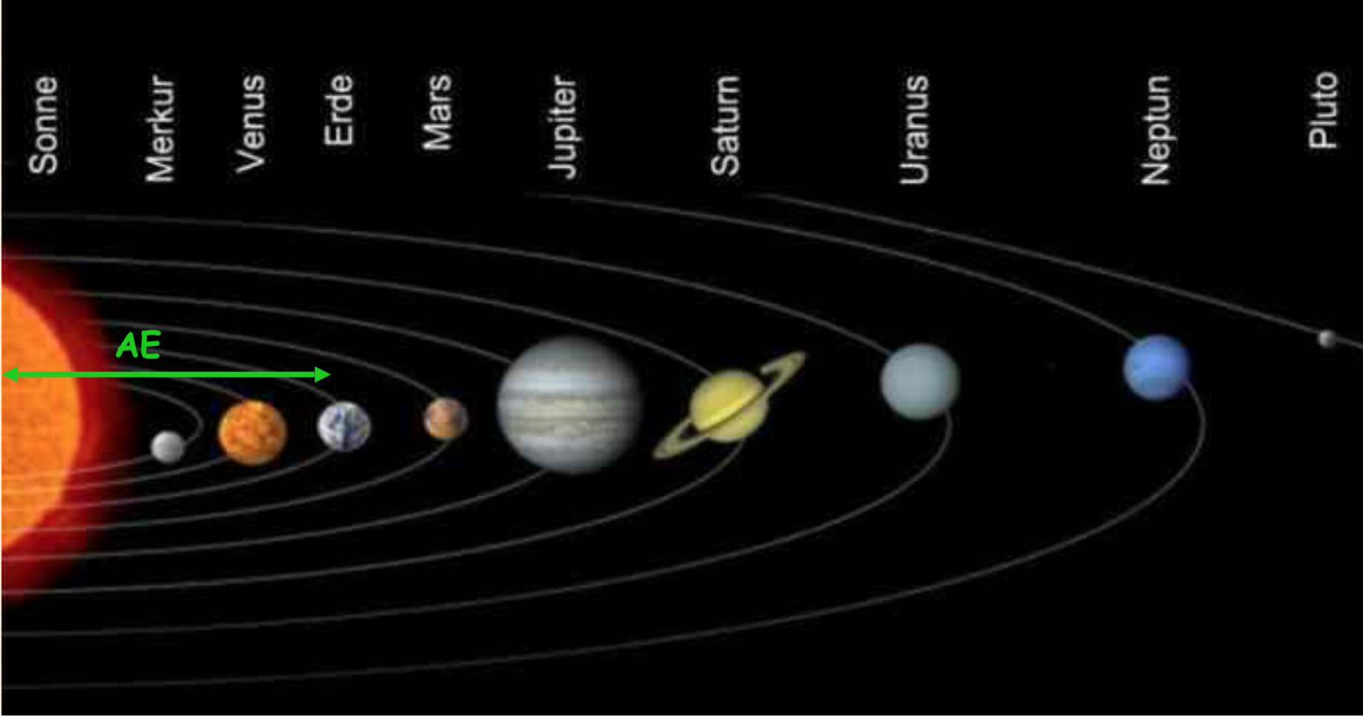
In terms of universal scale…
astronomical unit:
average distance earth-sun: 1 AE ≈ 150*10⁶ km
distance Pluto-Sun: ≈ 40 AE
10⁻¹⁸ m on the scale of a meter
means 6 μm on the scale of our planetary system
40 AE

Slide 12

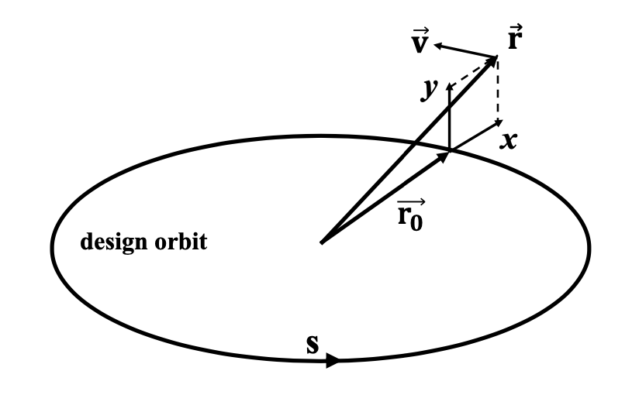

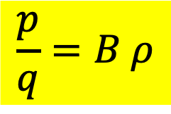


Where is the energy limit?
Why are these rings so large?
Lorentz Force
$$F_{L}=q v B$$
Centrifugal Force
The ideal circular orbit
$$F_{L}= F_{centr}$$
$$\frac{p}{q}=B ρ$$
$B ρ=$Beam rigidity
B < 16 T → build LARGE rings due to the centrifugal force.
q charge, p = ${γ m}_{0}v^{2}$ momentum, B magn. field strength, $ρ$ bending radius

Slide 13

What limits Luminosity?
N….. No. particles per bunch
k…… No. bunches
f……. revolution freq.
g…… rel. gamma
$β^{∗}$…. beta-function at IPs
$ε$…... norm. trans. emit
Limited by machine size and filling scheme
Limitation:
“Collective effects” cause beam instabilities for too high bunch intensities, too small bunch spacing, too “bright” beams.
Bunch 2
Defined by the injectors
Limited by aperture in the quadrupoles and Q’ correction scheme
10 ¹¹ particles
Bunch 1
IP
beam size
10 ¹¹ particles

Slide 14
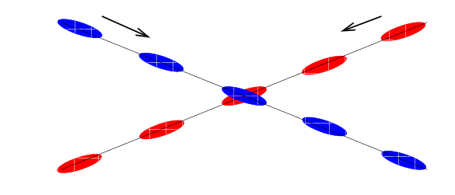
What limits Luminosity?
Beam 1
Beam 2
When colliding with many bunches, a crossing angle is needed to avoid unwanted collisions. However, this reduces the beam overlap and therefore the luminosity. Keep as small as possible!
Limited by beam-beam effects.

Slide 15
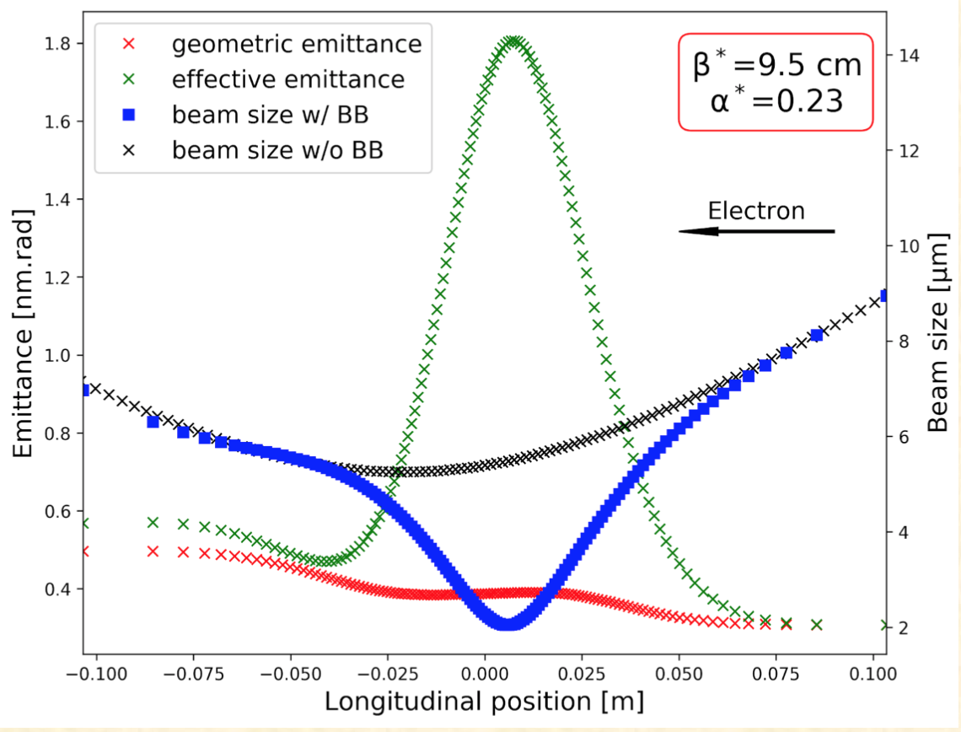
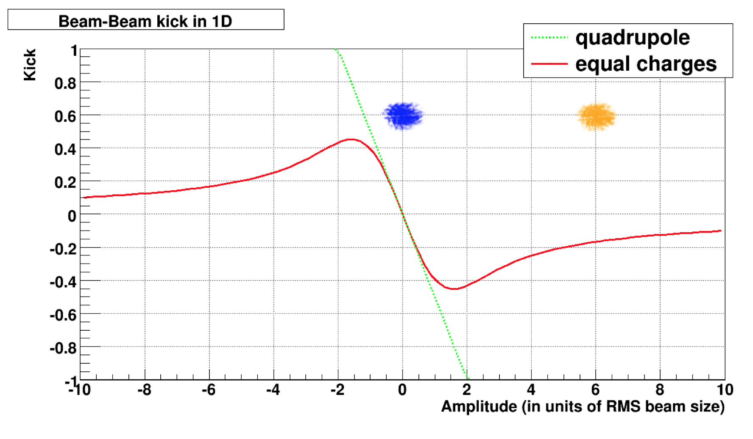
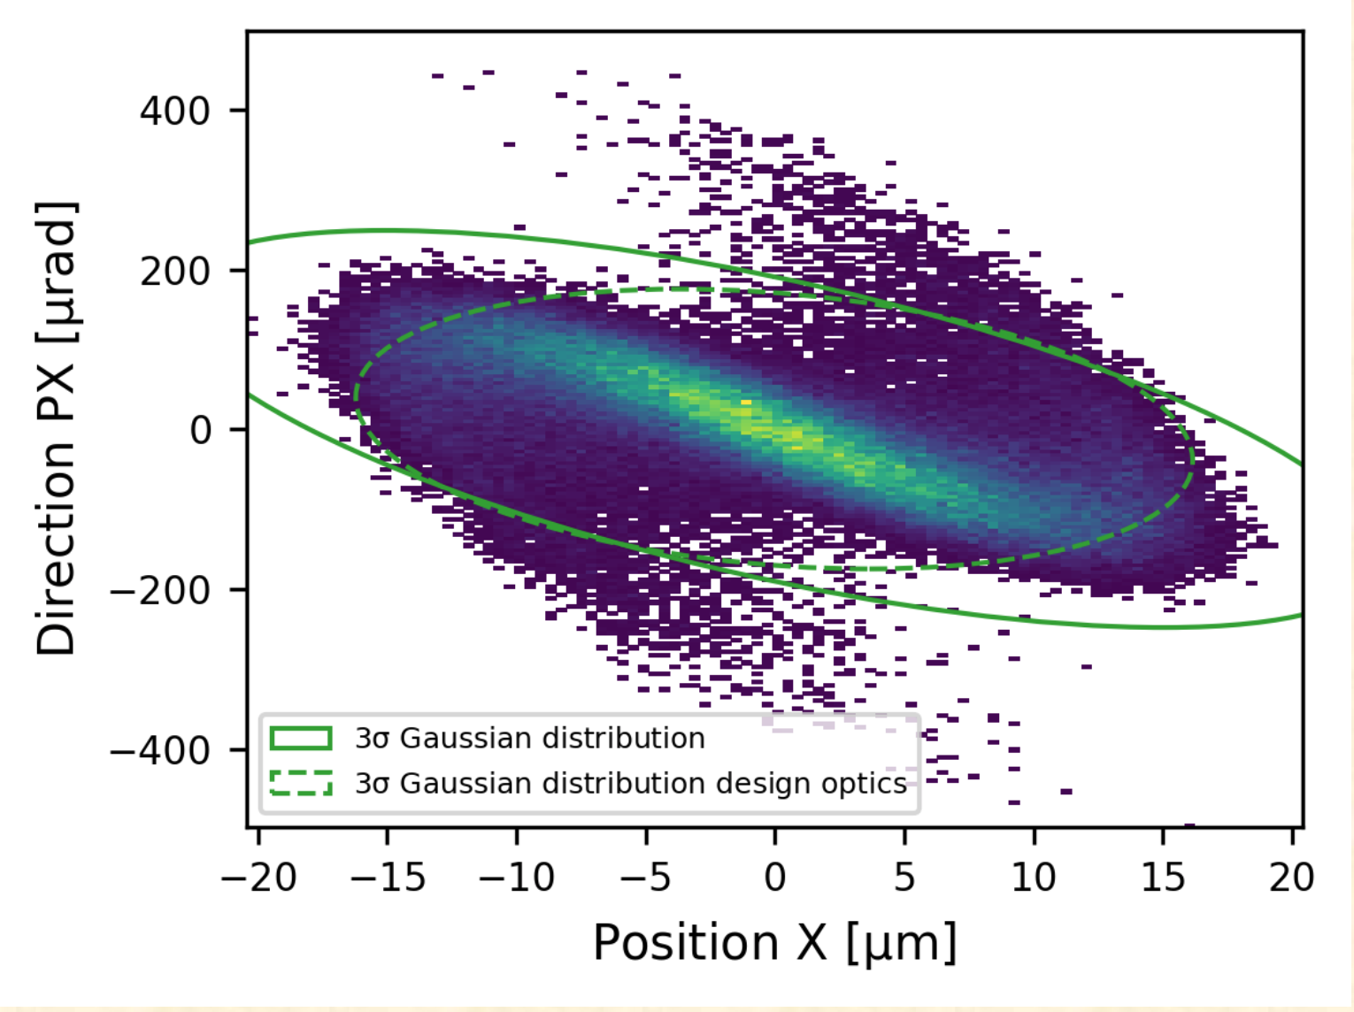
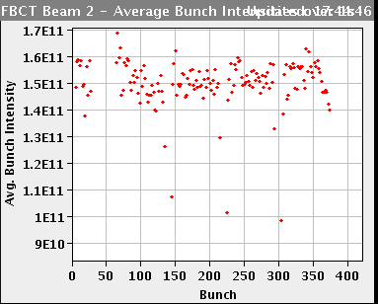
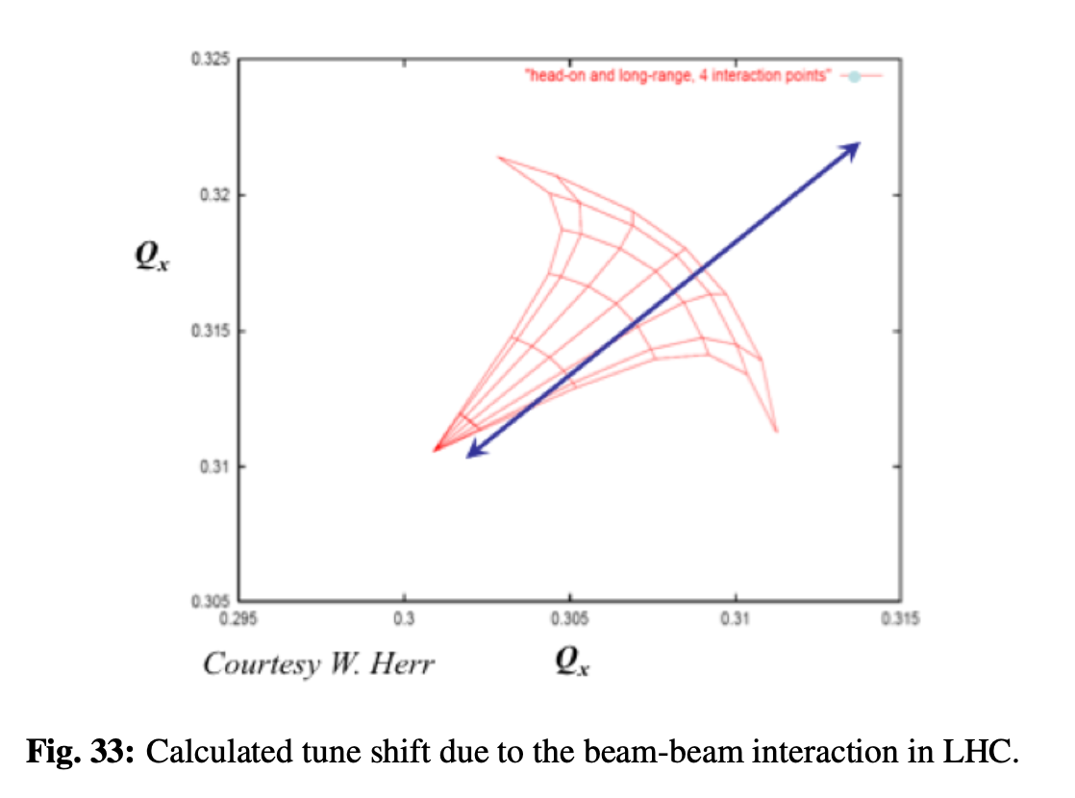
Beam-Beam Effects
Blue: bam size around IP including beam-beam effect (focusing in this case)
Black: ideal optics without beam-beam
beam-beam destroys the elliptic phase space distribution.
→ creation of tails in the transverse particle distribution
(LHeC)
head-on
long-range
observed particle losses when beams are brought into collision
(LHC)
Beam-Beam force acts (de)focusing
Like a quadrupole
Changes the tune of each single particles

