Slide 1
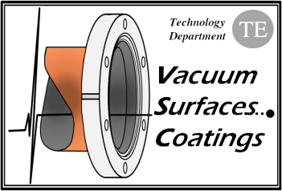
Preliminary Considerations for the LHeC Beam Vacuum System
J.M. Jimenez

Slide 2
Main Topics
Introduction
Beam Lifetime Considerations
Synchrotron Radiation Issues
Engineering and Pumping Considerations
Closing Remarks

Slide 3
Introduction
Accelerator vacuum requirements
Particle beams are travelling under vacuum to reduce beam-gas interaction which is responsible for:
  Machine performance limitations
    reduction of beam lifetime (nuclear scattering),
    machine luminosity (multiple coulomb scattering),
    intensity limitation by pressure instabilities (ionization) and
    for positive beams only, electron (ionization) induced instabilities (beam blow up).
  Heat load to the cryogenic system induced by the scatted protons/ions
  Magnet quench i.e. a transition from the superconducting to the normal state.
    heavy gases are the most dangerous because of their higher ionisation cross-sections.
Beam-gas scattering frequently induces background to the Detectors
  Non-captured particles which interact with the detectors
  Nuclear cascade generated by the lost particles upstream the detectors.
Beam-gas scattering can be responsible for the increase of the radiations
  High dose rates could lead to material activation (personnel safety issues), premature degradation of tunnel infrastructures like cables and electronics
  Higher probability of single events (induced by neutrons) which can
  destroy the electronics even in the service galleries

Slide 4
Introduction
Accelerator vacuum requirements [cont.]
Vacuum system shall obey to severe additional constraints which have to be considered at the design stage since retrofitting mitigation solutions is often impossible or very expensive
  Minimise beam impedance and HOM generation
  Optimise beam aperture in particular in the magnets
  Intercept heat loads (cryogenic machines)
    Synchrotron radiation
    Energy loss by nuclear scattering
    Image currents
    Energy dissipated during the development of electron clouds
  Specific shielding against radiation to protect magnet coils

Slide 5
Beam Lifetime Considerations
Beam-Gas Scattering
Beam-gas scattering dominated by bremsstrahlung on the nuclei of gas molecules. Therefore, depends on:
  Partial pressure
  Weight M of the gas species
  Radiation length [g/cm²]
  Typical composition of photon-stimulated desorption: 75% H₂, 24% CO/CO₂, 1% CH₄
  Ar is 67 times more harmful than hydrogen (H₂)
  CO₂, CO and N₂ are about 30 times worst compared to hydrogen (H₂)
  CH₄ is 10 times worst
Pressure requirements are expected to be 10 times higher in the Ring-Ring option compared to the Linac-Ring option
  Bake out shall be the baseline

Slide 6
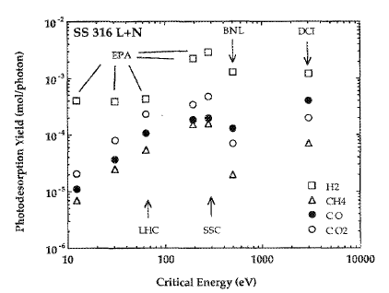
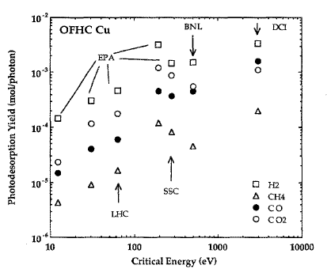
Beam Lifetime considerations
Critical Energy of Photons
Desorption rate depends on critical energy of the synchrotron light
ε_{c} is the energy which divides in 2 the emitted power
For most materials, desorption rates vary quasi linearly with critical energy
Equivalent to LEP at start
Intensities are by far different
η_{CH4} is 50 times lower than η_{H2}

Slide 7
Synchrotron Radiation
Photon-induced Outgassing
Synchrotron radiation power
  Is an issue for the heat load evacuation and scales:
    linearly with I (mA)
    Power of 4 for energy (GeV)
    Inversely to power 2 of bending radius
Linear photon flux proton beam
  Scales linearly with energy and intensity and
  Inversely with bending radius
Photon stimulated pressure rise
  At RT, scale:
    Power of 4 of E and linearly with I
  At cold, scale:
    Power of 3 with E and linearly with I

Slide 8
Synchrotron Radiation
Photon-induced Outgassing [cont.]
Synchrotron radiation power
  Ring-Ring: 45 times higher than LEP
  ~180 times in by-passes
  Linac-Ring: 10 times higher than LEP
  in bending sections/injection
Linear photon flux proton beam
  Ring-Ring: 45 times higher than LEP
  ~45 times in by-passes
  Linac-Ring: 5 times higher than LEP
  in bending sections/injection
Photon stimulated pressure rise
  Ring-Ring: 45 times higher than LEP
  Linac-Ring: 30 times less than LEP

Slide 9
Synchrotron Radiation
Vacuum Cleaning
Vacuum Cleaning
  Characterize the reduction of the desorption yields (η) of a surface resulting from the bombardment of the surface by electrons, photons, ions.
  η = Number of gas molecules desorbed from the surface/bulk by a primary
  electron, photon, ion.
Accelerator vacuum system can not be designed for nominal performances on “day 1”, shall rely on:
  Vacuum cleaning
    Reduction of the desorption yields (η) by photon, e- and ions bombardments
Necessitate accepting a shorter beam lifetime or reduced beam current during initial phase, about 500 h for LEP
  Could be significantly decreased by using NEG coatings

Slide 10
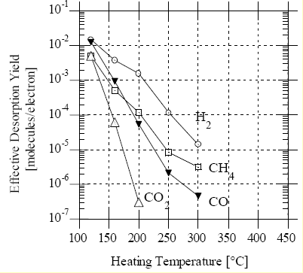
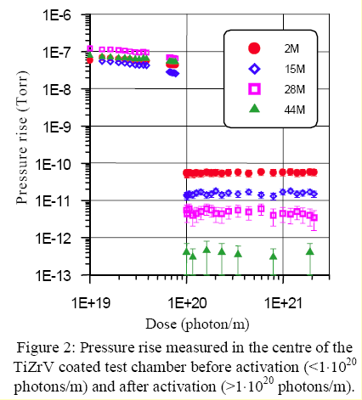
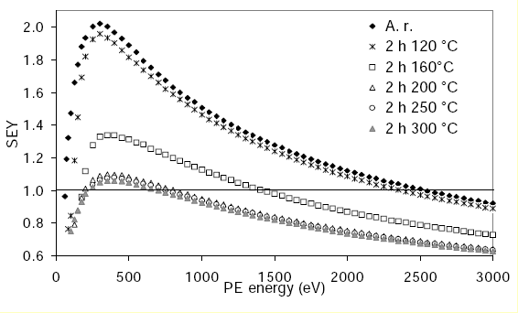
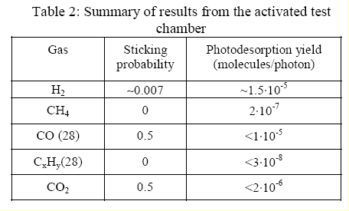
Synchrotron Radiation
NEG coatings: THE baseline…
Pumping Speed
ESD Yields
Courtesy P. Chiggiato TS/MME
C. Benvenuti et al. J.Vac.Sci.Technol A 16(1) 1998
Secondary Electron Yield
PSD Yields
C. Scheuerlein et al. Appl.Surf.Sci 172(2001)
…being successfully used in SR facilities

Slide 11
Synchrotron Radiation
NEG coatings: THE baseline… [cont.]
PSD at ESRF
Some evidences exist that a large part of the remaining desorption after activation could be due to a small fraction of the photons flux striking outside the chamber
Courtesy of
P. Chiggiato
CH₄ desorption yield reduced by a factor of at least 200 after activation, no Kr degassing detected

Slide 12
Synchrotron Radiation
Engineering Issues
Power deposition
  50% of the radiation power hitting the vacuum chamber is absorbed in the aluminum chamber
  Remainder 50% (high-energy part of the spectrum) escape into the tunnel and creates severe problems:
    Degradation of organic material and electronics due to high dose rates
    Formation of ozone and nitric acid could lead to severe corrosion problems in particular with aluminum material
Lead Shielding
  Lead shielding of 3 to 8 mm soldered directly on the vacuum chamber were used at LEP
    Higher SR flux could require more thickness, calculations still to be done.
Heat load extraction
  Evacuation of SR induced heat load on vacuum pipe wall and on lead shielding is a critical issue which need to be studied
    Bad experience in LEP, lead was melted
Material fatigue
  The induced stress (Ring-Ring option) resulting from the much higher intensity as compared to LEP shall be evaluated.

Slide 13
Engineering and Pumping Considerations
Materials
Aluminum extruded beam pipes are often used since
  Cheap and easy to extrude complex shapes
  High thermal conductivity, optimum for cooling issues
Is a limitation for:
  Bake out temperature and NEG coatings activation
  Reliability of vacuum interconnection based on aluminum flanges is a concern at high temperature (>150°C)
  Corrosion problems
  Larger thickness in particular if bake out is required
Stainless steel
  Is more difficult and costly to machine and shaped
  Has poor heat conductivity
But have higher resistance to corrosion and more reliable vacuum connections

Slide 14
Engineering and Pumping Considerations
Pumping Scheme
Pumping scheme based in both cases on:
  Mobile turbomolecular pumping stations for roughing
  UHV shall be ensured by NEG coatings…
    Sublimation pumps could be an alternative at some locations
  …combined with ion pumps
    Pumping of noble gasses and methane
  Use of superconducting RF structures and magnets imply Cold/Warm transitions
    Will need special attention in particular if using NEG coatings

Slide 15
Engineering and Pumping Considerations
Ring-Ring versus Linac-Ring
Vacuum design
  Easier for Ring-Ring since more space available around the beam pipes
    Much tight tolerances for the design of the Linac-Ring beam pipes
Vacuum stability
  Easier to ensure with the Linac-Ring
    Less SR and limited to the bending sections
Integration of vacuum pumps & instrumentation
  Easier for Ring-Ring since more space available around the beam pipes
    Space limitation introduce by the presence of the LHC
    By-pass around CMS shall be dismountable
      Shall use extensively NEG coatings + bake out to recover the required operating pressure and avoid having to go through vacuum cleaning process
Maintenance of the vacuum system
  Simpler for the Linac-Ring since the accelerator is independent from the LHC
    Ring-Ring will induce constraints to the LHC and vice-versa

Slide 16
Closing Remarks
Aspects to be addressed in details
Vacuum requirements
  Linac-Ring versus Ring-Ring Options
Vacuum stability (Synchrotron radiation and photon-induced desorption)
  Linac-Ring option versus Ring-Ring options
General description of the vacuum system
  Specificities of the Linac-Ring option
    Impact on design and vacuum stability
  Specificities of the Ring-Ring option
    Impact on design and vacuum stability
Vacuum systems
  Vacuum pumping
    Discrete versus distributed
    Cold/Warm configurations with Linac-Ring option
  Vacuum Diagnostics
  Vacuum Sectorisation – Sector valves
    Cold/Warm configurations with Linac-Ring option

Slide 17
Closing Remarks
Aspects to be addressed in details [cont.]
Vacuum engineering issues
  HOM and Impedance implications
    SR facilities design instead of simple LEP design(?)
  Bake-out of vacuum system
    Activation of NEG coatings
  Heat loads induced by synchrotron radiation
  Shielding issues
    Heat load evacuation
  Bellows and flanges
  Corrosion issues
Experimental areas
  SR induced pressure rise
  Heat load evacuation if using photon absorbers
    Photo-electrons generation
Technical challenges
  Vacuum stability of Experimental areas – long distances without pumping
Integration constraints at Injection and Extractions
Unexpected SR heat loads
Orbit displacements
Adjustments of quadrupoles and wiggler magnets
Were degrading LEP performances by inducing leaks

