Slide 1



ERL-based LHeC
BNL’s version
I. Ben-Zvi, Y. Hao, D. Kayran, V.N. Litvinenko, V.Ptitsyn, D. Trbojevic, N. Tsoupas
Stony Brook University, Stony Brook, NY, USA
Brookhaven National Laboratory, Upton, NY, USA
Center for Accelerator Science and Education
F. Zimmerman, R.Thomas, O. Bruening
CERN
V.N. Litvinenko, Third LHeC workshop, Chavannes-de-Bogis, Switzerland

Slide 2
ERL-based LHeC
We use racetrack configuration for the system with the beam parameters specified in IPAC’10 paper: Designs for a Linac-Ring LHeC, F. Zimmermann et al., Proceedings of First International Particle Accelerator Conference, IPAC’10, Kyoto, Japan from Sunday to Friday, May 23-28, 2010, pp. 1611-1613, http://accelconf.web.cern.ch/AccelConf/IPAC10/papers/tupeb039.pdf
Beam current is assumed to be 6.6 mA CW
Radius of the arc’s tunnel is 1 km, i.e. bending magnet field is > 0.2 T at 60 GeV arc
Race-track with two 9.95 GeV linacs, 3 passes
Injection energy – 0.3 GeV
TBBU limitation are reasonable, but further improvements are possible
e− energy at IP [GeV] | 60
Luminosity [10³² cm⁻²s⁻¹] | 10.1
Polarization (%) | 90
Bunch population [10⁹] | 2.0
e− bunch length [μm] | 300
Bunch interval [ns] | 50
Transv. emit. γε_{x,y} [μm] | 50
Rms IP beam size [μm] | 7
Hourglass reduction H_{hg} | 0.91
Crossing angle θc | 0
Repetition rate [Hz] | CW
Average current [mA] | 6.6
ER efficiency η | 94
V.N. Litvinenko, Third LHeC workshop, Chavannes-de-Bogis, Switzerland

Slide 3
Polarized electrons from the electron gun are accelerated to 300 MeV in the injector linacs and are injected into the racetrack ERL with two 9.95 GeV linacs. Electrons are accelerated to 60 GeV in 3 passes and then decelerated back to 300 MeV before being ejected into the injector. They are further decelerated in the injector and damped at energy ~ 10 MeV.
Separator +
Matching sections
erl
Matching sections +Combiner
9.95-GeV linac
Arc 1
3 vertically separated passes
injector
Arc 2
4 vertically separated passes
dump
0.3-GeV
gun
1.0 km
Pass | Arc 1 | Arc 2
1 | 10.25 | 20.20
2 | 30.15 | 40.10
3 | 50.05 | 60.00
4 | 50.05 | 40.10
5 | 30.15 | 20.20
6 | 10.25 | 0.30
2.0 km
LHC p
Matching sections +Combiner
9.95-GeV linac
IP
Separator +
Matching sections
V.N. Litvinenko, Third LHeC workshop, Chavannes-de-Bogis, Switzerland

Slide 4
Compensation scheme for 2.05 GeV SR losses with additional RF system
10.4 MeV
0.4 MW
152 MeV
2 MW
@ 40 GeV
803MeV
5.4 MW
@ 60 GeV
9.95-GeV linac
60 GeV
e-beam
1.0 km
injector
dump
gun
300 MeV
10.25 GeV
Legend
40.1 GeV
703 MHz SRF linac
1.406 GHz SRF linac
Diameter 2.0 km
20.2 GeV
30.15 GeV
394 MeV
5.2 MW
@ 50 GeV
52 MeV
0.7 MW
@ 30 GeV
9.95-GeV linac
1.0 km
50.05 GeV
0.7 MeV
0.03 MW
IP
LHC p
Additional 1.412 GeV RF linacs, need to by-pass these linacs
Using second harmonic RF is the key
V.N. Litvinenko, Third LHeC workshop, Chavannes-de-Bogis, Switzerland

Slide 5
New compensation scheme for SR losses with main linacs (VL)
Additional 0.4 GeV of the main RF linac (i.e. ~20 m)
10 GeV linac
Injector
300 MeV
Splitter
Combiner
60 GeV
e-beam
1.0 km
dump
gun
300 MeV
10.2875 GeV
 | Phase, radians | Comment
Injection phase | -0.05 | ϕ1, injection phase
10.2875 GeV arc | -0.211966 | Δϕ1, phase advance
20.2837 GeV arc | 0.231414 | Δϕ2, phase advance
30.2687 GeV arc | -0.166757 | Δϕ3, phase advance
40.3649 GeV arc | 0.322776 | Δϕ4, phase advance
50.3649 GeV arc | -0.00580018 | Δϕ5, phase advance
60 GeV arc | 2.586565 | Δϕ6, phase advance
40.3649 GeV
Diameter 2.0 km
30.2684 GeV
20.2837 GeV
10.35-GeV linac
50.1198 GeV
Splitter
60 GeV
Combiner
IP
LHC p
The electron bunch passes through the main linacs twelve times in the following sequence of phases: -0.05, -0.261966, -0.0305519, -0.197309, 0.125467, 0.119667, 3.08786, 2.85644, 3.0232, 2.70042, 2.70622, 2.87589. Finally, linac 1 will compensate for 0.922 GeV of the energy loss, while the linac 2 will compensate for the remaining 1.144 GeV.
V.N. Litvinenko, Third LHeC workshop, Chavannes-de-Bogis, Switzerland

Slide 6
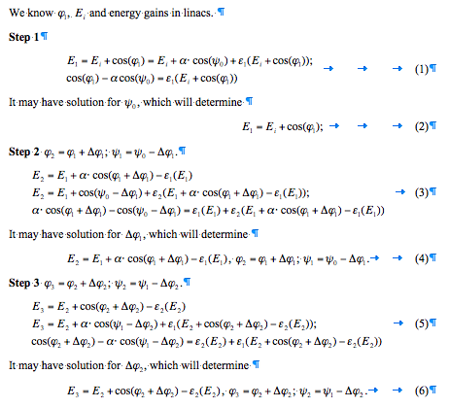
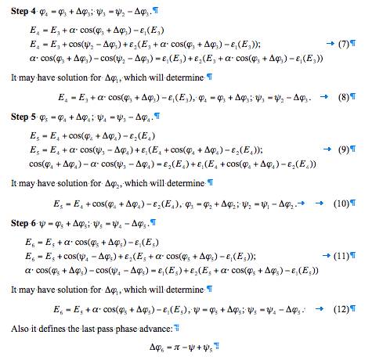
There are enough variables and even two parameters can vary
Mathematica was used to find some reasonable solutions
E_{i} , φ_{i}
Φ₁₌Φ₂-Δφ₁,E₁
Φ₂₌Φ₃-Δφ₂,E₂
Φ₃₌Φ₄-Δφ₃,E₃
Φ₄₌Φ₅-Δφ₄,E₄
Φ₅=ψ-Δφ₅, E₅
ψ, E_{o}=E₆
L1 ΔE₁
L2 ΔE₂
L1 ΔE₁
L2 ΔE₂
L1 ΔE₁
L2 ΔE₂
Arc 1.1
-ε1(E₁), Δφ₁
Arc 2.1
-ε2(E₂), Δφ₂
Arc 1.2
-ε1(E₃), Δφ₃
Arc 2.2
-ε2(E₄), Δφ₄
Arc 1.3
-ε1(E₅), Δφ₅
Arc 2.3
-ε2(E_{o}), π+Δφ₆
Ψ₅=Ψ+π+Δφ₆, E₅
Ψ₄=Ψ₅+Δφ₅, E₄
Ψ₃=Ψ₄+Δφ₄, E₃
Ψ₂=Ψ₃+Δφ₃, E₂
Ψ₁=Ψ₂+Δφ₂, E₁
Ψ_{o}=Ψ₁+Δφ₁, E_{i}
L1 ΔE₁
L2 ΔE₂
L1 ΔE₁
L2 ΔE₂
L1 ΔE₁
L2 ΔE₂
Arc 2.2
-ε2(E₄), Δφ₄
Arc 1.2
-ε1(E₃), Δφ₃
E_{i}
Arc 1.3
-ε1(E₅), Δφ₅
Arc 2.1
-ε2(E₂), Δφ₂
Arc 1.1
-ε1(E₁), Δφ₁
© VL

Slide 7
Longitudinal beam dynamics
Nothing pathological

Slide 8
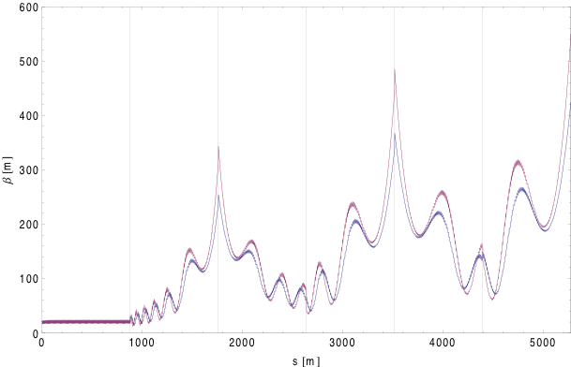
Linac without and with quads
# of pass in linac | β (entr.) | α (entr.) | β (exit) | α (exit)
1 | 294.6 | -1.14 | 769.3 | -1.18
2 | 898.1 | 1.89 | 905.3 | -1.53
3 | 915.4 | 1.84 | 916.7 | -1.61
4 | 919.7 | 1.81 | 920.0 | -1.65
5 | 921.4 | 1.79 | 921.6 | -1.67
6 | 922.3 | 1.78 | 922.2 | -1.68
On the way down the exit value becomes entrance and vice versa
No quadrupoles inside linac
© Y.Hao
For high energy, the average beta function is beta*+L^2/3/beta* (L is the half length of linac), therefore the best case is beta*=L/1.

Slide 9
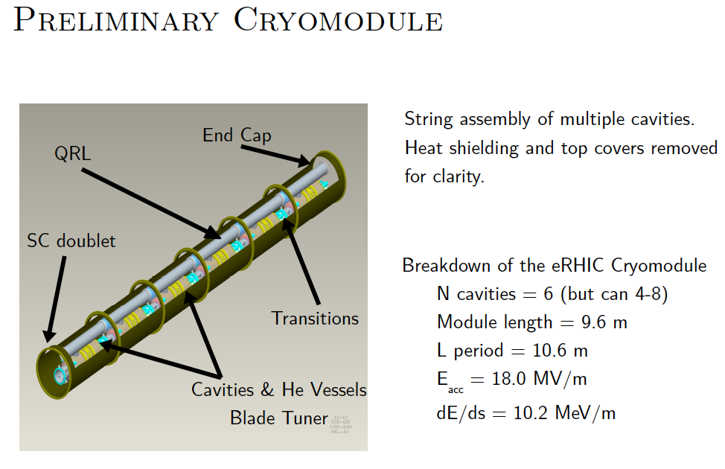
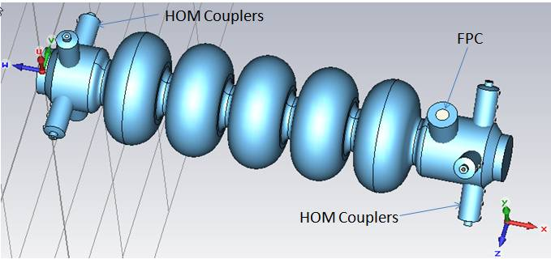
Linac: case #1
injection energy - 0.3GeV , top energy - 60GeV, energy gain per linac - 9.95GeV.
Each linac contains 80 eRHIC Cryomodules, each with 6 Cavities and 0.2m overhead length. Length of the linac is 800m with 20.73 MeV per cavity. More realistic is 83 modules (830 m) with 20 MeV per cavity.
Additional 1.4 GeV (90 m) of RF linacs at 700 MHz and 1.4 GHz to compensate for SRF
Linac: case #2
injection energy - 0.3GeV , top energy - 60GeV, max energy gain:
linac1 – 10 GeV, 84 modules, 840 m, 19.84 MeV per linac
linac2 – 10.35 GeV, 87 modules, 870 m, 19.83 MeV per linac
.
New design of 704 MHz cavity (BNL III):
-reduced peak surface magnet field
-reduced cryogenic load
© I. Ben Zvi

Slide 10
Expected cryogenic load
Assume Q vs. E as measured for BNL I.
Assume 18 MV/m operation.
Assume losses scale with surface magnetic field.
For comparison with measured results, scale field by the magnetic field ratio of BNL III to BNL I, giving 13.3 MV/m.
The measured Q for BNL I at this field is 4E10.
Assume losses scale down by the geometry factor, that leads to a Q of 5E10.
With this Q at 18 MV/m the cryogenic load is 13 W/cavity.
For 280 cavities the dynamic load is 3.6 kW: Less than MeRHIC estimate (which was based on older cavities).
© I. Ben Zvi

Slide 11

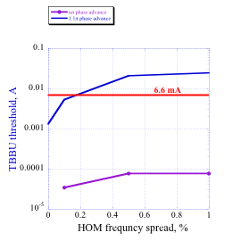
TBBU – Preliminary (©D. Kayran)
HOMs based on R. Calaga’s simulations/measurements
70 dipole HOM’s to 2.7 GHz in each cavity
No focusing in the linac
Excitation process of transverse HOM
F (GHz) | R/Q (Ω) | Q | (R/Q)Q
0.8892 | 57.2 | 600 | 3.4e4
0.8916 | 57.2 | 750 | 4.3e4
1.7773 | 3.4 | 7084 | 2.4e4
1.7774 | 3.4 | 7167 | 2.4e4
1.7827 | 1.7 | 9899 | 1.7e4
1.7828 | 1.7 | 8967 | 1.5e4
1.7847 | 5.1 | 4200 | 2.1e4
1.7848 | 5.1 | 4200 | 2.1e4
LHeC
Simulated BBU threshold (GBBU) vs. HOM frequency spread.
Threshold exceeds the required beam current,
Potential for increasing TBBU threshold further exists

Slide 12
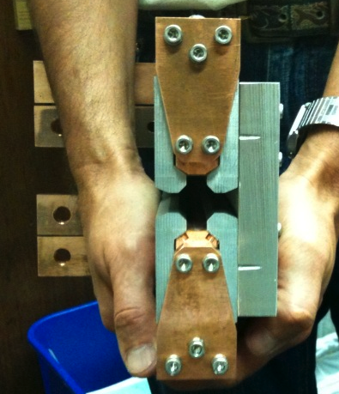
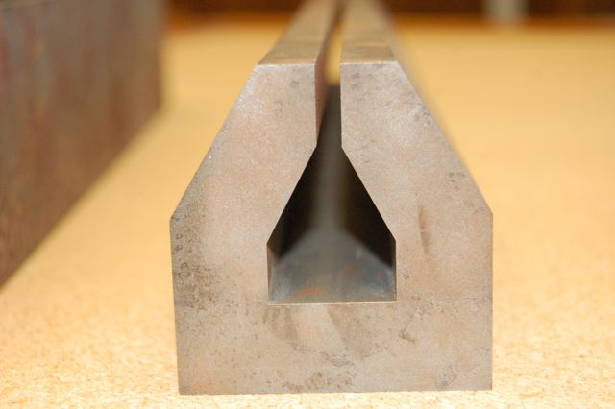
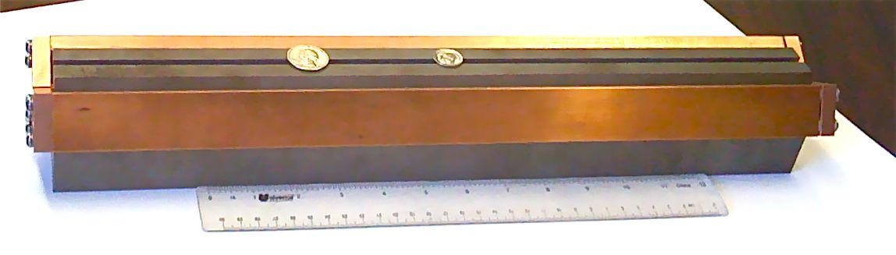
LHeC Isochronous arc cell
Each 180-degree arc is comprised of 113 cells
Note that arcs must be isochronous to avoid using 3rd harmonic cavities
© D.Trbojevic
Name | Length (m) | Gradient (T/m)
QF0 | 0.665 | 84.975
QD0 | 0.600 | -88.970
QF3 | 1.200 | 107.75
QD3 | 0.800 | -103/89
QF3S | 1.200 | 107.220
QD3S | 0.800 | -101.095
H function ~7E-5 m this arc
Filling factor 60%
Dipole field is ~ 0.28 T
@ 60 GeV pass
Gap 5 mm total
0.3 T for 60 GeV
Small magnets for eRHIC should
be fine for LHeC ERL © VL

Slide 13
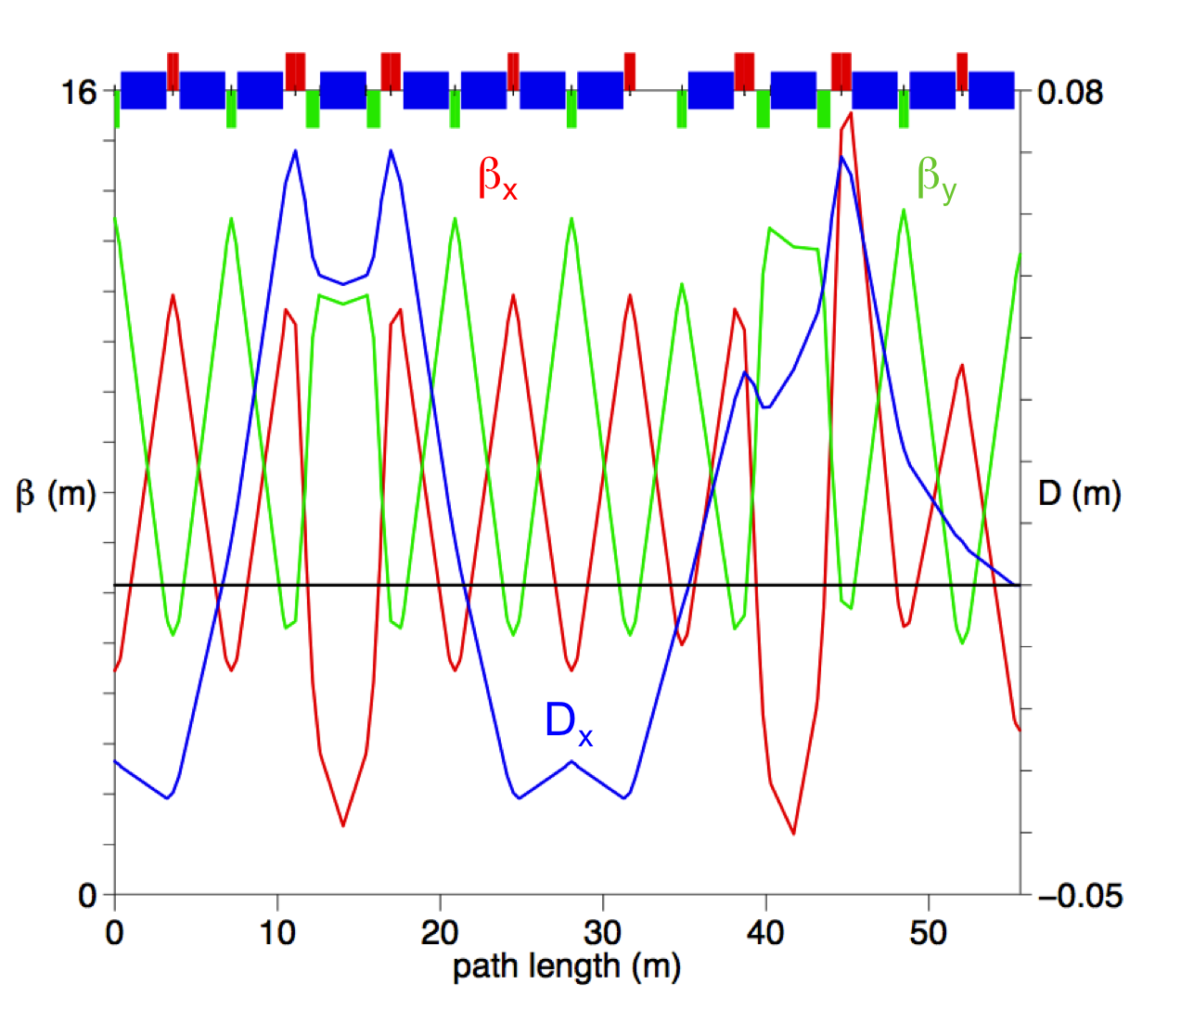
Arc’s lattice
© D.Trbojevic
Regular isochronous lattice of ERL’s arcs. Length of cell is 27.8017 m. Red line – horizontal β-function, green - vertical β-function, blue – dispersion.
The regular and the end of the arc cell lattice.

Slide 14
ERL-based LHeC with achromatic arcs
Up to the collision point
 | δε_{norm} | 8.59 | mm mrad
 | σ_{γ} | 31.27
 | σ_{E} | 15.98 | MeV
Accumulted
 | δε_{norm} | 36.53 | mm mrad
 | σ_{γ} | 68.96
 | σ_{E} | 35.24 | MeV
Formulae can be derived from equations (5.16) and (5.6) in Kolomensky/Lebedev book
© VL 28/09/10
Normalized emittance growth |  |  | per 180º arc!
Arc | E, GeV | γ | δE, SR, GeV | δεn, m rad | δγ² | total | σγ/γ
1 | 10.25 | 2.01E+04 | 6.93E-04 | 4.811615E-10 | 1.19E-02 | 1.19E-02 | 5.44E-06
2 | 20.2 | 3.95E+04 | 1.04E-02 | 2.818746E-08 | 1.37E+00 | 1.38E+00 | 2.98E-05
3 | 30.15 | 5.90E+04 | 5.18E-02 | 3.116532E-07 | 2.27E+01 | 2.40E+01 | 8.31E-05
4 | 40.1 | 7.85E+04 | 1.62E-01 | 1.725099E-06 | 1.67E+02 | 1.91E+02 | 1.76E-04
5 | 50.05 | 9.79E+04 | 3.94E-01 | 6.521871E-06 | 7.87E+02 | 9.78E+02 | 3.19E-04
6 | 60 | 1.17E+05 | 8.13E-01 | 1.935776E-05 | 2.80E+03 | 3.78E+03 | 5.23E-04
5 | 50.05 | 9.79E+04 | 3.94E-01 | 6.521871E-06 | 7.87E+02 | 4.56E+03 | 6.90E-04
4 | 40.1 | 7.85E+04 | 1.62E-01 | 1.725099E-06 | 1.67E+02 | 4.73E+03 | 8.77E-04
3 | 30.15 | 5.90E+04 | 5.18E-02 | 3.116532E-07 | 2.27E+01 | 4.75E+03 | 1.17E-03
2 | 20.2 | 3.95E+04 | 1.04E-02 | 2.818746E-08 | 1.37E+00 | 4.76E+03 | 1.74E-03
1 | 10.25 | 2.01E+04 | 6.93E-04 | 4.811615E-10 | 1.19E-02 | 4.76E+03 | 3.44E-03
Total |  |  | 2.05E+00 | 3.65E-05 | 4.76E+03
The bottom line – the quality of the beam is not spoiled neither in the collision
point nor on the way back to the injection energy
Classical radius of electron | r_{e} | cm | 2.817938E-13 | m | 2.81794E-15
Compton wavelength of electron | Λ_{e} | cm | 3.861591E-11 | m | 3.86159E-13

Slide 15
Splitters/combiners
“Beam” is nearly mirror symmetric with respect to a plane passing by the center of LINAC, Therefore
“Beam Optics” of Combiner is the near mirror image of that of the Splitter
ARCS
Symmetry Plane
ARCS
Combiner
Splitter
10 GeV LINAC
© N.Tsoupas

Slide 16
Splitters/combiners + matching
Optics functions of splitter for 20, 40 and 60 GeV beams and matching with the arc.
© N.Tsoupas

Slide 17
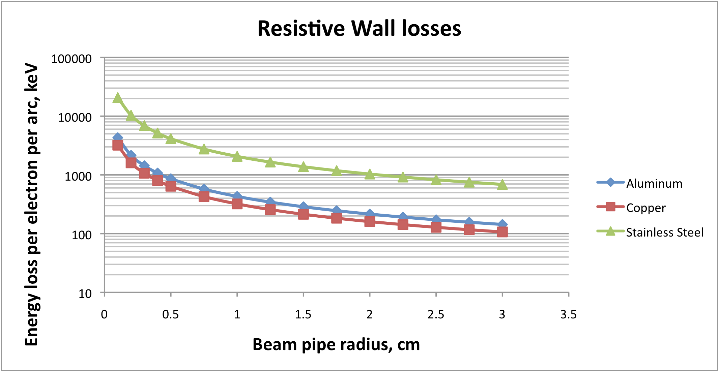
Other losses
13.54 MW of the SR losses radiated power with 6.6 mA CW current
Max power density ~ 2 kW/m, which is well within the demonstrated 8kW/m in B-factories
Bunch length 0.3mm
Number of electrons per bunch 2 10⁹
Average arc radius 1000 m
Bending radius 697 m
HOM loss
CSR power loss
Resistive wall losses
…….
(©V.Ptitsyn)
With the effective Al pipe radius ~ 2 mm there will be additional 24 MeV energy loss and similar level of the energy spread due to the resistive wall. While 24 MeV energy loss is very small compared with 2.05 GeV SR loss, the induced correlated energy spread is comparable with the 35 MeV RMS uncorrelated spread induced by SR

Slide 18
CSR power loss
Bunch length 0.3mm
Number of electrons per bunch 2 10⁹
Average arc radius 1000 m
Bending radius 697 m
Without shielding, the beam will loose 1.4 MeV per arc due to Coherent Synchrotron Radiation (CSR). Again, it is dwarfed by the incoherent SR losses. The total induced correlated energy spread will be about 12 MeV. In any case, the CSR will be strongly suppressed by the walls of the vacuum chamber
(©V.Ptitsyn)

Slide 19
Conclusions
High luminosity ERL-based LHeC looks feasible
Linacs with and without focusing elements can be used
Important feature is full (100%) spin transparency from the gun to the IP
Design has no obvious showstoppers
Beam-beam effects weaker that we had simulated for eRHIC, i.e. no unexpected surprises here
Details should be studied further
The BBU threshold should be further increased 3-4 fold by optimizing the arcs and linac lattice

Slide 20
Back up

Slide 21
New design of 704 MHz cavity (BNL III) with reduced peak surface magnet field should have similar cryogenic losses at 20 MeV per cavity
© I. Ben Zvi

Slide 22
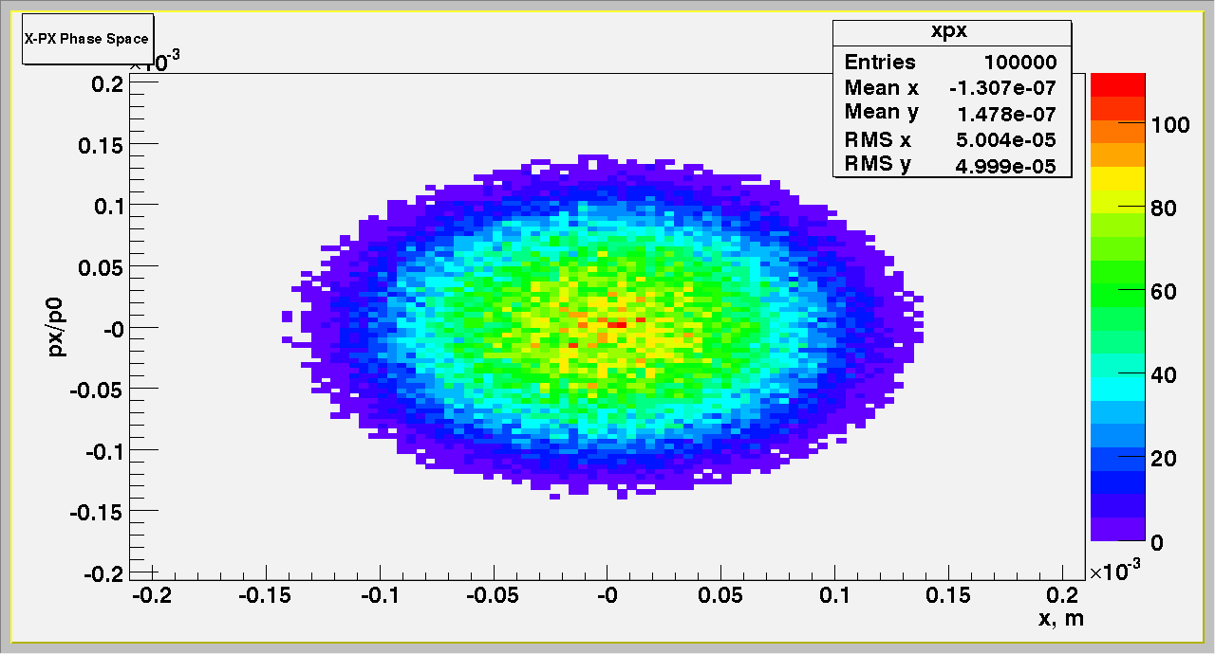
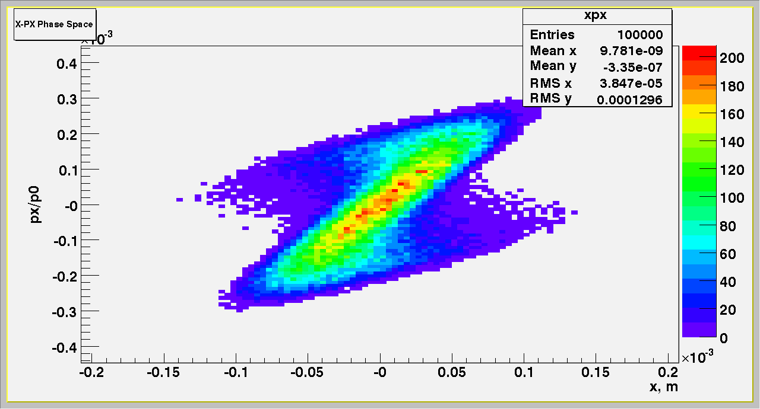
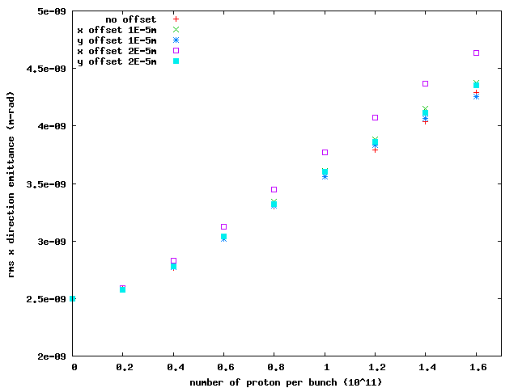
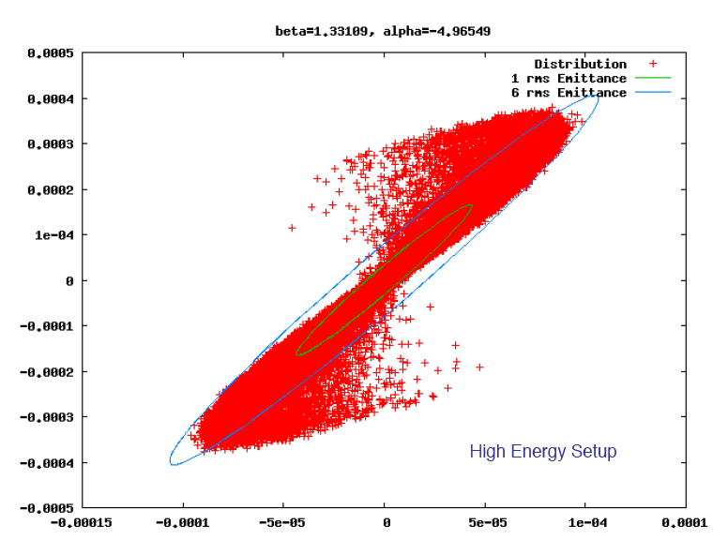
Beam Disruption
protons
e
Interaction
Optimized
©Y. Hao

Slide 23
LHeC Scope
LHC
Electron accelerator
p
Protons up to 7 TeV
Unpolarized and
polarized leptons
60-140 GeV
e⁻
e⁻
Heavy ions
3 TeV/u
e⁺
Other ions?
Center mass energy range: 0.5– 2 TeV

Slide 24
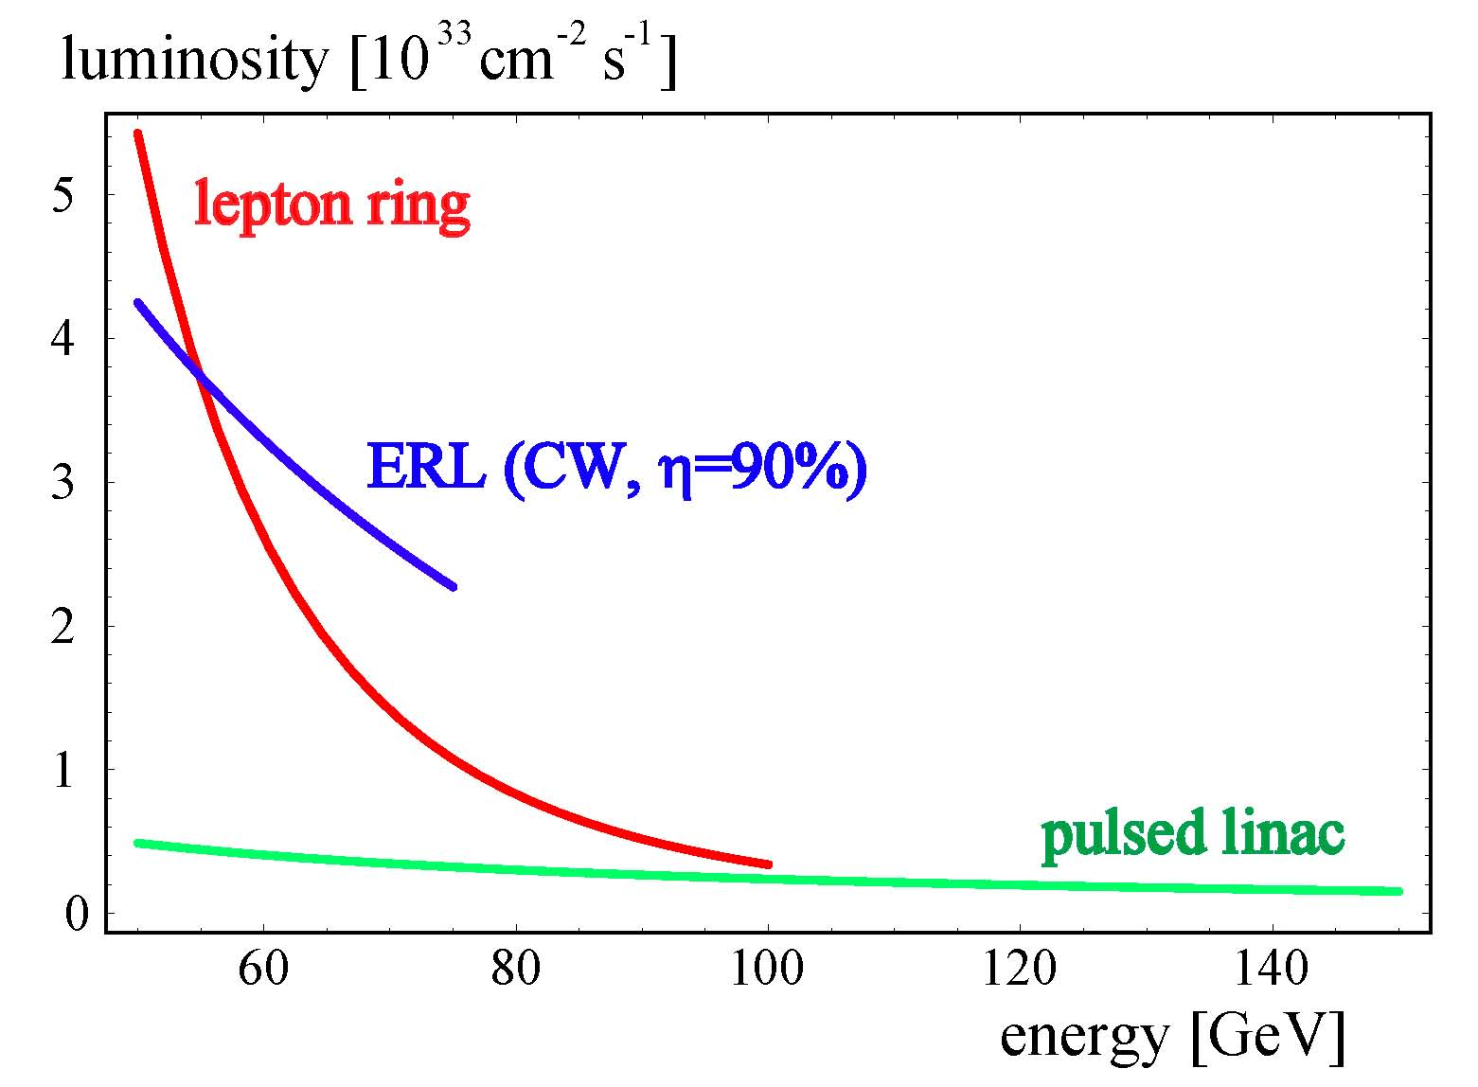
Luminosity vs e-beam energy
for AC-plug power consumption set at 100 MW
ERL, no recirculating arcs

Slide 25
Advantages & Challenges of ERL based eRHIC
Allows use of RHIC tunnel for the return passes and thus allow much higher (2-3 fold) energy of electrons compared with the storage ring.
High luminosity up to 10³⁴ cm⁻² sec⁻¹
Allows multiple IPs
Allows higher range of CM-energies with high luminosities
Full spin transparency at all energies
No machine elements inside detector(s)
No significant limitation on the lengths of detectors
Energy of ERL is simply upgradeable
Novel technology
Need R&D on polarized gun
May need a dedicated ring positrons (if ever required?)

Slide 26
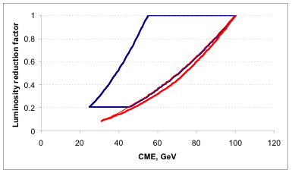
View from 2004: How eRHIC can be realized?
  Ring-ring:
  Linac (ERL)-ring:
Electron storage ring
RHIC
Electron linear accelerator
RHIC
Advantages & Challenges of ERL based eRHIC
Allows use of RHIC tunnel
2-3 fold higher energy of electrons
Higher luminosity up to 10³⁴ cm⁻² sec⁻¹
Multiple IPs
Higher range of CM-energies + high luminosities
Full spin transparency at all energies
No machine elements inside detector(s)
No significant limitation on the lengths of detectors
ERL is simply upgradeable
eRHIC can be staged
Novel technology
Need R&D on polarized gun
May need a dedicated ring positrons
3x250
10x250
3x50
10x50
5x250
5x50
In Ring-ring luminosity reduces 10-fold for 30 GeV CME.
Required norm.emittance (for 50 GeV protons) ~3 mm*mrad
http://www.agsrhichome.bnl.gov/eRHIC/

Slide 27
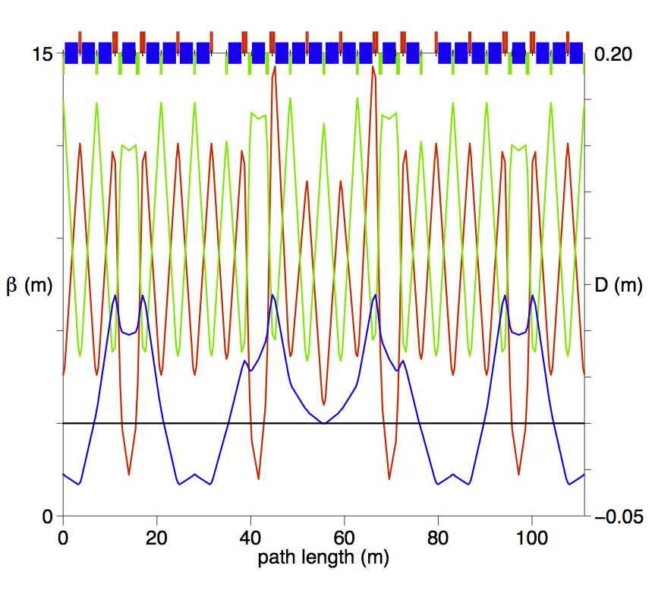
Arc and matching cell
β_{x}
β_{y}
D_{x}

Slide 28
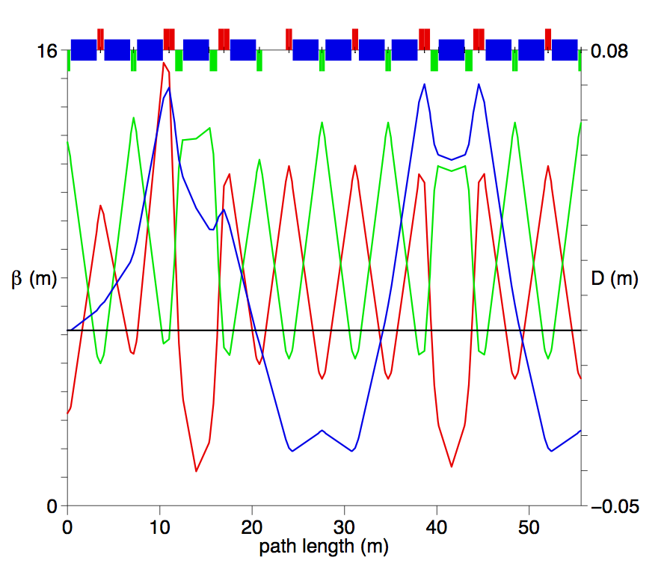
Matching and the arc cell
β_{x}
β_{y}
D_{x}

Slide 29
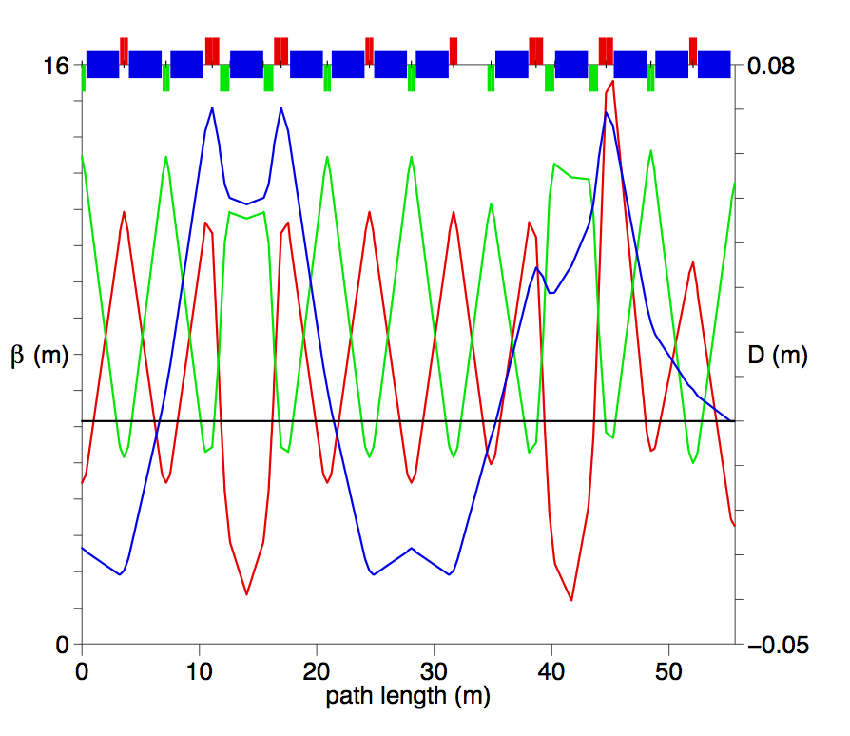
Arc cell and matching cell
β_{x}
β_{y}
D_{x}

Slide 30
Arc cell
EMAX (GeV) PC (GeV/c) BRHO (Tm)
60.000000000 59.999999998 200.138457112
DIPOLES:
ANG BL (m) N_{DIP} R_{DIP} (m)
0.004017382 2.80 1564 696.971326788
GF0 = 84.975 T/m
GD0 = -88.97 T/m
QLF = 0.665 m
QLD = 0.60 m
GF3 = 107.75 T/m
GD3 = -103.89 T/m
OFFW = 0.15272264 m
O1 = 0.065049881 m
O2 = 0.071114479 m
QLF3 = 1.20 m
QLD3 = 0.80 m
GF3S = 107.22407 T/m
GD3S = - 101.09491 T/m
QLF3 = 1.20 m
QLD3 = 0.80 m

Slide 31
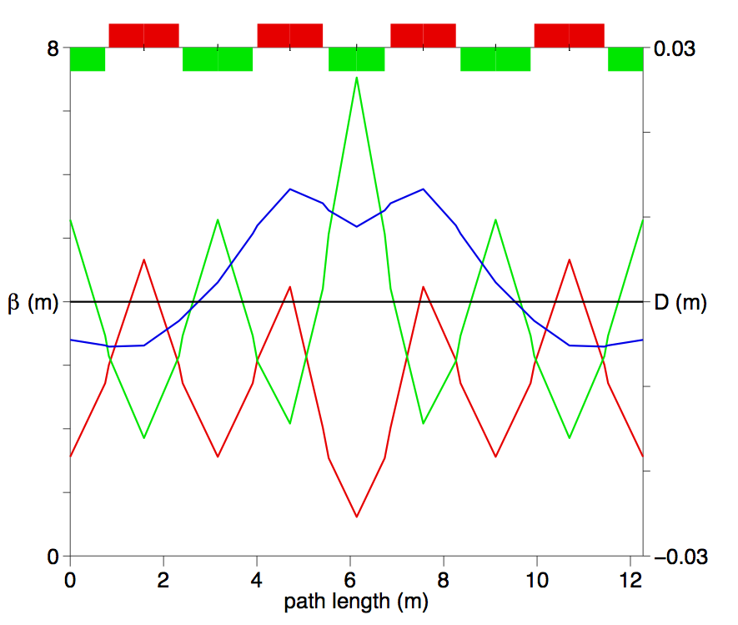
Arc cell with combined function magnets
D_{x}
β_{x}
β_{y}

Slide 32
Combined function magnet Properties
EMAX PC BRHO
60.000000000 59.999999998 200.138457112
BL = 1.5 m
QLF3 = 1.4 m
QLD3 = 1.2 m
RDIP (m) Field BY2 (T) Length BL (m)
937.104304925 0.213571164 1.500000000
NCELL ANG NDIP
512.000000000 0.001600676 3925.333333333
Gradients:
GFC = 155.590 T/m GDC = -148.300 T/m
GF3 = 207.371 T/m GD3 = -210.235 T/m

