Slide 1
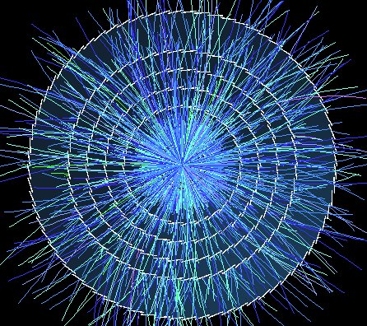
“Conventional” Silicon Pixel/Strip Tracker
Phil Allport
The University of Liverpool
12/11/10
3rd CERN-ECFA-NuPECC Workshop on LHeC
Brief Overview of Tracking in CMS and ATLAS
Silicon Detectors for sLHC (High Luminosity Upgrade LHC)
LHC Vertex Detector Technologies
Suggestions for LHeC
Conclusions

Slide 2
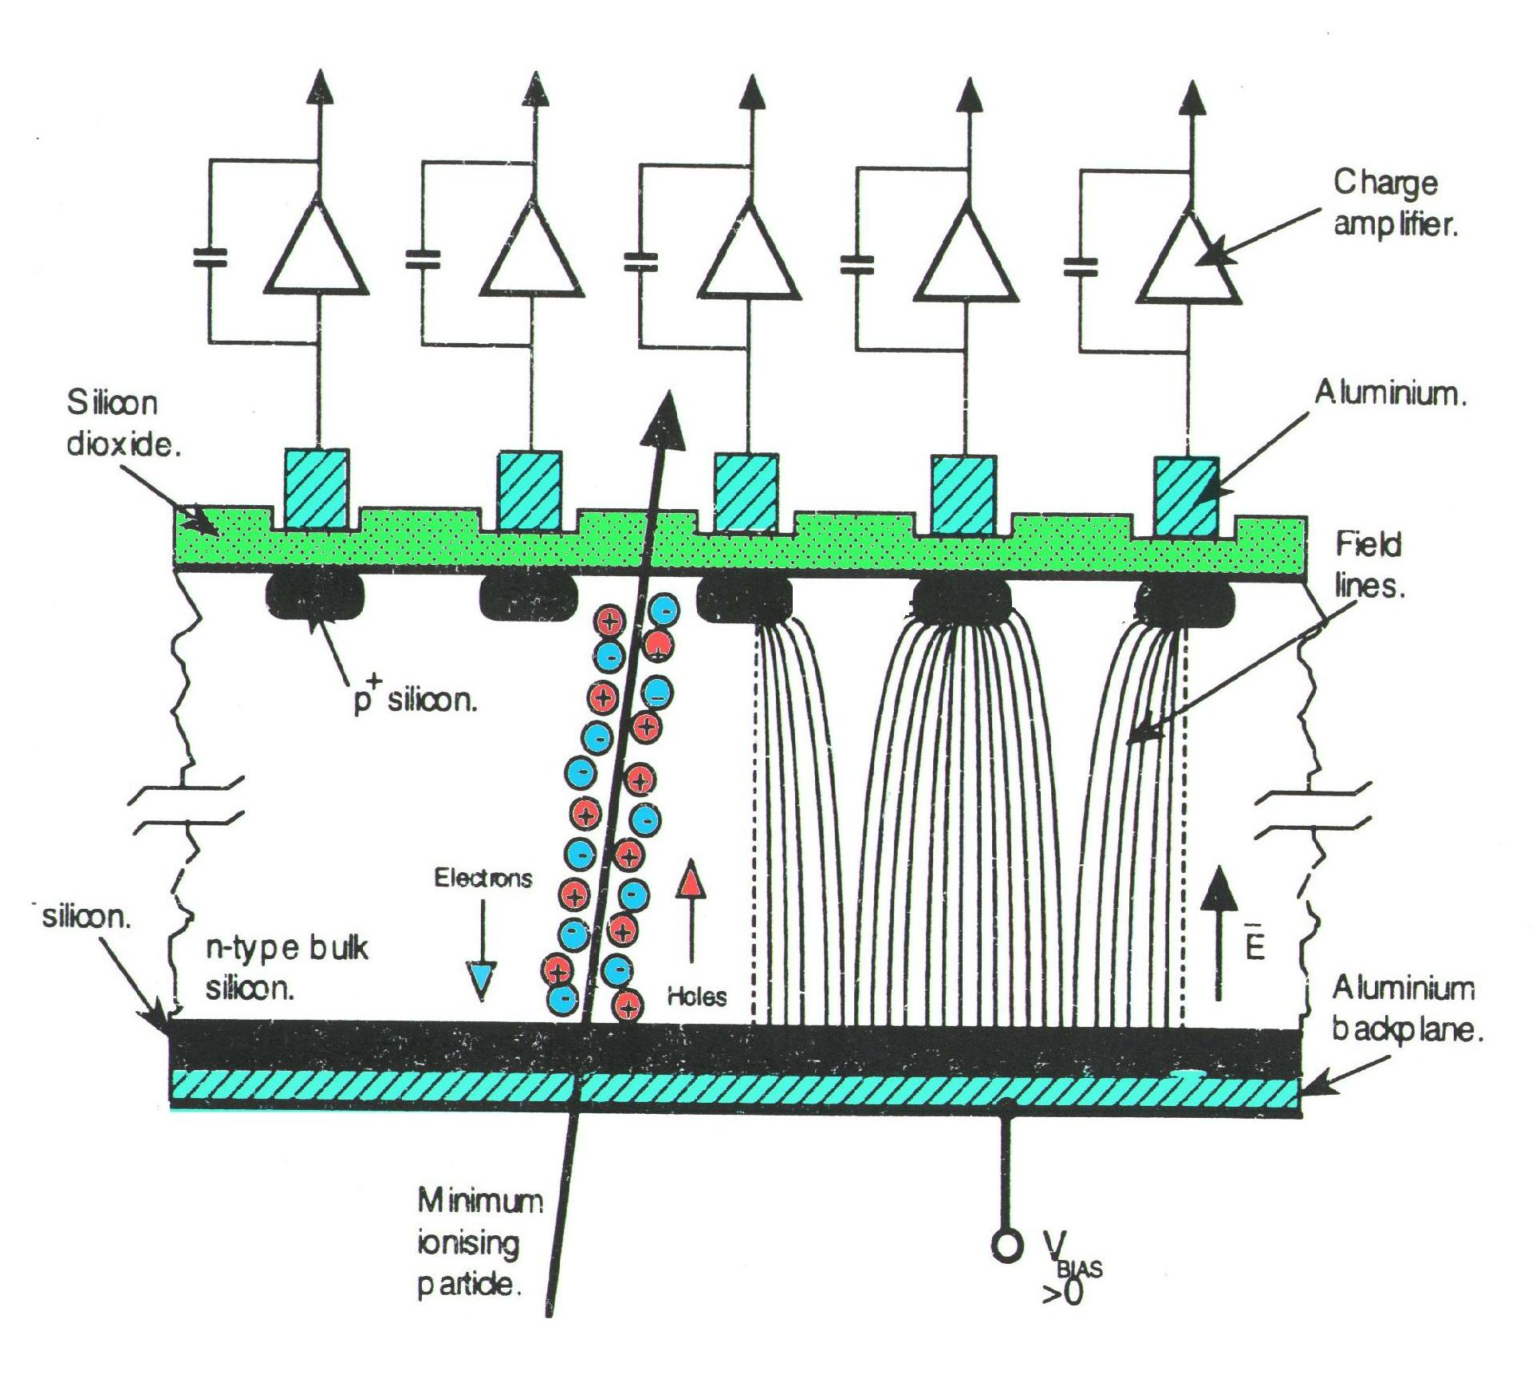
Physics of Silicon Pixel/Strip Detectors
Highly segmented silicon detectors have been used in Particle Physics experiments for nearly 30 years
  The principle application has been to detect the passage of ionising radiation with high spatial resolution and good efficiency.
  Segmentation → position
  Depletion depth → efficiency
  ( W_{Depletion} = {2ρμε(V_{ext} + V_{bi})}^{½} )
  ~80e/h pairs/μm produced by passage of minimum ionising particle, ‘mip’
  9.36cm X₀ → 300µm Si: 0.32% X₀
Pitch typically 50‒500μm
140-300µm typical
Thinner and thicker possible
p⁺ in n⁻
Resistivity
Applied Voltage
Mobility
Resolution in practice usually ≥ pitch/10
depends on signal/noise if analogue R/O
between pitch/3.46 and pitch/6.93 if binary

Slide 3
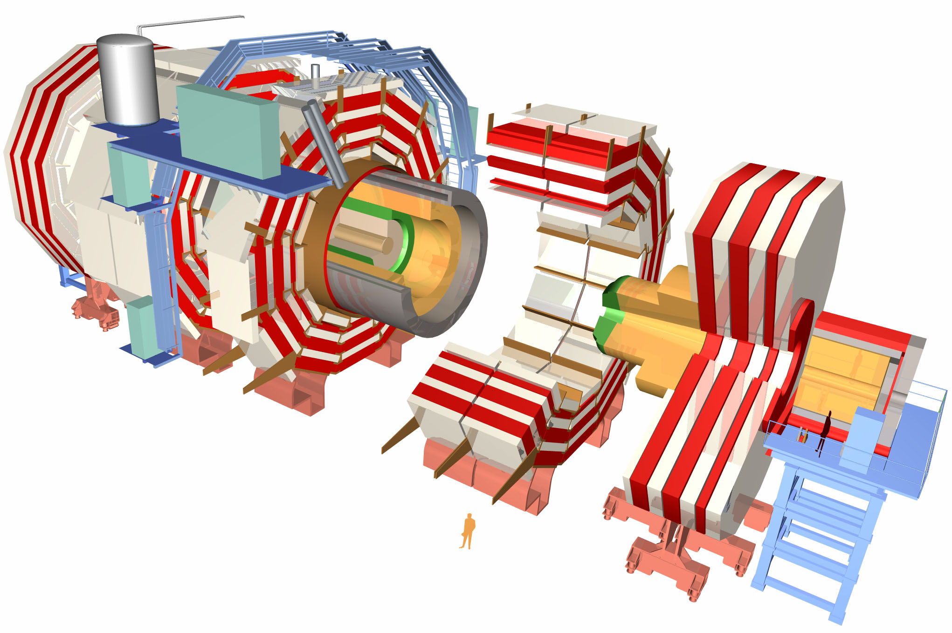
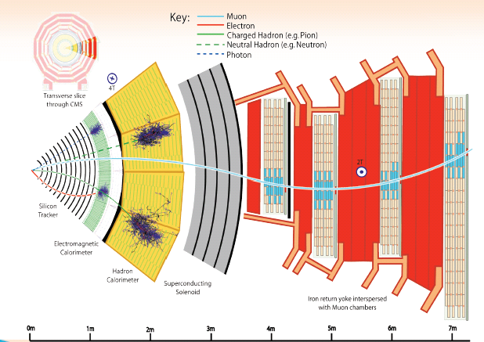
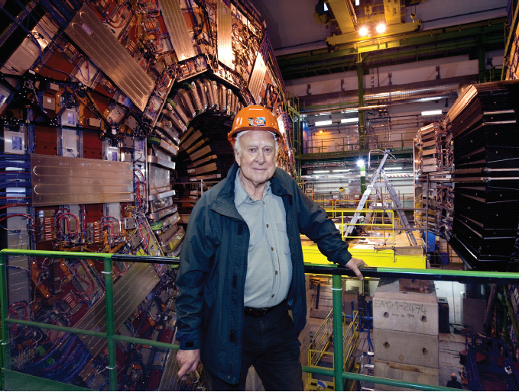
CMS: The Compact Muon Solenoid
HCAL
Muon chambers
Tracker
ECAL
4T solenoid
Total weight: 12,500 t
Overall diameter: 15 m
Overall length 21.6 m
Magnetic field 4 T
3
Notes:
3

Slide 4
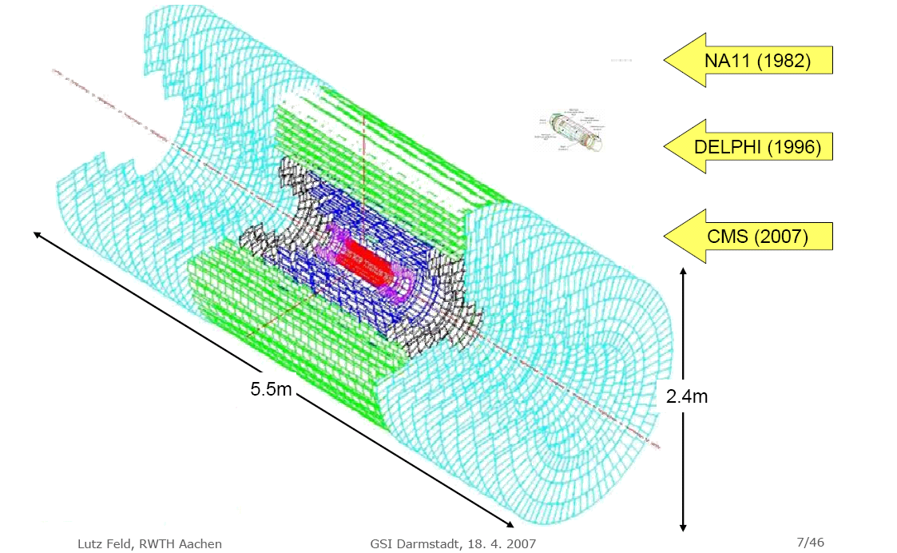
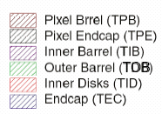
CMS Silicon Tracker: Largest Ever Built

Slide 5
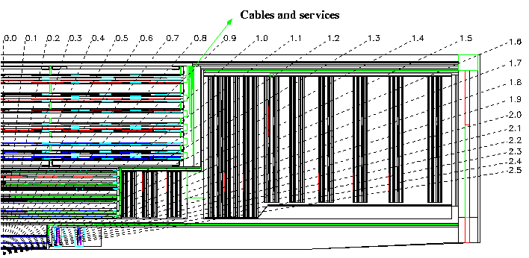
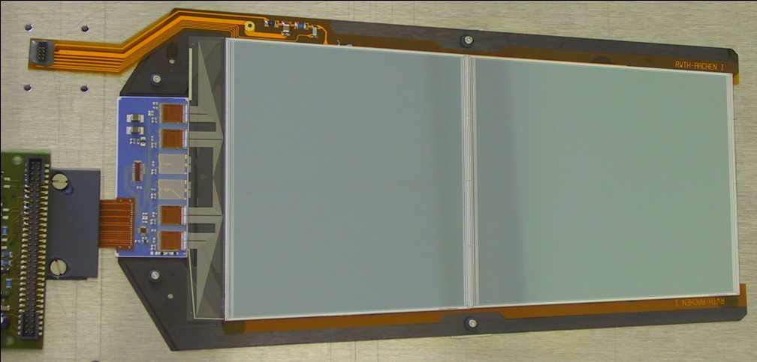
CMS Tracker System
Two main sub-systems: Silicon Strip Tracker and Pixels
3 SST sub-detectors
    Outer Barrel (TOB)
    Inner Barrel and Disks (TIB-TID)
    End-Cap (TEC)
  29 module types: 512 or 768 strips, 1 or 2 sensors, rectangular or wedge-shaped, ...
Silicon microstrip tracker
  ~210 m² of silicon, 10M channels
    75000 FE chips, 40000 optical links
Radiation environment
~10Mrad ionising
~10¹⁴ hadrons.cm⁻²
TOB
TOB
TEC
TEC
TIB
TIB
TID
TID
PD
PD

Slide 6
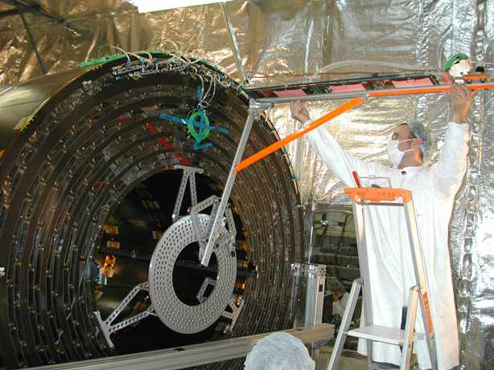
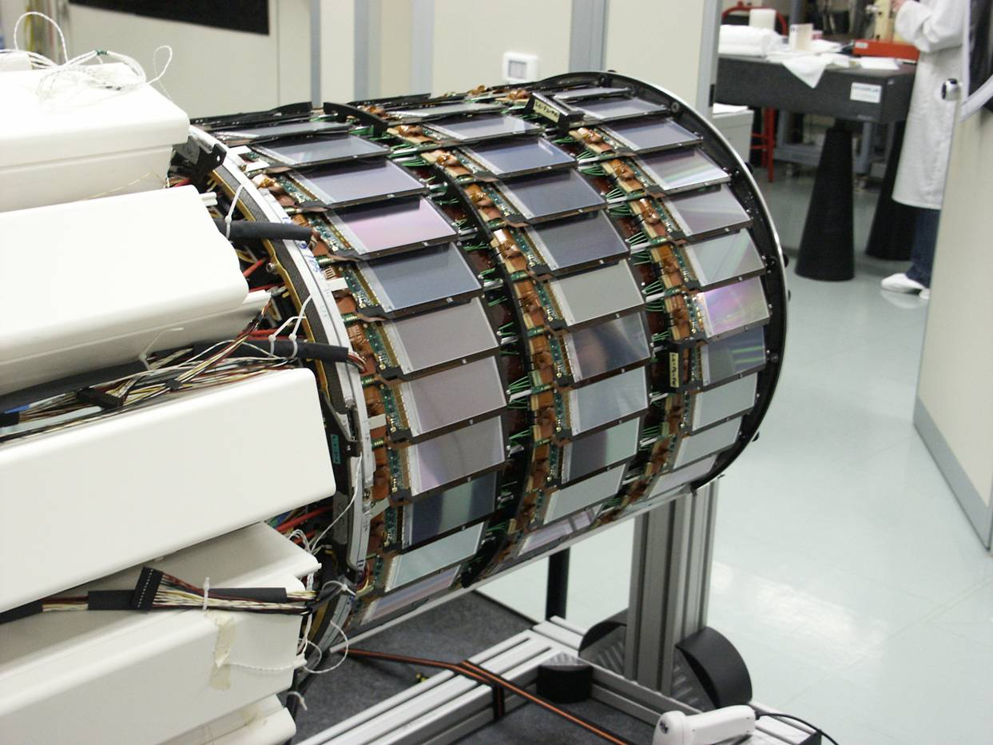
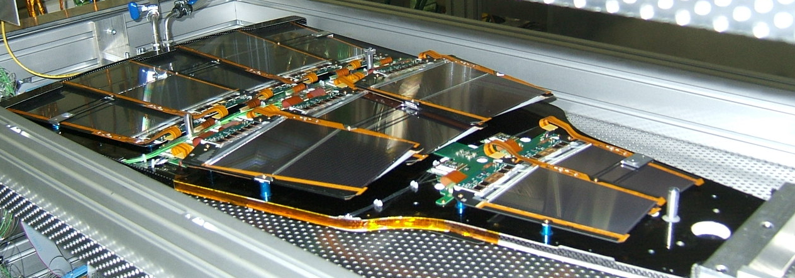
CMS Tracker Assembly
TOB Rod insertion
TIB Layer 1
Stereo
TEC Petal
15,000 modules mass produced using mainly automatic assembly techniques

Slide 7
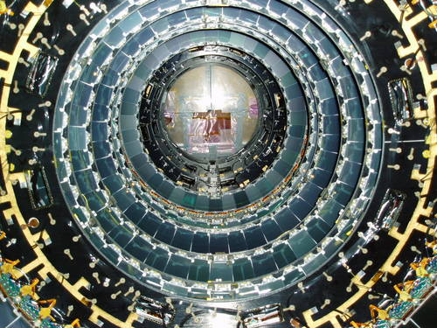
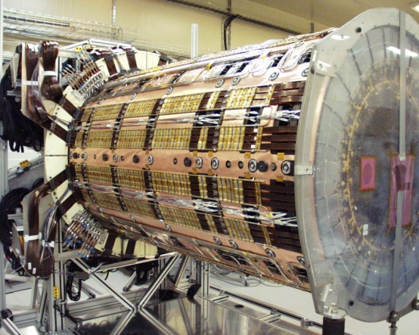
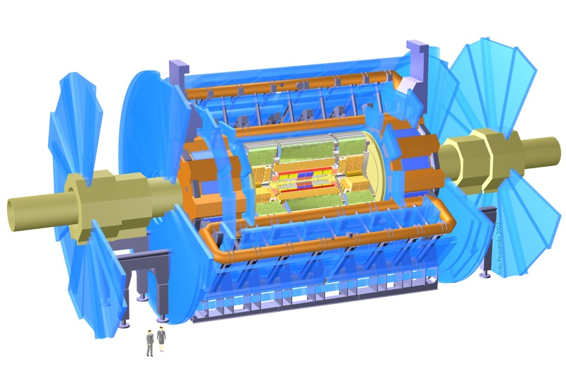
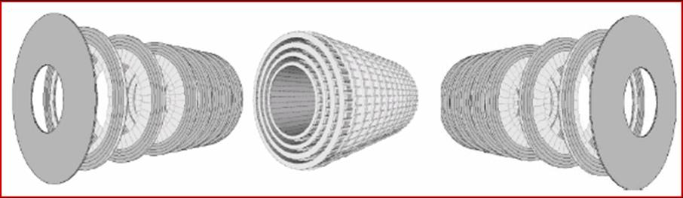
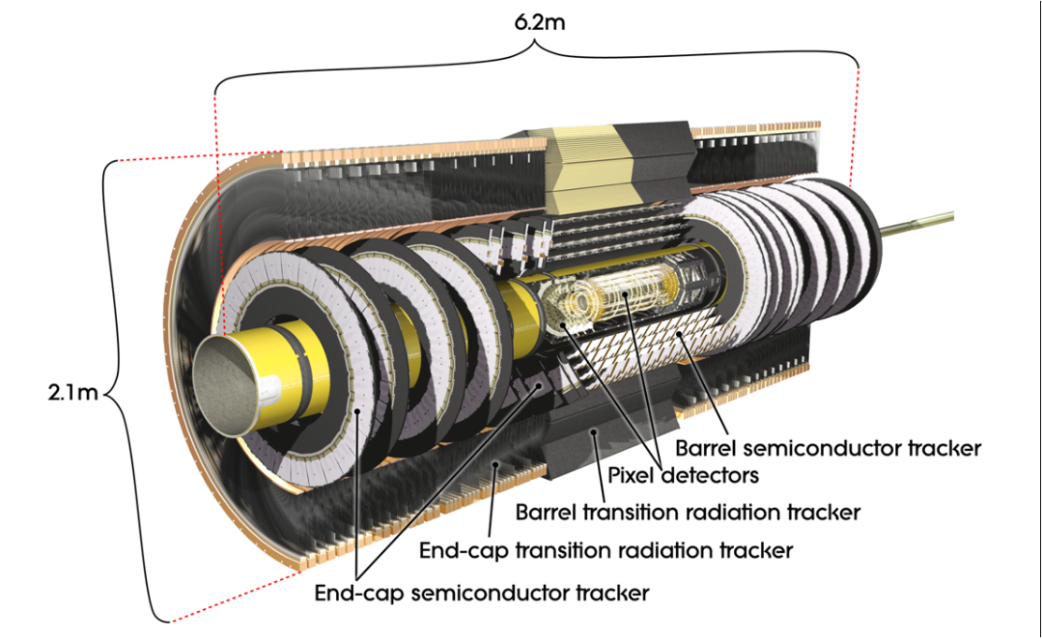
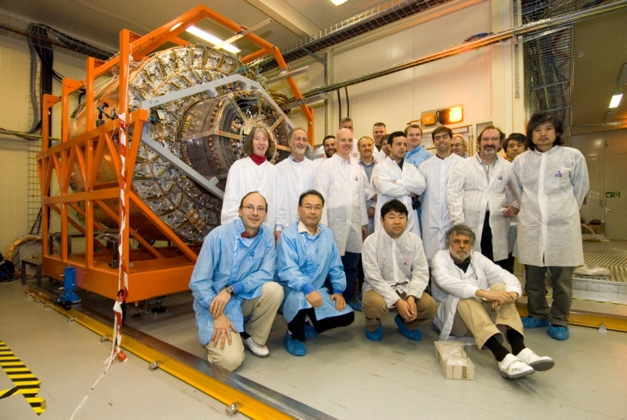
ATLAS Silicon Detector Tracker
2112 Barrel and 1976 End-Cap Double-Sided Modules
61m² of silicon micro-strip detectors
~20,000 separate sensors ordered
9 Disc End-Cap
2 End-Cap Arrays
Liverpool and NIKHEF
ATLAS
4 Concentric Barrel Array
Oxford and CERN

Slide 8
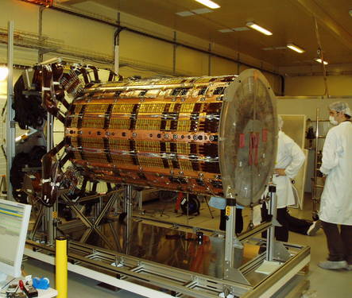
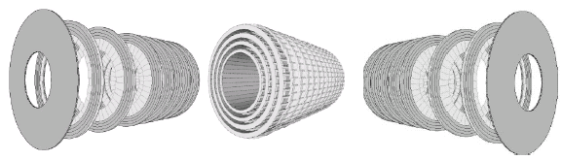
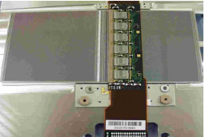
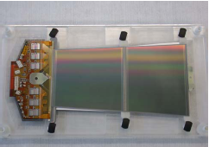
ATLAS SCT Module Designs
ATLAS Tracker Based on
Barrel and Disc Supports
Effectively two styles of double-sided modules (2×6cm long)
each sensor ~6cm wide (768 strips of 80μm pitch per side)
Hybrid cards carrying read- out chips and multilayer interconnect
circuit
Sensor
Sensor
Sensor
Sensor
Barrel Modules Forward Modules
(Hybrid bridge above sensors) (Hybrid at module end)

Slide 9
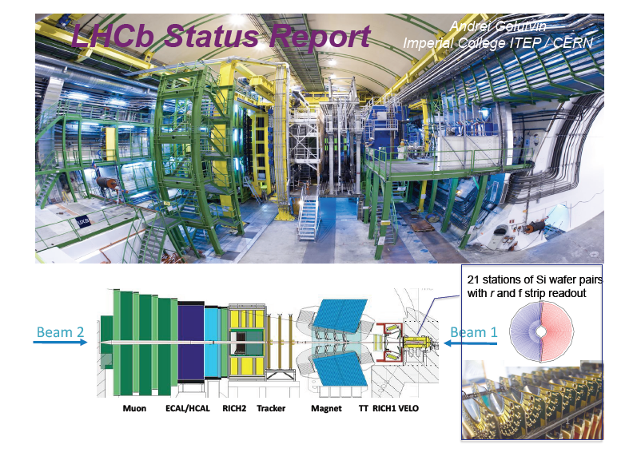

Slide 10
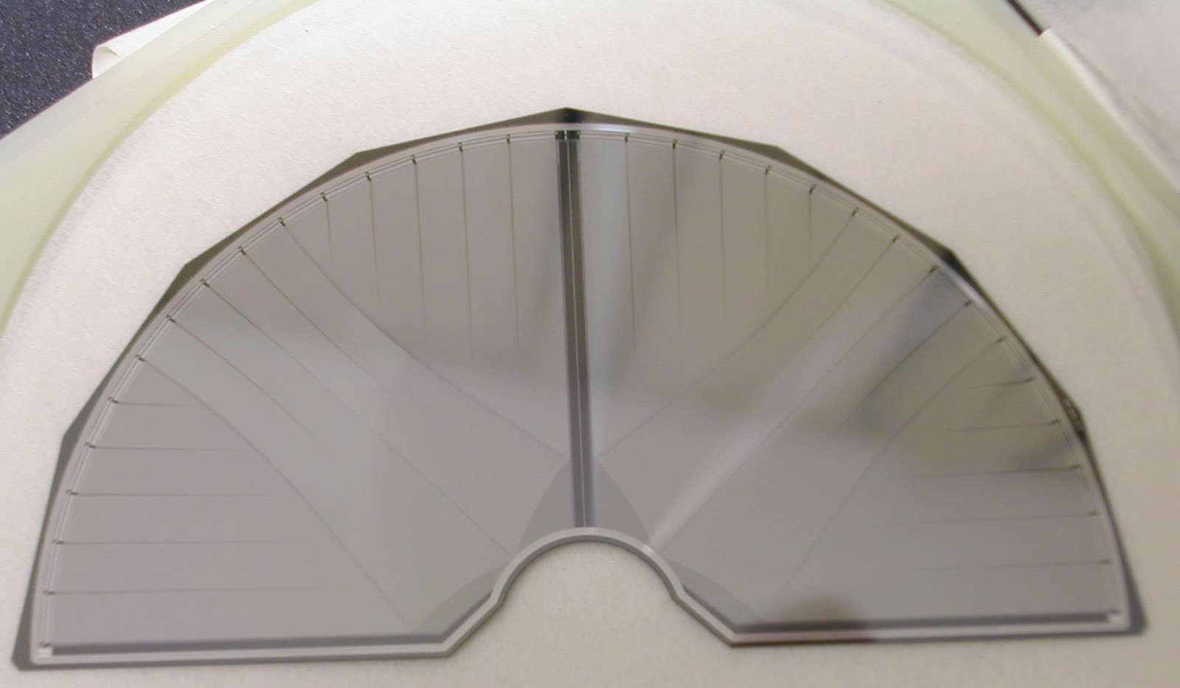
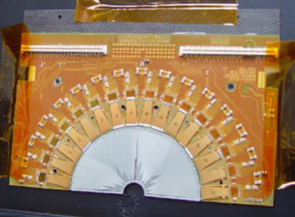
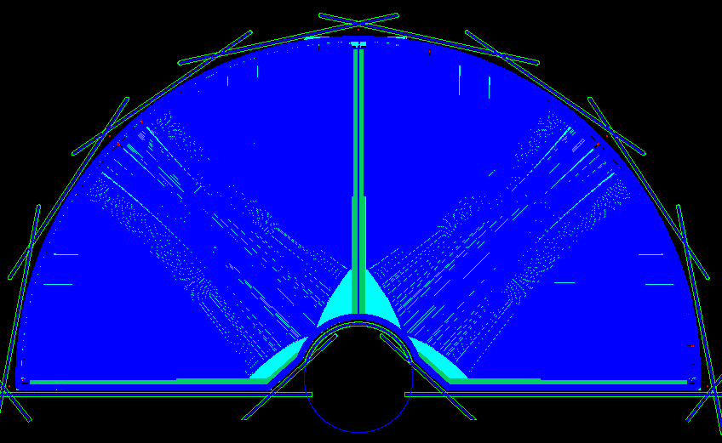
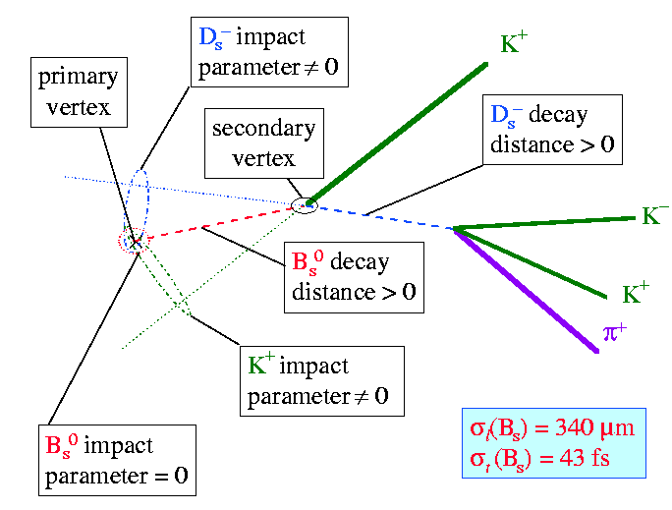
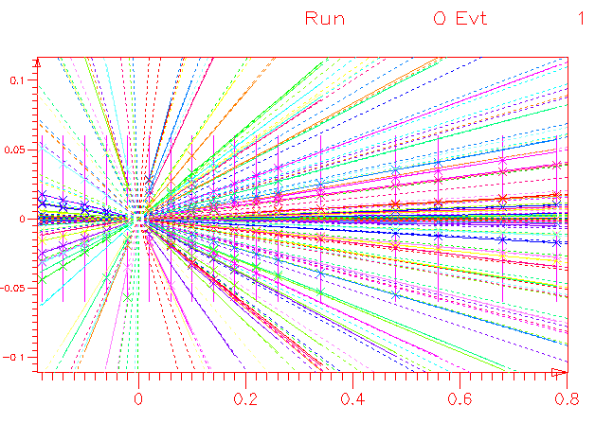
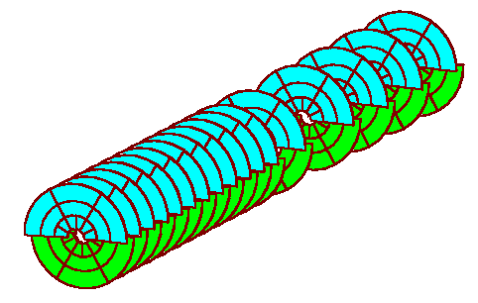
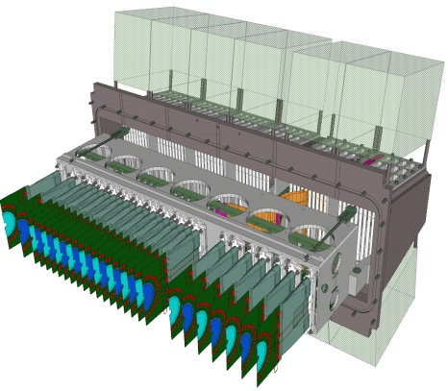
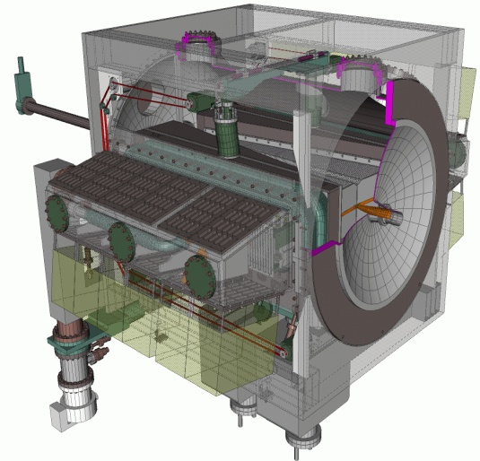
LHCb Vertex Locator Modules
At the LHC B-mesons are mostly produced in pairs going predominantly near the beam axis (forward region)
LHCb will see production of up to 10¹² b-pairs /year and the detector is optimized to study B-mesons
LHCb claims the most accurate projection to the interaction region for tagging on displaced vertices.

Slide 11
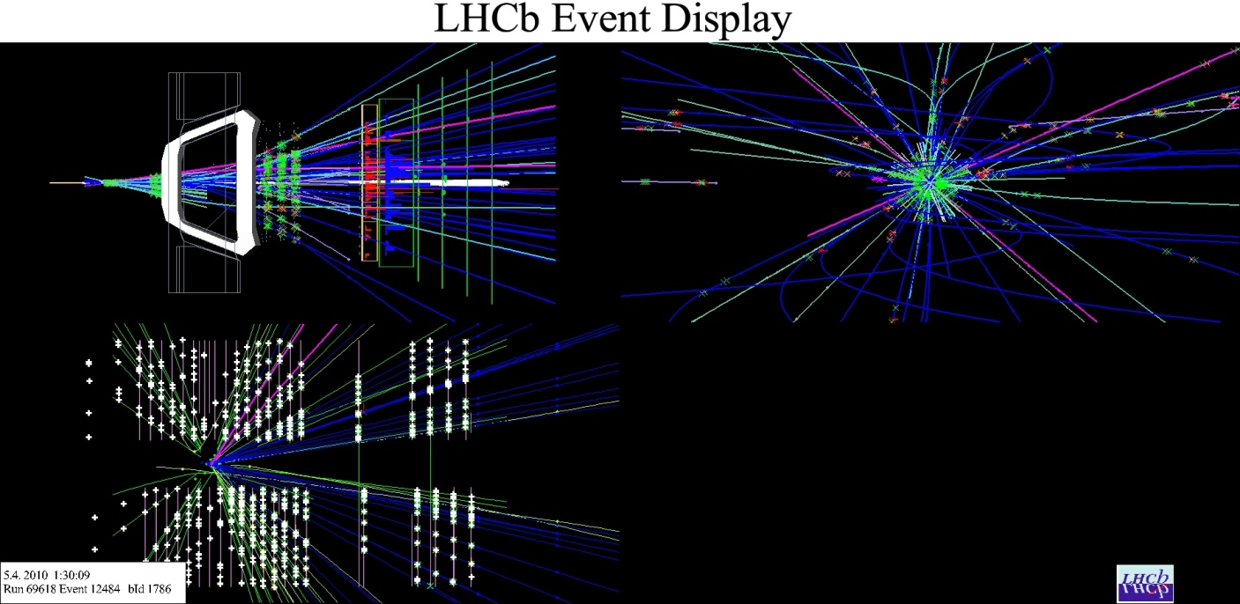
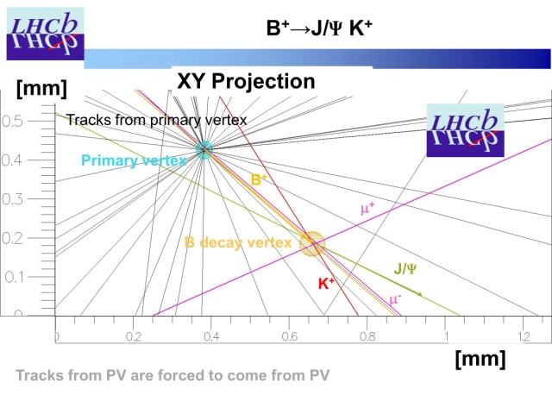
LHCb Vertex Locator: First B Event
At the LHC B-mesons are mostly produced in pairs going predominantly near the beam axis (forward region)
LHCb will see production of up to 10¹² b-pairs /year and the detector is optimized to study B-mesons
LHCb claims the most accurate projection to the interaction region for tagging on displaced vertices.

Slide 12
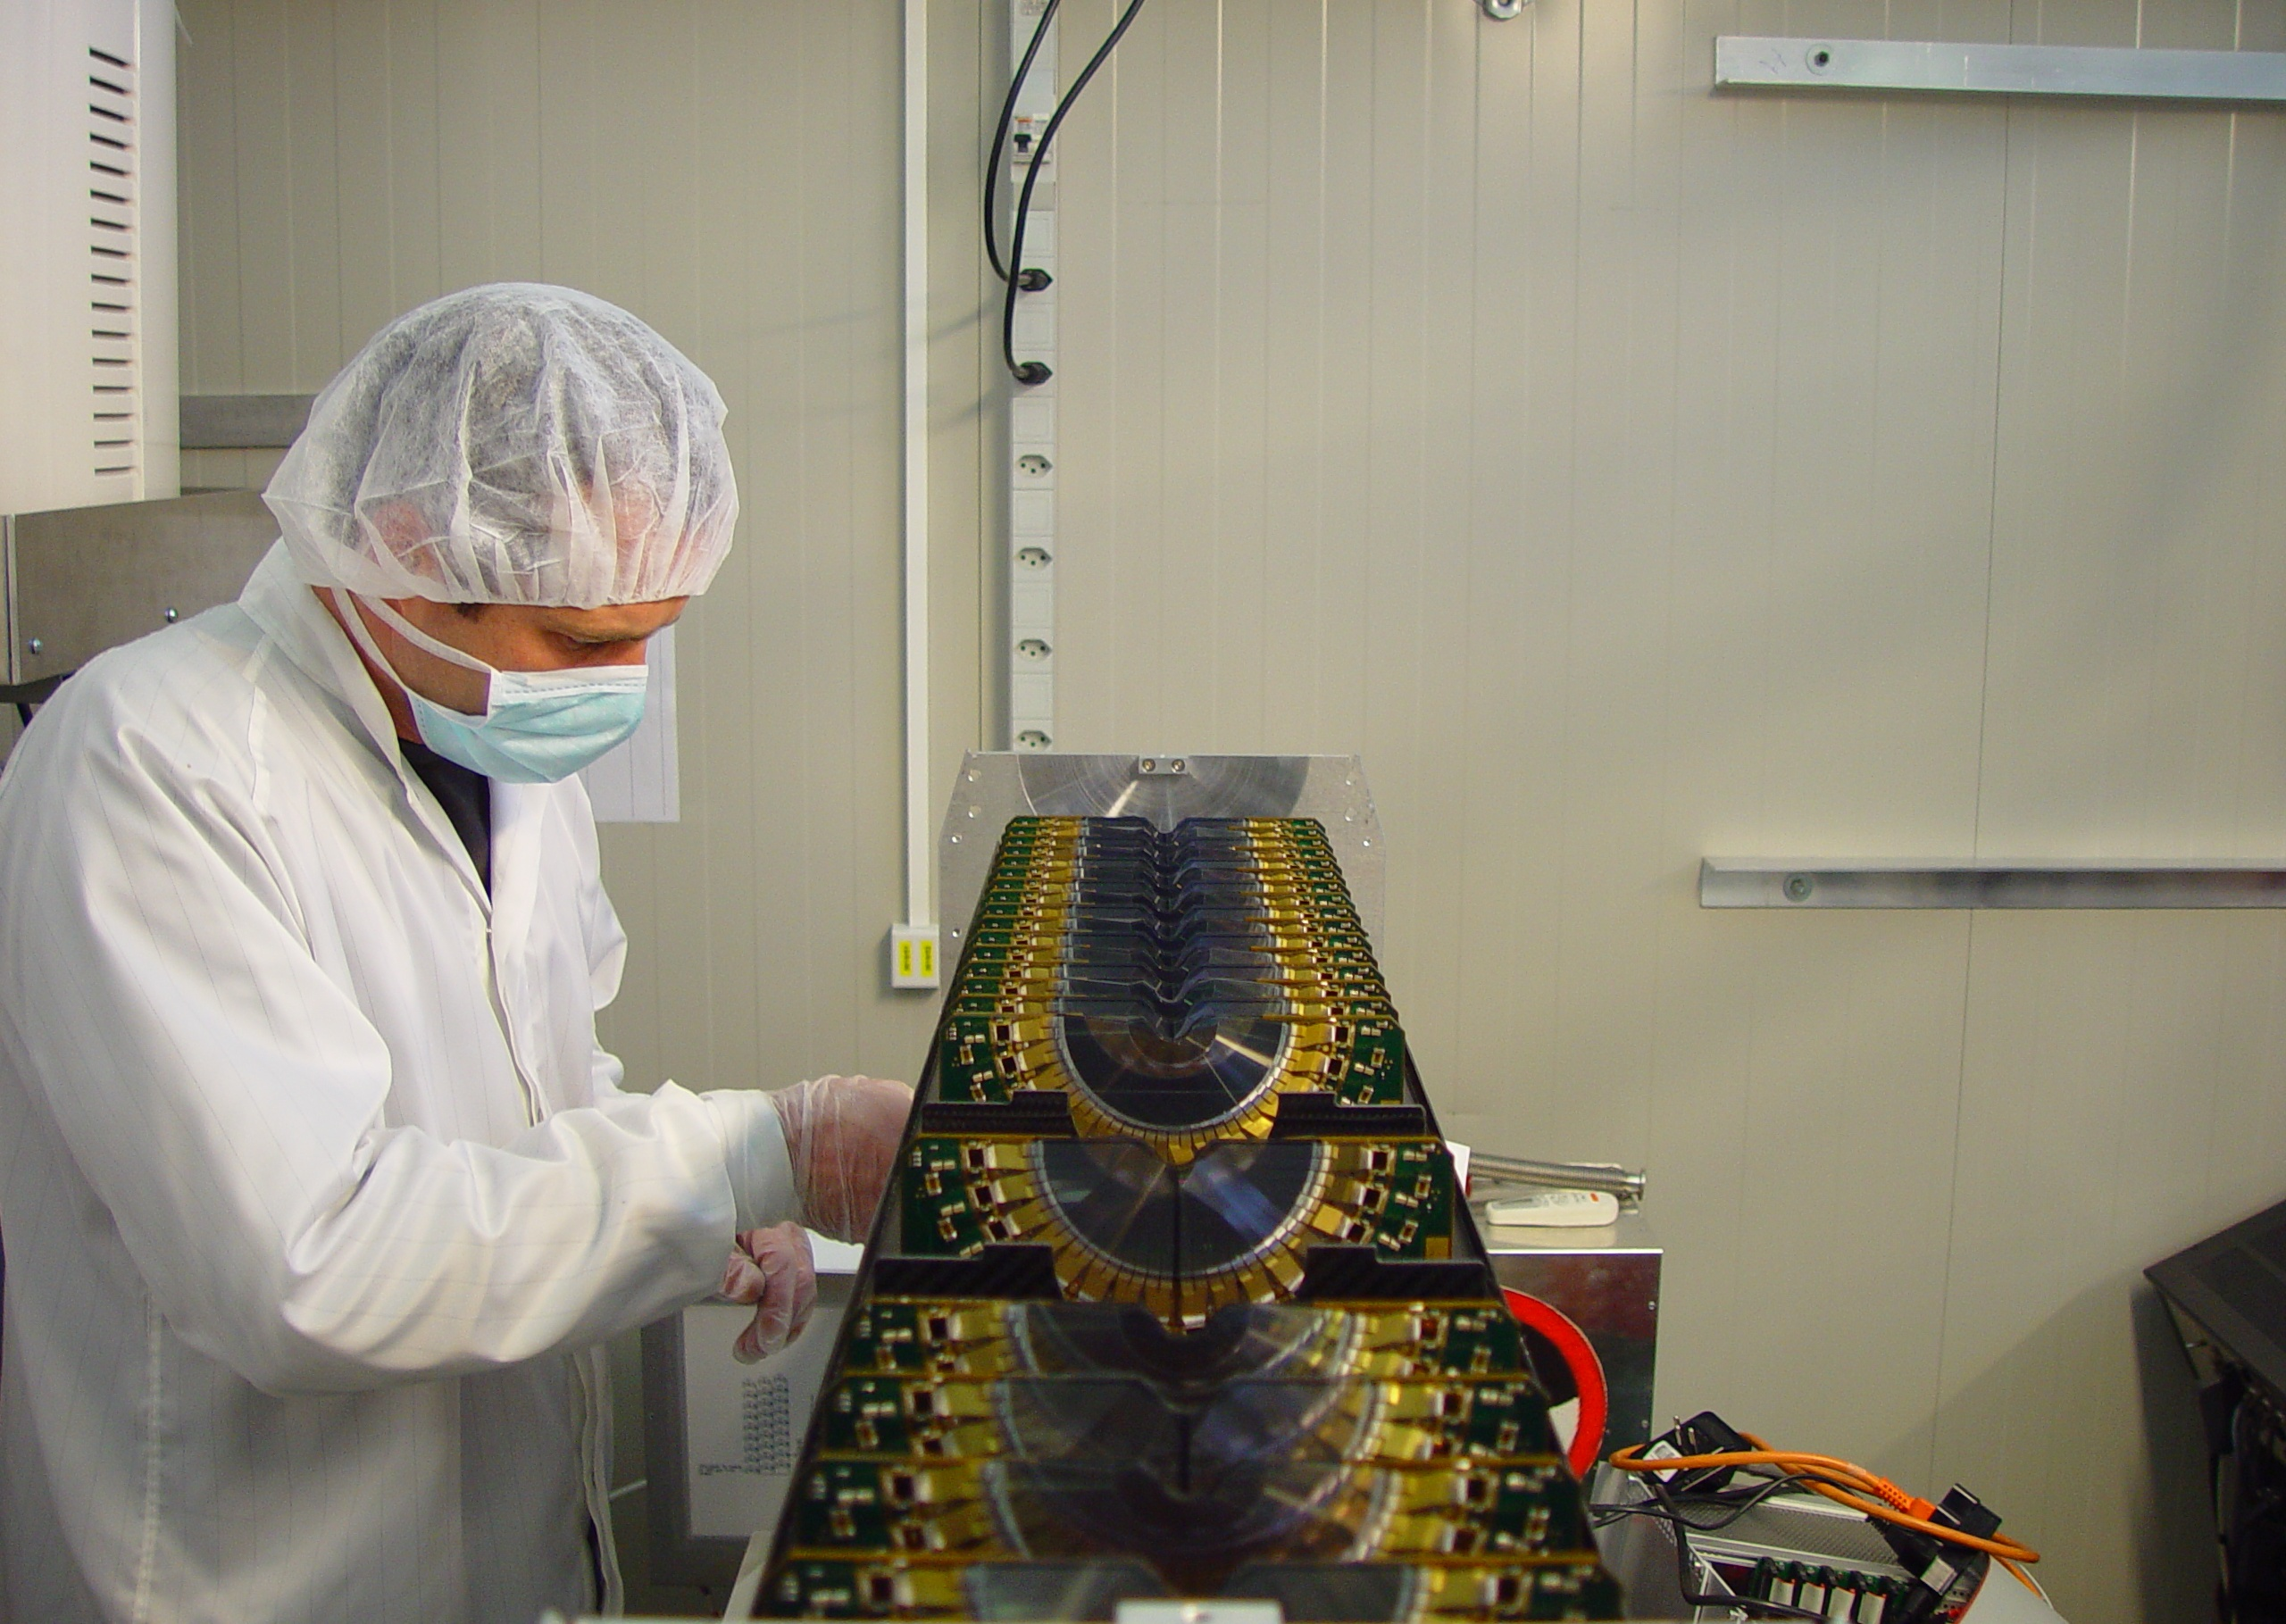

Slide 13
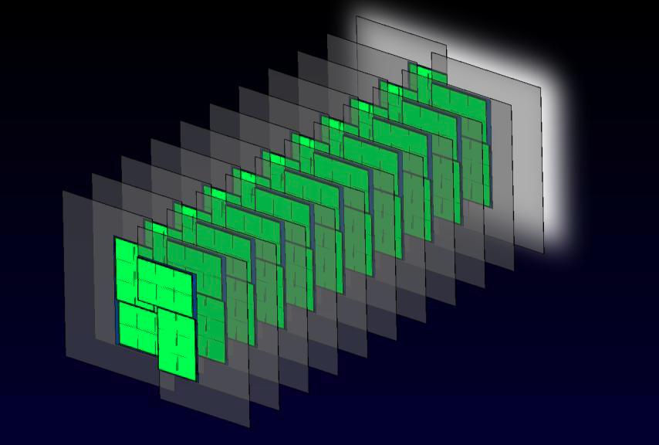
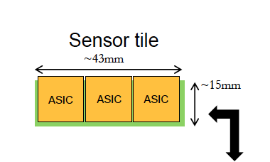
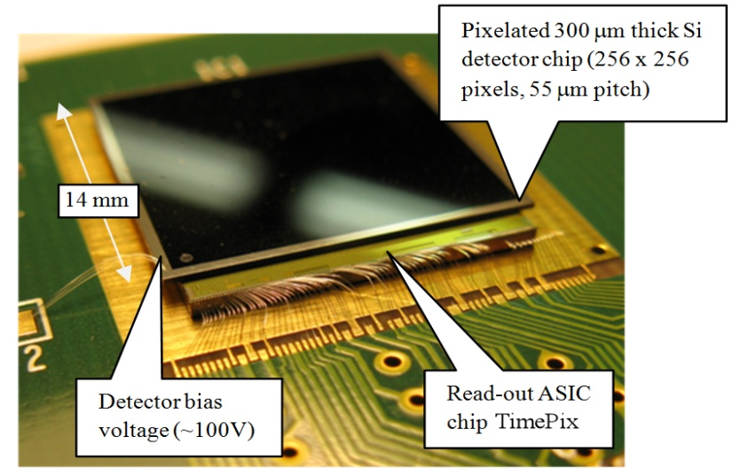
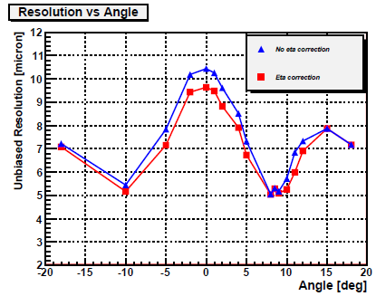
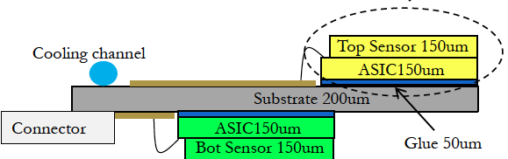
LHCb VELO PIXEL Upgrade
ASIC IS AN ARRAY OF 256X256 SQUARE PIXELS (55 μm X 55 μm )
Target ≥ 5µm resolution
VELOPIX development of TIMEPIX2 from MEDIPIX collaboration with clustering of sparsified information, data formatting, buffering, and multi-Gbit output links for 40 MHz operation

Slide 14
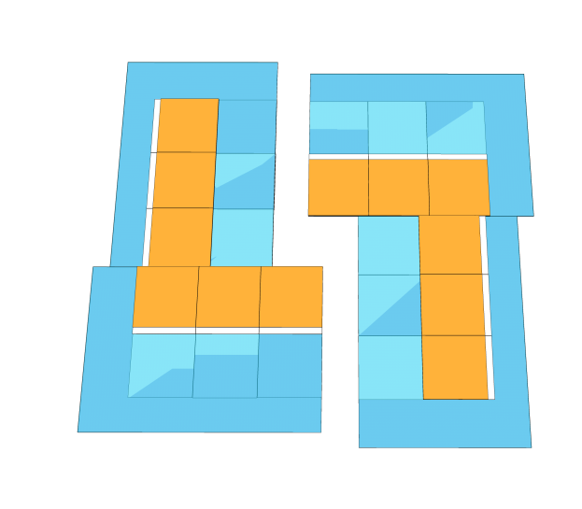
Possible Module Implementation
‘L shaped’ Modules
Sensor
CVD Diamond
Readout Chip
Readout and Power
CVD Diamond thermal substrate, double sided assembly mounting, conventional wire bonding readout
Three-by-One sensor & readout ladders minimize dead areas due to guard rings
The L shape gives some flexibility to the closest approach to the beam.
Footprint compatible with the Timepix chip
Richard Plackett University of Glasgow

Slide 15
Readout Chip Particle Flux
4.8 particles per bunch crossing per cm²
10 to 12 particles per 25ns bunch crossing on innermost chips
Due to charge sharing this will translate to ~36 pixel hits per 25ns
20x10³²
10x10³²
5x10³²
2x10³² Current
Particle Hits / Event / cm²
JC Wang
radius (cm)
Richard Plackett University of Glasgow

Slide 16
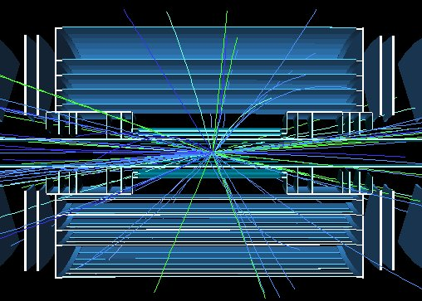
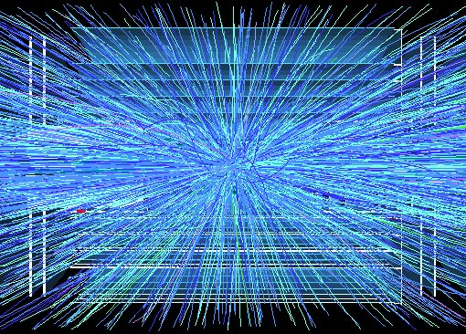
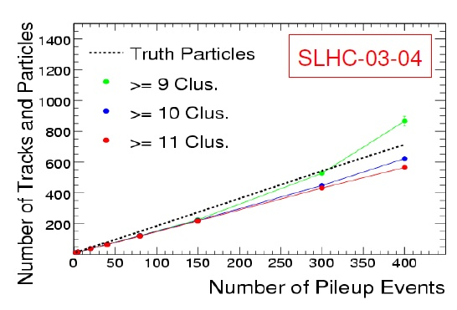
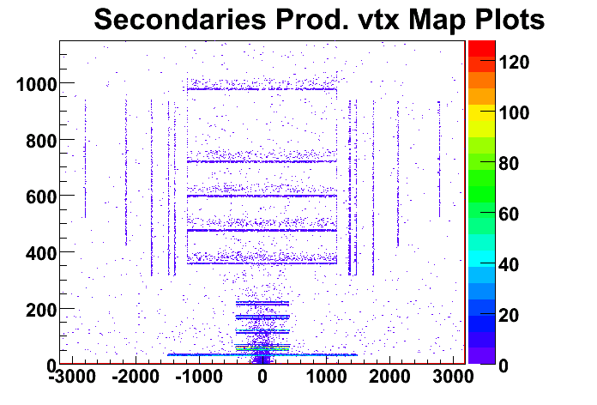
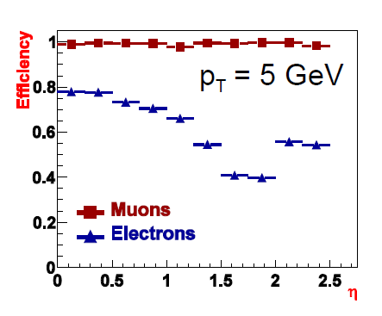
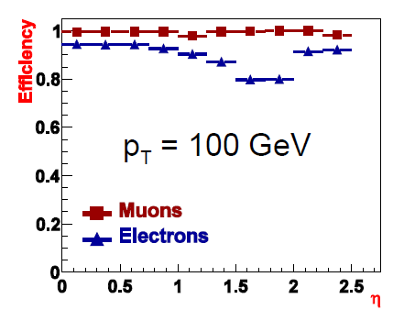
ATLAS All-Silicon Tracker Upgrade

Slide 17
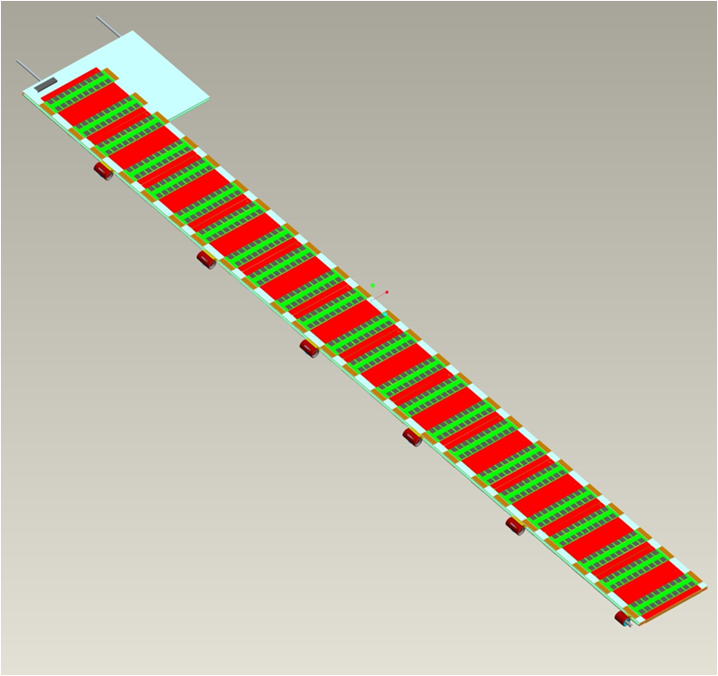
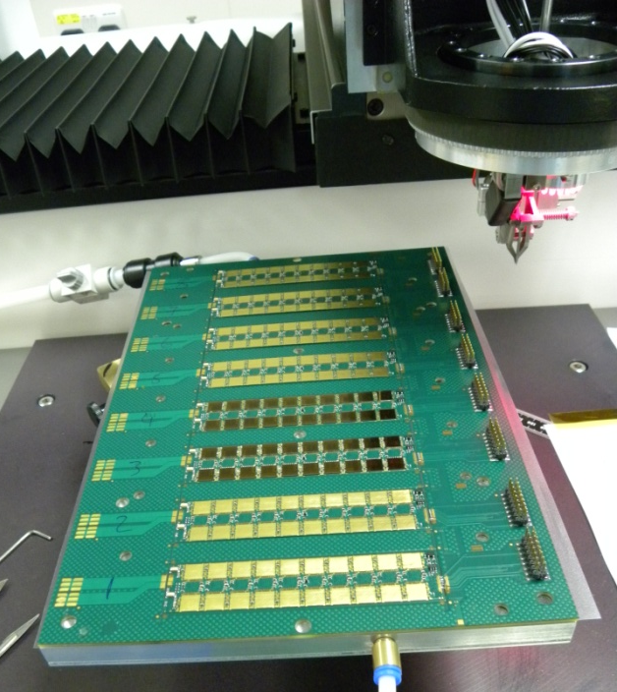
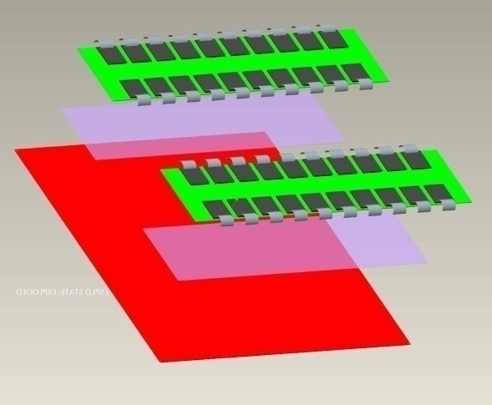
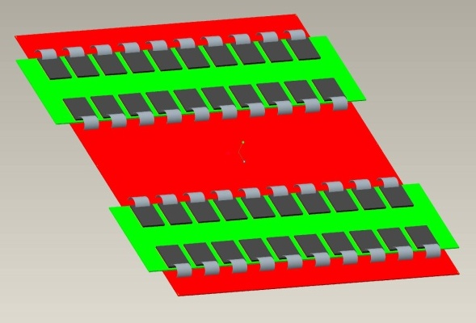












Liverpool University
Stave: Hybrids glued to Sensors glued to Bus Tape glued to Cooling Substrate
Glue
Glue
1.2m
1.2m
1.2m
RAL
LBNL, BNL, Yale, Oxford

Slide 18

ATLAS Stave Electrical Concepts
Need to bring in power at low current and high voltage but deep sub-micron ASICs operate at lower and lower voltages
... either serial powering
... or various proposals to achieve DC-DC conversion (Step down voltage at each module)

Slide 19


CMS Tracker Services
Major constraint on upgraded system
  Complex, congested routes
  Heat load of cables must be removed
  P_{cable} = R_{cable}(P_{FE}/V_{s})²
  Cable voltage drops exceed read-out chip supply voltages
    limited tolerance to voltage excursions
Installation of services was one of the most difficult jobs to complete CMS
It will probably be impossible to replace cables and cooling for sLHC
P_{FE} ≈ 33kW I=15,500A P_{S} = 300kVA
Geoff Hall
Vertex 2008
19
Notes:
19

Slide 20

CMS Tracker Replacement Module Concept

Slide 21




ATLAS Radiation Background Simulation
At inner pixel radii - target survival to 1-2×10¹⁶ n_{eq}/cm²
For strips 3000fb⁻¹
×2 implies survival required up to ~1.3×10¹⁵ n_{eq}/cm²

Slide 22









Technology in Current Highest Dose Regions
LHC vertex detectors closes to the interaction point:
Required to be very radiation hard and to be very finely segmented because of the very high density of tracks close to primary collisions
Doses 5 – 10 × 10¹⁴ n_{eq}cm⁻² (~100 Mrad)
0.05mm ×0.4mm pixels
(40 million images per second)
ALL USE PLANAR N-IN-N SILICON DETECTORS
ATLAS 100 million Pixels
LHCb
Vertex Locator
Z(mm)=0-990

Slide 23



Motivations for P-type Silicon Wafers
Starting with a p⁻-type substrate offers the advantages of single-sided processing while keeping n⁺-side read-out:
Processing Costs (~50% cheaper).
Greater potential choice of suppliers.
High fields always on the same side.
Easy of handling during testing.
No delicate back-side implanted structures to be considered in module design or mechanical assembly.
So far, capacitively coupled, polysilicon
biased p-type devices fabricated to
ATLAS provided mask designs by:
Micron Semiconductor (UK) Ltd
CiS Erfurt (Germany)
CNM Barcelona (Spain)
ITC Trento (Italy)
Hamamatsu Photonics HPK (Japan)
(Including full-size 10cm ×10cm prototype)
Ashley Greenall

Slide 24



n-in-p Planar FZ Sensor Irradiations
900V
Strip
Doses
500V
Pixel
Doses
Gianluigi Casse and Tony Affolder,

Slide 25



Possible ATLAS sLHC Pixel Mechanics
Independent thermal enclosure
for replacement pixel package
Will not fit into current pixel support
tube due to required radius of discs
SLAC
IBL remains separately insertable

Slide 26

Independently Installable Pixels
Consistent with
installation within current pixel radii
Current SCT quarter section layout showing pixel support tube at 23cm radius
Proposed All-silicon tracker layout showing radius of current pixel support tube.

Slide 27

Independently Installable Phase-II Pixel Design
LBNL

Slide 28


Current CMS Pixel Detector
Forward Pixel
Barrel Pixel

Slide 29


Slide 30

S
This is an old analysis but it still illustrates where one needs to focus
R. Horisberger PSI (2006)
(Current CMS microstrips ~40CHF/cm² )

Slide 31


Slide 32


Slide 33
Implications of LHeC Tracker Layout
  The layout is not dissimilar to the ATLAS Semiconductor Tracker except for the assumption that each plane is a doublet of presumably double-sided detectors
  This leads to it representing over double the area, being roughly 130m²
  Although still much less than CMS and similar to ATLAS Upgrade, requiring 10 space points and hence 20 silicon strip layers (if employing small angle stereo) does seem excessive
  Without knowing the average track densities per beam crossing it is hard to gauge at what radii the transition from pixel layers to strip layers should take place
  A similar comment applies to radiation levels, but it is hard to believe the expected levels for current ATLAS and CMS (never mind at sLHC) would be exceeded
  Since pixel layers are capable of having very low occupancy and being therefore much better for pattern recognition (never mind vertexing), a possible solution might be a highly performant (4-5 layer) central pixel detector, with the strip layers mostly for sagitta measurement (ie as a spectrometer)
  Strip layers may then not need to be double layers of double-sided silicon and the need to measure space points may be mostly at high radius to determine entry points into the calorimeter

Slide 34
Required Granularity
  The size of the sense elements in the strip tracker is largely determined by the momentum resolution required and the expected track density (assuming an occupancy of ≤ few % required)
  in the pixels, the lower limit for hybrid pixel assemblies is set by the microelectronics (pixel R/O chip) and the power density allowed (cooling/services – see below)
  Choices to look at include ATLAS FE-I4 (50µm×250µm), CMS (100µm×150µm) or LHCb Velopix ((55µm×55µm)
  If radiation field is low enough, other silicon technologies (MAPS, DepFET, SoI/vertical integration, ... ) may be workable with lower material and pixel size
  Other technologies may also demonstrate adequate radiation hardness on the required timescales
  For now, silicon micro-strips wire bonded to ASICs and planar silicon pixels bump-bonded to ASICs represent the conservative solution against which more innovative solutions should be compared
  If pattern recognition requires more layers, could also consider straw/TRT as used in ATLAS at higher radius
  Note the performance, particularly in the forward region, will be dominated by the impact of material, so services matter (often more important than sensor choice)
  - So do not employ many more R/O channels than you need, this is never “for free”

Slide 35


Possible Implementation
With thanks to Peter Kostka

Slide 36
Conclusions
  The current LHC experiments offer many features which match the requirements of an LHeC experiment
  So far, all LHC experiments are performing exceptionally well
  Plans are in place for upgrades of ATLAS and CMS to accommodate a major upgrade around 2020 and survive an integrated luminosity of 3000fb⁻¹ by 2030
  (remember Tevatron turned on in 1985 and was upgraded for Run-II in 2001)
  Silicon sensor technologies which can survive the expected doses at down to 3.5cm radius after such an integrated luminosity are under study
  Infrastructure for industrial scale production of strip and pixel modules will need to be developed for the ATLAS and CMS upgrades
  ASICs can be a huge up-front cost in deep-submicron technologies
  Issues of material tend to be more influenced by supports and services than very fancy sensor designs
  Silicon based tracking would seem to meet LHeC requirements but optimisation depends on required radiation tolerance and granularity

Slide 37
Back-up Material

Slide 38
ATLAS

Slide 39



Current ATLAS Inner Tracker TDR Layout
Pixels: 2 m², ~80M channels
SCT: 60 m², ~6.3M channels
TRT straws: ~400k channels
Pixels (50 μm × 400 μm): 3 barrels, 2×3 disks 4.7cm < r < 20cm
Pattern recognition in high occupancy region
Impact parameter resolution (in 3D)
Radiation hard technology: n⁺-in-n Silicon technology, operated at -6°C
Strips (80 μm × 12 cm) (small stereo angle): SCT 4 barrels, 2×9 disks
pattern recognition 30cm < r < 51cm
momentum resolution
p-strips in n-type silicon, operated at -7°C
TRT 4mm diameter straw drift tubes: barrel + wheels 55cm < r < 105cm
Additional pattern recognition by having many hits (~36)
Standalone electron id. from transition radiation

Slide 40
Current SCT ATLAS Module Designs
ATLAS Tracker Based on
Barrel and Disc Supports
Effectively two styles of double-sided modules (2×6cm long)
each sensor ~6cm wide (768 strips of 80μm pitch per side)
Hybrid cards carrying read- out chips and multilayer interconnect
circuit
Sensor
Sensor
Sensor
Sensor
Barrel Modules Forward Modules
(Hybrid bridge above sensors) (Hybrid at module end)

Slide 41



Current Silicon Microstrip (SCT) Material
Current Silicon Tracker
(4 barrel strip layers)
Module Support
Material Material
Old ATLAS Barrel Module
12 ASIC of 300μm thickness for double-sided module read-out
(ie just 6 read-out chips per side)
New ATLAS sLHC-Tracker Module
will have 80 ASICs in two hybrid fingers for just one-sided read-out
“The barrel modules of the ATLAS semiconductor tracker”.
Nucl.Instrum.Meth.A568:642-671,2006.
Hybrid area per module roughly ×2 at
sLHC - much higher R/O granularity

Slide 42
Direct Processing of Hybrid Circuit on Silicon Sensor
(Ultimate reduction in mass and assembly complexity.)
SMD Solder (FC4b)
Wirebond + fanin Au (FC4a)
3rd dielectric BCB (FD3) / via fill (FV3)
Gnd/trace2 Cu (FC3)
2nd dielectric BCB (FD2) / via fill (FV2)
Power/trace1 Cu (FC2)
1st dielectric BCB (FD1) / via fill (FV1)
Shield layer Cu ( FC1)
BCB (Benzocyclobutene) 5–15μm
Si base
Does away with need for hybrid substrate and thick-film processing.
Prototyping for ATLAS underway with several European manufacturers.

Slide 43

Requirements for LHC Luminosity Upgrade
To keep ATLAS and CMS running beyond ~10 years requires tracker replacement
Current trackers designed to survive up to 10Mrad in strip detectors ( ≤ 700 fb⁻¹)
For the luminosity-upgrade the new trackers will have to cope with:
  much higher integrated doses
  (need to plan for ≥ 3000 fb⁻¹)
  much higher occupancy levels (up
  to 400 collisions per beam crossing)
  Installation inside an existing
  4π coverage experiment
  Budgets are likely to be such that replacement trackers, while needing higher performance to cope with the extreme environment, cannot cost more than the ones they replace
  To install a new tracker in ~2020, require Technical Design Report 2014
(Note the ATLAS Tracker TDR: April 1997; CMS Tracker TDR: April 1998)
3600
3000
2400
1800
1200
600
0
2030
2029
2028
2027
2026
2025
2024
2023
2022
2021
2020
2019
2018
2017
2016
2015
2014
2013
2012
2011
2010

Slide 44



ATLAS Tracker Upgrade Layout
Barrel Pixel Tracker Layers:
Short Strip (2.4 cm) μ-strips (stereo layers):
Long Strip (9.6 cm) μ-strips (stereo layers):
r = 3.7cm, 7.5cm, 15cm, 21cm
r = 38cm, 50cm, 62cm
r = 74cm, 100cm

Slide 45
Geometry Choices
Bias Ring
n-in-n
p-in-n
  Least expensive
  Single-sided processing
  Available from all foundries
  Most experience in production
    All strips at CMS/ATLAS/ALICE, Tevatron, b-factories, …
n-in-p
  ~50% less expensive than n-in-n
  Single-sided processing
  More suppliers (including Hamamatsu)
  Limited production experience
    1 VELO module installed, spare system under construction
  As radiation hard as n-in-n
Guard Ring
SiO₂
n⁺
p-spray/stop
n⁻ bulk
p⁺
Al
Bias Ring
Bias Ring
n-in-p
n-in-n
  Most expensive
  Double-sided processing
  Limited suppliers
  Some experience with “large” scale production
    CMS/ATLAS pixels, LHCb VELO
  Much more radiation hard than p-in-n
Guard Ring
Bias Ring
p-in-n
Guard Ring
Guard Ring
SiO₂
SiO₂
p⁺
n⁺
p-spray/stop
n⁻ bulk
p⁻ bulk
Al
n⁺
p⁺
Al
A. Affolder - PSD08, 1st-5th September 2008, Glasgow, Scotland
45

Slide 46
P-strip vs. N-strip Readout
Effect of trapping on the Charge Collection Efficiency (CCE)
Q_{tc} ≅ Q₀exp(-t_{c}/τ_{tr}), 1/τ_{tr} = βΦ.
t_{C} is collection “time”, τ_{tr} is effective trapping time
“New” n-in-p geometry
“New” n-in-n geometry
( after type inversion)
“Standard” p-in-n geometry (after type inversion)
p⁺
n⁺
Un-depleted
e⁻
p⁻
p⁻
h⁺
Un-depleted
n⁺
p⁺
Type inversion turns lightly doped material to “p” type
Holes collected
Deposited charge cannot reach electrode
  Charge spread over many strips
  Lower signal
Electron collected
  Higher mobility and ~33% smaller trapping constant
Deposited charge can reach electrode
A. Affolder - PSD08, 1st-5th September 2008, Glasgow, Scotland
46

Slide 47





n-in-p Planar Sensors at Extreme Doses
1 and 2x10¹⁶ n_{eq} (innermost pixel layers at sLHC)
Trap-to-band tunnelling
Impact ionisation

Slide 48






Some Alternative Semiconductor Technologies to Planar Silicon for High Radiation Environments
3D Sensors with Doped Through Silicon Columns
Planar CVD Diamond: Poly-crystalline or Single Crystal
Diamond
Leakage current, -10ºC, 10¹⁶ n_{eq}/cm²
V_{bias} fixed at 150V
Trap-to-band tunnelling
Impact ionisation
Charge multiplication
Annealing time

Slide 49





ATLAS Pixel Module Upgrade
Silicon sensor
Bump bond connection
Current ATLAS Pixel Module
→ Single chip pixel modules on stave for insertable b-layer (IBL) (2016 shutdown)
Readout chip
1.9cm×2.0cm

Slide 50

ATLAS Pixel Upgrade ASIC
New Front-End chip (FE-I4) for smaller pixel dimensions being delivered
Fabricated for Phase-I b-layer replacement (IBL)
→ an intermediate step towards the full upgrade.
Performance improvements for the detector
(issues more related to FE chip):
  Reduce radius → Improve radiation hardness planar , 3D sensors, diamond, gas, …?)
  Reduce pixel cell size and architecture related dead time (→ deign FE using 0.13 µm 8 metal CMOS)
  increase the module live fraction
  → increase chip size, 19×20 mm²
50μm
250μm
FE-I4 (B-layer Replacement) Specifications: main parameters

Slide 51



SLHC Phase-II Pixels Outer Layer Stave Concept
4 FEI-I4 compatible sensors from IBL project suitable for prototyping
4 FEI-I4 ASIC module
38.0
35.9
Flex down to chip w-bonds
Active 33.9 x 40.6
42.6
Pixel orientation
15.0
Flex pigtail
(connector plugs into page)‏
(vertical inter-chip gap 0.1mm)‏
10.0
passives
stiffener
1.0 mm
flex
connector
sensor
FE
FE
glue
Compressed scale

Slide 52




Material Reduction
LBNL

Slide 53




Micron n-in-p Irradiated FE-I3 Pixel Package
Heat sink added to pixel board
Measurements pre-irradiation and at doses of 4×10¹⁵ n_{eq} cm⁻² and 9×10¹⁵ n_{eq} cm⁻² all show no evidence of edge breakdown at 500V.
FE-I3 ASIC surprisingly robust but number of dead channels does increase at doses well above design target.
After irradiation to 1.5 ×10¹⁶ p/cm²
At CERN PS (9×10¹⁵ n_{eq} cm⁻²) peak charge at 500V is ~4000e
(Threshold 3500e -26°C, I_{b} 44uA)
I. Tsurin – ATLAS UK Planar Pixel Sensor R&D Meeting, 16 Sept 10

Slide 54
Heavily Irradiated Micron n-in-p Pixel Sensor IV
Thermistor glued to surface of detector and covered to reduce the coupling to air
Found a 7 degree increase in sensor temperature during run at -15 C
After correcting the current point-by-point with standard temperature correction, all curves are consistent and straight
Previous planar p-type power over-estimated at 900 V by a factor of 2

Slide 55
LHCb

Slide 56
LHCb Upgrade schedule
Phase I: 2016 LHC long shutdown
  Novel pixel based vertex detector (VELOPIX)
  New front end electronics
  New trigger and data acquisition concept to achieve better efficiency for hadronic B decays
  RICH photon detector replacement
  New track trigger and inner tracker triggering systems
Phase II: 2020 LHC shutdown for luminosity upgrade
  new hadron ID system based on precision time of flight
  Better electromagnetic calorimeter segmentation
  Change to inner and outer tracking geometry

Slide 57
Medipix Development Path
Medipix1
1um SCAMOS 64 by 64 pixels
Photon Counting Demonstrator (1997)
Medipix2
250nm IBM CMOS, 256 by 256 55um pixels
Full photon counting (2002)
Timepix
Analogue (ToT) and Time Stamping (ToA) (2006)
130nm IBM CMOS
Photon Counting, Spectroscopic, Charge Summing, Continuous Readout (2009)
Medipix3
Fast front end, Simultaneous ToT and ToA (2011)
Timepix2
130nm/90nm/65nm
Future LHCb readout – Data driven 40MHz ToT 12Gb/s per chip (2013)
VELOpix
Timepix3CLICpix
130nm/90nm/65nm
Future Hybrid Pixel Time tagging layer for the LCD project (20??)
Richard Plackett University of Glasgow

Slide 58







“Spinning Back into HEP”?!
WA97 ‘noise free’ Pixel Tracking
VELOpix ?
LHCBPIX1
ALICE SPD 1st pixel trigger
Medipix2
Photon Counting
Timepix2
1ns, Data Driven Timepix
Medipix3
Colour X-ray imaging
Timepix
Time Tagging or Time over Threshold
Richard Plackett University of Glasgow

Slide 59
Data Driven Read Out Chip - VELOpix
All data has co come off chip….
Due to the events being sparse ~36 /65,000 hits per bunch crossing
Will push all events off the chip in an asynchronous way
Each hit will cause the pixel to grab the event timestamp and start the ToT counter
When the ToT is stopped the pixel will send the timestamp, ToT and location as a packet down the column and off the chip.
ToT (6bits) + Location (16 bits) + Timestamp (10bits) (30us) -> 32bits per pixel hit
32*36*40MHz ~ 45Gbit/s Very challenging / impossible to drive off the matrix within power budget
Make use of the fact that our hits are geographically and temporally clustered for factor 3 compression….
Richard Plackett University of Glasgow

Slide 60

Ultimate Interconnection: Vertical Integration
Ideal solution for reducing material and easing assembly in detector system is to integrate electronics and sensors into a single item
… if affordable
Many different aspects of these new technologies such as SLID (solid liquid inter-diffusion), TSV (through silicon vias), ICV (inter-chip vias) as well as more highly integrated concepts.
Commercial technologies becoming available for custom design:
IBM, NEC, Elpida, OKI, Tohoku, DALSA, Tezzaron, Ziptronix, Chartered, TSMC, RPI, IMEC……..
But are they all, or even, are any technologies radiation hard?
This has been a “dream” for many years
More complex detectors, low mass
Liberate us from bump/wire bonding

Slide 61
ALICE

Slide 62




A Large Ion Collider Experiment
(Dedicated experiment for heavy ion collisions)
ALICE
Simulation of lead ion collision in ALICE
Notes:
62

Slide 63


Optimize pixel material budget:
~1.1% X₀ per layer
Carbon fibre: 200 µm
Cooling tube (Phynox): 40 µm wall thickness
Grounding foil (Al-Kapton): 75 µm
Pixel chip (Silicon): 150 µm
Bump bonds (Pb-Sn): diameter ~15-20 µm
Silicon sensor: 200 µm
Pixel bus (Al+Kapton): 280 µm
SMD components
Glue (Eccobond 45) and thermal grease

Slide 64


Slide 65


Slide 66
CMS

Slide 67
CMS Planning for Upgrade Project
The SLHC planning assumptions keep changing in the light of experience with the machine and different ideas for achieving high luminosity running in a decade’s time
Developing and building a new tracker requires ~10 years
  5 years R&D
  2 years Qualification
  3 years Construction
  6 months Installation and Ready for Commissioning
NB – even this is aggressive
  System design and attention to QA are important considerations from a very early stage
  Cost was a driver for LHC detectors from day one
Geoff Hall
Vertex 2008
67
Notes:
67

Slide 68
Hybrid Pixel Detectors
Silicon sensor
Hybrid pixel detector:
The sensor and the readout electronic are realized in different semiconductor substrates
Size of the electronic readout pixels is equal to the size of the sensor pixels
The connection between the electronic and the sensor is done via bump bond connections
Bump bond connection
Readout chip
Bump bond technology:
Size: 20 µm, pitch: 50 µm
In (AMS) & PbSn (IZM) used for ATLAS pixel

Slide 69


Slide 70


Slide 71



CMS Irradiation Results
  Highly irradiated sensors
  operative up to 1kV
  No signal saturation with bias for
  Φ > 2×10¹⁵n_{eq}/cm²
    Is this a already a hint for charge
    multiplication?
  High electric field reduces mobility of charge carriers
  Lorentz angle is also reduced
  Fraction of double hits is reduced
  Resolution slowly degrades up to the binary value (pitch/sqrt(12) ~ 30μm with current pitch)
T. Rohe et al. Planar sensors for the upgrade of the CMS pixel detector, Pixel2020, Sep. 6-10, Grindelwald, CH

Slide 72



CMS Single-Sided (n-in-p) Sensors
Present CMS pixel detector uses
n-in-n-sensors
  double sided processing (back side is structured)
  all sensor edges at ground
  most expensive part of the module (only bump-bonding is more expensive)
Exploring n-in-p sensors as alternative
  recent studies show radiation hardness
  single sided process promise price benefit of factor 2-3
    important as the pixel area will be doubled
  Absence of guard rings on back side lead to fear of (destructive) sparking to the ROC
n-in-n
n-in-p
T. Rohe et al. Planar sensors for the upgrade of the CMS pixel detector, Pixel2020, Sep. 6-10, Grindelwald, CH

