Slide 1
Gantry layouts for brainstorming
Elena Benedetto, SEEIIST Association
Ugo Amaldi, TERA Foundation

Slide 2
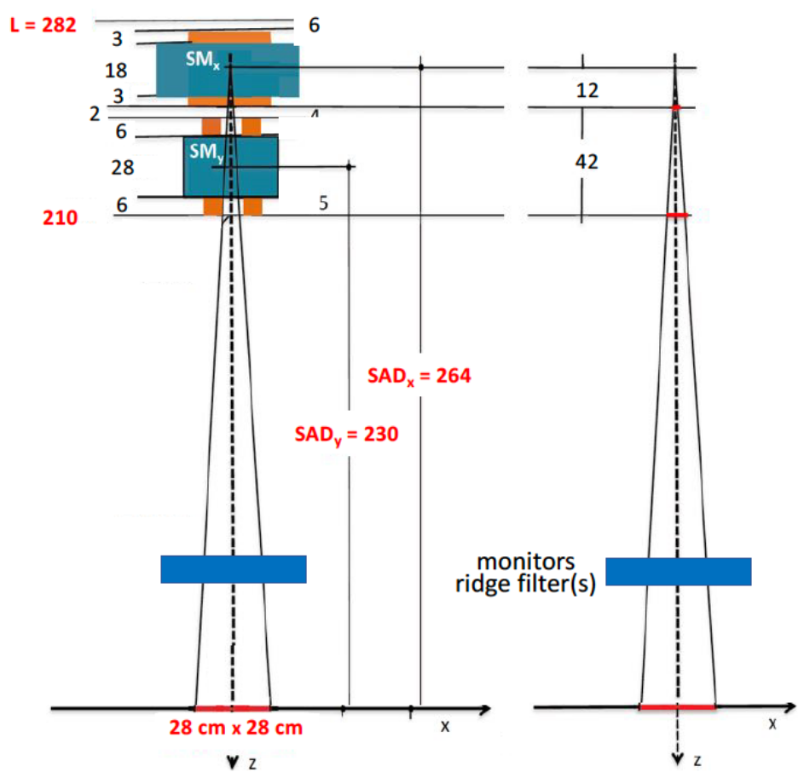
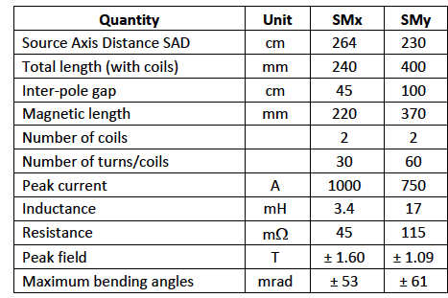
SCANNING SYSTEM
“A Carbon Ion SuperconductingGantry and a Synchrotron based on Canted Cosine Theta magnets” (https://arxiv.org/abs/2105.04205)
E. Benedetto^{1,3}, N.AlHarbi¹, L.Brouwer²,D.Tommasini³, S.Prestemon², P.Riboni¹ and U.Amaldi¹
¹TERA Foundation, Novara, Italy; ²LBNL, Berkeley, USA; ³CERN, Geneva, Switzerland

Slide 3
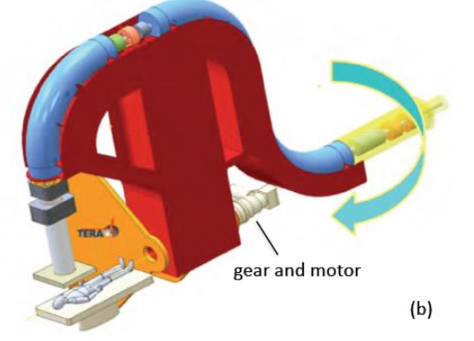
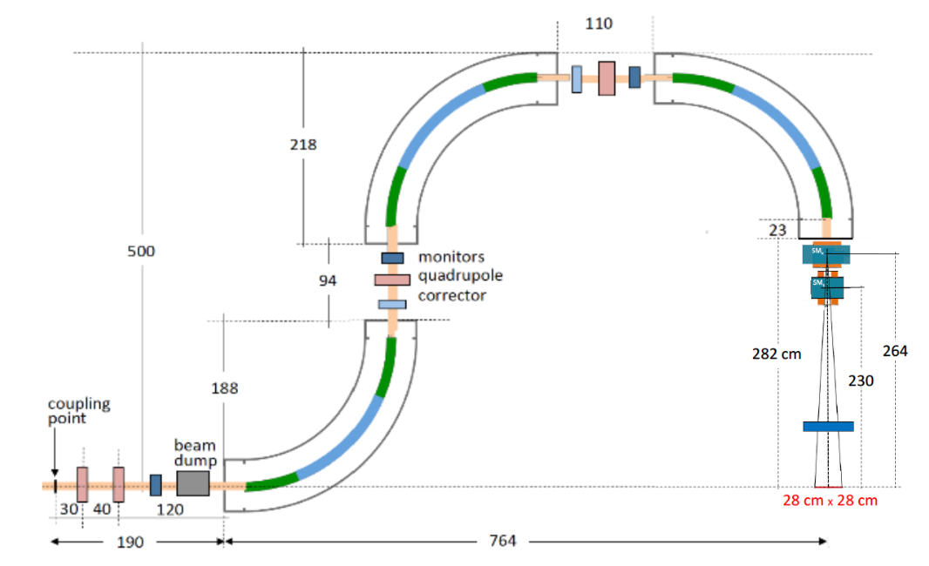
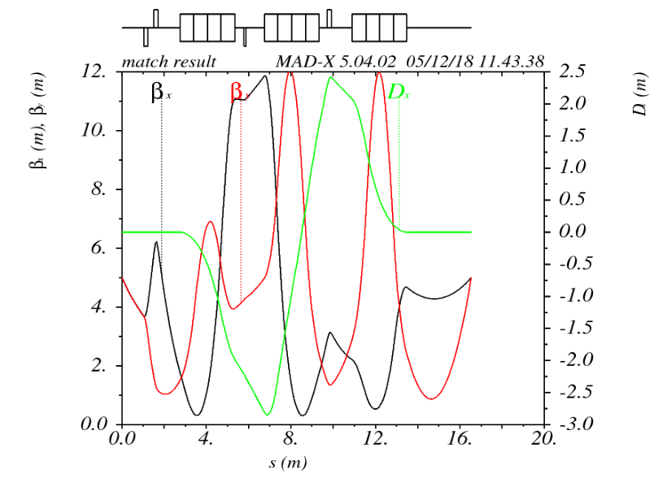
ADVANCED FIRST LAYOUT
4T AG-CCT magnets
External radius 5 m
Small aperture D= 40 mm
“A Carbon Ion SuperconductingGantry and a Synchrotron based on Canted Cosine Theta magnets” (https://arxiv.org/abs/2105.04205)
E. Benedetto^{1,3}, N.AlHarbi¹, L.Brouwer²,D.Tommasini³, S.Prestemon², P.Riboni¹ and U.Amaldi¹
¹TERA Foundation, Novara, Italy; ²LBNL, Berkeley, USA; ³CERN, Geneva, Switzerland

Slide 4
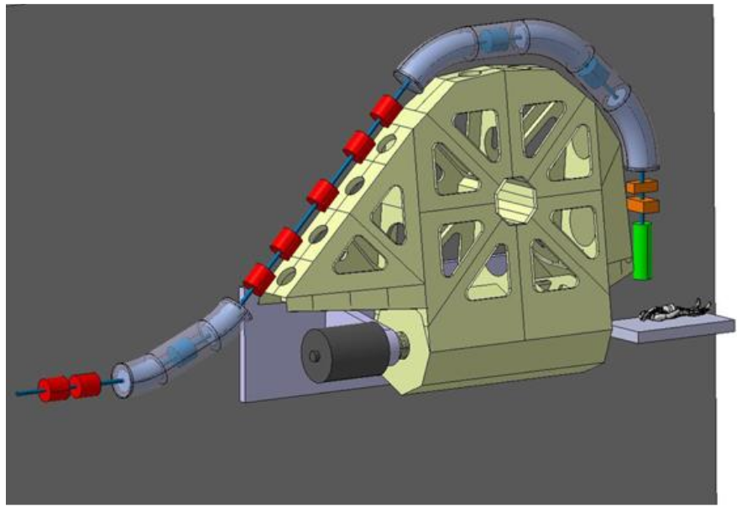
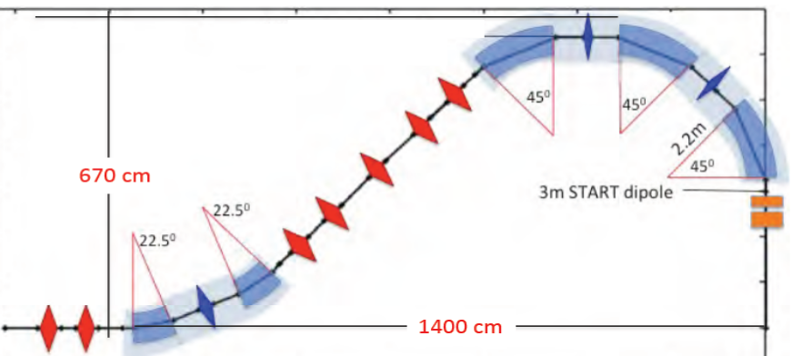
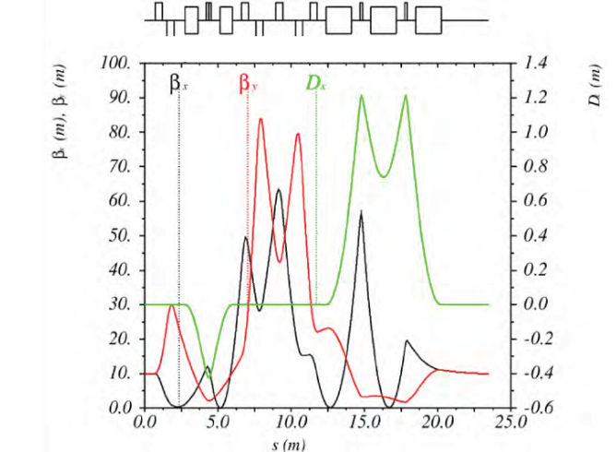
SIGRUM - CONSERVATIVE DESIGN
3T combined function magnets
Two bends, locally achromat → acceptance Δp/p=+/-1%
    3x 45⁰ magnets (same gradient) w. 2 quads
    2x 22.5⁰ magnets (same gradient) w. quad
External radius is large, aperture D=70mm
“SIGRUM –A superconducting ion gantry with Riboni’s Unconventional Mechanics“
U,Amaldi, N. Alharbi, E Benedetto¹, P.L. Riboni and M. Vaziri, TERA Foundation
D. Aguglia, V. Ferrentino. G. Le Godec, M. Karppinen, D. Perini, E. Ravaioli and D. Tommasini, CERN
CERN-NIMMS-Note-002: https://cds.cern.ch/record/2766876?ln=en

Slide 5
COMPACT PROPOSAL FOR SIGRUM
  Reduce external radius
  Ease magnet manufacture

Slide 6
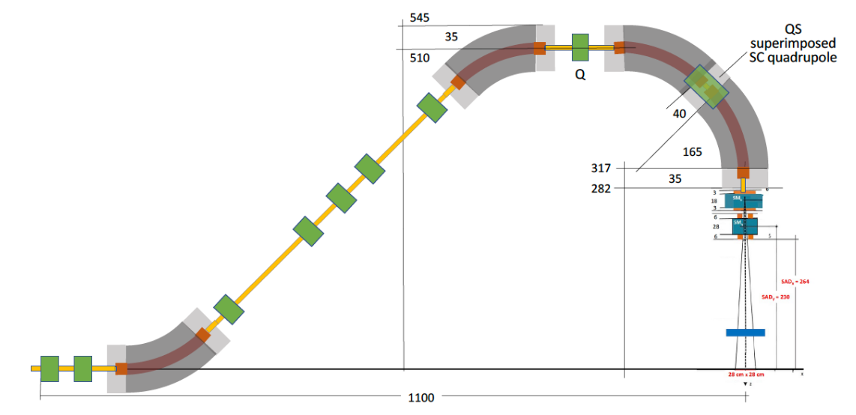
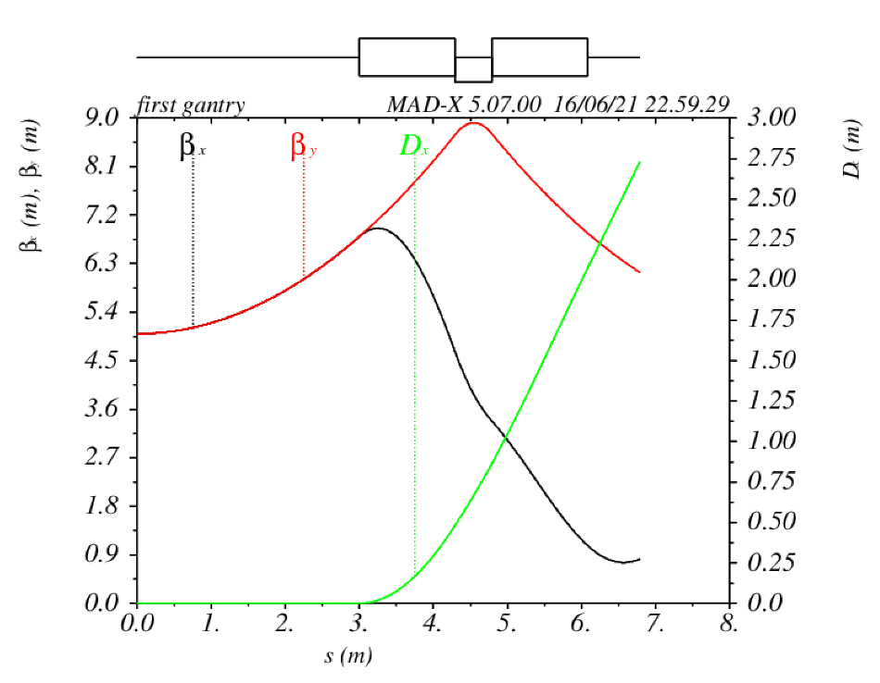
FOUR IDENTICAL MAGNETS + special SC QUAD
4T, pure dipole field (CF gradient is zero as baseline)
Special SC quad. superimposed to the dipoles coils (straight cosin-theta or CCT), ~2.6 T/m gradient, L_{mag}= 40cm
External radius 5.45 m
Small beta functions
tracking backward through last 2 magnets
“SIGRUM-45: A Ion Gantry a la Riboni
Based on Four 45° Superconducting Magnets”, June 2021
U. Amaldi, TERA Foundation,
E. Benedetto, TERA, CERN, SEEIIST

Slide 7
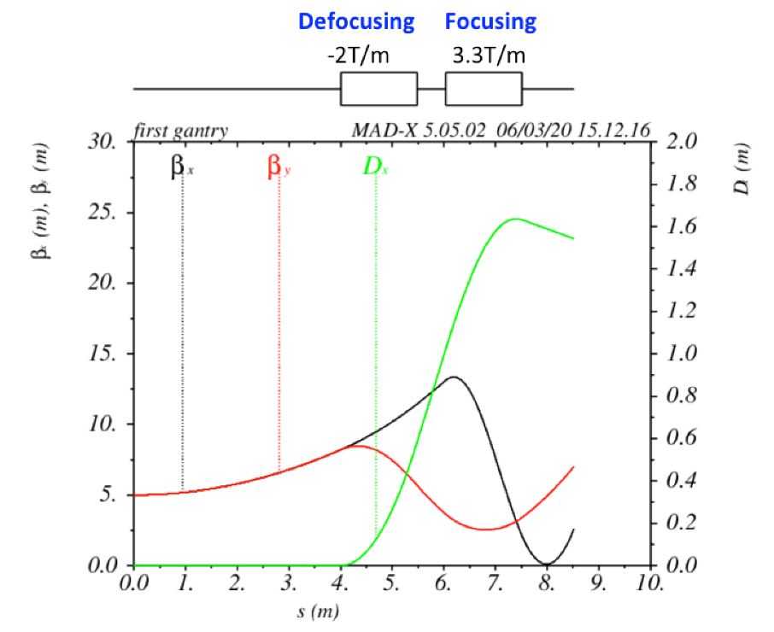
FOUR MAGNETS w. DIFFERENT GRADIENTS
either combined functions (but all different!)
or with an independent quadrupole trim
both beta-functions and dispersion small!
tracking backward through last 2 magnets
@3.5 T
“SIGRUM-45: A Ion Gantry a la Riboni
Based on Four 45° Superconducting Magnets”, June 2021
U. Amaldi, TERA Foundation,
E. Benedetto, TERA, CERN, SEEIIST

Slide 8
CAN WE MAKE IT <5M RADIUS?
(2)
Reduce:
iron on the outer side (transverse)
space for end-coils (longitudinal)
interspace between dipoles
space for the cryostat
(1)
B=4T → 4.5 T
rho=1.65m → 1.32m
(3)
Reduce SAD by 15 cm:
still 26 cm x 30 cm

Slide 9
CONCLUSIONS
Intermediate (size & complexity) solution between initial 4T 90⁰ AG-CCT magnets and conservative 3T 45^{0 –} 22.5⁰ combined function cosine-theta magnets designs allows to:
  Reduce dimensions: external radius & total length
  Ease manufacture
  Control beam dimensions & dispersion
Four 45⁰ magnets at 4T. Two options :
  Identical (zero gradient) dipoles + special superimposed straight SC Quad coils
  Combined-function magnets with different gradients (ideally trimmable)

