Slide 1
Brainstorming on Optics Layout for C-ion gantry
E. Felcini, G. Frisella,
A. Mereghetti, S. Savazzi,
M. Pullia
22/06/2021

Slide 2
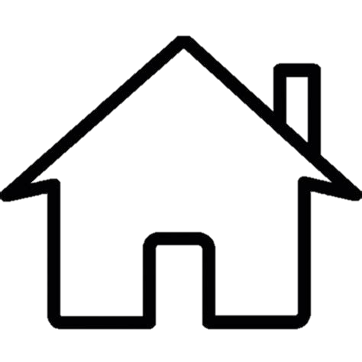
Purpose of the Presentation
Share the work we have done so far on the exploration of different (8+) gantry layouts
Discuss together and collect possible input and recommendations from the different teams and points of view

Slide 3
Structure of the Presentation
General overview of each layout
  Overall dimensions
  Beam optics properties
  Requirements on the magnets
Details on Beta functions and beam dimensions after corrections for
  Matching Point to Point for 3 Magnification Factors (MF)
  Different input beam size for a given MF
  Matching Parallel to Point for 3 Magnification Factors (MF)
  Different input beam size for a given MF

Slide 4
Optics | Comments
Locally achromatic | Allow you to use beam with larger momentum range. Allows separating the control of dispersion and betas.
Possibility of using different Magnification Factors (MF) i.e. changing spot size at isocenter with the same HEBT setting (acting only on the gantry) | More handles required → more quadrupoles or changing gradient on the dipoles
Dipoles with same gradient between MF | No need of separate circuits between dipole and quadrupole.
Dipoles with different gradients | How easy/expensive is to wind different gradient coils? Individual magnet coils to be considered (more spares)
Dipole with small gradient variation between MFs | A dipole/quadrupole trim can be used (i.e. two separate circuits)
Dipole with large gradient variation between MFs | Two separate circuits are required (nested magnet)
Varying the input beam size to change the spot size at isocenter | Beam size shall be kept under control along the whole range required. Flexibility/tunability pushed upstream, not removed. Orbit depends on beam size on a longer range.
Monitors and correctors to check and correct orbit errors along the line | Space required between the magnets → larger gantry
Larger SAD | Relax constraints on scanning magnets 🡪 larger gantry
Maximum beam size | Magnet aperture → field quality! (magnet radius = 3/2 beam size. i.e. 30 mm beam → 45 mm radius; 23 mm beam → 35 mm radius)
From Optics to Magnets

Slide 5
A few assumptions
Dipole Field: 4 T
Combined function dipole with 5-10 T/m gradient
(peak field on conductor 5 T, considering additional gradient)
Emittance 7π mm mrad (as in PIMMS)
3 beam dimension required at isocenter:
            FWHM: 5 mm
            FWHM: 8 mm
            FWHM: 12 mm
Matching procedures:
            Point to point: R12=R34=0; R11 and R33 for beam size control
            Parallel to point: R11=R33=0; R12 and R34 for beam size control
            D = 0 and D’ = 0 (R16=0 and R26=0)

Slide 6
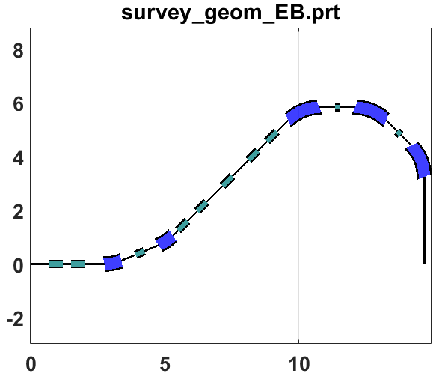
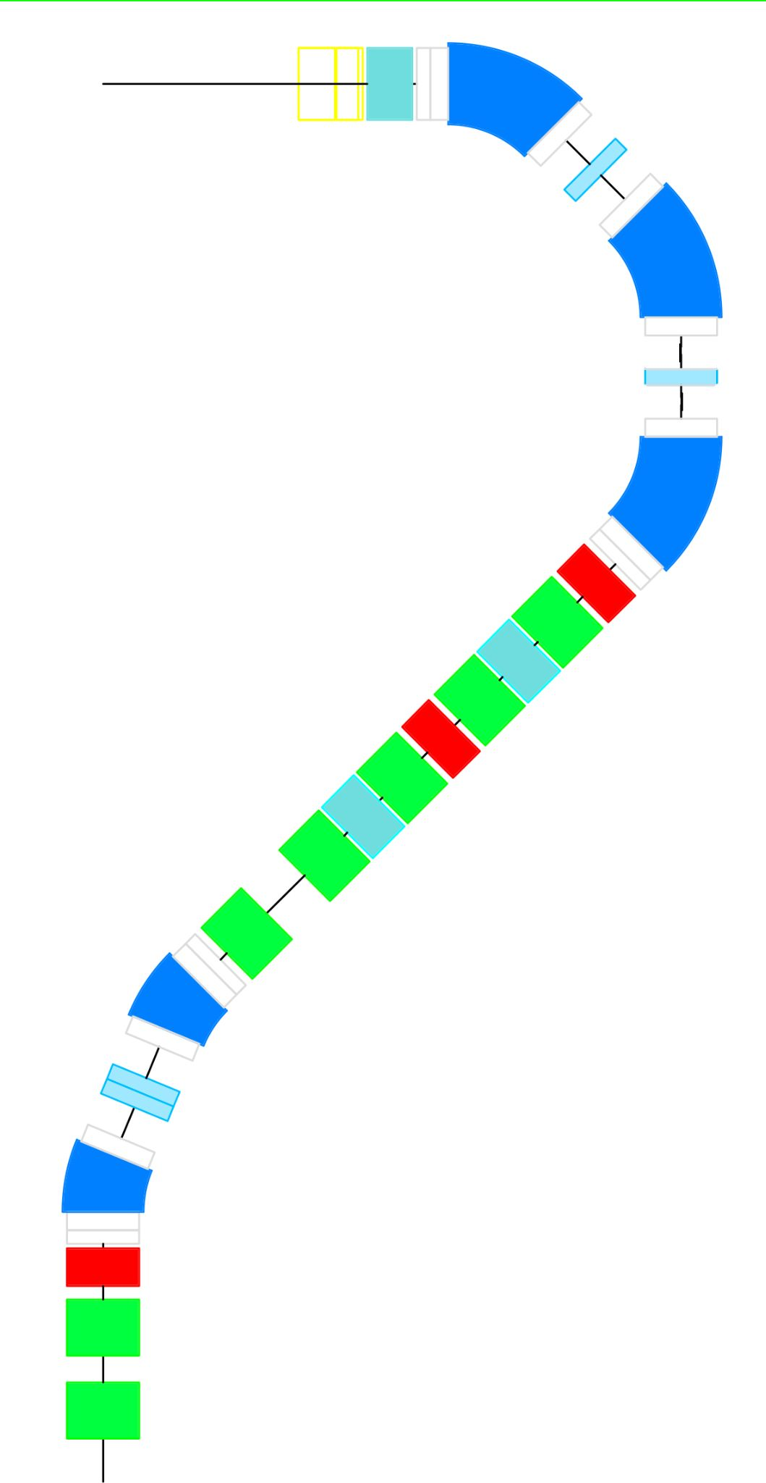
Locally achromatic YES
Dipole with constant gradient in 3 MF
Same gradient in all dipoles
K_{dip} < 5 T/m; K_{quad-H} < 20 T/m; K_{quad-C} < 50 T/m
Constant gradient sign for quadrupoles in 3 MF
(NC quads change sign)
Acceptable and coherent corrections in 3 MF
(corr3 Y at 95% < 7.8 mrad)
Envelope Radius + Max Error Radius < 90 mm (max 74mm)
Acceptable behavior with different input Beta
  Envelope Radius + Max Error Radius < 90 mm (max 82mm)
Sufficient space for all the elements: L from 14.7m to 15.5m H from 5.84m to 6.42m
slope from 6.1m to 6.9m
5.8 m
3 m
SAD 2.5 m
E. Benedetto at 4T
14.7 m
SAD
2.4m
from middle of last scanning
Point to Point

Slide 7
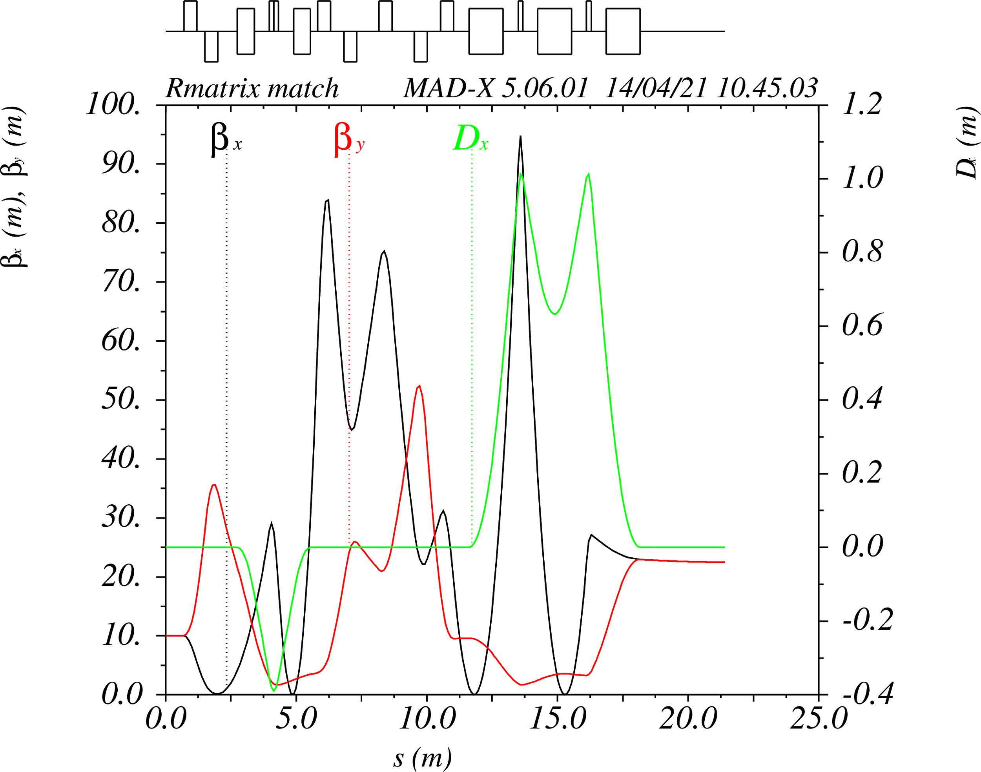
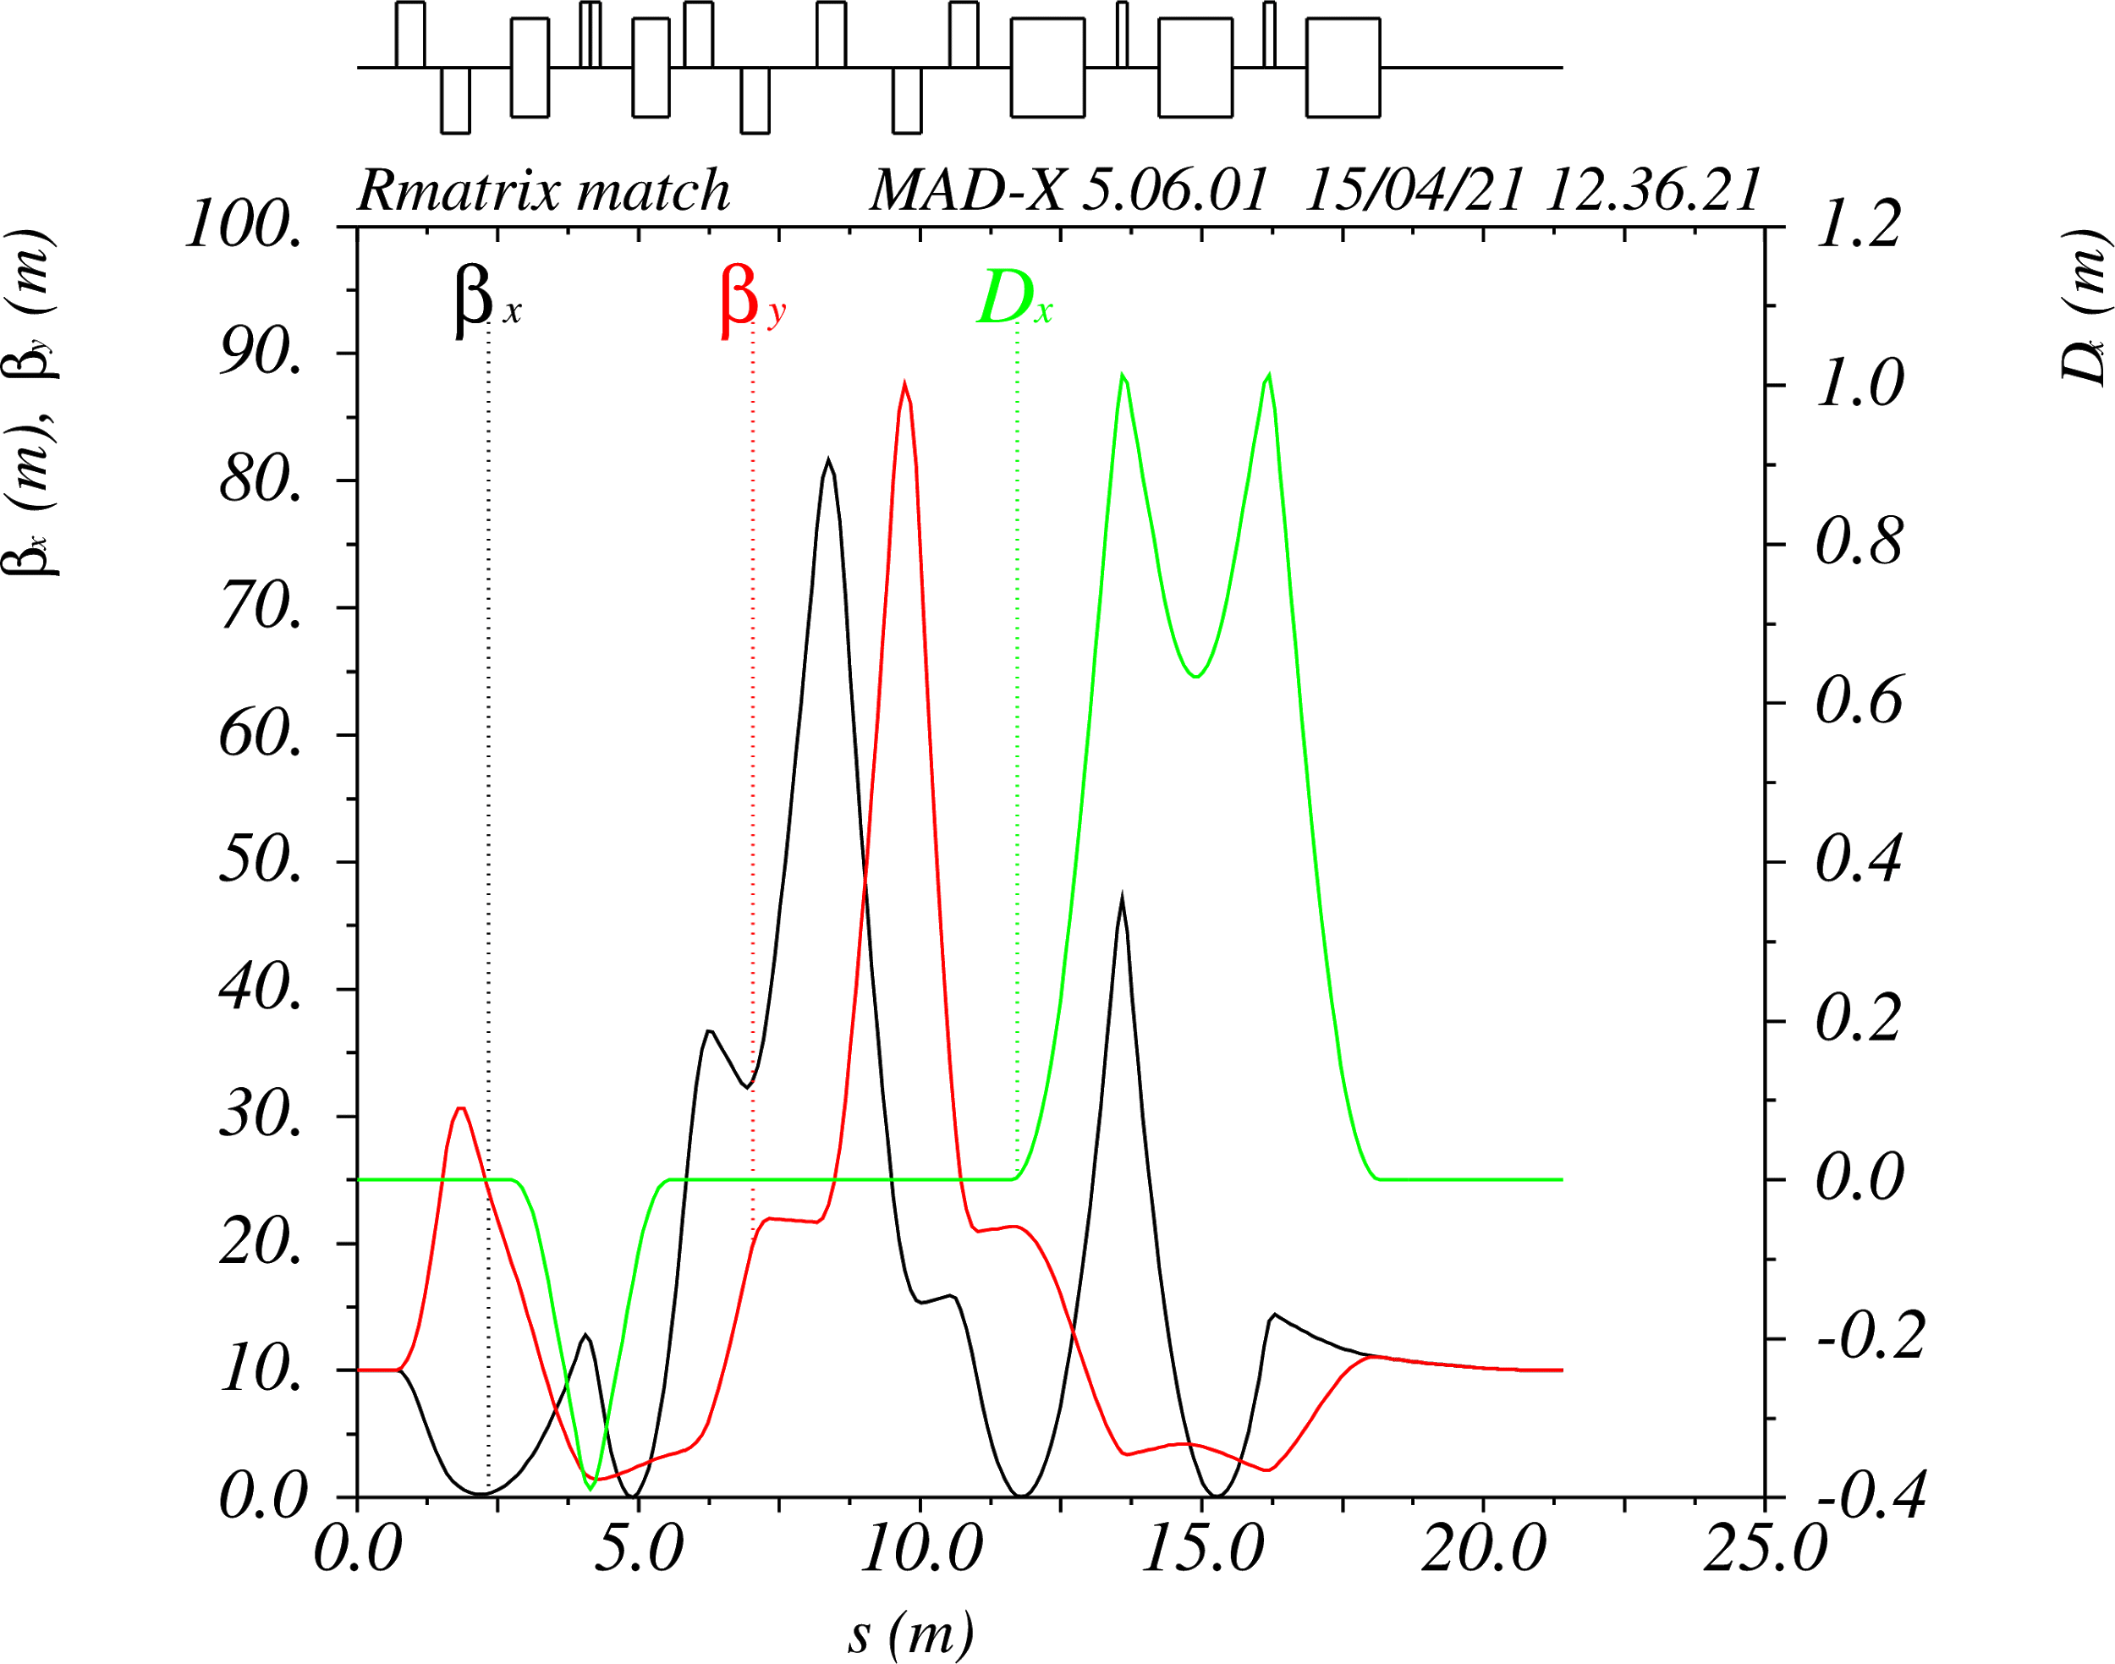
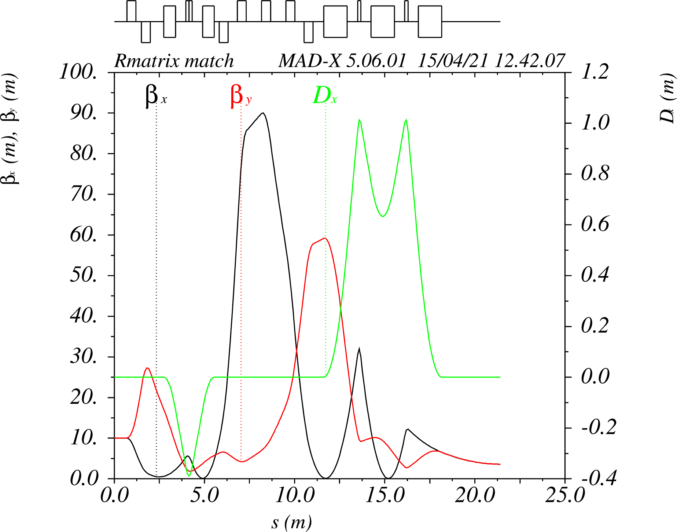
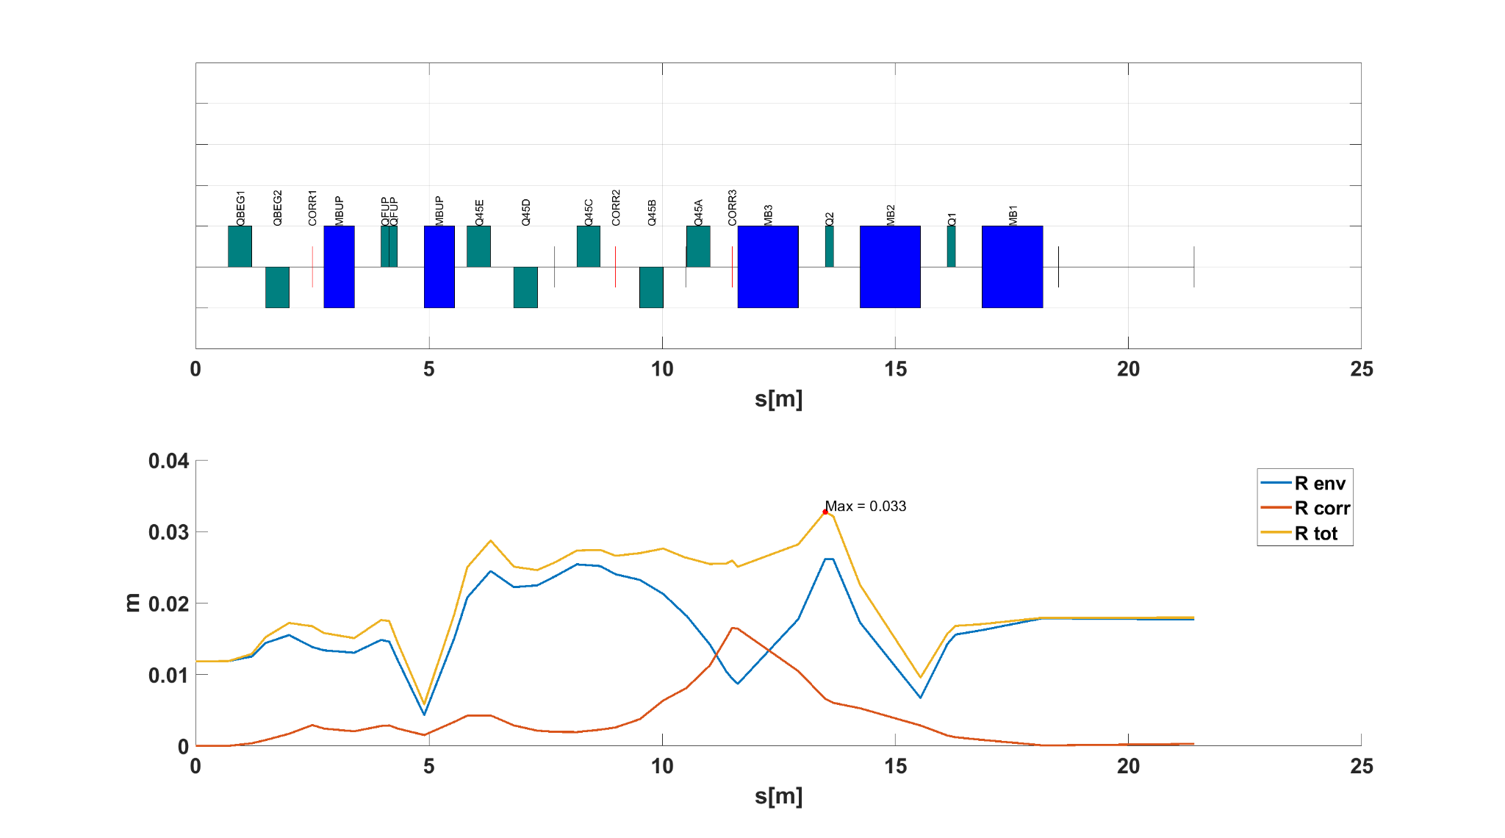
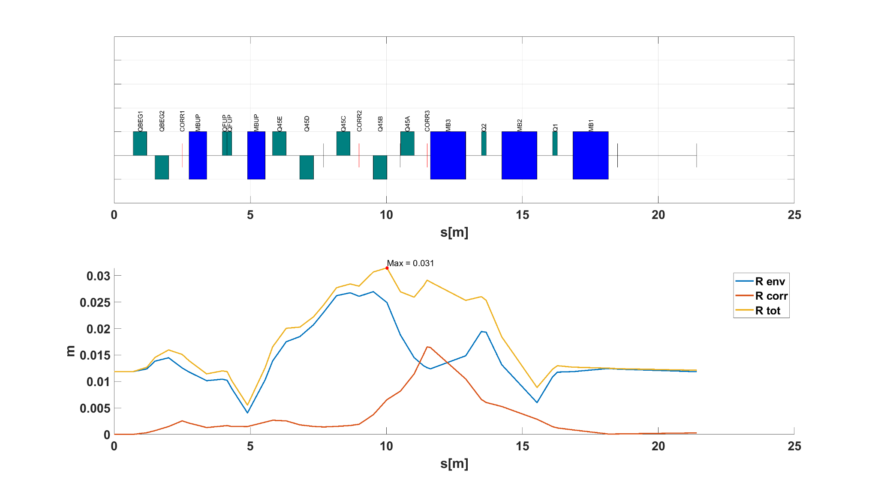

MF 1.5
MF 1.0
MF 0.6
E. Benedetto at 4T
Max Envelope = 33 mm
Max Envelope = 31 mm
Max Envelope = 37 mm
Point to Point

Slide 8
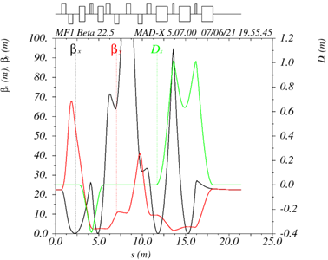
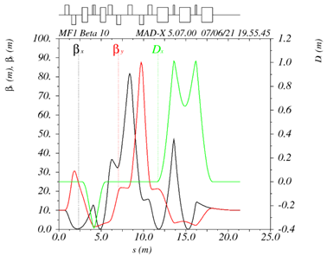
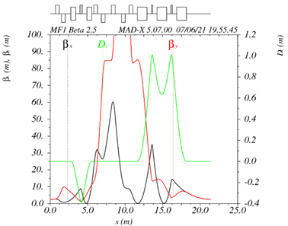

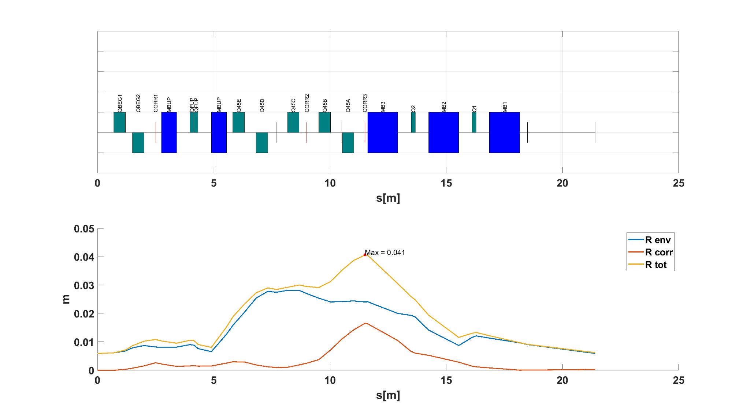
MF 1.0
BetX = BetY = 22.5 m
BetX = BetY = 10 m
BetX = BetY = 2.5m
E. Benedetto at 4T
Max Envelope = 33 mm
Max Envelope = 31 mm
Max Envelope = 41 mm
Point to Point

Slide 9
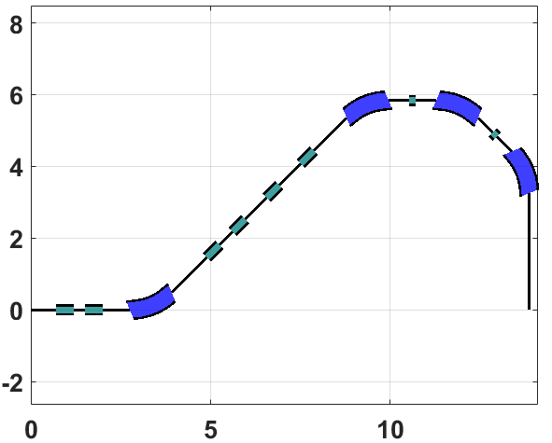
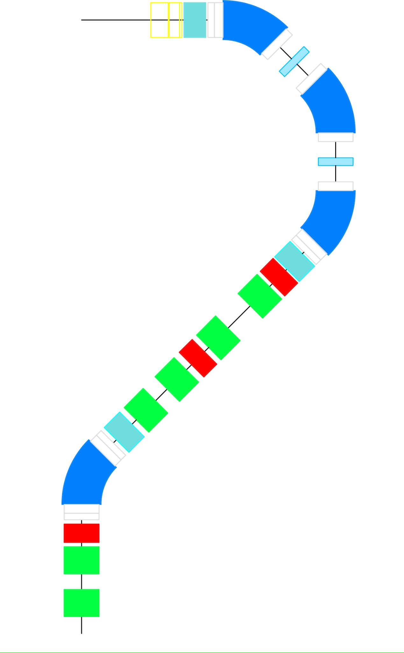
Locally achromatic NO
Dipole with varying gradient < 0.5 T/m in 3 MF (±0.4 T/m)
Same gradient in all dipoles
K_{dip} < 5 T/m; K_{quad-H} < 20 T/m; K_{quad-C} < 50 T/m
Constant gradient sign for quadrupoles in 3 MF
Acceptable and coherent corrections in 3 MF even switching monitor and scanning – (just MF1.5 for now))
Envelope Radius + Max Error Radius < 35mm
Acceptable behavior with different input Beta
  Envelope Radius + Max Error radius < 35mm
Sufficient space for all the elements - elements repositioned, but total length not modified -> to be rematched.
5.8 m
3 m
SAD 2.5 m
EF - 6 warm quad - config2
13.9 m
SAD
1.8m
from middle of last scanning
Point to Point

Slide 10
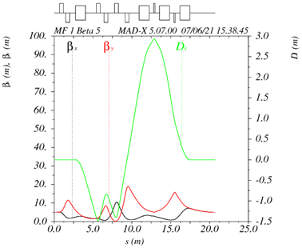
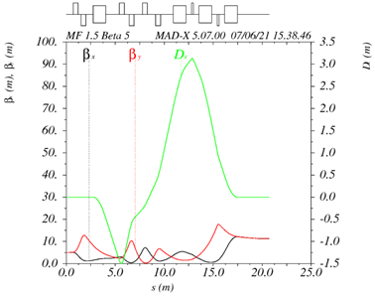
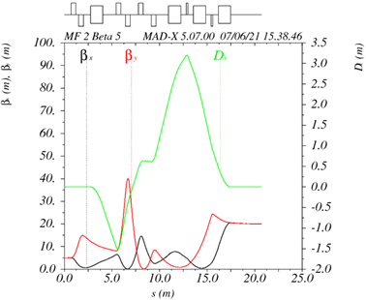
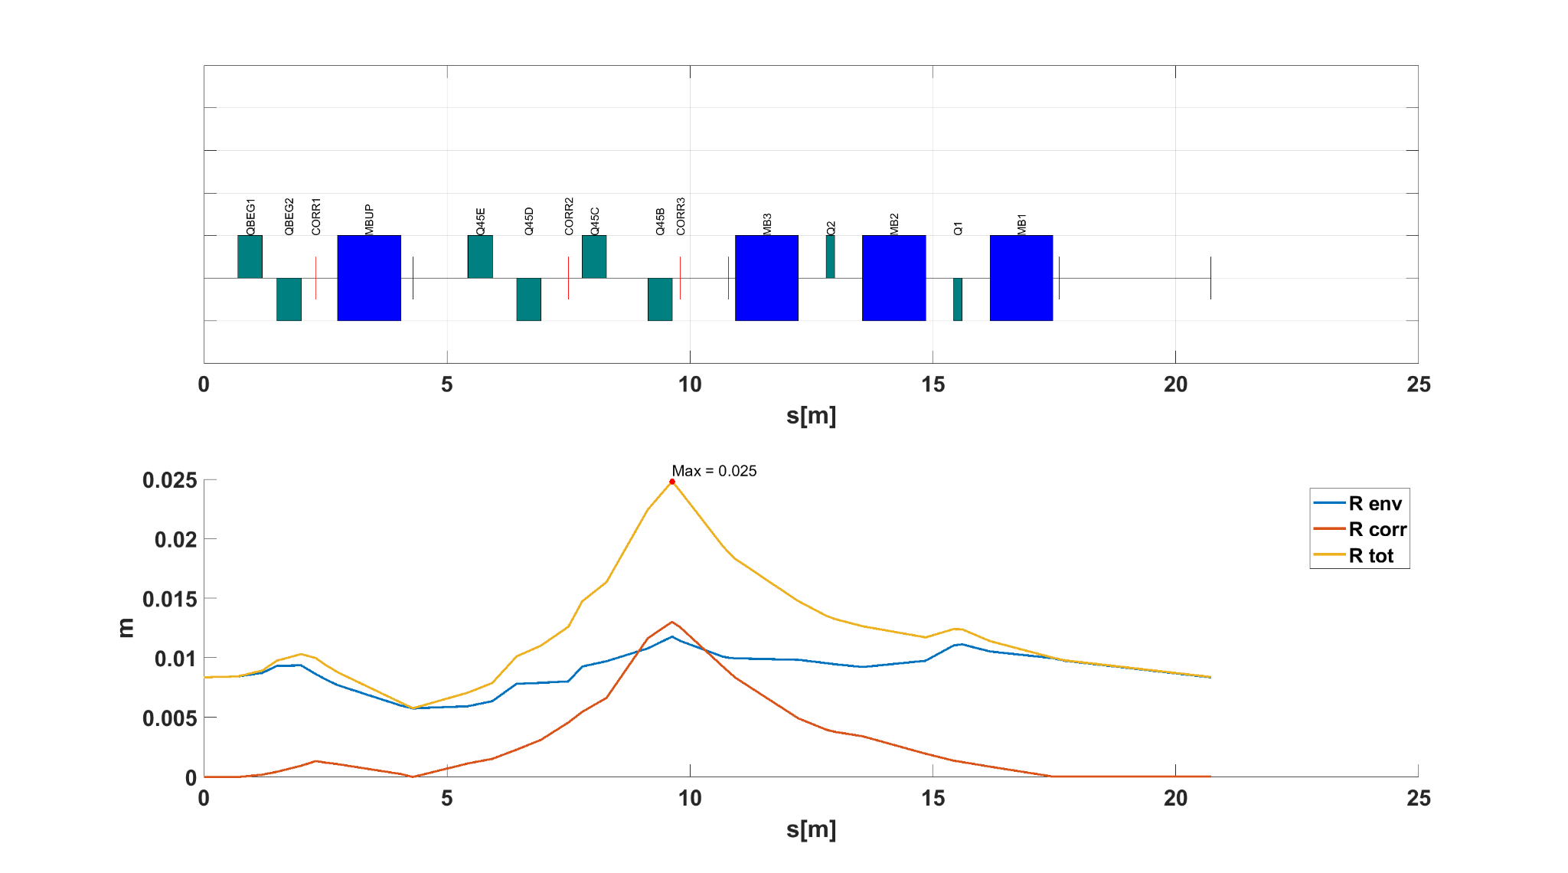
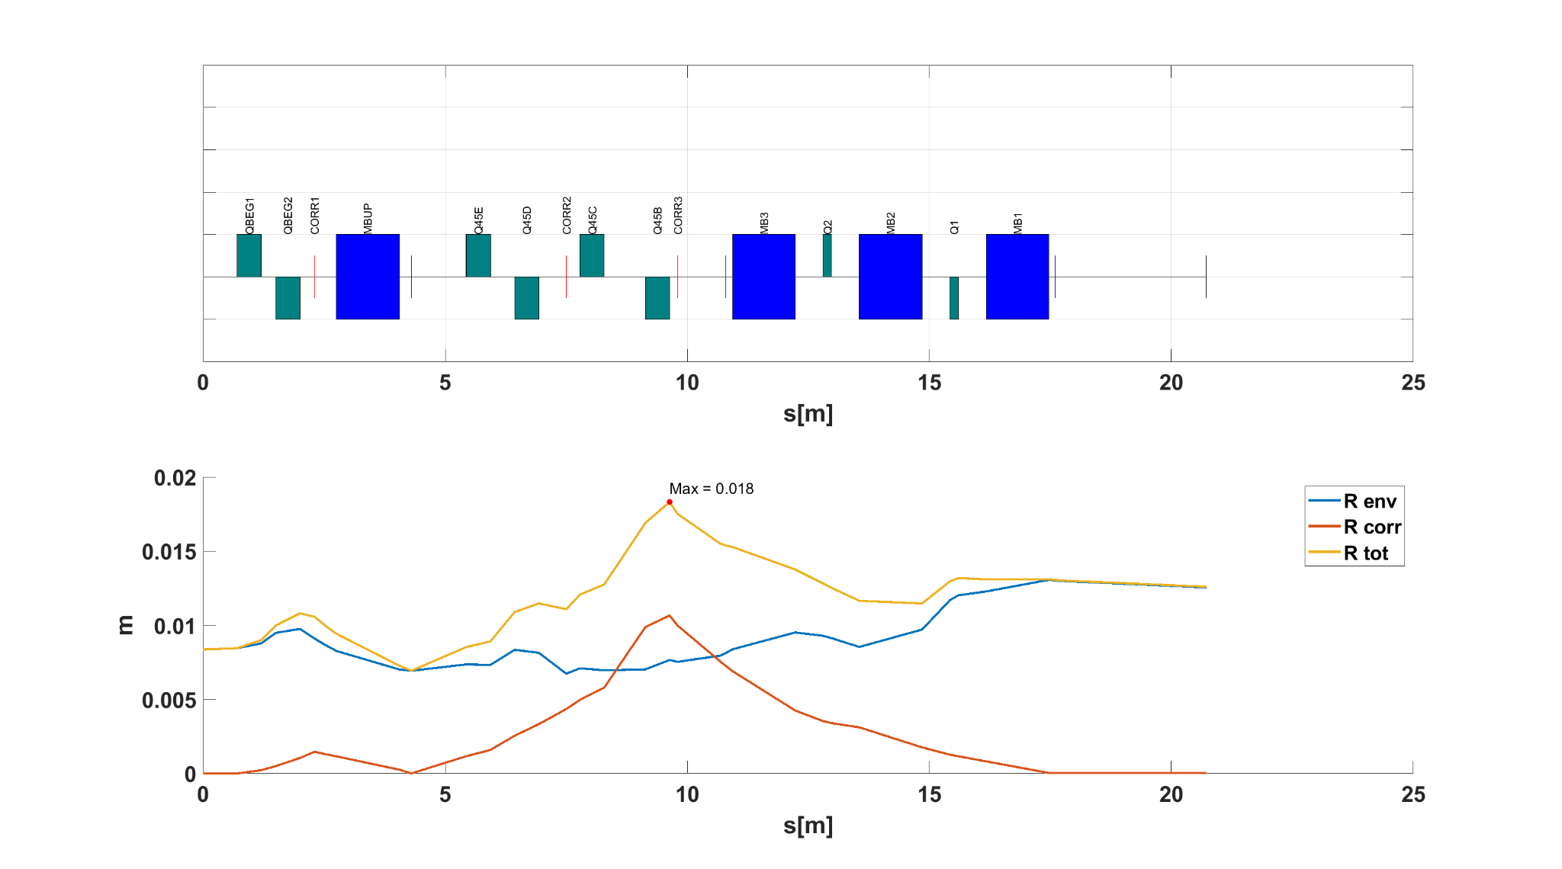
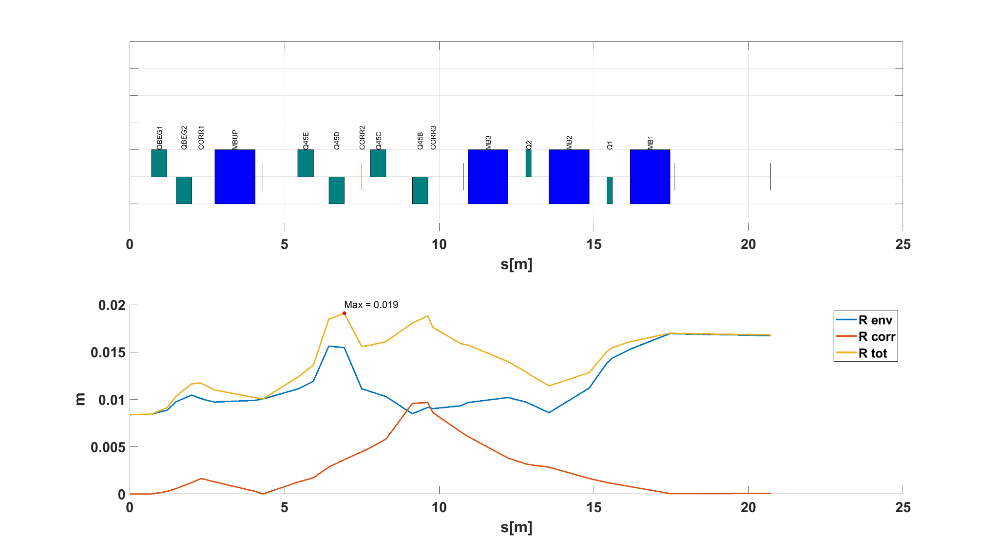
𝞫=5
MF 1.0
MF 2.0
MF 1.5
EF - 6 warm quad - config2
Max Envelope = 25 mm
Max Envelope = 18 mm
Max Envelope = 19 mm
Point to Point

Slide 11
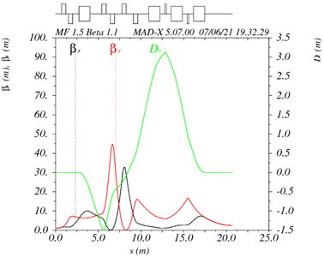

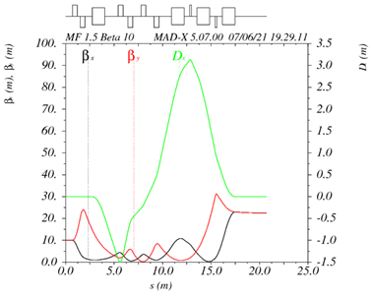

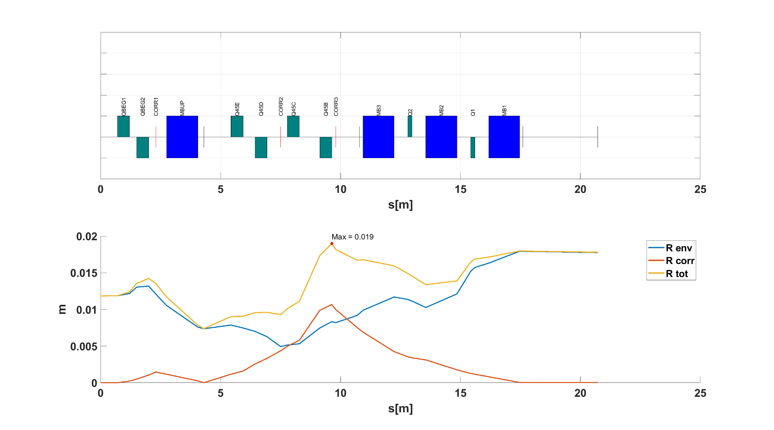
MF 1.5
best behaviour
BetX = BetY = 1.1 m
BetX = BetY = 5 m
BetX = BetY = 10 m
EF - 6 warm quad - config2
Max Envelope = 23 mm
Max Envelope = 18 mm
Max Envelope = 19 mm
Point to Point

Slide 12
Locally achromatic NO
Dipole with constant gradient in 3 MF
Dipole with varying gradient < 0.5 T/m in 3 MF (±0.2 T/m respect MF=1.5)
Same gradient in all dipoles
K_{dip} < 5 T/m; K_{quad-H} <= 20 T/m; K_{quad-C} < 50 T/m
Constant gradient sign for quadrupoles in 3 MF
Acceptable and coherent corrections in 3 MF (even switching monitor and scanning – (just MF1.5 for now))
Envelope Radius + Max Error Radius < 35mm (21 mm)
Acceptable behavior with different input Beta
  Envelope Radius + Max Error radius < 35mm (24 mm)
Sufficient space for all the elements - elements repositioned, but total length not modified -> to be rematched.
5.8 m
3 m
SAD 2.5 m
EF - 6 warm quad - config2
13.9 m
SAD
1.8m
from middle of last scanning
Parallel to Point

Slide 13
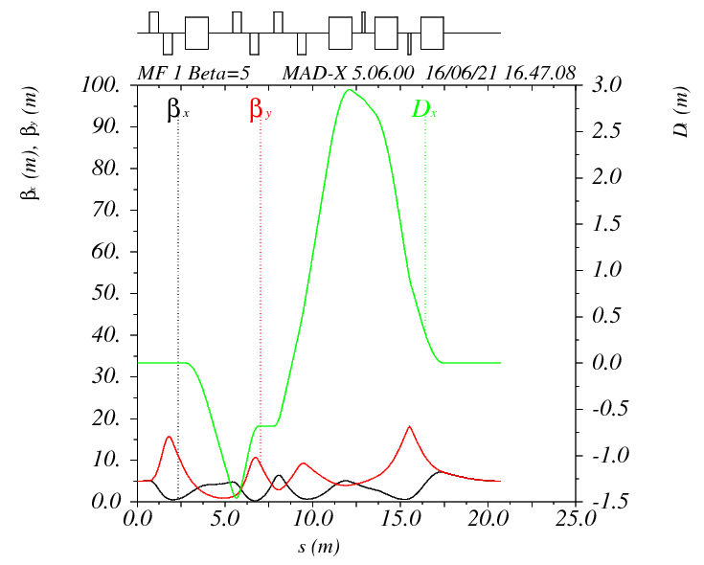
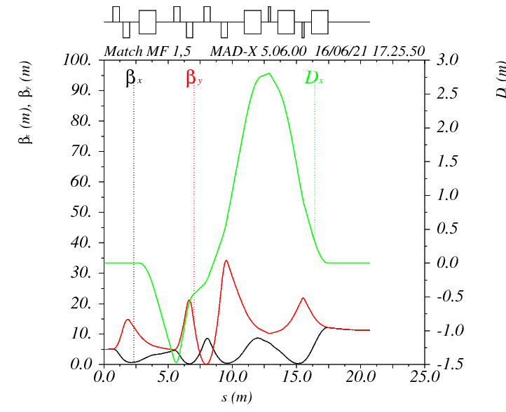
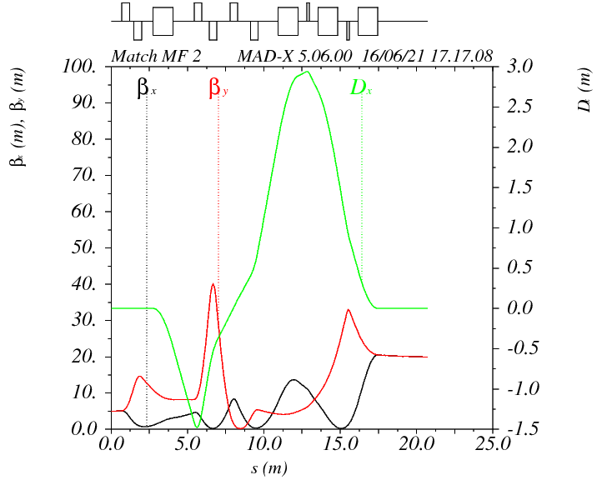

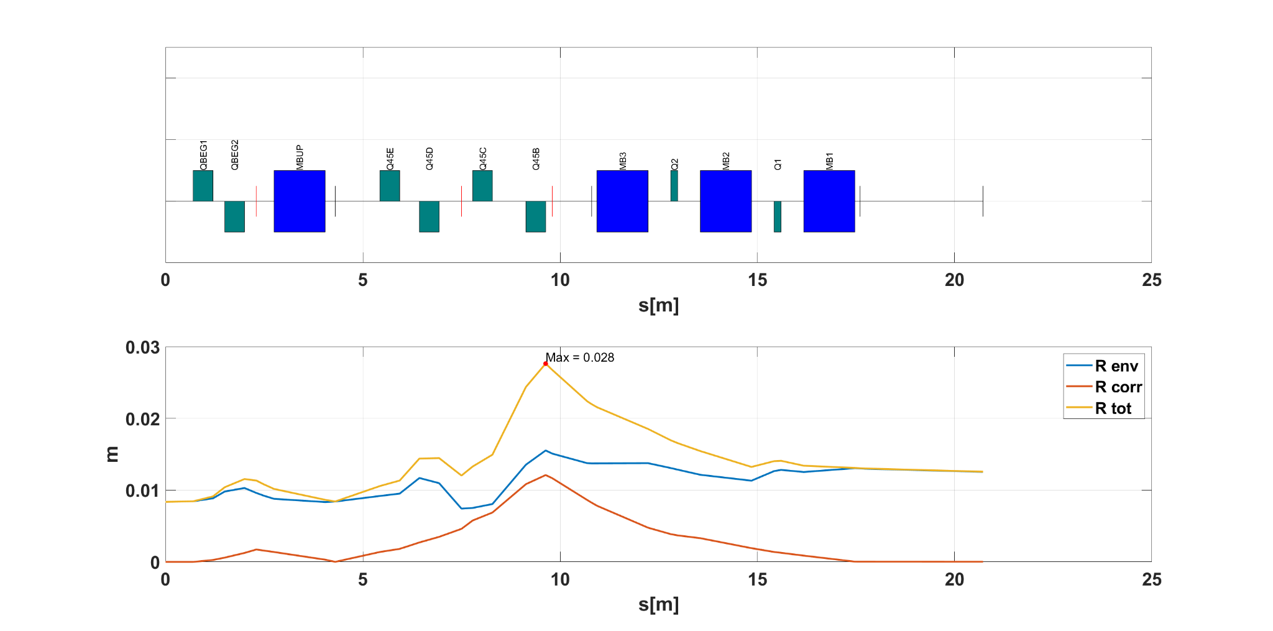
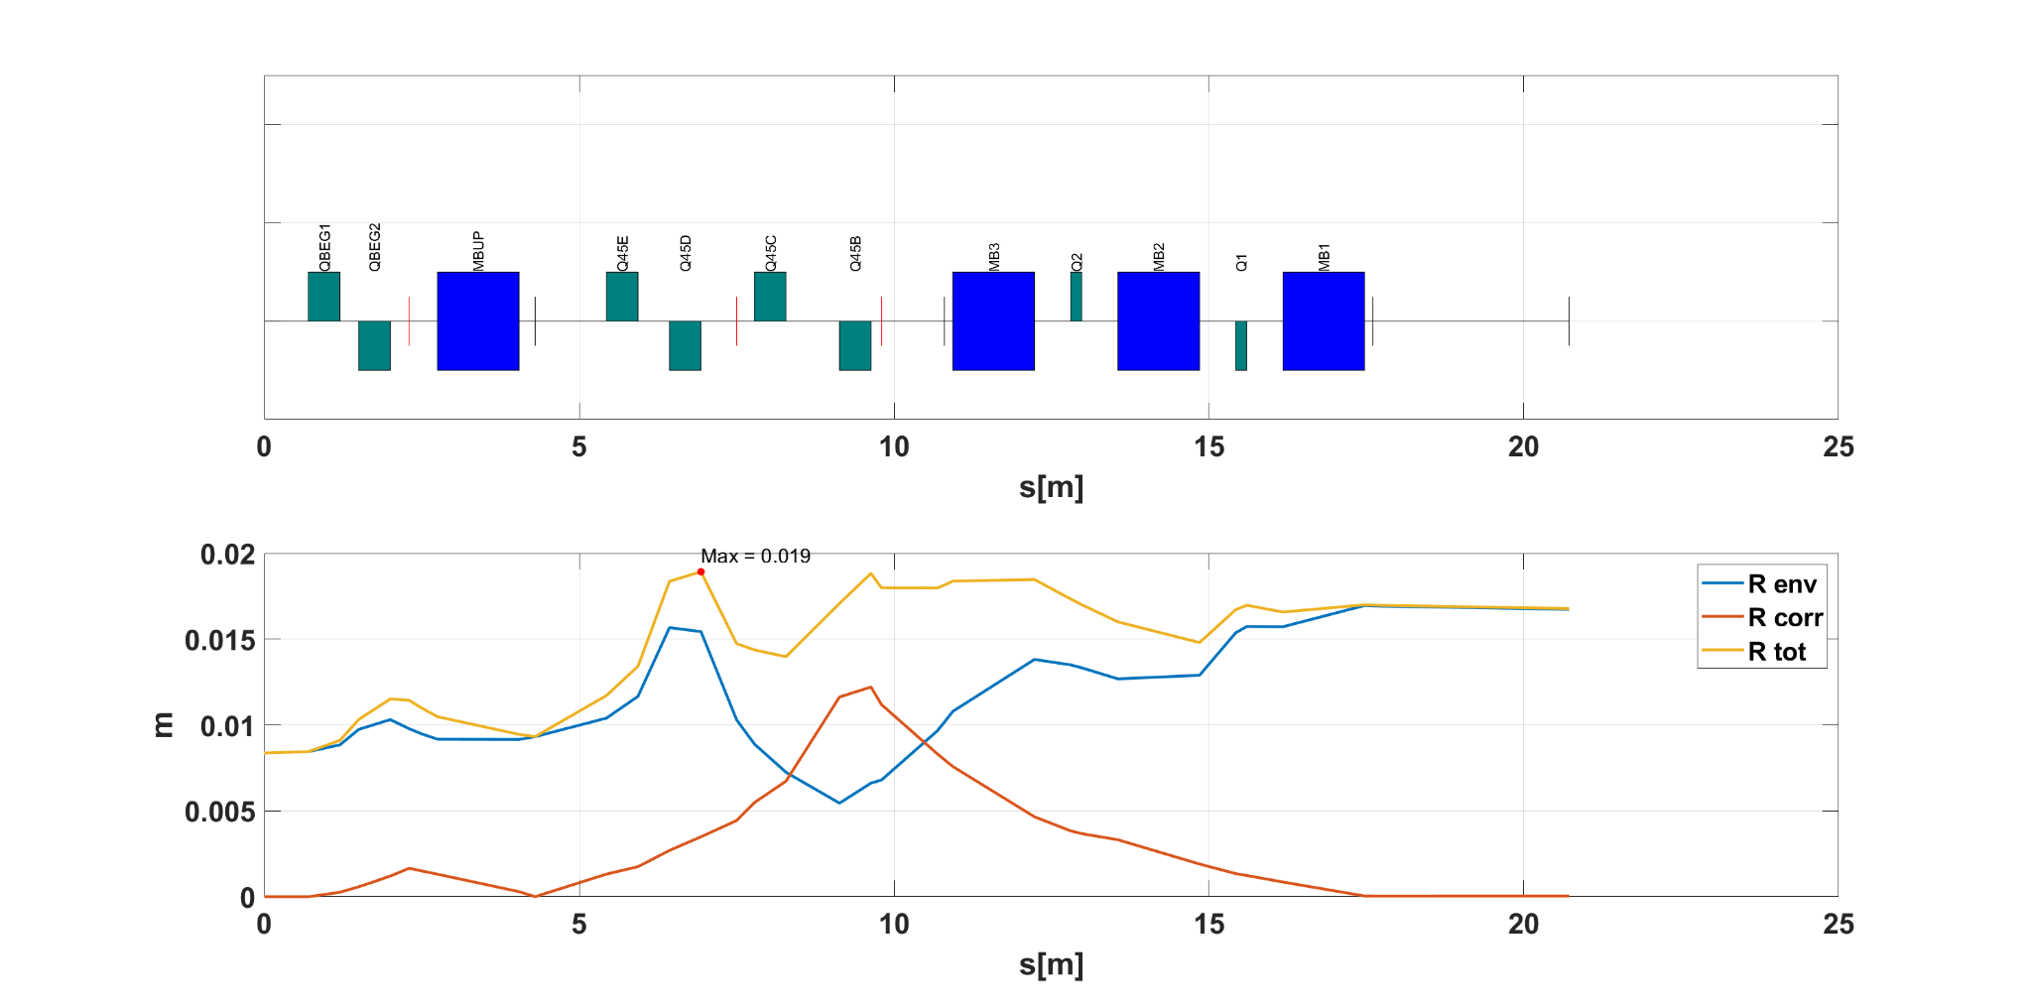
𝞫=5
MF 1.0
MF 1.5
MF 2
EF - 6 warm quad - config2
Max Envelope = 21 mm
Max Envelope = 28 mm
Max Envelope = 19 mm
Parallel to Point

Slide 14
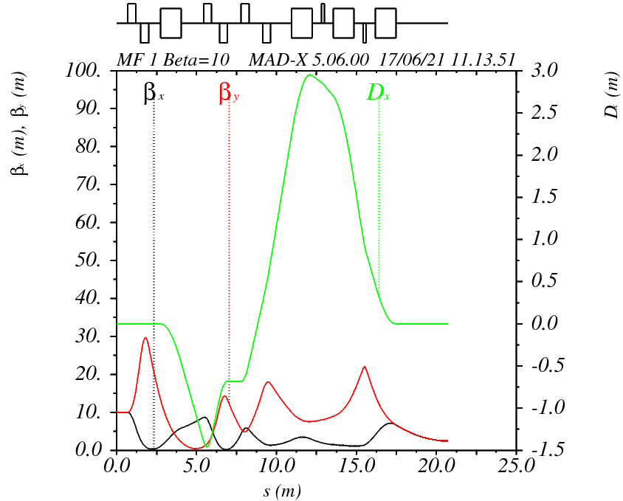
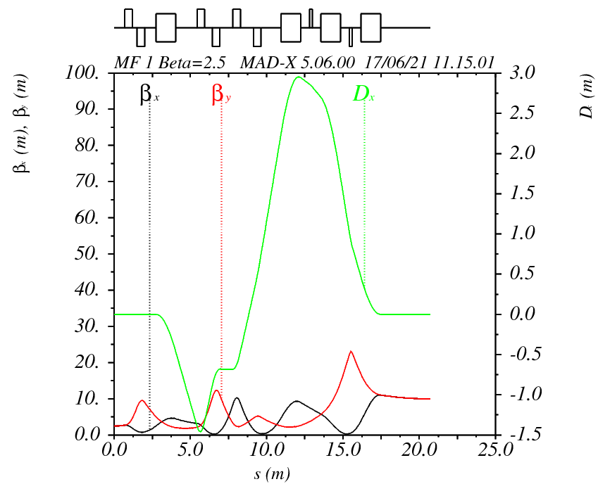
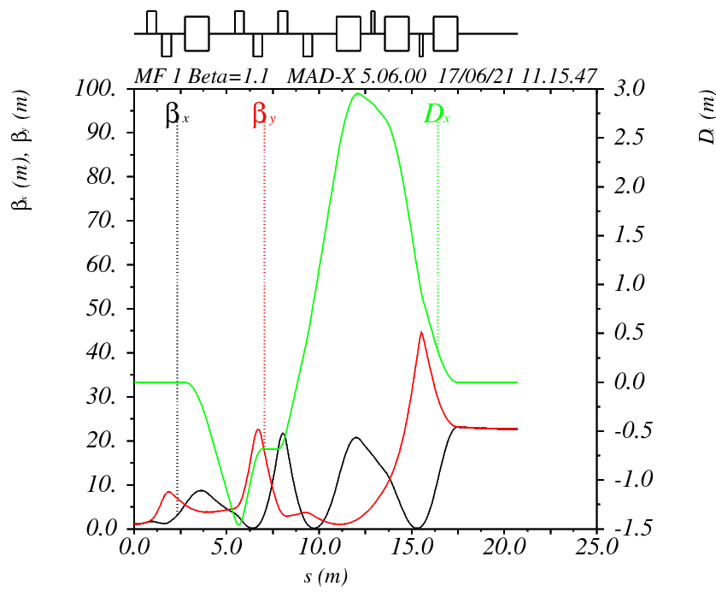
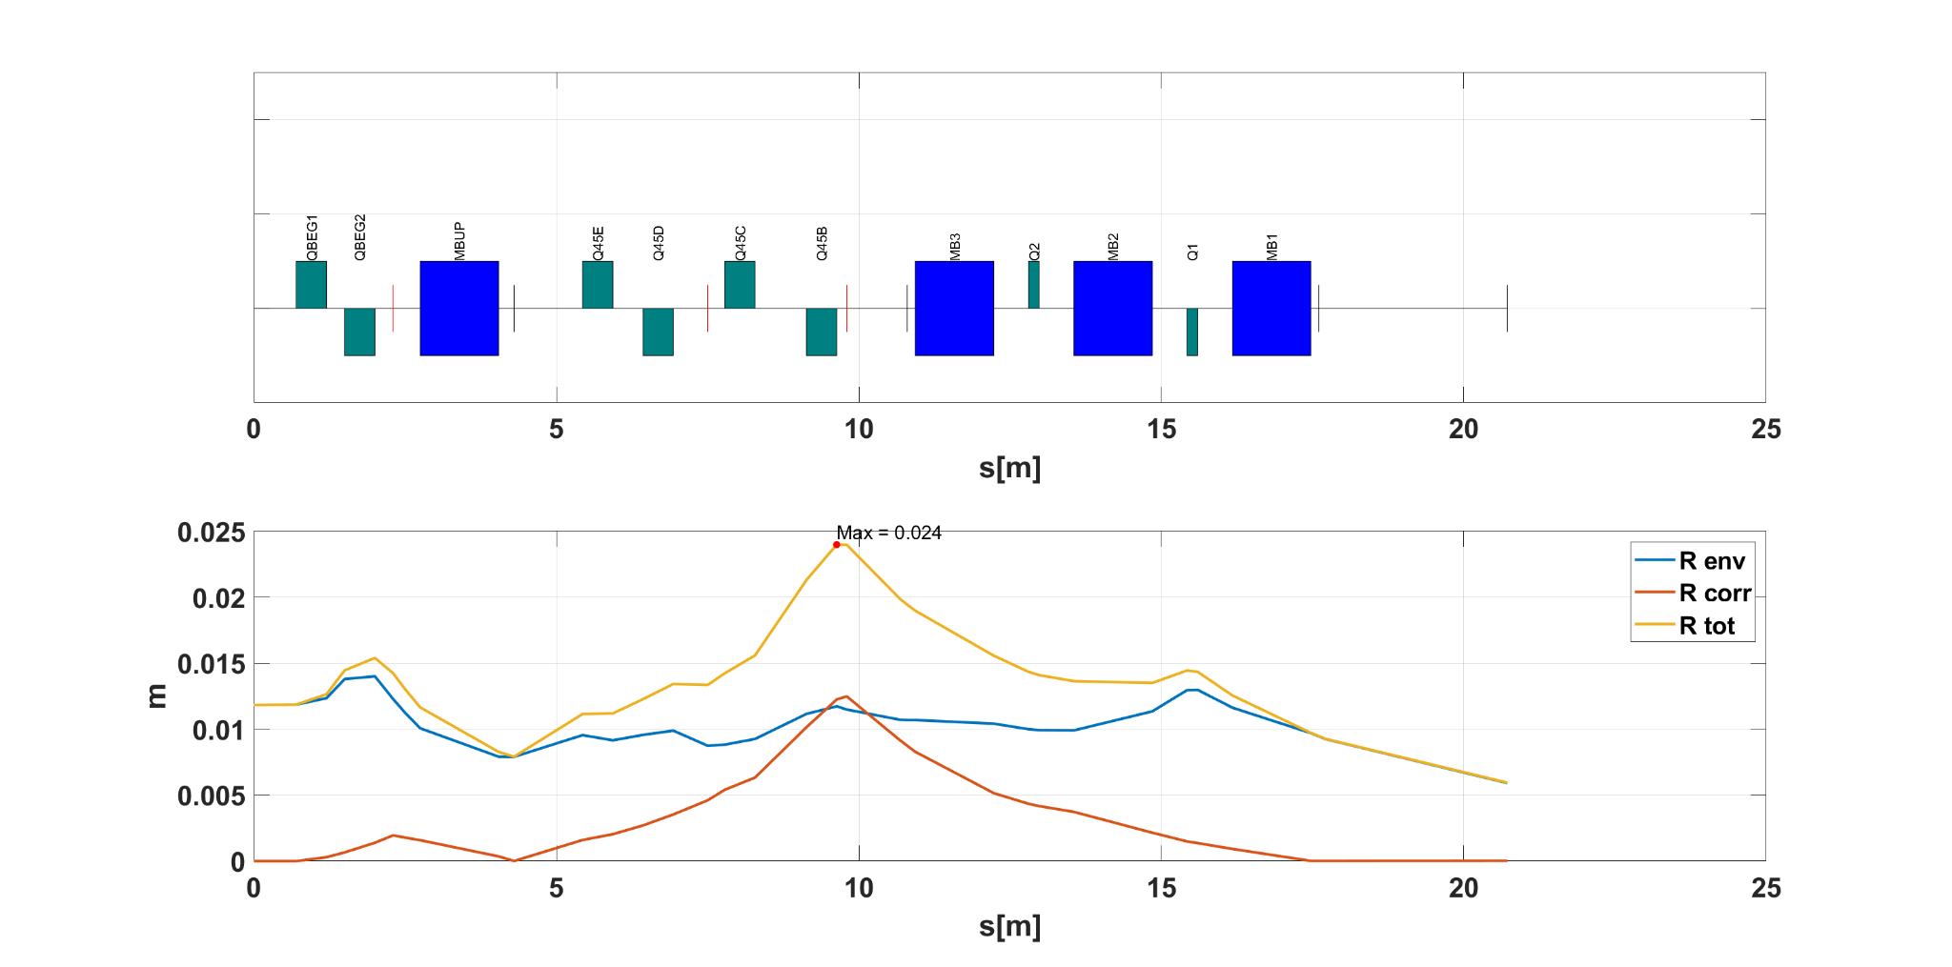

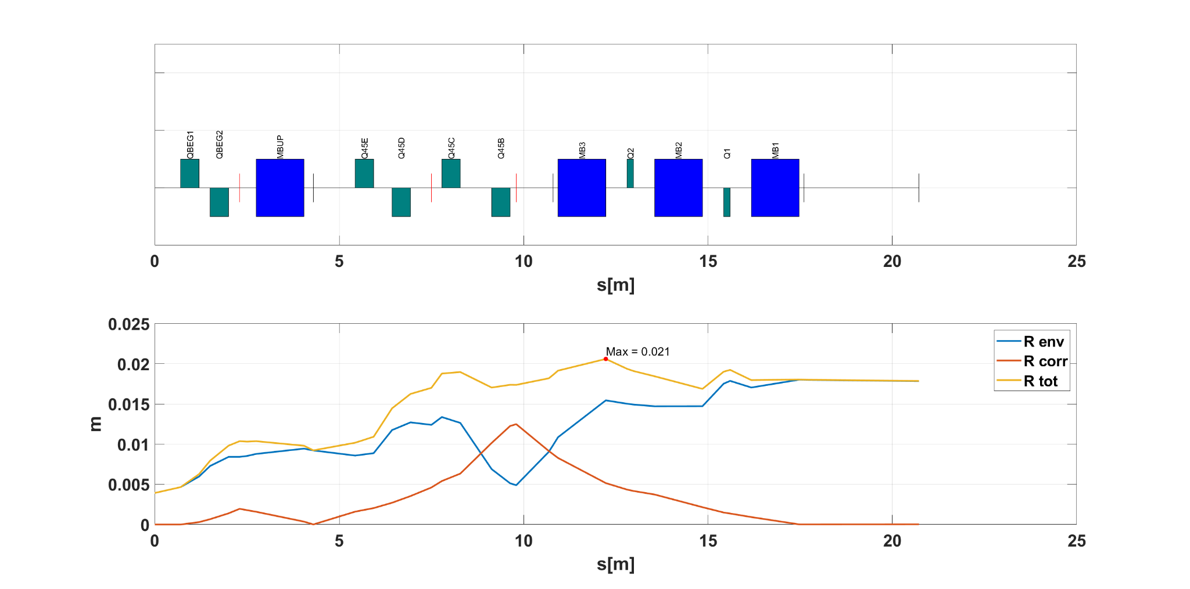
MF 1
best behaviour
BetX = BetY = 10 m
BetX = BetY = 2.5 m
BetX = BetY = 1.1 m
EF - 6 warm quad - config2
Max Envelope = 24 mm
Max Envelope = 21 mm
Max Envelope = 21 mm
Parallel to Point

Slide 15
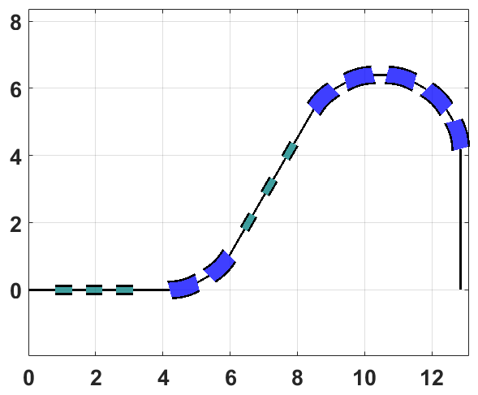
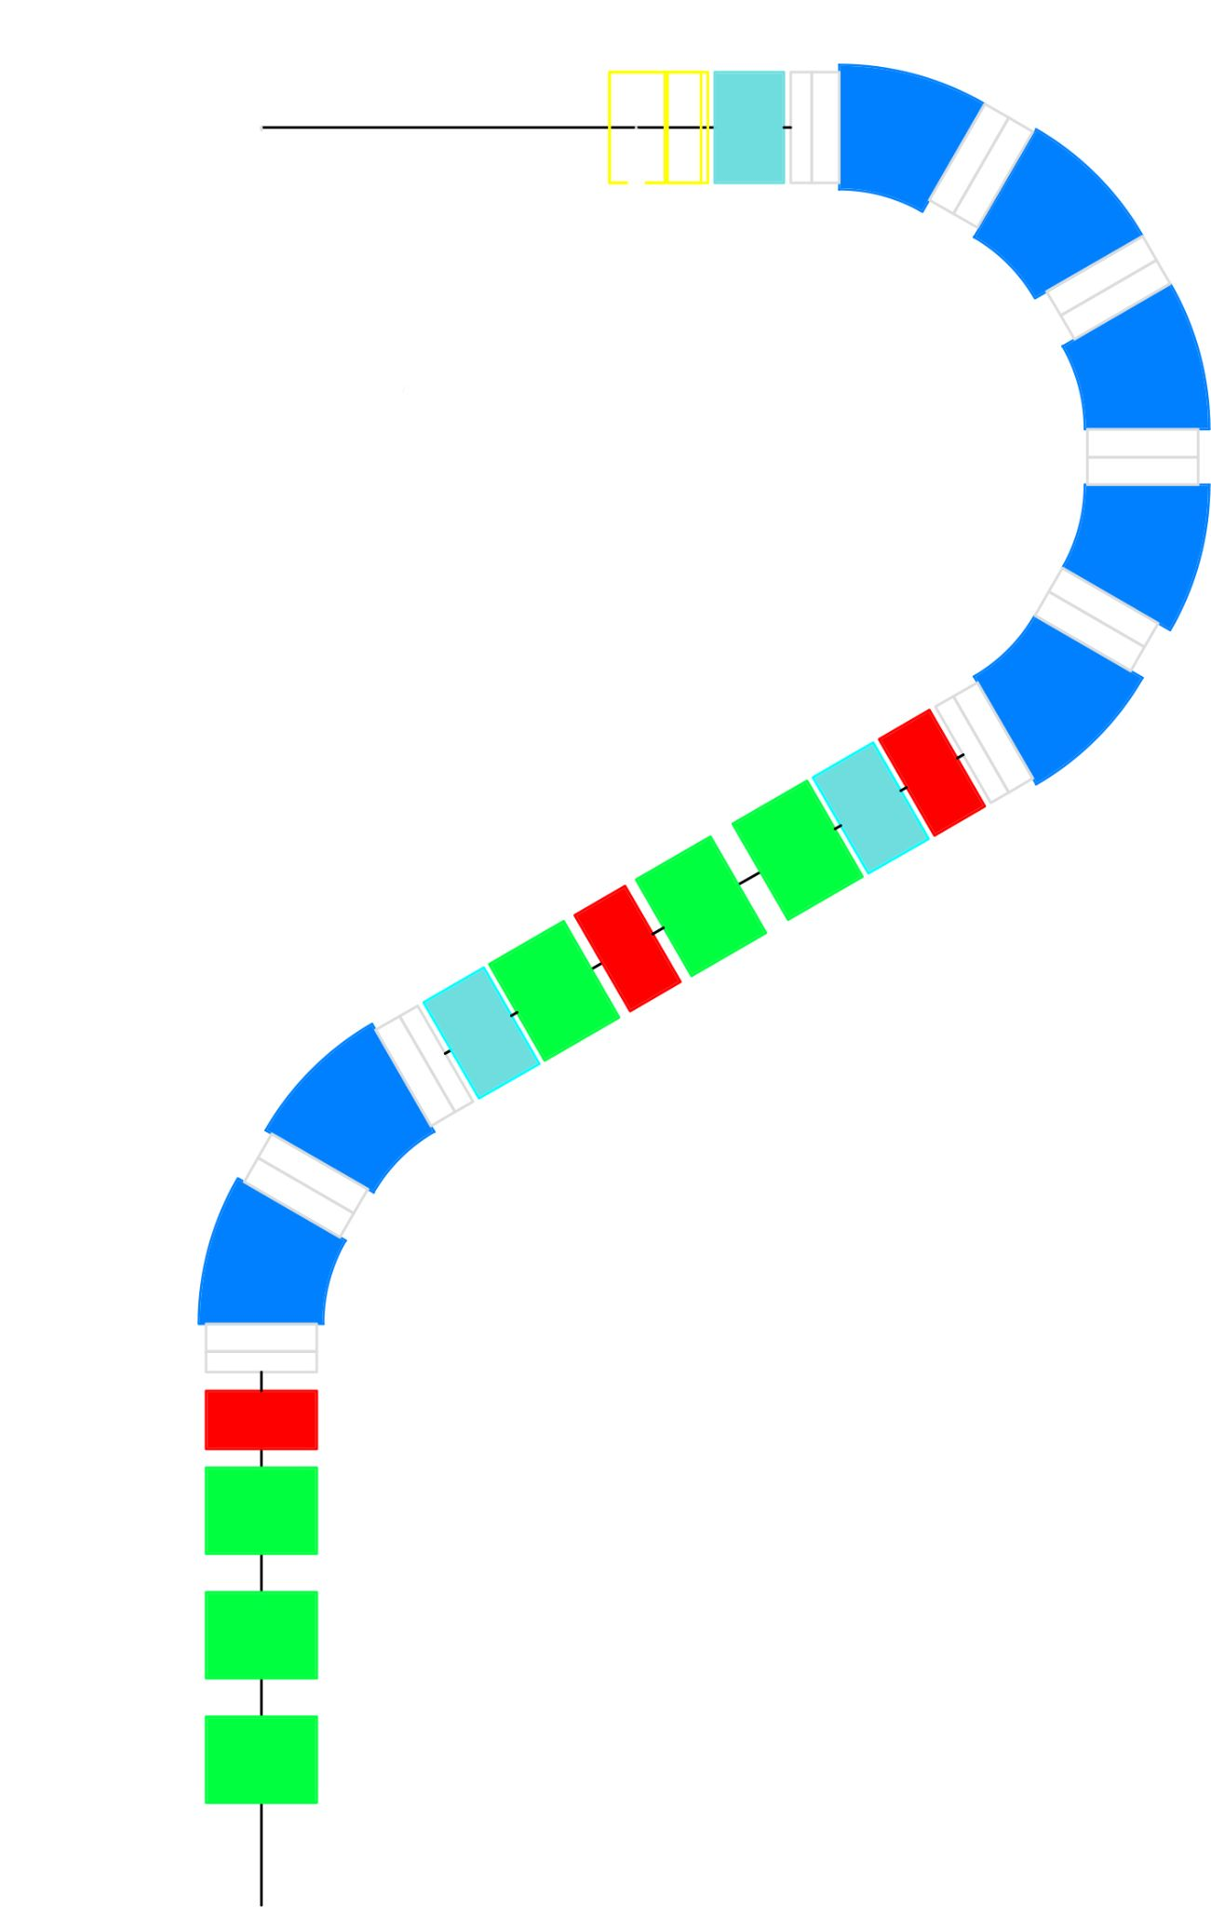
Locally achromatic NO
Dipole with varying gradient < 0.5 T/m in 3 MF (± 0.3 T/m)
Same gradient in all dipoles (3 families)
K_{dip} < 5 T/m; K_{quad-H} < 20 T/m; K_{quad-C} < 50 T/m
Constant gradient sign for quadrupoles in 3 MF (1 changes)
Acceptable and coherent corrections in 3 MF
Envelope Radius + Max Error Radius < 35mm (max 27mm)
Acceptable behavior with different input Beta
  Envelope Radius + Max Error radius < 35 mm (max 28mm)
Sufficient space for all the elements - elements repositioned, but total length not modified -> to be rematched.
6.4 m
4 m
SAD 3.5 m
12.9 m
DT1 – Config. 4
SAD
2.71m
from middle of last scanning
Point to Point

Slide 16
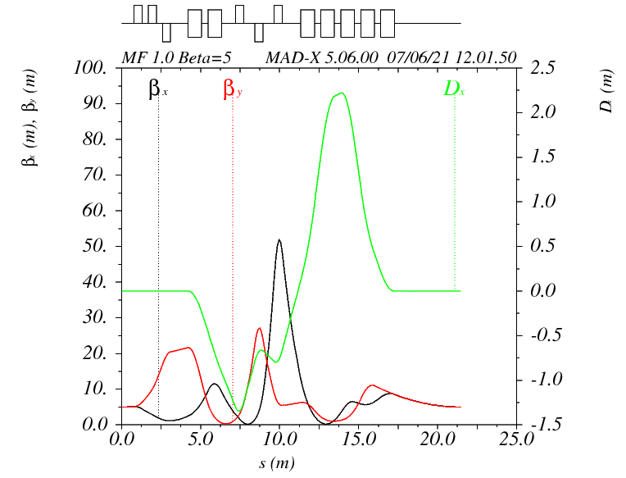
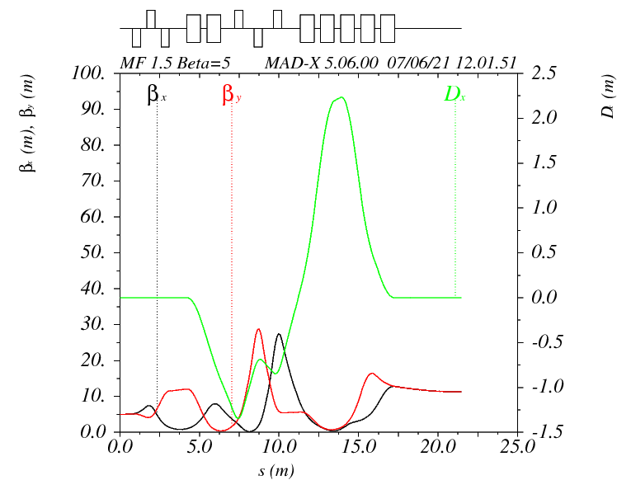
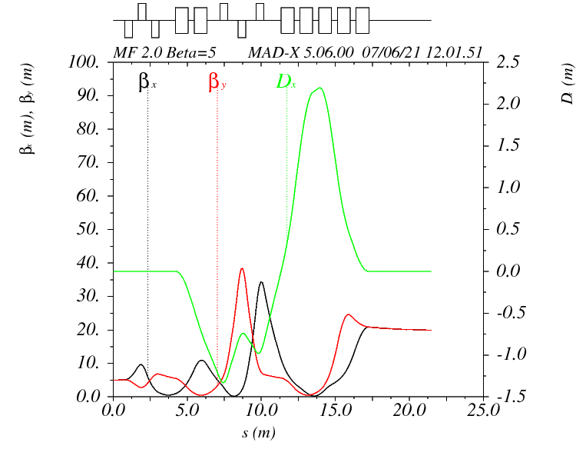
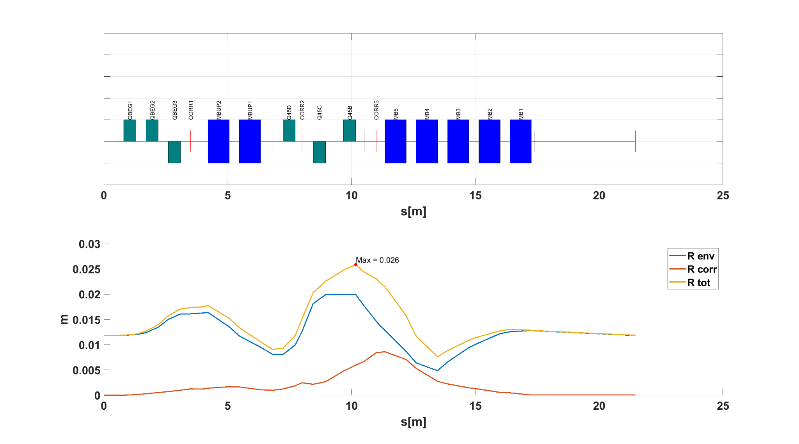
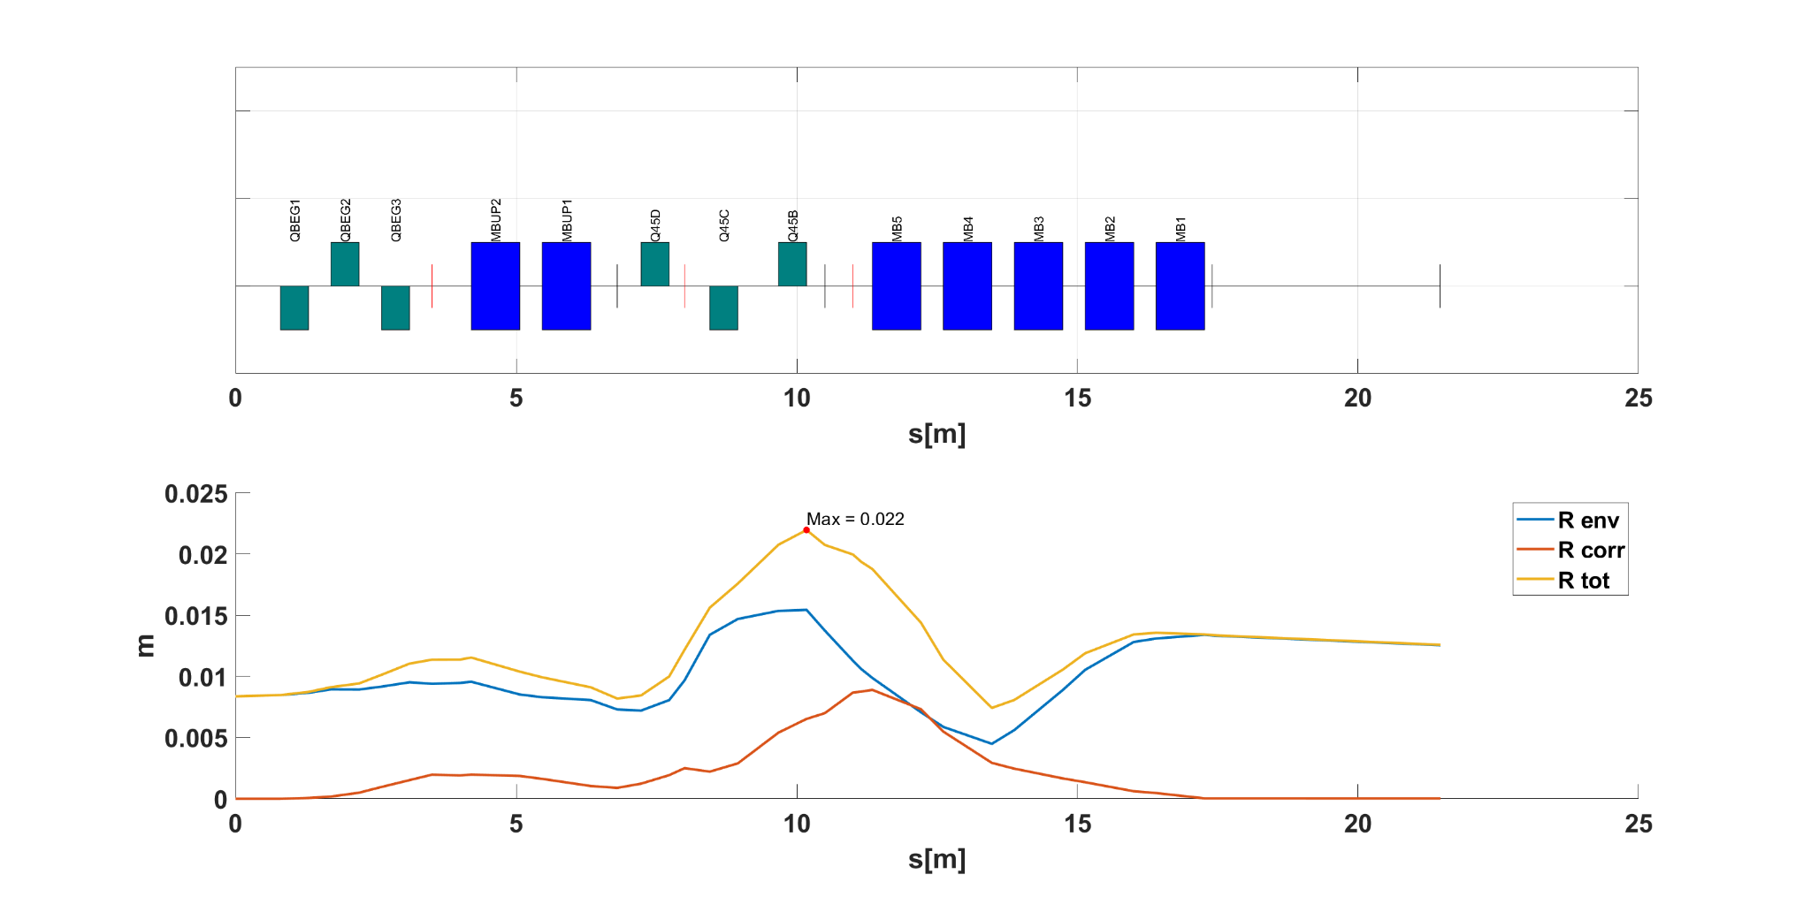

Beta 5
MF 1.0
MF 1.5
MF 2.0
DT1 – Config. 4
Max Envelope = 26 mm
Max Envelope = 22 mm
Max Envelope = 24 mm
Point to Point

Slide 17
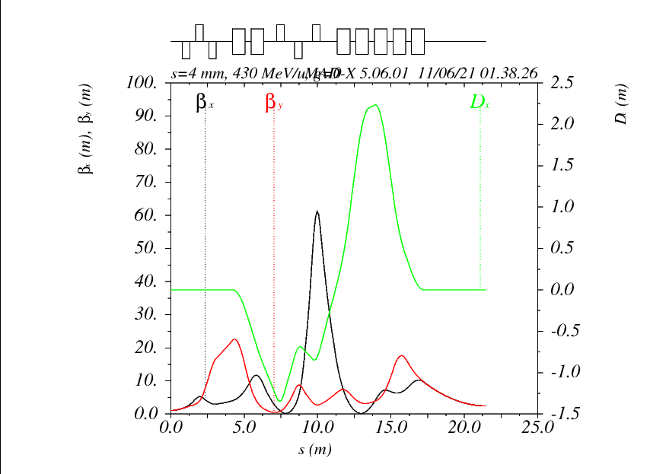
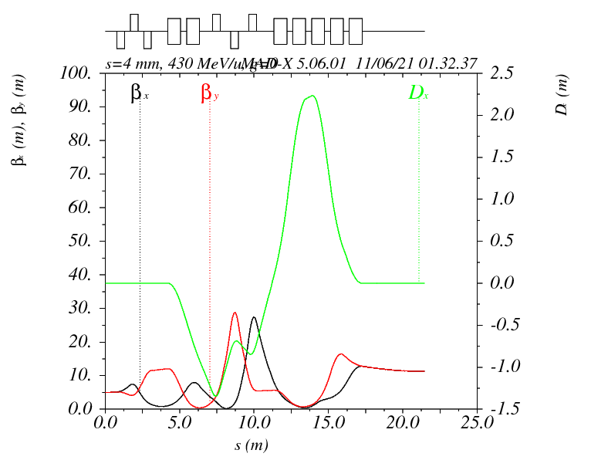
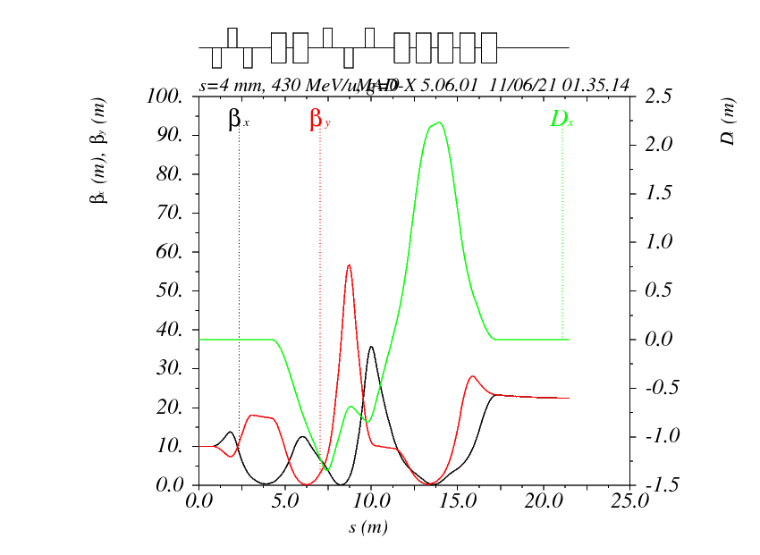
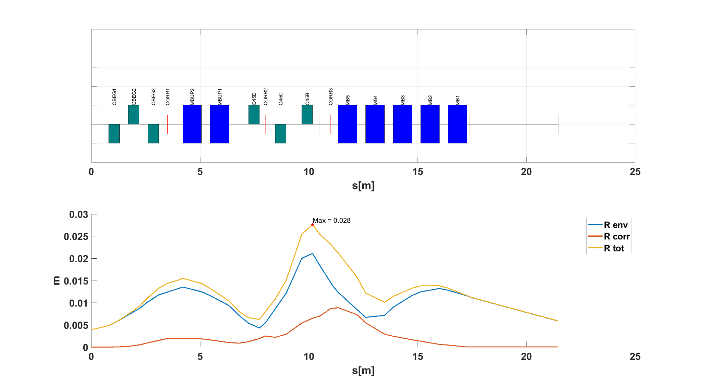
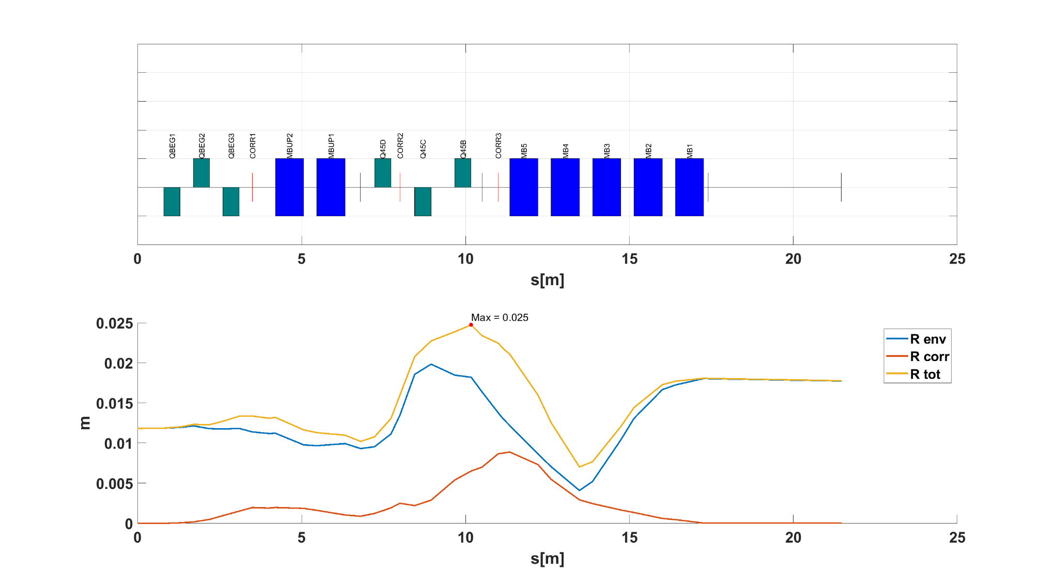
MF 1.5
best behaviour
BetX = BetY = 1.1 m
BetX = BetY = 5 m
BetX = BetY = 10m
DT1 – Config. 4
Max Envelope = 28 mm
Max Envelope = 22 mm
Max Envelope = 25 mm
Point to Point

Slide 18
Locally achromatic NO
Dipole with varying gradient < 0.5 T/m in 3 MF (± 0.3 T/m)
Same gradient in all dipoles (3 families)
K_{dip} < 5 T/m; K_{quad-H} < 30 T/m; K_{quad-C} < 50 T/m
Constant gradient sign for quadrupoles in 3 MF (1 changes)
Acceptable and coherent corrections in 3 MF
Envelope Radius + Max Error Radius < 35mm (max 24mm)
Acceptable behavior with different input Beta
  Envelope Radius + Max Error radius < 35mm (max 27mm)
Sufficient space for all the elements - elements repositioned, but total length not modified -> to be rematched.
6.4 m
4 m
SAD 3.5 m
12.9 m
DT1 – Config. 4
SAD
2.71m
from middle of last scanning
Parallel to Point

Slide 19
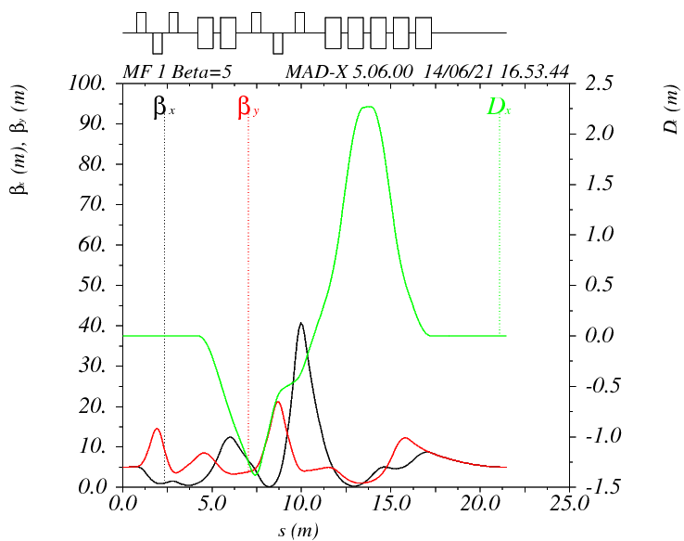
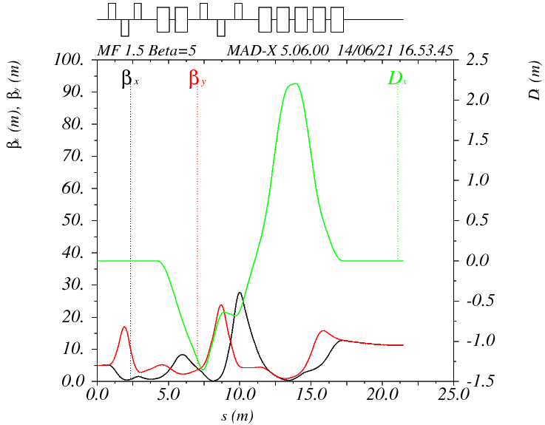
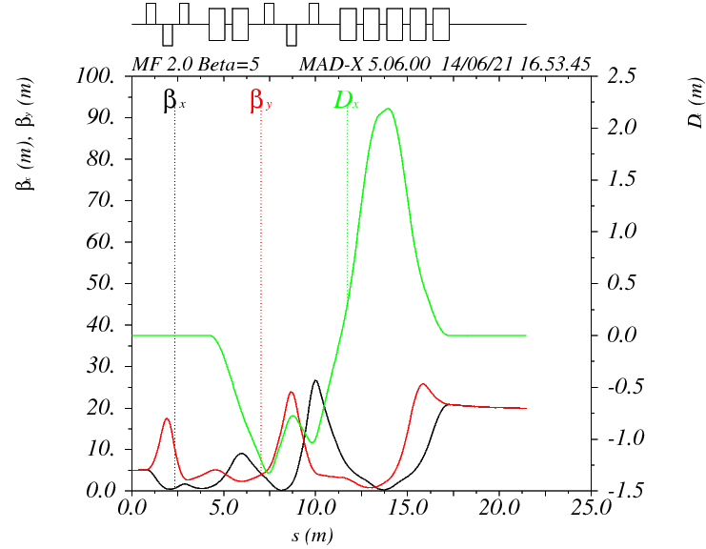
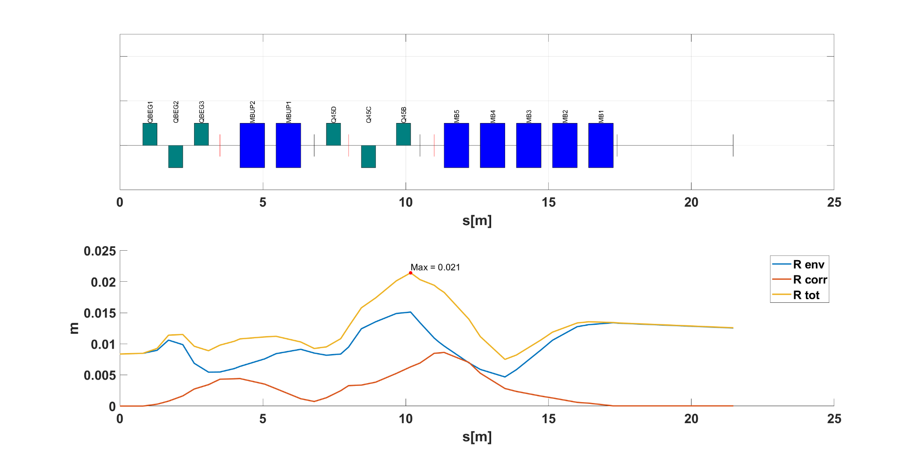
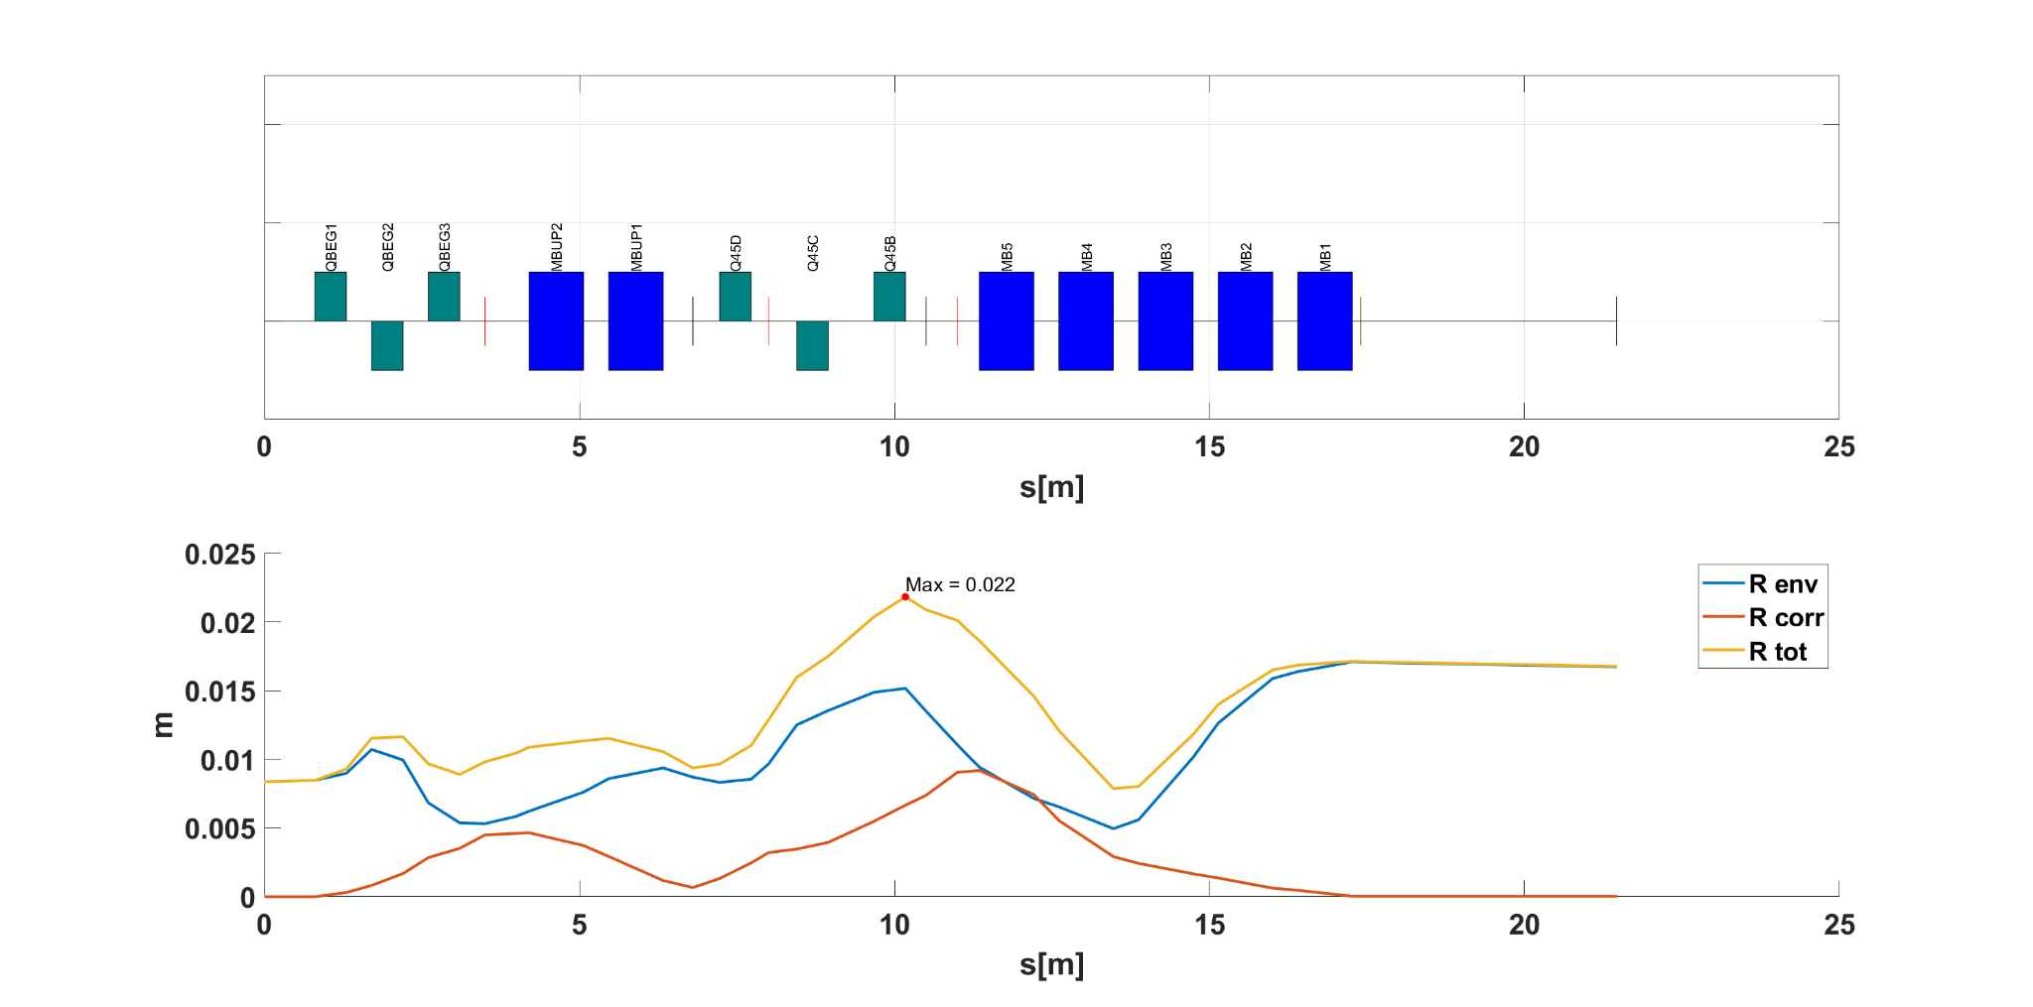

Beta 5
MF 1.0
MF 1.5
MF 2.0
DT1 – Config. 4
Max Envelope = 21 mm
Max Envelope = 22 mm
Max Envelope = 24 mm
Parallel to Point

Slide 20






MF 1.5
best behaviour
BetX = BetY = 2.5 m
BetX = BetY = 5.625 m
BetX = BetY = 22.5m
DT1 – Config. 4
Max Envelope = 24 mm
Max Envelope = 21 mm
Max Envelope = 27 mm
Parallel to Point

Slide 21

Locally achromatic NO
Dipole with constant gradient in 3 MF (Only in 1 family)
Dipole with varying gradient < 0.5 T/m in 3 MF
(1 family varies ±0.5 T/m)
Same gradient in all dipoles (2 families)
K_{dip} <= 5 T/m; K_{quad-H} < 20 T/m; K_{quad-C} < 50 T/m
Constant gradient sign for quadrupoles in 3 MF
(NC quads change sign)
Acceptable and coherent corrections in 3 MF
Envelope Radius + Max Error Radius < 35mm (max 34mm)
Acceptable behavior with different input Beta
  Envelope Radius + Max Error radius < 35mm (max 34mm)
6.4 m
4 m
SAD 3.5 m
14.6 m
DT1 – Config. 5
Point to Point

Slide 22






MF 1.5
MF 1.0
MF 0.5
DT1 – Config. 5
Max Envelope = 34 mm
Max Envelope = 25 mm
Max Envelope = 24 mm
Point to Point

Slide 23




MF=1
best behaviour
BetX = BetY = 22.5 m
BetX = BetY = 10 m
BetX = BetY = 2.5 m
DT1 – Config. 5
Max Envelope = 34 mm
Max Envelope = 25 mm
Max Envelope = 25 mm
Point to Point

Slide 24
Locally achromatic NO
Dipole with constant gradient in 3 MF (Two family)
Dipole with varying gradient < 0.5 T/m in 3 MF (Variation>0.5 T/m)
Same gradient in all dipoles (2 families)
K_{dip} <= 5 T/m; K_{quad-H} <= 20 T/m
Constant gradient sign for quadrupoles in 3 MF
(NC quads change sign)
Acceptable and coherent corrections in 3 MF
Envelope Radius + Max Error Radius < 35 mm (max 27 mm)
Acceptable behavior with different input Beta
  Envelope Radius + Max Error radius < 35 mm (max 31 mm)
6.4 m
4 m
SAD 3.5 m
14.6 m
DT1 – Config. 5
Parallel to Point

Slide 25






MF 1.36
MF 1.0
MF 0.64
DT1 – Config. 5
Max Envelope = 27 mm
Max Envelope = 24 mm
Max Envelope = 26 mm
Parallel to Point

Slide 26




MF=1
best behaviour
BetX = BetY = 4.5 m
BetX = BetY = 10 m
BetX = BetY = 40 m
DT1 – Config. 5
Max Envelope = 31 mm
Max Envelope = 24 mm
Max Envelope = 30 mm
Parallel to Point

Slide 27


Locally achromatic NO
Dipole with constant gradient in 3 MF
Same gradient in all dipoles (3 families)
K_{dip} < 5 T/m; K_{quad-H} < 20 T/m; K_{quad-C} < 50 T/m
Constant gradient sign for quadrupoles in 3 MF (1 SC quad changes sing)
Acceptable and coherent corrections in 3 MF
Envelope Radius + Max Error Radius < 35mm (max 27)
Acceptable behavior with different input Beta
  Envelope Radius + Max Error radius < 35mm (max 28)
Sufficient space for all the elements
7.3 m
4 m
SAD 3.5 m
13.2 m
DT2 – Config. 1
SAD
3.0m
from middle of last scanning
Point to Point

Slide 28






MF 1.5
MF 1.0
MF 0.5
DT2 – Config. 1
Max Envelope = 27 mm
Max Envelope = 20 mm
Max Envelope = 18 mm
Point to Point

Slide 29





MF 1.0
best behaviour
BetX = BetY = 22.5 m
BetX = BetY = 10 m
BetX = BetY = 2.5 m
DT2 – Config. 1
Max Envelope = 28 mm
Max Envelope = 20 mm
Max Envelope = 17 mm
Point to Point

Slide 30
Locally achromatic NO
Dipole with constant gradient in 3 MF
Same gradient in all dipoles (3 families)
K_{dip} < 5 T/m; K_{quad-H} < 20 T/m; K_{quad-C} < 80 T/m
Constant gradient sign for quadrupoles in 3 MF
Acceptable and coherent corrections in 3 MF
Envelope Radius + Max Error Radius < 45mm
Acceptable behavior with different input Beta
  Envelope Radius + Max Error Radius < 45mm
Sufficient space for all the elements
7.3 m
4 m
SAD 3.5 m
13.2 m
DT2 – Config. 1
SAD
3.0m
from middle of last scanning
Parallel to Point

Slide 31






MF 1.5
MF 1.0
MF 0.6
DT2 – Config. 1
Max Envelope = 30 mm
Max Envelope = 29 mm
Max Envelope = 42 mm
Parallel to Point

Slide 32





MF 1.0
best behaviour
BetX = BetY = 4.5 m
BetX = BetY = 10 m
BetX = BetY = 40 m
DT2 – Config. 1
Max Envelope = 33 mm
Max Envelope = 29 mm
Max Envelope = 37 mm
Parallel to Point

Slide 33


Locally achromatic NO
Dipole with large gradient variation (+1.3 T/m - 1.2T/m)
Same gradient in all dipoles (each one is different)
K_{dip} < 9.0 T/m; K_{quad-H} < 20 T/m; K_{quad-C} < 50 T/m
Constant gradient sign for nc quadrupoles in 3 MF
Acceptable and coherent corrections in 3 MF
Envelope Radius + Max Error Radius < 35mm (max24mm)
Acceptable behavior with different input Beta
  Envelope Radius + Max Error radius < 35mm (max 33mm)
Sufficient space for all the elements -> needs some fine adjustments (i.e. hor part = vertical part (from140cm to 160 cm))
6.0 m
3.6 m
SAD 3.1 m
DT3 – Config. 1
10.2 m
SAD
2.3m
from middle of last scanning
Point to Point

Slide 34






MF 1.5
MF 1.0
MF 0.5
DT3 – Config. 1
Max Envelope = 24 mm
Max Envelope = 24 mm
Max Envelope = 17 mm
Point to Point

Slide 35




MF 1.0
best behaviour
BetX = BetY = 22.5 m
BetX = BetY = 10 m
BetX = BetY = 2.5 m
DT3 – Config. 1
Max Envelope = 33 mm
Max Envelope = 24 mm
Max Envelope = 18 mm
Point to Point

Slide 36


Locally achromatic NO
Dipole with large gradient variation (+1.6 T/m - 1.6T/m)
Same gradient in all dipoles (each one is different)
K_{dip} < 9.2 T/m; K_{quad-H} < 20 T/m; K_{quad-C} < 50 T/m
Constant gradient sign for nc quadrupoles in 3 MF
Acceptable and coherent corrections in 3 MF
Envelope Radius + Max Error Radius < 35mm (max 35mm)
Acceptable behavior with different input Beta
  Envelope Radius + Max Error radius < 35mm
  Envelope Radius + Max Error Radius < 45mm
Sufficient space for all the elements: L from 10.4m to 11.1m
5.4 m
3.0 m
SAD 2.5 m
DT3 – Config. 2
10.2 m
SAD
2.25m
from middle of last scanning
Point to Point

Slide 37



MF 1.5
MF 1.0
MF 0.5
DT3 – Config. 2
Point to Point

Slide 38






MF 1.5
MF 1.0
MF 0.5
v.1
straight
Max Envelope = 35 mm
Max Envelope = 33 mm
Max Envelope = 23 mm
DT3 – Config. 2
Max Envelope = 26 mm
Max Envelope = 28 mm
Max Envelope = 25 mm
v.2
Straight and non zero @iso
Point to Point

Slide 39


MF 1.0
best behaviour
BetX = BetY = 22.5 m
BetX = BetY = 10 m
BetX = BetY = 2.5 m
DT3 – Config. 2
Point to Point

Slide 40


Locally achromatic YES
Dipole with constant gradient in 3 MF (by construction)
K_{dip} <= 6 T/m; K_{quad-H} < 20 T/m; K_{quad-C} < 50 T/m
Non-constant gradient sign for quadrupoles in 3 MF
Acceptable and coherent corrections in 3 MF (not straight)
Envelope Radius + Max Error Radius < 45mm (max 37 in SC section)
Acceptable behavior with different input Beta
  Envelope Radius + Max Error Radius < 45mm (max 37 in SC section)
Sufficient space for all the elements: elements repositioned -> to be rematched
5.5 m
T4: 2x30degs + 4x37.5degs
3 m
SAD 2.5 m
12.6 m
SAD
1.65m
from middle of last scanning
Point to Point

Slide 41






MF 1.5
MF 1.0
MF 0.5
T4: 2x30degs + 4x37.5degs
Double correction with 1 MON + 1 CORR
Max Envelope = 37 mm
Max Envelope = 29 mm
Max Envelope = 26 mm
Point to Point

Slide 42




MF=1
best behaviour
BetX = BetY = 22.5 m
BetX = BetY = 10 m
BetX = BetY = 2.5 m
T4: 2x30degs + 4x37.5degs
Max Envelope = 37 mm
Max Envelope = 29 mm
Max Envelope = 29 mm
Point to Point

Slide 43


Locally achromatic YES
Dipole with constant gradient in 3 MF (by construction)
K_{dip} <= 11 T/m; K_{quad-H} <= 21 T/m; K_{quad-C} < 50 T/m
Constant gradient sign for quadrupoles in 3 MF
Acceptable and coherent corrections in 3 MF (not straight at isocenter)
Envelope Radius + Max Error Radius < 45mm (max 39mm)
Acceptable behavior with different input Beta
  Envelope Radius + Max Error radius < 35mm (max 35mm)
Sufficient space for all the elements: L from 11.8m to 12.48m
H from 5.33m to 5.86m
5.4 m
3 m
SAD 2.5 m
T5: 2x30degs + 5x30degs
11.8 m
SAD
2.2m
from middle of last scanning
Point to Point

Slide 44






MF 1.5
MF 1.0
MF 0.5
T5: 2x30degs + 5x30degs
Max Envelope = 39 mm
Max Envelope = 26 mm
Max Envelope = 27 mm
Point to Point

Slide 45




MF=1
best behaviour
BetX = BetY = 22.5 m
BetX = BetY = 10 m
BetX = BetY = 2.5 m
T5: 2x30degs + 5x30degs
Max Envelope = 35 mm
Max Envelope = 27 mm
Max Envelope = 29 mm
Point to Point

Slide 46
Independent combined function magnets can help us to reduce dimensions.
    It is more effective to have combined functions (with separate circuits) than larger dipole field
To think about

Slide 47
Thank you for your attention

Slide 48
Backup Slides

Slide 49
Index of Configurations
E. Benedetto at 4T
EF - 6 warm quad - config2
DT1-config4
DT1-config5
DT2- config1
DT3-config1
DT3-config2
T4: 2x30degs + 4x37.5degs
T5: 2x30degs + 5x30degs

Slide 50
WARM QUAD
  drift -> 0.06m
  quad -> 0.5m
  dirft -> 0.06m
CHIARIRE con TOMMASINI: ingombri intorno a SC QUADS? (soprattutto per DT2-conf1)
SC DIPOLE
  drift -> 0.2m
  dipole
  dirft -> 0.2m
CRYOSTAT
  drift -> 0.15m
  elements
  dirft -> 0.15m
Ingombri (reminder)
KICKERS
  drift-> 0.21m
  kicker -> 0m
  drift -> 0.21m
MONITORS
  drift-> 0.25m
  monitor -> 0m
  drift -> 0.25m

