Slide 1
1st IFAST Steering Committee Meeting, June 25 - 2021
MUon collider STrategy network - MUST
Nadia Pastrone INFN-Torino
for the MUST team
INFN - CERN (+BINP) - CEA
IJCLAB – KIT – PSI – UKRI

Slide 2
I.FAST Steering: WP progress and plans for the next months

Slide 3
Muon Collider – second Community Meeting
https://indico.cern.ch/event/1043242/timetable/#all
Structure of the 3-day meeting:
July 12: plenary introduction, parallel working groups finalise list of required R&D
July 13: plenary: working groups present lists of required R&D and resource estimates
July 14: plenary: first prioritised list of R&D items, opportunity to express interest
Charge for this Second Muon Community Meeting:
During the first community meeting we identified a set of challenges in the delivery of the muon collider. The goal now is to confirm those challenges and develop them into a prioritised and resource loaded R&D list.
In particular:
Identify the R&D that has to be carried out before the next ESSU-PP to scientifically justify the investment into a full CDR for the muon collider and the corresponding demonstration programme.
Identify the main components of the demonstration programme together with the corresponding preparatory work.
Realistic but ambitious targets for the performance goals of the different collider systems.
This includes R&D to develop a baseline collider concept, well-supported performance expectations and an assessment of the associated key risks, cost and power drivers. Also the working groups should consider what could be assumed for the demonstration programme, i.e. in one or more test facilities starting in 2026, as well what one can anticipate to be available in 2035-2040 for a first collider stage and in 2050 for an energy upgrade.

Slide 4
second Community Meeting - WG
https://indico.cern.ch/event/1043242/timetable/#all
Radio-Frequency (RF): Alexej Grudiev, Jean-Pierre Delahaye, Derun Li, Akira Yamamoto.
Magnets: Lionel Quettier, Toru Ogitsu‎, Soren Prestemon, Sasha Zlobin.
High-Energy Complex (HEC): Antoine Chance, J. Scott Berg, Alex Bogacz, Christian Carli, Angeles Faus-Golfe, Eliana Gianfelice-Wendt, Shinji Machida.
Muon Production and Cooling (MPC): Chris Rogers, Marco Calviani, Chris Densham, Diktys Stratakis, Akira Sato, Katsuya Yonehara.
Proton Complex (PC): Simone Gilardoni, Frank Gerigk, Natalia Milas.
Beam Dynamics (BD): Elias Metral, Tor Raubenheimer, Rob Ryne.
Radiation Protection (RP): Claudia Ahdida.
Parameters, Power and Cost (PPC): Daniel Schulte, Mark Palmer, Philippe Lebrun, Mike Seidel, Vladimir Shiltsev,
Jingyu Tang.
Machine Detector Interface (MDI): Donatella Lucchesi, Christian Carli, Anton Lechner, Nicolai Mokhov, Nadia Pastrone.
Synergy: Kenneth Long, Roger Ruber.
Test Facility (TF): Roberto Losito, Alan Bross, Tord Ekelof.

Slide 5
Any suggestion?
In preparation for the meeting, you are invited to send to me and/or Maurizio proposals for names of members of the I.FAST Scientific Advisory Committee – we had a preliminary discussion a few months ago but nothing was finalised.
The three members of the SAC should be:
- Not from an I.FAST beneficiary or partner institute;
- Possibly with a wide experience in accelerator R&D;
- At least one member must be female;
- Available enough to find the time to be present at our Annual Meetings.

Slide 6
Slides from Kick-off Meeting

Slide 7
I.FAST online kick-off meeting, 4 May 2021
MUon collider STrategy network - MUST
Nadia Pastrone INFN-Torino
for the MUST team
INFN - CERN (+BINP) - CEA
IJCLAB – KIT – PSI – UKRI

Slide 8
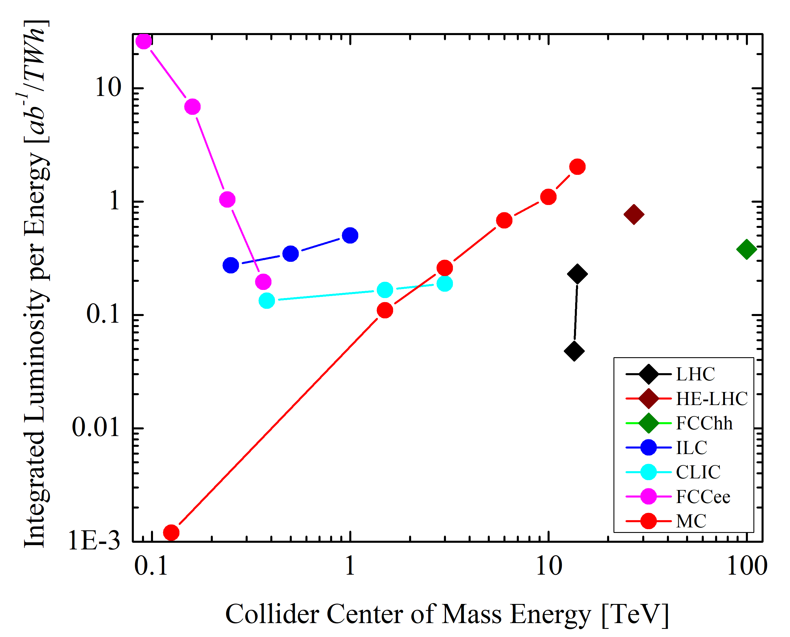
Why a multi-TeV Muon Collider?
arXiv:2007.15684 [physics.acc-ph]
Energy Efficiency of Future Colliders
Overwhelming
physics potential:
Precision measures
Discovery searches
FCCee
Muon Collider
ILC
FCChh
HL-LHC
CLIC
Challenging
Machine Design:
Key issues/risks
R&D plan and synergies

Slide 9
MUon collider STrategy network - MUST
INFN, CERN (+BINP), CEA, IJCLAB, KIT, PSI, UKRI (USA not beneficiary)
Task 5.1
A collider of muons could be a compact and efficient way to reach energies of interest for future physics discoveries; but, a substantial R&D program is needed to prove its feasibility and to assess its cost. The first Strategy group in WP5 will prepare the ground for a future high-energy muon collider, by comparing alternative options for muon production and cooling, by developing a baseline collider scenario, and by devising the optimum test facilities to prove its feasibility.
It will serve as the common ground for a growing international muon-collider collaboration.
Task 5.1 MUST will support to establish an international collaboration and develop an optimised R&D roadmap towards a future muon collider, including the definition of optimum test facilities and possible intermediate steps.

Slide 10
Muon Collider – international scenario
International Muon Collider Collaboration - Project Leader: Daniel Schulte
Objective:
In time for the next European Strategy for Particle Physics Update, the study aims to establish
whether the investment into a full CDR and a demonstrator is scientifically justified.
It will provide a baseline concept, well-supported performance expectations and assess the associated key risks as well as cost and power consumption drivers.
It will also identify an R&D path to demonstrate the feasibility of the collider.
Scope:
• Focus on two energy ranges:
– 3 TeV if possible with technology ready for construction in 10-20 years
– 10+ TeV with more advanced technology, the reason to chose muon colliders
• Explore synergy with other options (neutrino/higgs factory)
• Define R&D path

Slide 11
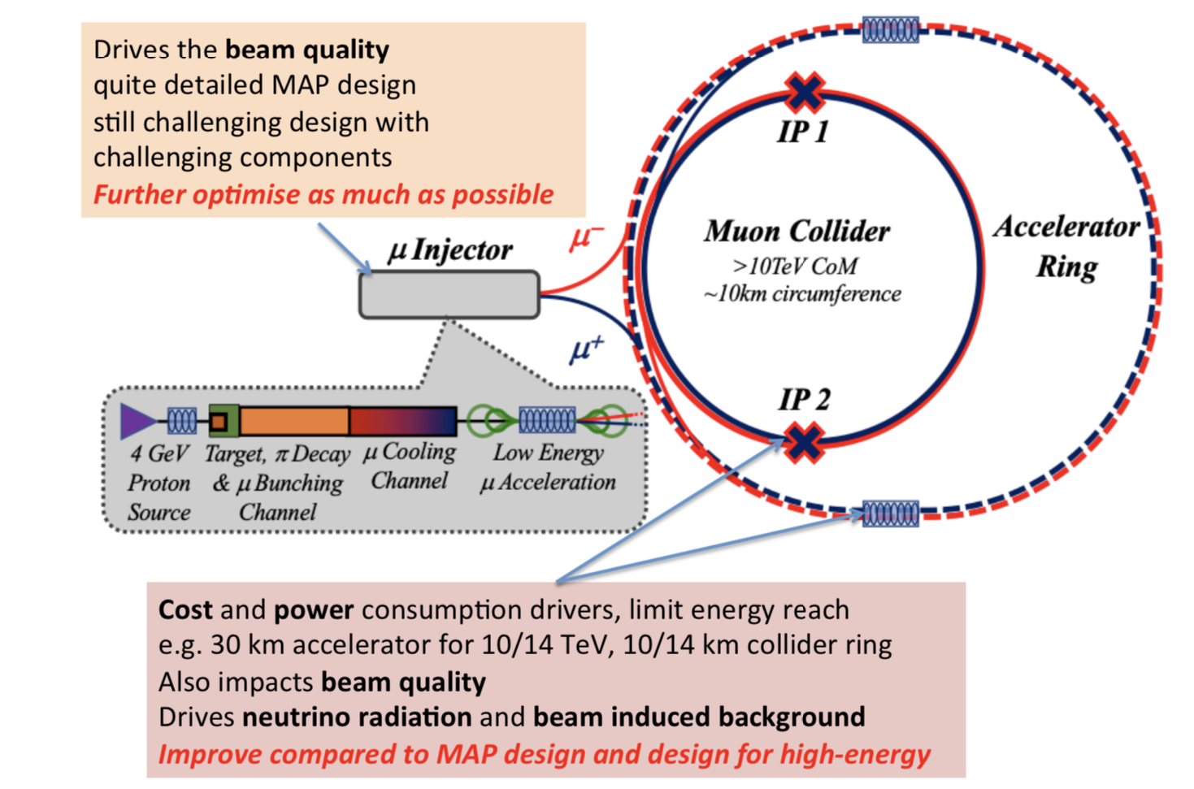
Baseline facility sketch
Alternative Muon production Sources,
such as LEMMA, could be considered

Slide 12
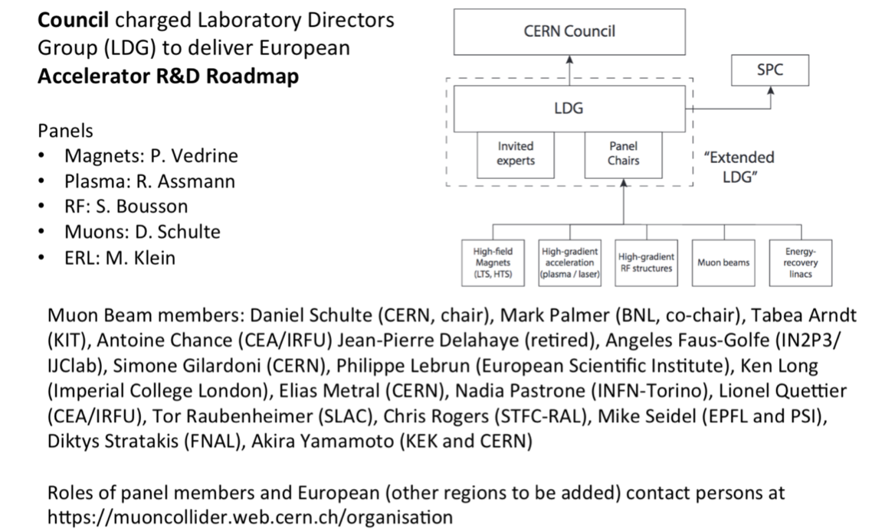
European Accelerator R&D Roadmap
Muon Beam Panel
Community Meeting May 20-21:
https://indico.cern.ch/event/1030726/
RF
Magnets
High-energy complex
Muon production and cooling
Proton complex
Beam Dynamics
Radiation protection and other technologies
MDI

Slide 13
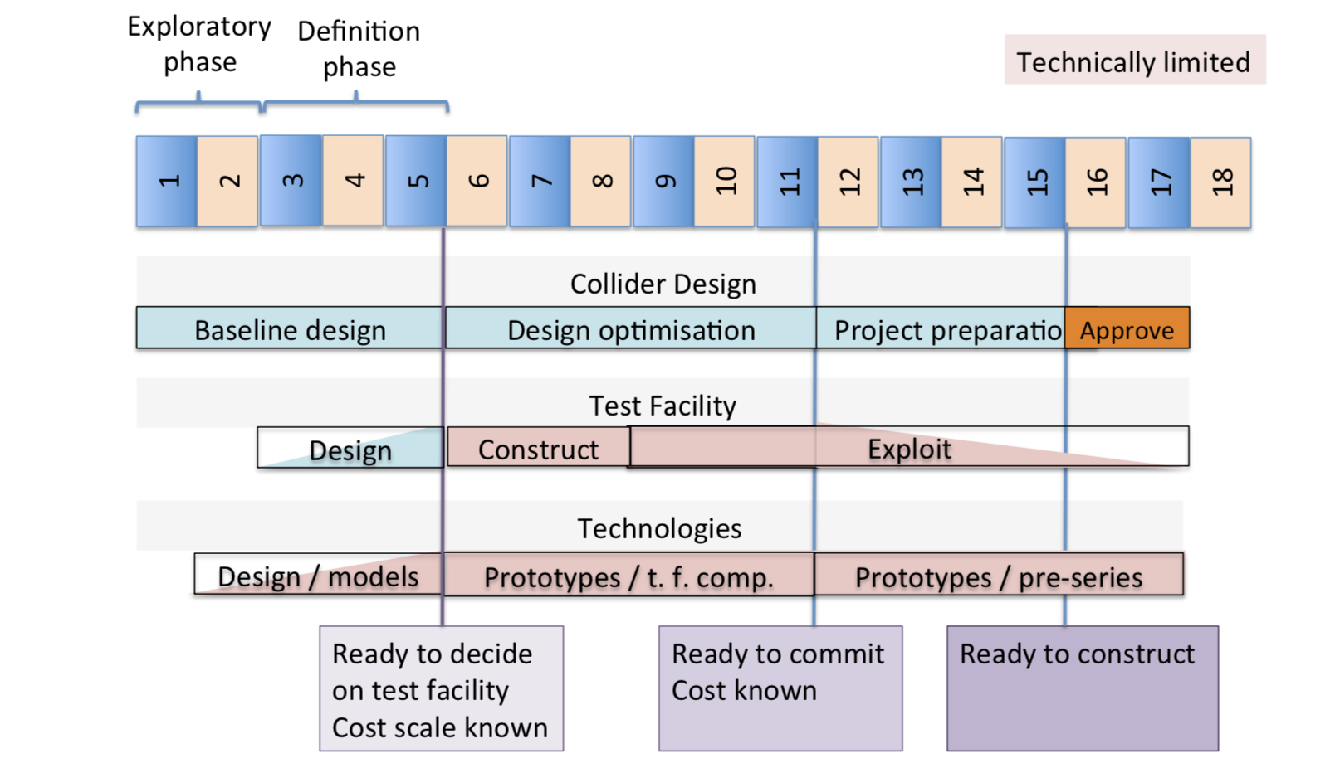
Potential long-term timeline
Web page:
http://muoncollider.web.cern.ch
Mailing lists to subscribe:
Login at: https://e-groups.cern.ch
search for “muoncollider”
i.e. -FACILITY@cern.ch

Slide 14
MUST activities and goals
INFN, CERN (+BINP), CEA, IJCLAB, KIT, PSI, UKRI /STFC
Support the effort to design a muon collider and to project and plan the required R&D
Consolidate the community devoted to develop an international future facility
Prepare the platform to disseminate the information (website, meetings, simulation tools)
A Europe-wide network is essential for the development of the collider design and technology, which will serve as a common forum to coordinate with the growing international muon-collider efforts, including the US-MAP collaboration, sharing data and results.
The muon collider requires an intense muon source, fast muon acceleration to high energies and efficient collisions to provide high luminosity:
  The fast acceleration stage and the collider ring are critical for the collider cost, power consumption and performance, and technologies that can be developed in synergy with other future projects.
  The decay of muons produces intense fluxes of neutrinos and electrons, sources of background in the machine and in the detector. Dedicated technology development and close collaboration between the accelerator and the detector will be needed to address this issue.
This task will provide a platform to discuss the plans for key R&D and test facilities as well as disseminate the information on muon colliders activities.

Slide 15
MUST deliverables and milestones
D5.1: International collaboration plans towards a multi-TeV muon collider M46
Report on established collaboration and results disseminated by the action
MS15: International workshop on muon source design M18
Report
MS16: International workshop to define R&D plans M36
Report
Budget: 240 keu + overhead
Total manpower: 58 PM

Slide 16
Planning ahead
AMBITION: successful implementation of an international plan to address all studies and key issues towards the design of a muon collider capable to reach multi-TeV collision energies with an adequate luminosity for high-precision measurements and new discoveries.
CHALLENGES: establish an organized international collaboration to address key issues and plan future steps. Evaluate reuse of existing infrastructures taking into account neutrino radiation hazards. Design of needed test facilities to address final feasibility.
MUST will actively contribute:
Seeking for new EU et other regions collaborators
Network in EU & other regions: USA – ASIA - activities ongoing at SnowMass21 process
Promote synergies with other projects/industries for technologies R&Ds

Slide 17
Thanks for the attention!

