Slide 1
SINDES
Secure INformation DElivery System
CERN IT/CF-ASI

Slide 2
Outline
What is SINDES
Weak points
How to improve

Slide 3
What is SINDES
Main purpose:
  CA - manage the certificates
  Store & deliver confidential information

Slide 4
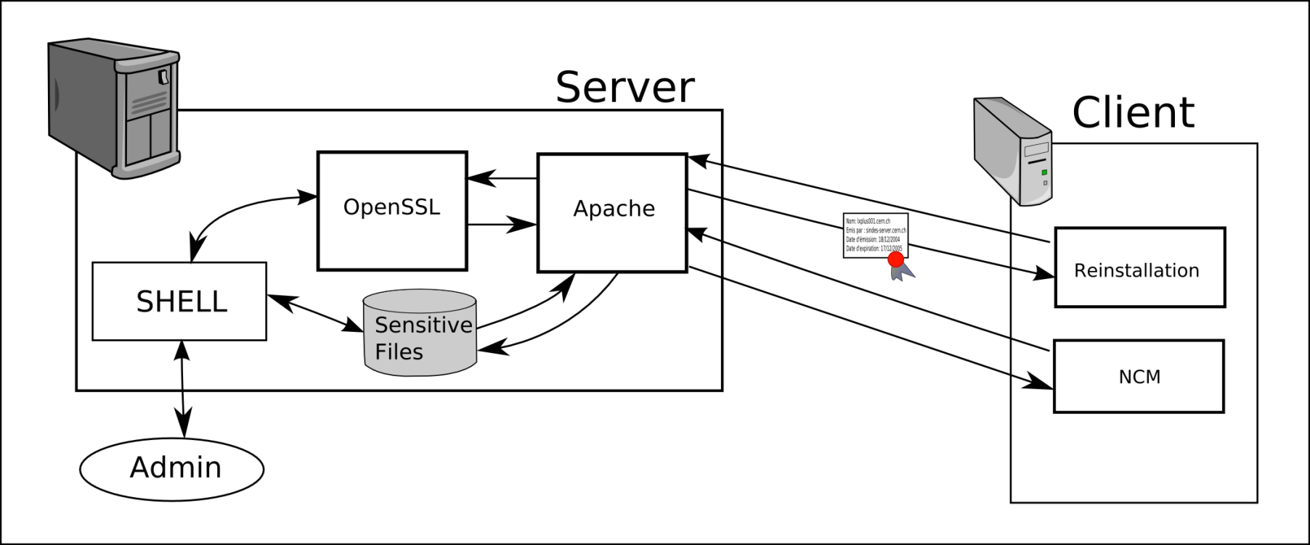
SINDES – Certificate Authority
CA functionality:
Create certificates
Sign certificates
Confirm identities
Revoke certificates

Slide 5
SINDES – Storage & delivery
Storage centre
Upload secret files
Store passwords
Deliver files in a secure way

Slide 6
What is SINDES
Main purpose:
  CA - manage the certificates
  Store & deliver confidential information
Architecture based on OpenSSL x509 standard, Apache with mod_ssl and mod_rewrite
Automated certification process – client has defined time window to ask for a certificate

Slide 7
Outline
What is SINDES
Weak points
How to improve

Slide 8
Weak points of SINDES
Usability
  No delete file feature
  Only two target types:
    cluster
    host
  today also subcluster type needed
  No mechanism to move a machine between clusters
  No view file feature; fetch file to client only
  No file versioning

Slide 9
Weak points of SINDES
Security issues:
  Only one SINDES system user
    anybody with the access may tamper any file stored with SIDNES
    no user information in log files
  No privileges granularity

Slide 10
Weak points of SINDES
On the one hand:
  System in production serving more than 8.000 hosts at CERN
  A number of crucial applications relying on SINDES CA functionality to authenticate (i.e. Lemon, CDB, CluMan)
On the other hand:
  Limited functionality
  Room for improvement in security aspect

Slide 11
Outline
What is SINDES
Weak points
How to improve

Slide 12
How to improve SINDES
Ways of improvement
  Enhance the usability and security in the current version of the system
  Find and adopt a new tool, keep the functionality
    Freeware tools: i.e. wallet by Russ Allbery http://www.eyrie.org/~eagle/software/wallet/
  Write a completely new tool
We have 1 year manpower starting from the 1st October 2010

Slide 13
Thank you
We would be glad to receive any feedback from You!
jan.dudziec@cern.ch

