Slide 1
P219 Experiment at GSI-PHELIX : Introduction, Status, Planning
Experiment Progress Meeting
Online meeting – 23.06.2021
A. Bertarelli (CERN)

Slide 2
Outline
Introduction
Partners
Proposal
Simulations
Instrumentation
Open Questions
Proposed Timeline

Slide 3
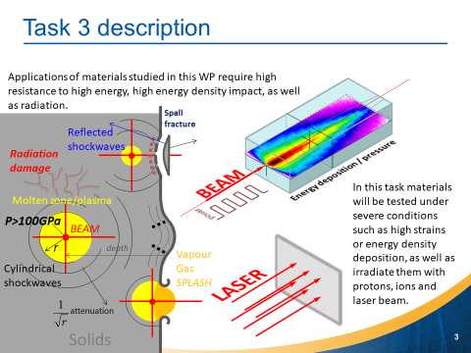
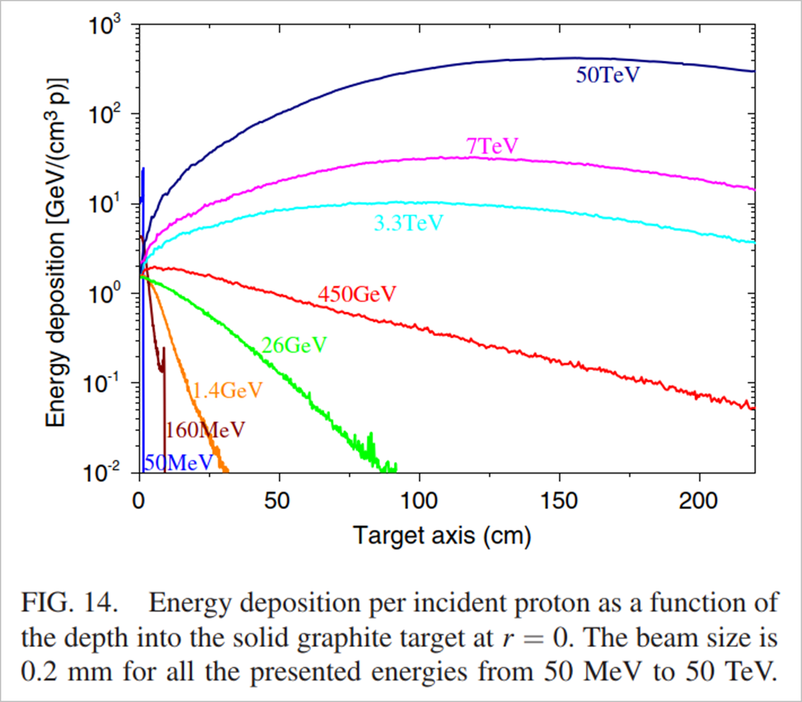
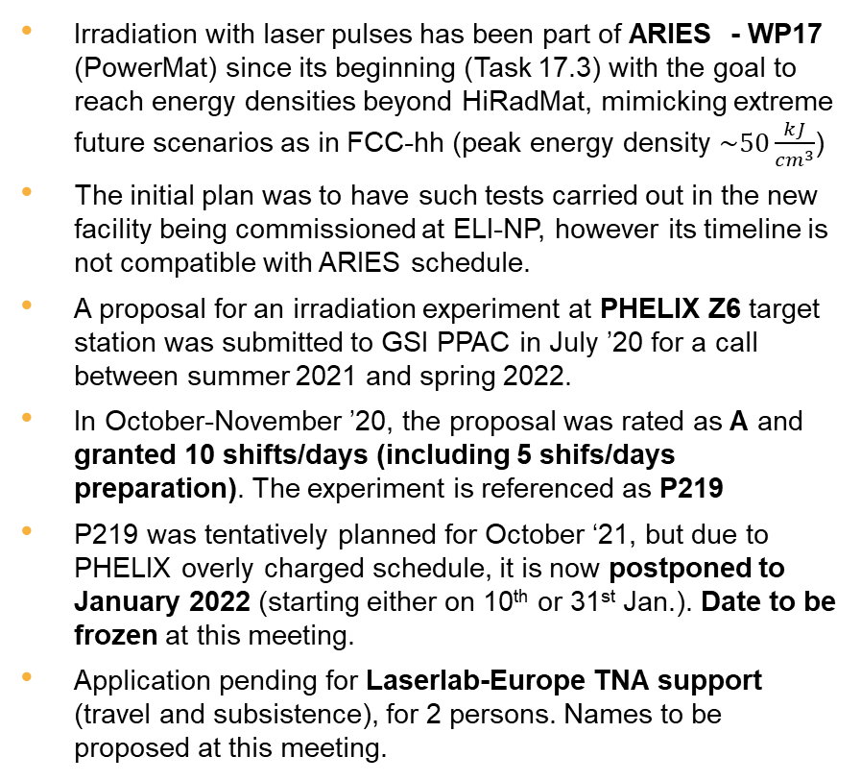
Introduction to P219 Experiment
Irradiation with laser pulses has been part of ARIES - WP17 (PowerMat) since its beginning (Task 17.3) with the goal to reach energy densities beyond HiRadMat, mimicking extreme future scenarios as in FCC-hh (peak energy density $\sim 50\frac{kJ}{{cm}^{3}}$)
The initial plan was to have such tests carried out in the new facility being commissioned at ELI-NP, however its timeline is not compatible with ARIES schedule.
A proposal for an irradiation experiment at PHELIX Z6 target station was submitted to GSI PPAC in July ’20 for a call between summer 2021 and spring 2022.
In October-November ’20, the proposal was rated as A and granted 10 shifts/days (including 5 shifs/days preparation). The experiment is referenced as P219
P219 was tentatively planned for October ‘21, but due to PHELIX overly charged schedule, it is now postponed to January 2022 (starting either on 10th or 31st Jan.). Date to be frozen at this meeting.
Application pending for Laserlab-Europe TNA support (travel and subsistence), for 2 persons. Names to be proposed at this meeting.

Slide 4
Partners within ARIES and beyond …
WWU Münster
  Marilena Tomut – Principal Investigator
  PhD doctoral student?
GSI
  Dennis Schumacher – Local Contact Person
  Vincent Bagnoud
  Christian Brabetz
  Paul Neumayer
  Marilena Tomut
  Philipp Bolz
Politecnico di Torino
  Lorenzo Peroni
  Martina Scapin
  Alberto Morena
ELI-NP
  Mihail Cernaianu
  Theodor Asavei
CERN
  Alessandro Bertarelli – Principal Investigator, Spokesperson
  Federico Carra
  Jorge Guardia Valenzuela
  Carlotta Accettura
  Michael Guinchard
  Oscar Sacristán de Frutos
  Lucie Baudin
Università di Roma “La Sapienza”
  Michele Pasquali
  Silvio Rasile
Other partners and participants may possibly join on the way …

Slide 5
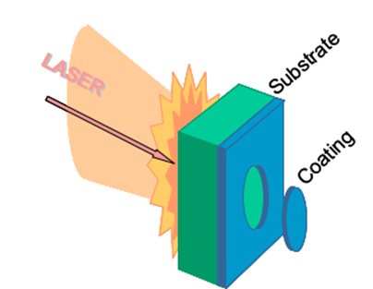
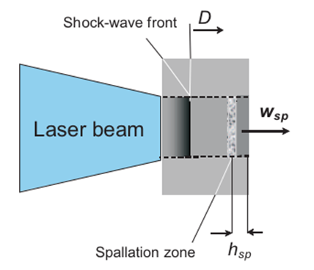
Experiment Proposal
The experiment aims at testing thin samples (disks or plates) of several materials under intense laser pulses:
  MoGr (several grades), CrGr (several grades), CFC, Graphite (several grades), CuCD, Carbon Foams … other materials also considered (e.g. bulk amorphous alloys, high entropy alloys from ). List to be confirmed
  Reference targets (e.g. Al) to be foreseen for calibration purposes
  In-plane and through-plane orientation for orthotropic materials
  Back face coated (Mo, Cu) to probe thin film adhesion (LASAT – Laser Adhesion Test)
  In some cases, impact face may be Al coated to get rid of “messy” laser-plasma interaction and obtain a “clean” planar wave in substrate (need to be confirmed by simulations). To be confirmed.
  Thickness varying from 0.25 mm to 2.5 mm
  Cross-section dimension 10÷20 mm. Cross-check with simulations
  In total ~40 specimens, including ~10 for set-up and calibration purposes (typically well-known metals as Al and/or Ta)
A strong shock wave will be generated in the impacted face, quickly decaying while moving towards the back face, possibly down to the acoustic regime (depending on sample thickness), but still strong enough to generate spallation near the back face

Slide 6
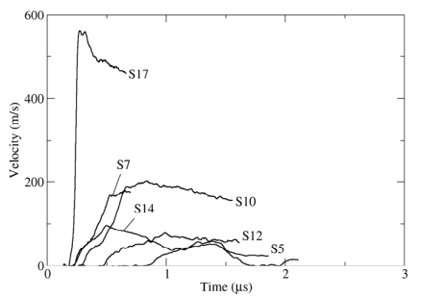
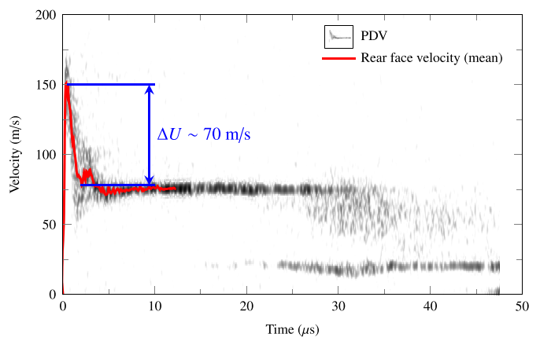
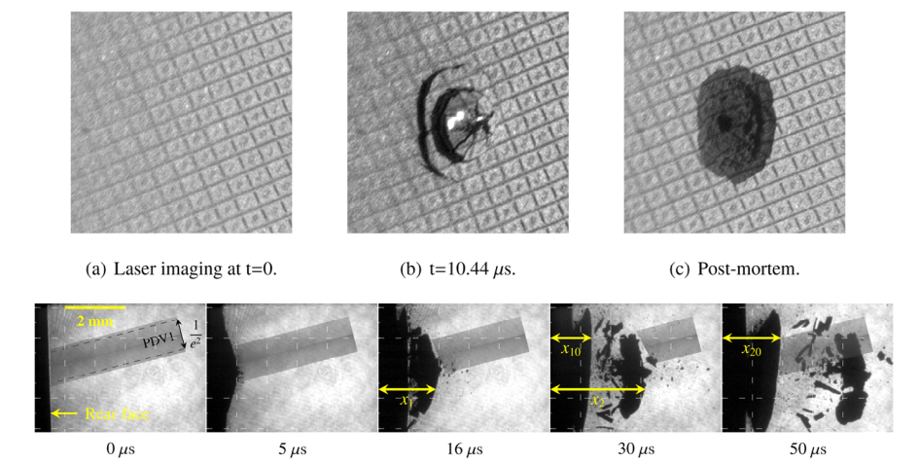
Experiment Diagnostics and PIE
The most important experimental information is the free surface velocity as a function of time. Through this parameter, a number of additional data and properties can be derived:
  Maximum pressure in spallation region
  Strain rate at back surface
  Material spall strength
  Coating dynamic adhesion strength
Online monitoring should focus on the behavior of back (free) surface.
  Free surface velocity acquired by VISAR; LDV (limited to 24 m/s) could be used away from centre or at end of phenomenon, when surface velocities drop below threshold. To be cross-checked with simulations
  Possibility of High speed photography of free surface ?
Post Irradiation Examination shall complement online measurements
  SEM imaging of front and back surfaces
  Raman spectroscopy of affected regions
  Micro-tomography
  ….

Slide 7
Simulation Activities
1-D simulation first performed at ELI-NP with HELIOS hydrodynamic code, using ATJ isotropic graphite
Results used as initial input for explicit simulations (LS-Dyna) at POLITO to study shock wave propagation (presentation by L. Peroni)
Numerical results should allow determining specimens thickness and velocity profile (temporal and spatial) on back surface to calibrate VISAR and LDV (aim at radially-offset location or study tail of the signal?)
Is it possible to simulate anisotropic (i.e. MoGr, CFC, CrGr) materials?
Is it possible to include coatings in simulations (on one or both faces)?

Slide 8
Instrumentation List
Non-exhaustive list of possible experiment instrumentation
  GSI VISAR
  POLITO High Speed Camera
  CERN Laser Doppler Vibrometer
  Other instrumentation available at GSI?
Specifications of these devices to be collected

Slide 9
Technical Questions
Z6 Test Station
  How long for the preparatory phase (e.g. chamber mounting, table preparation …)
  Any specific safety requirement?
Experimental Chamber:
  Is it compatible with several instruments simultaneously (i.e. VISAR, LDV, High Speed Camera …)?
  Are specimens supports already available? Compatible with which dimensions?
GSI VISAR (see Christian’s presentation):
  What are its specifications (Max acquisition time, max/min measurable velocity …) ?
  Who will operate it?
  How many shots for calibration/synchronisation?
  Any available reference measurements on well know-materials? Available publications?
POLITO High Speed Camera:
  Is it available at the time of the experiment?
  What are its specifications?
  Who will operate it?
  Is pulse-laser illumination needed? Available?
Specimens
  Can we freeze their dimensions (thickness and diameter)?
  Any requirement of (back) surface roughness? Any reflectivity issue?
  Can we freeze the list of materials, including BAA and HEA?

Slide 10
Logistics Questions
Personnel
  How many people can/should be simultaneously present at test station?
  Is it recommended/possible to visit the facility before the test?
  Any access restriction?
  Who should we include in TNA support request?
Material
  Procurement timeline for specimens (including coatings) to be defined
  Any specific support component or tool to be procured/supplied (e.g. holders …)?
Costs
  Experiment takes place beyond WP17 closure date (31.12.2021). All material costs should be engaged and paid before end of the year …
  Informal agreement with ARIES Project Leader to pay travels on ARIES WP1 which will remain operational until 30.04.22

Slide 11
Proposed Timeline
September ‘21. Complete numerical simulations on maximum spectrum of materials (likely not possible for all). Who? ELI-NP (Helios), POLITO (Helios, LS-Dyna), CERN (Autodyn), UniRoma (?)
Summer ‘21. Start specimens procurementJun. 21 – Jul. 21. Pre-irradiation measurements and controls
November ‘21. Specimens available and pre-irradiation examined
January-February ‘22. Experiment (proposed start date 31 January, if all agree)
Feb. ‘22 - Mar.’22. First post-irradiation examinations and preliminary reports
April ’22. Presentation at ARIES close-out meeting

Slide 12
Thank you for your attention!

Slide 13
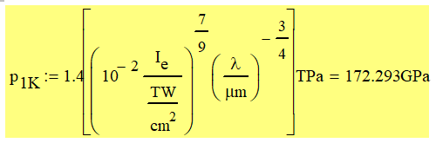
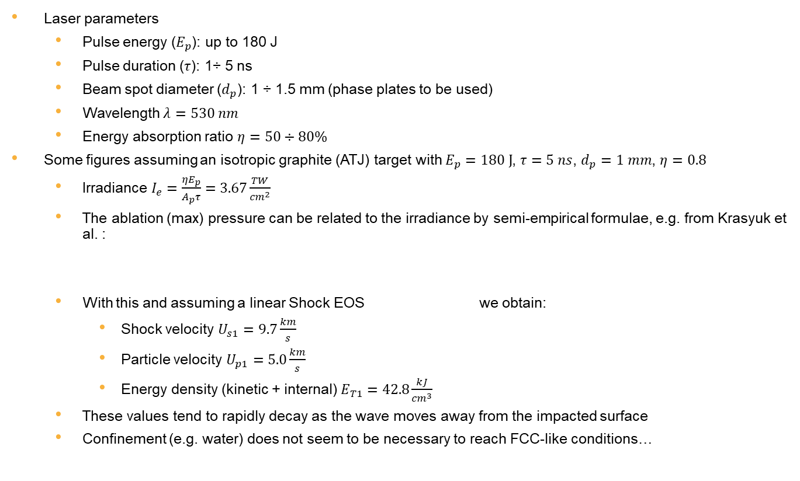
Some figures …
Laser parameters
  Pulse energy ($E_{p}$): up to 180 J
  Pulse duration ($τ$): 1÷ 5 ns
  Beam spot diameter ($d_{p}$): 1 ÷ 1.5 mm (phase plates to be used)
  Wavelength $λ=530 nm$
  Energy absorption ratio $η=50÷80\%$
Some figures assuming an isotropic graphite (ATJ) target with $E_{p}=180 J$, $τ=5 ns$, $d_{p}=1 mm$, $η=0.8$
  Irradiance $I_{e}=\frac{ηE_{p}}{A_{p}τ}=3.67\frac{TW}{{cm}^{2}}$
  The ablation (max) pressure can be related to the irradiance by semi-empirical formulae, e.g. from Krasyuk et al. :
  With this and assuming a linear Shock EOS we obtain:
    Shock velocity $U_{s1}=9.7\frac{km}{s}$
    Particle velocity $U_{p1}=5.0\frac{km}{s}$
    Energy density (kinetic + internal) $E_{T1}=42.8\frac{kJ}{{cm}^{3}}$
  These values tend to rapidly decay as the wave moves away from the impacted surface
  Confinement (e.g. water) does not seem to be necessary to reach FCC-like conditions…

