Slide 1
Simulations results
Overview of results collected at ELI-NP and POLITO
Progress meeting for P219 Experiment in PHELIX
Lorenzo Peroni
Martina Scapin and Alberto Morena

Slide 2
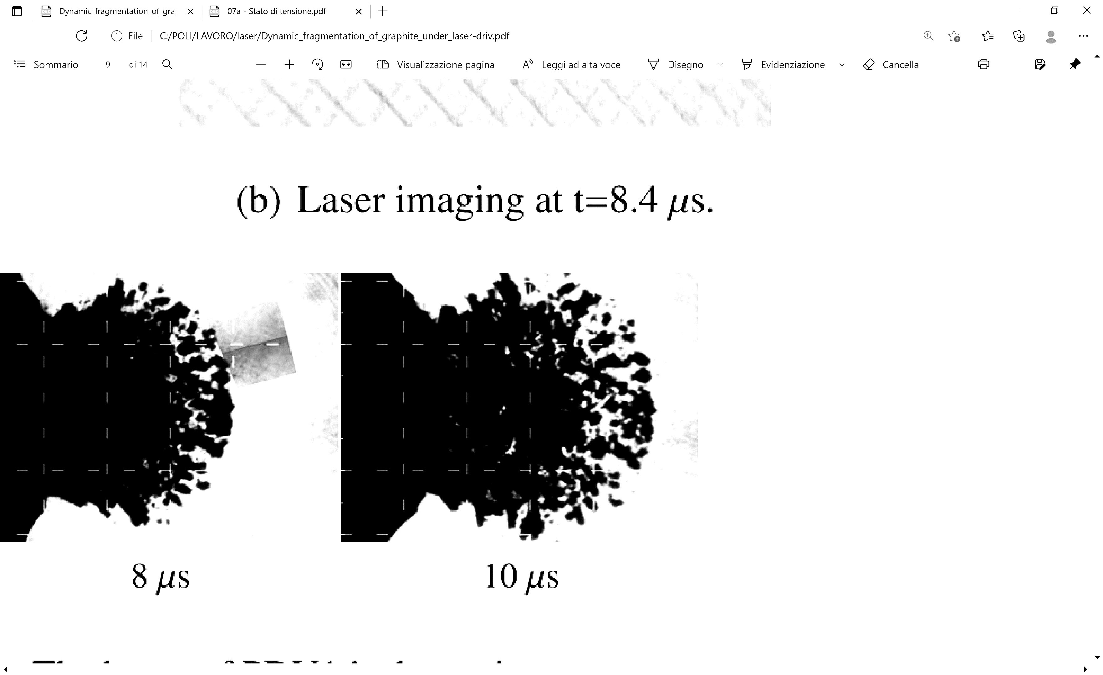
Summary
  ELI-NP simulations (HELIOS)
  POLITO methodology
  Benchmark and calibration
  GSI experiments predictions
  Conclusions and outcomes

Slide 3
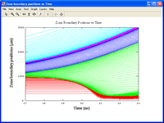
HELIOS code
  The high-power lasers produce a surface plasma condition which acts as high-pressure loading source condition for the material in the rear portion of the sample.
HELIOS is a 1-D radiation-hydrodynamics code designed to study the hydrodynamic evolution of radiating plasmas. It can be used to study the evolution of planar, cylindrical, or spherical plasmas heated by laser beams.
The code updates energy and momentum conservation equations in a Lagrangian reference frame (i.e., grid moves with fluid).
Target → SESAME equation of state, thermal conductivity, and electrical resistivity data.
Laser → Irradiance (W/m²); pulse time history

Slide 4
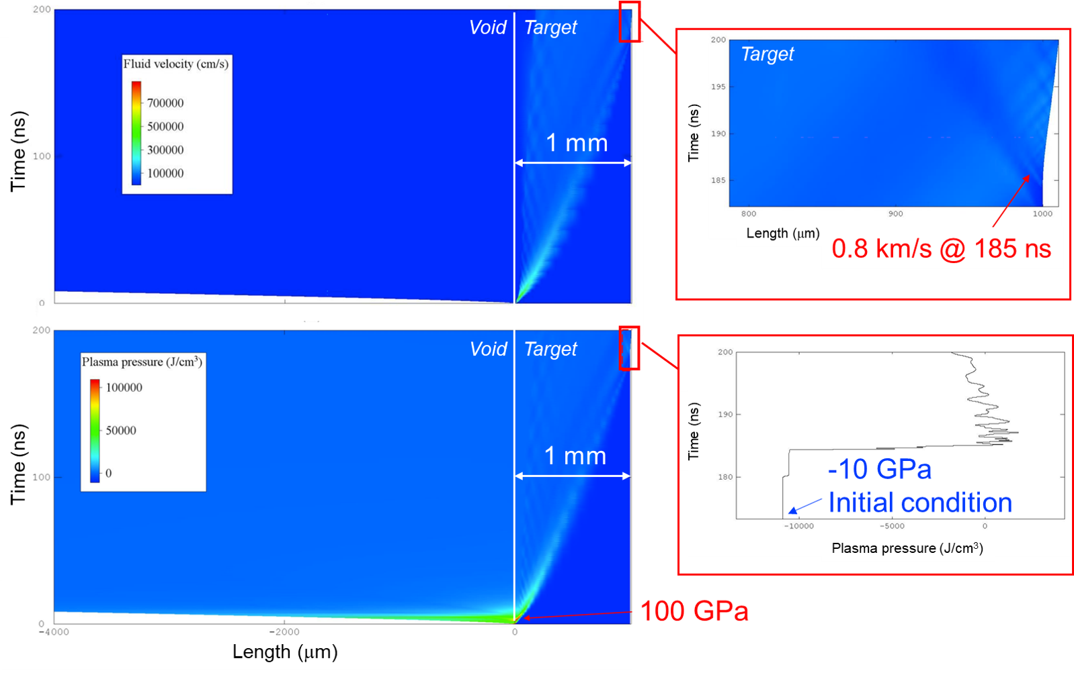
ELI-NP preliminary results
Velocity
Pressure
Target → material: graphite 1.77 g/cm³; thickness: 1 mm
Laser → energy: 180 J; spot diameter: 1 mm; pulse duration: 5 ns

Slide 5
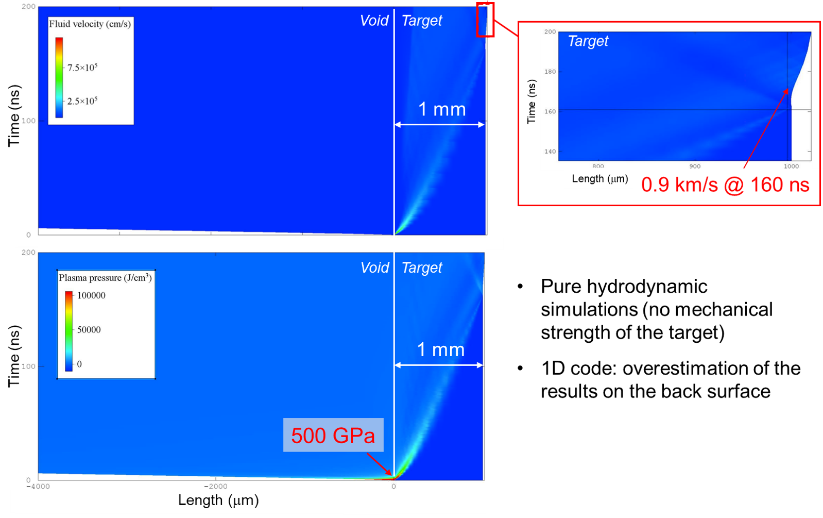
ELI-NP preliminary results
Velocity
ELI-NP Conclusion:
Pressure
Target → material: graphite 1.77 g/cm³; thickness: 1 mm
Laser → energy: 180 J; spot diameter: 1 mm; pulse duration: 1 ns

Slide 6
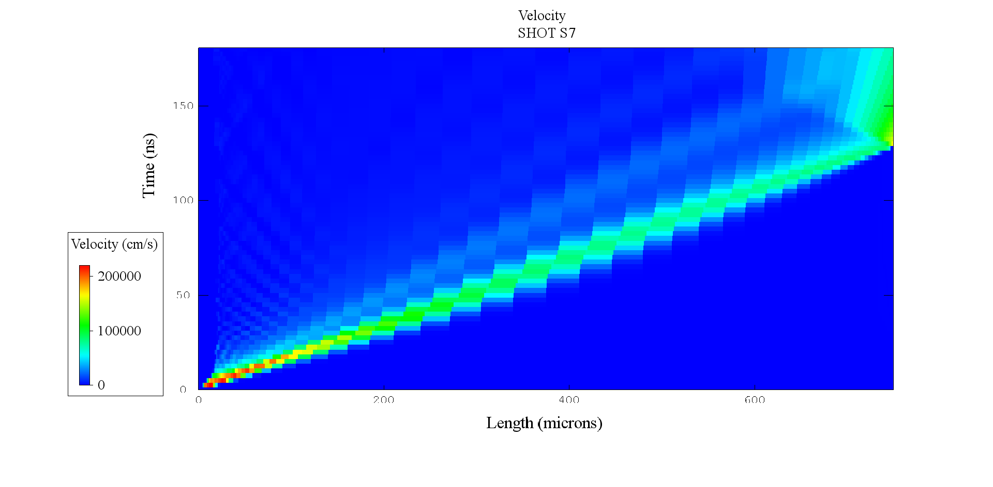
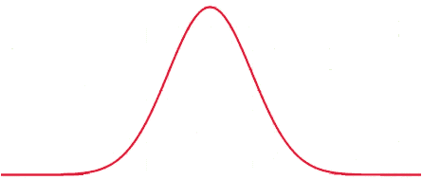

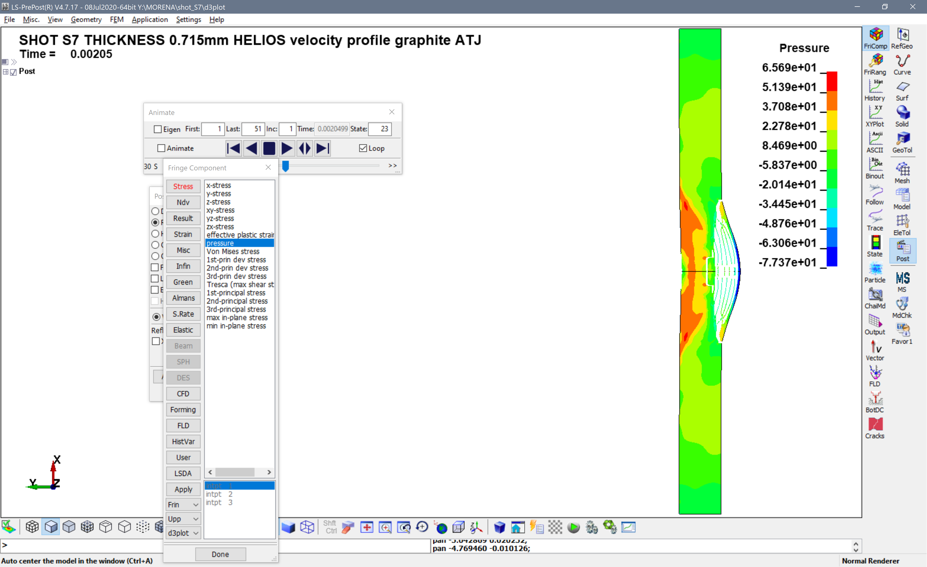

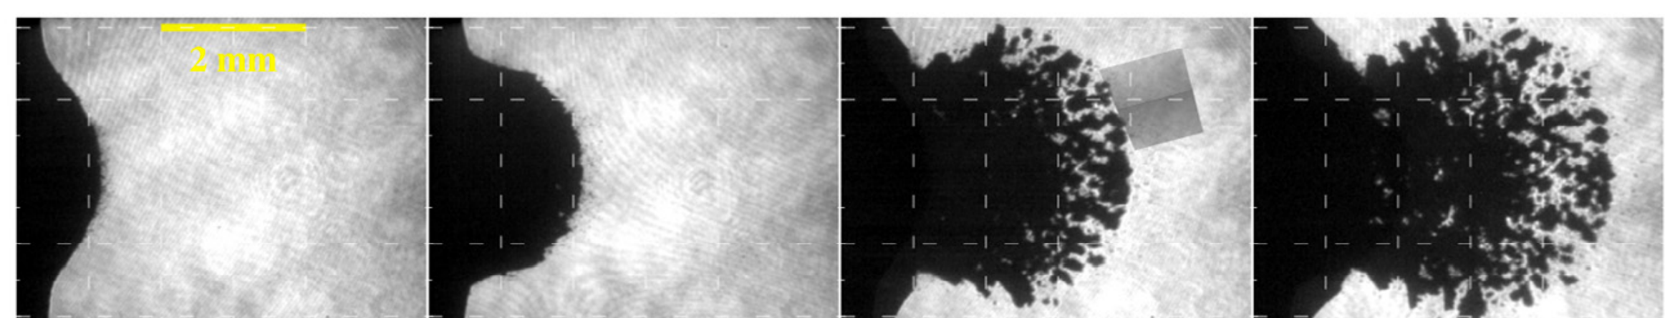
The experiment methodology
Design of the experiment
Helios
Spatial distribution
time duration
Target
3D/2D axisymmetric simulation of the shock propagation and the target failure
1D simulation for the laser deposition phase
Shock
LASER
Bulge Fragmentation
VISAR,
PDV, (LDV)
Spot size
Spall
Thickness
High-speed camera
LS-DYNA
Comparison of the results and model validation

Slide 7
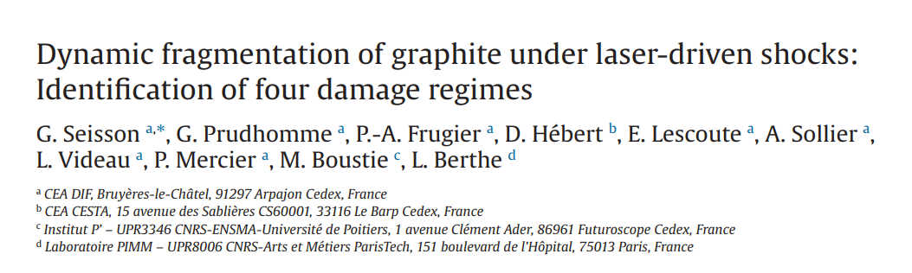
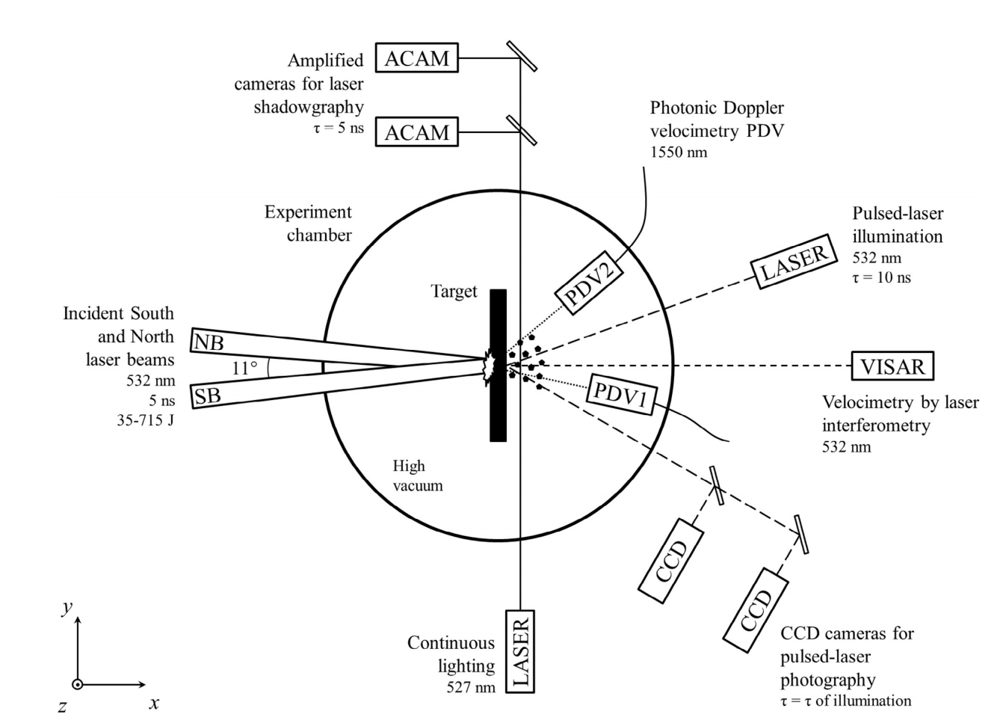
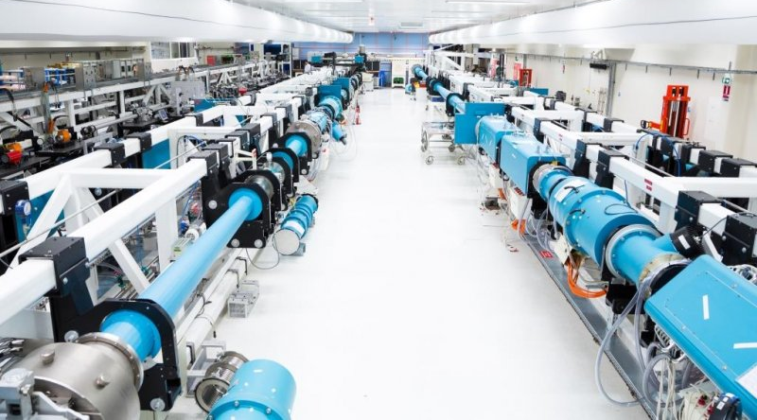
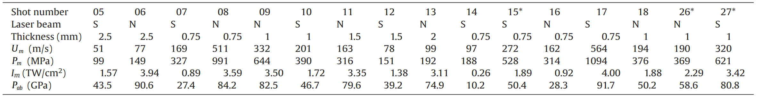
Benchmark
Validation and tuning of FE simulations based on CEA experiments
Experimental setup
LULI2000
Target → material: graphite (ρ₀=1.754 g/cm³)
Laser → spot diameter: 4 mm; pulse duration: 5 ns
Shot conditions

Slide 8
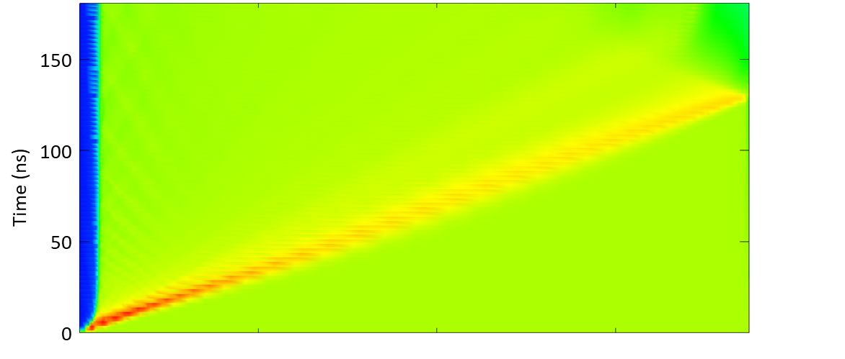
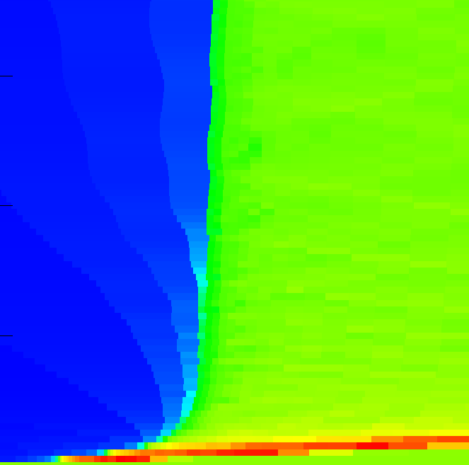
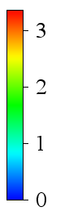
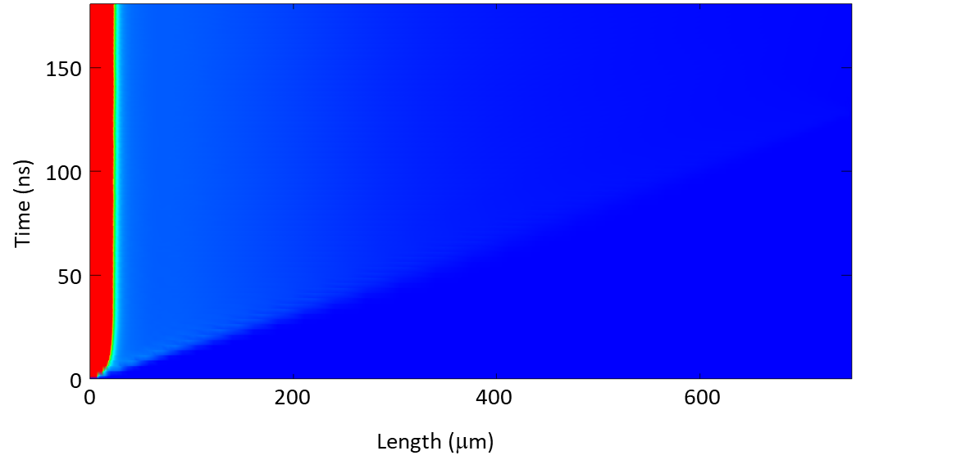
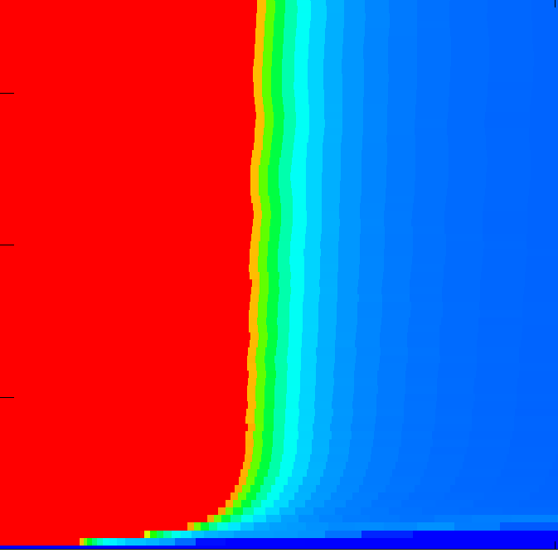
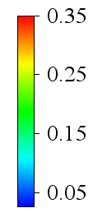
Helios results
Target
Non-solid region
CEA SHOT7
Shockwave
Mass density (g/cm³)
Target
50 μm
Non-solid region
Temperature (eV)
0.35 eV ≈ 4000 K
graphite melting temperature

Slide 9
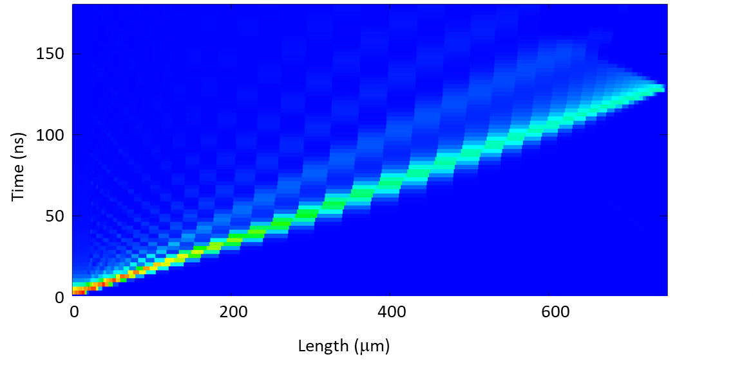
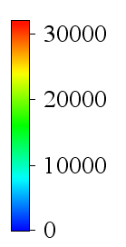
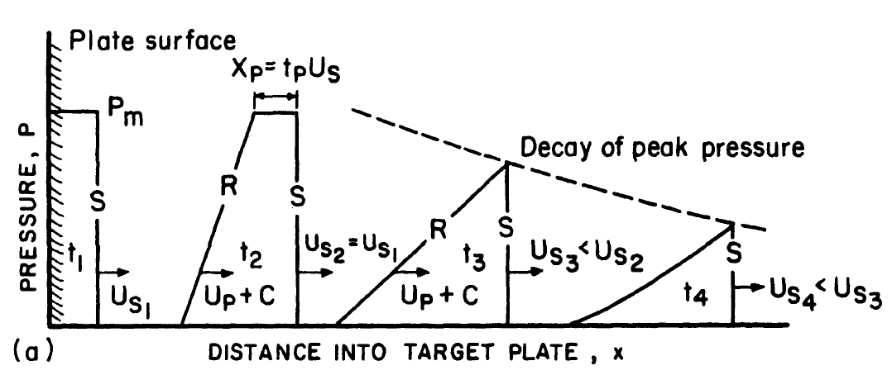
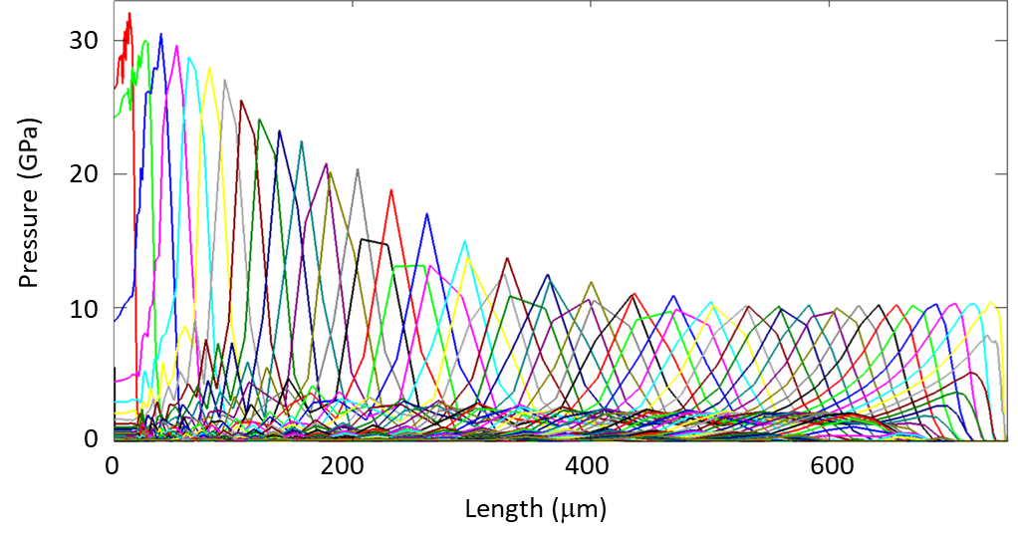
HELIOS results
Pressure
(MPa)
Target
Decay of the pressure peak
5 ns
At the end deposition time of 5 ns the shock wave front is at 35 microns far from the front surface
20 ns
30 ns
40 ns
50 ns
HELIOS
LS-DYNA

Slide 10
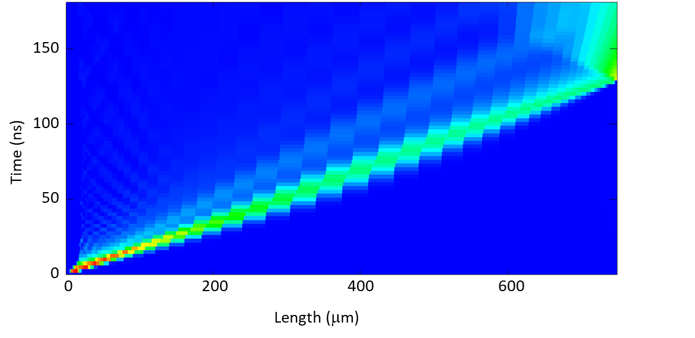
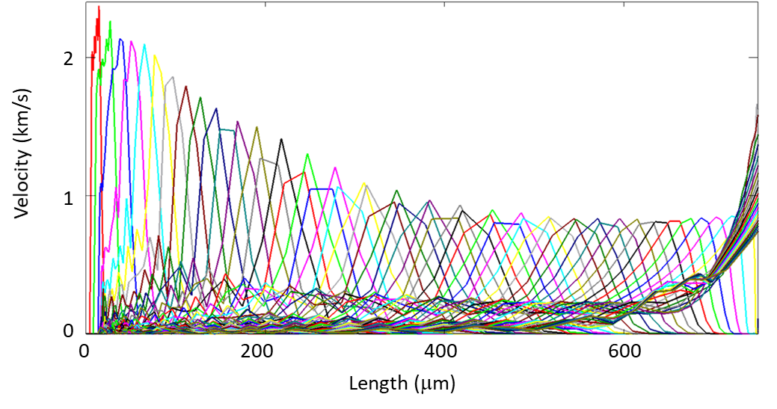
HELIOS results
Velocity
(cm/s)
Target
5 ns
20 ns
30 ns
40 ns
50 ns
Boundary condition for FE simulations
Helios
LS-DYNA

Slide 11
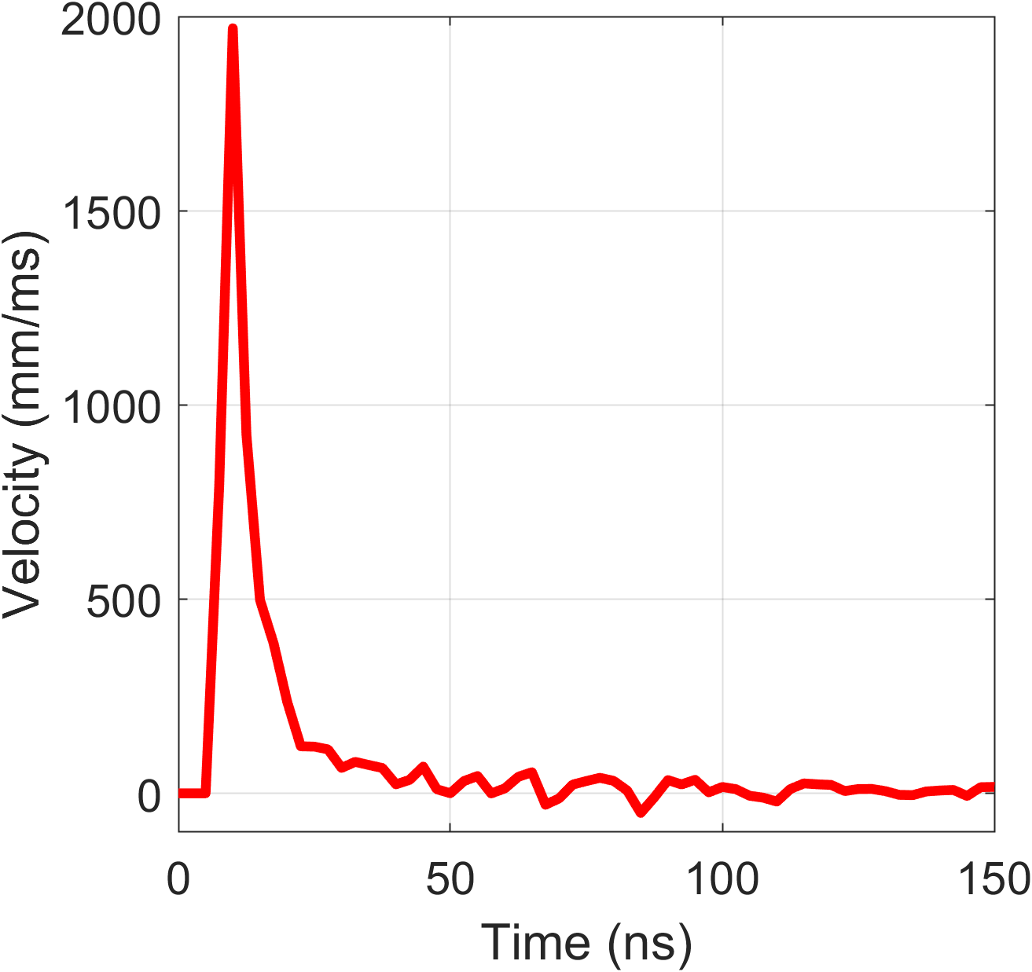
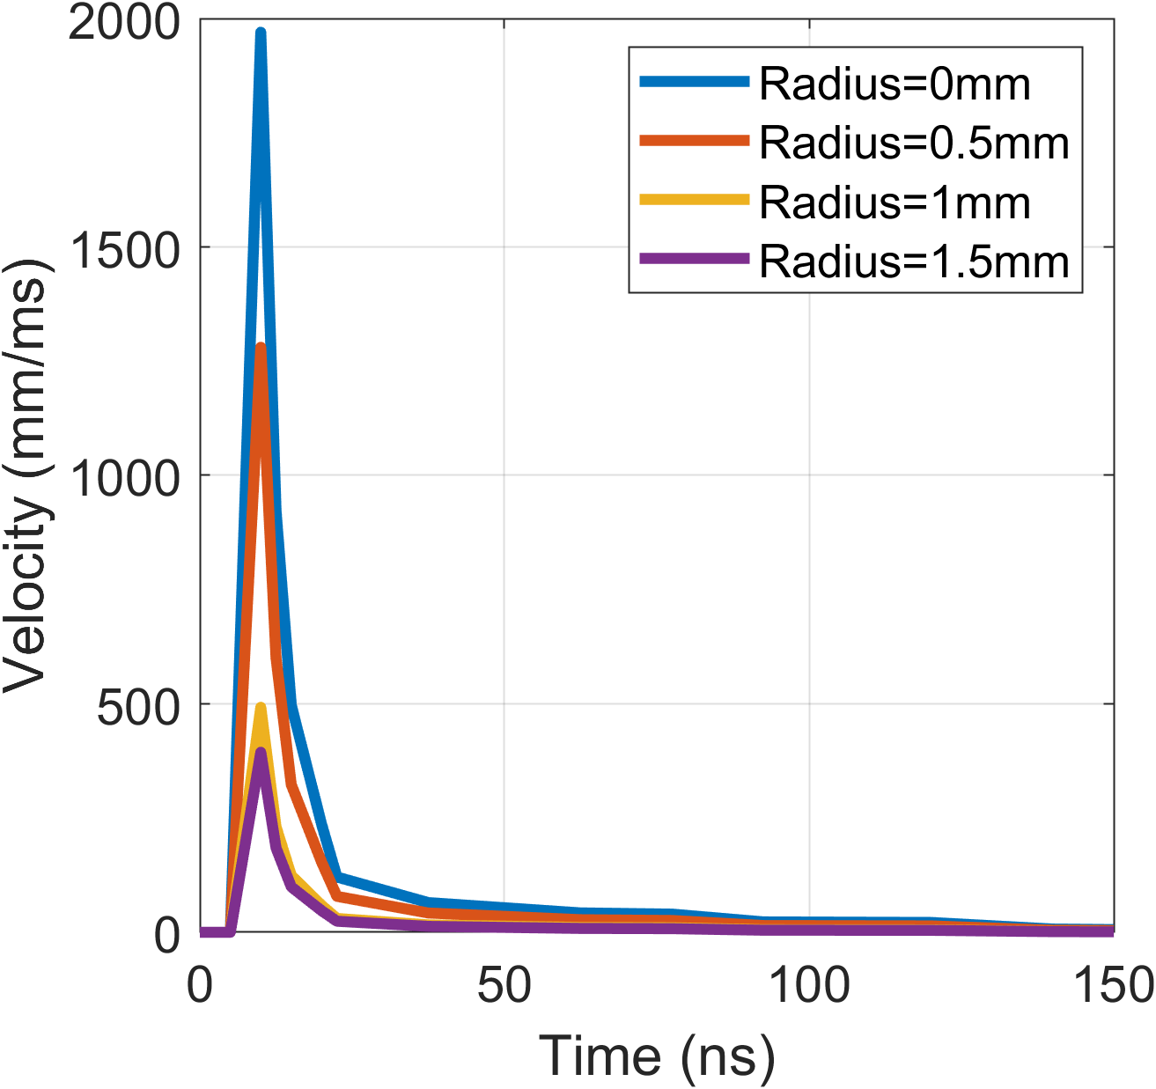
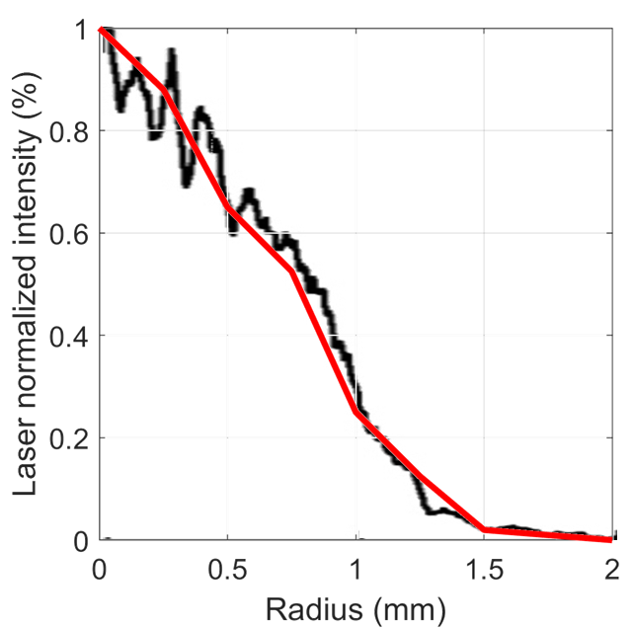
HELIOS to LS-DYNA
From HELIOS at a chosen depth
Attention to the Timestep!
Boundary conditions: velocity time history profiles imposed to the nodes on the surface
R=0 mm
R=0.5 mm
R=1 mm
Scale factor: spatial characteristic of the laser pulse
R=1.5 mm
Velocity
Solid target
Spot radius
Reduced Thickness
LS-DYNA
Radius

Slide 12
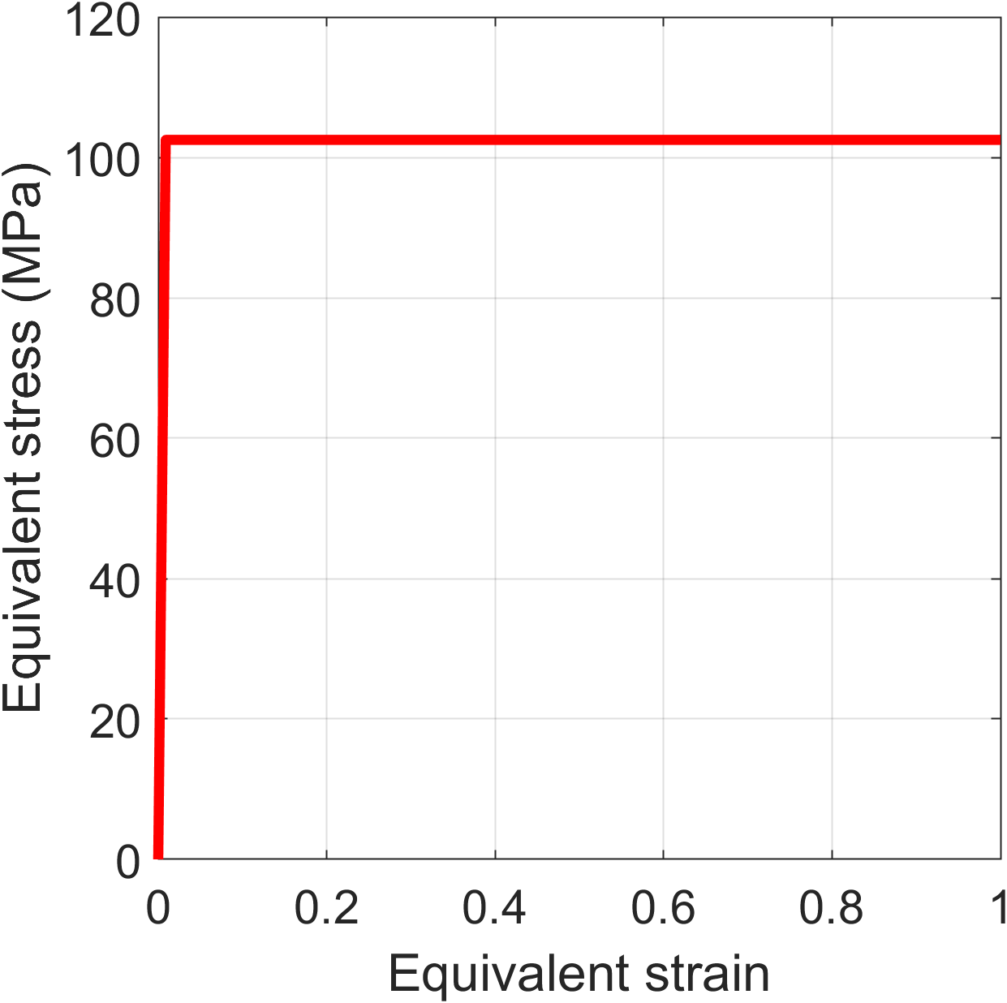
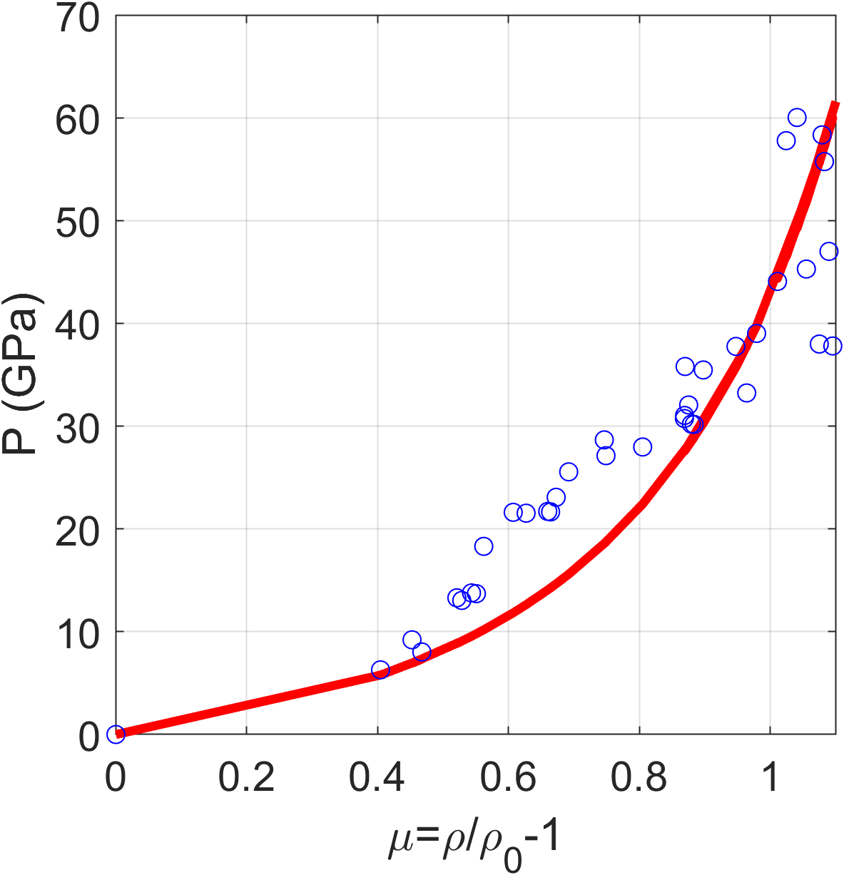
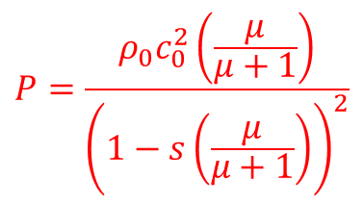
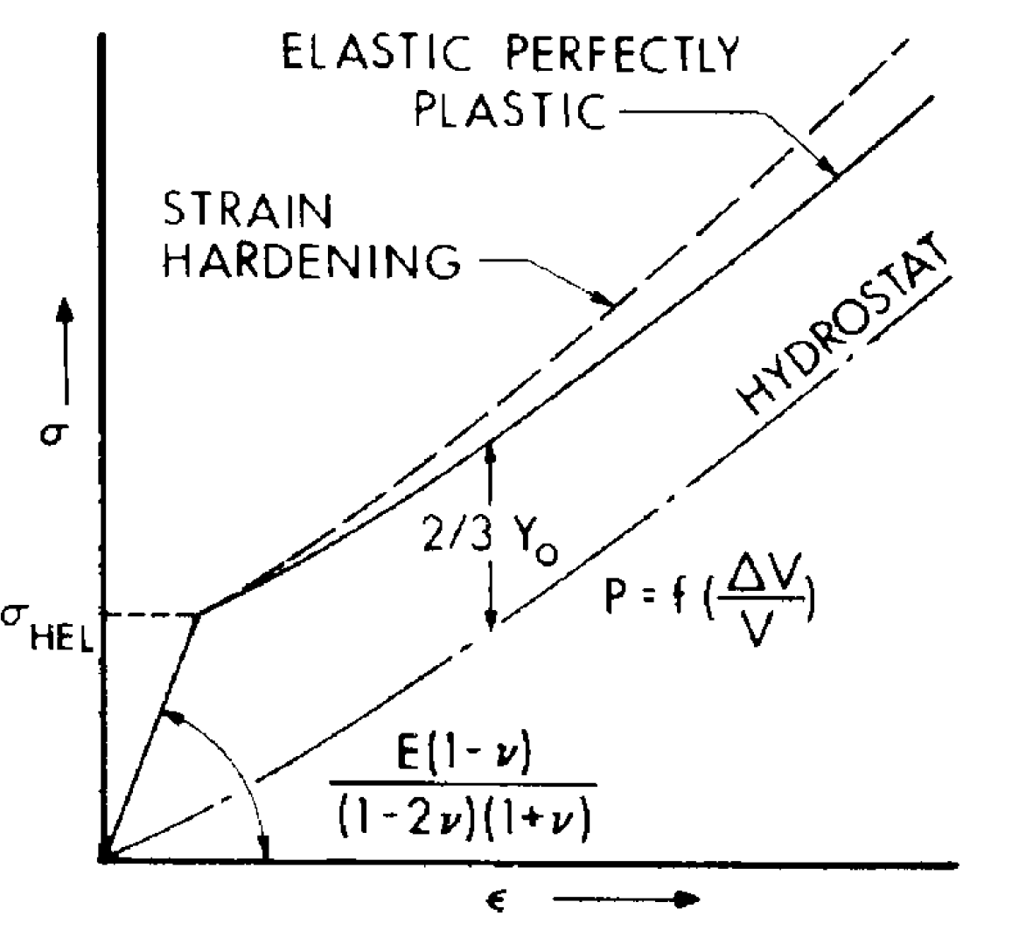
LS-DYNA material model
EOS: Grüneisen
Elastic-perfectly plastic model
Porous graphite
data
In uniaxial strain case
(Compression)
Compression
FAILURE CONDITIONS
σ_{MAX}
ε_{MAX}
In tension!!

Slide 13
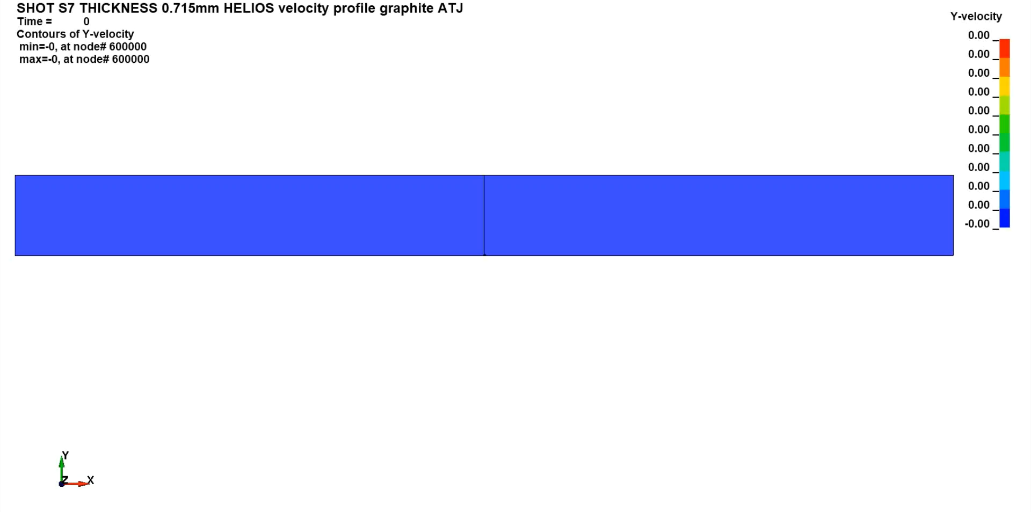
LS-DYNA results
SHOT 7 @ CEA
Target → material: porous graphite; thickness: 0.75 mm
Laser → energy: 121 J; pulse duration: 5 ns
Y-velocity (mm/ms)
v_{yMAX} = 1970 mm/ms
2 mm
LASER
0.715 mm
Evaluation of the velocity of the back surface
Mesuring spot dimension/position

Slide 14
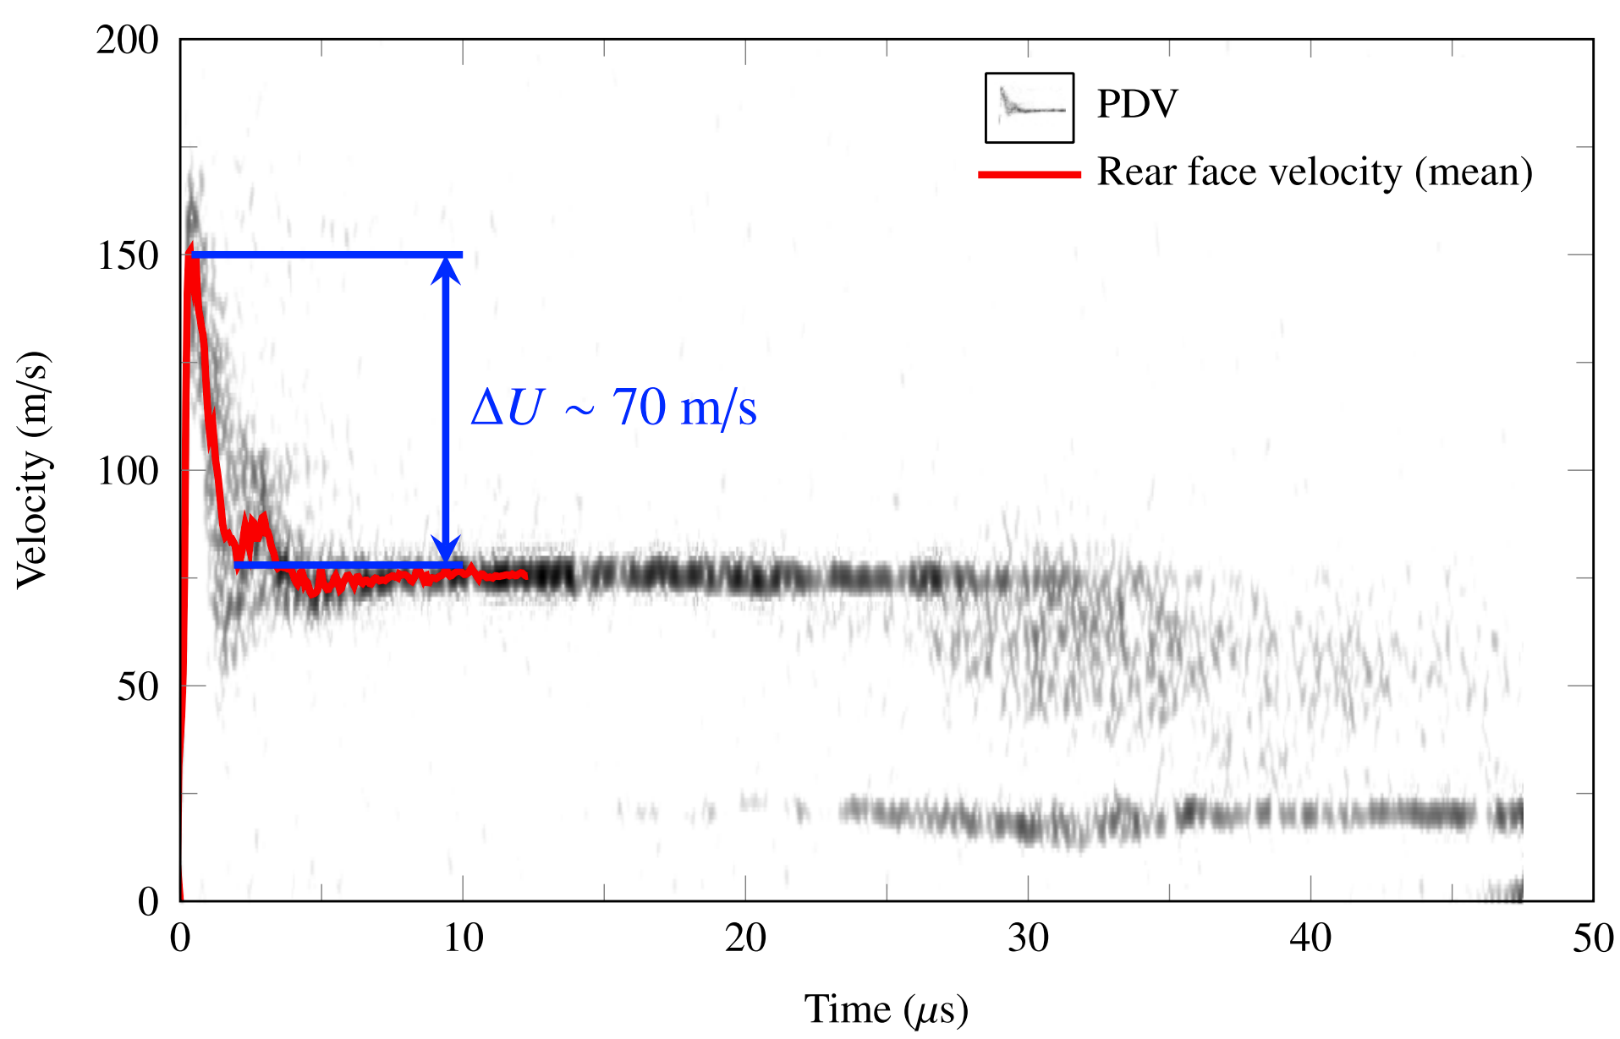
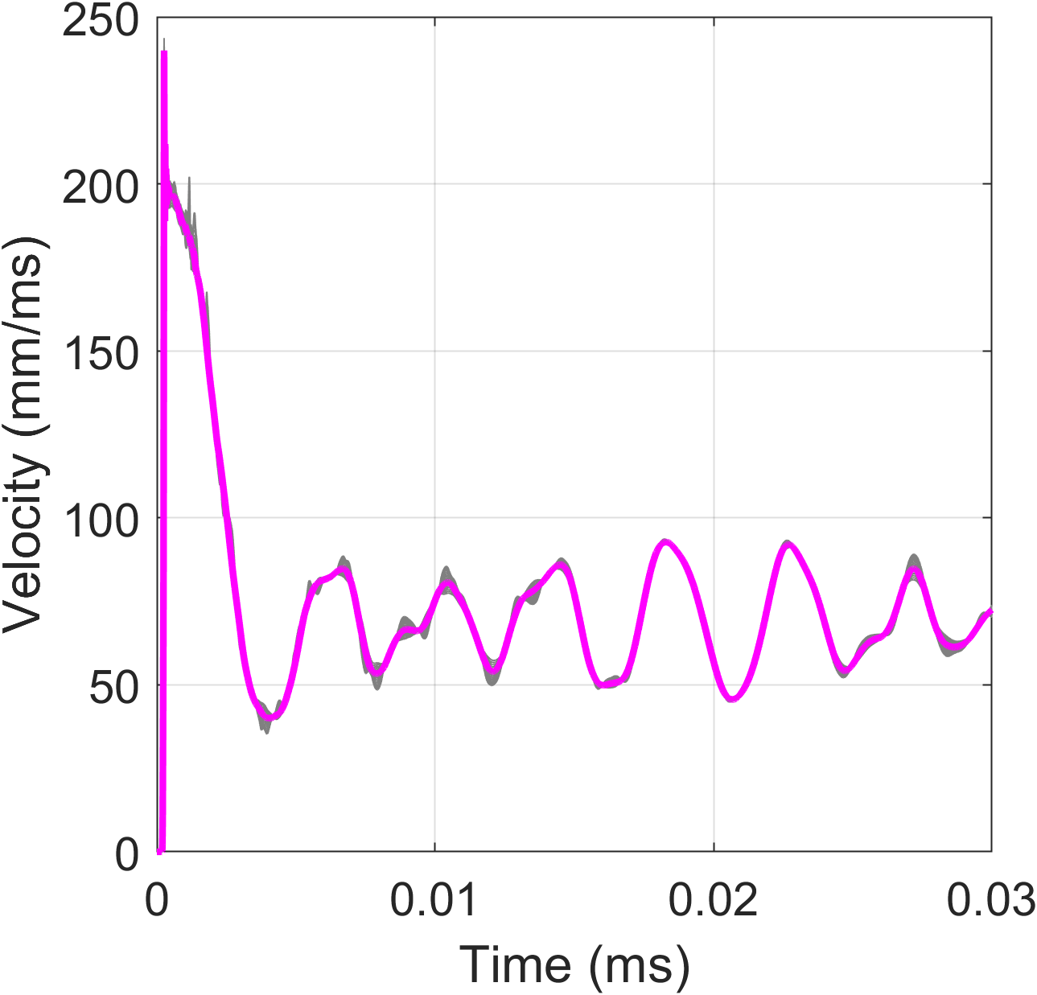
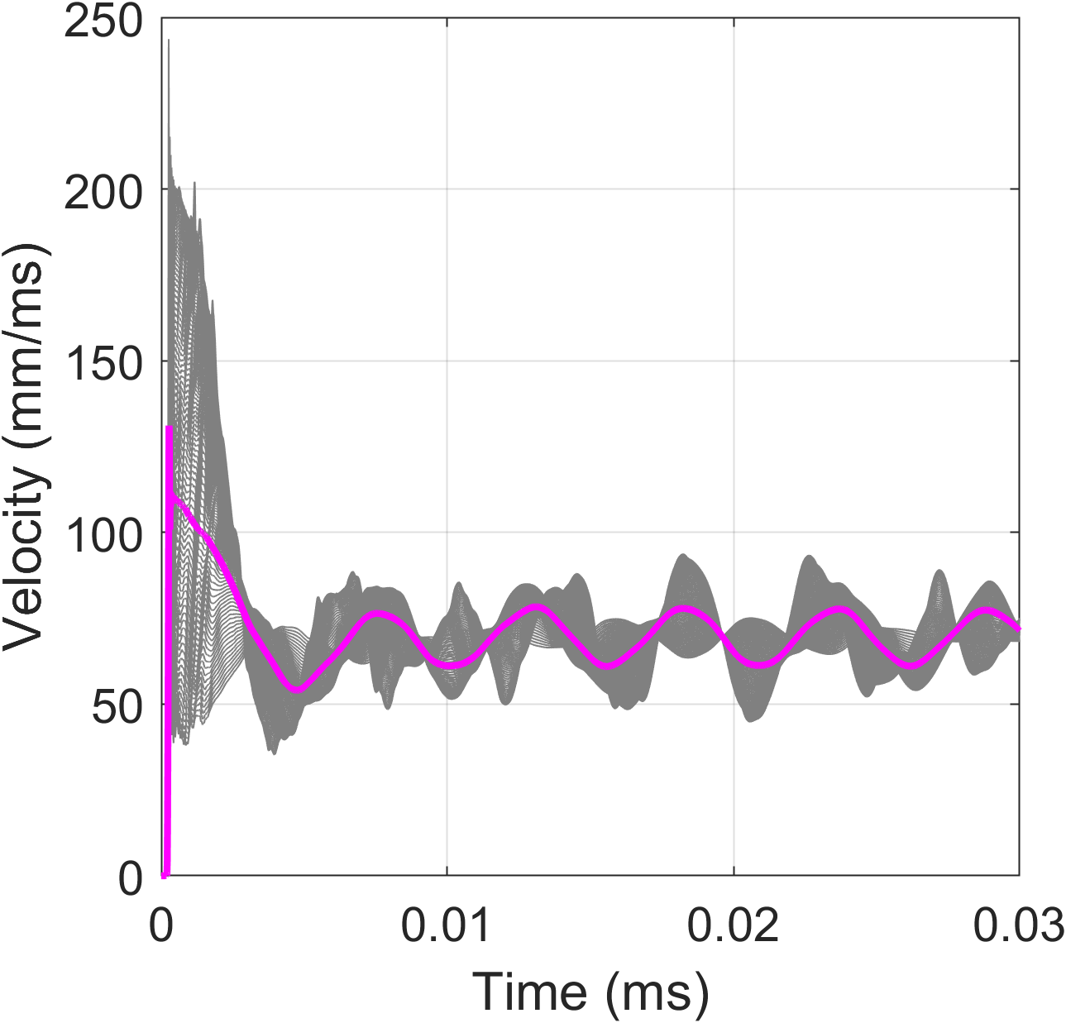
LS-DYNA results
SHOT 7 @ CEA
Target → material: porous graphite; thickness: 0.75 mm
Laser → energy: 121 J; pulse duration: 5 ns
v_{yMAX} = 1970 mm/ms
Comparison with experimental results
Averaged curve
Averaged curve
Range of measurement 0 ≤ R ≤ 0.2 mm
Range of measurement 0 ≤ R ≤ 1mm

Slide 15
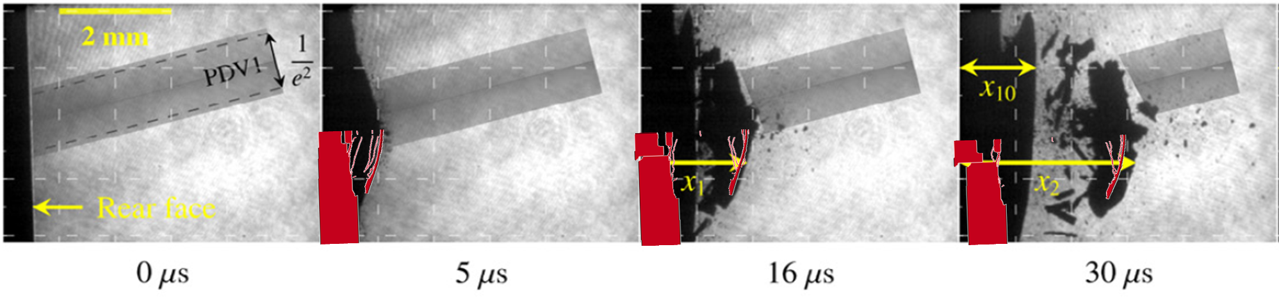
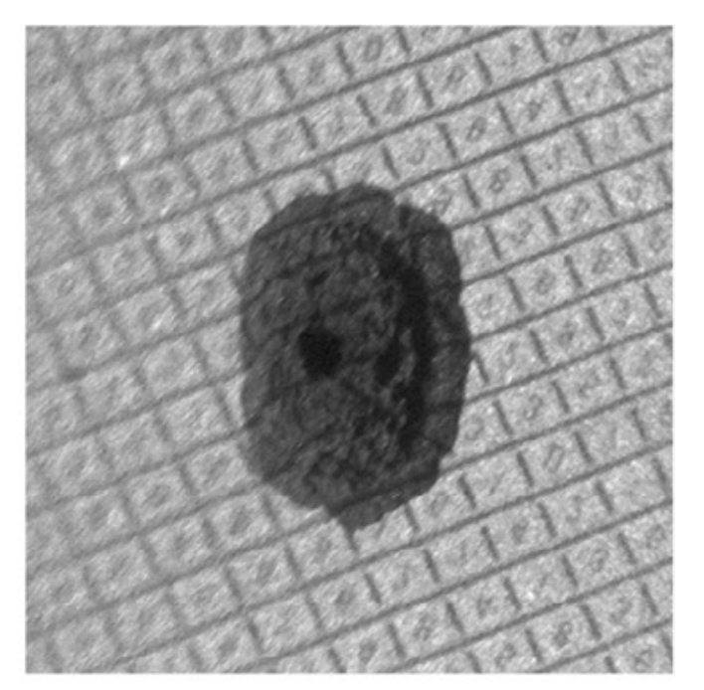
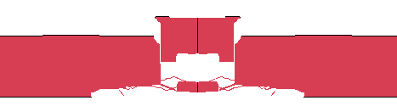
LS-DYNA results
Comparison with experimental results
SHOT 7 @ CEA
Target → material: porous graphite; thickness: 0.75 mm
Laser → energy: 121 J; pulse duration: 5 ns
LS-DYNA
Post-mortem
2.5 mm

Slide 16
Results analysis: back surface velocity
Same order of magnitude of the pulse duration
Damage Evolution/
Energy dissipation
DAMPING
(model dependent)
SPALL STRENGTH
Rayleigh damping coefficient for stiffness weighted damping
(0.06)
FAILURE CONDITION

Slide 17
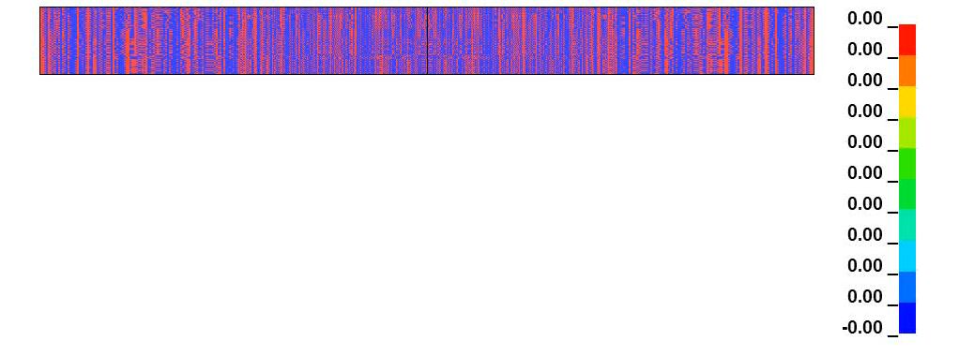
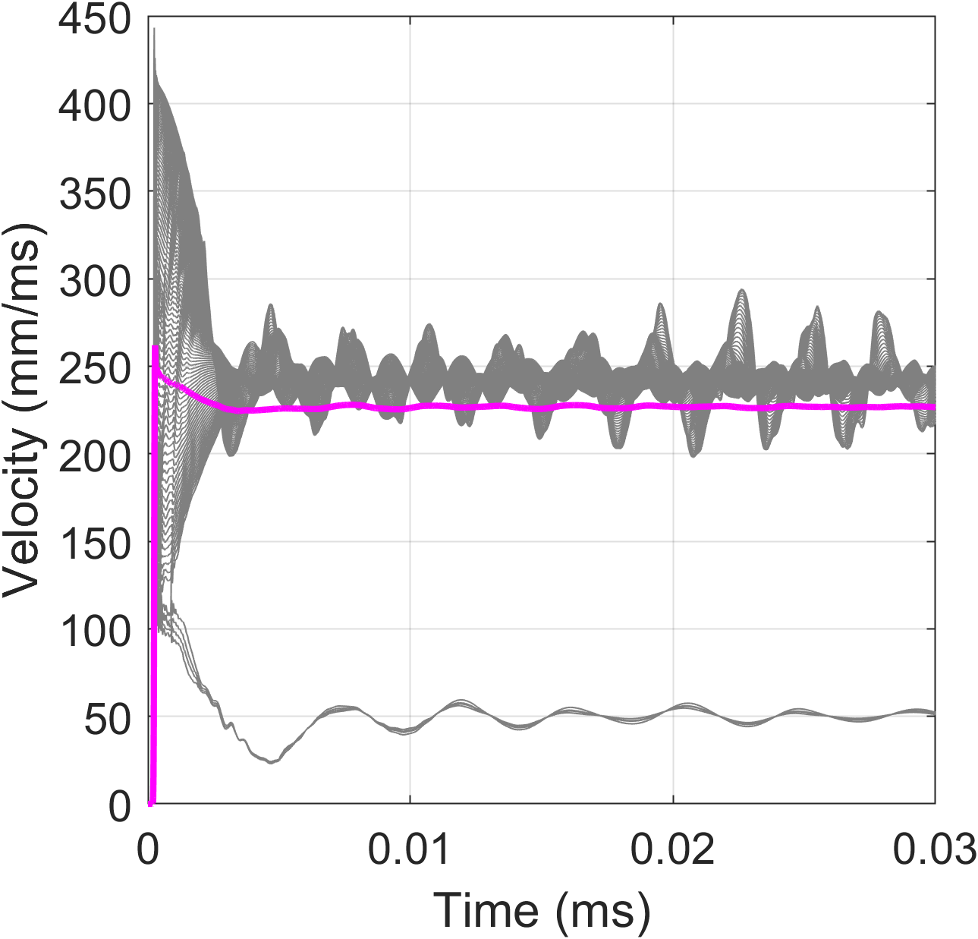
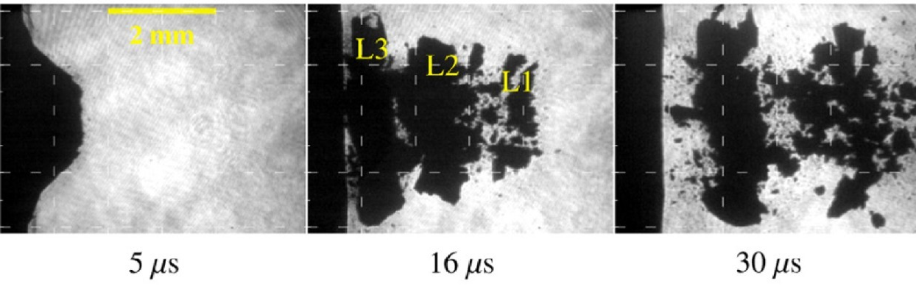
LS-DYNA results
v_{yMAX} = 2754 mm/ms
2 mm
0.703 mm
LASER
Pressure(MPa)
Range of measurement 0 ≤ R ≤ 1 mm
R= 1 mm
SHOT 15 @ CEA
Target → material: porous graphite; thickness: 0.75 mm
Laser → energy: 259 J; pulse duration: 5 ns

Slide 18
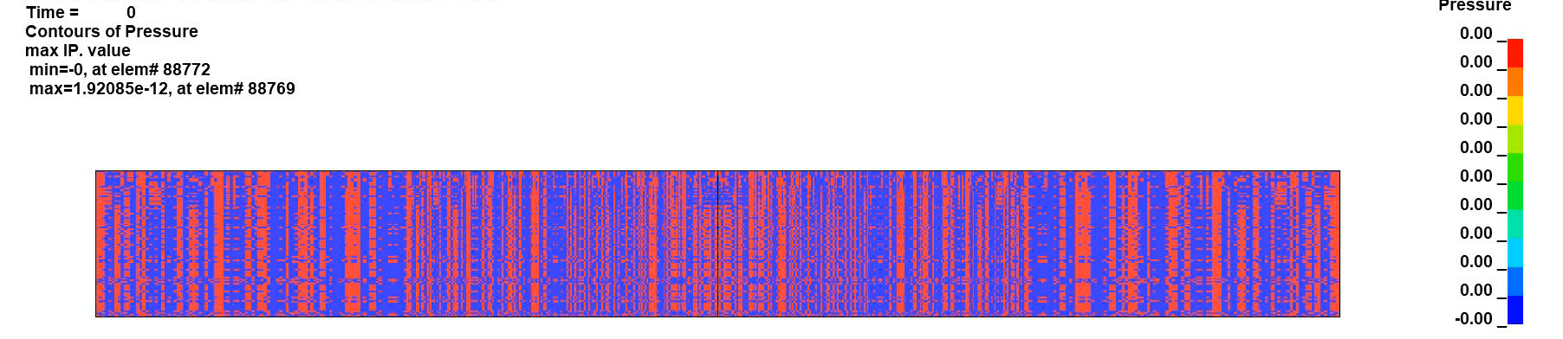
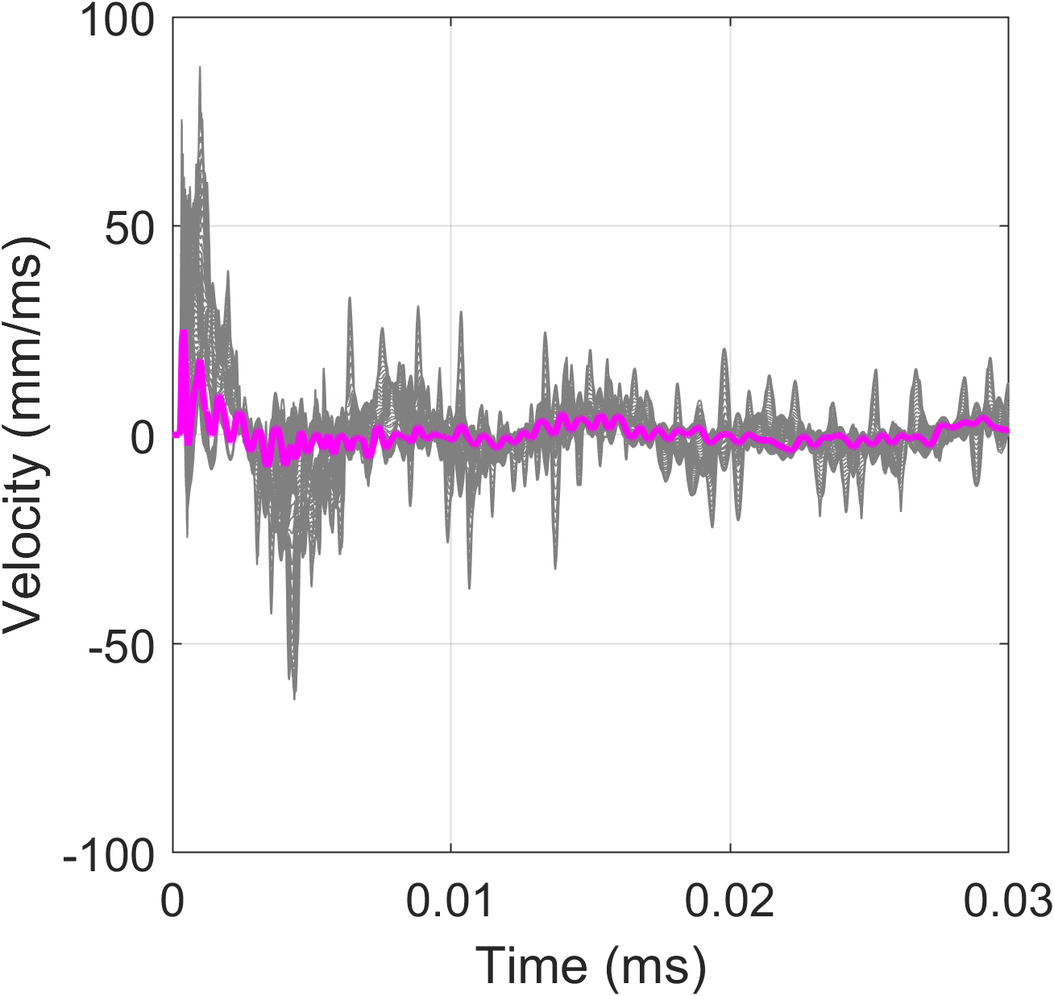
LS-DYNA GSI Prediction 5 ns
v_{yMAX} = 4000 mm/ms
Pressure(MPa)
0.5 mm
0.943 mm
LASER
Range of measurement 0 ≤ R ≤ 1 mm
R= 1 mm
SHOT LOW @ GSI
Target → material: porous graphite; thickness: 1 mm
Laser → energy: 180 J; pulse duration: 5 ns

Slide 19
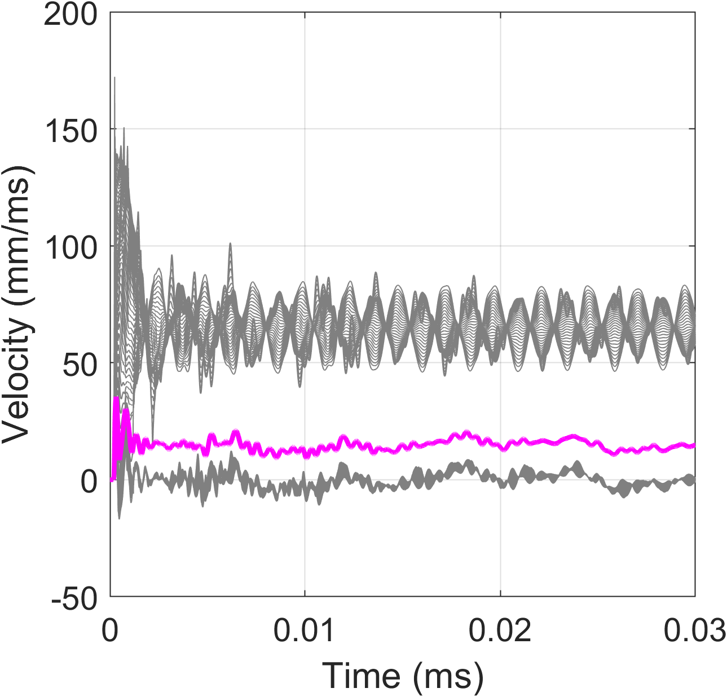
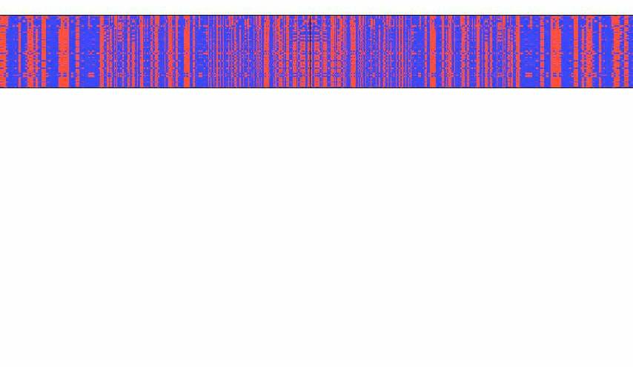
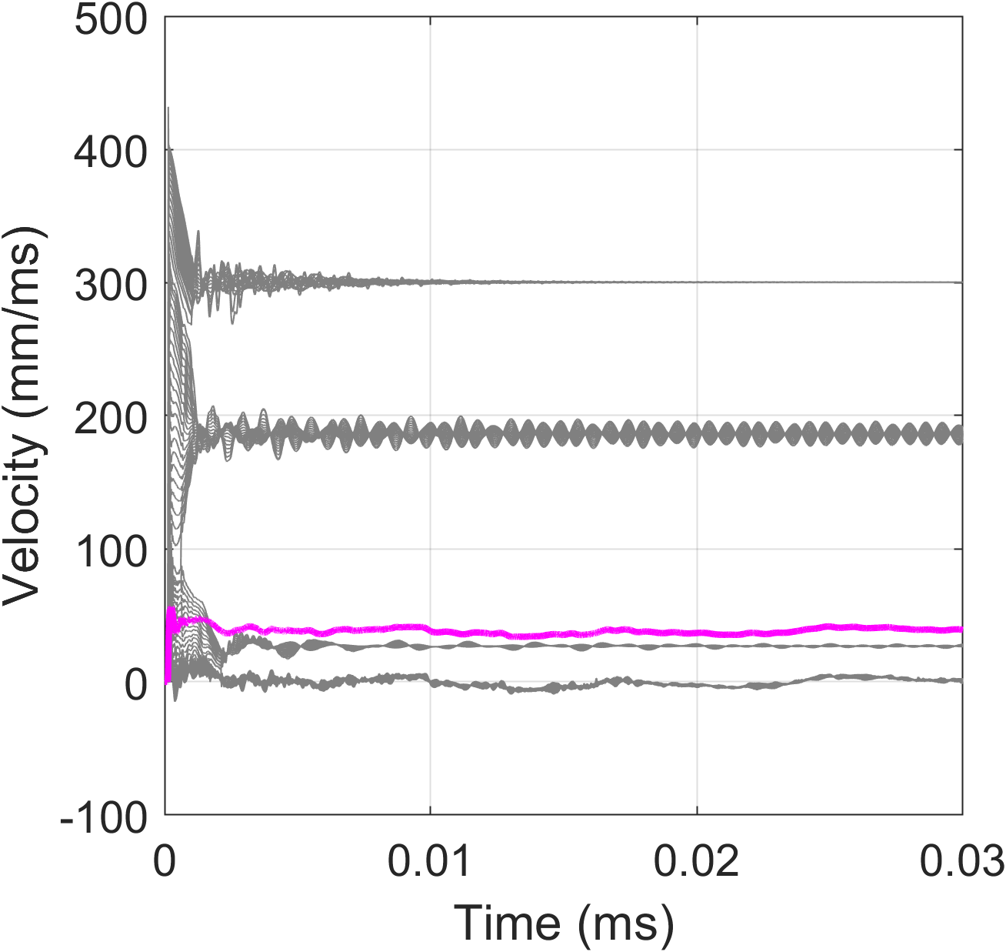
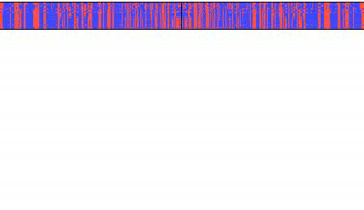
LS-DYNA GSI Prediction 5 ns
SHOT LOW @ GSI
Target → material: porous graphite; thickness: 0.75 mm
Laser → energy: 180 J; pulse duration: 5
Range of measurement 0 ≤ R ≤ 1 mm
Average
R
Range of measurement 0 ≤ R ≤ 1 mm
R
Average
SHOT LOW @ GSI
Target → material: porous graphite; thickness: 0.5 mm
Laser → energy: 180 J; pulse duration: 5

Slide 20
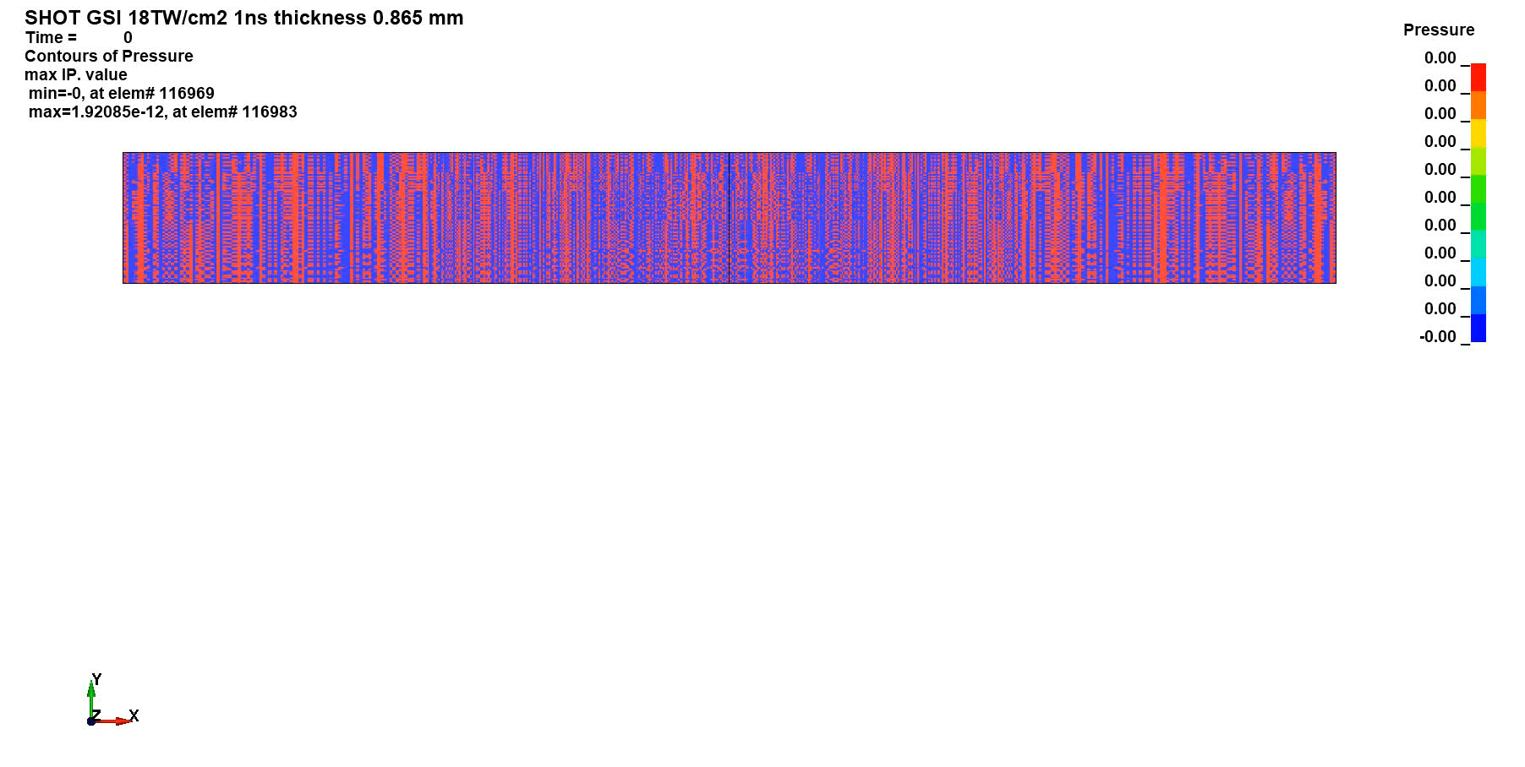
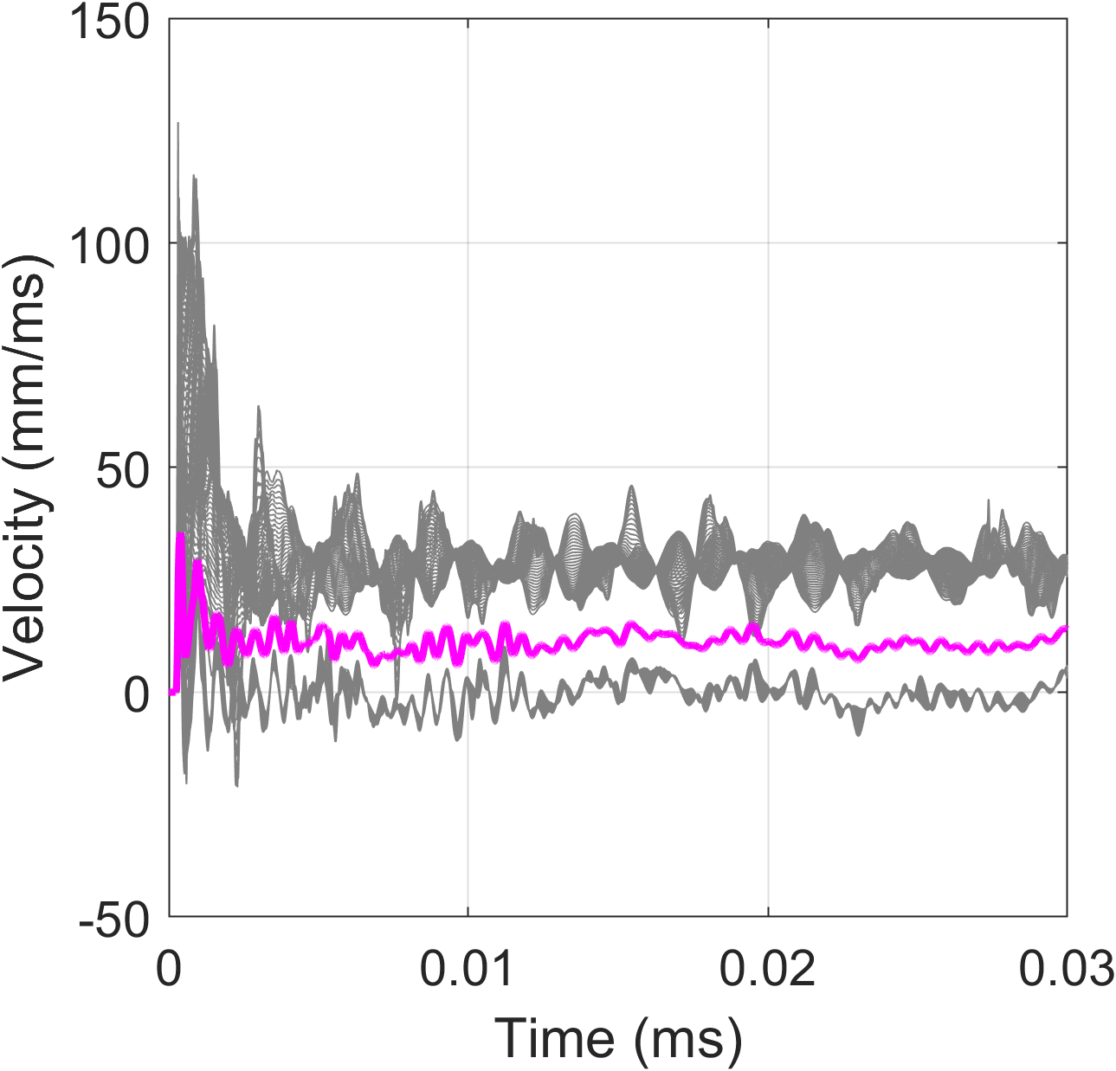
LS-DYNA GSI Prediction 1 ns
R= 1 mm
Range of measurement 0 ≤ R ≤ 1 mm
R
Average
SHOT HIGH @ GSI
Target → material: porous graphite; thickness: 1 mm
Laser → energy: 180 J; pulse duration: 1 ns

Slide 21
Conclusions and outcomes
Following the preliminary ELI-NP results the laser deposition phase could be simulated with 1D code HELIOS
The obtained velocity at the plasma-solid interface could be used as boundary condition for the LS-DYNA model in order to assess the conditions at the back surface tacking into account the strength and failure model of the material
Different modelling techniques were tested (2D FE, 3D FE, SPH, FE-SPH) and 2D axisymmetric model results as the much effective solution (fast and enough accurate)
The results are strongly dependent from the adopted damping and failure model
Velocity measurements on the back surface could strongly vary in function of the portion of the sample considered and the dimensions of the measuring spot

Slide 22
Thank you for your attention!

