Slide 1
Digital Camera Deployment Status
&
Rad-Tol. Camera Development Update
SY-BI TB 2021_07_01
S.Burger with inputs from Enrico, Stefano, Athanasios…

Slide 2
Digital Camera deployment status
Content
  Intro
  3 radiation levels for the digital cameras
  Layout of Digital Hardware
  R2E simulations
  Deployment strategy

Slide 3
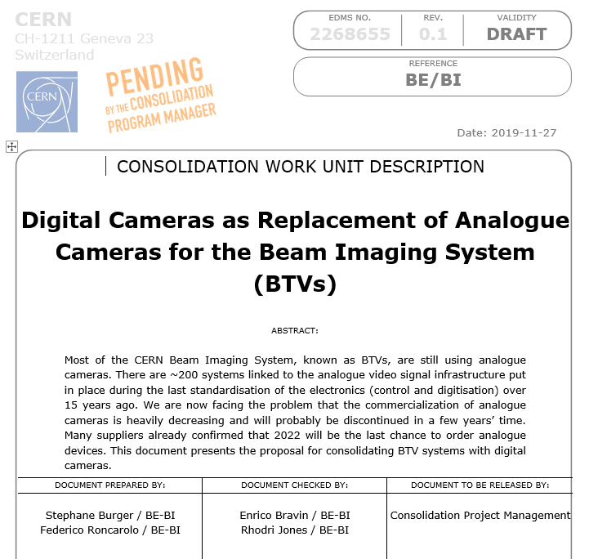
Digital Camera deployment status (1)
Intro
Reason for change:
  Analogue cameras out of the market from 2022 (CCD production already stopped)
  Limited performance (rate, IT, gain, noise, etc…)
A: Low radiation: standard cameras tested at CHARM
  → TID ~100Gy and SEE cross section ~ 1e-9cm2
B: Radiation up to 350Gy: radiation tolerant cameras can be used. BE-BI already uses this kind of products in some locations + MicroCamera new rad.tol. design
C: Radiation from up to 30KGy: So far using commercial rad.hard cameras and tube-based cameras

Slide 4
Digital Camera deployment status (6)
R2E Simulations (1)
Identification of radiation level at each BTV location, using RPL survey at first step → only TID information
→ R2E is involved – simulating (confirming) both TID and SEE cross section values to validate the type of camera to be used at each location
Deployment of non-rad cameras
As a first step, 40 potential locations were identified:
CPS : AD , ELENA, LEIR
SPS : TT10, TT41, TT43, TI2, TI8
LHC : LSS IR2, 3, 4, 7 & 8 and TD62, TD68

Slide 5
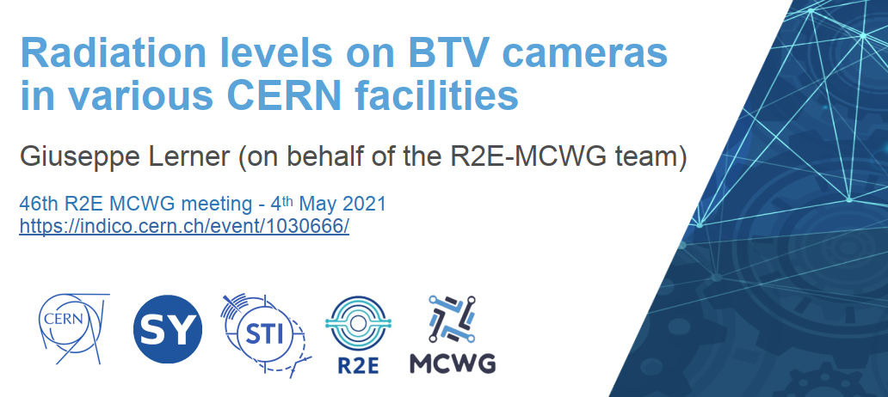
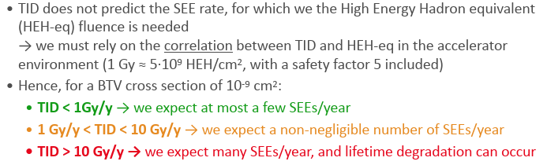
Digital Camera deployment status (7)
R2E Simulations (2)
Thanks to R.Garcia and G.Lerner SY-STI-BMI !

Slide 6
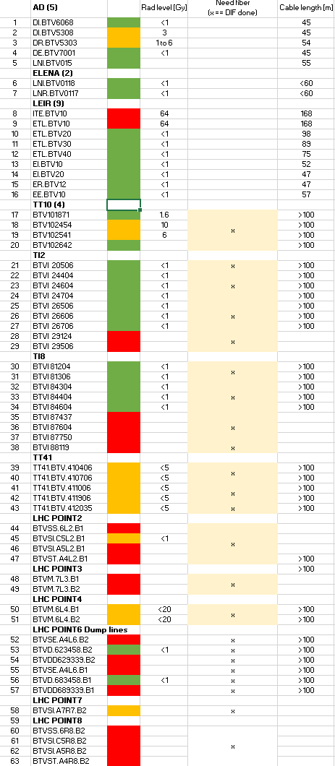
Digital Camera deployment status (8)
Deployment (1)
28 locations <1Gy
→ OK for commercial CMOS (non rad) BASLER camera
13 locations between 1Gy and 10Gy
→ Proposed for BASLER camera as well
Same cabling for the Rad.Tol. camera in case
21 locations above 10Gy
  → No BASLER camera
Cabling request was done for AD and LEIR (shortest cables, easy access)
  For YETS 2021/22
Preparation for all the rest from the list below but need:
  Best locations for converters and switches → R2E consulting

Slide 7


Digital Camera deployment status (2)
Digital Camera hardware layouts (1)
MENA25
CTRV
XMC401/402
Single camera
<100m distance
Ethernet
VME crate

Slide 8
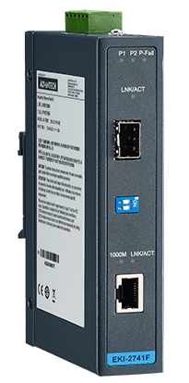
Digital Camera deployment status (3)
Digital Camera hardware layouts (2)
MENA25
CTRV
XMC401/402
Convert EKI-2741
Fibre ←→ Ethernet
Convert EKI-2741
Ethernet ←→ Fibre
Single camera
>100m distance
Fibre
Ethernet
Ethernet
VME crate

Slide 9
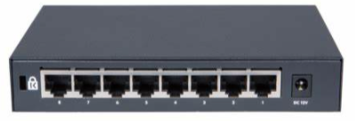
Digital Camera deployment status (4)
Digital Camera hardware layouts (3)
Multi cameras
>100m distance
MENA25
CTRV
XMC401/402
Convert EKI-2741
Ethernet ←→ Fibre
Convert EKI-2741
Fibre ←→ Ethernet
Ethernet switch
Ethernet
Fibre
Ethernet
Ethernet
VME crate
Identification of low radiation level areas in the machine
    Tested at CHARM: TID >50Gy and SEE cross section ~1.5e-9 cm2
    To be tested end of this year at CHARM

Slide 10
Digital Camera deployment status (5)
NEED
New cables / fibres / converter / switch
Camera support: can be used on all BTV camera supports replacing one interface to compensate for the optical height difference
New focal length camera lens

Slide 11
Digital Camera deployment status (1)
Digital systems already installed
BSRT LHC
BSRT SPS
New HiRadMat BTV
New BTV SBDS
New BTV AD Target
New LHC BGC
AWAKE downstream BTV
CLEAR BTV
Software → see Athanasios’ presentation
New FESA Class BTVDC
AWAKE ‘laser’ mode
External trigger mode
Free running mode with auto selection of the image

Slide 12
Digital Camera deployment status (9)
Systems ‘ready’ for digital cameras standardization
  AWAKE (Stefano):
    Specific acquisition process with the ‘laser mode’ (10Hz acquisition)
    Requires a dedicated server for the huge amount of data. Tested and validated in 2020/21
    Cameras: 6x BTVs + 4x Spectro + 2x plasma cell (will certainly evolve)
    Cabling requested (pulling next week)
    Wait for the new person (PJAS) requested to specifically take care of the software (may be involved for the other digital installation in CLEAR as well)
  CLEAR situation should be rediscussed

Slide 13
Digital Camera deployment status (10)
Budget/Planning
Goal is to consolidate as much as we can for LS3
Project linked to the BTV Electronics Consolidation
Thanks !

Slide 14
Radiation Tolerant Camera Development (1)
Content
  MicroCameras & Space Exploration
  BeamCam Hardware
  Irradiation tests
  Planning

Slide 15

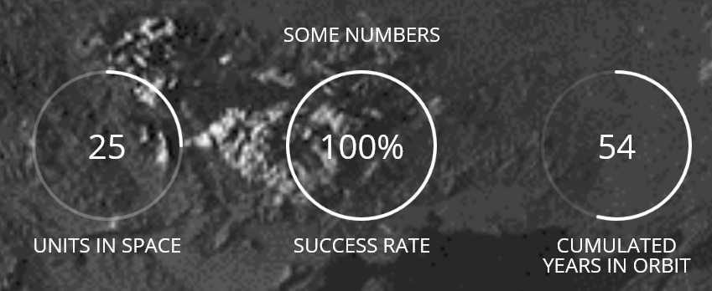
Radiation Tolerant Camera Development (1)
www.microcameras.ch
“Micro-Cameras & Space Exploration SA (MCSE) develops since more than 20 years specific systems in the field of scientific instrumentation for space exploration and has been selected for the development of imaging systems in several ESA missions, like PROBA 1 and 2, SMART-1, Rosetta, MarsExpress/Beagle2, Sentinel 1a, BepiColombo, JUICE, Biomass, and also onboard the International Space Station.”
  Technical specs for a dedicated CERN (accelerator ‘compatible’) camera
  Partnership agreement involving joint R&D, IP co-ownership and cross-licensing

Slide 16
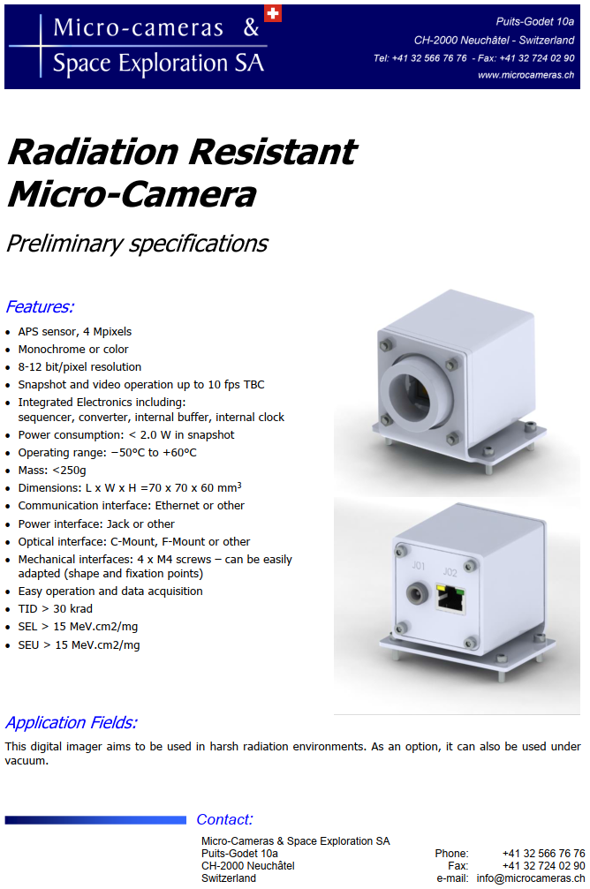
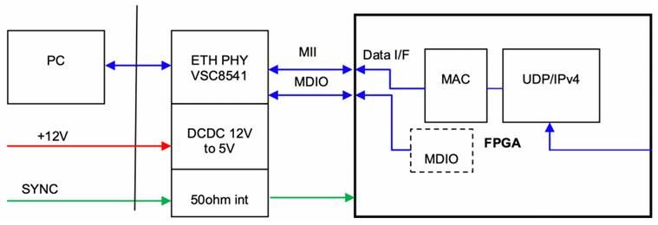
Radiation Tolerant Camera Development (2)
Min 10 bits
ETH PHY VSC8541 (rad.tol. From Microchip)
+12V inputs
  2x FEAST modules (+5V & +1V)
External trigger

Slide 17
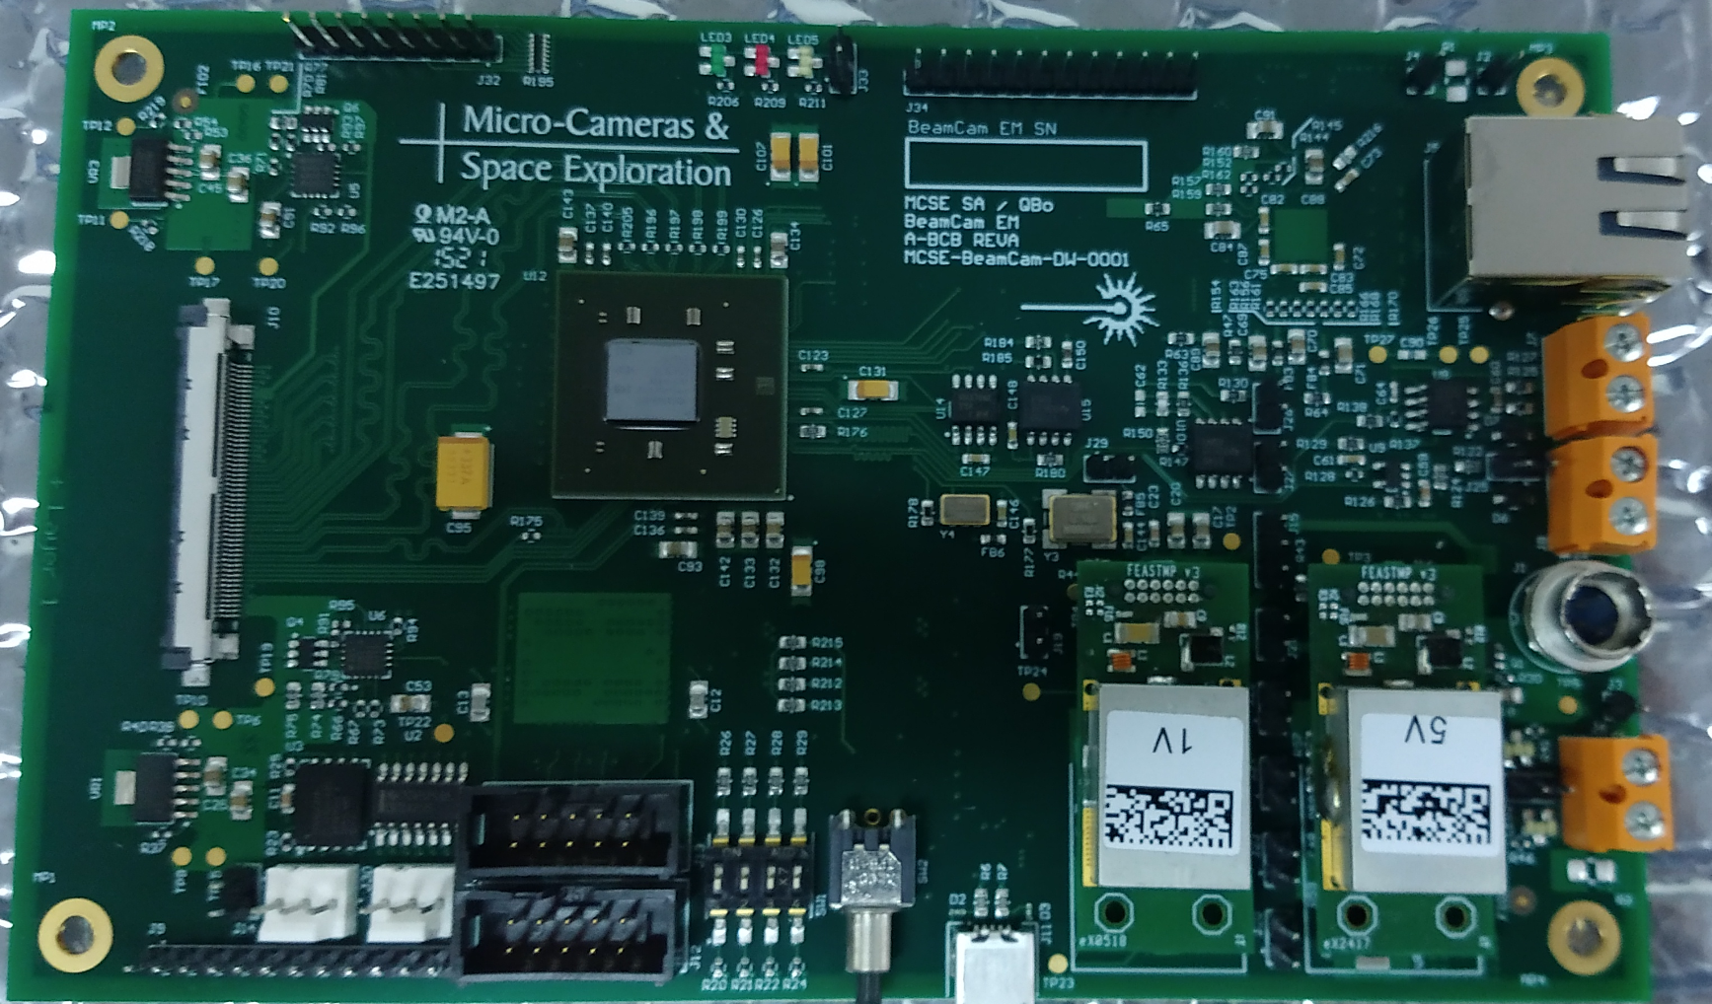
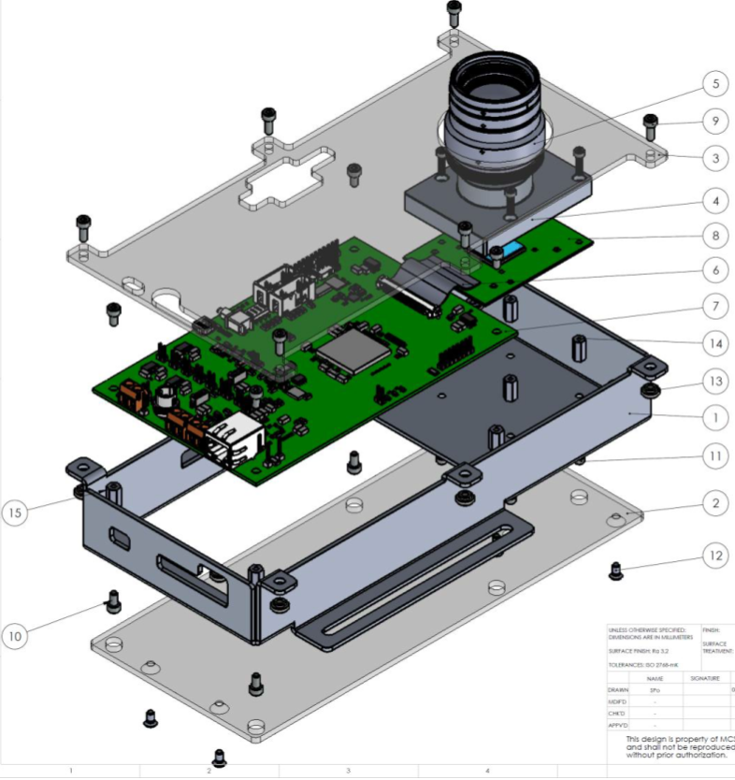
Radiation Tolerant Camera Development (3)
End of May 2021, boards are ready for firmware development
Communication protocol (UDP based) was discussed & list of commands sent in April 2021
In the coming weeks:
  Planning will be defined for the camera test 1/ in lab 2/in CHARM

Slide 18
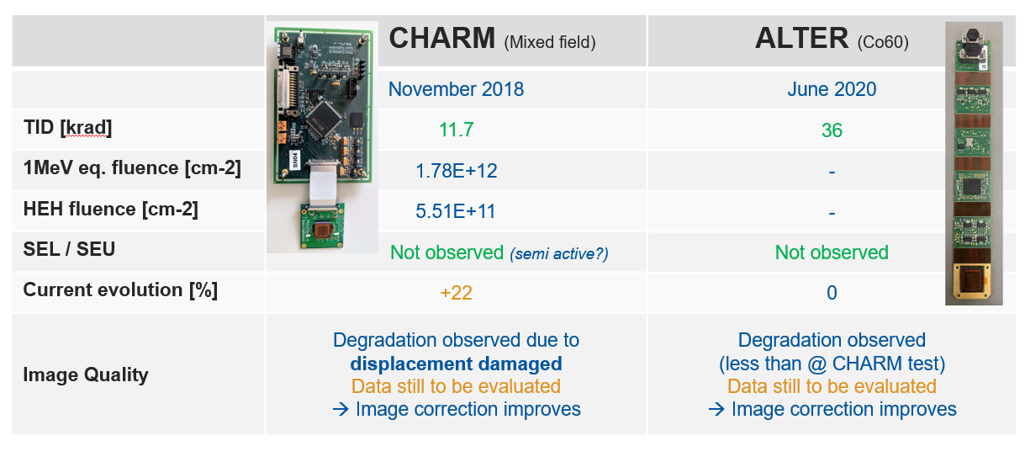
Radiation Tolerant Camera Development (4)
Irradiation tests
→ Final test hopefully at CHARM end of this year with an ACTIVE test

Slide 19
Timeline & Conclusion
Radiation Tolerant Camera Development (5)
Hardware and Firmware specifications for new BeamCam done
Prototypes are ready
  Test in Lab (@CERN?)
  CHARM test end of 2021
  Test in machine in 2022 (?)
Goal: After validation, ~100 cameras ready for LS3
‘Paperwork’ collaboration ongoing with IPT
  Team Work
      Micro-Cameras Stephane Beauvivre / Nikhil Banerji / Quentin Bouille
      SY-STI Ruben Garcia
      BE-CEM Salvatore Danzeca
      EP-ESE Federico Faccio / Stefano Michelis
      IPT-KT Enrico Chesta
      IPT-PI Nordine Azizi
      SY-BI Enrico Bravin / Stephane Burger
Thanks !

Slide 20
Thanks !

Slide 21
Digital Camera deployment status
Digital camera is the obvious candidate for analogue cameras replacement
→ Unfortunately, not a plug and play operation
 | Analogue camera | Digital camera
Video transmission/Communication | Differential mode (CCD box) | Ethernet + fibre if >100m
Power | From BTV electronics | From BTV new electronics
Radiation | 50 to 400Gy | Max 100Gy
Rad.Tolerant Camera
Ethernet + fibre if >100m
From BTV new electronics
350Gy TBC (CHARM)
Dedicated solutions to be defined per camera or batch of cameras to optimize the cost of fibres
  Converter Ethernet ←→ fibre
    Tested at CHARM: TID >50Gy and SEE cross section ~1.5e-9 cm2
  Ethernet switch to limit the number of fibre:
    To be tested end of this year at CHARM
Camera support: can be used on all BTV camera support replacing 1 interface to compensate for the optical height difference
Identification of low radiation level areas in the machine (<100m)

Slide 22
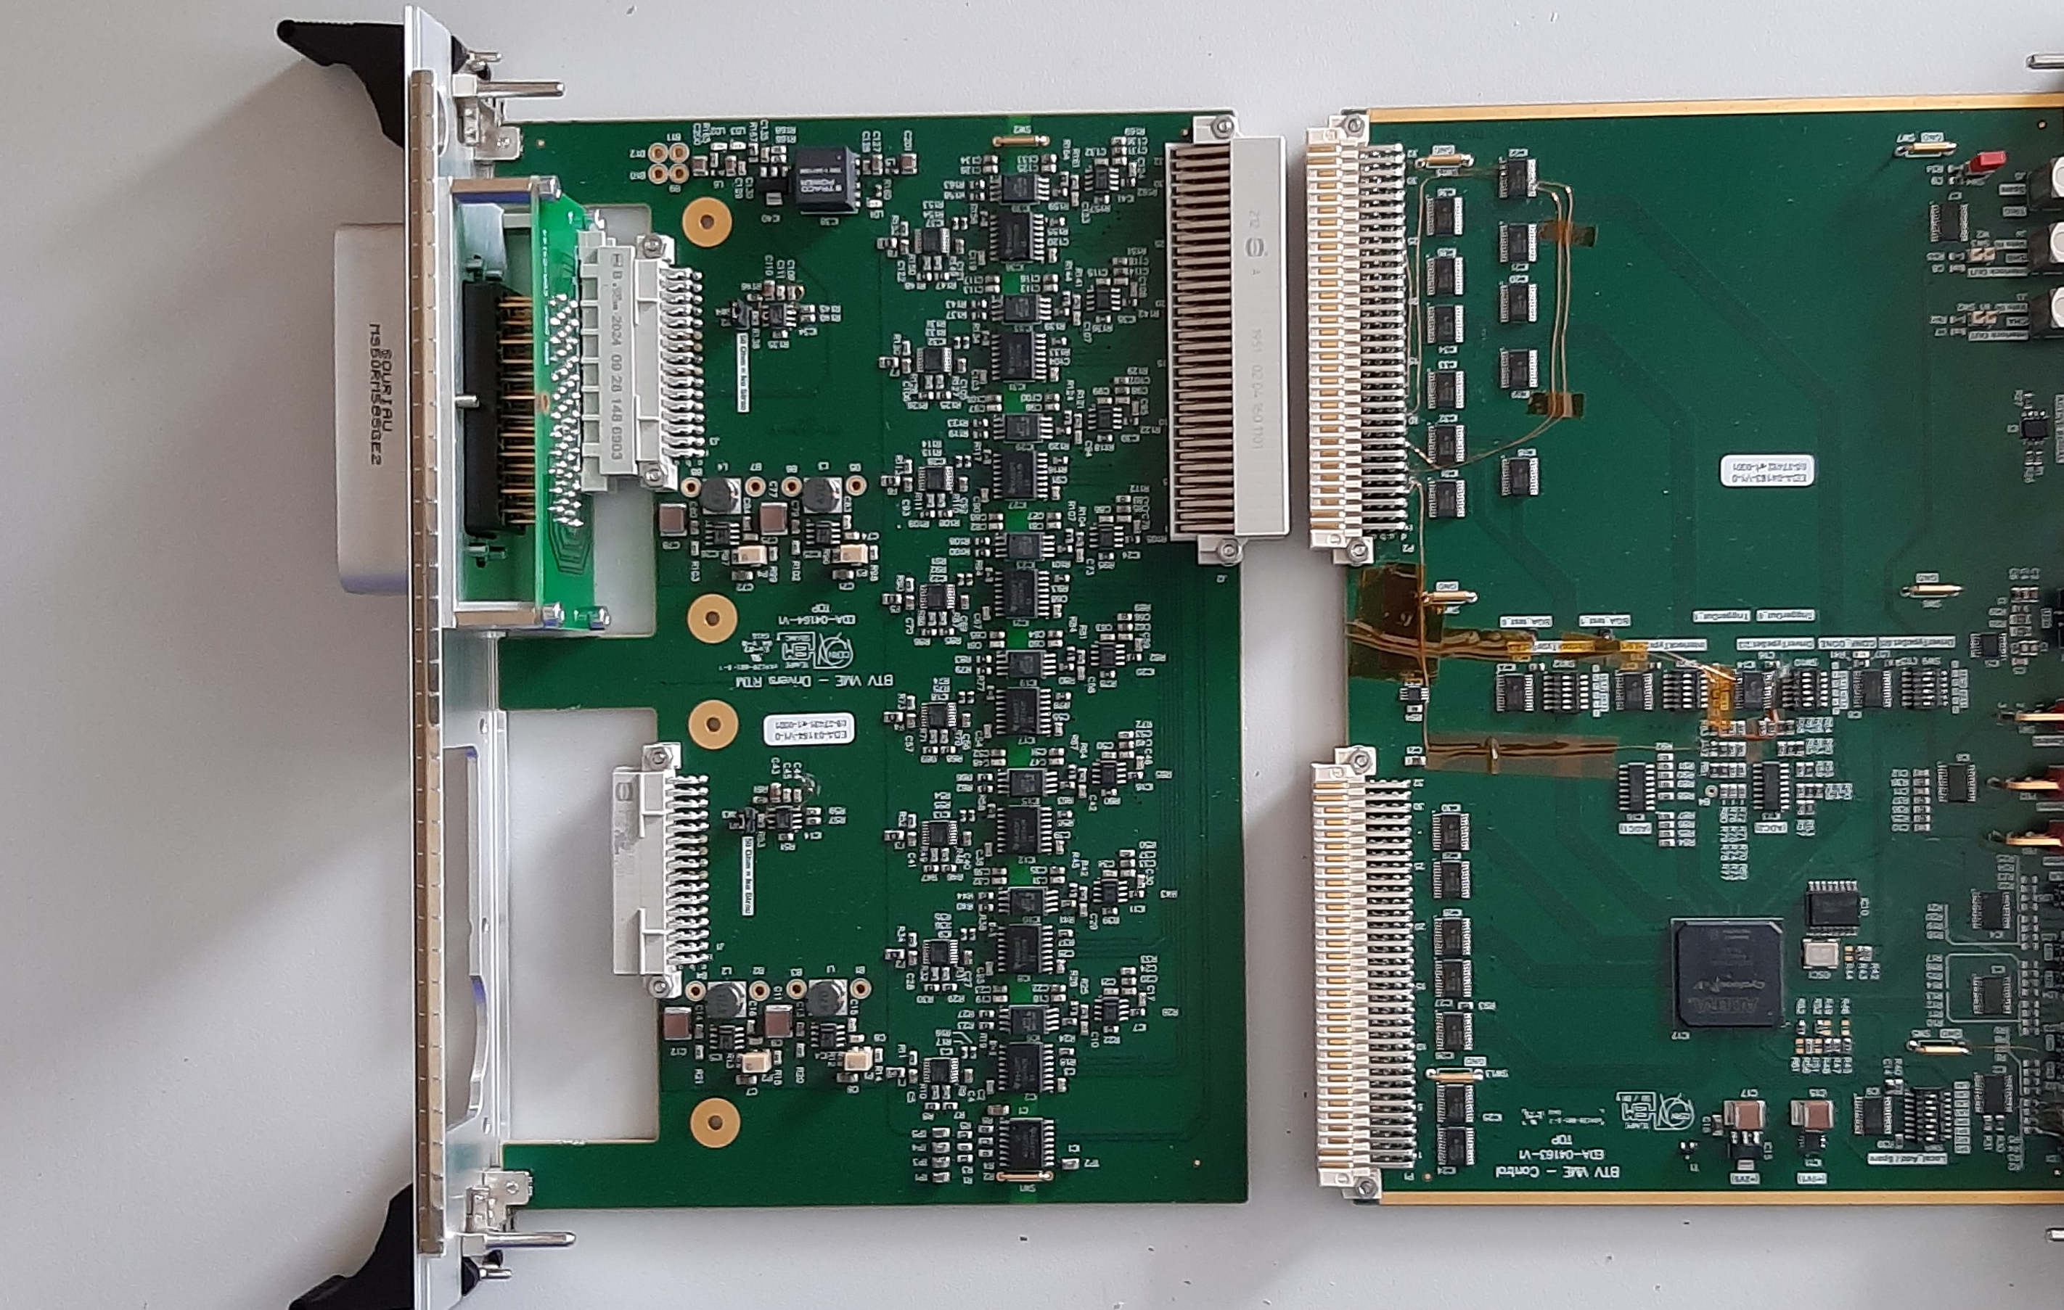
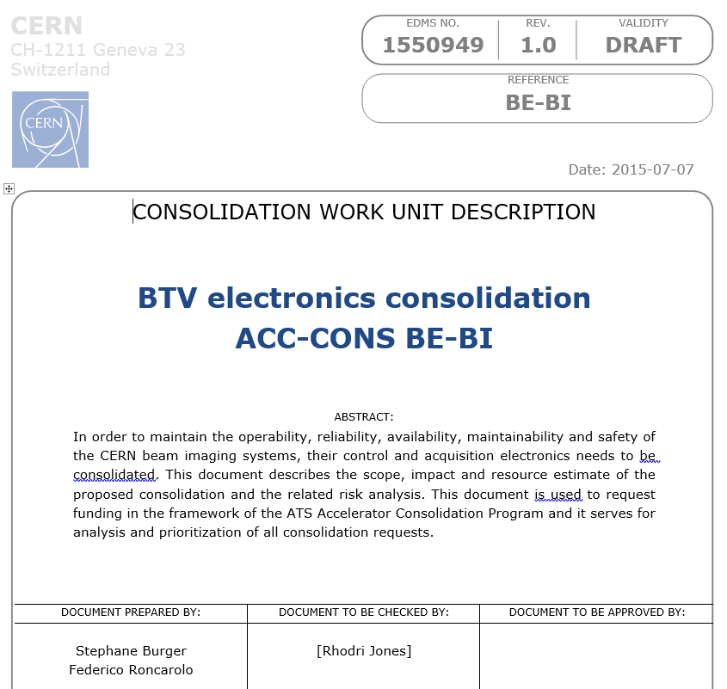
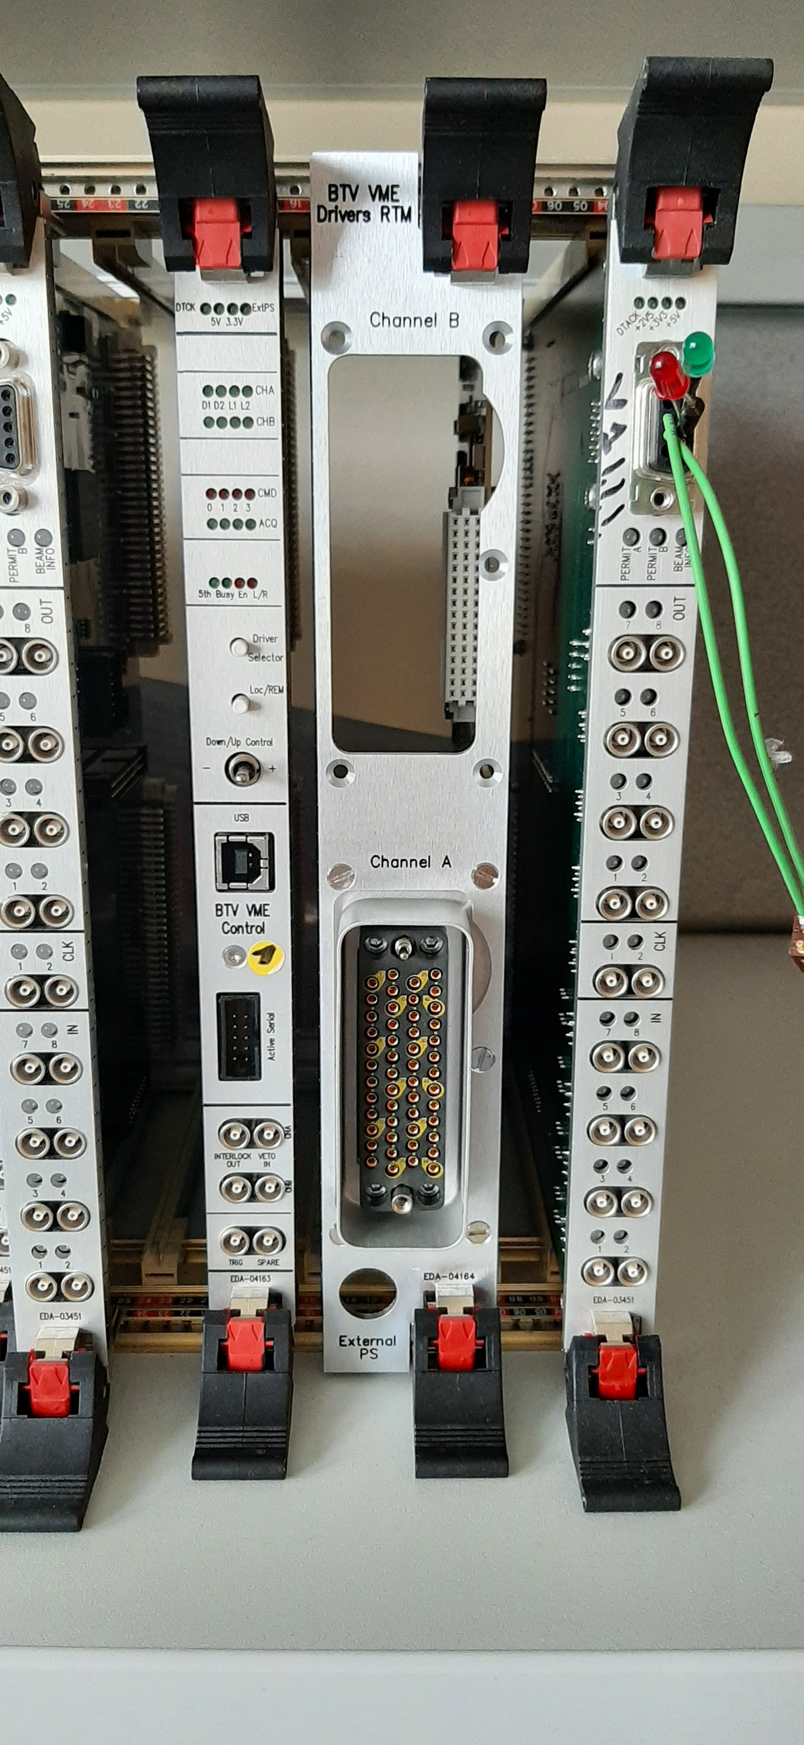
BTV Electronics Consolidation (1)
BTV_VME_CTRL
EDA-04163-v1
BTV_RTM_Drivers
EDA-04164-v1
VME format
New BTV standard crate VME ELMA (21 or 6 slots)
8 Drivers (for screens and filter wheels DC actuators and lights)
Local CTRL of the drivers
Power for digital camera + hardware
Veto/Interlock feature
External trigger

Slide 23
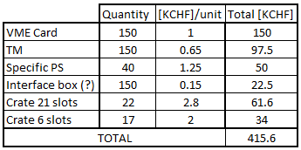
BTV Electronics Consolidation (2)
Planning
Budget
Phase | Planning
1st Prototype | Q4 2020
Test – Validation | Q2 2021
Production | Q3 2021
Installation | From 2022
Updated Planning
Q4 2020
Q4 2021
Q2 2022
From 2023
Budget Profile
 |  |  |  |  | 2021 | 2022 | 2023 | 2024 | 2025 | 2026 | Comments May 2021
Active | PS-CONS (THIS) | 64222 | BTV acquisition electronics renovation | EDMS 2267978 | 160 | 175 |  |  |  |  | Very low spending <1%
 |  |  |  |  | 2021 | 2022 | 2023 | 2024 | 2025 | 2026 | Comments May 2021
Active | PS-CONS (THIS) | 64222 | BTV acquisition electronics renovation | EDMS 2267978 | 50 | 110 | 175 |  |  |  | Very low spending <1%

