Slide 1

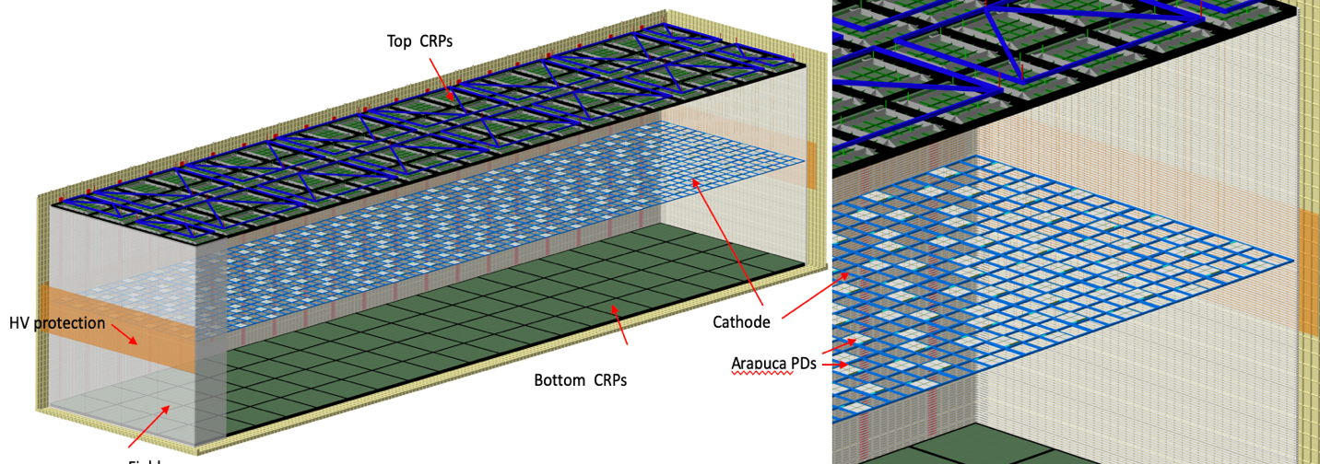
​Vertical Drift Requirements
Steve Kettell
EB Meeting
24 June 2021

Slide 2
EB-held Requirements
Proposal to modify some far detector requirements for vertical drift (FD2-VD)
EB Requirements
Single-Phase (FD1-HD): https://edms.cern.ch/document/2346091
Dual-Phase: https://indico.fnal.gov/event/20587/contributions/58403/attachments/36568/44520/DUNE-req-DP_V2.xlsx
FD2-VD: we started from FD1-HD
Today is an introduction to start the discussion
Would like to get EB approval before LBNC completes CDR review

Slide 3
EB-held Requirements – Single-Phase (Dec 2018)
DOORS ID | TDR ID | Name | Primary Text | Value | Rationale | Note | Additional 1
2233 | SP-FD-1 | Minimum drift field | The drift field in the TPC shall be greater than 250 V/cm, with a goal of 500 V/cm. | >250 V/cm (goal 500 V/cm) | Limits impacts of electron-ion recombination (on particle ID via dE/dx versus range), reduces effect of finite electron lifetime on S/N ratio (with implications on tracking and calorimetry), and limits electron diffusion and to a lower degree space charge effects. | MicroBooNE is demonstating that a field of 270 V/cm can be a viable operating point in terms of particle ID. Early simulation results shown at the January collaboration meeting suggest that detector performace would degrade below 200 V/cm. The previous comments apply in case of "infinite" electron lifetime. Degradation of detector performance (e.g. low Signal-to-Noise ratio) associated with finite electron lifetime is enhanced at lower electric field settings. | ProtoDUNE will demonstrate if the present HVS design allows reaching the nominal electric field in the drift volume. Initial data taking will be with the maximum obtainable electric field setting, but additional studies at lower fields to study the effect on particle ID will also be targeted. Detector simulation will take advantage of the experimental data collected with ProtoDUNE. Additional runs collected at lower field settings will allow for more fine tuning of the models.
2234 | SP-FD-2 | System noise | The total system noise seen by each wire should be no more than 1000 enc of noise. It is expected that random noise on the FE amplifier will be the dominant contribution to the total system noise. | < 1000 electrons | The noise specification is driven by pattern recognition and two-track separation. Studies suggest that a minimum of ~5:1 signal to noise ratio on individual strip measurements allows for sufficient reconstruction performance. For the worst possible case when all factors affecting the S/N correspond to to the bare minimal requirement values (electrons lifetime=5ms, effective CRP gain=6, 250 V/cm drift field) the smallest MIP signal after the longest possible drift (12 m) is 6643 electrons on each one of the two collection views) giving a S/N ~6.6 assuming 1000 ENC. | Reconstruction algorithms are still under development, but it is clear that lower noise enables better perfromance and allows more access to lower energy events such as those associated with astronomical sources. | ProtoDUNE will demonstrate the noise level achievable by the current electronics and validate the grounding and shielding rules being used. Simulation will quantify how physics reach is correlated to electronics noise for selected physics channels.
2235 | SP-FD-3 | SP Light yield | The average light yield (LY) shall be high enough to reach similar calorimetric energy resolution with the PDS for low energy supernova neutrinos as with the TPC. The average LY shall also be sufficient to enable triggering on neutrinos from supernova bursts. The minimum LY in the active volume shall be sufficient to correctly associate scintillation light with events with energy >200 MeV with efficiency >99%. | > 20 PE/MeV (avg), > 0.5 PE/MeV (min) | Calorimetric energy reconstruction of supernova neutrino events sets the most stringent requirement on the average light yield. This light yield gives a resolution of 20% for neutrinos below 7 MeV, the same as that achieved by the TPC. Yields below this rapidly degrade resolution while for yields above this improvement is slow. Fiducializing, and thus enabling rejection of nucleon decay backgrounds with >99% efficiency at all points in the detector sets the requirement on minimum light yield in the active volume. | Studies of nucleon decay and supernova neutrinos are continuing as simulation and reconstruction improve, and may provide further updates to this number in the future. | This requirement was determined with supernova neutrino and K+nu nucleon decay events (serving as a model for nucleon decay backgrounds) in far detector. They were fully simulated at a variety of detector performances and passed through full reconstruction and analysis.
2237 | SP-FD-4 | Time resolution | The time resolution of the photon detection system shall be less than 1 microsecond in order to assign a unique event time. | < 1 microsecond (goal < 1 ns) | Based on the minimal energy deposition (10 MeV), spatial separation (1 m), and temporal separation (1 ms) for which one wants to assign a unique event time. Time resolution of 1 us is required to have position resolution along the drift direction of about 1mm. | 1 us timing is readily obtainable from a technological perspective for original PDS design, but may be challenging for newer designs. Physics needs for SNB have not yet been studied in detail.
2238 | SP-FD-5 | SP Liquid argon purity | The SP LAr purity shall remain lower than 100 ppt (with a goal of < 30 ppt). This corresponds to electron lifetime of 3 (10) ms. | < 100 ppt (goal 30 ppt) | Liquid argon purity directly impacts the number of electrons received at the APA collection wires and hence the S/N. | Quoted numbers are for oxygen-equivalent contamination although electron lifetime depends directly on comibined oxygen and water contamination. | Liquid argon purity will be measured via dedicated purity monitors and through different analysis techniques. We will have the ability to operate at different purity levels to study its effects on track reconstruction and HVS stability.
2240 | SP-FD-6 | SP Gaps between APAs | The gap size between APAs shall minimize loss of fiducial volume and distortion of charge collection. | <15 mm between APAs on same support beam; <30 mm between APAs on different support beams | Allowing gaps to open up between some APAs will reduce the overall shrinkage of the detector. This also simplifies construction and installation of the detector support structure. Use of electron diverters should minimize impact of gaps, based on simulation. | Current conceptual design has 17mm gaps between each grouping of three APAs, in addition to 12 mm gap between APAs on the same support beam. | Effect of gaps between APAs (and effectiveness of installed electron diverters) on track reconstruction will be studied using the ProtoDUNE data.
2242 | SP-FD-7 | Drift field nonuniformity due to component alignment | <1% throughout volume | < 1% throughout volume | (DP) DSS hanging system should provide support such that FC can maintain rectangular parallelepiped under LAr conditions. The cathode structure over 12 m should not exceed 12cm sagging. Space charge effects due to possible ion backflow from the LEM generated by the Ar39 (1Bq/kg) ionization may also contribute in distorting the field. In case this distortion is higher than 1% calibrations with the laser system are mandatory to meet the 1% field uniformity requirement. (SP) DSS should provide support such that the APA, CPA and FC can maintain rectangular parallelepiped under LAr conditions. Specifically the rails should remain parallel to each other at a fixed distance throughout the detector volume |  | Space charge in ProtoDUNE will complicate the analysis of the field uniformity. Local effects close to the field cage electrodes could be in principle be disentagled, exploiting through-going muon tracks.
2243 | SP-FD-8 | SP APA wire angles | The wire angles shall be set such that each induction wire crosses each collection wire only once, reducing ambiguities. | 0 degrees for collection wires, plus/minus 35.7 deg for induction wires | This starts from the constraint that wire readout electronics sits on top of APA to minimize dead space between APAs. |  | No validation required; this is a geometrical calculation.
2244 | SP-FD-9 | SP APA wire spacing | The wire spacing shall be chosen as a compromise between good S/N (coarser pitch) and good vertex resolution (finer pitch). | 4.7 mm (4.669 for U,V; 4.790 for X,G) | S/N consistent with 100% hit reconstruction efficiency for MIPs. Spacing fine enough to provide 1.5cm vertex resolution in y-z plane. |  | No validation required; this is a design choice. Monte Carlo studies have been performed showing no significant difference in sensitivity to CP violation for smaller wire spacing.
2245 | SP-FD-10 | SP APA wire position tolerance | The wire position tolerance shall be set so as to ensure uniform wire plane transparency and required reconstruction precision on dE/dx. | plus/minus 0.5 mm | Tolerance is on both the spacing between adjacent wires in each plane and the spacing between the wire planes.

Slide 4
EB-held Requirements – Single-Phase (Dec 2018)
2249 | SP-FD-11 | Drift field nonuniformity due to HVS | Design of TPC cathode and FC components shall ensure uniform field. Production tolerances shall be set so as to maintain flatness of component surfaces and, by extension, the shape of the drift field volume. | < +/-1% in 99.8% of the active volume | Non-uniformity of E field affects 3D reconstruction due to introduction of non-constant electron drift velocity, including residual transverse components with respect to the nominal drift direction. This uniformity of the E-field is guaranteed by the HVS consortium based on 3D numerical calculations in the case of nominal HV electrodes configuration and with no resistor failure. No measuremens of the uniformity is planned by the HVS consortium. | update value and name 6/2020 per EJames | Space charge in ProtoDUNE will complicate the analysis of the field uniformity. Local effects close to the field cage electrodes could be in principle be disentagled, exploiting through-going muon tracks. Simulation will be used to determine fiducial volume cuts, with input from the ProtoDUNE data.
2250 | SP-FD-12 | Cathode HV power supply ripple contribution to system noise | Power supply ripple shall be adequately attenuated to guarantee that its contribution to the overall system electronics noise is negligible. | < 100 electrons |  |  | Effect of HV system on the baseline electronics noise should be easily measured by switching on and off the HV power supply. Equivalent full circuit simulation of the coupling between the HVS and the FE electronics will be performed to compare against ProtoDUNE data and validate the FD design.
2251 | SP-FD-13 | Front-end peaking time | The FE peaking time shall be set so as to optimize vertex resolution. | 1 microsecond (goal: adjustable to be able to take advantage of lower noise if the noise depends on peaking time) | Driven by the need for optimal vertex resolution, which is itself determined from single-track resolution, pitch and the ability of the reconstruction algorithms to separate two nearby tracks. 1 us matches 3mm pitch and DP S/N ratio.
2252 | SP-FD-14 | SP Signal saturation level | ~500,000 electrons | ~500,000 electrons (goal: Adjustable so as to see saturation in less than 10% of beam-produced events) | The largest signals correspond to events with multiple protons produced in the primary event vertex, in particular, when the trajectories of one or more of those particles are parallel to the wire, causing the charge over a long path length to be collected within a short time period.
2254 | SP-FD-15 | SP LAr nitrogen contamination | The nitrogen contamination in the LAr shall remain below 25 ppm in order not to significantly affect the number of photons that reach the detectors (for both fast and late light components). | < 25 ppm | Production quenching prevents most late light from being collected at levels of 10ppM and above. The attenuation length in liquid argon with 50 ppM of Nitrogen contamination is roughly 3m, which starts to signifcantly affect the number of photons that reach the detectors (for both fast and late light components). |  | Nitrogen contamination levels can be measured both from gas analyzers and from studies of the effective shortening of the slow component of generated scintillation light orginating from nitrogen quenching. Comparison of the two will inform light simulation models.
2256 | SP-FD-17 | Cathode resistivity | The cathode resistivity shall ensure that in the event of an HV discharge, the release of the large stored energy is spread out over time. | Lower limit: > 1 MegaOhm/square (goal: > 1 Gohm/square); Upper limit: 10 Tohm/square | This prevents damage to detector components. The goal resistivity is > 1 GOhm/square. The upper limit is derived from the irriducible ionization rate in the LAr-TPC which, underground, is mainly due to Ar39 decays and results in 5 pA/m2. With 10 TOhm/sqare resistivity, the voltage at the center of a resistive CPA panels is 1 KV higher than at the borders. The related field non uniformity is well within the 1% requirement, | update value and rationale 6/2020 per EJames | In ProtoDUNE the resistivity of the CPA panels is in the MW/sq range due to the detector being operated on the surface. There will be opportunities to test if the front-end electronics is adequately protected against discharges (hopefully at the end of beam operations). Existing discharge simulations can be tuned based on ProtoDUNE data to better validate far detector designs.
2257 | SP-FD-18 | Cryogenic monitoring devices | CISC shall provide sufficient instrumentation to validate the fluid flow model, which constrains the level of purity inhomogeneities within the liquid. |  |  |  | All cryogenic instrumentation devices will be validated in ProtoDUNEs as same designs are being used for DUNE. The current CFD simulation will be validated/tuned using ProtoDUNE instrumentation data.
2258 | SP-FD-19 | ADC sampling frequency | The ADC sampling frequency shall be set so as to extract maximal information without unecessarily increasing data rate. | ~2 MHz | This value is chosen to match 1us shaping time (the approximate Nyquist requirement). Adapted to finer space pitch of 3.125 mm. | Value was 2.5 MHz. Changed to ~2 per M. Verzocchi. Looking at different versions of the EB spec spreadsheet, it changed from 2.5 to ~2 at some point after import to DOORS. AHeavey 3/3/2020 | No validation required; this is a design choice.
2259 | SP-FD-20 | Number of ADC bits | The ADC shall digitize the charge deposited on the wires with12 bits precision. | 12 bits | The lower end of the ADC dynamic range is driven by the requirement that the ADC digitization not contribute to the total electronics noise. The upper end of the ADC dynamic range is defined by the previous requirement on the signal saturation level. Combining these two requirements with the specification for the total electronics noise results in a the need for a 12 bits digitization. |  | No validation required; this is a design choice.
2260 | SP-FD-21 | SP Cold electronics power consumption | The SP CE power consumption shall remain below 50 mW/channel. | < 50 mW/channel | The SP CE power consumption must be low enough to prevent the occurrence of local hot spots that could cause bubbling in the LAr, potentially leading to HV discarges. | Electronics infrastructure is designed to channel bubbles away from active regions of the detectors at least partially mitigating this issue.
2262 | SP-FD-22 | Data rate to tape | The DAQ shall provide capability for triggering on events of interest in order to limit the total volume for events stored on tape. | <30 PB/year
2263 | SP-FD-23 | Supernova trigger | The DAQ architecture shall provide a mechanism for triggering on galactic supernova bursts and recording neutrino interactions associated with those bursts over a 30 second period, with a goal of 100 seconds. During this period, the full raw data information must be stored. | >95% efficiency for a SNB producing at least 60 interactions with a neutrino energy >10 MeV in 12 kt of active detector mass during the first 10 seconds of the burst. | Most models of SNB show structure in the neutrino flux for up to 30s and there is potential for interesting measurements to be made up to 100s. 95% triggering efficiency for a burst which produces at least 60 neutrino interactions in a 12 kt module will provide sensitivity to the great majority of SNBs in our galaxy as well as some bursts in small nearby galaxies, as described in the TDR's SNB physics requirements section.
2264 | SP-FD-24 | Local electric fields | The integrated detector design shall minimize potential pathways for HV discharges. | <30 kV/cm; Exceptions: for specific components with localized E-field higher than 30 kV/cm, perform test in pure LAr at 120% of the designed operating voltage, | HV discharges limit detector livetime and have the potential for damaging detector components. Keeping the local fields to this value is necessary in order to reach the desired drift fields. The minimum E field requirement is based on the minimum drift-field goal of 500 V/cm. In case of field cage components for which the limit cannot be guaranteed, a dedicated test in ultrapure LAr at a E-field at least 120% higher than nominal is has to be successfully passed. | In ProtoDUNE phase one the HV feed through underwent and passed the >120% efield test, due to a field of ~45 kV/cm in a limited volume below the toroidal rim of the ground shield Update Value, Rationale and Note 6/2020 per EJames
2265 | SP-FD-25 | Non-FE noise contributions | All non-FE noise contributions shall be much lower than the targeted system noise level | << 1000 electrons
2266 | SP-FD-26 | LAr impurity contributions from components | Contributions to LAr contamination from detector components, through outgassing or other processes, shall remain << 30 ppt so as to avoid significantly increasing the nominal level of contamination. | << 30 ppt
2267 | SP-FD-27 | Introduced radioactivity | Introduced radioactivity shall be less than that from 39Ar. | less than that from 39Ar | Materials used in construction of detector components should not significantly increase the radiological background beyond nominal levels.
2268 | SP-FD-28 | Dead channels | Detector components shall be sufficiently reliable so as to ensure that dead channels do not exceed 1% over the lifetime of the experiment. | < 1 % | Detector needs to operate over a 20-30 year liftime with components that will be inaccessible post-installation, so components must be robust against damage during installation/cooldown and have long-term stability. To be noted that the dual-phase design has no electronics components for the charge readout inaccessible inside the cryostat. |  | ProtoDUNE will identify infant mortality rates for the current detector components. Additional cosmic-ray operation in 2019 will validate longer-term stability.
2269 | SP-FD-29 | Detector uptime | The overall FD uptime, in which at least one FD module is active, shall be at least 98%. | > 98% (goal: > 99%) | In order to collect the required physics data, the detector must operate stably over long time periods. The specification is driven by the risk of missing a supernova burst if all operating cryostats are offline. |  | Operation of the ProtoDUNE detector will provide information on the stability of the HVS over time.
2270 | SP-FD-30 | Individual detector module uptime | The uptime of any FD module shall be at least 90%. | > 90% (goal: > 95%) | In order to meet the far detector uptime requirement, driven by the risk of missing a supernova burst, each operating detector module must operate stably over long time periods. |  | Operation of the ProtoDUNE detector will provide information on the stability of the HVS over time.

Slide 5
EB-held Requirements – Dual-Phase (22 May 2019)
ID | Subsystem | Name | Primary Text | Value | Goal | Rationale
 |  | Descriptive name of the specification | Full text of the req/specification. | Specification value |  | State what drives and/or supports this specification. (REQUIRED)
1 | HVS | Minimum drift field | >250 V/cm (goal 500 V/cm) | $>$\,\SI{250}{ V/cm} | $>\,\SI{500}{ V/cm}$ | Limits impacts of electron-ion recombination (on particle ID via $dE/dx$ versus range), reduces effect of finite electron lifetime on S/N ratio (with implications on tracking and calorimetry), and limits electron diffusion and to a lower degree space charge effects.
2 | TPC Electronics | System noise | < 2500 electrons | $<\,\SI{2500}\e^-$ | ALARA (e.g. ~1000 electrons achieved on 3x1x1) | The noise specification is driven by pattern recognition and two-track separation. Studies suggest that a minimum of ~5:1 signal to noise ratio on individual strip measurements allows for sufficient reconstruction performance. For an effective CRP gain of 20, the smallest MIP signal after 12 m drift with an electron lifetime of 3ms is ~2.5 fC (15600 electrons) giving a S/N ~7 assuming 2500 ENC.
3 | PDS | Light yield | > 1 PE/MeV (at anode plane), > 5 PE/MeV (average over TPC active volume) | >1PE/MeV (at anode plane), >5PE/MeV (average over TPC active volume) |  | Enable the fiducialization of nucleon decay candidates anywhere in the TPC active volume with $>90\%$ NDK flash reconstruction efficiency and $>90\%$ purity in correct flash association. Enable a SN burst triggering efficiency $>90\%$ via the DP-PDS alone up to the Milky Way boundaries (\SI{20}{\kilo\parsec}) and with a fake trigger rate $<$1/month.
4 | PDS | Time resolution | < 1 microsecond (goal < 100 ns) | <1usec | $<\,\SI{100}{\nano\second}$ | Based on the minimal energy deposition (10 MeV), spatial separation (\SI{1}{m}), and temporal separation (\SI{1}{ms}) for which one wants to assign a unique event time. Time resolution of \SI{1}{\mu}s is required to have position resolution along the drift direction of about \SI{1}{mm}.
5 |  | Liquid argon purity | < 100 ppt (goal 30 ppt) | <100ppt | $<\,\SI{30}{ppt}$ | Liquid argon purity directly impacts the number of electrons received at the CRP collection strips and hence the S/N.
6 | CRP | Gaps between CRPs | <30 mm between adjacent CRPs | $<\,\SI{30}{mm}$ between adjacent CRPs | 6 mm achieved among groups of adjacent CRPs | Allowing gaps between CRPs is needed for the CRPs posititioning and to place the grid supports along the edges of the active CRP surface. This also simplifies construction and installation of the detector. 6 mm distance is an already achieved figure. Gaps up to 30 mm may exist in between some groups of CRPs in order to adjust for thermal shrinkage over the whole 60x12 m2 readout area.
7 |  | Drift field uniformity due to component alignment | <1\% throughout fiducial volume | $<\,1\,$\% throughout fiducial volume |  | DSS hanging system should provide support such that FC can maintain rectangular parallelepiped under LAr conditions. The cathode structure over 12 m should not exceed 12cm sagging. Space charge effects due to possible ion backflow from the LEM generated by the Ar39 (1Bq/kg) ionization may also contribute in distorting the field. In case this distortion is higher than 1% calibrations with the laser system are mandatory to meet the 1% field uniformity requirement.
8 | CRP | CRP effective gain | 6 | \num{6} | goal: AHARA (e.g. ~20) | An equivalent S/N ratio of 5:1, as required for SP, can be achieved for signals coming from the extreme end of the 12 m drift and assuming an electron lifetime corresponding to the minimal requirement of 3ms with the achieved noise figure of 1000 electrons and a minimal effective CRP gain of 6. This figure translates, still for 3 ms electron lifetime, into a S/N ratio of 17.3 for 6 m drift and 32.25 for 3 m drift. For purity conditions corresponding to 6 ms electron lifetime the same figure on minimal CRP effective gain=6 translates to to a S/N ratio of 17.3 for 12 m drift and 32.25 for 6 m drift and 44.0 for 3 m drift.
9 | CRP | CRP strips spacing | <4.7 mm | $<\,\SI{4.7}{mm}$ | 3.125 mm achieved corresponding to present design | 4.7 mm pitch defined for SP detector, S/N consistent with 100\% hit reconstruction efficiency for MIPs. Spacing fine enough to provide \SI{1.5}{cm} vertex resolution in $y-z$ plane.
10 | CRP | CRP planarity | plus/minus 0.75 mm | $\pm\,\SI{0.75}{mm}$ |  | CRP planarity should be respected over 3x3 m2 surface in order to guarantee the uniformity of the extraction field and the immersion of the extraction grid. The ideal positioning of the extraction grid is 5 mm below the LAr liquid level.

Slide 6
EB-held Requirements – Dual-Phase (22 May 2019)
11 | HVS | Drift field uniformity due to HVS | <1\% throughout fiducial volume | <1% throughout fiducial volume |  | Non-uniformity of \efield affects 3D reconstruction due to introduction of non-constant electron drift velocity, including residual transverse components with respect to the nominal drift direction.
12 | HVS | Cathode HV power supply ripple contribution to system noise | < 500 $e^-$ | $<\,\SI{1500}e^-$
13 |  | Front-end peaking time | 1 microsecond | \SI{1}{\micro\second} | \SI{1}{\micro\second} achieved in current design | Driven by the need for optimal vertex resolution, which is itself determined from single-track resolution, pitch and the ability of the reconstruction algorithms to separate two nearby tracks. 1 us matches 3mm pitch and DP S/N ratio.
14 |  | Signal saturation level | ~7,500,000 electrons | \num{7500000} electrons |  | The largest signals correspond to events with multiple protons produced in the primary event vertex, in particular, when the trajectories of one or more of those particles are parallel to the wire, causing the charge over a long path length to be collected within a short time period. This figure takes into account an effective CRP gain of 20 in the DP signal dynamics
15 |  | LAr nitrogen contamination | < 3 ppm | $<\,\SI{3}{ppm}$ |  | Production quenching prevents most late light from being collected at levels of 10 ppM and above. The attenuation length in liquid argon with 3 ppM of Nitrogen contamination is roughly 22 m. Higher contaminations significantly affect the number of photons that reach the PMTs (for both fast and late light components), since the distance between the PMT plane and the scintillation production site can be as large as 13 m and the detector system is not segmented.
16 |  | Detector dead time | <0.5\% | $<\,\SI{0.5}{\%}$ |  | In order to collect the required physics data, the detector must operate stably over long time periods. The specification is driven by the risk of missing a supernova burst if all operating cryostats are offline.
17 | HVS | Cathode resistivity | > 1 megohm/sq (goal: up to 1 G ohm) | $>\,\SI{1}{\mega\ohm/square}$ | $up to \,\SI{1}{\giga\ohm/square}$ | This prevents damage to detector and cryostat components. The goal resistivity is up to \SI{1}{\giga\Omega}/sq
18 | CISC | Cryogenic monitoring devices
19 | TPC Electronics | ADC sampling frequency | 2.5 MHz | $\sim\,\SI{2}{\mega\hertz}$ |  | This value is chosen to match \SI{1}{\musec} shaping time (the approximate Nyquist requirement). Adapted to finer space pitch of 3.125 mm.
20 | TPC Electronics | Number of ADC bits | 12 bits | \num{12} bits |  | The lower end of the ADC dynamic range is driven by the requirement that the ADC digitization does not contribute to the total electronics noise. The upper end of the ADC dynamic range is defined by the previous requirement on the signal saturation level. Combining these two requirements with the specification for the total electronics noise results in the need for a 12 bits digitization.
21 | TPC Electronics | Cold electronics power consumption | < 50 mW/channel | $<\,\SI{50}{ mW/channel} $ | Achieved ~11 mW.channel | The CE power consumption must be low enough to prevent the occurrence of local hot spots that could cause bubbling in the LAr, potentially leading to HV discarges.
22 | DAQ | Data rate to tape | <30 PB/year | $<\,\SI{30}{PB/year}$
23 | DAQ | Supernova trigger | > 90\% efficiency for SNB within 100 kpc | $>\,\SI{90}{\%}$ efficiency for SNB within \SI{100}{kpc} |  | Most models of SNB show structure in the neutrino flux for up to 30s and there is potential for interesting measurements to be made up to 100s. 90% triggering efficiency for a typical burst out to 100 kpc provides sensitivity to SNB in our galaxy and several small nearby galaxies.
24 | HVS | Local electric fields | <30 kV/cm | $<\,\SI{30}{kV/cm}$ |  | HV discharges limit detector livetime and have the potential for damaging detector components. Keeping the local fields to this value is necessary in order to reach the desired drift fields. The minimum \efield requirement is based on the minimum drift-field goal of \SI{500}{V/cm}.
25 |  | Non-FE noise contributions | << 1000 electrons | $<<\,\SI{1000}\e^- $ |  | It is expected that system noise will be dominated by random noise on the front-end.
26 |  | LAr impurity contributions from components | << 30 ppt | $<<\,\SI{30}{ppt} $
27 |  | Introduced radioactivity | less than that from 39Ar | less than that from $^{39}$Ar |  | Materials used in construction of detector components should not significantly increase the radiological background beyond nominal levels.
28 |  | Dead channels | < 1\% | $<\,\SI{1}{\%}$ |  | Detector needs to operate over a 20-30 year liftime with components that will be inaccessible post-installation, so components must be robust against damage during installation/cooldown and have long-term stability. To be noted that the dual-phase design has no electronics components for the charge readout inaccessible inside the cryostat.

Slide 7
Original proposed Vertical Drift Requirements
Under discussion
EB-held requirements are at https://edms.cern.ch/document/2346091
Draft DUNE VD requirements at https://edms.cern.ch/project/CERN-0000214368
ID | Subsystem | Name | Values | Comments
1 | HVS | Minimum drift field intensity | >300 V/cm (goal: 500 V/cm) | The minimum E-field requirement for the vertical drift (VD) is set at 300 V/cm (5.2 ms maximum drift time in VD) based on the experience of the ProtoDUNE-SP; the goal is set at 500 V/cm as in the horizontal drift (HD) and dual-phase(DP) far detector requirements. This gives a 4.2 ms maximum drift time in the VD. In ProtoDUNE-SP, a value of 500 V/cm was routinely maintained. In the last days of operation, the E- Field was increased to 650 V/cm and kept stable for several days.
2 | HVS | Electric field uniformity | 1% | Same as for HD. The E-field stability and uniformity at the 1% level is required to guarantee energy scale determination as the same 1% level. E-field variation can be due to uncertainty on drift distance and to the planarity of the Cathode and Anode planes: the overall uncertainty has to be kept within 6.5 cm.
3 | HVS | HV Power supply ripple | better then 10⁻⁵ | Same as for HD. The HV ripple requirement on the cathode is dV < 1mV at 10-100 kHz, comparable to that of the HD. This is achieved by appropriate RC filtering along the warm cable from the HV-Power Supply to the HV Feed-through (HVFT) as demonstrated with NP04. For the 2-view configuration, the 1st view strip length is about ¼ of the HD wire length, but there is no shielding from the grid plane wires. A more stringent requirement (by a factor of ~3) is expected for the 3-view configuration compared to the HD due to the wider strip width and longer lengths.
4 | TPC | Liquid argon purity | > 6 ms electrons lifetime (goal: a few tens ms) | Free electron lifetime (Liquid Argon purity): >6 ms (50 ppt O2 equivalent) This requirement derives from the equivalent one for the HD far detector, scaling the 3 ms HD requirement by the ratio of the drift distances (3.5 m versus 6.5 m). With this requirement, the survival probability for any electron cloud to be recorded at the anode would never be below 50% at 500 V/cm and 42% at 300 V/cm. As a reminder, the free electron lifetime in NP04 and NP02 exceeded many tens of milliseconds.
5 | TPC Electronics | Minimal S/N | S/N>10 (collection); S/N>5 (induction) (goal: AHARA) | Same as for HD. Required minimal S/N values compatible with a drift field of 300V/cm and 6ms electron lifetime (1) and (4)
6 | PDS | PD argon purity requirement | nitrogen<2ppm w/o Xe, nitrogen<10ppm w/ Xe~10ppm | Stringent oxygen and water requirements set by TPC. Up to ~10 ppm nitrogen can be fully recovered with Xenon (demonstrated in ProtoDUNE-SP)
7 | PDS | photo-sensor S/N | S/N>5 | demonstrated in ProtoDUNE-SP
8 | PDS | photo-detector Efficiency | >3% | demonstrated in ProtoDUNE-SP and tests

Slide 8
Proposed modifications to EB-held Requirements for FD2-VD
DOORS ID | TDR ID | Type | Name | Primary Text | Value | Rationale | Status | ref.
2233 | SP-FD-1 | Spec | Minimum drift field | The drift field in the TPC shall be greater than 250 V/cm, with a goal of 500 V/cm. | >250 V/cm (goal 500 450 V/cm) | Limits impacts of electron-ion recombination (on particle ID via dE/dx versus range), reduces effect of finite electron lifetime on S/N ratio (with implications on tracking and calorimetry), and limits electron diffusion and to a lower degree space charge effects. |  | a: HVS-1
2234 | SP-FD-2 | Spec | System noise | The total system noise seen by each wire should be no more than 1000 enc of noise. It is expected that random noise on the FE amplifier will be the dominant contribution to the total system noise. | < 1000 electrons | The noise specification is driven by pattern recognition and two-track separation. Studies suggest that a minimum of ~5:1 signal to noise ratio on individual strip measurements allows for sufficient reconstruction performance. For the worst possible case when all factors affecting the S/N correspond to to the bare minimal requirement values (electrons lifetime=5ms, effective CRP gain=6, 250 V/cm drift field) the smallest MIP signal after the longest possible drift (12 m) is 6643 electrons on each one of the two collection views) giving a S/N ~6.6 assuming 1000 ENC. | Unchanged | c
2235 | SP-FD-3 | Spec | SP Light yield | The average light yield (LY) shall be high enough to reach similar calorimetric energy resolution with the PDS for low energy supernova neutrinos as with the TPC. The average LY shall also be sufficient to enable triggering on neutrinos from supernova bursts. The minimum LY in the active volume shall be sufficient to correctly associate scintillation light with events with energy >200 MeV with efficiency >99%. | > 20 PE/MeV (avg), > 0.5 PE/MeV (min) | Calorimetric energy reconstruction of supernova neutrino events sets the most stringent requirement on the average light yield. This light yield gives a resolution of 20% for neutrinos below 7 MeV, the same as that achieved by the TPC. Yields below this rapidly degrade resolution while for yields above this improvement is slow. Fiducializing, and thus enabling rejection of nucleon decay backgrounds with >99% efficiency at all points in the detector sets the requirement on minimum light yield in the active volume. | Unchanged | e
2237 | SP-FD-4 | Spec | Time resolution | The time resolution of the photon detection system shall be less than 1 microsecond in order to assign a unique event time. | < 1 microsecond (goal < 1 ns) | Based on the minimal energy deposition (10 MeV), spatial separation (1 m), and temporal separation (1 ms) for which one wants to assign a unique event time. Time resolution of 1 us is required to have position resolution along the drift direction of about 1mm. | Unchanged | e
2238 | SP-FD-5 | Spec | SP Liquid argon purity | The SP LAr purity shall remain lower than 100 ppt (with a goal of < 30 ppt). This corresponds to electron lifetime of 3 (10) ms. [> 6 ms electrons lifetime (goal: a few tens ms)] | < 100 ppt (goal 30 ppt) [50ppt (goal ALARA)] | Liquid argon purity directly impacts the number of electrons received at the APA collection wires and hence the S/N. Free electron lifetime (Liquid Argon purity): >6 ms (50 ppt O2 equivalent) This requirement derives from the equivalent one for the HD far detector, scaling the 3 ms HD requirement by the ratio of the drift distances (3.5 m versus 6.5 m). With this requirement, the survival probability for any electron cloud to be recorded at the anode would never be below 50% at 500 V/cm and 42% at 300 V/cm. As a reminder, the free electron lifetime in NP04 and NP02 exceeded many tens of milliseconds. |  | a: TPC-4
2240 | SP-FD-6 | Spec | SP Gaps between APAs | The gap size between APAs shall minimize loss of fiducial volume and distortion of charge collection. | <15 mm between APAs on same support beam; <30 mm between APAs on different support beams | Allowing gaps to open up between some APAs will reduce the overall shrinkage of the detector. This also simplifies construction and installation of the detector support structure. Use of electron diverters should minimize impact of gaps, based on simulation.
2242 | SP-FD-7 | Spec | Drift field nonuniformity due to component alignment | <1% throughout volume | < 1% throughout volume | (DP) DSS hanging system should provide support such that FC can maintain rectangular parallelepiped under LAr conditions. The cathode structure over 12 m should not exceed 12cm sagging. Space charge effects due to possible ion backflow from the LEM generated by the Ar39 (1Bq/kg) ionization may also contribute in distorting the field. In case this distortion is higher than 1% calibrations with the laser system are mandatory to meet the 1% field uniformity requirement. (SP) DSS should provide support such that the APA, CPA and FC can maintain rectangular parallelepiped under LAr conditions. Specifically the rails should remain parallel to each other at a fixed distance throughout the detector volume | Unchanged
2243 | SP-FD-8 | Spec | SP APA wire angles | The wire angles shall be set such that each induction wire crosses each collection wire only once, reducing ambiguities. | 0 degrees for collection wires, plus/minus 35.7 deg for induction wires | This starts from the constraint that wire readout electronics sits on top of APA to minimize dead space between APAs.
2244 | SP-FD-9 | Design choice | SP APA wire spacing | The wire spacing shall be chosen as a compromise between good S/N (coarser pitch) and good vertex resolution (finer pitch). | 4.7 mm (4.669 for U,V; 4.790 for X,G) | S/N consistent with 100% hit reconstruction efficiency for MIPs. Spacing fine enough to provide 1.5cm vertex resolution in y-z plane.
2245 | SP-FD-10 | Spec | SP APA wire position tolerance | The wire position tolerance shall be set so as to ensure uniform wire plane transparency and required reconstruction precision on dE/dx. | plus/minus 0.5 mm | Tolerance is on both the spacing between adjacent wires in each plane and the spacing between the wire planes.
2249 | SP-FD-11 | Spec | Drift field nonuniformity due to HVS | Design of TPC cathode and FC components shall ensure uniform field. Production tolerances shall be set so as to maintain flatness of component surfaces and, by extension, the shape of the drift field volume. | < +/-1% in 99.8% of the active volume | Non-uniformity of E field affects 3D reconstruction due to introduction of non-constant electron drift velocity, including residual transverse components with respect to the nominal drift direction. This uniformity of the E-field is guaranteed by the HVS consortium based on 3D numerical calculations in the case of nominal HV electrodes configuration and with no resistor failure. No measuremens of the uniformity is planned by the HVS consortium. | Unchanged | a: HVS-2
2250 | SP-FD-12 | Spec | Cathode HV power supply ripple contribution to system noise | Power supply ripple shall be adequately attenuated to guarantee that its contribution to the overall system electronics noise is negligible. | < 100 electrons | Same as for HD. The HV ripple requirement on the cathode is dV < 1mV at 10-100 kHz, comparable to that of the HD. This is achieved by appropriate RC filtering along the warm cable from the HV-Power Supply to the HV Feed-through (HVFT) as demonstrated with NP04. |  | a: HVS-3

Slide 9
Proposed modifications to EB-held Requirements for FD2-VD (2)
2251 | SP-FD-13 | Spec | Front-end peaking time | The FE peaking time shall be set so as to optimize vertex resolution. | 1 microsecond (goal: adjustable to be able to take advantage of lower noise if the noise depends on peaking time) | Driven by the need for optimal vertex resolution, which is itself determined from single-track resolution, pitch and the ability of the reconstruction algorithms to separate two nearby tracks. 1 us matches 3mm pitch and DP S/N ratio. | Unchanged | c
2252 | SP-FD-14 | Spec | SP Signal saturation level | ~500,000 electrons | ~500,000 electrons (goal: Adjustable so as to see saturation in less than 10% of beam-produced events) | The largest signals correspond to events with multiple protons produced in the primary event vertex, in particular, when the trajectories of one or more of those particles are parallel to the wire, causing the charge over a long path length to be collected within a short time period. | Unchanged | c
2254 | SP-FD-15 | Spec | SP LAr nitrogen contamination | The nitrogen contamination in the LAr shall remain below 25 ppm in order not to significantly affect the number of photons that reach the detectors (for both fast and late light components). | < 25 ppm nitrogen < 2 ppm without Xenon doping, nitrogen < 10 ppm with Xenon doping ~ 10 ppm (by mass) | Production quenching prevents most late light from being collected at levels of 10ppM and above. The attenuation length in liquid argon with 50 ppM of Nitrogen contamination is roughly 3m, which starts to signifcantly affect the number of photons that reach the detectors (for both fast and late light components). Stringent oxygen and water requirements set by TPC. Up to ~10 ppm nitrogen can be fully recovered with Xenon (demonstrated in protoDUNE-SP) |  | a: PDS-6
2256 | SP-FD-17 | Spec | Cathode resistivity | The cathode resistivity shall ensure that in the event of an HV discharge, the release of the large stored energy is spread out over time. | Lower limit: > 1 MegaOhm/square (goal: > 1 Gohm/square); Upper limit: 10 Tohm/square | This prevents damage to detector components. The goal resistivity is > 1 GOhm/square. The upper limit is derived from the irriducible ionization rate in the LAr-TPC which, underground, is mainly due to Ar39 decays and results in 5 pA/m2. With 10 TOhm/sqare resistivity, the voltage at the center of a resistive CPA panels is 1 KV higher than at the borders. The related field non uniformity is well within the 1% requirement, | Unchanged | d
2257 | SP-FD-18 | Spec | Cryogenic monitoring devices | CISC shall provide sufficient instrumentation to validate the fluid flow model, which constrains the level of purity inhomogeneities within the liquid.
2258 | SP-FD-19 | Design choice | ADC sampling frequency | The ADC sampling frequency shall be set so as to extract maximal information without unecessarily increasing data rate. | ~2 MHz | This value is chosen to match 1us shaping time (the approximate Nyquist requirement). Adapted to finer space pitch of 3.125 mm. | Unchanged | c
2259 | SP-FD-20 | Design choice | Number of ADC bits | The ADC shall digitize the charge deposited on the wires with12 bits precision. | 12 bits | The lower end of the ADC dynamic range is driven by the requirement that the ADC digitization not contribute to the total electronics noise. The upper end of the ADC dynamic range is defined by the previous requirement on the signal saturation level. Combining these two requirements with the specification for the total electronics noise results in a the need for a 12 bits digitization. | Unchanged | c
2260 | SP-FD-21 | Spec | SP Cold electronics power consumption | The SP CE power consumption shall remain below 50 mW/channel. | < 50 mW/channel | The SP CE power consumption must be low enough to prevent the occurrence of local hot spots that could cause bubbling in the LAr, potentially leading to HV discarges. | Unchanged | c
2262 | SP-FD-22 | Spec | Data rate to tape | The DAQ shall provide capability for triggering on events of interest in order to limit the total volume for events stored on tape. | <30 PB/year |  | Unchanged | f

Slide 10
Proposed modifications to EB-held Requirements for FD2-VD (3)
2263 | SP-FD-23 | Spec | Supernova trigger | The DAQ architecture shall provide a mechanism for triggering on galactic supernova bursts and recording neutrino interactions associated with those bursts over a 30 second period, with a goal of 100 seconds. During this period, the full raw data information must be stored. | >95% efficiency for a SNB producing at least 60 interactions with a neutrino energy >10 MeV in 12 kt of active detector mass during the first 10 seconds of the burst. | Most models of SNB show structure in the neutrino flux for up to 30s and there is potential for interesting measurements to be made up to 100s. 95% triggering efficiency for a burst which produces at least 60 neutrino interactions in a 12 kt module will provide sensitivity to the great majority of SNBs in our galaxy as well as some bursts in small nearby galaxies, as described in the TDR's SNB physics requirements section. | Unchanged | f
2264 | SP-FD-24 | Spec | Local electric fields | The integrated detector design shall minimize potential pathways for HV discharges. | <30 kV/cm; Exceptions: for specific components with localized E-field higher than 30 kV/cm, perform test in pure LAr at 120% of the designed operating voltage electric field, | HV discharges limit detector livetime and have the potential for damaging detector components. Keeping the local fields to this value is necessary in order to reach the desired drift fields. The minimum E field requirement is based on the minimum drift-field goal of 500 V/cm. In case of field cage components for which the limit cannot be guaranteed, a dedicated test in ultrapure LAr at a E-field at least 120% higher than nominal is has to be successfully passed. |  | d
2265 | SP-FD-25 | Spec | Non-FE noise contributions | All non-FE noise contributions shall be much lower than the targeted system noise level | << 1000 electrons |  | Unchanged
2266 | SP-FD-26 | Spec | LAr impurity contributions from components | Contributions to LAr contamination from detector components, through outgassing or other processes, shall remain << 30 ppt so as to avoid significantly increasing the nominal level of contamination. | << 30 ppt |  | Unchanged
2267 | SP-FD-27 | Spec | Introduced radioactivity | Introduced radioactivity shall be less than that from 39Ar. | less than that from 39Ar | Materials used in construction of detector components should not significantly increase the radiological background beyond nominal levels. | Unchanged
2268 | SP-FD-28 | Spec | Dead channels | Detector components shall be sufficiently reliable so as to ensure that dead channels do not exceed 1% over the lifetime of the experiment. | < 1 % | Detector needs to operate over a 20-30 year liftime with components that will be inaccessible post-installation, so components must be robust against damage during installation/cooldown and have long-term stability. To be noted that the dual-phase design has no electronics components for the charge readout inaccessible inside the cryostat. | Unchanged
2269 | SP-FD-29 | Spec | Detector uptime | The overall FD uptime, in which at least one FD module is active, shall be at least 98%. | > 98% (goal: > 99%) | In order to collect the required physics data, the detector must operate stably over long time periods. The specification is driven by the risk of missing a supernova burst if all operating cryostats are offline. | Unchanged | f
2270 | SP-FD-30 | Spec | Individual detector module uptime | The uptime of any FD module shall be at least 90%. | > 90% (goal: > 95%) | In order to meet the far detector uptime requirement, driven by the risk of missing a supernova burst, each operating detector module must operate stably over long time periods. | Unchanged | f
new from CRP |  | CRP Req | Anode plane global flatness |  | <20mm | Maintains CRP bottom and top planes global flatness within 20mm each to satisfy the requirement on the drift field uniformity of <1% throughout each 6m drift region | new | b: 1
new from CRP |  | CRP Req | Minimum permeability |  | >15% ? | transparency to liquid argon flow through the anode planes (need estimate from simulation for bottom and top positions…) | new | b: 3
new from CRP |  | CRP Req | Shield plane | add an shield layer on the anode facing the cathode |  | to reduce risk of discharge on FEE from the cathode plane | new | b: 4
new from CRP |  | CRP Req | Anode strip width/pitch | 5mm for the collection strips and <8.5mm for the induction strips |  | Similar pitch defined for SP detector, S/N consistent with 100\% hit reconstruction efficiency for MIPs. Spacing fine enough to provide \SI{1.5}{cm} vertex resolution in $y-z$ plane. | new | b: 5
References
a | https://edms.cern.ch/file/2454611/1/DUNE-requirements-VD.xlsx |  |  |  | Requirements workshop |  | several changes
b | https://edms.cern.ch/file/2565834/1/DUNE-req-spec-VD-CRPv4.xlsx |  |  |  | https://indico.cern.ch/event/1026162/contributions/4308960/attachments/2229490/3777871/CRPoverview-20April2021.pptx |  | several new in CRP
c | https://edms.cern.ch/file/2590797/1/FD2-VD_CE_Requirements_27May2021.xlsx |  |  |  | https://indico.cern.ch/event/1038739/contributions/4362138/attachments/2253634/3823484/CE_CDR_Overview_05-28-2021.pptx |  | no changes in elec
d | https://indico.cern.ch/event/1038741/contributions/4362155/attachments/2263535/3843315/VD_HVS_overview_2021-06-14.pptx |  |  |  |  |  | 2 changes in HV
e | https://indico.cern.ch/event/1026160/contributions/4308719/attachments/2223903/3766324/requirements_segreto_12_04_21.pdf |  |  |  |  |  | no changes to top PDS
f | https://indico.cern.ch/event/1038731/contributions/4407125/attachments/2263991/3843498/CDR%20summary.pptx |  |  |  |  |  | no changes in DAQ

Slide 11
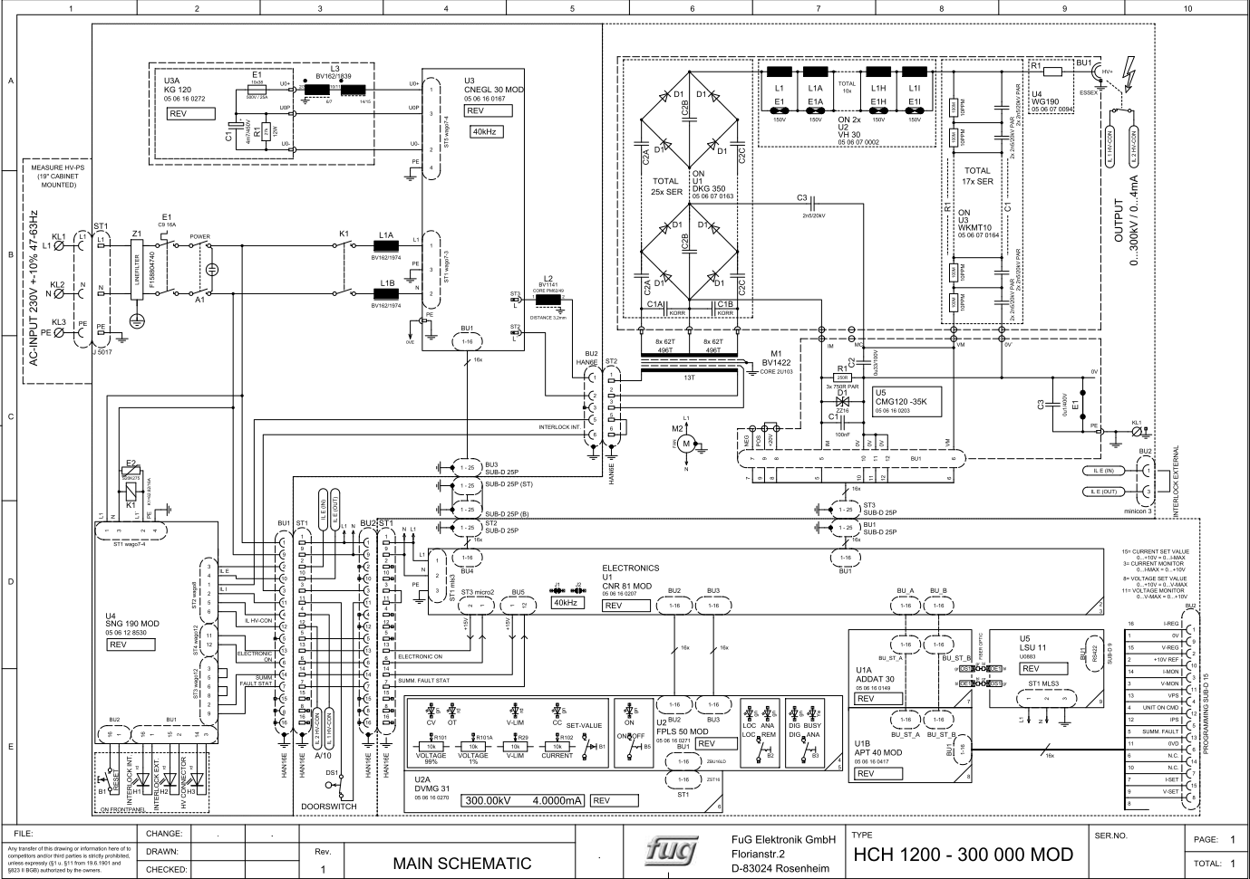
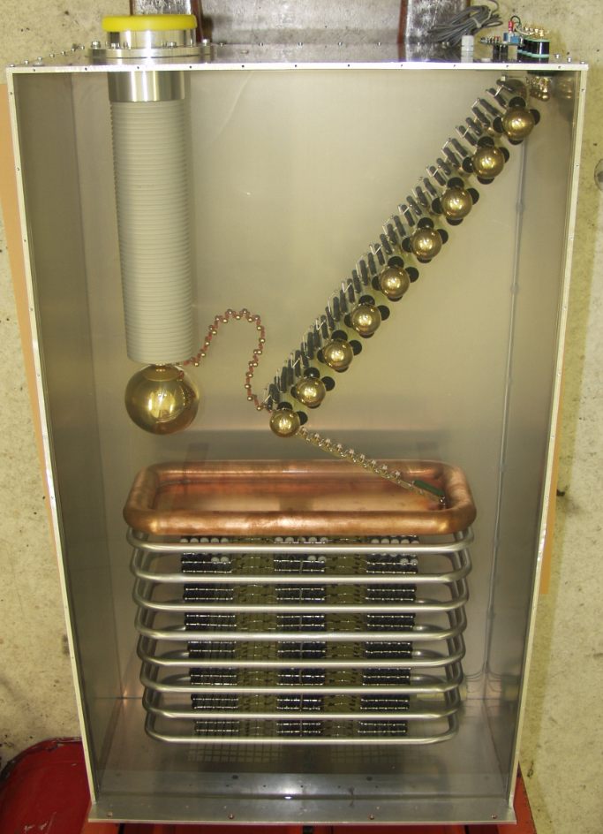
R&D on 350-360 kV HV-PS
SP-FD-1 Minimum drift field
Investigations are ongoing to develop a 350-360kV power supply:
Heinzinger, FuG Elektronik.
FuG was very responsive and willing to collaborate on a joint R&D program:
detailed discussions on technical aspects on HV scaling and tooling required to achieve it, while maintaining the specs on stability, ripple and longevity.
Scaling reachable with present technology
~one year to develop a working prototype
BUT: very expensive R&D (650 kEuro including prototype) due to development of infrastructures and tooling and very limited commercial market
High cost of the final HV-PS (~240 kEuro)
Alternative solutions also surveyed with the help of French colleagues (ILL 380 kV PS built by Heinzinger with dedicated oil bath design)
Similar cost (> 400-500 kEuro) as for the FuG solution and additional R&D required to adapt to the DUNE underground environment.
Other alternatives under study as well

Slide 12
Motivations for HV-PS delivering more than 300 kV?
SP-FD-1 Minimum drift field
In present VD layout, the total resistance of the field cage is 2.81 GOhm (96 RDV in parallel, 270 GOhm each; schematics successfully tested in NP04/02).
A ~50 MOhm resistance for the warm RC ripple filters should be included (as demonstrated by NP04)
With these conditions, to reach the nominal drift field of 500 V/cm, the HV-PS should deliver 330 kV.
With a 300 kV HV-PS, a drift field of 450 V/cm could be reached.
Variation of the most relevant LAr-TPC parameters, going from 500 V/cm to 450 V/cm, (https://lar.bnl.gov/properties/#basic-prop) are sublinear:
Free electron drift velocity = 1.601 mm/us —> 1.517 (-5.25%)
Max drift time (6.5m) = 4063 us —> 4285 us (+5.25%)
El-ion recombination = 0.595 —> 0.5814 (-2.3%)
Scintillation yield = 0.4395 —> 0.4473 ( + 1.8%)
Longitudinal diffusion coef. = 6.627 cm2/s—> 6.589 (-0.6%)
Transverse diffusion coef. = 13.24 cm2/s—> 12.62 (-4.6%)
Ion drift velocity = 8 mm/s —> ~7.2 (~ -10%)
DUNE physics analysis group involved to evaluate the performance of the VD TPC at a drift field of ~ 450V/cm, compared to 500 V/cm.

Slide 13
​Backup

Slide 14
CRP/anode spec/requirements
ID | Name | Value | Rationale
1 | Anode plane global flatness | <20mm | Maintains CRP bottom and top planes global flatness within 20mm each to satisfy the requirement on the drift field uniformity of <1% throughout each 6m drift region
2 | Vertical position tolerance of 2 adjacent CRPs | ±2mm | A 2mm vertical height mismatch between 2 adjacent CRP modules keeps the drift line distortion around the CRP borders below 6mm
3 | Minimum permeability | >15% ? | transparency to liquid argon flow through the anode planes (need estimate from simulation for bottom and top positions…);
4 | Anode strip width/pitch | 5mm for the collection strips and <8.5mm for the induction strips | Similar pitch defined for SP detector, S/N consistent with 100\% hit reconstruction efficiency for MIPs. Spacing fine enough to provide \SI{1.5}{cm} vertex resolution in $y-z$ plane.
5 | Vertical gap between the PCBs | >8mm | >5us drift time between the 2 anodes for better separation of the signal and safe running environment at lower bias voltages.
6 | Anode plane bias voltages | <2kV | beyond this value the size, cost of capacitors shoot up and choices plummet.
7 | minimum wall thickness between holes | >0.5 mm | for mechanical properties of the perforated PCB the minimum wall thickness between holes should be >0.5mm. Given the full electron transparency, the hole size does not have any effect on charge collection.

Slide 15
CRP/anode specifications & design parameters
ID | Name | Value | Rationale
1 | Anode plane bias voltages | In 2-view case: Induction at 0V, collection at 1kV. In the case of 3-view: first induction at -340V, second induction at 0V and the collection 900V. | Voltage difference between the PCB faces and also two PCBs in the case of 3-view should allow full electron transparency. FEA and 50L tests have demonstrated that, keeping values at the level of 1kV maximum will allow us to have some headroom in case of adjustment.
2 | Anode strips length | <1.7m for the collection strips and <2.5m for the induction strips | The induced noise by the strip capacitance should be compatible with the S/N requirement. The anode strip capacitance is around 80 to 120 nF/m => maximum capacitance < 250 nF for the longer and wider strips (2.4 m and 8.5mm)
3 | Anode strip angles | Collection plane is perpendicular to the beam direction in any configuration. In 2-view case the collection and induction strips are oriented orthogonal to each other. In 3-view case, 1 option is the first induction at 48° second at 0°, and an other option is with induction strips at ±30° | To reduce ambiguities related neutrino interactions reconstruction. It needs input from simulation and reconstruction as well as results from first CRP
4 | Gaps between CRPs | <10 mm between adjacent CRPs on same SuperStructure on top; <30 mm between CRPs on different SuperStructure; <15mm between adjacent CRPs at the Bottom | Allowing gaps between CRPs is needed for the CRPs positioning and for passage of supporting cables for the cathode structure . This also simplifies construction and installation of the detector. The gaps will reduce at cold due to differential shrinkage of stainless steel superstructure with composite frame.
5 | CRP planarity | ± 2.5 mm overall deformation with a more stringent criteria <1mm along the anode PCB sides with connectors | CRP planarity over 3x3 m2 surface should guarantee the uniformity of the anode vertical position and horizontal alignment of neighboring PCB anode for collection and the induction layers at the same bias voltage. Stricter criteria of 1mm on the borders to avoid mechanical stress on the anodes at the level of the strip electrical connectors between the PCB layers and electronic adapter boards.
6 | CRP Top Superstructure planarity | <10 mm | a SuperStriucture at the top of the detector with several CRPs attached to it together with the load of the cathode modules should have a maximal deformation when immersed in liquid less than 10 mm. This guarantees the global anode flatness specification for the drift field uniformity over the superstructure area and adds a limited contribution to the deformation of the cathode structure hanged below.

Slide 16
Bottom CE Requirements
Executive Board held requirements for FD1-HD are also valid for FD2-VD
TDR ID | Name | Primary Text | Value
SP-FD-2 | System noise | The total system noise seen by each wire should be no more than 1000 enc of noise. It is expected that random noise on the FE amplifier will be the dominant contribution to the total system noise. | <1000 electrons
SP-FD-13 | Front-end peaking time | The FE peaking time shall be set so as to optimize vertex resolution. | 1 microsecond (goal: adjustable to be able to take advantage of lower noise if the noise depends on peaking time)
SP-FD-14 | SP signal saturation level | ~500,000 electrons | ~500,000 electrons (goal: Adjustable so as to see saturation in less than 10% of beam-produced events)
SP-FD-19 | ADC sampling frequency | The ADC sampling frequency shall be set so as to extract maximal information without unnecessarily increasing data rate. | ~ 2MHz
SP-FD-20 | Number of ADC bits | The ADC shall digitize the charge deposited on the wires with 12 bits precision | 12 bits
SP-FD-21 | SP cold electronics power consumption | The SP CE power consumption shall remain below 50 mW/channel | < 50mW/channel
SP-FD-25 | Non-FE noise contributions | All non-FE noise contributions shall be much lower than the targeted system noise level | << 1000 electrons

Slide 17
Bottom CE Requirements
Most consortium held requirements for FD1-HD are also valid for FD1-HD
Combination of requirements, design choice and specifications
TDR ID | Name | Primary Text | Value
SP-ELEC-2 | Gain of the SP TPC elec. front-end amplifier | Gain of the front-end amplifier | 10 mV/fC (adjustable in the range of 5-25 mV/fC)
SP-ELEC-3 | SP TPC elec system synchronization | Maximum time difference between ADC samples on different wires | 16 ns
SP-ELEC-4 | Number of channels per SP TPC elec front-end motherboard | Number of channels in each front-end motherboard | 128
SP-ELEC-5 | Number of links between the SP TPC elec FEMB and the WIB | Maximum number and speed of links used for data transmission between the FEMB and the WIB | 4 at ~ 1.28 Gbps
SP-ELEC-6 | Nunber of SP TPC elec FEMBs per WIB | Number of FEMB connected to each WIB | 4
SP-ELEC-7 | Data transmission speed between the SP TPC elec WIB and the DAQ backend | Each WIB should transmit data to the DAQ backend at a speed of 10 Gbps | 10 Gbps
SP-ELEC-8 | Maximum diameter of conduit enclosing the SP TPC elec cold cables | Maximum diameter of conduit enclosing the cold cables while they are routed through the APA frame | 6.35 cm

Slide 18
Bottom CE Requirements
Additional requirements or specifications under consideration at the CE Consortium level
Listing sample requirements here. See EDMS#2590797 for a complete list
Data transmission:
FEMB can drive signal over cold cable > 25m (open eye diagram)
ADC linearity requirements: INL, DNL and ENOB
Warm interface crates, WIB, and PTC requirements:
WIB calibration
Clock jitter from WIB to FEMB
PTC output voltage ripple, etc.
Power supply requirements:
Current and voltage requirements
Noise ripple, V/I readback rate, etc.
Offline physics requirements:
ADC overflow logic
Double pulse resolution
Saturation recovery
Channel-to-channel cross talk, etc.

Slide 19
https://edms.cern.ch/document/2454611

Slide 20
PDS

Slide 21
PDS

Slide 22
Charge Question #1
High Level Requirements (EB/TB held)
Most requirements for FD1-HD are also valid for FD1-VD
Higher Cathode voltage and different HV distribution (extender) included
Consortium held requirements and specifications under development.
ID | Description | Spec (Goal) | Comment
SP-FD-1 | Minimum drift field | >250 V/cm, (500V/cm) | Request change the goal to ~ 450V/cm to enable the use of existing 300kV HVPS.
SP-FD-11 | Drift field uniformity due to HVS | < +/-1% in 99.8% of the active volume | Larger drift distance relaxes cathode flatness requirement
SP-FD-12 | Cathode HV power supply ripple contribution to system noise | < 100 e
SP-FD-17 | Cathode resistivity | > 1MΩ/□, <10TΩ/□ (> 1GΩ/□)
SP-FD-24 | Local electric fields | < 30 kV/cm; Exceptions: for specific components with localized E-field higher than 30 kV/cm, perform test in pure LAr at least at 120% of the designed operating voltage | Minor change of wording: voltage -> electric field
SP-FD-29 | Detector uptime | >98%, (>99%)
SP-FD-30 | Individual detector module uptime | >90%, (>95%)
SP-HV-1 | Maximize power supply stability | > 95% uptime
SP-HV-2 | Provide redundancy in all HV connections | Two-fold, (Four-fold) | Request exception on single HVFT

Slide 23
R&D on 350-360 kV HV-PS
Investigations are ongoing to develop a 350-360kV power supply:
Heinzinger, FuG Elektronik.
FuG was very responsive and willing to collaborate on a joint R&D program:
detailed discussions on technical aspects on HV scaling and tooling required to achieve it, while maintaining the specs on stability, ripple and longevity.
Scaling reachable with present technology
~one year to develop a working prototype
BUT: very expensive R&D (650 kEuro including prototype) due to development of infrastructures and tooling and very limited commercial market
High cost of the final HV-PS (~240 kEuro)
Alternative solutions also surveyed with the help of French colleagues (ILL 380 kV PS built by Heinzinger with dedicated oil bath design)
Similar cost (> 400-500 kEuro) as for the FuG solution and additional R&D required to adapt to the DUNE underground environment.
Other alternatives under study as well

Slide 24
Motivations for HV-PS delivering more than 300 kV?
In present VD layout, the total resistance of the field cage is 2.81 GOhm (96 RDV in parallel, 270 GOhm each; schematics successfully tested in NP04/02).
A ~50 MOhm resistance for the warm RC ripple filters should be included (as demonstrated by NP04)
With these conditions, to reach the nominal drift field of 500 V/cm, the HV-PS should deliver 330 kV.
With a 300 kV HV-PS, a drift field of 450 V/cm could be reached.
Variation of the most relevant LAr-TPC parameters, going from 500 V/cm to 450 V/cm, (https://lar.bnl.gov/properties/#basic-prop) are sublinear:
Free electron drift velocity = 1.601 mm/us —> 1.517 (-5.25%)
Max drift time (6.5m) = 4063 us —> 4285 us (+5.25%)
El-ion recombination = 0.595 —> 0.5814 (-2.3%)
Scintillation yield = 0.4395 —> 0.4473 ( + 1.8%)
Longitudinal diffusion coef. = 6.627 cm2/s—> 6.589 (-0.6%)
Transverse diffusion coef. = 13.24 cm2/s—> 12.62 (-4.6%)
Ion drift velocity = 8 mm/s —> ~7.2 (~ -10%)
DUNE physics analysis group involved to evaluate the performance of the VD TPC at a drift field of ~ 450V/cm, compared to 500 V/cm.

Slide 25
DAQ Requirements
Distribute clock and unique timestamping to all detectors
Common clock (62.5 or 125 MHz)
1 us synchronization across FDs
~10 ns synchronization within one FD
Configure, control and monitor the data taking process
Provide sw tools for detector experts to implement their specific functions within the DAQ framework
The DAQ shall introduce negligible downtime, compared to the experiment requirements
Receive timestamped data over optical links from all detectors
Charge readout: data sampled at ~2 MHz
Photon detectors: 5 us waveforms of tiles that pass an internal trigger threshold

Slide 26
DAQ Requirements
See talk by J. Klein
Buffer, select, aggregate and store detector data
Select data with > 100 MeV of visible ionization energy with very high efficiency (>90%)
Select data with < 100 MeV and > 10 MeV of neutrino visible energy with a good efficiency
Generate a SNB trigger candidate if there are more than 60 neutrino interactions wih E_{ν}>10 MeV within 10 seconds with an efficiency > 95%
Store all data for 30s corresponding to a SNB trigger (goal to reach 100 s)
Transfer the recorded data to FNAL over a dedicated WAN connection
Cap of 30 PB/year for all far detectors raw data set by offline long-term storage capacity; more data may be transferred to FNAL, but not for permanent storage
In addition, condition, configuration and monitoring data will be transferred to FNAL

Slide 27
DAQ VD Specifications
Readout 1040 WIB links (10G), 400 uTCA links (40G), few hundred PDS links (?)
While internal data organisation differs, all packets coming from the electronics shall have a 64b timestamp and a field fully specifying the origin
WIB frame has a header with the required info and 1 ADC value for 256 channels,
PDS data expected to have a header with the required info and 375 (750?) consecutive ADC values for 1 channel,
Data from uTCA boards will have the required info and N consecutive ADC values for 64 channels
It is a responsibility of the electronics experts to provide data decoders for their data
Reduce data volume from ~2 TB/s to ~0.5 10⁻³ TB/s -> reduction factor 4000
Achieved through selection in time and geographic regions of activity based on the data themselves and through lossless data compression at the end of the chain
See talk by R. Sipos

Slide 28



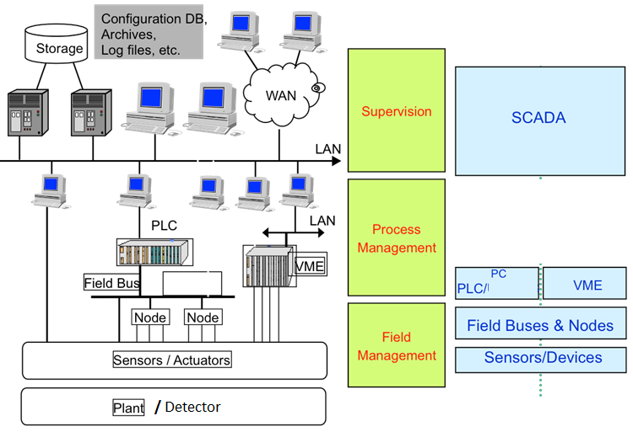




Slow Control requirement. Connectivity
The essential point of the Slow Controls is the connectivity
The openness to a comprehensive range of drivers or protocols
Vertical Drift DDCS gives priority to the OPC UA
Hardware
Drivers/
Protocols

Slide 29
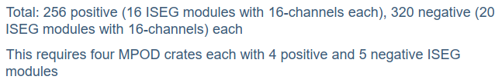

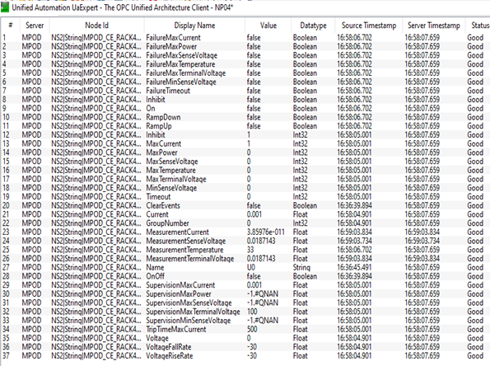
Slow Control Requirement. Scalability
From M. Verzocchi, Bottom Detector
Single Phase Cold Electronics
6 Low Voltage Channels
36 HV Channels
X 37 OPC items /channel 1110 items
Total amount of WIENER channels = 678 channels
X 37 OPC items /channel = 25086 items
The Slow Controls has to provide the tools to facilitate and simplify the configuration, operation and archiving of such amount data/channels

Slide 30
Supervisory or Scada Software Requirements
Homogeneity. Ideally the SC provides a homogeneous environment into which all its parts can be integrated
Scalability
To connect to different subsystem and devices
Capacity to handle huge amounts of data.
Openness.
Possibility of parallel developers
Comprehensive range of drivers and Connectivity
Priority to the OPC UA
Data Archiving & Data retrieving
User Interface. Data reporting, trending…
Multi-user system. User interface
Access Control. User rights
Web User Interface, Mobile User Interface (only monitoring)
Redundancy (Passive or Active), suitable.

Slide 31
